Slide 1
Example: HATC SD
TO92-UT
HATC-2-3
HATC
HATC-DJ-A
TP
…
TP
ASS
TP
…
TP
T&F
TP
…
TP
HAL3930DJ-A
Mask-set
die
device
product
Foundry
Wafer Sort (probing)
assembly
Final Test
Lead-framed
Singulated

Slide 2
Example: CTCA
TSSOP16
CTCA_2_4
CTCA-2-4
TP
…
TP
CTCA-DJ-A
ASS
TP
…
TP
T&F
TP
…
TP
HAC1234DJ_A
TMR_8_2
TMR-8-2
Mask-set
die
device
product
Foundry
Wafer Sort (probing)
assembly
Final Test
Lead-framed
Singulated

Slide 3

Example: HATC DD
MIR – FAMLY_ID → this is the “test Project”, here it would become probably HATC
Valid python class names
MIR – JOB_NAM
HATCM40C1
HATCM40C2
HATCP170C1
MIR – OPER_FREQ
HATC1
HATC2
HATCn
MIR – TEST_COD
SOIC8
HATC-2-3
HATC
TP
…
TP
HATC-DJ-A
HATCC
ASS
TP
…
TP
T&F
TP
…
TP
HAR3930DJ_A
HATC-2-3
TP
…
TP
MIR – OPER_FREQ
HATCC1
HATCC2
HATCCn
HAR3930DJ_A1
MIR – TEST_COD
MODE_COD ?!?
MIR – JOB_NAM
HATCCM40C1
HATCCP150C1
HATCCP150C2
HAR3930DJ_AP150C1
Mask-set
die
device
product
Foundry
Wafer Sort (probing)
assembly
Final Test
Lead-framed
Singulated

Slide 4
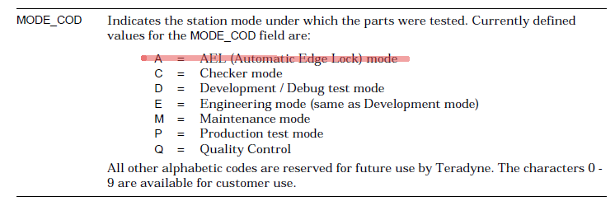
TDK
MODE_COD | Meaning
P | Production program
Q | Qualification program
C | Checker program
… | …
What with tester self check in production, automatically before / after the execution of a production program ?!?

Slide 5
MODE_COD | Meaning
P | Production program
Q | Quality (Q-Check …) program
C | Checker program

Slide 6
Any program can be run in Quality
(multiple flows for WS ?) & multiple flows for FT
Quality can make their own programs (not tests!)
“Qualification” in Micronas terms
2
QC test program is part of Production flow
Quality
If (WL)BI with MSCT, then it is part of a WS production flow
3
4
5
8D
CR
(WL)BI
Prod
QC
Goods
6
HALT / ESD / …
Data
1
7
Customer
Design
Verification
Characterization
Data
8
One flow for WS & 1 flow for FT
Applications
Tools
multiple flows for WS & multiple flows for FT
(normally such flows have only a single TP in them)
???
Sales

Slide 7
Project zip file = MIR-FAML_ID + .zip eg : HATC project MIR-FAMLY_ID = HATC → “HATC.zip”
JOB_NAM = product/die + [NP] + D* + C + n D* = the temperature (absolute), sign is P or N C = C (celcius) n = sequence number in the product/die
Example : HATCP150C2 → die = HATC
temperature = P150C = +150*C
2 : second program in the flow that uses 150*C
MIR – OPER_FREQ = MIR – TEST_COD
= product/die + n n = sequence number in the product/die
Example : HATC2 → die = HATC
2 = second test program to ‘make’ die ‘HATC’

Slide 8
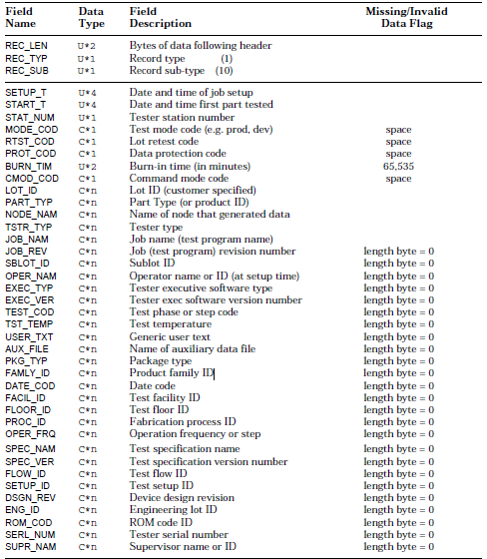
MIR
From OS
From OS
ATE hook, standard = empty, will be hooked up to SCT function
From UI (is crucial that this one is correct!!!)
Not used ?!?
Not used
Not used
Not used
From UI (is crucial that this one is correct!!!)
In test program = “Product” for Final test, “Die” for probing
ATE hook, standard = empty, will be hooked up to SCT function
From project, = MSCT
From project, = die/product+temperature+nr → HATCM40C1 = HATC (die), M40C (-40C), 1
(first TP with that temperature)
The git hash ?!?
From UI (=Splitlot)
From OS = the user that is logged in
= ‘TEF’ (Test Execution Framework)
= the tag on the ‘TEF’ in GIT
=product/die & sequencial number
In test program (flow)
Not used
Not used
In test program (flow)
In test program (flow)
From UI ? … do we have lasers ?
From OS (DNS domain name?)
??? Need to talk to IT to see if we can resolve this ‘automagically’
In test program (flow) → product/die and a sequence number starting with 0
In test program = “Product” for Final test, “Die” for probing
Shall we use this ??? If so, it must be a part from the flow.
??? This comes from a test (if applicable), but the test is executed AFTER the MIR is written … need for a hook!
ATE hook, standard = empty, will be hooked up to SCT function
Not used

Slide 9
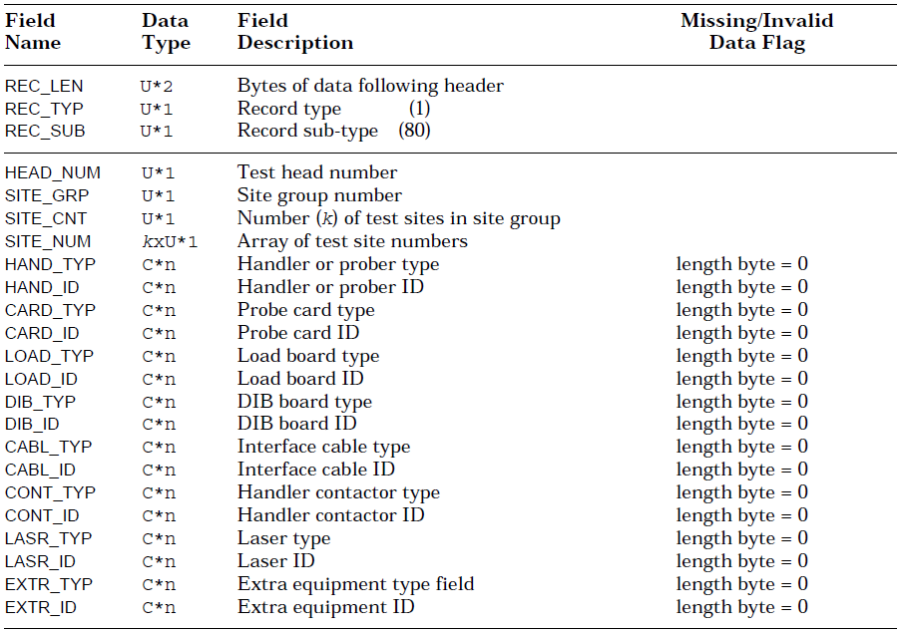
SDR
Always ‘1’
Always ‘1’
From flow meta data
Indirect from flow meta data → 0, 1, … k-1 (always start with 0)
From flow meta data (Prober/leadframe/leadless)
ATE hook, standard = empty, will be hooked up to SCT function
From flow meta
ATE hook, standard = empty, will be hooked up to SCT function
From flow meta
ATE hook, standard = empty, will be hooked up to SCT function
From flow meta
ATE hook, standard = empty, will be hooked up to SCT function
From flow meta
ATE hook, standard = empty, will be hooked up to SCT function
From flow meta
ATE hook, standard = empty, will be hooked up to SCT function
From flow meta
ATE hook, standard = empty, will be hooked up to SCT function
From flow meta
ATE hook, standard = empty, will be hooked up to SCT function

Slide 10
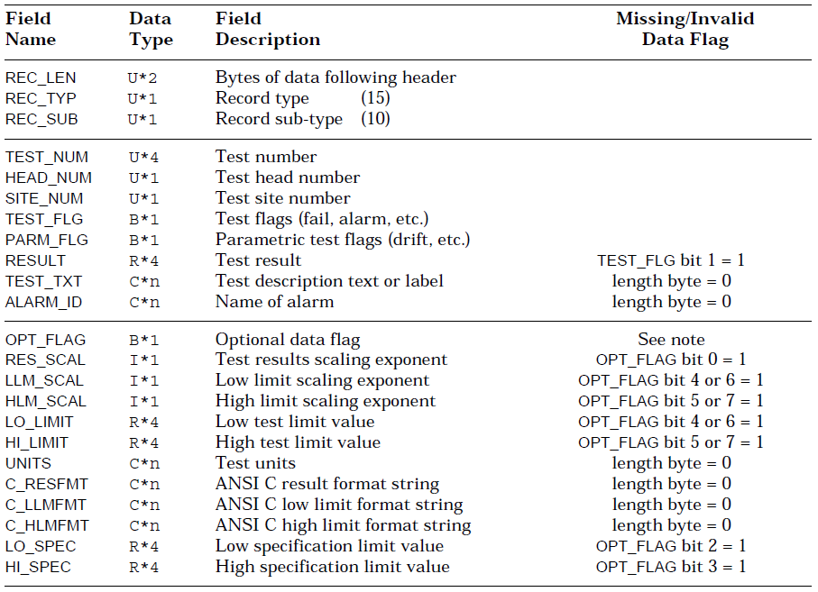
PTR
Automatically assigned by the test (unique in the whole project / FAMLY_ID)
Always ‘1’
From flow meta data
Indirect from flow meta data → 0, 1, … k-1 (always start with 0)
From flow meta data (Prober/leadframe/leadless)

