Slide 1
Exploratory Data Analysis of Large-Scale Retail Transaction Data Using Univariate, Bivariate, and Multivariate Statistical Techniques
NEXTHIKE IT SOLUTIONS
Presented by: Awantika Patil

Slide 2
Dataset Overview
18 attributes describing customers, orders and products
Customer
Order
Product
customer_id
age
gender
city
state
customer_segment
order_id
order_date
payment_method
shipping_type
delivery_days
return_status
product_category
product_subcategory
product_price
quantity
discount_percentage
final_price
6
Numeric
9
Categorical
2
Identifiers
1
Date

Slide 3
Objectives & Approach
Each level of analysis mapped to the dataset variables
1
Univariate
2
Bivariate
3
Multivariate
Profile single variables
Test pairwise relationships
Find structure and drivers
Age, price, quantity, discount, delivery days: mean, median, skewness
Category, payment, return status: frequency and share
Box plots, IQR outliers
Outlier’s detection and correction
Discount vs quantity: correlation
Final price by segment: ANOVA
Payment vs return status: chi-square
Outlier’s detection and correction
Correlation matrix of numeric fields
PCA and K-means on customer behaviour
Logistic regression for return status
Outlier’s detection and correction
Preparation: order_date, derive month and age group, check final_price against price, quantity and discount, handle missing and duplicate records.

Slide 4
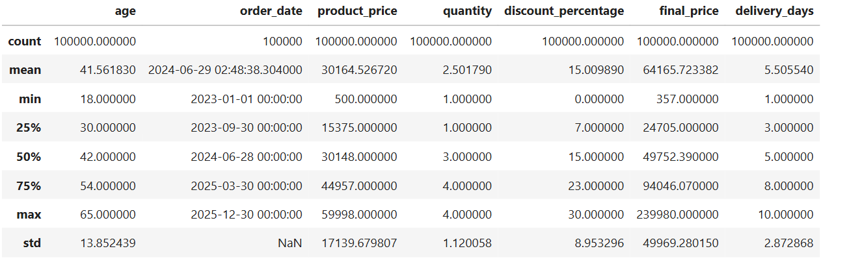
Univariate Analysis
1. UNIVARIATE ANALYSIS - NUMERIC COLUMNS

Slide 5
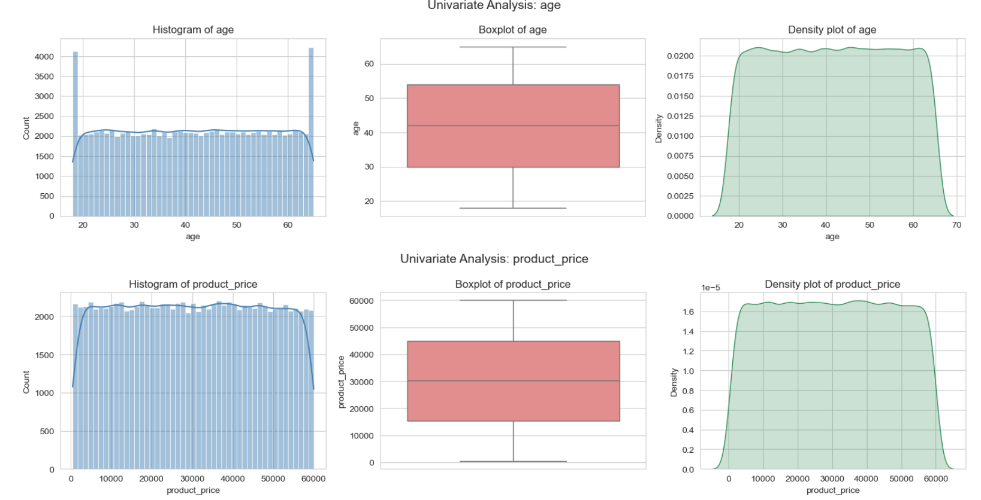
Histogram Plot , Boxplot Plot , Density Plot for Age and Product Price
Takeaway: product_price is uniformly distributed across its full range (500–59,998), matching its skew ≈ 0. No unusual outliers or concentration — every price point is roughly equally likely.

Slide 6
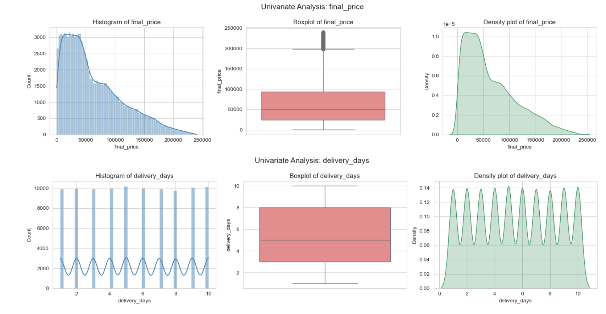
Histogram Plot , Boxplot Plot , Density Plot for Final price and Delivery days
Takeaway: final_price behaves very differently from the other columns — most orders have lower final prices, but a smaller number of high-value orders pull the distribution's tail out and create actual outliers. For delivery_days is a discrete uniform variable (1–10 days, equal frequency), just like quantity.

Slide 7
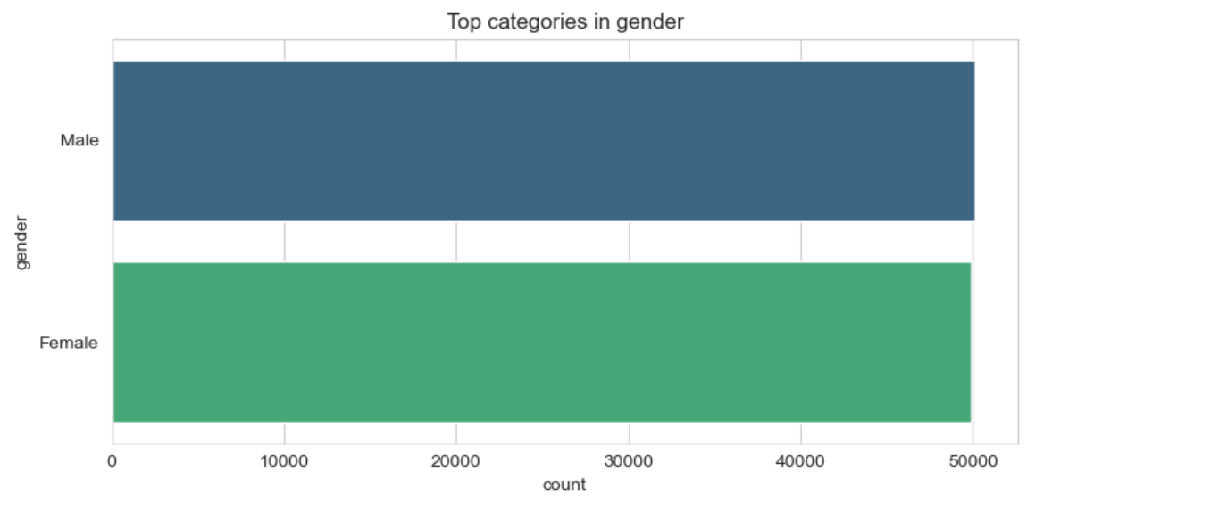
Univariate Analysis
2. UNIVARIATE ANALYSIS - CATEGORICAL COLUMNS
This is a bar chart showing the gender distribution in a dataset:
Male: 50,111 records
Female: 49,889 records

Slide 8
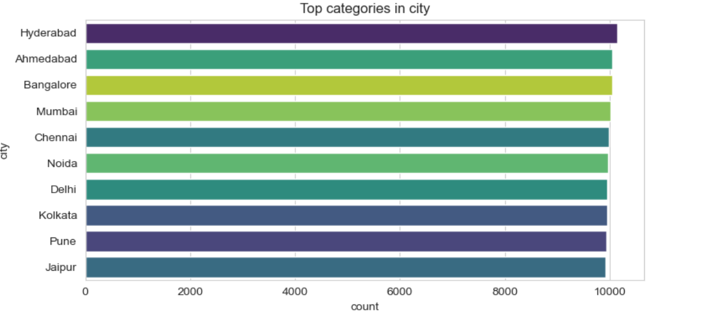
Univariate Analysis
2. UNIVARIATE ANALYSIS - CATEGORICAL COLUMNS
It shows record counts across 10 Indian cities (Hyderabad, Ahmedabad, Bangalore, Mumbai, Chennai, Noida, Delhi, Kolkata, Pune, Jaipur), each with roughly 9,900–10,150 entries.

Slide 9
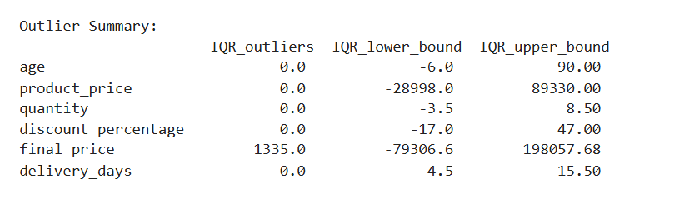
Univariate Analysis
Outlier Detection
Almost every column has 0 outliers — all values fall comfortably within their expected IQR range.final_price is the only column with outliers — 1,335 records fall outside the range (-79,306.6 to 198,057.68), meaning some final prices are unusually high (or low) compared to the typical spread.

Slide 10
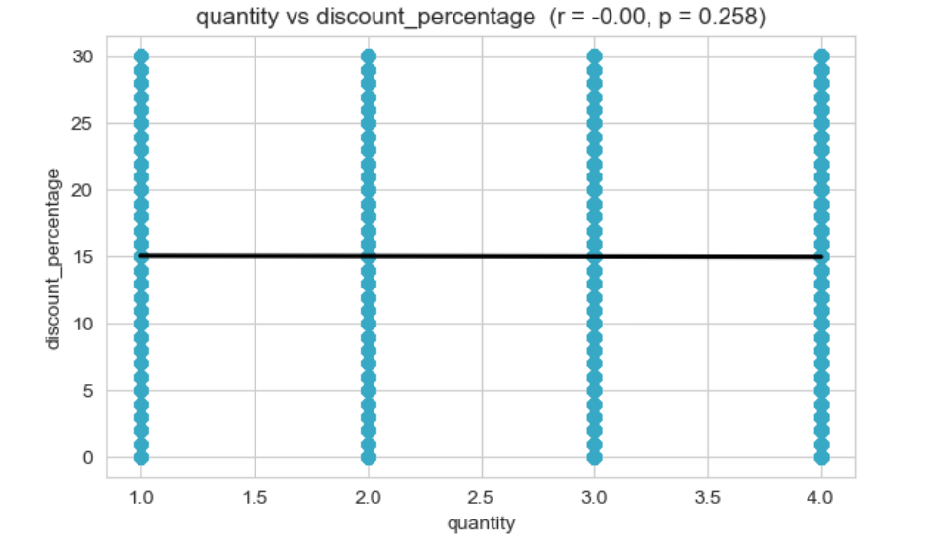
Bivariate Analysis
1. NUMERIC vs NUMERIC
Numeric vs numeric
discount_percentage vs quantity: Pearson r = -0.00

Slide 11
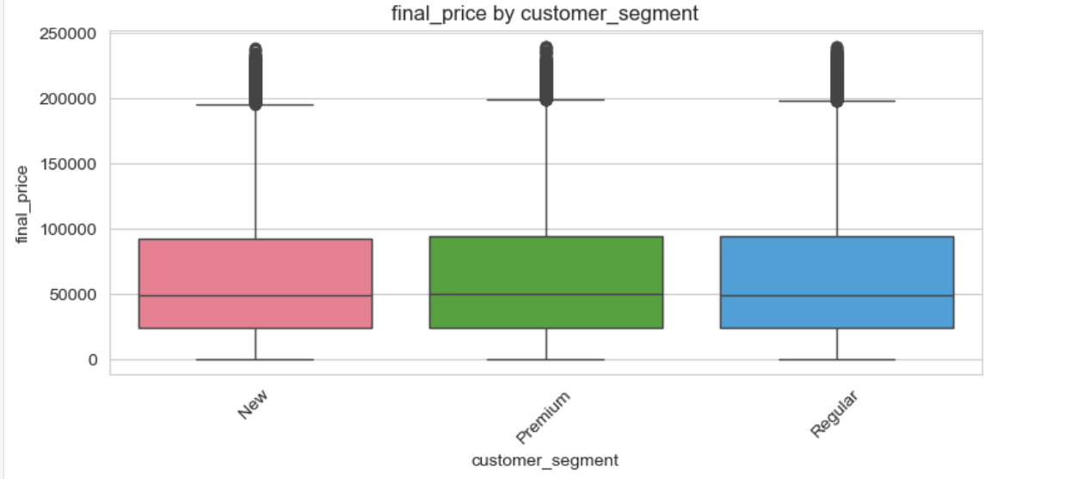
Bivariate Analysis
2. NUMERIC vs CATEGORICAL
Numeric vs category
final_price by customer_segment: ANOVA, p = 0.1904
ANOVA final_price ~ customer_segment: F=1.66, p=0.1904 -> not significant difference between groups

Slide 12
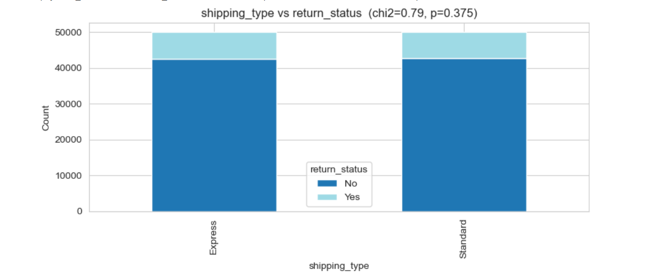
Bivariate Analysis
3. CATEGORICAL vs CATEGORICAL
Category vs category
Shipping_type vs return_status: chi-square, p < 0.001
Shipping_type vs return_status: chi2=0.79, p=0.3751 -> variables are independent

Slide 13
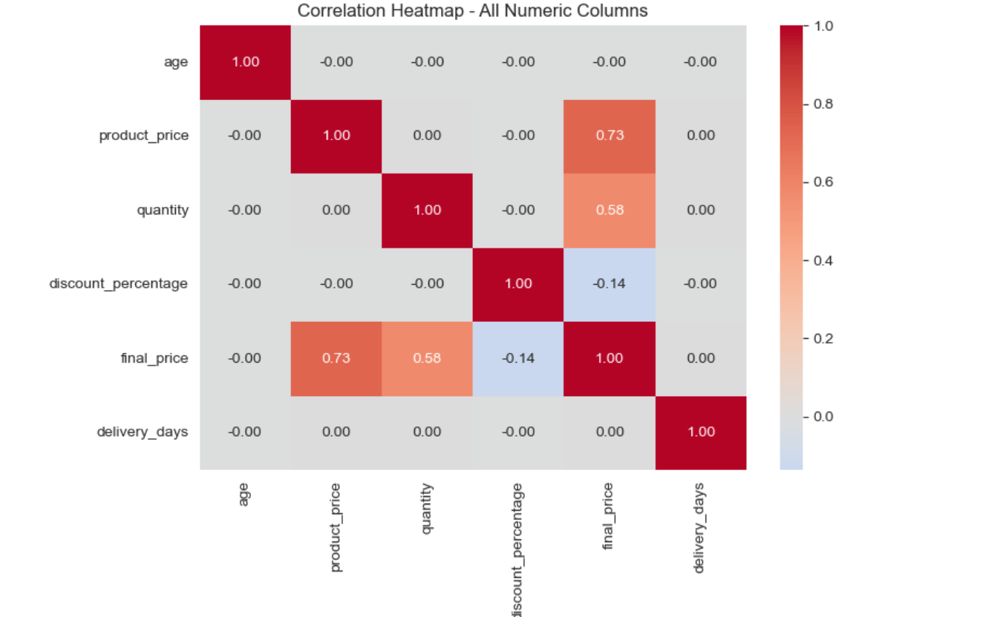
Multivariate Analysis
Correlation structure, segmentation and return drivers
Correlation of numeric variables

Slide 14
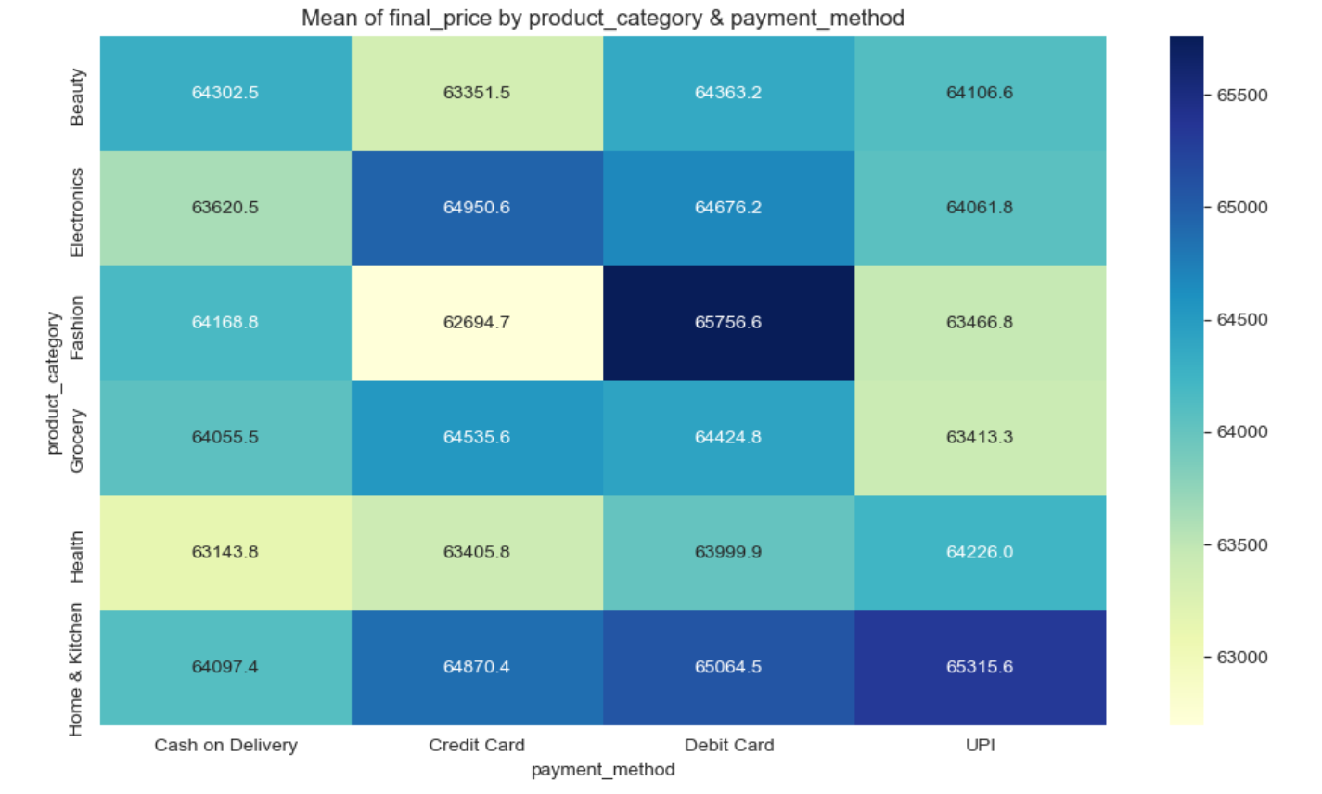
Multivariate Analysis
PIVOT-TABLE HEATMAPS (2 categorical dims x 1 numeric measure)

Slide 15
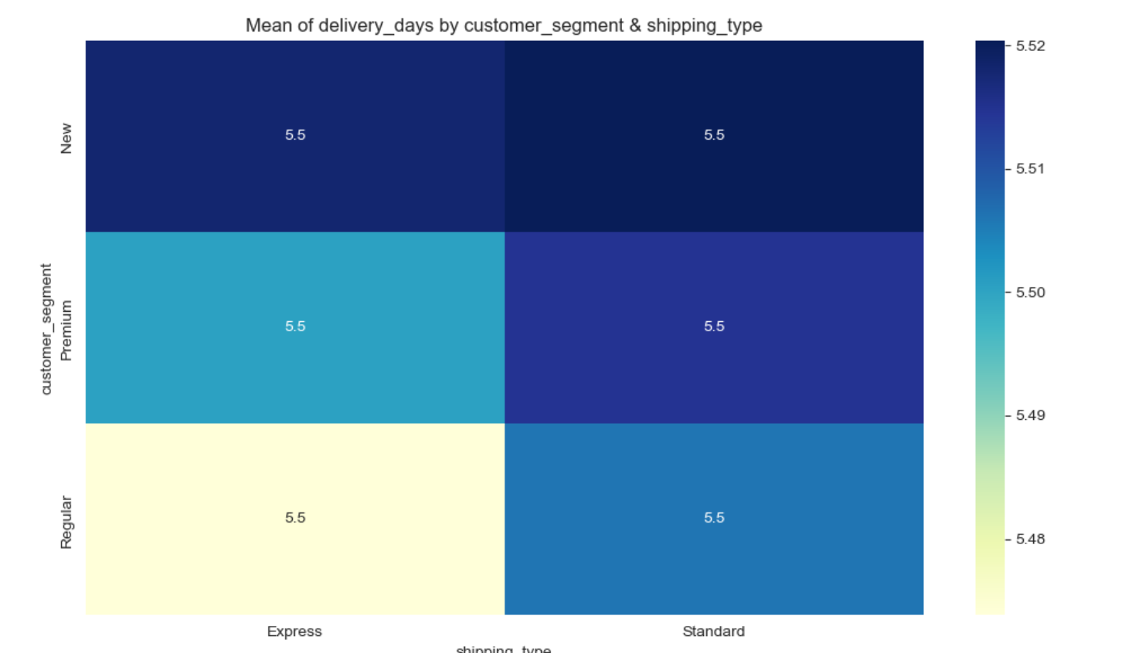
Multivariate Analysis

Slide 16
Conclusions
Key findings
Univariate statistical analysis
Bivariate relationship analysis
Multivariate interaction analysis
Correlation study
Outlier detection
Skewness and kurtosis measurement

Slide 17
THANK YOU

