Slide 1
Note: I used the pages that follow to assemble the poster I presented at the inaugural Victorianist Data Network Conference at the University of Virginia on 16 November 2019. I’m now releasing these pages, like the rest of the Fieldwork of Empire website (https://awisnicki.github.io/fieldwork_of_empire/index.html), under a Creative Commons Attribution-NonCommercial 4.0 International (CC BY-NC 4.0) license (https://creativecommons.org/licenses/by-nc/4.0/). Please feel free to reuse the material that follows in any way that suits you. Please just be sure to attribute it properly per the terms of the license.
Adrian S. Wisnicki (U. Nebraska-Lincoln, awisnicki@yahoo.com)

Slide 2
Fieldwork of Empire
(the Monograph)
Meets Minimal Computing

Slide 3
Adrian S. Wisnicki (U. Nebraska-Lincoln)

Slide 4
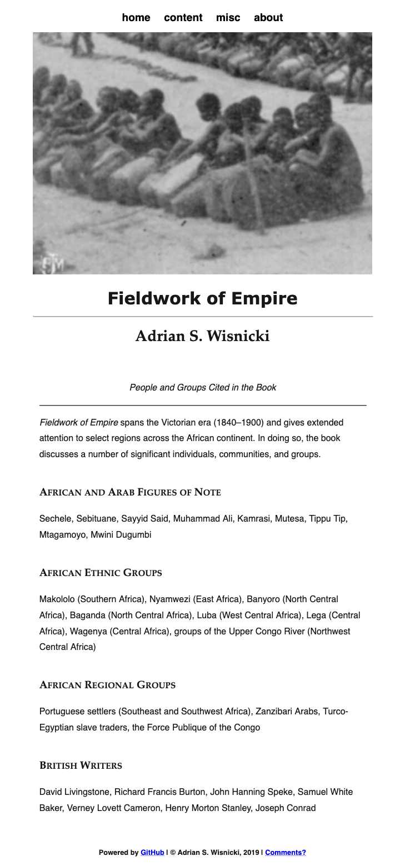

Fieldwork of Empire (the Website)
simple design
white background
gray-scale images (usually)
blue hyperlinks • black fonts
one HTML template; one CSS file; JPEGs
led by content • fully responsive on mobile
works in complementary fashion with the book

Slide 5
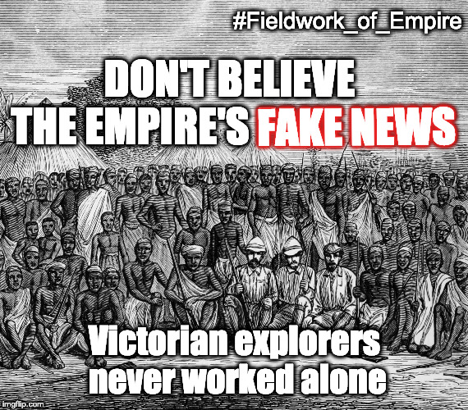
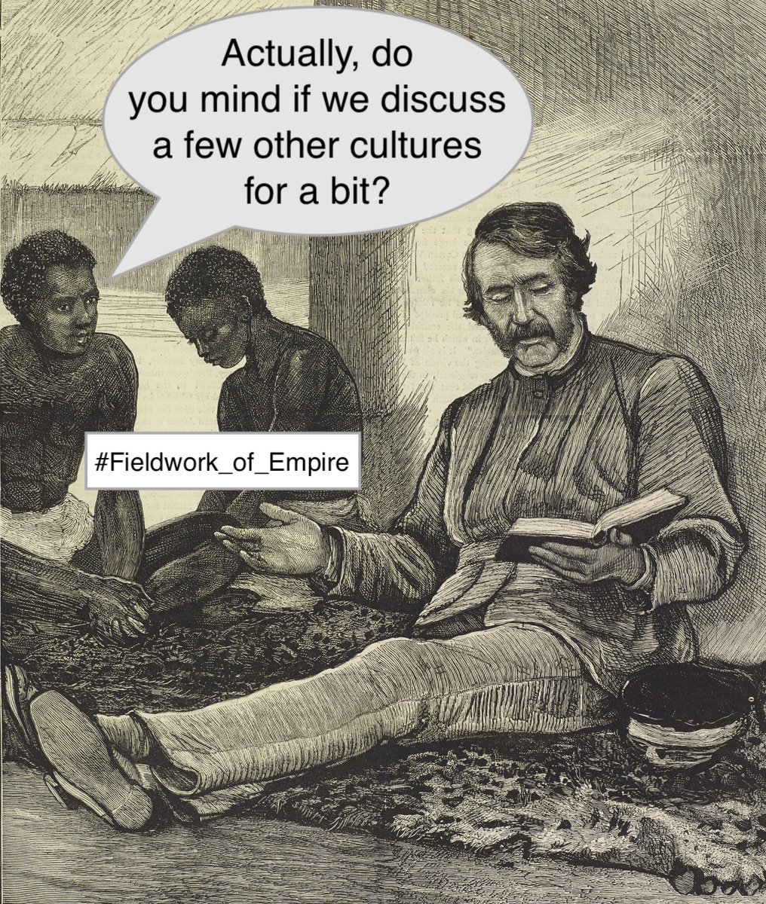
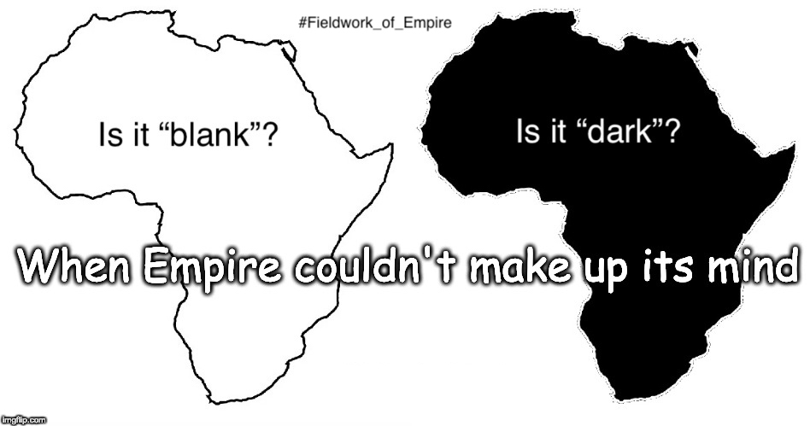
Memes to mix it up!

Slide 6







Built completely with free resources
BBEdit
GIMP

Slide 7
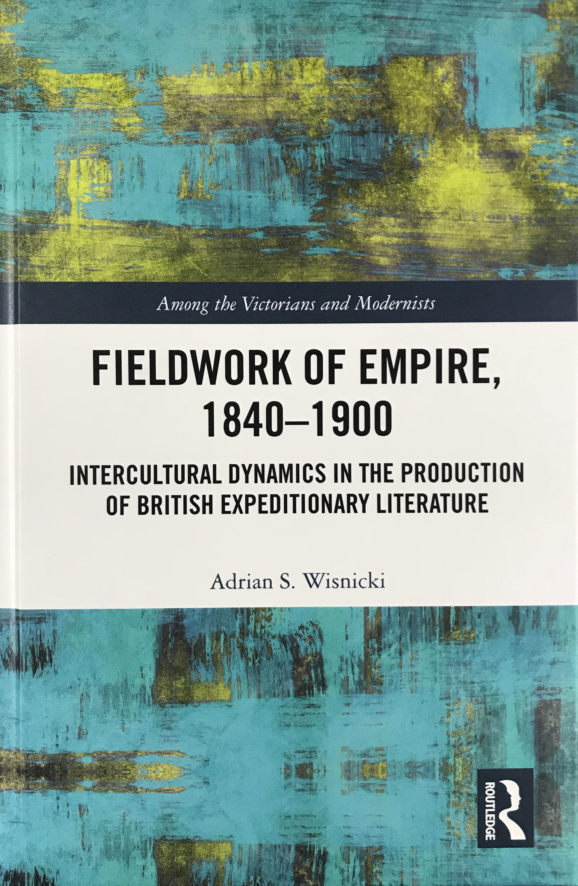
Facts about the Book • Published by Routledge in 2019 • Fifteen-year gestation period • Details the impact of non-European cultural, political, and social forces and agencies on the production of British expeditionary literature • Discursive and material analysis of primary texts • Focus region: Africa

Slide 8
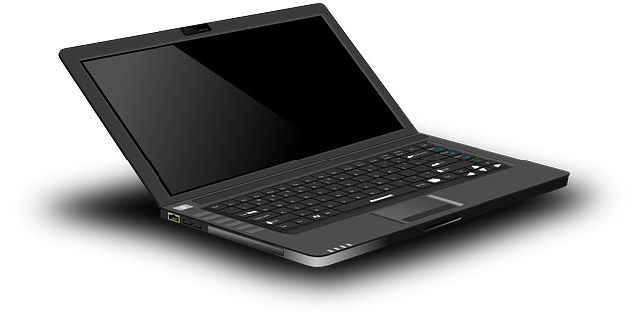
What is
Minimal Computing?
“What do we need?” (Alex Gil, 2015)
ease of use • ease of creation • increased access • reductions in computing
produce • disseminate • preserve • within your means
Many options (Jentry Sayers, 2016)
Minimal Design • Use • Consumption • Maintenance • Barriers • Internet
Externals • Automation • Space • Technical Language • [fill in the blank]

Slide 9
Available for reuse by others!
Web address
bit.ly/36XSXPW
Book in hand … full index online!
Includes “fun facts” about the book!
Allows the author to control dissemination!

