Slide 1
Introduction to High-Throughput Sequence Data
GATK Best Practices for Variant Discovery
Understanding the origin and shape of the data

Slide 2
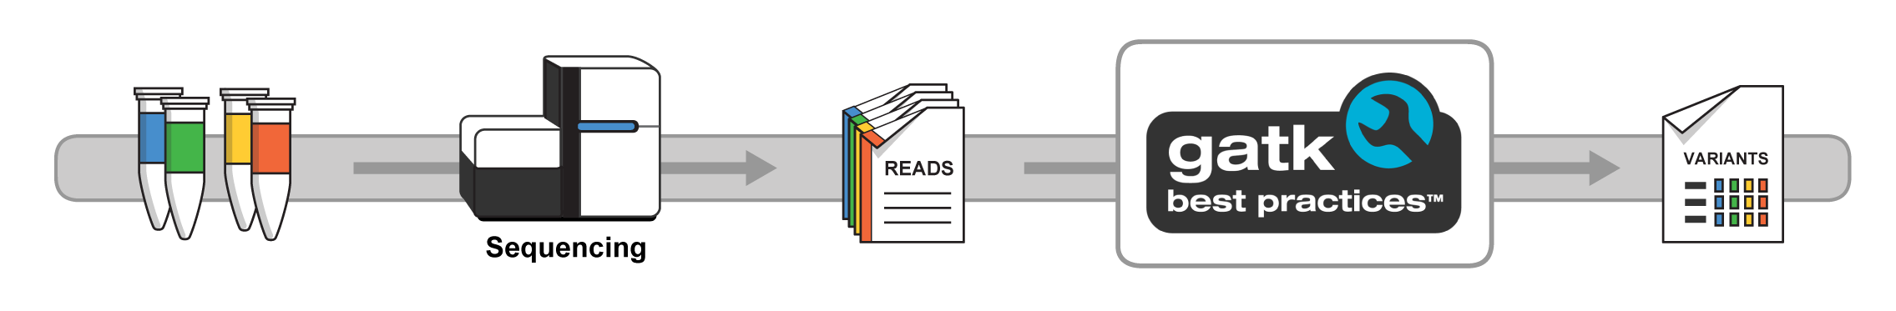
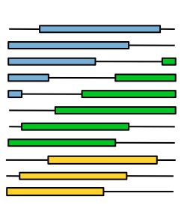
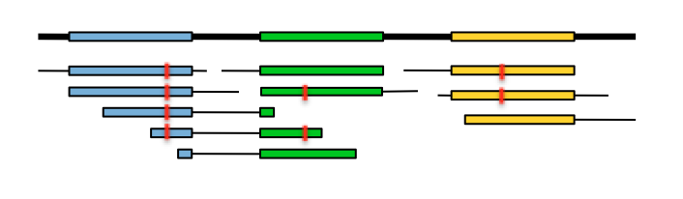

From biological sample to DNA data
Library preparation
Sequencing
Reads mapped and cleaned up
List of
variants
Enormous pile of short reads
Notes:
Here we’re talking about the primary analysis: turning a biological sample into DNA sequence data. Note that we’re going to emphasize the experimental designs, data types and formats more than the technology itself. The goal is for everyone to understand the key aspects of the data, where they come from and what it all means for variant calling.
We’re also going to touch on some elements of quality control, which will require anticipating on the early stages of secondary analysis; so spoiler alert, we’ll mention the mapping/alignment of the reads already even though that belongs to the data processing talk that comes after this.

Slide 3



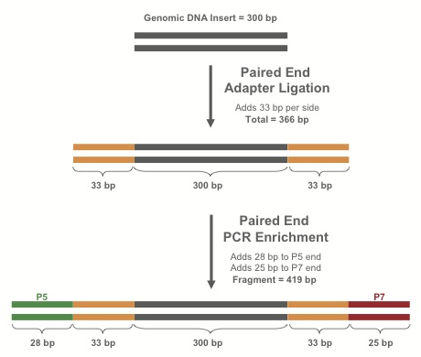

Library preparation
Purify*
fragments
Fragments
DNA
RT-PCR
If RNA:
make cDNA
RNA
Extract nucleic acids from blood, tissue, saliva, etc.
Shear dsDNA into fragments
Attach adapters to fragments
Library
* Protocol varies depending on experimental design (WGS, exome etc)
Notes:
The point here is to get people to understand that we’re cutting up the DNA into fragments and doing some biochemical modification to prepare for sequencing. There’s different approaches depending on the experimental design, most importantly in the “purify fragments” step where we determine whether we want to sequence “everything” (WGS) or just a subset (eg exome)

Slide 4
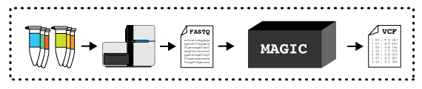
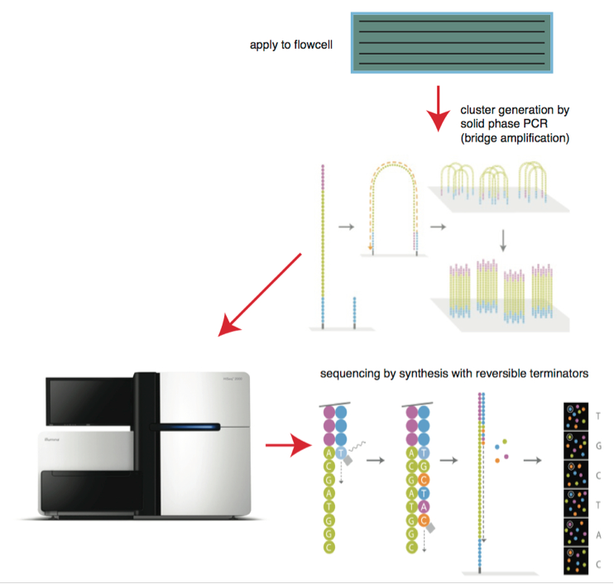
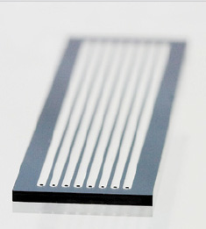
Sequencing the library
DNA libraries
Bitesizebio.com
Flowcell
DNA libraries deposited on flowcell
-> amplified to form clusters
Lanes
Illumina
HTS machine processes a flowcell containing lanes
Each lane may contain multiple samples (indexed with a DNA barcode)
Read group (RG) specifies a combination of sample and flowcell
Enormous pile of short reads
Notes:
Multiplexing – multiple samples per lane enables throughput scaling
Read group – ID that generally specifies the combination of (1) the sequencing library (ie the sample) and (2) the sequencing run (ie the flowcell)
Bridge amplification – sparse clusters synthesized on the floor of the flow cell. Each cluster contains many identical copies of a single fragment.
Sequencing by synthesis – nucleotides added one at a time to complementary strand, emitting light that travels to a detector in the sequencer. Software is used to interpret the light signals emitted from each cluster and translate them to actual base calls.
Paired end reads – both ends of each fragment are sequenced

Slide 5
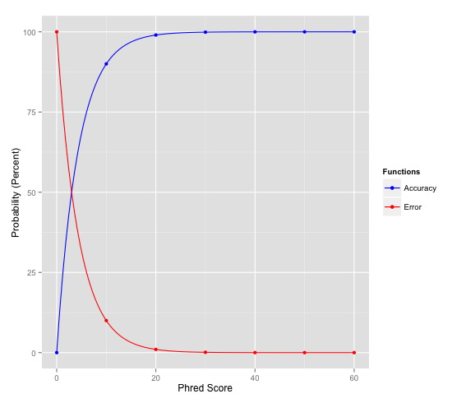
Raw sequence: typically in FASTQ format
Sequence Name (read name, group, etc.)
Sequence
+ (optional: Sequence name again)
Associated quality score
Accuracy
Phred value = −10 * log₁₀(ε)
20 and higher is generally a good score
Q10 = 90% confidence (10% error rate)
Q20 = 99% confidence (1% error rate)
Q30 = 99.9% confidence (0.1% error rate)
Big pile of reads
One example read
@EAS54_6_R1_2_1_413_324
CCCTTCTTGTCTTCAGCGTTTCTCC
+
;;3;;;;;;;;;;;;7;;;;;;;88
Error
ASCII code translates to Phred-scale Q scores
Format specification http://maq.sourceforge.net/fastq.shtml
Notes:
Point here is that the resulting data is in these huge text files where each sequence read is represented by this information: name, sequence of bases and quality scores, which are going to be very relevant in the next talk.
At this point we don’t know yet where the reads belong, so the next step will be mapping/alignment. But first we’re going to talk a bit about experimental design (wgs vs exome etc) and quality control (how do we know if our sequence data is good enough to actually do worthwhile analysis).
Note that we say this data is typically in FASTQ, but at the Broad we make unmapped bams because of reasons. We’ll talk about that in the pre-processing talk, next.
----
Sequence name – unique to every read; specifies sequencer, flow cell, cluster coordinates, etc.
Base quality – PHRED score is an approximation of the base error probability and is efficiently encoded as a character, which is a space-efficient (1 byte for a char vs 4 bytes for a float)

Slide 6
Whole genome vs Exome?
Intergenic
Exon I
Intron I
Exon II
Intergenic
Whole
Genome
Variant site
Exome
(+ gene panels)
Notes:
Transition: ok so we talked about how we make sequence data, and we handwaved the details. But now that we know how we get the data in general, let’s take a step back and talk about the big decision we need to make up front: what kind of experimental design are we going for? Two main types today (for humans at least): whole genome vs exome. -> Go into the pros and cons of each.
----
Whole genome = more sequencing, bigger data, more $$, even coverage
Exome = less sequencing, smaller data, less $$, capture bias
Small targeted experiments, gene panels, RADseq - Similar to exomes for most purposes

Slide 7
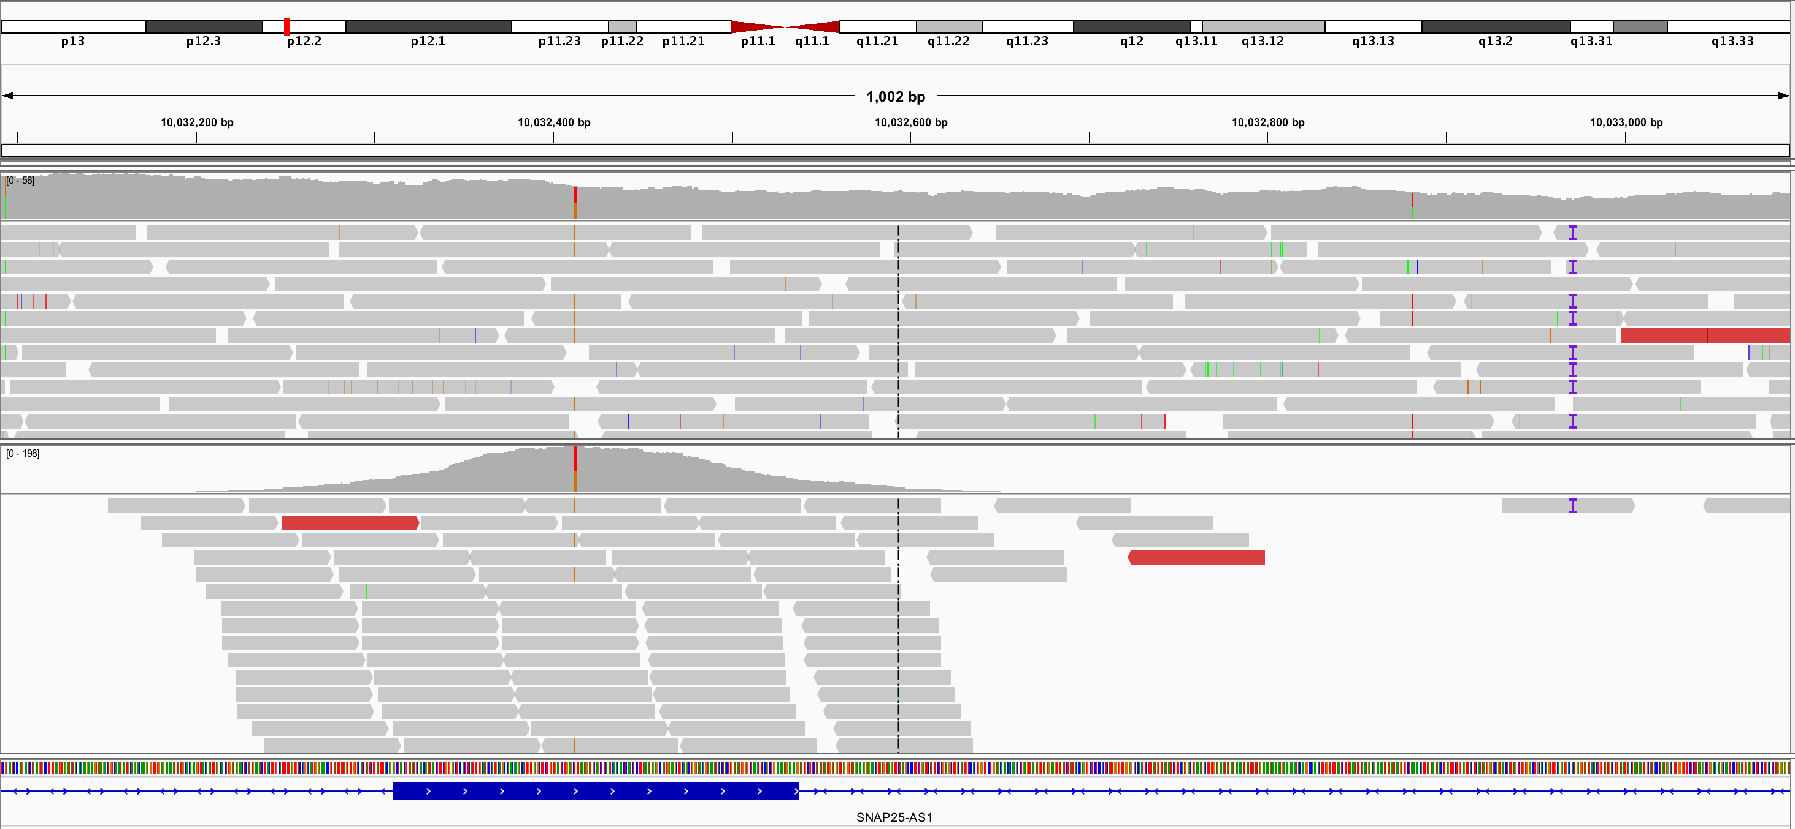
What that looks like in practice
Whole genome (WGS)
Exome
Small targeted experiments, gene panels, RADseq
Similar to exomes for most purposes
Notes:
Calling that SNP on the left, in the exon? Works in both. The insertion on the right, in the intron? Only in WGS!

Slide 8
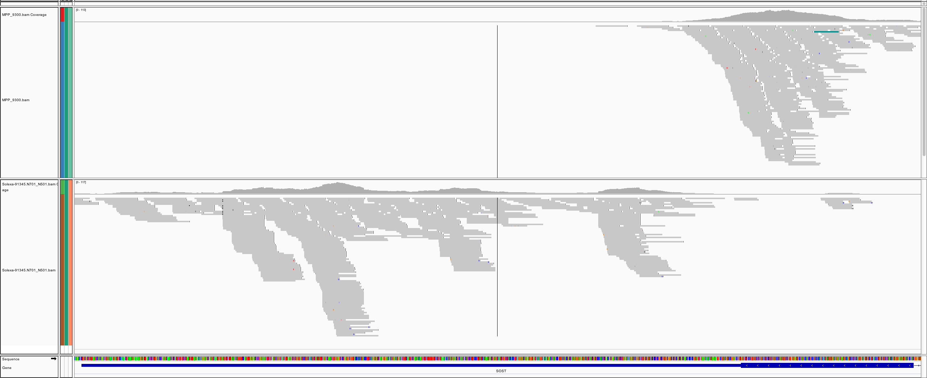
Different exome kits produce different analyzable territory
Kit A provides decent coverage in this exon
Kit A
Kit B produces bad coverage in the same exon
Kit B
Kit B produces abundant coverage in the intron region
Notes:
The takeaway here is that you must understand what is the territory that’s available to analysis for any given dataset, which depends on how the sequencing was done

Slide 9
Quality control is essential to catch problems early
Normal amounts of raw data (in Gb) but poor target coverage
High proportion of chimerism
Strange insert size distribution (too big / too small)
Shearing-based oxidation (poor OxoQ values)
Library size too small
Exomes
Whole genomes
Severe unevenness in distribution of coverage (Fold80 penalty values)
HS / reference bias based oxidation (poor cref-OxoQ values)
High proportion of unmapped reads
High percentage of adapter/oligo
Notes:
We just looked at the differences you can get *when everything goes well enough* just because of the experimental design. Now we’re going to review a few examples of cases where there were issues during either the library prep, flowcell loading or the sequencing process that cause bad data, and how to recognize them through QC metrics.
NOTE that here we’re looking at metrics that we get after mapping, so technically it belongs with pre-processing, but we’re covering this here because it’s kind of a logical extension of the wgs vs exome discussion and it tracks to data generation issues.

Slide 10
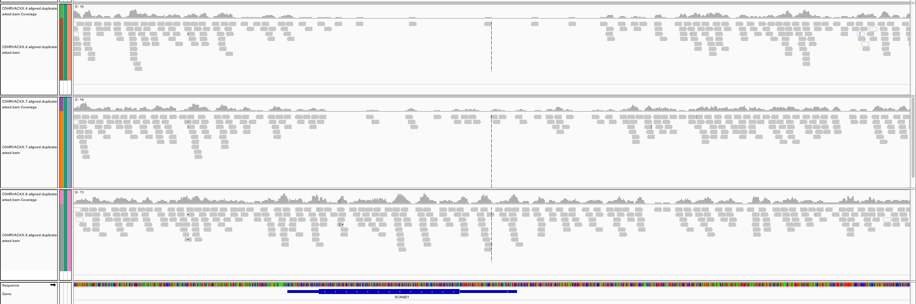
Various factors interfere with data generation
This GC-rich region is poorly covered in the first two samples -> unusable
GC content = 0.69
Notes:
For example, GC content (probably need to explain a bit what is high GC and some of the reasons problems can pop up in these areas). The first two samples have unusable coverage in this high GC region.

Slide 11
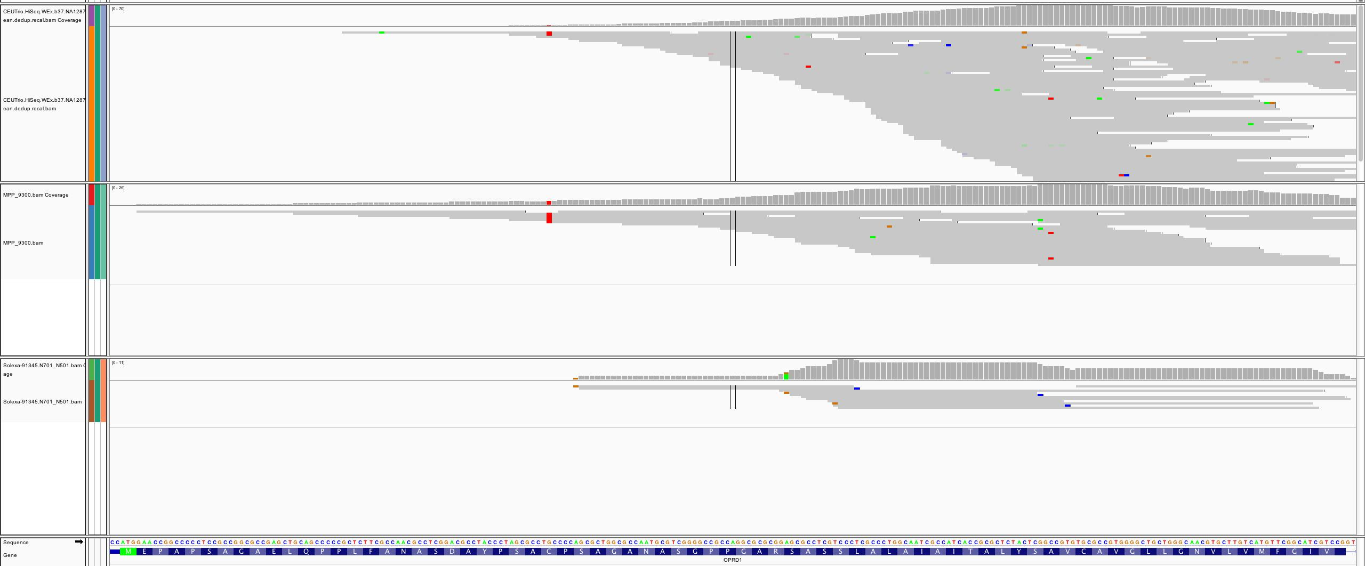
Distribution of coverage matters
Kit A and B coverage is very low in this area
Kit A
But deeper coverage in the rest inflates the overall coverage score for the exon, allowing it to pass filters
Kit B
Kit C performs badly throughout the exon; failure is more obvious!
Kit C
exon
Notes:
It’s not enough to just have good average coverage; that single number might hide distribution problems, where some areas are covered with much more than necessary, and others are essentially bare.

Slide 12
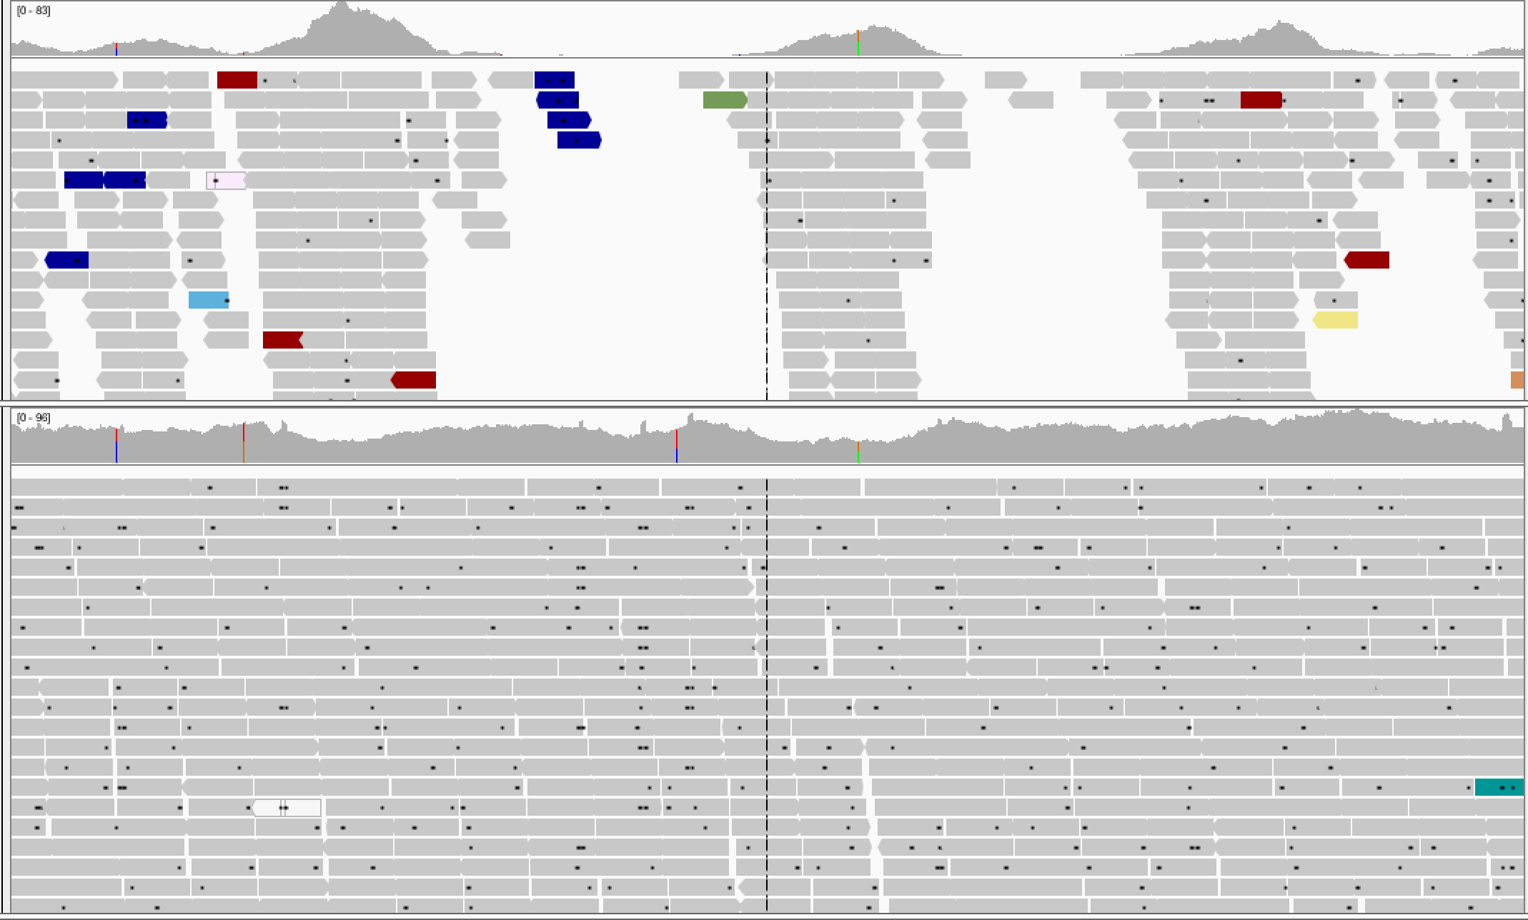
Uneven coverage in a PCR-Free whole genome
Mean coverage | % bases at 15X
31.6 | 69
Reaches overall coverage target but data is unevenly distributed: piles of reads in some places alternate with uncovered regions
Unevenly covered
WGS sample
Evenly covered
WGS sample
Notes:
Here’s another case, with relevant metrics. You’d think that the top sample is an exome but it’s not! Very abnormal distribution for a WGS.

Slide 13
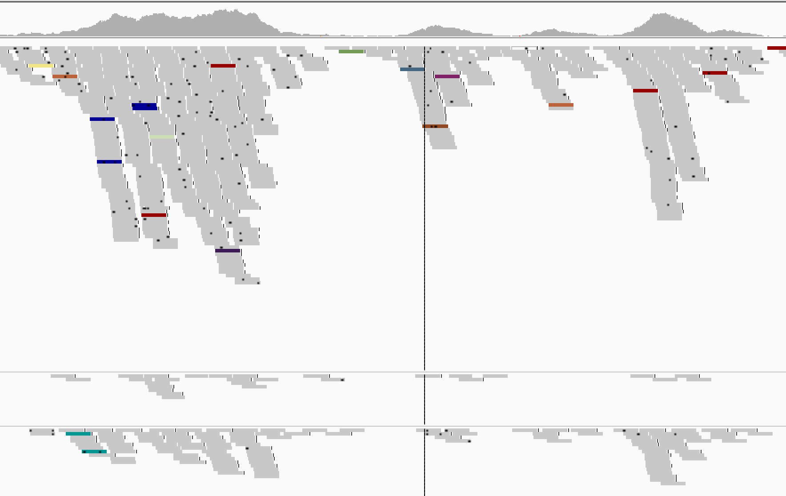
Uneven coverage between read groups
Not always a problem – sometimes we add an extra run for a sample to “top up” coverage
(but in this case RG2 does look problematic)
Read Group 1
2
3
Notes:
Special case: comparing coverage between read groups for a single sample (exome here). Sometimes you just need to throw away one read group’s worth and generate some new sequence to “top up” the sample.

Slide 14
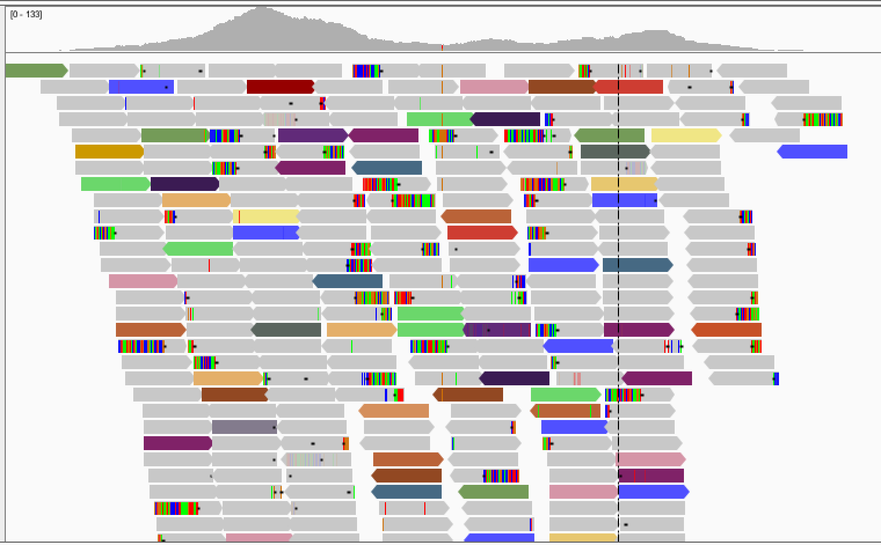
High percentage of chimerism
Reaches coverage goals but data integrity may be an issue as number of chimeric reads is so high; could confound detection of structural rearrangements and indels.
% Chimeras | % Selected bases | % Target bases 20X
30.272 | 65.438 | 78.478
13.405 | 70.036 | 84.811
Notes:
Another manifestation of coverage issues: distribution is fine but rampant chimerism suggests something deeply screwy. (need to explain chimerism briefly)

Slide 15
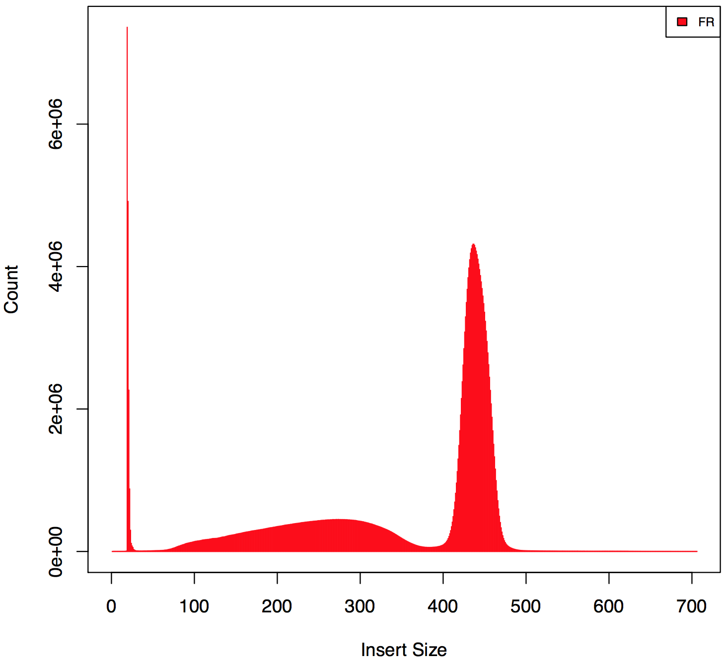
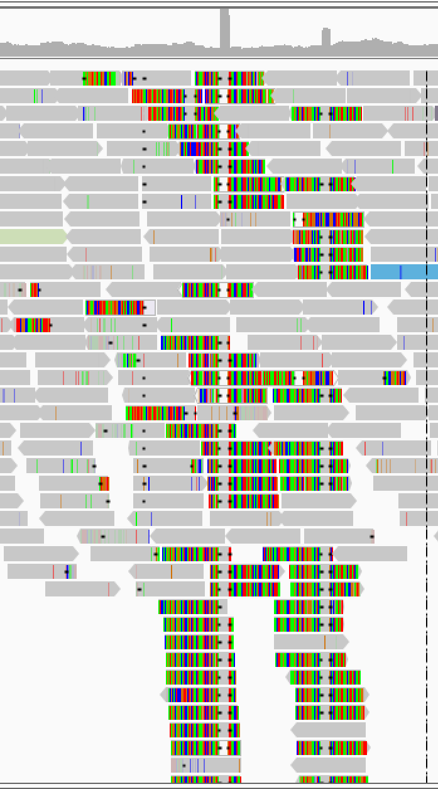
Strange insert size distribution
Abnormal spike
Notes:
And finally another fun case where looking at mapping info tells us there’s something deeply wrong. In this case, bacterial contamination in cheek swabs from sick kids caused this weird pattern of lots of very short inserts with a ton of soft-clips.

Slide 16
Recap: From biological sample to DNA data
Library preparation
Sequencing
Reads mapped and cleaned up
List of
variants
Enormous pile of short reads
Notes:
So we covered all of this, talked about data types and formats. Now the next step is that red arrow that takes us to “reads mapped and cleaned up”.

