Slide 1
Introduction to Germline Variant Discovery
GATK Best Practices for Variant Discovery
Key considerations and workflow logic
Notes:
30min talk
First going to do a bit of review
Going from an Aligned and recalibrated BAM to snps and short indels

Slide 2
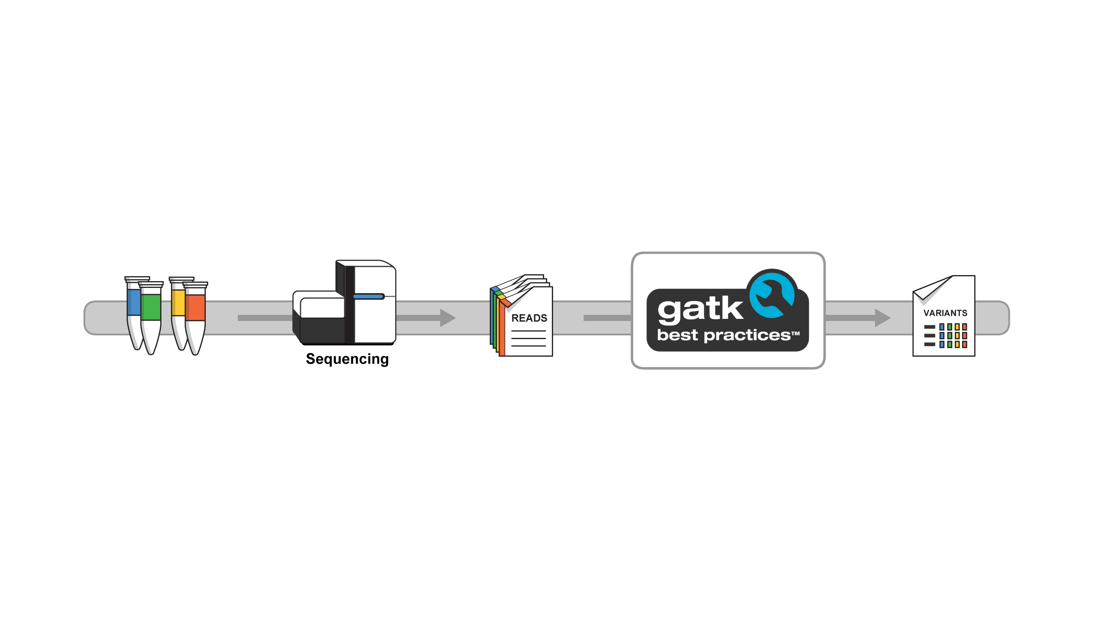
Workflows for all major variant classes
 | GERMLINE | SOMATIC
SNPs & INDELs | HaplotypeCaller GVCF | MuTect2
Copy Number | GATK gCNV | GATK CNV + aCNV
Structural Variation | GATK SVDiscovery (beta) | (planned)
https://software.broadinstitute.org/gatk/best-practices
Notes:
Spit blood and input data etc → go into the sequencer → get output reads → get high quality vriants
Matrix of diff tools for diff scientific applications – today we are going to talk about germline SNPs and Indels but the somatic components of these tools are going to be talked about later

Slide 3
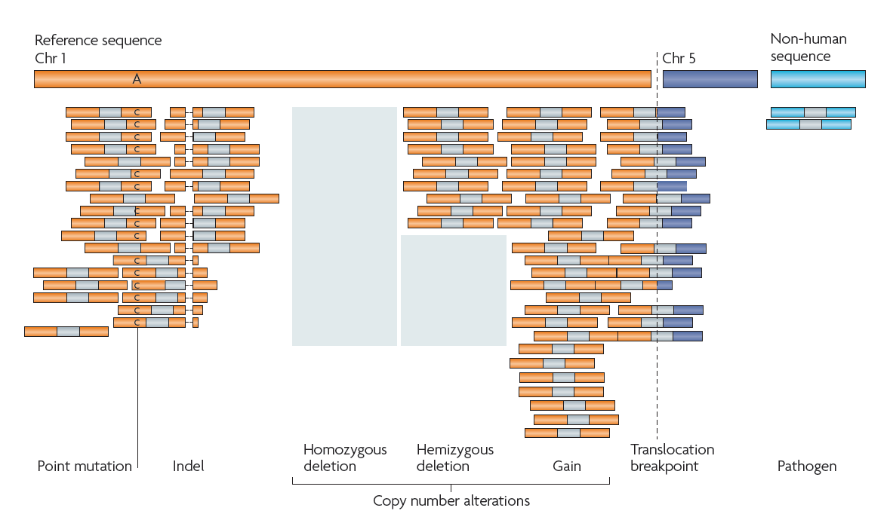


Today we focus on germline short variants
Germline
Specific ploidy
Short variant (<50bp)
CNV
SV
PathSeq
Somatic
Mixed purity, heterogeneous or mosaic
Notes:
There are different kinds of variants.
Types:
1. Germline variants – born with them. Inherit most of them but small # (30) that are totally new to each individual. They don’t have to be deleterious but just something interesting.
2. Somatic – variants that tissues pick up over time as cells divide. Also don’t have to be cancerous – just different as tissues in the body grow.
There are different sizes of variants.
A) Short Variants:
Short – point mutations. SNPs - single nucleotide polymorphism. Polymorphism/polymorphic = polymorphic different variants in different people in a population. (Single base changes in the genome that can be seen in most cases just by looking in an IGV screenshot down the line.)
SNPs are to describe germline mutations and SNVs are to define somatic mutations.
2. Indels – insertion and deletions. Small # of bases are inserted or deleted with respect to the reference genome/sequence. Typically the cutoff is 50 bases before it becomes a structural variant (longer variant) from a short variant. The cutoff depends on the algorithm of the alignments and sometimes have to use lots of other evidence to find structural variants. For longer variants just a bwa alignment isn’t enough since it would span larger than the length of a single read so you have to inform your structural variants with other evidence.
3. Structural Variations – SVs invcude inversions and translocations - mate of read is on a separate chromosome because that read can map to multiple loci in your DNA
4. Copy Number Variations – CNVs . The are larger deletions (>a couple hundred bases) they’re copy number variations (alterations)
CNV Loss / gain
The above two tend to be more common in somatic variation rather than germline.
We do have tools for germline copy number and structural variation but we are going to talk about them later.
SVs are in beta. No workspace currently but there is documentation if someone is interested.
Not discussed in video talk but additional notes left in this ppt slide:
5. Pathogens
Sequences that don’t align well or at all.
PathSeq tool

Slide 4
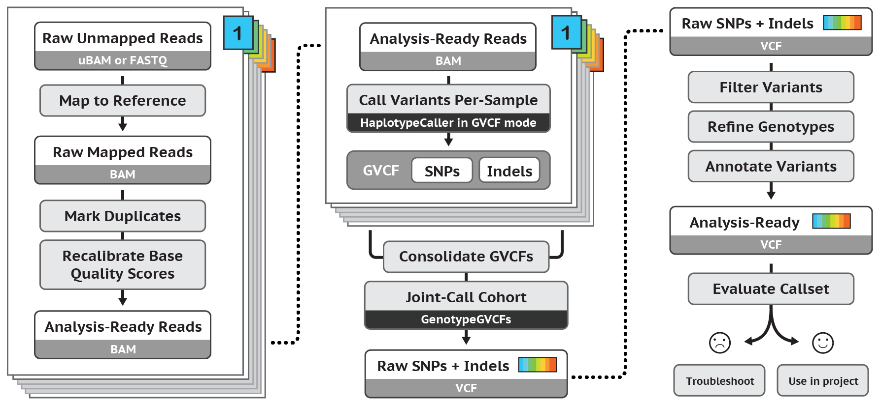
Idealized workflow for calling germline short variants
Notes:
Left panel:
pre-processing with end result being an aligned recalibrated bam (details in previous talk)
Middle and Right column:
Call variants and do refinement and post -processing

Slide 5
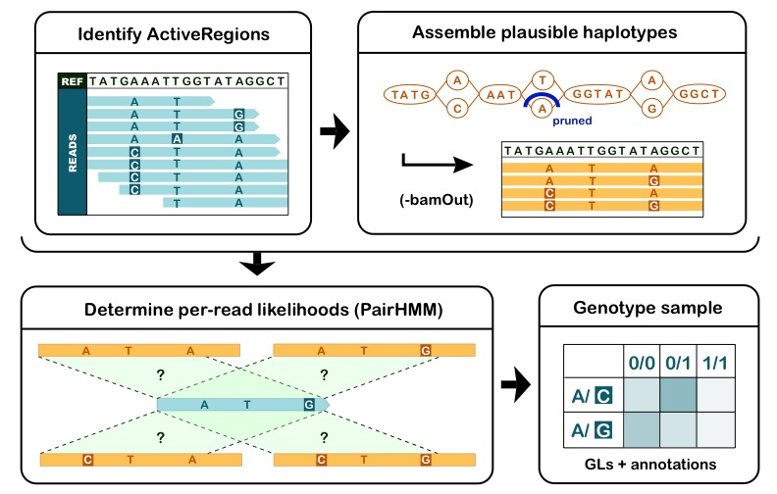
HaplotypeCaller calls germline short variants
Notes:
Tool that does actual variant calling is HaploTypeCaller
4 different steps
1. Identify active regions – restrict analysis to just interesting regions to be more efficient. Most of reference is the same sequence as our reads
2. Local alignment based on graph based assembly. This step helps in complex regions of reference, or repetitive regions or variants that unusual in sequence.
3. Assess likelihood of each read with respect to variant haplotypes we discovered using full sequence of the read and not just pileup of the bases
4. Germline genotyping

Slide 6
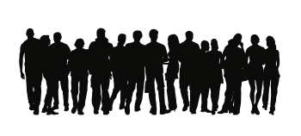

Joint analysis empowers discovery
Single genome in isolation: almost never useful
Family or population data add valuable information
rarity of variants
de novo mutations
ethnic background
Individual callsets
Joint callset
Underpowered
Superpowered!
Notes:
Germline case – we do joint calling/analysis with perhaps one ore more samples of interest or larger cohort.
One genome by itself is not that useful. One variant that looks deleterious its hard to tell how important it is on the actual biological pathway. Usually need to compare groups of people who have a particular phenotype to another group of people of the lacking phenotype. Exac and gnomad are used to compare a variant relevance for example.
1. Bigger reference panel to cross reference the presence of a variant across a healthy population.
2. Family cohort by comparing offspring to parents for de novo variants.
3. Helpful to have cohorts that are the same ethnic background as the samples that you are interested in. For example, a big cohort with 1 Qatari may result in some variants that are rare in the single sample within the cohort but if you had a cohort with a large group of Qatari samples, that variant may not still be rate – rather it is very common across the Qatari population.
------ Preexisting Notes Below
Helpful to draw from a large cohort to find how common a variant is in a population.
Looking at a variant in isolation (such as in a clinical environment) is only useful if you know how rare that allele is. That is, if there’s a rare disease, the associated variant should be rare in the population as well.
Family data – child with disease, sequence parents to see if they have alleles that would cause a problem in the child.
Use population data to add info on rarity of variants, de novo mutations, and ethnic background
Ethnic background
Big cohort with 1 Qatari, there may be some variants in that single person that are very rare, but in the context of a large group of Qataris those variants would be common.
A couple of ways to do this – call separately and put calls together, but this analysis has less power than pooling the data into a single joint callset and performing the analysis on all data together

Slide 7
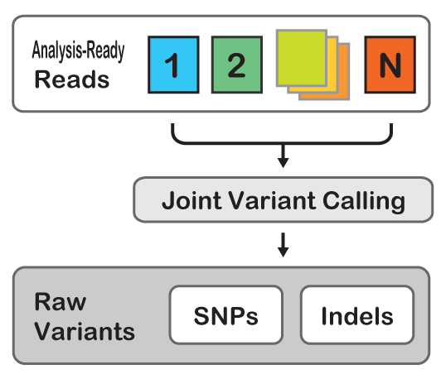
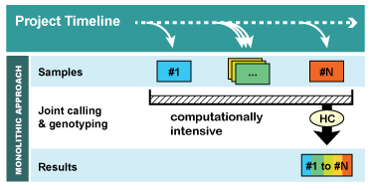
Calling all samples together directly scales poorly
Increasing number of samples increases compute requirement
It gives us the right answers, BUT
Want to add new samples? Having to re-run pipeline from scratch gives rise to the N+1 problem.
Notes:
Once upon a time, we would run all our samples together at the same time to do joint calling with Haplotype Caller. It works well by combining bams together and get one graph together but more samples means bigger graphs which means that at some point not enough memory for the tool.
When we add new samples for the cohort, you had to start again each time from the BAM step and wait again for the big graph which takes time and memory that has limitations.
What was the solution for larger cohorts? Found a new paradigm in a 2 step process:
----
This is fine if you have all your data together to start with, but if you ever want to add another sample to the call, you’ll need to rerun all the data!
This is very slow and inefficient.
And in the real world, you’re likely to run into this – getting samples in and people are slow to sign consent forms so you can’t use their data all at once. When that last person signs the forms and you have access to their data you’ll have to rerun everything all over again.
Moreover, the runtime of this scales exponentially with the number of samples. So it can be very slow.
----
But there is new way; a better way.
Our new multisample calling runs through GVCF mode.
Each sample is run through haplotype caller and produces intermediate output that we can run together later.

Slide 8
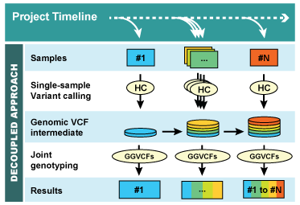
Two-step GVCF workflow scales linearly
Scales linearly with number of samples
Want to add a new sample?
Make a GVCF for that sample then re-call the cohort
Notes:
gVCF model to work in 2 steps.
Scales linearly in runtime and cost. Only do the expensive haplotype caller step on each sample just ONE TIME where you do the variant calling.
Multiple waves of sequencing sometimes happen so you can take the samples that you have and run the gVCFs that you generated from HaplotypeCaller to do the GenotypeGVCFs tool and look at results.
When you get more samples, you can run haplotypecaller and get new GVCFs and then run HaplotypeCaller on the new samples.
GenotypeGVCFs and GenomicsImportDB are the steps that you have to repeat each time for a new incoming sample.
----Preexisting Notes Below
Our new multisample calling runs through GVCF mode.
Each sample is run through haplotype caller and produces intermediate output that we can run together later.
----------
GVCF version – produces genotype likelihoods for each variant, enabling joint calling
Scales linearly with number of samples
So you can hold onto intermediate output for your samples and then run them all together whenever you get more data to produce an updated joint callset.

Slide 9
Call variants per-sample with HaplotypeCaller -> GVCF
Notes:
Starting with recalibrated aligned analysis ready reads we do all 4 hpC steps

Slide 10
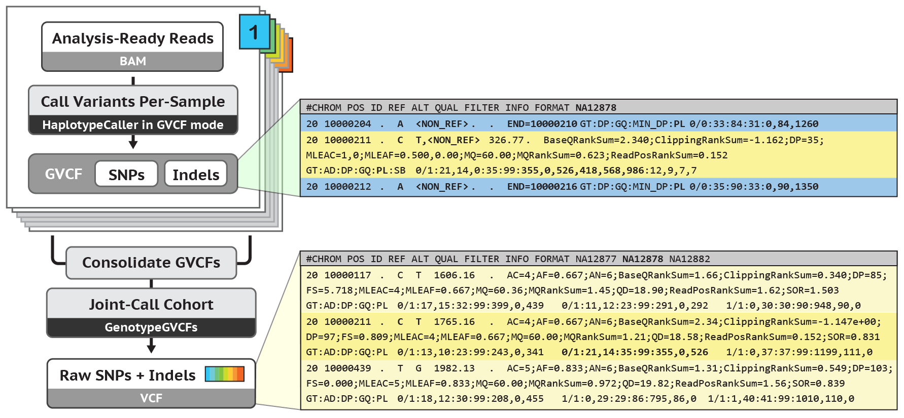
Joint call GVCF intermediates to produce final VCF
Generate per-sample Genomic VCFs (GVCFs)
then joint-call across all samples for final VCF
Notes:
Each sample gets its own genomic VCF (gVCF). Genomic VCF = Information about each position in the vcf whether or not there is a variant in the position.
NON_REF allele means there is no variant in that reference position.
The blue line gives just the reference information because there was no variant there but its important to know when you look at the cohort how many samples were confidently reference information.
To know how many of the samples were confidently referenced.
1 sample with 1 variant and then 10K samples that do not have that variant is information that you want.
Combine the GVCFs from samples in this round.
Do joint genotyping and the reference blocks are analyzed for variants in the cohort.
See the rows where there are variants but the ones that are blue get dropped if there is no variant in any of the other samples when compared to the cohort.
Get a traditional VCF with just variant sites
MISSING variants versus data where there is no coverage at that position. NON_REF is for when there is coverage but there is no variant at that position with respect to the reference genome.

Slide 11
Project-specific refinement steps
Notes:
We are still not done.
We just have raw SNPs and indels. HPC is sensitive to capture as much as we can so we may have artifacts from mapping or sequencing errors.
Filter out false positives that are called as variants but don’t count since they may be due to artifacts, mapping errors, sequencing errors, etc.
Another part of the tool is to filter out stuff that is likely to be a false positive.

Slide 12
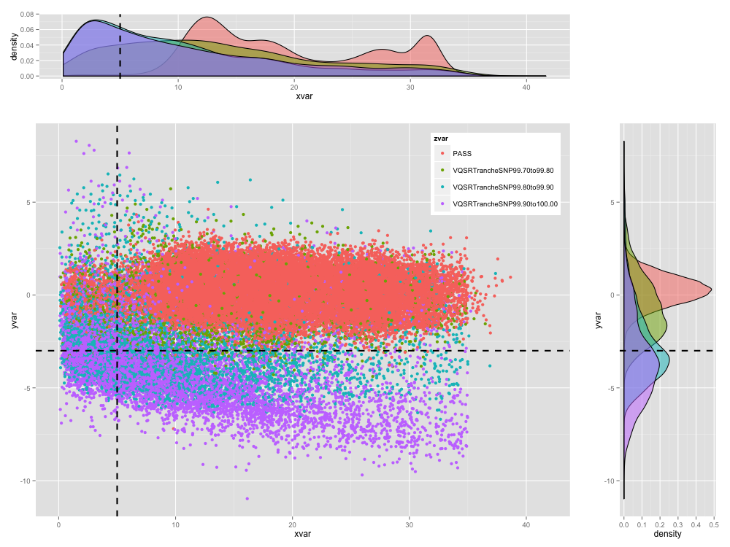
Variant filtering reduces false positives
Notes:
Raw variants from HaplotypeCaller need to be filtered. Filter by ~ 8 different features like strand bias, depth, position of variant with the read and others to do some filtering.
Project these features into 2D but you will lose precision.
Hard filter example: One annotation on x and one annotation on y in this scatter plot of variants. Don’t need to worry about which annotations but just that they describe something about the variant context and tell us something about how trustworthy the variant call is.
Results from filtering model and you can see the red clump. Try and capture those red dots with just two straight lines.
Its hard to do that simply since there is intermixing and complex space. There are some times where you have to do this when there are limitations of data but --
still have to pick thresholds where you have to set a cut-off. If x variable is > 5 == good.
The current standard approach for GATK is VQSR, a machine-learning technique that integrates multiple annotations into a model and then produces filtering “tranches”, or slices, ranked by quality -> colors of the dots show in which tranche each variant falls.
The newest/hottest thing is called “deep learning” and is a newer form of machine learning that goes much further in how it models variant quality; that’s a work in progress that will hopefully be released as an experimental feature in the near future.

Slide 13
Genotype refinement improves GT quality and de novo calls
417 de novos from
raw GT calls
17 de novos based on posterior GTs
8 high confidence
de novo variants
after GQ filtering
Notes:
Access to external data like population priors and reference panels to get estimates of population allele frequencies so that you can use that to do further filtering of your variant calls. Go through Bayesian math to use them to improve quality of the genotype calls.
In addition to filtering, we will cover Genotype Refinement using population priors or family members.
Genotype refinement improves GT quality and de novo calls
One part of refinement is functional annotation.
Functional annotation predicts effects of variants
This example is clinical data:
Real clinical data
Base genotype calling produced 417 different de novo genotyping potential variants in the offspring but we epxct like 30 in the terms of germline variants
Ballpark is 30 per exome
Apply population priors and family to get down to 17 from 1000 genomes data
Then we apply high-confidence filter, we are left with 8, which is much easier to deal with. Applied pedigree information to get information about what was in the parents and what was not in the parents and then take the ones that are of high quality and that is now there are now 8 variants which is more reasonable.
We will go into this in detail in another day.

Slide 14
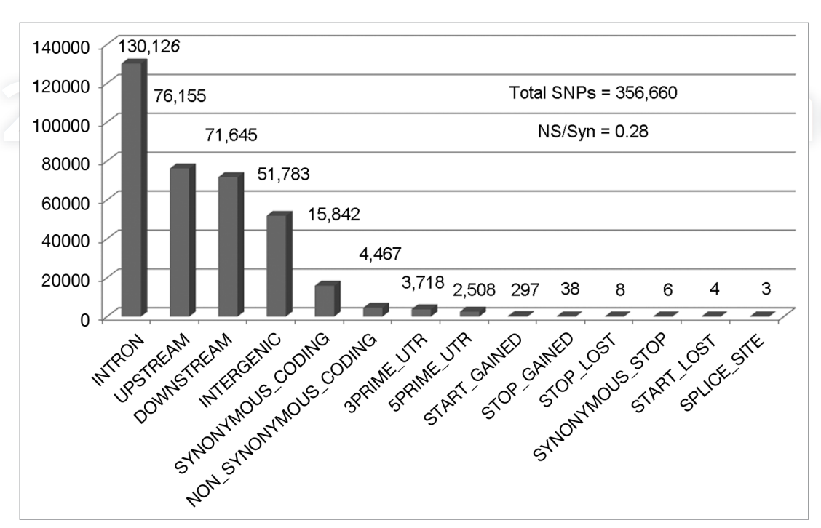
Functional annotation predicts effects of variants
Notes:
Functional annotation = labels a variant with how it changes the biological function of a cell. Predicted biological consequences from ref seq etc.
Variants don’t even happen in the gene since most of the genome is non coding so variantion is also non coding
Helps to compare this to the reference genome even though this itself is not a smoking gun type graph that you can use to draw huge conclusions.
E.g.: what gene is this annotation in? Where in the gene? Which exon? What is the resulting protein change? How would you classify a variant?
Graph shows a histogram of variant classifications for SNPs.
Most SNPs are in INTRONs or outside of a gene (directly upstream/downstream of a gene or in the intergenic region).
A few are in the gene itself and have various effects:
create a new stop codon, truncating a protein (STOP GAINED)
Remove the stop codon to create a NONSTOP mutation (STOP_LOST)
Even variants that don’t change the protein – SYNONYMOUS (_CODING, NON_ _CODING, _STOP)
Use Funcotator!

Slide 15
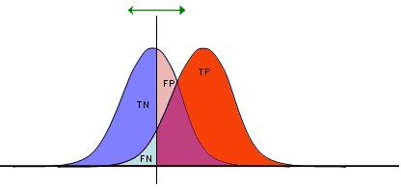
Evaluate callset for downstream analyses
Adapted from Wikipedia https://en.wikipedia.org/wiki/Receiver_operating_characteristic
⬆
⬆
sensitivity
specificity
TP
FN + TP
TN
FP + TN
test statistic
What is considered true?
Site level concordance
Allele level concordance
Genotype concordance and correct zygosity
ROC curve of TPs vs. FPs
Steeper inclines indicate better test statistic
Notes:
Lastly we can evaluate our callsets to see how clean and correct our data are after we annotate and filter.
Can we use it in our project? After all the filtering is done does the callset still look good?
Use truth samples like NA12878 since it is really trustworthy to compare sensitivity and precision. We have reliable variant calls so we can asses the sensitivity of the variants we have against the known set.
True positives and false positives. Based on the hard filtering thresholds or limits on BSQR you may lose some TPs and pick up some FPs. Get some insight into how your thresholds change the variants that you get.
Receiver Operating Characteristic curve: how did you rank your variants based on the scheme that you used. Good curve has sharp dropoff. The shallower slopes are not great results. I want to pick as many Tps as possible before my FP rate increases.
---Preexisting Notes Below
https://gatkforums.broadinstitute.org/gatk/discussion/6308/evaluating-the-quality-of-a-variant-callset
Variant level concordance
Genotype concordance
Zygosity
number of snps and indels, TiTv ratio
We do this by comparing our callset to a similar callset or a sample in our callset to it’s known truth set.
This is one step in our pipeline that is not automated.
We go over this in depth on day 2.
Multiple metrics measure callset quality, e.g.
Ti/Tv ratio.
Het/Hom-var ratio
Total HET depth
Inbreeding coefficent, e.g. is the allele in Hardy Weinberg equilibrium?
However, mostly we use a truthset like GIAB that allow us to calculate the following metrics.
Sensitivity (recall)
Specificity
Precision
FPR (false positive rate)
Here we show sensitivty and specificity
Greater sensitivity increases false positives
Greater specificty increases false negatives and decreases true positive.
Balancing the two for downstream analyses is the bulk of refinement
We use ROC curves, e.g. those produced by RTG-Tools to visualize these metrics.
We don’t cover this though.
---
[Soo Hee notes of 1/22/2016]
What we want are tools that maximize both sensitivity and specificity.
Here I’m showing [in classical format] the trade-off between sensitivity and specificity.
The test statistic’s cutoff for calls is represented by this vertical line.
If you shift it to the right, you increase specificity at the expense of missed true calls.
If you shift it to the left, you increase sensitivity. You call more true calls but also more false positives.
[Animation applied; need to click]
An alternative approach to obtaining high sensitivity and high specificity is to apply after-detection-filters.
The engine focuses on increased sensitive detection by shifting this cutoff to the left.
Then the tool applies a variety of specific filters to chip away at the false positives.
[Much of the fine-tuning of tools relates to these filters.]

Slide 16
Idealized workflow for calling germline short variants
Notes:
This was all an overview of what we are going to be talking about today but this is an introduction and the rest of the talks will go into more detail about the things we talked about.

