Slide 1
Variant calling with HaplotypeCaller
GATK Best Practices for Variant Discovery
Basic operation and algorithm

Slide 2
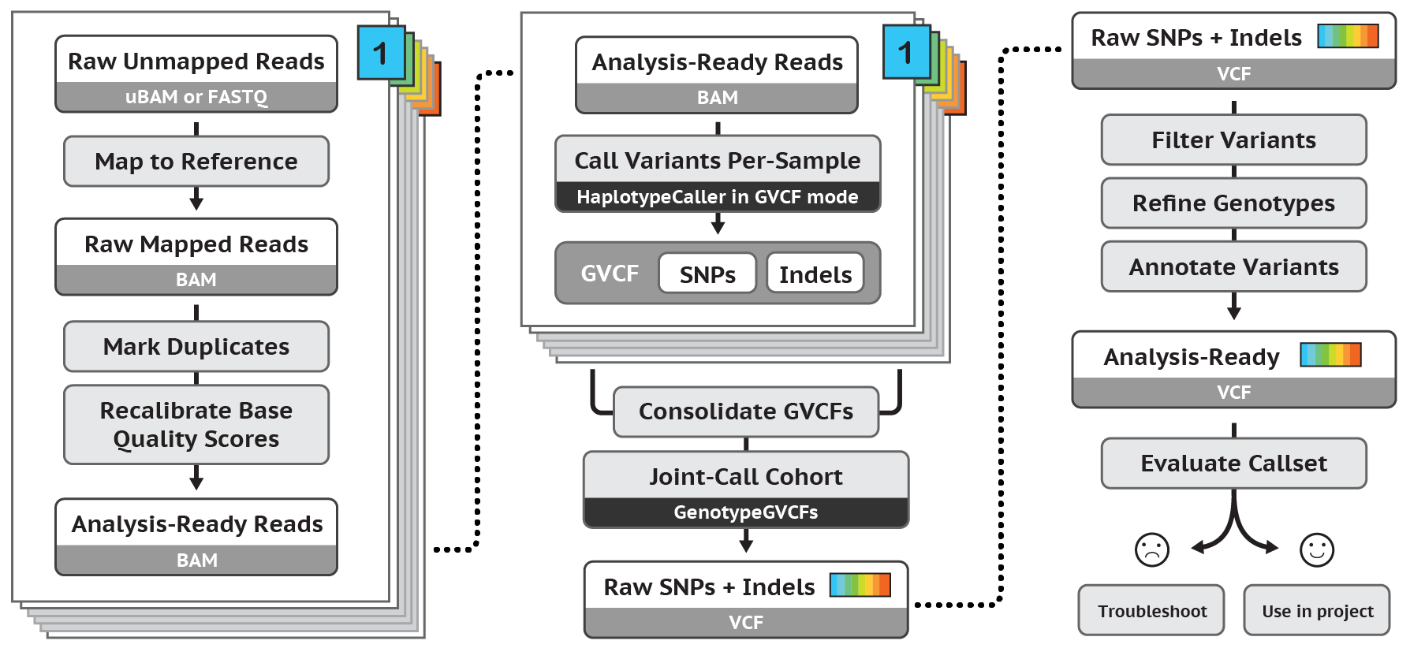
Best Practices for Germline SNP & INDEL Discovery
Notes:
Now have multiple samples which will be called individually by HaplotypeCaller in GVCF mode

Slide 3
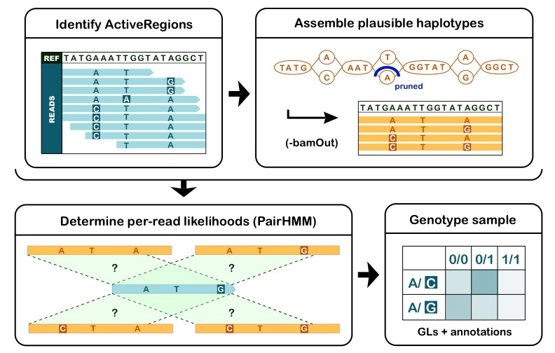
Call variants per-sample with HaplotypeCaller -> GVCF

Slide 4
HaplotypeCaller consists of 4 distinct operations
Notes:
Identify ActiveRegions – areas of likely variation
Assemble haplotypes – in each active region, assemble reads into a representation of the likely haplotypes
Determine likelihoods – determine how likely each read is to have come from each haplotype
Genotype – calculate genotype likelihoods to determine alleles at each position
GVCF = “Genomic VCF”
GVCFs have calls for all positions in the reference, regardless of whether there is a variant

Slide 5
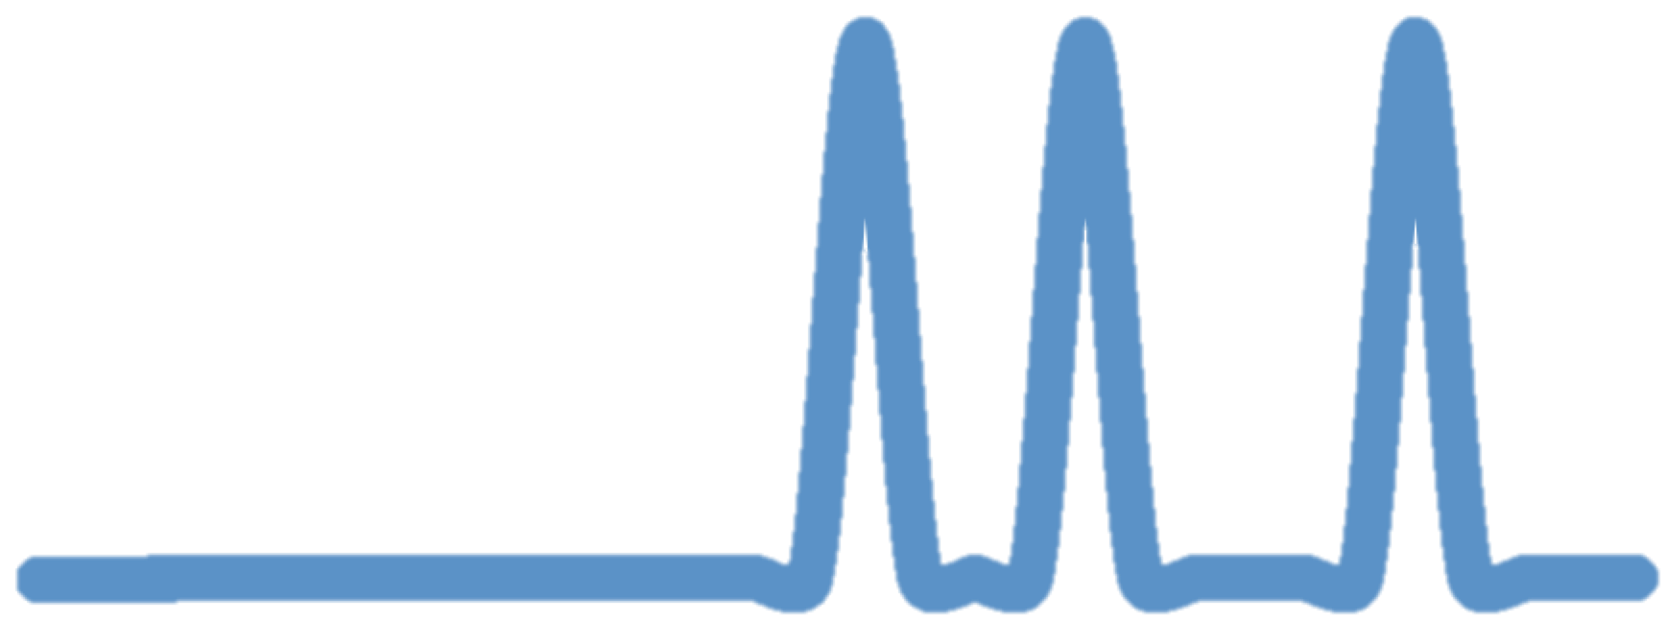

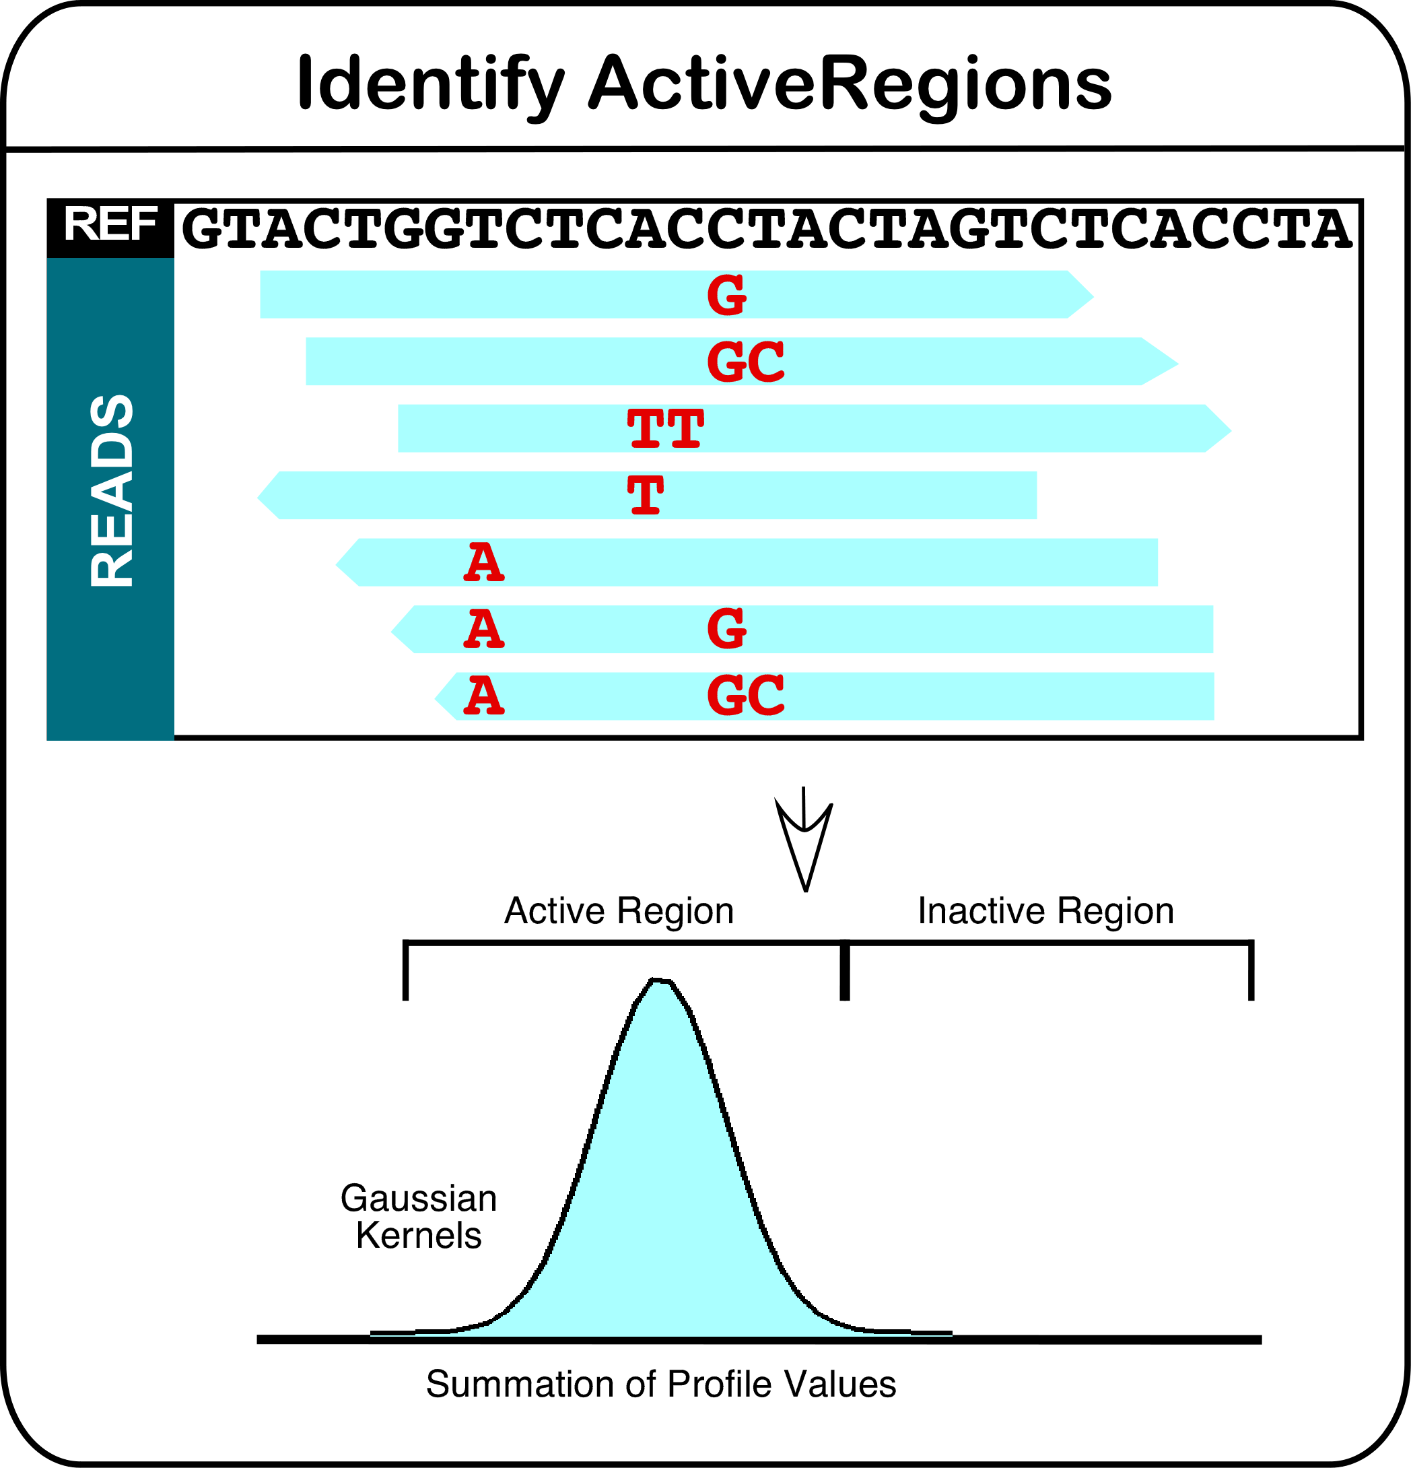
Step 1: Identify ActiveRegions
Sliding window along the reference
Count mismatches, indels and soft-clips
Measure of entropy
Trim and continue with ActiveRegions over threshold
inactive
active
* Toy example
Notes:
Step 1 – Identify Active Regions
Compute an activity score for ea. genomic position & generate a raw activity profile.
Uses a sliding window
“interesting regions” are ones with indels, soft clips, and mismatches (high entropy)
Smooth raw profile (to gaussian curve shown)
Find local maxima above the entropy threshold, and trim ends only supported by low qual bases
Active regions go on to the next step
SH 9/11/2017: This is a toy example where scale is in miniature.
LG: The active probability will peak at pretty much 1 at each of those sites with alt reads. The active region will be about 77bp wide. In theory there should be some dips in between the alt loci, but it might be a little subtle. I didn't actually calculate that part.
there are a bunch of bases on either side that go into the calculations
There is a minimum and maximum active region size. Here we need to increase the size to meet the minimum
the active region is about 77bp and so this bottom active region should be much wider
------------------------------------------------------------------------
In step 1, the tool determines which regions of the genome are of interest, based on the presence of evidence for variation above random noise. We call these regions of interest active regions. Of course, in GVCF mode every region is of interest for calculating probabilities and I’ll explain this more later. For reassembly, however, only active regions are of interest.
This step uses three phases
One. The tool computes an activity score for each genomic position to give a raw activity profile. It uses a sliding window. Interesting regions are those that include indels, soft-clips, and mismatches. These regions look messy in IGV and contribute to a measure we call entropy.
Two. The tool then smoothes the raw profile. It spreads raw entropy peaks to contiguous bases to give a smoothed gaussian as shown {here}.
Three. The tool then identifies local maxima over an empirically determined entropy threshold. This phase includes trimming of intervals. We tighten up the interval by cutting away edges supported only by ends of reads with low quality bases (BQ <10).
These active regions go on to the next steps.
==========
Of those regions passing the threshold, the minimum active region size is 50 bp (trimming) and adjustable maximum’s default is 250 bp (window size).
{identified from CIGAR strings}
Two ways to examine intervals:
Debug mode outputs intervals to log.
Or, use the –activeRegionOut argument to output an IGV-compatible active intervals to a 1-column list.
For those super-interested folks, use –activityProfileOut argument for IGV-compatible per bp probabilities of being active. Alternatively, you can also provide your own intervals using the –activeRegionIn argument.

Slide 6
Step 2: Assemble plausible haplotypes
Local realignment via graph assembly
Traverse graph to collect most likely haplotypes
Align haplotypes to reference using Smith-Waterman
Likely haplotypes + candidate variant sites
Can make HC output the reassembled reads and selected haplotypes using the –bamOut parameter

Slide 7
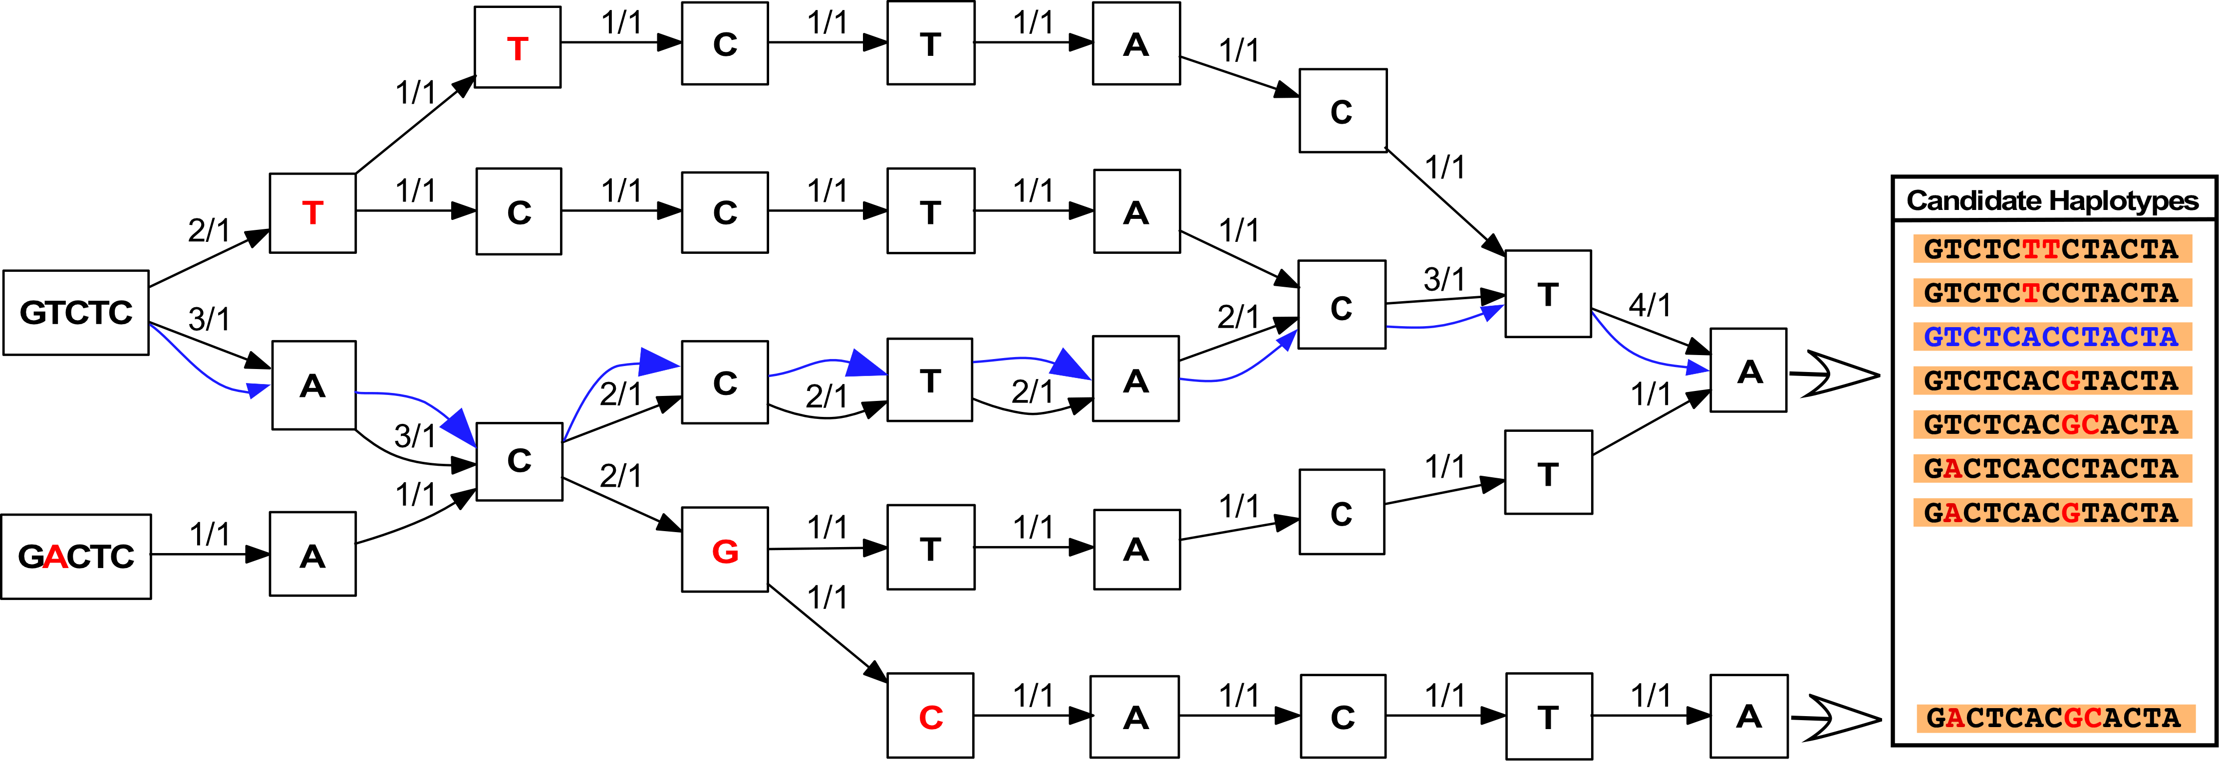
Example HaplotypeCaller assembly graph
Ignore previous alignments
Graph consists of every possible sequence combination based on reads
Count reads that support paths
Notes:
Count the reads that support each path, and that’s how you rank them in the list of candidate haplotypes
Repetitive regions can cause loops in the graph, in which case HaplotypeCaller increases the k-mer size. Occasionally the k-mer cannot be made large enough and the assembly fails.
The tool can optionally emit the assembly graphs

Slide 8
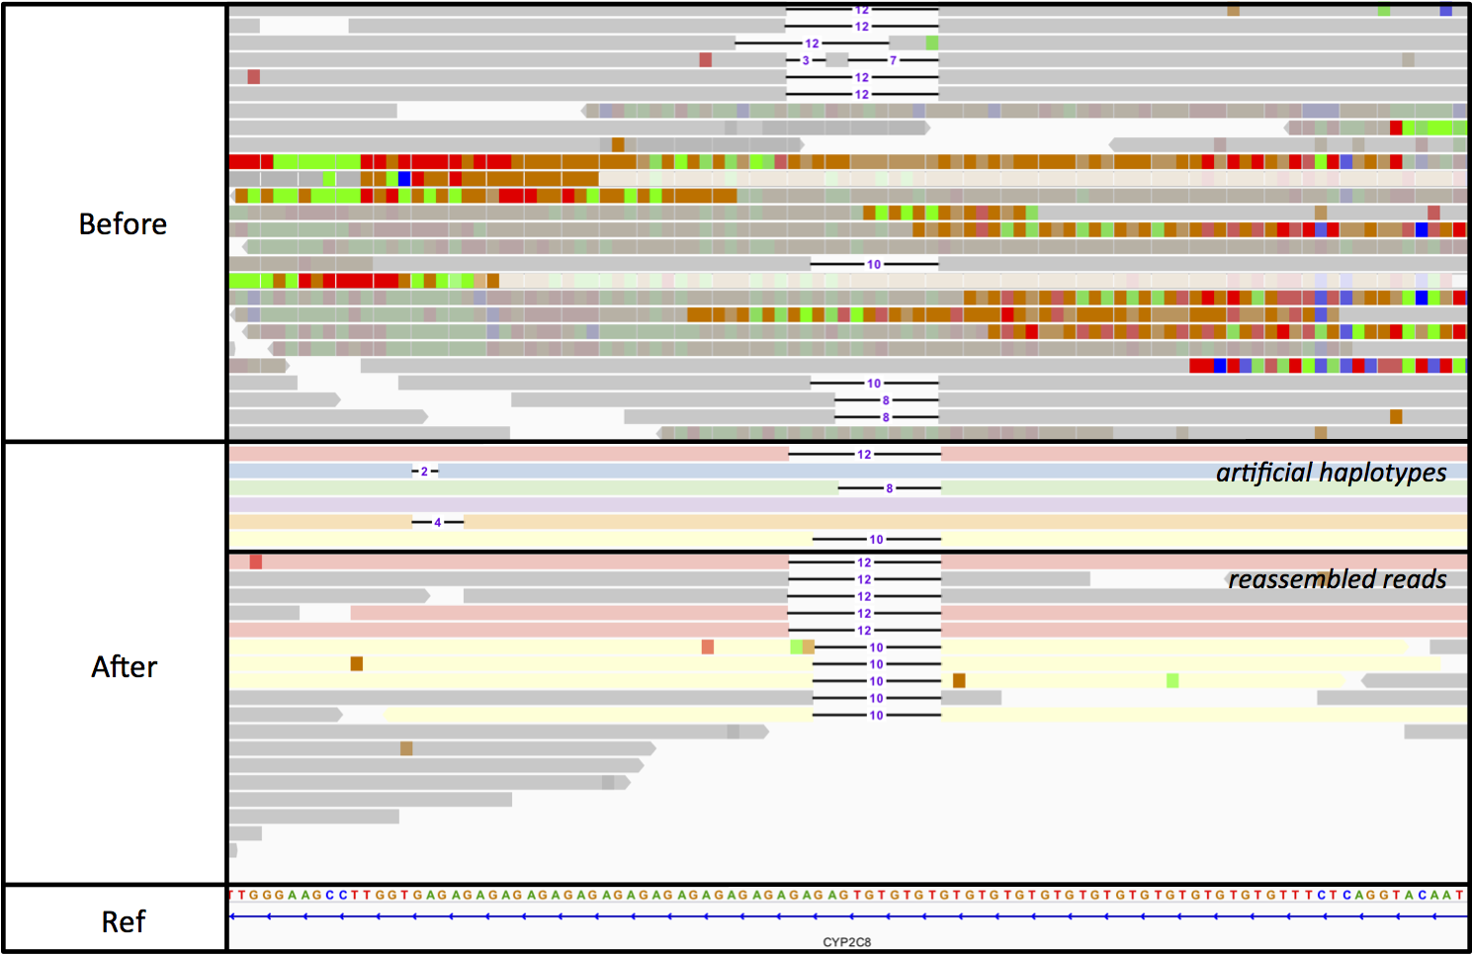
Graph assembly recovers indels and removes artifacts
Showing 100bp region starting at 10:96,825,862 for NA12878
Notes:
Now here’s why we do a realignment.
Top track is reads before HC, Bottom track is reads after HC
Before, the mapper found a lot of individual mismatches, b/c region is repetitive-- & hard to filter because multiple reads agree
After, graph assembly found a large deletion that better fit the data
SHL has original alignment figure and data.
-----------------------------------------------------------------------------------------
Take a look at this region on IGV. We are looking at reads before and after HC.
The top track shows before data that has already been through indel realignment and BQSR.
The region is messy as you can see by the multiple mismatches and indels.
You could say these variants are well supported by the read data.
We know these are artifacts and we know that in this state they will be hard to filter out later.
And we ask, what is the point of filtering out false positives if we do NOT even have the true variant?
In the lower track, we show the region after HC’s realignment.
The reassembled region reveals a 30 bp deletion!
This region was difficult for the mapper because of small repeating sequences as well as for indelrealigner because it only handles small indels.
Graph assembly allows us to resolve this type of complexity.
================
If we scan the reference sequence at the very bottom we see something interesting. GTGTGT {here} and again {here}. ACACAC {here} and again {here}. ATATA {here} and again {here} and again {here}. We have small repetitive domains that can end up as cycles in the graph. HC is able to resolve this region’s large deletion using larger kmer sizes.
As shown by this example, HC is capable of producing accurate calls in regions with poor mapping quality

Slide 9
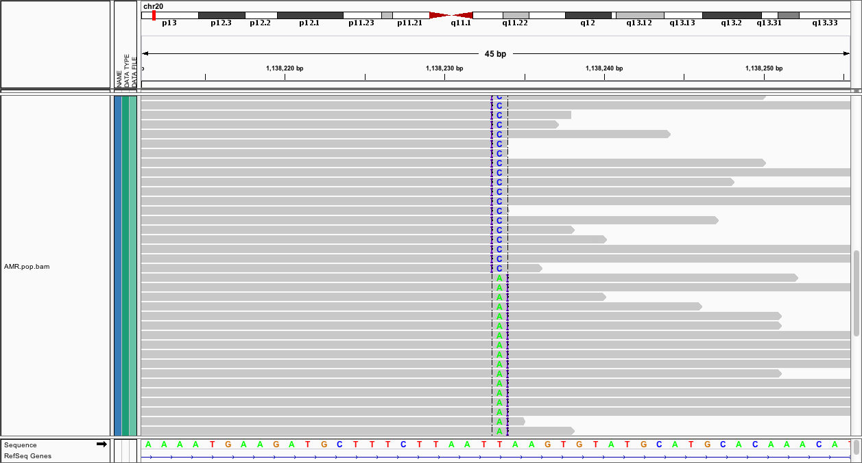
Resolves complexity caused by mapper limitations
Reference T
Consensus C T T A A T A A G T G T
Reads A C
Mapper can represent two different ways, at random:
Original BWA alignments
[+A][T->C]
[T->A][+C]
HaplotypeCaller will settle on one representation -> cleaner output call
Notes:
HC also:
Resolves tie-breaks (more parsimonious)
Haplotype’s decision will be reflected in the output BAM
---------------------------------------------------
In addition to helping call indels, HC resolves ambiguity from random aligner tie-breaks. In other words, HC increases parsimony.
For the example sequence shown, we compare a reference sequence to reads sequence.
In black is the shared sequence, in blue the reference only and in red the reads only sequence.
The aligner can represent the red AC in two ways against the blue T and does so at random given the mapping scores are identical either way.
We will get an insertion for one base and a mismatch for the other.
HC takes into consideration the stack of reads in the locus, and it settles on one variant representation.
And this results in more parsimonious variant calls.
========
Graph assembly, based on order reads are fed in, can be nondeterministic
Downsampling can be nondeterministic
VQSR is nondeterministic
We don’t know which one HC will pick from the two, but it will pick one.

Slide 10
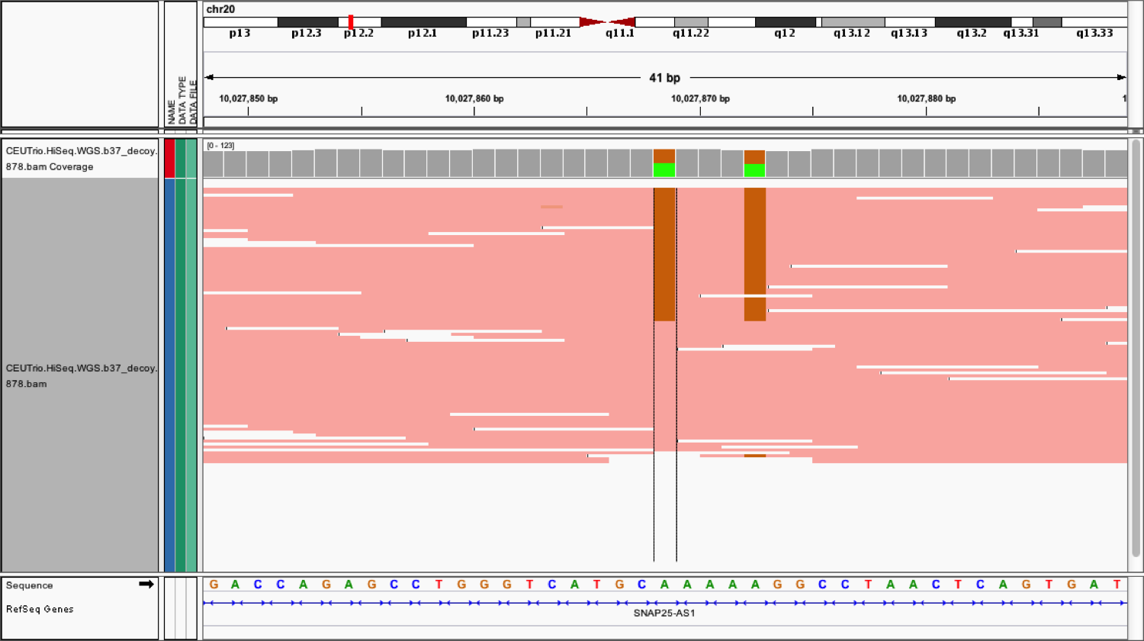
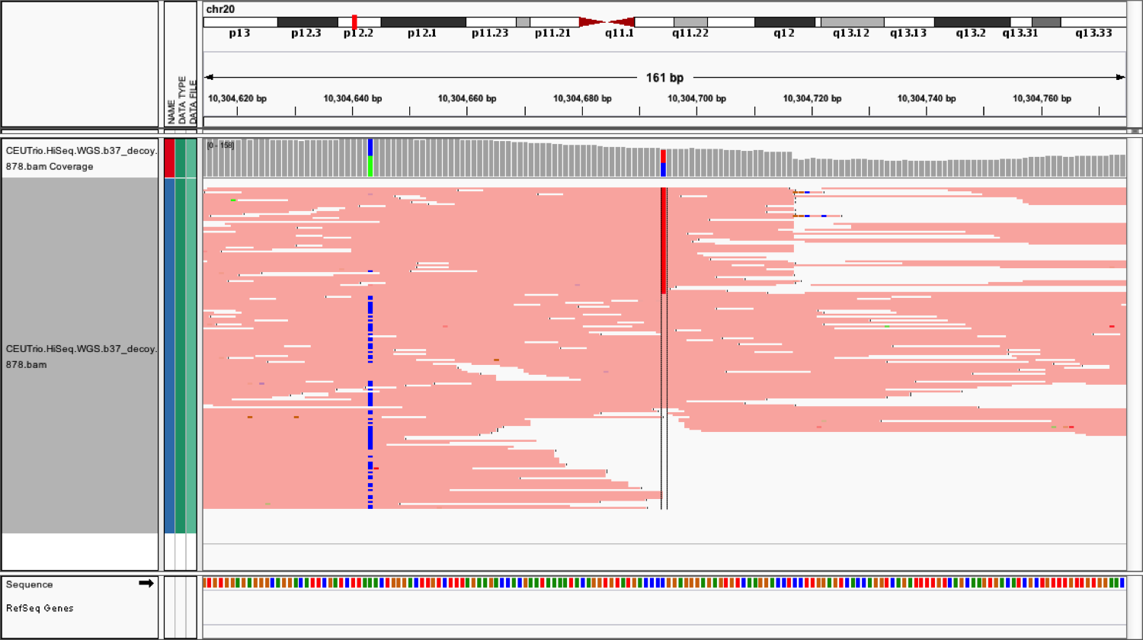
Bonus perk of haplotype calling: physical phasing
Same haplotype
Different haplotypes
Two new sample-level annotations are PGT (phased genotype) and PID (phase identifier):
#CHROM POS … REF ALT … FORMAT SAMPLE
1 1372268 . G A,<NON_REF> … GT…:PGT:PID:… 0/1…:0|1:1372268_G_A:…
1 1372269 . G T,<NON_REF> … GT…:PGT:PID:… 0/1…:0|1:1372268_G_A:…
Notes:
HC ALSO (pt 2)
Give physical phasing (relatively rare)
When variants are close to each other, we can tell if they are on the same haplotype
----------------------------------------------------------------------------
A bonus perk of assembly is physical phasing.
This the tool does automatically for active regions run in GVCF mode for GATK v3.3+.
The phasing information carries over to the multi-sample VCF.
Here we show two examples. On the left, the region’s two SNPs are on the same haplotype. On the right, the regions two SNPs are on different haplotypes.
This phasing information appears as two sample-level annotations—PGT and PID—as shown in this example GVCF under the format field.
The PGT is the phased genotype that uses a pipe, which you can distinguish from the unphased genotype which uses the forward slash as shown under the sample column.
The PID is the phase identifier which keeps track of the phased variants per haplotype. The identifier uses the position of the first phased variant and the variation itself. For example, {here} we have a G-to-A variant at position 1,372,268. The PID is 1,372,268-underscore-G-underscore-A for both variants.
Ok, let’s move onto step 3 of HC. Any questions so far?
===============================
Because 2 nearby snps will be considered “messy”, most sites we care about will be phased.
Physical phasing is different from transmission overlap phasing. The latter is based on inheritance.
As of GATK 3.3, HC outputs physical (read-based) information (see version 3.3 release notes and documentation for details).
Note that as of GATK 3.3, physical phasing is performed automatically by HC when it is run in -ERC GVCF or -ERC BP_RESOLUTION mode, so post-processing variant calls with ReadBackedPhasing is no longer necessary unless you want to merge consecutive variants into MNPs.
Before, another tool, ReadBackedPhasing gave us phasing information. This tool is still relevant for MNPs (multinucleotide polymorphisms).
The PGT is always ‘0 | 1’ even for hom-vars. This is a temporary notation, a hack so to speak, because it is in the GVCF.

Slide 11
Functional implications of variant phasing
ref
|
*
*
functional
cis
*
|
*
*
*
|
*
*
non-functional
*
trans
*
*
|
*
Notes:
This is why phasing matters:
In both cases you are het for 2 mutations.
If cis, then both your proteins are functional b/c complementary mutations
If trans, then both your proteins are non-functional b/c they can’t fold properly
=================================
Product can be RNA or Protein.
Notice we use a diploid case.
Two copies that are functional or

Slide 12
Functional implications of variant phasing
Two SNPs in the same codon: A > T and C > G
In trans – two copies, each with a missense mutation
In cis – one functional copy and one loss of function!
AAC
(Asn)
AAG
(Lys)
TAC
(Tyr)
TAG
STOP!
Notes:
This is why phasing matters:
In both cases you are het for 2 mutations.
If trans, then both your proteins have missense mutations – probably somewhat functional, but not optimal
If cis, then one protein is normal and the other is likely non-functional
Depending on the pathway,
=================================
Product can be RNA or Protein.
Notice we use a diploid case.

Slide 13
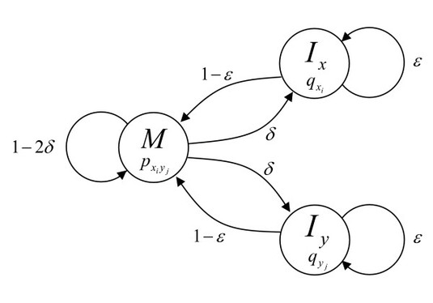
Step 3: Score haplotypes using PairHMM
PairHMM* aligns each read to each haplotype
Uses base qualities as the estimate of error
Likelihoods of the haplotypes given reads
* Hardware-optimized versions of PairHMM are included and are activated automatically at runtime
Notes:
Step 3: Score Haplotypes
- Now we’ve just determined all possible haplotypes, and it’s time to score them, given the base qualities, to determine how likely each haplotype is

Slide 14
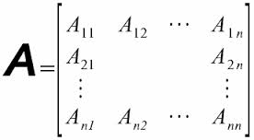
PairHMM uses base qualities to score alignments
State
(M) Match
(I_{x}) Insertion
(I_{y}) Deletion
Transition probabilities
(ε) = Gap continuation
(δ) = Gap open penalty
(1 - ε) = Base precedes an insertion or a deletion
(1 - 2δ) = Base matches and continues
Haplotypes
Reads
A_{ij} = probability of haplotype-read pair
Matrix contains likelihoods of the haplotypes given the reads
Notes:
HC scores the haplotypes using an algorithm called PairHMM (for pairwise comparison hidden markov model)
Top diagram: calculation done per haplotype:read pair, which is then stored in bottom diagram matrix
Algorithm gives us a score for the pairwise probability, which is based on BQ scores (hence why BQSR is important!)
-----------------------------------------------------------------
Just to reiterate, step 3’s PairHMM is what uses base qualities to score alignments.
On this slide, the top figure diagrams the calculations PairHMM does for each haplotype:read pair.
Each time we run through the PairHMM, we get one number, a pairwise probability, which we store in {this matrix}.
For an explanation of the top diagram, I refer you to Richard Durbin’s (Biological Sequence Analysis). Briefly,
This diagram represents how the PairHMM algorithm decides on the final pairwise alignment of two sequences, the haplotype and the read.
I will not go into details.
What is important to note is that the PairHMM gives us a score for the pairwise alignment that we call the pair-wise probability.
This probability is based in part on base quality scores and
Brings us back to the importance of reliable base qualities as we discussed {in the last talk before lunch}.
Fine-tuning your data’s base qualities through BQSR ensures this part of HC runs optimally.
A haplotype spans the entire active region, more or less.
Each read in the region, depending on the region size, may align to part of the haplotype or the full haplotype.
It may align well or poorly depending on the combination.
The PairHMM gives a read:haplotype pair the opportunity to showcase its best alignment.
The best alignment’s score, the pairwise probability, is the maximal score we can expect from the pair.
We store each pair-wise probability in {this} matrix.
We call this matrix the per-read-haplotype-likelihood-matrix,
because we can derive the likelihoods of the haplotypes given the reads from it.
You’re going to see this matrix again, spiffed up with PowerPoint formatting.
{So, how do we transform support for haplotypes, that is haplotype likelihoods, into support for alleles?}
==============================
For a better explanation of the top diagram, I refer you to Richard Durbin’s (Biological Sequence Analysis). Briefly,
This diagram shows states in circles and transitions as arrows for a pairwise alignment of two sequences, x and y.
Start and End states are omitted for clarity.
State M emits two letters, one from each sequence, and corresponds to the two letters being aligned together.
State I-sub-x emits a letter in sequence x that is aligned to a gap, and similarly state I-sub-y emits a letter in sequence y that is aligned to a gap.
The formulas next to the arrows give transition probabilities. [reduce complexity of this, saving full explanation]
Scoring, e.g. penalties, for gaps and for mismatches, are based in part on base quality scores.
This is why it’s important to have reliable base qualities and to run your data through BQSR.
Given the transition probabilities and the input haplotype and read sequences, {(an analogue of) the Viterbi} another algorithm gives the most probable path through the HMM and this ends up as the alignment and provides a probability score.
{The Viterbi algorithm = Needleman-Wunsch with appropriate parameters.
The logarithm of the emission probability function p(.,.) at M corresponds to a substitution scoring matrix, while affine gap penalty parameters can be derived from the transition probabilities δ and ϵ.}
-------------------------------------------------------
From matrix, we can derive the likelihoods of the haplotypes given the reads {or the converse—the likelihoods of the reads given the haplotypes}. These in turn will tell us which alleles are most likely.
Indel qualities are going away.
Laura doesn’t like this slide and recommends “hand-wavy version”.
Align each read to each haplotype. For each pair of those sequences (haplotype:read) run through pairHMM. For each base, either a match or Ix (insertion) or Iy (deletion in read). The alignments aren’t necessarily unique as two sequences can be aligned in a variety of ways with varying mismatches. Mismatch penalty is represented by P-sub-x-i-y-j, transition probabilities describe how likely it is to initiate an insertion or a deletion, we say we derive these transistion probabilities form bQSR but not really in production. Diagram of two sequences aligning to each other, We calculate the likelihood of the read a…
All the transition probabilities originating from one state add up to one.
For example, for M, {this} delta, {this} delta, and {this} 1 minus 2delta add up to one.
<http://genome.cshlp.org/content/15/2/330/F1.expansion.html>:
Basic pair-HMM for sequence alignment between two sequences, x and y. State M emits two letters, one from each sequence, and corresponds to the two letters being aligned together. State I_{x} emits a letter in sequence x that is aligned to a gap, and similarly state I_{y} emits a letter in sequence y that is aligned to a gap. Finding the most likely alignment according to this model by using the Viterbi algorithm corresponds to applying Needleman-Wunsch with appropriate parameters. The logarithm of the emission probability function p(.,.) at M corresponds to a substitution scoring matrix, while affine gap penalty parameters can be derived from the transition probabilities δ and ϵ
<http://www.slideshare.net/GenomeInABottle/ryan-poplin-sources-of-bias>:
Empirical gap penalties derived from data using BQSR; base mismatch penalties are the base quality scores.
(ε) = Gap continuation penalty {[arbitrarily assigned a value of Q10 (0.1)] AND/OR [Empirical gap penalties derived from data using BQSR]}
Base mismatch penalties are the base quality scores. If the BQ is not reliable, the estimate is not reliable. Hence importance of BQSR.

Slide 15
Transforming support for haplotypes into support for alleles
Haplotypes
1
2
3
4
1
0.05 | 0.10 | 0.06 | 0.01
0.05 | 0.02 | 0.09 | 0.10
0.05 | 0.12 | 0.03 | 0.02
Reads
2
1
3
3
2
4
Alleles
C
A
1
0.10 | 0.06
0.10 | 0.09
0.12 | 0.05
Take the highest per-read likelihood of haplotypes with allele
2
3
Numbers are artificially large for illustration.
Notes:
We’re not done with step 3 yet. We need allele likelihoods to determine the genotype, not haplotype likelihoods.
Suppose we have four possible haplotypes (1-4) and three reads (1-3) at a site (position 1)
PairHMM gave us scores for the top table by comparing each read and each haplotype
Looking at read 1 only (1st row, pictured green read)
H2 & 4 agree that position 1 has a C, so to fill in that allele, we pick the H with the highest score (0.10, H2)
H1 & 3 agree that position 1 has an A, so to fill it in, again pick the H with the highest score (0.60, H3)
Repeat until filled in.
But Read 1 has an ‘A’ at position 1! Why do we care how likely it is that it matches a ‘C’ haplotype?
Because we are looking at the likelihood of all reads overall at that site, and for the haplotype as a whole (other positions, not just position 1)
We still need a score though to make the comparison later!
--------------------------------------------------------------
How do we transform support for haplotypes, that is haplotype likelihoods, into support for alleles?
Here we’re showing an example region and four different haplotypes. I’ve labeled the haplotypes {R, 1, 2 and 3}.
There are two positions, with two alleles each, that differ in combinations to make each of the four haplotypes unique.
Some haplotypes could be real and some are chimeras. {In another words, mixed in with our horses and eagles are hippogriffs.}
However, the truth of each contiguous haplotype isn’t our focus.
Rather, we are interested in the variants within the haplotypes.
So we reduce the dimensionality of the haplotypes table into a table of variant alleles per site. {Variants are from step 2}.
Notice we’ve color-coded the columns for each haplotype. The rows for both tables are reads.
Warm color columns, red and orange, support allele A, while cool color columns, green and blue, support allele C.
We transplant values from the Haplotypes table into the Alleles table, matching cell colors.
The reasoning in how we transplant values is as follows.
A read supports each of the different haplotypes the best it can and gives the varying per-read-haplotype likelihoods.
We know some of these are spurious matches and we make the assumption that the best matches represent real events.
We sift the wheat from the chaff by taking the highest per-read likelihood of the haplotype columns that support an allele and use this number as the degree of support for that allele.
For example, allele C has 2 haplotypes that support it, haplotypes 1 and 3 in green and blue.
The haplotype 1 likelihood, at 0.10, is the higher number and so it is transplanted into the Alleles table for read 1.
For read 2, again for allele C, haplotype 3’s 0.10 is highest and is transplanted into the Alleles table for read 2.
We repeat the process for read3 and then for the allele A and the 3 reads.
Then we move on to the next variant position and draw up another table and repeat the process.
===============

Slide 16
Step 4 : Genotype each sample at each potential variant site
Determine most likely combination of allele(s) for each site
Based on allele likelihoods (from PairHMM)
Apply Bayes’ theorem with ploidy assumption*
G_{i} = H₁H₂ for diploids
Genotype calls
Read-haplotype likelihoods
* Default is diploid; can set desired ploidy in command line
Notes:
Step 4: Genotype
Look at per-read-ALLELE-likelihoods (we just calculated) in aggregate to determine the genotype
We will use Bayes’ rule and find the best genotype for our ploidy. Here we will use a diploid example.
LET’S LOOK AT THE MATH!
--------------------------------------------
From the previous step we have a table of per-read–allele-likelihoods for each candidate variant allele.
In step 4, we genotype the sample at each potential variant site.
We evaluate the per-read-allele-likelihoods in aggregate to determine what is the most likely genotype of the sample at each site.
To this end, we apply Bayes’ rule to calculate the probabilities of each possible genotype, {given the read data}, and select the most likely set FOR OUR PLOIDY.
This produces a genotype call per site, per sample.
How do folks feel about doing some math? Feeling awake?
===========================
We also calculate various annotation metrics for the output VCF if a variant call is emitted.

Slide 17
And finally, a bit of Bayesian math
Posterior probability of the genotype given the reads
Likelihood
Genotype prior (constant)
G_{i} = H₁H₂ for diploids
Read-haplotype likelihoods
Plug in the numbers!
Determines the most likely genotype of the sample
at each event in the haplotypes
Alleles
C
A
1
0.10 | 0.06
0.10 | 0.09
0.12 | 0.05
Reads
2
3
Notes:
* *UPDATED for Seville by Mark W, for added clarity and to reflect the equations in Poplin et al 2017 bioRxiv and https://software.broadinstitute.org/gatk/documentation/article.php?id=4442 **
THIS IS BAYES’ THEOREM.
We have 3 equations; to solve the 1st we need the 2nd. To solve the 2nd, we need the 3rd.
Equation 1 calculates the probability of the genotype, Gi, given the observed reads data, R
Denom is constant for all Gi, so ignore it
We have the prior probability of the genotype on the right. This is also a constant, since the mutation rate is the same across all reads in a single sample, so we can also ignore it.
The last term we have is the probability of the reads given the genotype, which is proportional to the likelihood of the reads given the genotype
Equation 2 changes based on ploidy. Here we have two terms, divided by two, inside the parentheses, which respects our diploid organism.
Each term inside is the likelihood of the read given each haplotype, which is the term defined in equation 3!
Equation 3 (which more aptly could be described as a single term rather than an equation) is what we solved for in the previous step of HC. Plug in those per-read-allele-likelihoods, and you can solve!
Let’s do the math.
----------------------------------------------
Here’s Bayes’ Theorem. It will allow us to calculate the genotype probabilities.
I’m going to break this slide down for you in simple parts to highlight the logic of what determines the most probable genotype.
I’ve listed 3 equations that make up our Bayesian model.
To solve the first equation, we need to solve the second, and to solve the second we need the third.
The first equation calculates the probability of the genotype G given the observed reads data R.
The denominator will be the same for all the genotypes so we will ignore it.
Of the two parts in the numerator, the right term is the prior probability of the genotype.
In HC, this is a constant, so as to give unbiased genotype probabilities, and so we will ignore it too.
{A constant set to the mutation rate in humans that you can change for your own data}
Next to it is the term that gives the probability of the reads given the genotype
We do not have this probability, but we can compute a likelihood using our read-haplotype likelihoods in the next equation
(Likelihood is proportional to the probability)
This is what we care about and it is defined in the second equation.
This equation is the part of the model that changes depending on ploidy.
Here we assume we have a diploid genotype with H1 and H2 representing the two haploids.
This is why we have two terms {here} and {here} and why each is divided by two.
This pie symbol tells us we will multiply over the reads j.
For each genotype combination G, we calculate the likelihood of the read-j given the haploid (H-sub-1). We do this again given the other haploid (H-sub-2). We repeat for each read and then multiply across the reads.
For a diploid site with a potential alt, we will have 3 potential genotypes: hom-ref, hom-var, and het. So we repeat this calculation for each genotype.
How do we calculate the likelihood of a haploid?
The likelihood of a haploid, represented by the last term {here}, is something we already have.
We derived them in step 3, in the per-read-alleles-likelihood table.
We just have to plug in the numbers from our table to calculate the raw genotype likelihood.
What this all does is determine the most likely genotype of the sample at each event in the haplotypes generated from the graph-building step.
Shall we do the math?
=====================
{The second term tells us how likely are we to pull out a read with a particular sequence from an individual that has this particular genotype.}

Slide 18
Follow through for genotype probability
G_{i} = H₁H₂ for diploids
Alleles
Likelihoods for reads R₁₋₃ given genotypes G_{C/C}, G_{C/A} and G_{A/A} :
C
A
L(R₁₋₃|G_{C/C}) = [(0.10+0.10)/2]*[(0.10+0.10)/2]*[(0.12+0.12)/2] = 0.00120
L(R₁₋₃|G_{C/A}) = [(0.10+0.06)/2]*[(0.10+0.09)/2]*[(0.12+0.05)/2] = 0.00065
L(R₁₋₃|G_{A/A}) = [(0.06+0.06)/2]*[(0.09+0.09)/2]*[(0.05+0.05)/2] = 0.00027
1
0.10 | 0.06
0.10 | 0.09
0.12 | 0.05
2
Reads
3
Genotype probability :
P(G_{C/C}|R₁₋₃) = 0.567
P(G_{C/A}|R₁₋₃) = 0.305
P(G_{A/A}|R₁₋₃) = 0.128
Multiply by prior and divide by sum (0.002116)
Assigns highest probability genotype C/C
For variant genotypes, emit variant record
Notes:
Here is the equation we are solving for again.
On the left, we have our color-coded per-read-alleles-likelihood table.
We have two alleles, C and A, that give us three genotypes CC, CA and AA.
For each allele, we have likelihoods for three reads.
Each likelihood calculation is per genotype and over all three reads.
For genotype CC, we fill in the haploid likelihoods with 0.10 twice for read 1, 0.10 twice for read 2, and 0.12 twice for read 3. Solving for the equation we get 0.0012.
For genotype CA, the haploid likelihoods come from each column of the alleles table and solving the equation we get 0.00065.
For genotype AA, again we fill in the haploid likelihoods from column A of the alleles table and we get 0.00027.
For HC, all the genotype priors are the same {doesn’t matter the genotype (hom-ref, hom-var, het)}.
So we normalize the likelihoods by dividing each by the sum of the likelihoods to obtain genotype probabilities.
=======================
The probabilities add to 1. In the next slide I’ll show you how these probabilities get Phred-scaled and normalized.
Later, in another talk, Larson will tell you how the tool CalculateGenotypePosteriors uses actual priors based on population allele frequency to calculate genotype probabilities.
This tool you’ll hear about emits a metric called Phred-Scaled Posterior Probability, that we shorthand to PP.
To distinguish the metrics output by these tools, for the purposes of HaplotypeCaller, we refer to the genotype probabilities we’ve calculated using flat priors still as likelihoods. We shorthand the phred-scaled likelihood to PL.
Of these genotypes, genotype CC gives us the highest probability.
The tool chooses this as the likely genotype.
Because this is a homozygous-variant genotype, the tool emits a variant record for the site.
If on the other hand the highest probable genotype was reference, then we would not emit a variant record for the site.
(1) If these numbers were in [0, 1] probability space, then yes, the C/C genotype is the most likely. If they're in Phred-scaled probability space then the smallest number is the most likely. I understand that these are made up numbers, so it's probably easiest to pretend they're in [0, 1] probability space. (2) Yep. At this point in the pipeline, all the genotype priors are the same. CalculateGenotypePosteriors will apply more informative priors based on the population allele frequency in your input resources. (3) Let's leave priors for the CGP talk -- we don't want to steal Larson's thunder. If you want to do something with the empty space, you should show how the probabilities (genotype likelihoods or GLs) are Phred-scaled and normalized to make the PL vector we all know and love. This is a huge oversight that has persisted for a long time. When we did the workshop in South Africa I think I ended up doing it on the whiteboard.

Slide 19
Example PL and GQ calculations
PL is the normalized Phred-scaled probability of each genotype
 | A/A | A/C | C/C
P(G_{i}|R) | 0.128 | 0.305 | 0.567
Raw PL | 8.94 | 5.15 | 2.46
Normalized PL | 6 | 20 | 0
(-10) ∗ log₁₀{P(G_{i}|R)}
subtract smallest PL
3
GQ
GQ is the Genotype Quality and is the smaller of the 2nd PL and 99
PLs are in pre-set order of possible genotypes, 0/0, 0/1 and 1/1 (for biallelic diploid)
#… REF ALT … FORMAT SAMPLE
… A C … GT…:GQ:PL… 1/1…:3:6,3,0…
Notes:
We have just a few more hoops to jump through so the numbers are manageable.
The genotype probabilities are phred-scaled and normalized to give us PL scores. The PL is output to the VCF.
For example, here are our probabilities again ordered by hom-ref, het, and hom-var genotypes.
We take log 10 and multiply by -10 to obtain raw PLs, {shown in the middle row}.
We then subtract the smallest PL from each raw PL so that the most likely genotype’s PL is zero, {as shown in the last row}.
In this case the smallest PL is 2.46 so our normalized PLs become--rounding to integers--6, 3, and 0.
We can easily evaluate how confident we are in the genotype since the distance to the next most likely = the next most likely PL.
We capture this distance in the annotation, genotype quality, GQ.
So the GQ is the PL of the next most likely, capped at 99.
In our toy example, the GQ is 3.
Here I’m showing you what our example PLs and GQ would look like in a VCF.
We have 3 PLs for our 3 genotypes AA, AC and CC, in order increasing genotype assignment 0/0, 0/1, then 1/1.
You should get the sense that low GQ does not necessarily mean a bad variant call. You can have a good variant call with a low GQ. That is, we can be sure something is not hom-ref, but not be sure whether it is het or hom-var.
Any questions before we move on?
==================
<http://gatkforums.broadinstitute.org/gatk/discussion/5913/math-notes-how-pl-is-calculated-in-haplotypecaller>
Message is that PL represents the genotype probabilities on a convenient human-readable scale, normalized so the assigned genotype's PL is always zero, and we can easily evaluate how confident we are in the genotype since distance to the next most likely = next most likely = genotype quality.
NOTE! Low GQ doesn't mean bad variant! Can have a good variant call with low GQs, i.e. we can be sure something is not hom-ref, but not be sure whether it's het or hom-var.
As for QUAL -- not very useful, more on that in the next talk, but should point out that by default, HC in normal mode (as shown here) pre-filters out anything with QUAL < 30. No pre-filtering in GVCF mode, but GenotypeGVCfs does pre-filter on QUAL < 30.
GVCF:
#CHROM POS ID REF ALT QUAL FILTER INFO FORMAT NA12878
20 10000000 . T <NON_REF> . . END=10000008 GT:DP:GQ:MIN_DP:PL 0/0:16:48:16:0,48,497
20 10000117 . C T,<NON_REF> 262.77 . BaseQRankSum=-0.831;ClippingRankSum=-0.092;DP=23;MLEAC=1,0;MLEAF=0.500,0.00;MQ=60.47;MQRankSum=1.446;ReadPosRankSum=0.462 GT:AD:DP:GQ:PL:SB 0/1:11,12,0:23:99:291,0,292,324,327,652:9,2,9,3
20 10000211 . C T,<NON_REF> 326.77 . BaseQRankSum=2.340;ClippingRankSum=-1.162;DP=35;MLEAC=1,0;MLEAF=0.500,0.00;MQ=60.00;MQRankSum=0.623;ReadPosRankSum=0.152 GT:AD:DP:GQ:PL:SB 0/1:21,14,0:35:99:355,0,526,418,568,986:12,9,7,7
GGVCF:
#CHROM POS ID REF ALT QUAL FILTER INFO FORMAT NA12877 NA12878 NA12882
20 10000117 . C T 1606.16 . AC=4;AF=0.667;AN=6;BaseQRankSum=1.66;ClippingRankSum=0.340;DP=85;ExcessHet=3.9794;FS=5.718;MLEAC=4;MLEAF=0.667;MQ=31.45;MQRankSum=1.45;QD=18.90;ReadPosRankSum=1.62;SOR=1.503 GT:AD:DP:GQ:PL 0/1:17,15:32:99:399,0,439 0/1:11,12:23:99:291,0,292 1/1:0,30:30:90:948,90,0
20 10000211 . C T 1765.16 . AC=4;AF=0.667;AN=6;BaseQRankSum=2.34;ClippingRankSum=-1.147e+00;DP=97;ExcessHet=3.9794;FS=0.809;MLEAC=4;MLEAF=0.667;MQ=36.04;MQRankSum=1.21;QD=18.58;ReadPosRankSum=0.152;SOR=0.831 GT:AD:DP:GQ:PL 0/1:13,10:23:99:243,0,341 0/1:21,14:35:99:355,0,526 1/1:0,37:37:99:1199,111,0
20 10000439 . T G 1982.13 . AC=5;AF=0.833;AN=6;BaseQRankSum=1.31;ClippingRankSum=0.549;DP=103;ExcessHet=3.0103;FS=0.000;MLEAC=5;MLEAF=0.833;MQ=32.38;MQRankSum=0.972;QD=19.82;ReadPosRankSum=1.56;SOR=0.839 GT:AD:DP:GQ:PL 0/1:18,12:30:99:208,0,455 1/1:0,29:29:86:795,86,0 1/1:1,40:41:99:1010,110,0

Slide 20
HaplotypeCaller recap: reads in / variants out
BAM
This is all you need for a
single sample or traditional multi-sample analysis
VCF & index
Notes:
We’ve just gone over the four stages of HC.
Let’s recap.
Reads in a BAM go into HC.
We identify active regions needing attention, assemble plausible haplotypes using a graph for reads in these regions, determine haplotype likelihoods using PairHMM, transform these to allele likelihoods and calculate genotype probabilities using Bayes’ rule.
We finally emit genotypes in an indexed VCF format
Any questions before we move on?
This is all you need to do if you’re only interested in one sample.
This is also what happens if you give HC multiple samples at the same time.
It the multi-sample case, HC applies a different set of equations in the last step to take into account what it sees across samples. It emits the results as a multi-sample VCF.
For scalable multi-sample analysis we have a 3rd scenario, the GVCF workflow, which we are going to talk about now in the remaining few slides.
=========

Slide 21
For scalable analysis: emit GVCF + add joint calling step
Run HC in GVCF mode to emit GVCF
s
Run GenotypeGVCFs to re-genotype samples with multi-sample model

Slide 22
Running HaplotypeCaller
Basic mode (no GVCF):
gatk HaplotypeCaller \
-R reference.fasta \
–I preprocessed_reads.bam \
–O germline_variants.vcf
To produce a block-compressed GVCF, substitute output filename and add:
–O germline_variants.g.vcf \
–ERC GVCF

Slide 23
Next step: joint calling

