Slide 1
Joint variant calling
GATK Best Practices for Variant Discovery
GVCF-based workflow using GenomicsDB and GenotypeGVCFs
Notes:
This section is the second part of the 2 step variant calling process of germline short variants which is this gVCF based workflow.

Slide 2
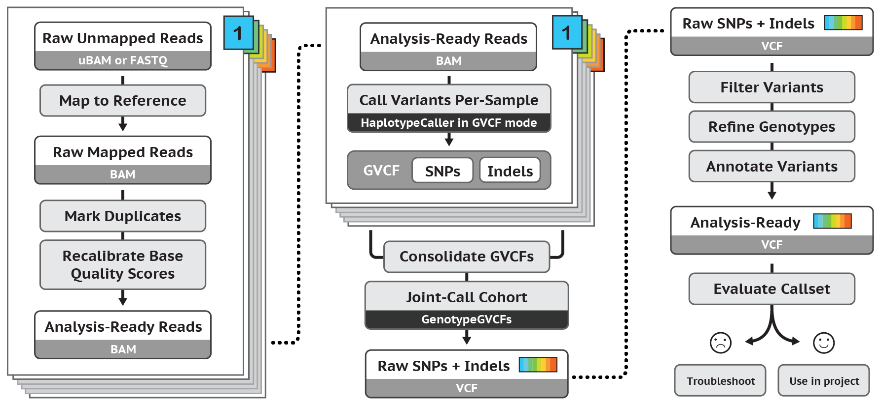
Best Practices for Germline SNP & INDEL Discovery
Notes:
At this point:
What we do per sample with HaplotypeCaller is get variant calling results in the form of gVCFs
Now we are going to talk about consolidating gVCFs and “joint calling” them.

Slide 3
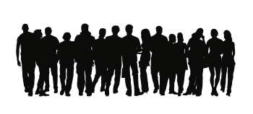

Joint analysis empowers discovery
Single genome in isolation: almost never useful
Family or population data add valuable information
rarity of variants
de novo mutations
ethnic background
Individual callsets
Joint callset
Underpowered
Superpowered!
Notes:
For germline varaints we want to look across populations to empower us in specifically the technical standpoint for the variant calling process right now.
Can do single sample pipeline and finish the entire pipeline including the genotyping and then finally combining the VCFs is the underpowered component.
What we want to do is combine the samples FIRST before JOINT genotyping. We want to genotype them together upfront to make them powerful before genotyping.
Call first then “smush”
More valuable information if you “smush” and then call.

Slide 4
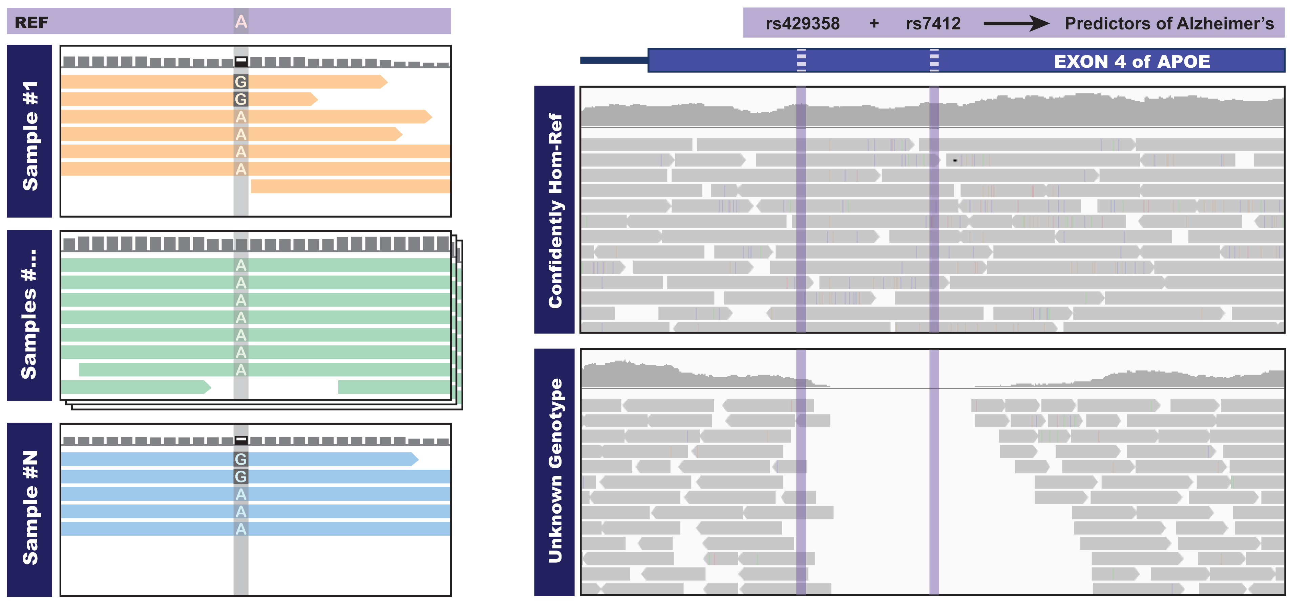
Discovery is empowered at difficult sites
Sample #1 or Sample #N alone:
weak evidence for variant
may miss calling the variant
Both samples seen together:
unlikely to be artifact
call the variant more confidently
Notes:
WHY is Joint Genotyping Good? What does it do for you.
Helps us deal with errors – or when data is not obvious.
For short variants you can pretty much look at the pileup of variants or reads in IGV. IF there is good balance between alleles with clean data and good coverage you can say confidently that this is a variant.
Most times you see low quality or low coverage.
This example in Sample #1 – don’t have many reads. Just 6 and 4 are reference allele A and the others are possible variant allele G. This is not great evidence especially at this coverage can be just an artifact. Weak evidence would mean that this call gets filtered out.
Sample #2 in addition to Sample #1 = if there is a chance that the variant is real, you might see the variant again. You may see that many of them are reference in this position but if you see the same variant allele pattern then you get more confidence that this variant is actually present in the population rather than an artifact.
One of the reasons why we want to look at multiple samples with germline calling.
IF you are looking at common variants you don’t always need lots of samples but if you are looking for rare variants then the large cohorts are important.
Why repeat the joint genotyping steps? Need to evaluate all the samples together. In the original cohort you found a potential variant but didn’t find anything compared to that cohort. But then you get a bunch of new samples and this second cohort may have evidence to support the variant from cohort 1. If you don’t combine these two cohorts you will lose that variant since the information from 1 part doesn’t know about the information from the 2nd. Gnomad is the resource that is a massive call-set that was made on over 100K samples which is useful for analysis

Slide 5
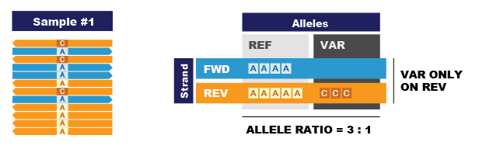
Joint analysis helps resolve bias issues
Single sample showing strand and allelic biases – would you call it?
Notes:
Want to evaluate whether what we are seeing is real variation in the case there is evidence. Or is it artifactual.
If you look at the left picture:
There is a stack of reads at this single position. You can see some Cs among some As. Is this a variant?
Lets break down the distribution of the reads and which variants exist on them.
The F reads are in blue and the R ones in orange. The Reference Allele is A and the Alternate Allele is C.
We see that the Ref allele is represented on both F and R reads.
The variant allele C, however is only on the R read but not on any of the F reads.
There may be fewer F reads and didn’t catch any with the variant allele but it could also be a sign of an artifact. We know of reasons for strand specific artifacts.
So, is this C variant an actual variant or is it an artifact?
Additionally we can see that there is a 3:1 ratio of the reference allele A to the variant allele C. 9 As and 3 Cs
Is this C variant an actual variant or is it an artifact?
We would probably want to take this variant out BUT is the single sample’s information enough evidence to filter out this variant?
This breakdown is useful on one sample but we don’t always have enough information and it could just be by accident.
Single sample showing strand and allelic biases (could be an artifact).
With just one sample it’s hard to know if this is an artifact or a true variant.

Slide 6
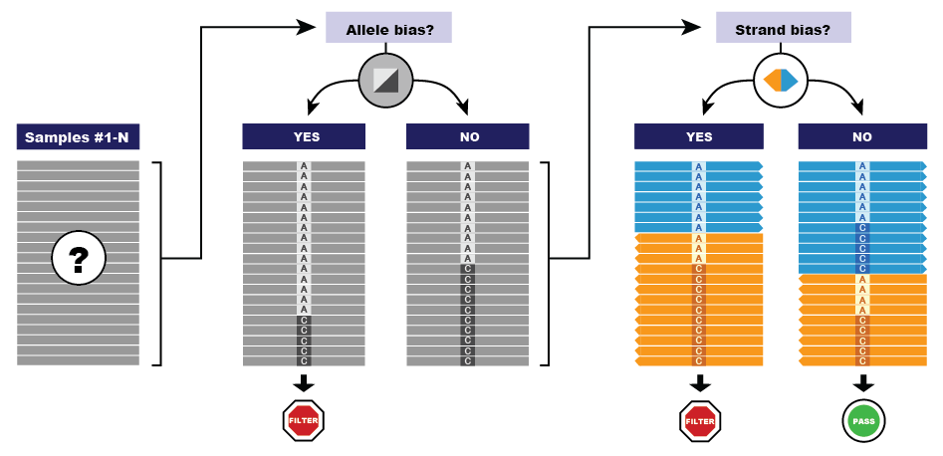
Joint analysis helps resolve bias issues
Decision process using evidence from multiple samples to filter out sites showing systematic biases
Notes:
What happens if we look at our cohort instead of a single sample (from the previous slide).
This pictures here represent the cohort. Look at multiple samples and look for patterns of bias from the larger data points.
In the Allele bias section:
Left Gray: If you still see the 3:1 ratio in the cohort, you would flag the variant so that we can perhaps filter it out later.
Right Gray: If you see in the cohort that there is an even 1:1 ratio then you keep the variant.
In the Strand bias section:
Left :If you still see the same bias where the alternate allele, C, are all still on the reverse strand in the cohort you would probably flag to filter them out at a later time.
Right: If you see that there is now an even distribution of the reference A and alternate C on equal Reverse and Alternate then you would keep it.
Allele bias– frequency of observation
Strand bias – which strand is it on
Why do we filter allele bias first and then strand bias?

Slide 7
And we get full information at all sites of interest
Analyzed individually:
No call for either sample
Very different reasons!
In joint analysis with other samples:
Hom-ref call and no-call genotypes emitted
SAMPLE A
SAMPLE B
Notes:
In the gVCF output that we produce we want to ask the important question:
Ff we don’t get a variant call, is it because we have good evidence that there is actually NO variant?
Or is it because there is insufficient evidence to say for sure that there is NO variant?
This is important to the interpretation of the variants presence and significance.
In this image we see two predictive markers that are indicative for risk for Alzheimers.
If you have variants at these loci you are at higher risk for developing Alzheimers.
From sequencing these individuals separately, we can see that there is NO variant at the rs sites BUT for different reasons.
Sample A – We have excellent coverage and quality. We are very satisfied that this person does not have this risk factor, the variant is NOT called, and we don’t see the variant in the output VCF.
Sample B – It has bad sequencing with the gap in coverage in the sequence middle, so you can’t say for sure that there is NO variant. It may exist but the sequencing is bad but we wouldn’t see this variant in the output VCF either.
May have to do a separate coverage analysis etc to figure this one out.
So, in the final VCF you would not have any information about this site but you can’t always tell why.
This is where Joint Analysis comes in:
With other samples included in the cohort, you may have positive controls of people who actually have variation at this locs. Therefore, in the final cohort VCF you will have a record at that site and for each person in the cohort you will have qualified information of “Do they have something and if so how likely is it to be real and if they don’t how likely is that call correct?”

Slide 8
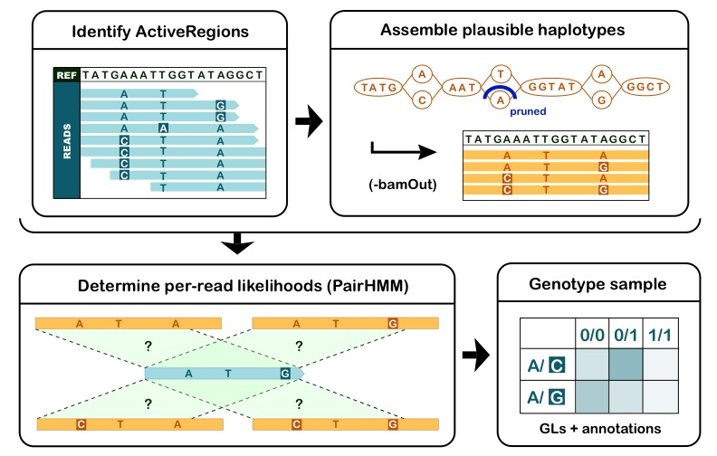
Joint calling implemented as a two-step process for scalability
Run HC in GVCF mode to emit GVCF
s
Run GenotypeGVCFs to re-genotype samples with multi-sample model
Notes:
First we run HaplotypeCaller for each sample and getting a gVCF for each sample.
Then we do the Joing Calling across all the samples’ gVCF.

Slide 9
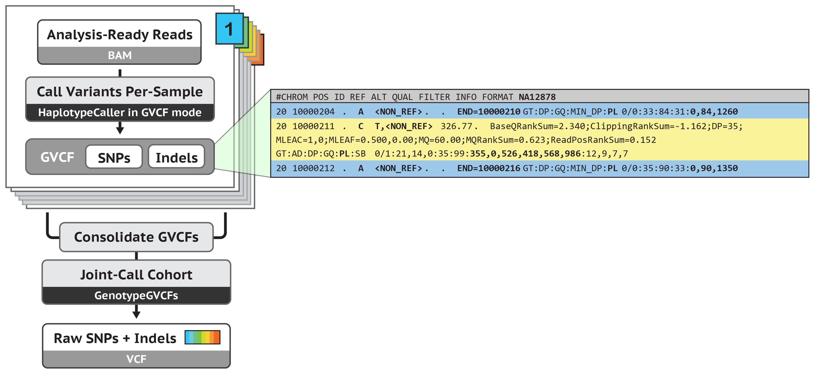
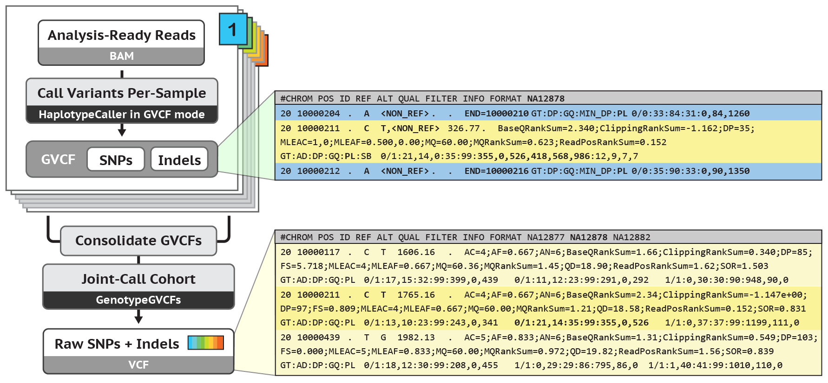
GVCF intermediate contains reference confidence estimate
NON-REF symbolic allele
+ corresponding PLs
Ref block
Non-variant intervals
Notes:
Lets talk about what the gVCF has – this is the output for HaplotyeCaller:
Yellow: Usual variant call records. At this site we found there was a possible T variant.
Blue: Contain NON variant calls/reference calls. Here we don’t have evidence of variation but we record what we did see. The NON_REF is a placeholder allele so we can have phred scale likelihoods for the homozygous reference case. This symbolizes the residual chance that this call might actually be a variant.
Mix of these kinds of records. gVCFs have the NON_REF alleles in it so you can recognize them.
PL = Phred-scaled likelihoods of genotypes
Google or Illumina came up with a genomic VCF spec that is different
No NON_REF allele and no PLs, so we can’t use for joint calling
NON_REF is the bucket where anything that is not the reference
PL is 0, 84, 1260

Slide 10
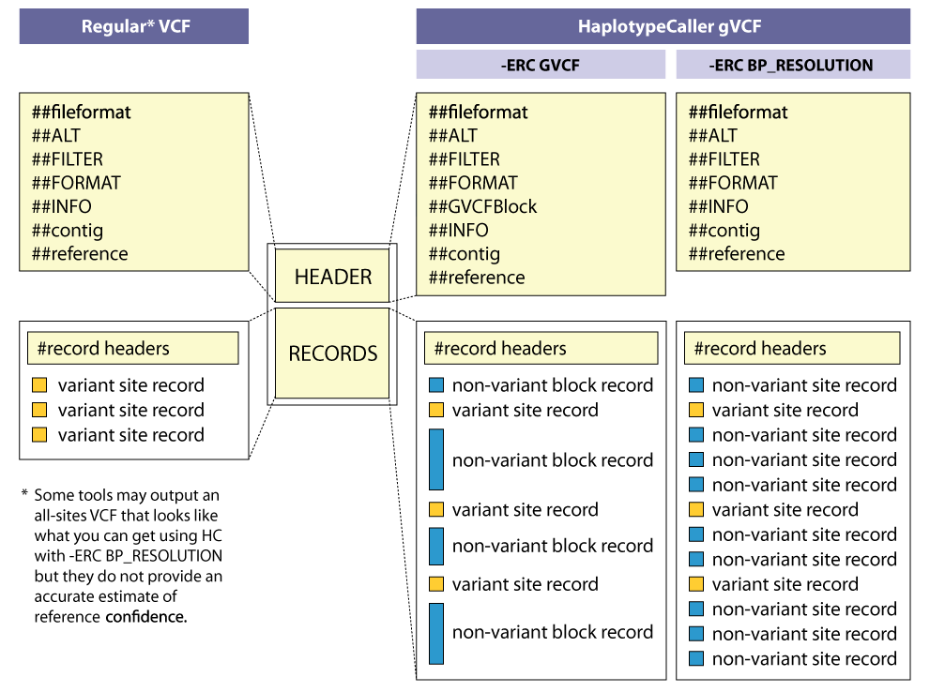
GVCFs are valid VCFs with extra information
Notes:
I just want to reiterate that the GVCF format is a valid VCF that follows the VCF specification.
It has of course some extra information as we’ve covered.
Here on the left is a diagram of a regular VCF and on the right HC’s GVCF.
Just like the VCF, the GVCF’s header contains descriptions of the annotations within the file.
What I didn’t mention before is that there are two options for HC’s ERC--Emit Reference Confidence--Mode.
One is in the GVCF mode *proper*, {in the middle}, where consecutive NON-REF sites, of similar read depths, are in blocks. {Diagrammed here as these long blue records}
Two is in basepair resolution mode, {on the right}, were every site produces a record. The long blue records are broken up at a higher resolution {here}.
Any questions before we look at commands?
==========
GVCF:
##FILTER=<ID=LowQual,Description="Low quality”>
##FORMAT=<ID=AD,Number=.,Type=Integer,Description="Allelic depths for the ref and alt alleles in the order listed">
##FORMAT=<ID=DP,Number=1,Type=Integer,Description="Approximate read depth (reads with MQ=255 or with bad mates are filtered)">
##FORMAT=<ID=GQ,Number=1,Type=Integer,Description="Genotype Quality">
##FORMAT=<ID=GT,Number=1,Type=String,Description="Genotype">
##FORMAT=<ID=MIN_DP,Number=1,Type=Integer,Description="Minimum DP observed within the GVCF block">
##FORMAT=<ID=PGT,Number=1,Type=String,Description="Physical phasing haplotype information, describing how the alternate alleles are phased in relation to one another">
##FORMAT=<ID=PID,Number=1,Type=String,Description="Physical phasing ID information, where each unique ID within a given sample (but not across samples) connects records within a phasing group">
##FORMAT=<ID=PL,Number=G,Type=Integer,Description="Normalized, Phred-scaled likelihoods for genotypes as defined in the VCF specification">
##FORMAT=<ID=SB,Number=4,Type=Integer,Description="Per-sample component statistics which comprise the Fisher's Exact Test to detect strand bias.">
Multi-sample VCF from GGVCFs:
##ALT=<ID=NON_REF,Description="Represents any possible alternative allele at this location">
##FILTER=<ID=LowQual,Description="Low quality">
##FORMAT=<ID=AD,Number=.,Type=Integer,Description="Allelic depths for the ref and alt alleles in the order listed">
##FORMAT=<ID=DP,Number=1,Type=Integer,Description="Approximate read depth (reads with MQ=255 or with bad mates are filtered)">
##FORMAT=<ID=GQ,Number=1,Type=Integer,Description="Genotype Quality">
##FORMAT=<ID=GT,Number=1,Type=String,Description="Genotype">
##FORMAT=<ID=MIN_DP,Number=1,Type=Integer,Description="Minimum DP observed within the GVCF block">
##FORMAT=<ID=PGT,Number=1,Type=String,Description="Physical phasing haplotype information, describing how the alternate alleles are phased in relation to one another">
##FORMAT=<ID=PID,Number=1,Type=String,Description="Physical phasing ID information, where each unique ID within a given sample (but not across samples) connects records within a phasing group">
##FORMAT=<ID=PL,Number=G,Type=Integer,Description="Normalized, Phred-scaled likelihoods for genotypes as defined in the VCF specification">
##FORMAT=<ID=RGQ,Number=1,Type=Integer,Description="Unconditional reference genotype confidence, encoded as a phred quality -10*log10 p(genotype call is wrong)">
##FORMAT=<ID=SB,Number=4,Type=Integer,Description="Per-sample component statistics which comprise the Fisher's Exact Test to detect strand bias.”>
Multi-sample VCF:
##FILTER=<ID=LowQual,Description="Low quality">
##FORMAT=<ID=AD,Number=.,Type=Integer,Description="Allelic depths for the ref and alt alleles in the order listed">
##FORMAT=<ID=DP,Number=1,Type=Integer,Description="Approximate read depth (reads with MQ=255 or with bad mates are filtered)">
##FORMAT=<ID=GQ,Number=1,Type=Integer,Description="Genotype Quality">
##FORMAT=<ID=GT,Number=1,Type=String,Description="Genotype">
##FORMAT=<ID=PL,Number=G,Type=Integer,Description="Normalized, Phred-scaled likelihoods for genotypes as defined in the VCF specification">
##INFO=<ID=AC,Number=A,Type=Integer,Description="Allele count in genotypes, for each ALT allele, in the same order as listed">
##INFO=<ID=AF,Number=A,Type=Float,Description="Allele Frequency, for each ALT allele, in the same order as listed">
##INFO=<ID=AN,Number=1,Type=Integer,Description="Total number of alleles in called genotypes">
##INFO=<ID=BaseQRankSum,Number=1,Type=Float,Description="Z-score from Wilcoxon rank sum test of Alt Vs. Ref base qualities">
##INFO=<ID=DP,Number=1,Type=Integer,Description="Approximate read depth; some reads may have been filtered">
##INFO=<ID=DS,Number=0,Type=Flag,Description="Were any of the samples downsampled?">
##INFO=<ID=Dels,Number=1,Type=Float,Description="Fraction of Reads Containing Spanning Deletions">
##INFO=<ID=FS,Number=1,Type=Float,Description="Phred-scaled p-value using Fisher's exact test to detect strand bias">
##INFO=<ID=HaplotypeScore,Number=1,Type=Float,Description="Consistency of the site with at most two segregating haplotypes">
##INFO=<ID=InbreedingCoeff,Number=1,Type=Float,Description="Inbreeding coefficient as estimated from the genotype likelihoods per-sample when compared against the Hardy-Weinberg expectation">
##INFO=<ID=MLEAC,Number=A,Type=Integer,Description="Maximum likelihood expectation (MLE) for the allele counts (not necessarily the same as the AC), for each ALT allele, in the same order as listed">
##INFO=<ID=MLEAF,Number=A,Type=Float,Description="Maximum likelihood expectation (MLE) for the allele frequency (not necessarily the same as the AF), for each ALT allele, in the same order as listed">
##INFO=<ID=MQ,Number=1,Type=Float,Description="RMS Mapping Quality">
##INFO=<ID=MQ0,Number=1,Type=Integer,Description="Total Mapping Quality Zero Reads">
##INFO=<ID=MQRankSum,Number=1,Type=Float,Description="Z-score From Wilcoxon rank sum test of Alt vs. Ref read mapping qualities">
##INFO=<ID=QD,Number=1,Type=Float,Description="Variant Confidence/Quality by Depth">
##INFO=<ID=RPA,Number=.,Type=Integer,Description="Number of times tandem repeat unit is repeated, for each allele (including reference)">
##INFO=<ID=RU,Number=1,Type=String,Description="Tandem repeat unit (bases)">
##INFO=<ID=ReadPosRankSum,Number=1,Type=Float,Description="Z-score from Wilcoxon rank sum test of Alt vs. Ref read position bias">
##INFO=<ID=SOR,Number=1,Type=Float,Description="Symmetric Odds Ratio of 2x2 contingency table to detect strand bias">
##INFO=<ID=STR,Number=0,Type=Flag,Description="Variant is a short tandem repeat">

Slide 11
Joint calling produces final multi-sample VCF
Notes:
Joint Calling will run through all of the gVCFs and in the final VCF output you will not have any of the non variant records (NON_REF).
All you should see are the definitive variant records determined based on the Joint calling.
In GATK 4.1 and newer you CAN however get the non variant records if you choose to do so.

Slide 12
Need to consolidate GVCFs before joint calling!
Necessary for efficient scaling
In GATK 3.x : CombineGVCFs Hierarchical merge on batches of 200 samples max; outputs GVCF
In GATK 4.x : GenomicsDBImport All samples processed in a single command; outputs datastore
Notes:
There are 2 steps to the combination of the gVCFs.
The consolidation is technical step to deal with a large number of samples. We don’t want 1000 samples open at the same time so we are going to consolidate the files. There are 2 ways to do this:
In GATK3 we had a way to combine all the files into 1 mega VCF file in batches of 200 samples at a time. Not efficient or elegant.
GenomicsDBImport uses datastore which is a database format that allows you do process them all at once with an intermediate database

Slide 13
Consolidating GVCFs
With CombineGVCFs:
With GenomicsDBImport:
gatk CombineGVCFs \
-R reference.fasta \
–V sample1.g.vcf \
–V sample2.g.vcf \
–O combined.g.vcf
gatk GenomicsDBImport \
-R reference.fasta \
–V sample1.g.vcf \
–V sample2.g.vcf \
-L chr20,chr21 \
--genomicsdb-workspace-path gvcfs_db
CombineGVCFs does not scale well
Notes:
These are the commands that you can run for each of the aforementioned steps:
CombineGVCFs: Combines all the files and it does not scale very well. This is better for about 500 files but larger than that you want to use GenomicsDBImport
GenomicsDBImport: can supply a –V with a list of all the file names that you want to feed in for the combination. Can use multiple intervals or a single interval.

Slide 14
Joint calling with GenotypeGVCFs
GenotypeGVCFs can take either a single GVCF file (can be a merged multi-sample GVCF from CombineGVCFs) or a GenomicsDB datastore
No more multiple inputs! (unlike GATK3)
Notes:
Now you will have either the mega gVCF or the GenomicsDB intermediate that you can run the Joint Calling tool on which is called GenotypeGVCFs which can either take multiple gVCFs or a single vcf from the datastore.
If you’ve already been using GATK3, these are the differences with GATK4

Slide 15
Running GenotypeGVCFs
On a single- or multi-sample GVCF:
On a GenomicsDB workspace:
gatk GenotypeGVCFs \
-R reference.fasta \
–V variants.g.vcf \
-O final_variants.vcf
gatk GenotypeGVCFs \
-R reference.fasta \
–V gendb://gvcfs_db \
-O final_variants.vcf
GenotypeGVCFs cannot take multiple inputs (unlike the GATK3 version)
Notes:
The commands are similar but the difference is that you are not using a path to the GenomicsDB workspace/datastore database. You provide that this is a genomicsDB workspace but everything else is the same.

Slide 16
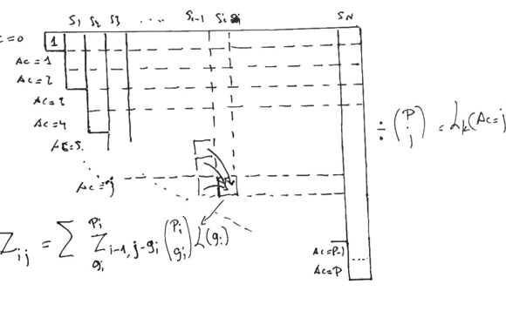
Multi-sample QUAL calculation
Uses human SNP heterozygosity 1/1000 bases = Phred scale Q30 (can be modified)
QUAL > 30 means a variant is more likely than this base level
Heuristic for the QUAL score: sum(PL[0])-30 across samples
Notes:
Recalculating QUAL scores for every record. As of version 4.1 there is a new model that is more appropriate and more robust and you can read more about it in the blogpost by David Benjamin.
This is essentially giving you a floor of how likely a variant call is. This is saying if you variant is above this QUAL score, it might not be junk but it is not the end all be all of variant quality – rather it is just an initial determination to see what is output in the VCF output file but there are other models that are sophisitacated.
--OLD
This is “OLD Qual”. Not going into too much detail, because we now have NEW qual. Old model (detailed on this slide and in the notes below) was inferior due to:
From David Benjamin, “[old QUAL had high] combinatorial complexity, and the fact that it necessitated awful hacks to shoehorn multiallelic sites and higher ploidies”
----
Score to see how reliable the variant call is across all samples.
Qual > 30 - more likely than human heterozygosity. So we’ll only work with these.
But it’s a low bar, lots of variants. And we’re as permissive as possible.
Therefore we must filter our false-positives. Next talk will go over filtering in detail.
QUAL
LG says: “QUAL emission threshold is typically 30. (I think we changed this, but in my heart it's still 30.) This is because human SNP heterozygosity is one per thousand bases, which Phred-scaled is 30, so you could think of any given site as having a 1/1000 probability of being variant. A QUAL score above 30 means your variant is more likely than this base level. So you'd need more than GQ 30 to emit based on a single sample, which is roughly three high quality reads. But if you had two reads each in two samples (~GQ 24), now you've got a QUAL of (24+24)-30=18”
Annotations
Plot shows values for ReadPosRankSum annotation for a set of variants called in a single sample along (green) or in a large cohort (red). The joint calling tightens the distribution -> stabilizes the annotation and makes it more reliable for filtering.
SKIP THIS SLIDE. Needs to be replaced with the new Qual model. It’s good to show that the old model was difficult, but given that we don’t have a slide on the new model yet, it’s more confusing than helpful to go over.
---
This is “OLD Qual”. Not going into too much detail, because we now have NEW qual. Old model (detailed on this slide and in the notes below) was inferior due to:
From David Benjamin, “[old QUAL had high] combinatorial complexity, and the fact that it necessitated awful hacks to shoehorn multiallelic sites and higher ploidies”
----
Score to see how reliable the variant call is across all samples.
Qual > 30 - more likely than human heterozygosity. So we’ll only work with these.
But it’s a low bar, lots of variants. And we’re as permissive as possible.
Therefore we must filter our false-positives. Next talk will go over filtering in detail.
QUAL
LG says: “QUAL emission threshold is typically 30. (I think we changed this, but in my heart it's still 30.) This is because human SNP heterozygosity is one per thousand bases, which Phred-scaled is 30, so you could think of any given site as having a 1/1000 probability of being variant. A QUAL score above 30 means your variant is more likely than this base level. So you'd need more than GQ 30 to emit based on a single sample, which is roughly three high quality reads. But if you had two reads each in two samples (~GQ 24), now you've got a QUAL of (24+24)-30=18”
Annotations
Plot shows values for ReadPosRankSum annotation for a set of variants called in a single sample along (green) or in a large cohort (red). The joint calling tightens the distribution -> stabilizes the annotation and makes it more reliable for filtering.

Slide 17
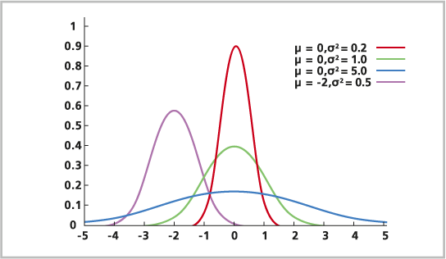
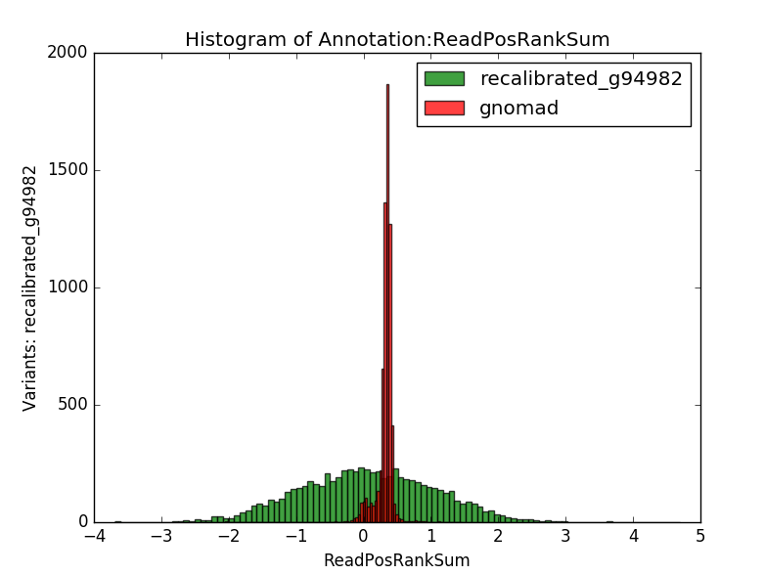
Combination of annotations stabilizes distributions
Common
Rare
Singletons
Errors
Theoretical distribution of annotation values
Distinct for TP vs FP
Tighter for common variants
Annotation values for same variants called in :
Single-sample run (recalibrated_g94982, green)
Multi-sample run (gnomad, red)
Notes:
Read about rank sum.
Joint Calling tools also adds annotations (in addition to HaplotypeCaller).
The annotations help do better modeling and filtering of variants.
Here we see the effect of adding many samples to the analysis. It smooths out the chance fluctuations we may see.
In the first panel we see theoretically how we imagine the annotation distribution where we expected it to center around 0. If we have rare variants or singletons we can see that the spreads of valleys is pretty wide versus the more common variants within the samples you will have a tighter distribution. The recalculation across all the samples will even out disparities. As you tighten the distribution you get more separation from the good variants and the pink variants that shows the bad variants within the datasets.
The entire goal of filtering is to increase the gap between the distributions so you have more confident evidence of what you want to keep or throw out.
Green is single sample annotation values.
With Joint Calling with Gnomad you see a tighter distribution.
The x axis can be a statistic that measure strand bias or allele bias. There are various statistics that we can use but in general it’s a stat summarizing a variant.
In this case we consider the right one to be correct and the left to be incorrect.
Negative values are indicative of error.
Joint calling makes filtering easier.
Plot on left show theoretical distributions for different subsets of variants
Farther from zero = more likely bad variant – Purple / error / false-positives
Plot on right shows values for ReadPosRankSum annotation for a set of variants called in a single sample along (green) or in a large cohort (red). The joint calling tightens the distribution -> stabilizes the annotation and makes it more reliable for filtering.
Tighter distribution = easier to set a threshold val.
.

Slide 18
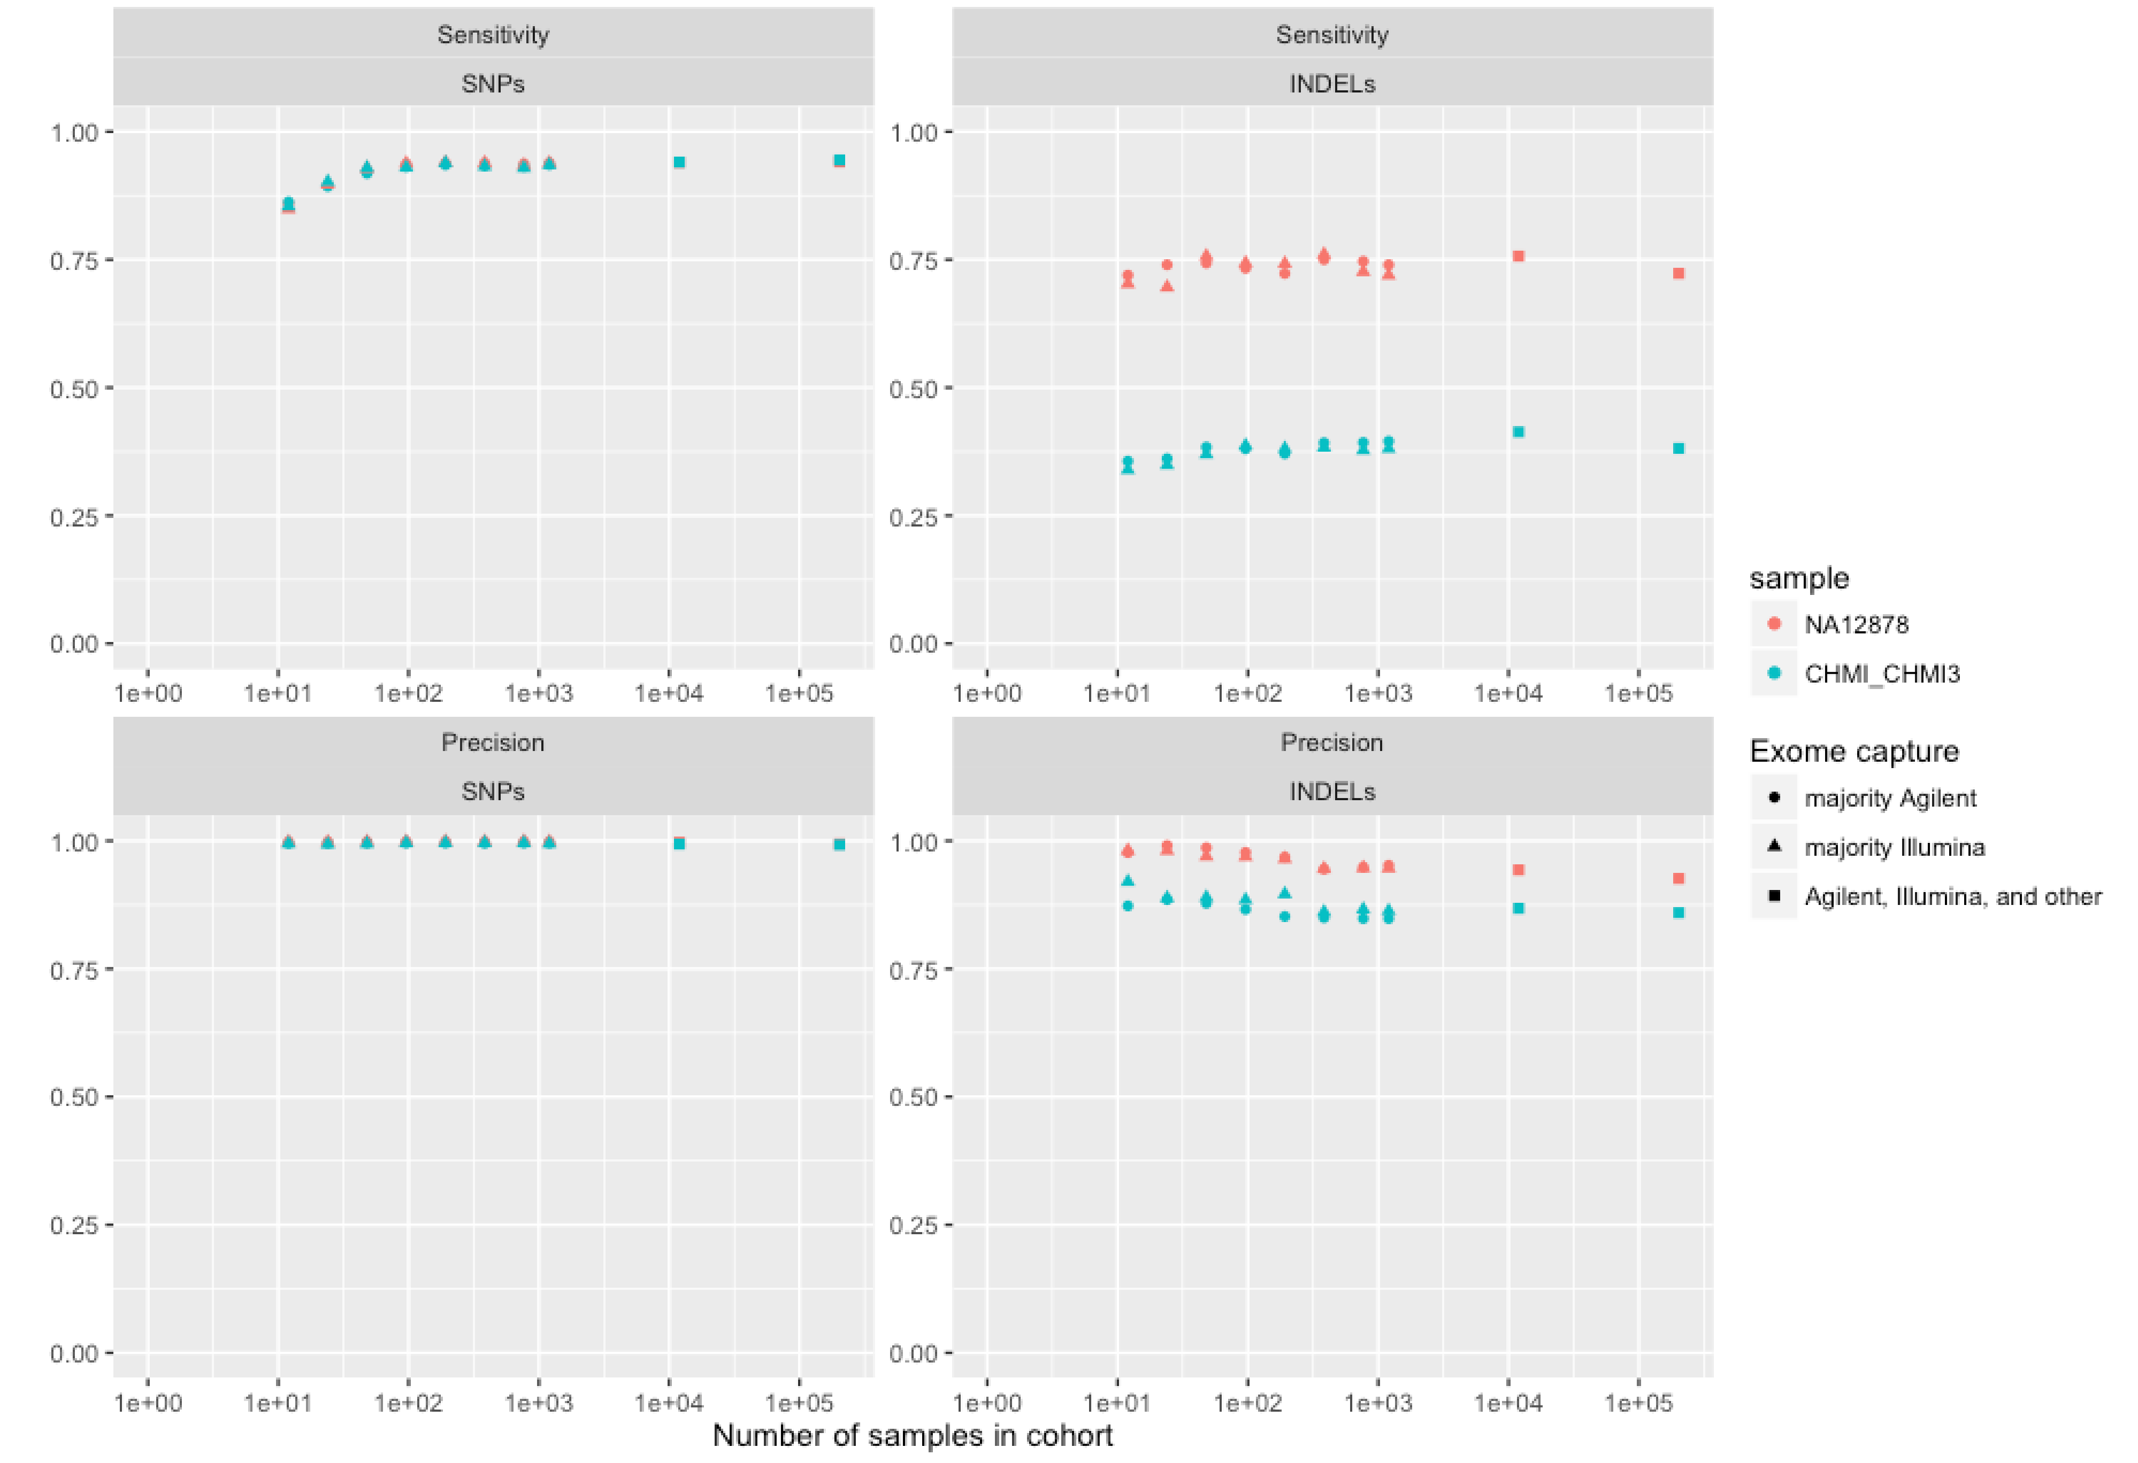
Use of a larger cohort increases sensitivity
Increased sensitivity
Saturation ~600 samples
Gauthier et al., 2016 (ASHG)
Notes:
At what point do you max out the utility of adding more samples?
This analysis shows us that at low numbers of samples there is a very rapid gain in terms of how much sensitivity you gain but it does max out on this set of the 120K exomes.
Essentially a titration experiment: measuring on increasingly large subsets you saturate at a few hundred samples and after that the gains get more and more marginal.
With small numbers of samples still makes it worth it even if you do not have thousands of samples.
Increase in sensitivity, no loss of precision in SNPs; slight loss of precision in indels linked to heterogeneous capture types
and/or differing read lengths
LG says: “These are short reads so the NA12878 indel sensitivity isn't great. The CHM is because the easy indels were removed from the truth set.”

Slide 19
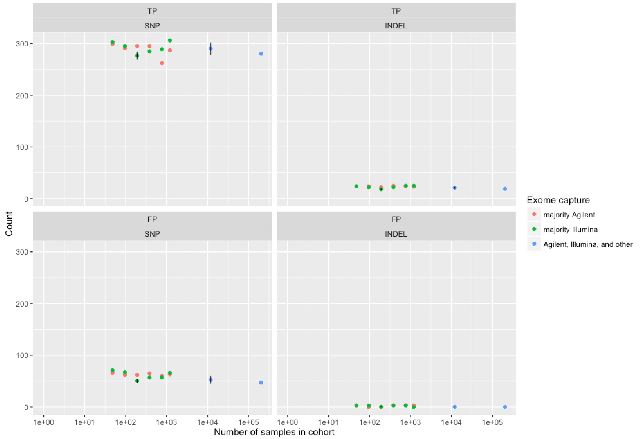
No loss of accuracy on singletons
Set of singleton truth variants compared across cohort sizes
At scale of largest cohort, many are no longer singletons
Notes:
This is the flip side question:
If I do a Joint calling and see things multiple times, will I lose confidence in the singletons.
Anything you call by itself you will still be able to call with Joint Calling.
As normal, you wont be able to call it better but you also wont lose it via Joint Calling either.
Despite doing joint calling, we can still call singleton variants as well.

Slide 20
Joint calling scales massively better + faster with GenomicsDB
GATK 3
With CombineGVCFs
+ GenotypeGVCFs
Subset of samples
3,000 WGS
6 weeks
GATK 4
With GenomicsDB
+ GenotypeGVCFs
Full gnomAD v1
15,000 WGS
2 weeks
5x increase in scale
processed 3x faster
Notes:
144K is the new number as of March BroadE
Stats not yet available on the 65k. At the time of this writing, the 76k → 65k once duplicate samples were removed.

Slide 21
Next steps: filtering and other callset refinements
Notes:
This is it. The end.

