Slide 1
Genotype Refinement Workflow
GATK Best Practices for Variant Discovery
Using additional data to improve genotype calls and likelihoods
Notes:
Improve our sample-level data by recalibrating the genotype likelihoods and potentially improving our genotype calls.

Slide 2
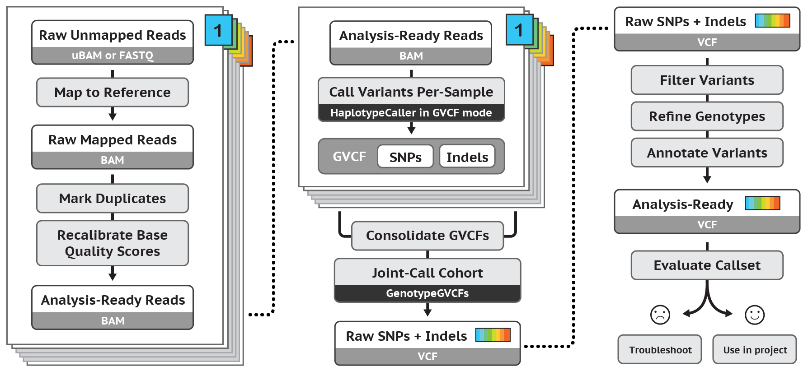
Best Practices for Germline SNP & INDEL Discovery
Notes:
This is in the later stretch of our pipeline, just after filtering variants.

Slide 3
Why care about genotypes?
Medical geneticists need genotypes for patients
Do any patients have two copies of a LOF mutation?
Are the parents of a diseased child likely to have more afflicted children?
Population geneticists need genotypes for association studies
How does the number of copies of an allele affect the phenotype?
Notes:
A lot of projects stop at variant discovery, but many, including those in medical genetics, want to know the genotype of each sample at each variant site.
Read examples in bullet points.
2 copies of an allele has 2x as much protein than 1 copy, could affect the phenotype.

Slide 4
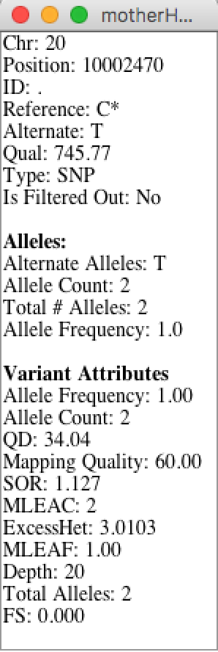
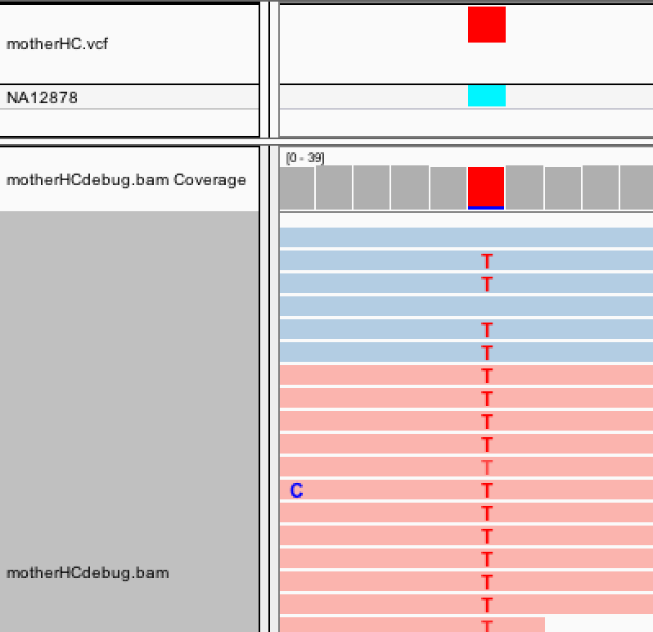
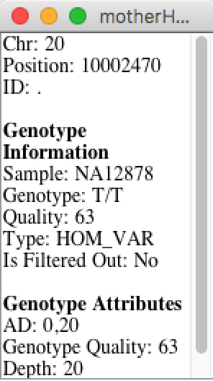
Variant call vs. Genotype call
Notes:
A variant call is made on an individual read. It is any site on the read that does not match the reference genome.
A genotype call collects information from multiple reads to make a call on whether a site is HomRef, Het, or HomVar.
Variant call
= there is variation at this site in one or more samples
Genotype call
= these are the haplotypes present in this sample

Slide 5
Genotype call quality is important!
Some sites/samples have poor genotype calls
Can be ambiguous due to low confidence
Might be entirely wrong!
Can additional (independent) data improve genotype calls?
Use high quality data (like 1000G) as priors
Use pedigree (if available)
Calculate posterior genotype probabilities
Notes:
The initial genotype calls coming from HC might be ambiguous, low confidence, or even wrong.
We can use other data (independent of the sample’s reads) to improve our confidence in GT calls (and correct if necessary.)
Pedigree for family data
(or 1000 genome data for general use)
Use those to calculate posterior genotype probabilities.

Slide 6
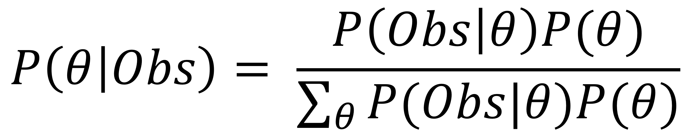
Review of Bayes’s Rule
Given that your coworker just walked in with an umbrella, what is the probability that it is raining?
Observation = umbrella
Θ = probability of rain
posterior
probability
likelihood
prior
(normalize)
Notes:
When we apply prior knowledge to likelihoods, we derive a more informed posterior probability – hence calculate genotype POSTERIORS
We would say that the likelihood of rain given umbrella is low b/c it doesn’t rain much in South Africa.
- Probably using the umbrella to block out the sun.
But what if you were in England, where where the prior probability of rain is high?
-------
But what if we’re in southern California in the summer? Then the prior probability of rain is low and the posterior probability of rain given umbrella is decreased. Maybe your coworker is fair skinned and using the umbrella for shade from the sun.
===========
Calculating Genotype Likelihood and applying our priors from the population allele frequencies to better inform our genotype posteriors

Slide 7
Genotype Refinement Workflow
Notes:
We start with recalibrated variants out of the VQSR,
apply population priors and (if available) family priors with CalculateGenotypePosteriors,
filter out remaining low quality genotypes,
then as a simple preliminary analysis we tag possible de novo mutations using the VariantAnnotator.

Slide 8
CalculateGenotypePosteriors
gatk CalculateGenotypePosteriors \
-R reference.fasta \
-V input.vcf \
-ped family.ped \
-supporting population.vcf \
-O output.vcf
Notes:
Go over command-line options briefly.

Slide 9
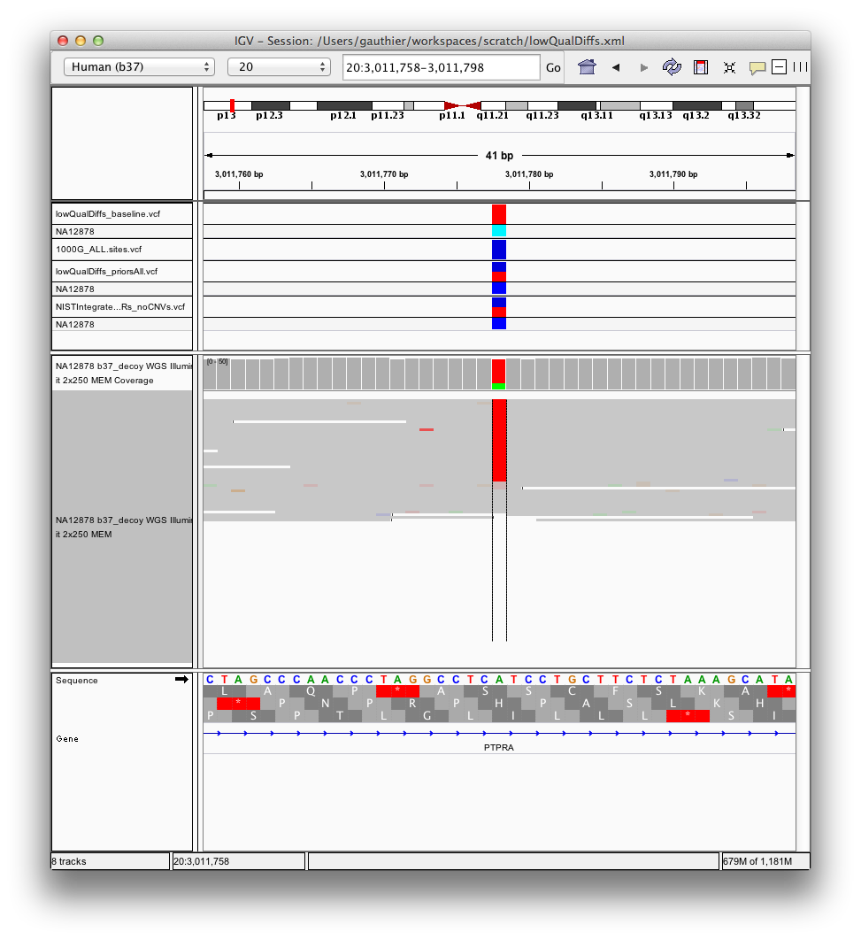
Case 1: HOM_VAR Call w/ Low Frequency Priors
1) Baseline HOM_VAR call
2) Priors w/low allele frequency applied
3) Posterior genotype called HET
4) In agreement w/NIST
and BAMs
Likelihoods x Priors = Posterior Probabilities
Genotype corrected
Confidence improved from Q3 to Q27
[895,3,0]
AF=0.002
[868,0,27]
[HOM_REF, HET, HOM_VAR]
[HOM_REF, HET, HOM_VAR]
Notes:
IGV screenshot with priors from 1000 genomes.
Baseline HOM_VAR (cyan) - red bar is full – 2 copies of red allele (all the same allele)
Prior is 1000Genomes (prior in blue – mostly a different allele) this allele only occurs at 0.2% in 1000 genomes – 0.2% is our prior
Update the genotype with prior information and since it’s NA12878 we can verify with NIST data.
The genotype call at this particular site on chr 20 is HOM_VAR with low confidence, but the AF from 1000G is very low, so the posterior probability of HOM_VAR is actually lower than HET and we change our genotype call.
Remember that these are Phred-scaled likelihoods so the lowest values are going to be the most probable. [895,3,0] means definitely not HOM_REF, but probably HOM_VAR and maybe HET?
(FYI the BAMs shown here for validation are higher DP than the BAMs we used for calling)

Slide 10
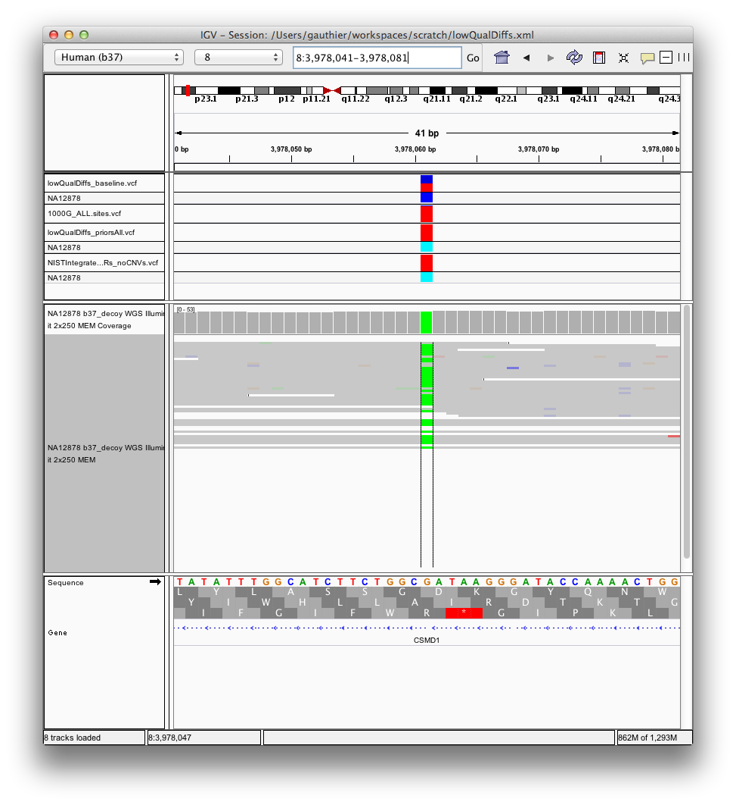
Case 2: HET Call with High Frequency Priors
1) Baseline HET call
2) Priors w/high allele frequency applied
3) Posterior genotype called HOM_VAR
4) In agreement w/NIST
and BAMs
Likelihoods x Priors = Posterior Probabilities
Genotype corrected
Confidence improved
from Q0 to Q16
[894,0,0]
AF=0.987
[932,16,0]
[HOM_REF, HET, HOM_VAR]
[HOM_REF, HET, HOM_VAR]
Notes:
In this example GQ=0, so we essentially flip a coin to decide between HET and HOM_VAR, but the population AF is very high so we correct the genotype and confidence is improved from Q0 to Q16.

Slide 11
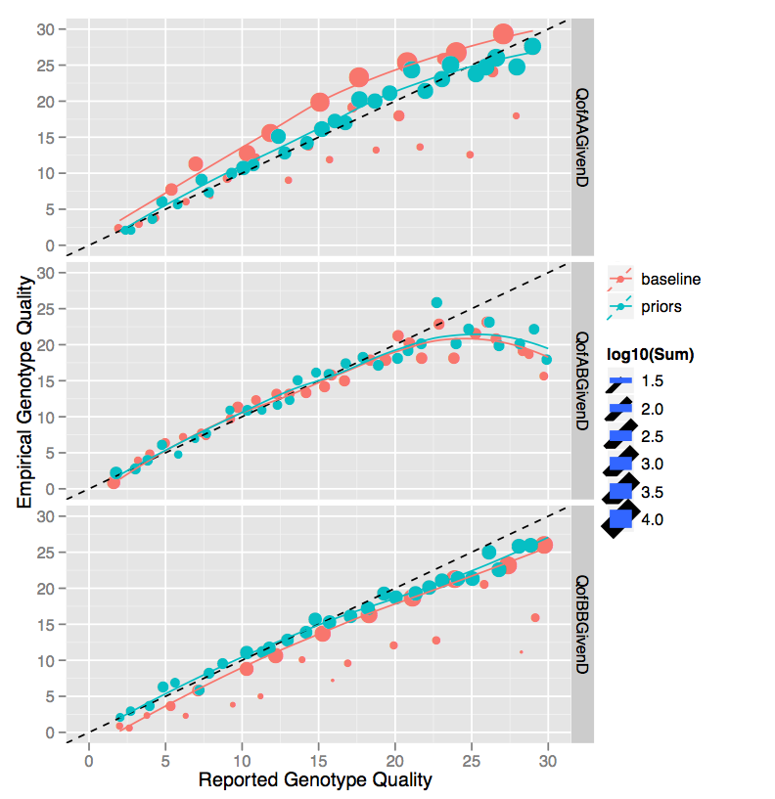
Population priors improve genotype confidence
Baseline HomRef calls are under confident, but posterior calls are more accurate
Hom Ref
baseline
adjusted
Het
Baseline HomVar calls are over confident, but posterior calls are improved
Hom Var
Notes:
This plot takes all of the genotypes at each reported quality level and compared them with the truth data to assess the empirical quality (based on the % of correct calls), similar to BQSR.
Take slices of genotypes from our vcf based on reported quality and compare to known truth resource to get empirical quality.
If we have GQ30, in Phred scale, that’s 1/1000 chance it’s wrong.
Look at 10000 calls that are GQ30, we expect 10 errors.
Cross referencing our calls with truth, we can count up errors we actually have and that gives our actual quality.
HOM_REF calls are actually underconfident (GQ15 is actually GQ20)
If you only look at data above a certain confidence, then you’d filter out good data. After recalibration, you would include those data.
Conversely HOM_VAR is over-confident, but posterior calls are much better.
‘prior’ color = Posteriors probabilities

Slide 12
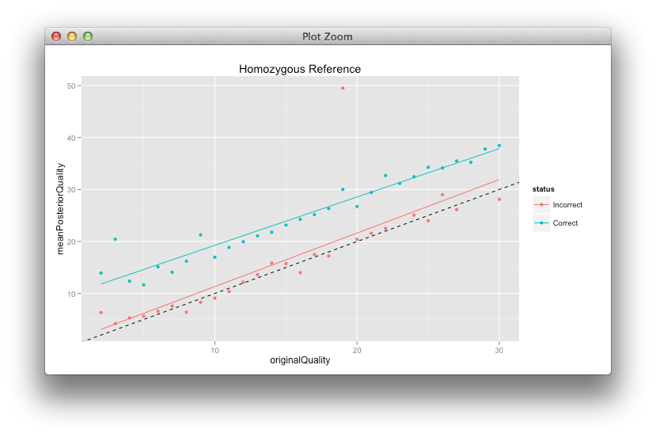
Assessing confidence and correctness
Homozygous Reference Calls
Average Q10 increase for correct calls, Q≤30
Intercept = 9.9612
Slope = 0.9302
Posterior Genotype Quality
Incorrect calls stay about the same
Baseline Genotype Quality
Notes:
The interpretation of the “quality-group” analysis in the previous slide makes it difficult to see how individual variants are modified.
Here we see the quality scores for the low-quality GTs (GQ<=30) before and after priors, split into correct calls and incorrect calls.
Slope stays about the same, so we’re not biasing the incorrect calls. So while we’re still making incorrect calls, we’re not adding bias to them.
(FYI there’s some overplotting here, so there are actually a lot of variants, just some are plotted on top of each other.) (We see similar trends for heterozygous and homozygous reference calls)

Slide 13
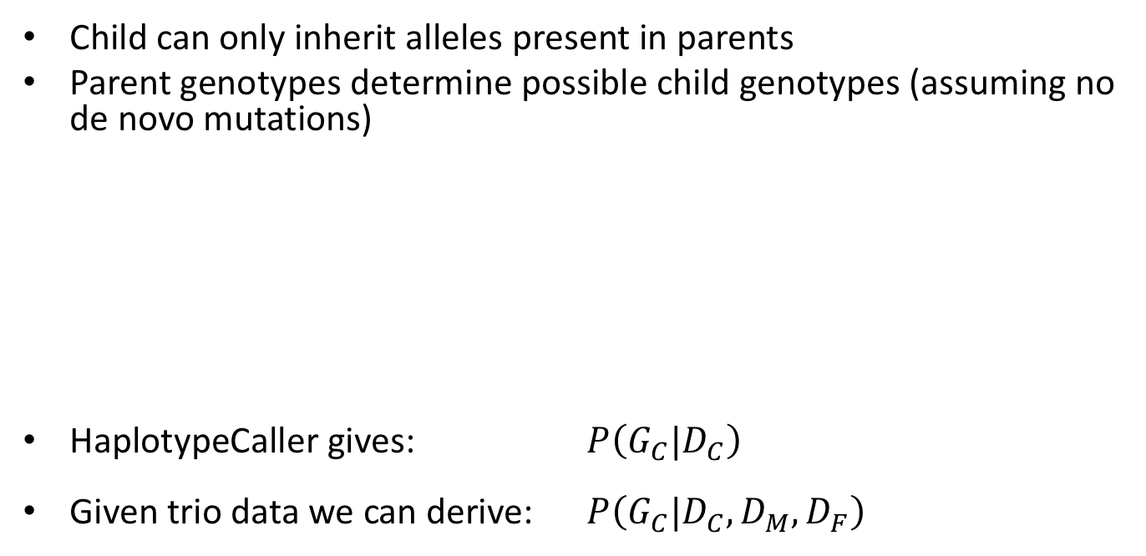
Parental genotypes inform child genotypes
Child can only inherit alleles present in parents
Parent genotypes determine possible child genotypes (assuming no de novo mutations)
HaplotypeCaller gives: $P\left(G_{C}|D_{C}\right)$
Given trio data we can derive: $P\left(G_{C}|D_{C},D_{M},D_{F}\right)$
Child | Mother | Father
HR | HR | HR
HR | HR | HET
HR | HET | HR
HR | HET | HET
Child | Mother | Father
HET | HET | HET
HET | HR | HET
HET | HET | HR
HET | HV | HET
HET | HET | HV
HET | HR | HV
HET | HV | HR
Child | Mother | Father
HV | HV | HV
HV | HV | HET
HV | HET | HV
HV | HET | HET
Notes:
Trios can greatly help to narrow down genotype choices.
Only certain combinations of genotypes in a trio are valid if we assume that there are no mutations, so whereas HC determines the probability of the child’s genotype given the child’s read data, if we have data on the parents then we can use that independent data to help inform the child’s genotype.

Slide 14
Bayesian priors applied to trios
Recall Bayes’s Rule:
Establish genotype configuration probabilities
Apply family priors
likelihood
posterior
apply
prior
normalize
Notes:
For the invalid family genotype configurations, they can happen, but only if there is a mutation, the probability of which is small (parameter mu).
The family prior takes into account this mutation prior and the likelihoods of both parents.
Walk through equation:
Probability of the genotype of both parents and the child.
No MVs = derivation: unity minus the number of configurations that yield a single Mendelian violation minus the configurations yielding 2
MV = Mendelian violation
HR = HOM_REF

Slide 15
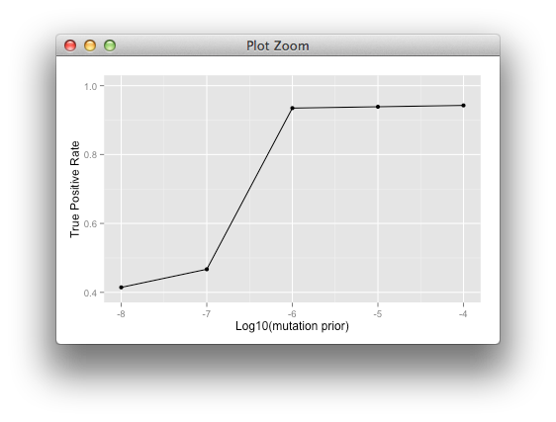
Priors can be tuned for sensitivity
Mutation rate prior is a parameter in genotype configuration probability:
Increasing Sensitivity
Sensitivity and specificity can be tuned as in VQSR
Notes:
De novo mutation detection is a simple downstream analysis using the confidence refinement and we can tune the sensitivity similarly to the way we did for VQSR by modulating the value of the mutation probability.
This is a straight forward example of the application and tuning of genotype refinement, but it’s extensible to other analyses where truth data is available.
MU can be tuned for sensitivity and specificity. Literature says 10^-8 and that it depends on parental age, but gives low sensitivity, so we can increase sensitivity by increasing the value of mu.
(Asymptote doesn’t reach 100% because methodology to choose validation sites included many with low GQ that this method filters out)

Slide 16
Filter low confidence GQs
gatk VariantFiltration \
-R reference.fasta \
-V input.vcf \
--genotype-filter-expression “GQ<20” \
--genotype-filter-name “lowGQ” \
-O output.vcf
Use VariantFiltration to filter ambiguous, low-confidence calls
Recommended threshold is GQ = 20
GQ 20 is Phred-scaled 99% confidence
Restrict further analysis to high-quality data
Notes:
Now we can filter ambiguous low-confidence calls.

Slide 17
VariantAnnotator
gatk VariantAnnotator \
-R reference.fasta \
-V input.vcf \
-A PossibleDeNovo \
-O output.vcf
Notes:
Run VariantAnnotator to tag possible de novo mutations.
Particularly useful in the case of a trio experiment design.
Given that parents have GQ20 HOM_REF calls, does the child have any HET calls where that allele was not seen in the parents?

Slide 18
What are De Novo mutations?
Culprits in many rare Mendelian disorders
~30 de novo mutations occur per human genome
Parents are homozygous reference
Child is het (one copy of alt allele)
Notes:
De novo = spontaneous mutation in the child resulting in a new allele not seen in parents.
Many causes of de novo mutations.
There are a wide variety of rare, inherited diseases that result from de novo mutations where a mutant alternate allele arises spontaneously in the child.
Generally, you’ll see less than 1 de novo mutation per exome.

Slide 19
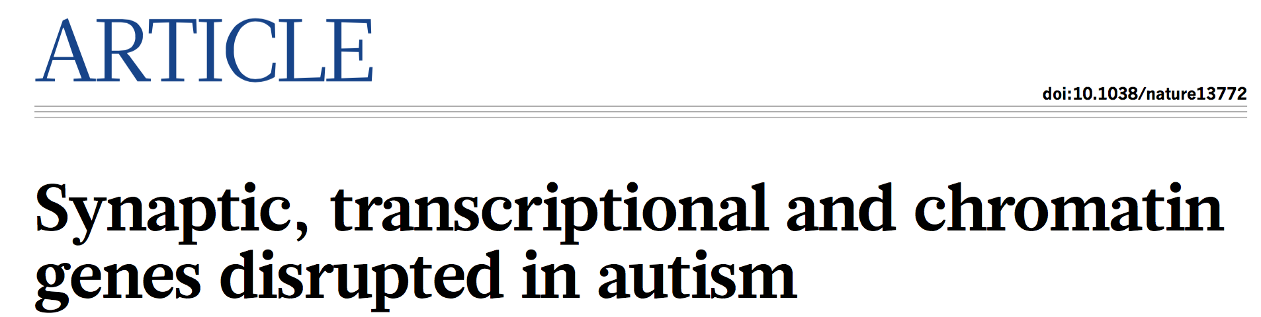
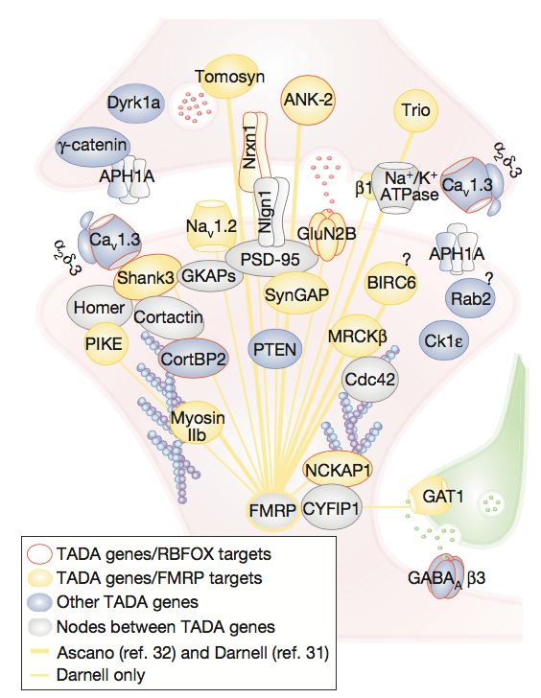
Properties of sequenced De Novos
Novelty
Child has only alt allele in trio, not inherited
Rarity
Allele frequency across all samples sequenced is low
Confidence
Set GQ threshold for parents and child
(GQ improvement tools help A LOT here!)
Notes:
When identifying possible de novo mutations the data may not be perfect, but we require the mutant allele to be novel, rare and we want to call with some threshold minimum confidence.
Broad Institute study looking at thousands of Autism patients with ancestry-matched or parental controls.
Conf threshold on parents because you might be undersampling one of the parents haplotypes. So you may just have gotten unlucky and not seen the alt allele in the parents.
Many de novo loss-of-function mutations are in synaptic proteins.

Slide 20
Example of a clinical case
Real clinical data
Suspected de novo mutation in offspring
417 de novos from raw GT calls
17 de novos based on posterior GTs
8 high confidence de novos after GQ filtering
Notes:
Data from a real clinical case at the Broad.
417 raw de novos – way more than the 30 per genome that we expect.
Recalibrate based on the priors and family data to get posterior genotypes (17)
Filter based on confidence to get 8.

Slide 21
Genotype refinement yields more high-quality genotypes
Initial genotype calls may be ambiguous or wrong
Applying population + family priors improves confidence
More high confidence genotypes -> more data for downstream analysis!
Tools can be used for further variant annotation (e.g. Funcotator)
*SnpEff is not supported by GATK
Notes:
The genotype calls using the current best practices pipeline can be ambiguous or even wrong, but we can use these tools and some external data to correct wrong calls and improve our confidence, which leads to more high-quality genotypes for downstream analysis.
There are a number of external tools to carry out additional variant annotation – some based on well known genomic motifs in eukaryotes. Other tools use information about protein structure.

Slide 22
Best Practices for Germline SNP & INDEL Discovery

