Slide 1
Next-Generation Sequencing Analysis
Dr Alan Pittman and Dionysios Grigoriadis
SGUL Bioinformatics Unit
Friday 31st January 2020
A and D

Slide 2
Workshop set-up
D

Slide 3
Learning Objectives
Quick overview of next generation sequencing
Linux command line
Next-generation sequencing software/tools
Genome reference download and index
Raw sequencing reads pre-processing and quality control
Reads alignment to the reference genome
Alignment quality control and refinement
Variant calling and filtration
Annotation of the called variants
Visualisation of alignments and called variants
A

Slide 4
Introduction
A

Slide 5




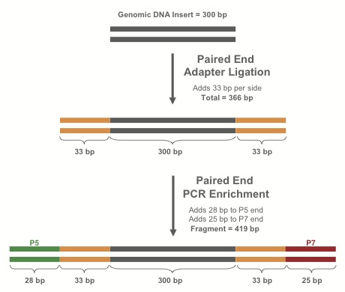
Library Preparation
Purify*
fragments
Fragments
DNA
RT-PCR
If RNA:
make cDNA
RNA
Extract nucleic acids from blood, tissue, saliva, etc.
Shear dsDNA into fragments
Attach adapters to fragments
Library
* Protocol varies depending on experimental design (WGS, exome, targeted sequencing etc)
A

Slide 6
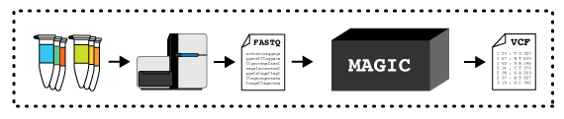
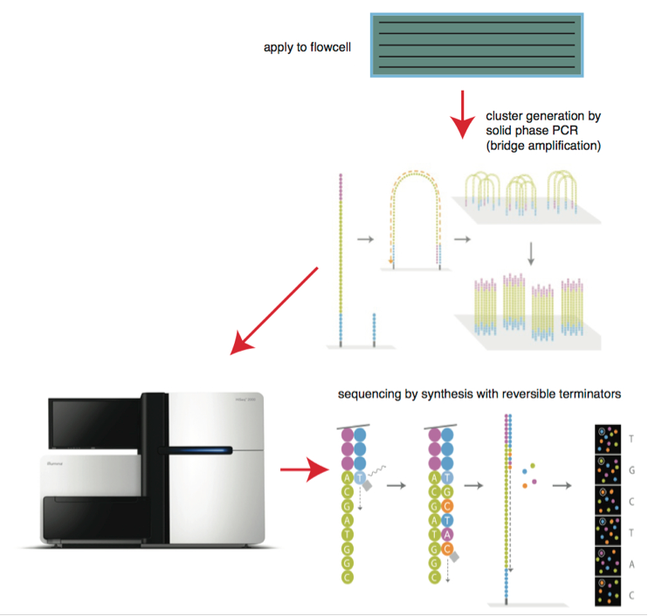

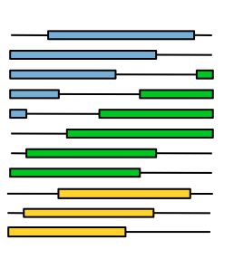
Sequencing the library I
DNA libraries
Bitesizebio.com
Flowcell
DNA libraries deposited on flowcell
-> amplified to form clusters
Lanes
Illumina
HTS machine processes a flowcell containing lanes
Each lane may contain multiple samples (indexed with a DNA barcode)
Read group (RG) specifies a combination of sample and flowcell
Enormous pile of short reads
A

Slide 7
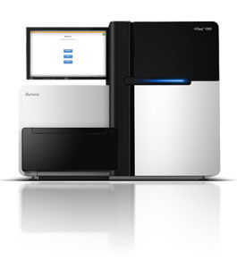
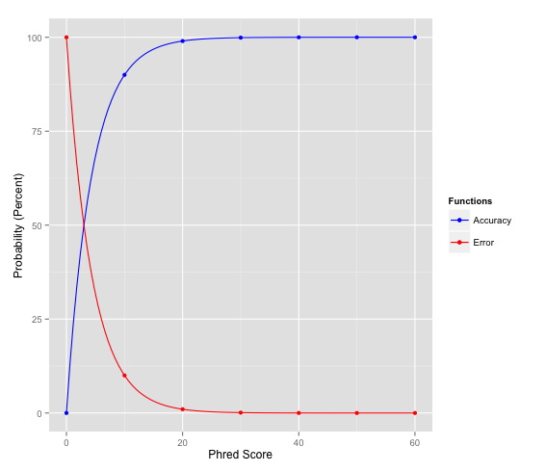
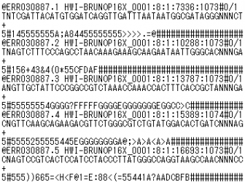
Sequencing the library II
FASTQ file
Accuracy
Big pile of reads!
20 and higher is generally a good score
Sequence Name (read name, group, etc.)
Sequence
+ (optional: Sequence name again)
Associated quality score
Phred value = −10 * log₁₀(ε)
Error
Q10 = 90% confidence (10% error rate)
Q20 = 99% confidence (1% error rate)
Q30 = 99.9% confidence (0.1% error rate)
Format specification http://maq.sourceforge.net/fastq.shtml
ASCII code translates to Phred-scale Q scores
A

Slide 8
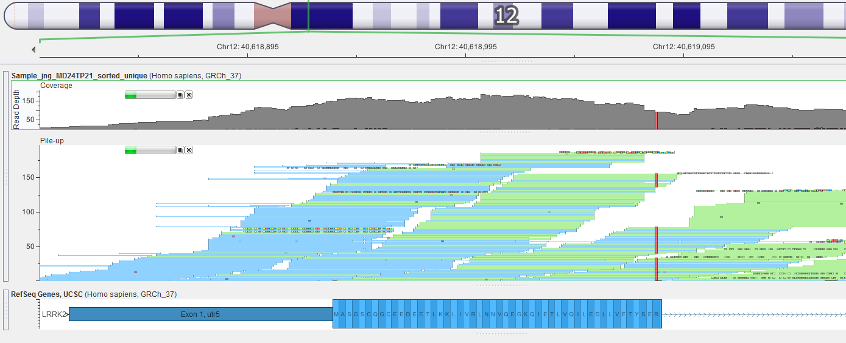
Mapping The Short Reads
Mapping and alignment algorithms
Short read sequences from the machine need to be re-assembled like a jigsaw
Mapped against the reference genome using the alignment algorithm BWA
BWA for DNA
Enormous pile of short reads from sequencer
Reference genome
Reads mapped to reference
A

Slide 9
Introduction to UNIX Command Line How to run simple commands and executable applications
This is where you specify which application you want to run and where it is.
This is where you set specific arguments for your application. Typically set with: “-”,”--“ or “=“ (see examples).
[user@stats3 ~]$ /path/to/application [ARGUMENTS]
Examples of simple commands:
[user@stats3 ~]$ #Bash ignores everything that is written after the hash mark (#)
[user@stats3 ~]$ cd ~/software
[user@stats3 ~]$ ls ~/resources/etc
[user@stats3 ~]$ mkdir reference/
[user@stats3 ~]$ software/samtools view –Sb sample1.sam -o sample1.bam
[user@stats3 ~]$ software/fastp -i sample1_r1.fastq --html sample1_results.html --json sample1_results.json
D

Slide 10
Introduction to UNIX Command Line How to run simple commands and executable applications
This is where you specify which application you want to run and where it is. In this case is the compiler of the specific language.
This is where you set specific arguments for the compiler. Typically set with: “-”,”--“,“=“ or just a word or character (see examples).
This is where you set specific arguments for your script. Typically set with: “-”,”--“,“=“ or just a word or character (see examples).
Full path to the script.
[user@stats3 ~]$ /path/to/language/compiler [COMPILER’S ARGUMENTS] /path/to/script [SCRIPT’S ARGUMENTS]
Examples:
[user@stats3 ~]$ sh ~/software/linux_script.sh –i data1.csv –d 20
[user@stats3 ~]$ bash ~/software/linux_script.sh data1.csv
[user@stats3 ~]$ python ~/software/myscript.py –i sample1.vcf –o sample1.processed.vcf
[user@stats3 ~]$ Rscript ~/software/plot_samples.R --input table.txt –f 20 –d 9 --output plot.jpeg
[user@stats3 ~]$ java –jar gatk-4.0.4.0-local.jar HaplotypeCaller –I sample1.vcf
[user@stats3 ~]$ java –jar –Xms30g gatk-4.0.4.0-local.jar HaplotypeCaller –I sample1.vcf
D

Slide 11
Hands On Workshop
A

Slide 12
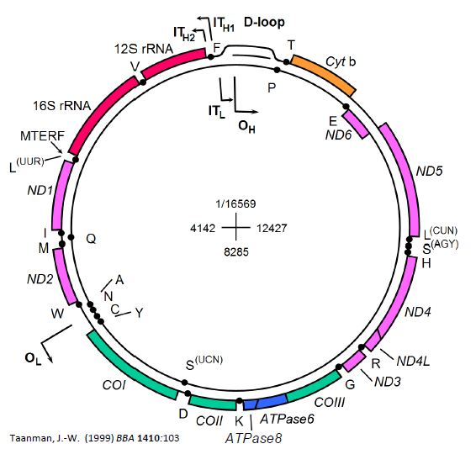
Analysis of the Human mtDNA Sequence
Mitochondrial DNA (mtDNA)
Closed- circular 16.6kb in size
mtDNA encodes 13 proteins
Essential subunits of oxidate phosphorylation
A

Slide 13
Part 1
Downloading and preparing our mitochondrial reference (chrM) fasta file.
At the Linux terminal type:
mkdir reference
wget –timestamping 'ftp://hgdownload.cse.ucsc.edu/goldenPath/hg38/chromosomes/chrM.fa.gz' -O reference/chrM.fa.gz
…here we are creating a new directory (called reference) with the linux mkdir command, then using the wget command to download chrM fasta file to that new directory
A

Slide 14
Part 1
Unzipping and viewing the compressed chrM fasta txt file.
At the Linux terminal type:
gunzip reference/chrM.fa.gz
head reference/chrM.fa
…the chrM reference fasta file is currently compressed and we are unzipping it to it’s text format. We can view the top 10 lines of the unzipped file with the head command.
A

Slide 15
Part 1
Generate the FM-index from the chrM reference fasta file for use in BWA
At the Linux terminal type:
software/bwa index reference/chrM.fa
…we are using the index function of the bwa software to make the FM-index of our reference fasta genome
A

Slide 16
Part 1
Prepare the index file for use in the Genome Analysis Toolkit (GATK)
Fasta index file (.faidx)
Sequence dictionary file (.dict)
At the Linux terminal type:
software/samtools faidx reference/chrM.fa
java -jar software/gatk-package-4.0.4.0-local.jar CreateSequenceDictionary -R reference/chrM.fa -O reference/chrM.dict
…..producing some more text files describing the contents of the chrM FASTA file for the genome analysis toolkit.
A

Slide 17
Part 2
D

Slide 18
Part 3
Alignment of the mitochondrial fastq sequence data to the chrM using BWA
At the Linux terminal type:
software/bwa mem reference/chrM.fa sample1_out.R1.fq.gz sample1_out.R2.fq.gz -R '@RG\tID:sample1\tSM:sample1\tLB:sample1\tPL:ILLUMINA' -o sample1.sam
….. we are using the bwa alignment algorithm ‘mem’ to align our sample fastq data against the reference chrM fasta file
-o generating an output .sam (sequence alignment format) file
-R embedding the sample/sequence information in file
A

Slide 19
Part 3
Converting the sam output to a common binary alignment format (.bam)
At the Linux terminal type:
software/samtools view -Sb sample1.sam -o sample1.bam
….. we are using the samtools software ‘view’ command to print our .sam file into a different file format, in this case a .bam file (basically same as a .sam file but takes up much less disk space and retains all of the information)
A

Slide 20
Part 3
Sorting by genomic co-ordinate and indexing the .bam file
At the Linux terminal type:
software/samtools sort sample1.bam -o sample1_sorted.bam
software/samtools index sample1_sorted.bam
….. we are using the samtools software ‘sort’ command to sort the alignment .bam file by genomic coordinate
..then we are using the samtools ‘index’ command to create the .bai index – the .bam companion file that allows for faster read access for downstream steps
A

Slide 21
Part 3
Deduplicate with picardtools in GATK
At the Linux terminal type:
java -jar software/gatk-package-4.0.4.0-local.jar MarkDuplicates -I sample1_sorted.bam -O sample1_sorted_unique.bam -M sample1_picard_metrics.txt
…the deduplication step locates and tags duplicate reads in the .bam, where duplicate reads are defined as originating from a single fragment of DNA. Duplicates can arise during sample preparation e.g. library construction using PCR.
A

Slide 22
Part 3
Base quality score recalibration with GATK
At the Linux terminal type one after the other
java -jar software/gatk-package-4.0.4.0-local.jar BaseRecalibrator -I sample1_sorted_unique.bam -R reference/chrM.fa --known-sites software/common_all_chrM.vcf.gz -O recal_data_table.txt
java -jar software/gatk-package-4.0.4.0-local.jar ApplyBQSR -I sample1_sorted_unique.bam -R reference/chrM.fa --bqsr-recal-file recal_data_table.txt -O sample1_sorted_unique_recalibrated.bam
…we are performing base quality score recalibration to recalculate the base calling quality scores. The sequencing machines tend to overestimate the data quality (!) ..so we can model the actual data quality on the number mismatches in the observed data… and adjust them accordingly!
A

Slide 23
Part 4
D

Slide 24
Part 5
D

Slide 25
Part 6
A+D

Slide 26
Quiz
In the VEP annotation results table, find the genomic coordinates of the missense variant with the highest Polyphen score.
Download the annotated vcf file using the VCF download button on the upper-right corner
Get the genomic position of the variant you selected in question 1 and extract this variant’s information from the vcf file (using the grep command) and save it into a new file (using the > symbol).
A+D

