Slide 1
Next-Generation Sequencing Analysis
Dr Alan Pittman and Dionysios Grigoriadis
SGUL Bioinformatics Unit
Friday 31st January 2020

Slide 2
Workshop set-up
D

Slide 3
Learning Objectives
Quick overview of next generation sequencing
Linux command line
Next-generation sequencing software/tools
Genome reference download and index
Raw sequencing reads pre-processing and quality control
Reads alignment to the reference genome
Alignment quality control and refinement
Variant calling and filtration
Annotation of the called variants
Visualisation of alignments and called variants

Slide 4
Introduction
A

Slide 5




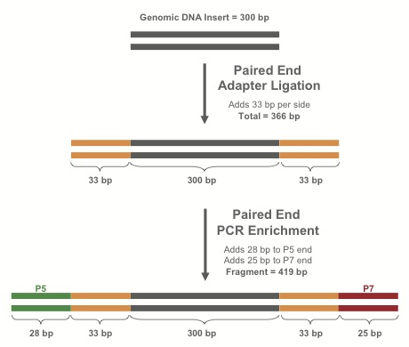
Library Preparation
Purify*
fragments
Fragments
DNA
RT-PCR
If RNA:
make cDNA
RNA
Extract nucleic acids from blood, tissue, saliva, etc.
Shear dsDNA into fragments
Attach adapters to fragments
Library
* Protocol varies depending on experimental design (WGS, exome, targeted sequencing etc)
A

Slide 6
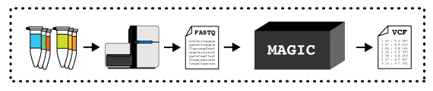
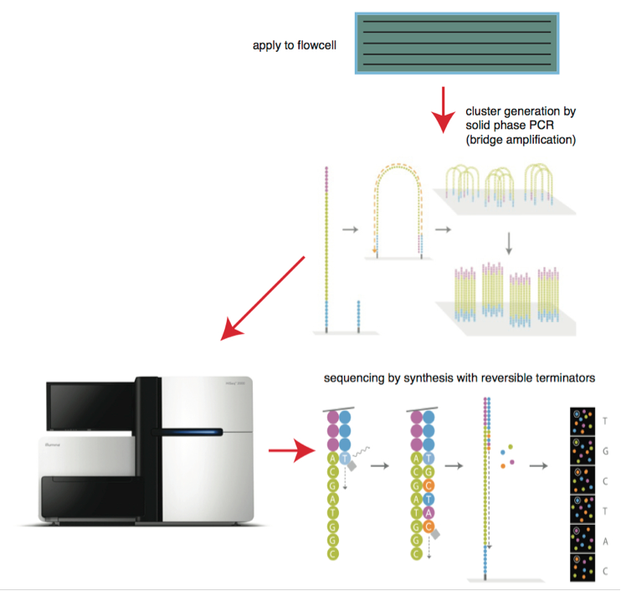

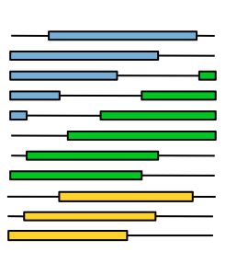
Sequencing the library I
DNA libraries
Bitesizebio.com
Flowcell
DNA libraries deposited on flowcell
-> amplified to form clusters
Lanes
Illumina
HTS machine processes a flowcell containing lanes
Each lane may contain multiple samples (indexed with a DNA barcode)
Read group (RG) specifies a combination of sample and flowcell
Enormous pile of short reads

Slide 7
Sequencing the library II

Slide 8
Introduction to UNIX Command Line How to run simple commands and executable applications
This is where you specify which application you want to run and where it is.
This is where you set specific arguments for your application. Typically set with: “-”,”--“ or “=“ (see examples).
[user@stats3 ~]$ /path/to/application [ARGUMENTS]
Examples of simple commands:
[user@stats3 ~]$ #Bash ignores everything that is written after the hash mark (#)
[user@stats3 ~]$ cd ~/software
[user@stats3 ~]$ ls ~/resources/etc
[user@stats3 ~]$ mkdir reference/
[user@stats3 ~]$ software/samtools view –Sb sample1.sam -o sample1.bam
[user@stats3 ~]$ software/fastp -i sample1_r1.fastq --html sample1_results.html --json sample1_results.json
The “\” character is used to indicate that the code line continues in the following line. Example:
[user@stats3 ~]$ software/fastp -i sample1_r1.fastq \
--html sample1_results.html \
--json sample1_results.json
D

Slide 9
Introduction to UNIX Command Line How to run simple commands and executable applications
This is where you specify which application you want to run and where it is. In this case is the compiler of the specific language.
This is where you set specific arguments for the compiler. Typically set with: “-”,”--“,“=“ or just a word or character (see examples).
This is where you set specific arguments for your script. Typically set with: “-”,”--“,“=“ or just a word or character (see examples).
Full path to the script.
[user@stats3 ~]$ /path/to/language/compiler [COMPILER’S ARGUMENTS] /path/to/script [SCRIPT’S ARGUMENTS]
Examples:
[user@stats3 ~]$ sh ~/software/linux_script.sh –i data1.csv –d 20
[user@stats3 ~]$ bash ~/software/linux_script.sh data1.csv
[user@stats3 ~]$ python ~/software/myscript.py –i sample1.vcf –o sample1.processed.vcf
[user@stats3 ~]$ Rscript ~/software/plot_samples.R --input table.txt –f 20 –d 9 --output plot.jpeg
[user@stats3 ~]$ java –jar gatk-4.0.4.0-local.jar HaplotypeCaller –I sample1.vcf
[user@stats3 ~]$ java –jar –Xms30g gatk-4.0.4.0-local.jar HaplotypeCaller –I sample1.vcf
D

Slide 10
Part 1
Downloading and preparing our mitochondrial reference sequencing fasta file.
mkdir reference
wget –timestamping 'ftp://hgdownload.cse.ucsc.edu/goldenPath/hg38/chromosomes/chrM.fa.gz' -O reference/chrM.fa.gz
A

Slide 11
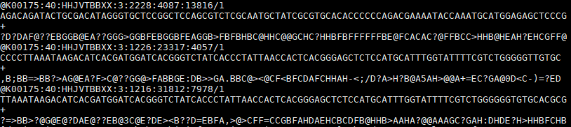
Part 2
Inspect sequencing reads in FASTQ format
At the Linux terminal type:
head –n 12 sample1_r1.fasta
Enormous pile of short reads
sample1_r1.fastq
sample1_r2.fastq
FASTQ file
Every new entry (read) is starting with an “@”.
Each entry (read) in a FASTQ file consists of four lines:
1st: Read identifier
2nd: Nucleotide sequence
3rd: Quality score identifier (is always a “+”)
4rd: Per base quality score
DG

Slide 12
Part 2
Quality control of our mitochondrial NGS sequence data prior to alignments
At the Linux terminal type:
software/fastp -i sample1_r1.fastq -I sample1_r2.fastq -o sample1_out.R1.fq.gz –O \ sample1_out.R2.fq.gz --html \
sample1_results.html --json sample1_results.json --report_title sample1_results
This steps achieves 2 main goals
Process the reads prior to the alignment step:
Trim read bases that might be of low quality (usually on the tail end of the reads).
Remove any adapter sequences (have been artificially inserted during library preparation).
Report the reads quality in a human-readable format
!!Use bad sequencing example
DG

Slide 13
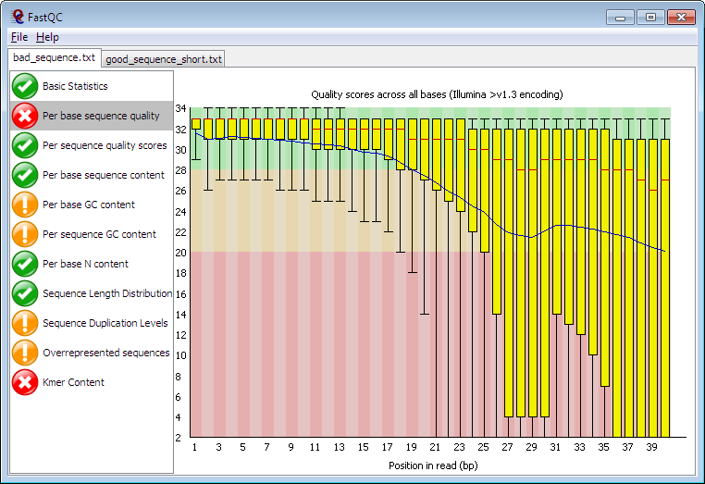
Part 2
An alternative way of visualising the reads quality before and after trimming.
At the Linux terminal type:
software/fastqc sample1_r1.fastq sample1_r2.fastq sample1_out.R1.fq.gz \ sample1_out.R2.fq.gz
Read more about how to interpret the FASTQC reports: http://www.bioinformatics.babraham.ac.uk/projects/fastqc/Help/
DG

Slide 14
Part 3
A

Slide 15
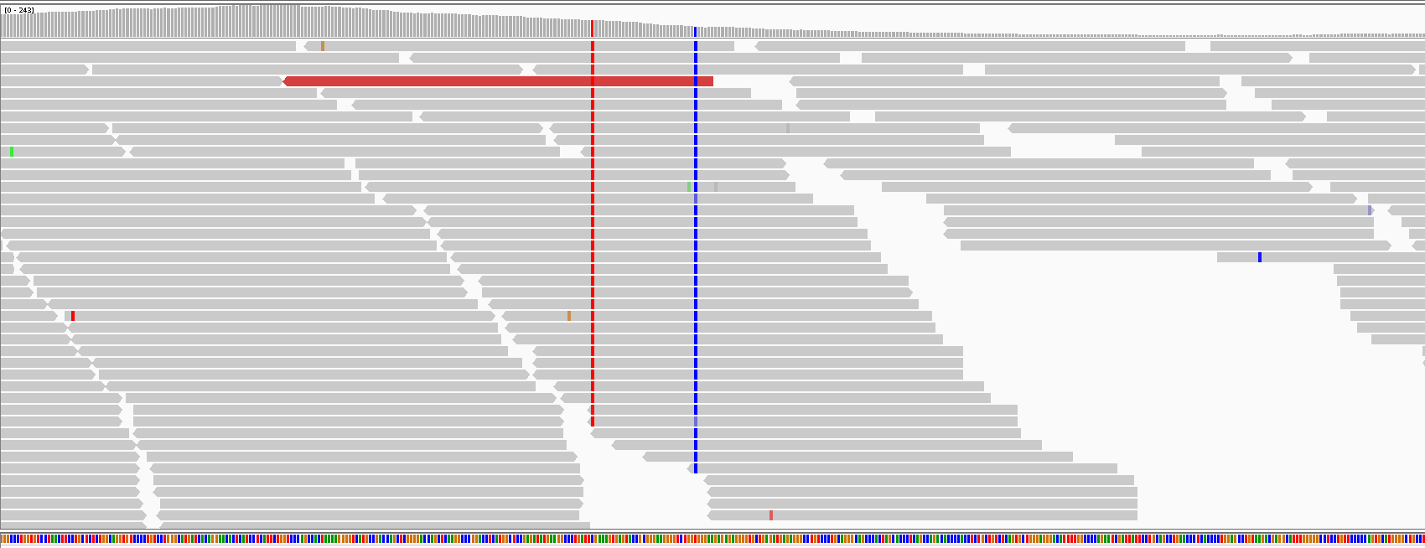
Part 4
Identifying single nucleotide variants and small indels in our aligned mtDNA
At the Linux terminal type:
java -jar software/gatk-package-4.0.4.0-local.jar HaplotypeCaller \ -I sample1_sorted_unique_recalibrated.bam \
-R reference/chrM.fa -G StandardAnnotation \
-bamout sample1_sorted_unique_recalibrated.bamout.bam \
-O sample1.vcf
HaplotypeCaller scans the aligned reads for mismatches against the reference genome
Read more here: https://gatk.broadinstitute.org/hc/en-us/articles/360035531412-HaplotypeCaller-in-a-nutshell
D

Slide 16
Part 4
Hard-Filtering of the previously called variants
At the Linux terminal type:
java -jar software/gatk-package-4.0.4.0-local.jar VariantFiltration -V sample1.vcf -R reference/chrM.fa --genotype-filter-expression "GQ < 30.0“ --genotype-filter-name "LowGQ" \ --filter-expression "QD < 1.5" --filter-name "LowQD" --filter-expression "DP < 6" --filter-name "LowCoverage" \ --filter-expression "SOR > 10.0" --filter-name "StrandBias" -O sample1.filtered.vcf
Filters used in this example
Genotype Quality less than 30.0: GQ < 30 to tag variants with low genotype quality
Quality of Depth less than 1.5: QD < 1.5 to tag variants with low quality of depth
Approximate read depth less than 6: DP < 6 to tag variants with low read coverage
Strand Odds Ratio more than 10: SOR > 10 to tag variants with strand bias
D

Slide 17
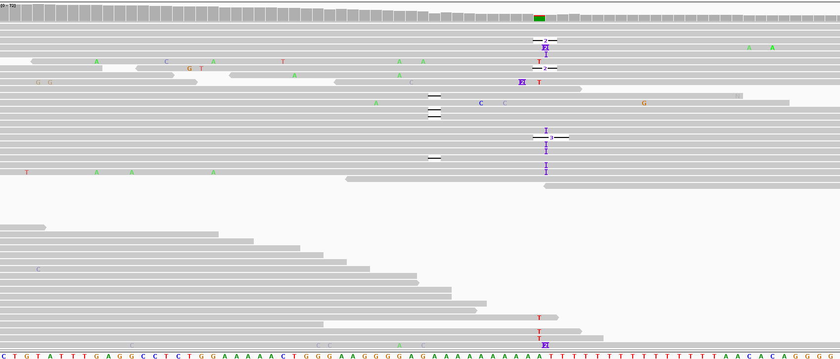
Part 4
Hard-Filtering of the previously called variants
At the Linux terminal type:
java -jar software/gatk-package-4.0.4.0-local.jar VariantFiltration -V sample1.vcf -R reference/chrM.fa --genotype-filter-expression "GQ < 30.0“ --genotype-filter-name "LowGQ" \ --filter-expression "QD < 1.5" --filter-name "LowQD" --filter-expression "DP < 6" --filter-name "LowCoverage" \ --filter-expression "SOR > 10.0" --filter-name "StrandBias" -O sample1.filtered.vcf
D

Slide 18
Part 5
Functional annotation of the called genetic variants
Gene annotations
Region annotations
Filter annotations
Variant information that you want to annotate
D

Slide 19
Part 5
Functional annotation of the called genetic variants
Variant information that you want to annotate
D

Slide 20
Part 5
Functional annotation of the called genetic variants
We are using an online freely available annotation tool: (ensemble VEP)
Open an internet browser (Mozilla Firefox, Google Chrome)
Navigate to https://www.ensembl.org/Multi/Tools/VEP
! Double check the human genome build you are using !
Fill the job form using:
Name for this job: sgul_workshop_ followed by your initials (e.g. sgul_workshop_DG)
Input data -> Or upload file: -> Choose file -> Navigate and select your sample1.filtered.vcf.gz file
Transcript database to use: Ensembl/GENCODE transcripts
Make sure you will leave Additional configurations field untouched using the pre-defined default fields.
Click
Wait for the job to finish
When finished, click [View results]
D

Slide 21
Part 6
A+D

Slide 22
Quiz
In the VEP annotation results table, find the genomic coordinates of the missense variant with the highest Polyphen score.
Download the annotated vcf file using the VCF download button on the upper-right corner
Get the genomic position of the variant you selected in question 1 and extract this variant’s information from the vcf file (using the grep command) and save it into a new file (using the > symbol).
A+D

