Slide 1
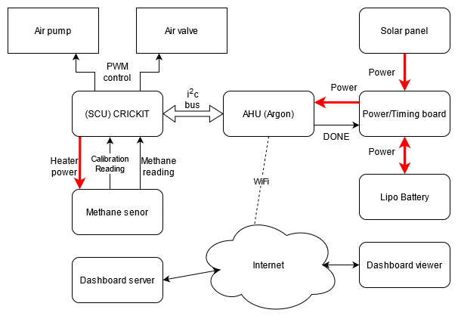
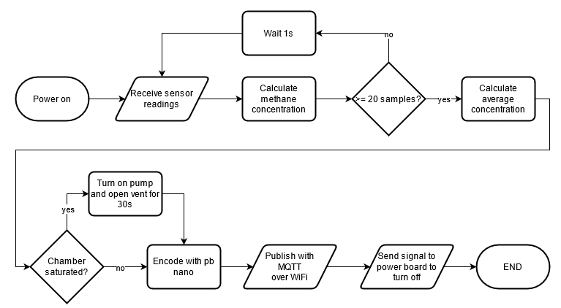
Floating Fart Collector
Brendon Duncan, Isaac Graham, Lachlan Smith, Byan Herrington – Kyamites Brown
KPI’S
The device can measure methane with a sufficient accuracy
Able to detect unsafe methane levels and vent the chamber
Device can connect to a WiFi network and send protocol buffer encoded sensor readings to the Dashboard using MQTT.
Capable of running for a minimum of one day using the onboard battery and solar panel
The device can enter low power mode while not taking measurements
SYSTEM OVERVIEW
RESULTS
These
Are
The
results
CONCLUSIONS
Here
Are
Some
conclusions
CHALLENGES & SOLUTIONS
Problem: No Zephyr support for CKRICKIT board. Solution: Ported the Adafruit seesaw C++ library to C used to create a driver.
Problem: Unstable methane sensor reading. Solution: Take average of many sensor readings and added 10nF capacitor to signal line.
MOTE FLOWCHART

