Slide 1
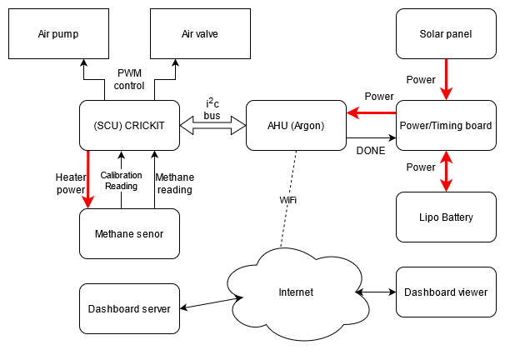
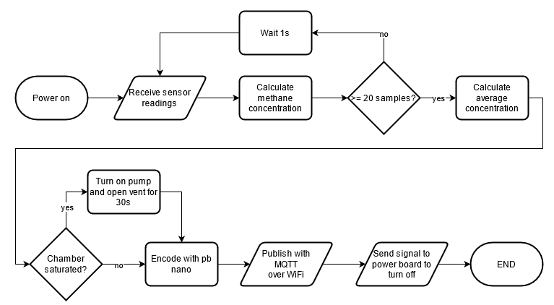
Floating Fart Collector
Brendon Duncan, Isaac Graham, Lachlan Smith, Byan Herrington – Kyamites Brown
KPI’S
The device can measure methane with a sufficient accuracy
Able to detect unsafe methane levels and vent the chamber
Device can connect to a WiFi network and send protocol buffer encoded sensor readings to the Dashboard using MQTT.
Capable of running for a minimum of one day using the onboard battery and solar panel
The device can enter low power mode while not taking measurements
SYSTEM OVERVIEW
RESULTS
These
Are
The
results
CONCLUSIONS
Here
Are
Some
conclusions
CHALLENGES
Problem: WiFi would sometimes fail to connect if the signal was poor. Solution: Attempt connection multiple times.
Problem: No Zephyr library for interfacing with the CRICKIT board. Solution: Port Adafruit C++ seesaw library to Zephyr (uses same i2c messaging protocol) and wrote drivers for the CRICKIT.
MOTE FLOWCHART

