Slide 1
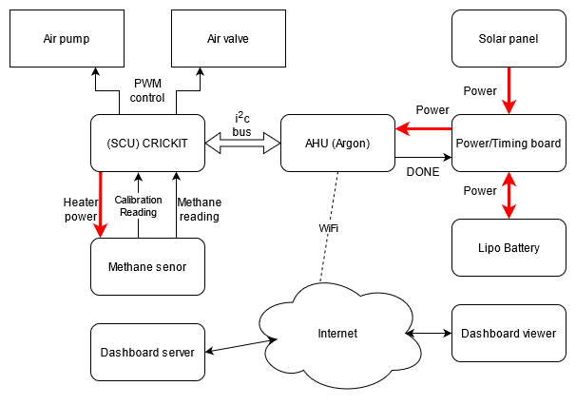
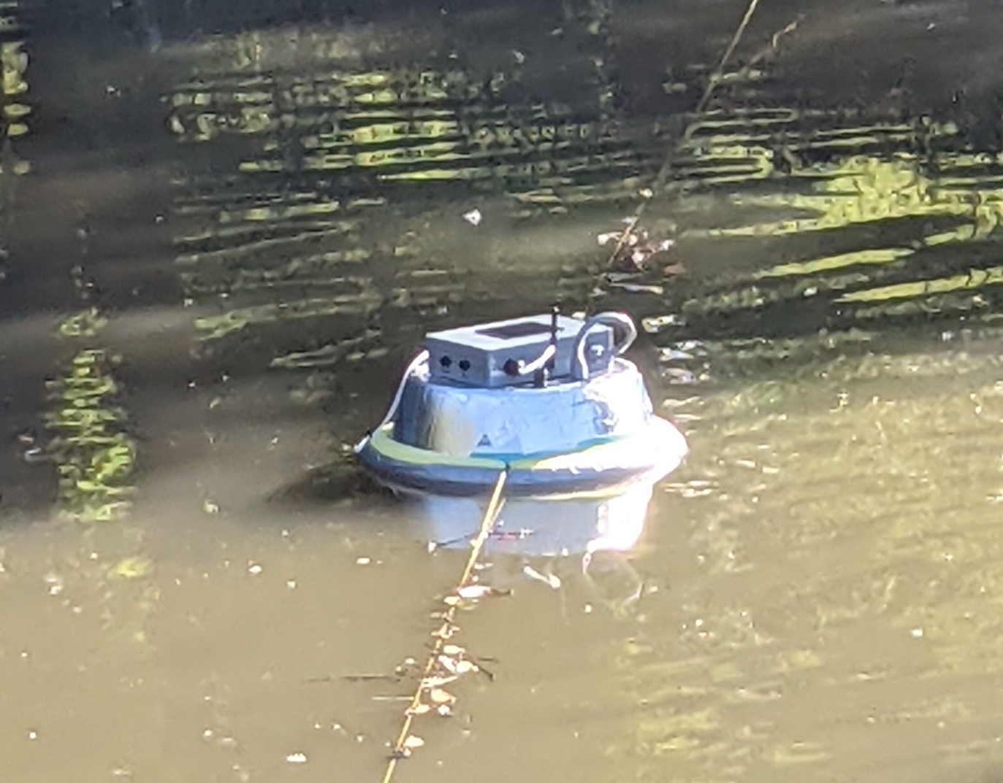
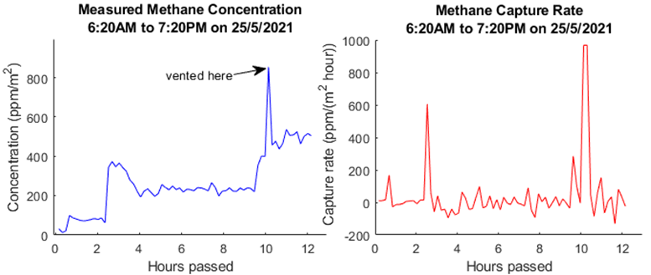
Greenhouse gas monitoring using a Capture Chamber
Brendon Duncan, Isaac Graham, Lachlan Smith, Byan Herrington – Kyamites Brown
KPI’S
The device can measure methane with a sufficient accuracy
Able to detect unsafe methane levels and vent the chamber
Device can connect to a WiFi network and send protocol buffer encoded sensor readings to the Dashboard using MQTT.
Capable of running for a minimum of one day using the onboard battery and solar panel
The device can enter low power mode while not taking measurements
SYSTEM OVERVIEW
Capture chamber deployed during the day
CONCLUSIONS
Device measured methane concentration to a good level of accuracy and consistency.
Successfully vented the chamber at 750ppm. Concentration did not return to zero as the pump is too small, but it is sufficient to avoid dangerous methane concentrations
Data was successfully sent to an online dashboard using protocol buffer encoding and MQTT over a WiFi connection.
Measurement interval was set to 10 minutes for testing. The battery lasted for ~12 hours over night starting with 75% charge. For deployment measurements will be taken once per hour which will result in > 24 hours up-time.
The device powered on at the chosen intervals, then powered off after measurements were taken and sent over WiFi.
CHALLENGES
Problem: WiFi would sometimes fail to connect if the signal was poor. Solution: Attempt connection multiple times.
Problem: No Zephyr library for interfacing with the CRICKIT board. Solution: Port Adafruit C++ seesaw library to Zephyr (uses same i2c messaging protocol) and wrote drivers for the CRICKIT.
Problem: Excessive power usage running board and sensor continuously. Solution: Periodically power on the system using a low power timer IC.
RESULTS

