Slide 1

Brief Intro to Machine Learning CS539
Prof. Carolina Ruiz
Department of Computer Science (CS)
& Bioinformatics and Computational Biology (BCB) Program
& Data Science (DS) Program
WPI
Most figures and images in this presentation were obtained from Google Images
Notes:
<number>

Slide 2
Reminder: What is AI?
There are many definitions of Artificial Intelligence. Two of them are:
“AI as an attempt to understand intelligent entities and to build them“ (Russell and Norvig, 1995)
"AI is the design and study of computer programs that behave intelligently" (Dean, Allen, and Aloimonos, 1995)
But what is an “intelligent entity" or what does it mean to “behave intelligently"?
Intelligence is the degree of accomplishment exhibited by a system when performing a task" (Allen, AAAI97 invited lecture)

Slide 3
WHAT IS AI? (Cont.)
AI can be seen as an ensemble of ideas & techniques for:
representing knowledge
using knowledge to solve problems
with two goals:
Engineering Goal:
To solve real-world problems using AI
Scientific Goal:
To explain various sorts of intelligence

Slide 4
What is AI? (cont.)
Core AI:
Knowledge Representation Techniques:
Semantic Nets, Rules, Propositional Logic, 1st Order Logic,
Probability, . . .
Problem Solving Strategies:
Blind Search, Heuristic Search, Optimal Search, Adversarial Search
(Game Playing), Constraint Satisfaction, Logical Inference, Planning,
Probabilistic Reasoning, . . .
AI Areas:
Machine Learning
Machine Vision
Natural Language Processing (NLP)
(Robotics combines these 3 areas)
←

Slide 5
What is Machine Learning?
Writing computer programs that learn from experience
More precisely (Mitchell, 1997)
Given:
A class of tasks T (e.g., recognizing faces)
A performance measure P (e.g., accuracy)
Training experience E (e.g., dataset of faces with names)
Write computer programs that can learn from experience E to improve their performance, as measured by P, on tasks in T

Slide 6





Supervised vs. Unsupervised Learning (e.g., implementing a “smart doorman” to do automatic face recognition)
Supervisor or Teacher
No supervisor
Training experience:
face teacher says:
yes
no
yes
no
Training Experience:

Slide 7
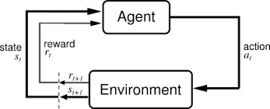
Reinforcement Learning
Task: Learning a policy: Learning what action to perform in a given situation
and what sequence of actions to perform to achieve a goal
“Hands-off” Supervisor / Teacher / Environment
provides + and – rewards

Slide 8


How to provide “experience”?
Using Data: experience is recorded in data
Not using data: Direct experience
(e.g., medical records)
(e.g., robot motion)
Learning from data is also
called data mining

Slide 9

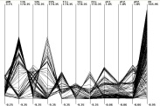
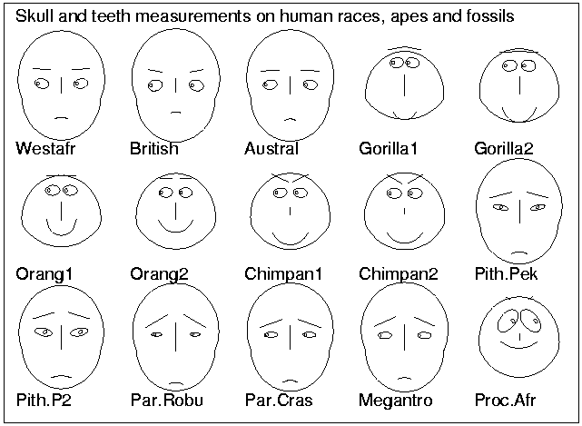
What do you want to learn from your data?
regression
IF A & B THEN
IF A & D THEN
classification
clustering
Data
change/deviation
detection
summarization
dependency/assoc. analysis
0.5
IF a & b & c THEN d & k
IF k & a THEN e
A B
C D
A, B -> C 80%
C, D -> A 22%
0.3
0.75
Notes:
<number>
Regression:
Parametrically summarize data points

Slide 10
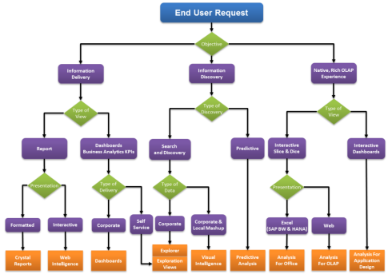
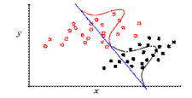
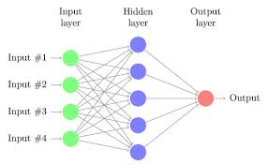
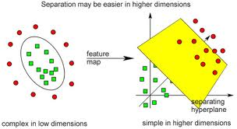
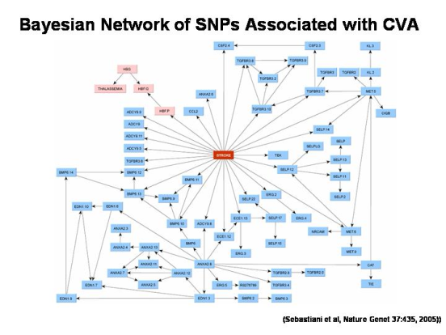
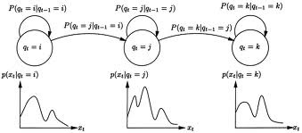
Topics that we’ll cover in this course
Supervised: Classification & Regression
Decision Trees
Linear Discrimination
Multilayer Percept. / Neural Nets
Deep Learning
Graphical Models
Naïve Bayes & Bayesian Networks
Kernel methods
Support Vector Machines
Hidden Markov Models
Notes:
Data mining methods in and for bioinformatics have been developing fast, more efficient and more scalable.
<number>

Slide 11
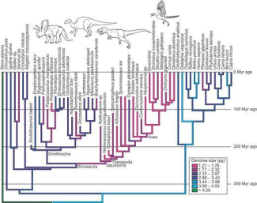
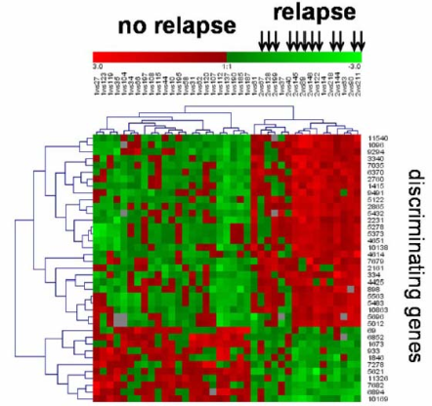
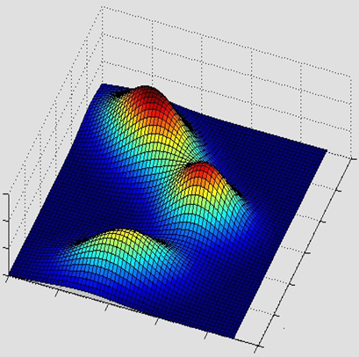
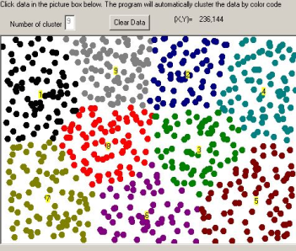
Topics that we’ll cover in this course
Unsupervised Learning
Clustering:
Expectation Maximization (EM)
Reinforcement Learning
Notes:
Data mining methods in and for bioinformatics have been developing fast, more efficient and more scalable.
<number>

Slide 12
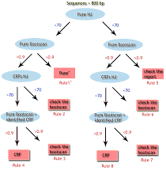
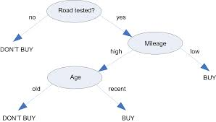
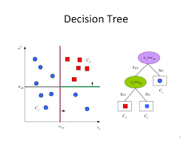
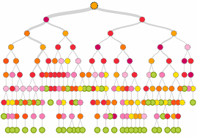
Decision Trees
Decision trees are used for classification
Regression trees follow a similar idea

Slide 13
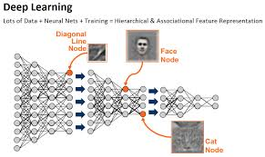
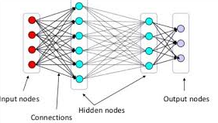

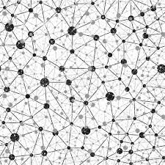
Artificial Neural Networks (ANNs) and Deep Learning
ANNs / Deep Learning can be used for classification, regression, or unsupervised learning (e.g., self-organizing maps)

Slide 14
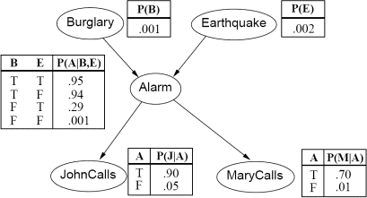
Bayesian Networks
Can be used for classification, for regression,
or for dependency analysis

Slide 15
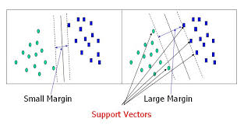
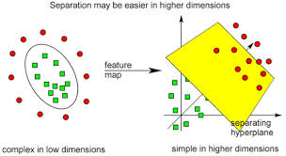
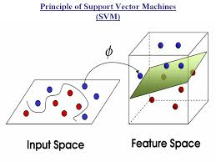
Support Vector Machines (SVMs)

Slide 16
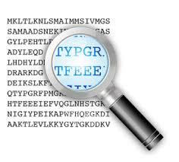

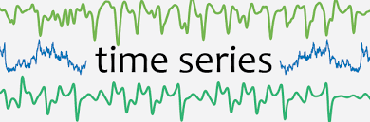
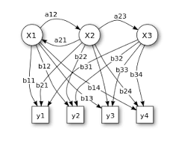
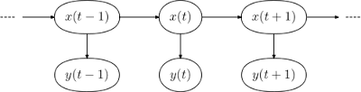
Hidden Markov Models

Slide 17
CS539 Machine Learning
Keep in mind:
Although this course is taken by students from different departments and programs
(BCB, CS, DS, ECE, MA, RBE, … )
this course focusses on CS aspects of machine learning across these disciplines
students may explore aspects of machine learning related to their own discipline in the course project

Slide 18

So much to talk about so little time!
Thanks

