Slide 1
CHAPTER 5: Multivariate Methods

Slide 2
Multivariate Data
<number>
Multiple measurements (sensors)
d inputs/features/attributes: d-variate
N instances/observations/examples

Slide 3
Multivariate Parameters
<number>
Covariance Matrix:

Slide 4
Parameter Estimation from data sample X
<number>

Slide 5
Estimation of Missing Values
<number>
What to do if certain instances have missing attribute values?
Ignore those instances. This is not a good idea if the sample is small
Use ‘missing’ as an attribute: may give information
Imputation: Fill in the missing value
Mean imputation: Use the most likely value (e.g., mean)
Imputation by regression: Predict based on other attributes

Slide 6
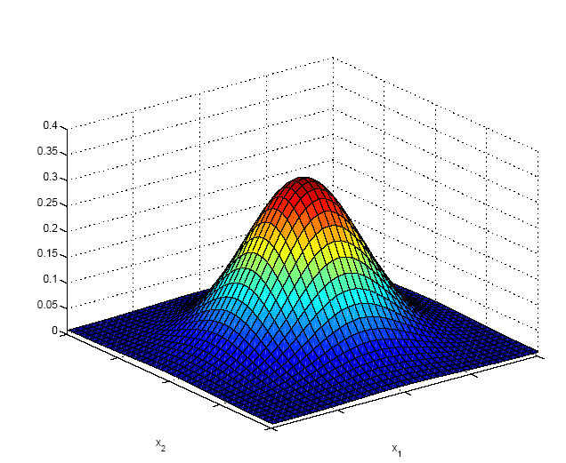
Multivariate Normal Distribution
<number>
Notes:
|Sigma| is the determinant of the Sigma matrix.
The determinant of a matrix is the factor by which the linear transformation represented by the matrix alters volume. If the determinant of a matrix is 0, the matrix is not invertible (also called singular matrix).
Sigma^-1 is the inverse of matrix Sigma. Sigma * Sigma^-1 = Identity matrix.
<number>

Slide 7
Multivariate Normal Distribution
<number>
Mahalanobis distance: (x – μ)^{T} ∑^{–1} (x – μ)
measures the distance from x to μ in terms of ∑ (normalizes for difference in variances and correlations)
Bivariate: d = 2
z-normalization
Notes:
In the univariate case, the density function of a normal distribution is given by equation (A.42) p. 601. The exponent (x - mu)^2 / sigma^2 = [(x - mu) / sigma]^2 can be seen as normalizing the distance of x to the mean in standard deviation units, normalizing for variance.
The Mahalanobis distance does the same in the multivariate case.
Note also that when z_1^2 – 2 p z_1 z_2 + z_2^2 = c is the equation of an ellipse.
<number>

Slide 8
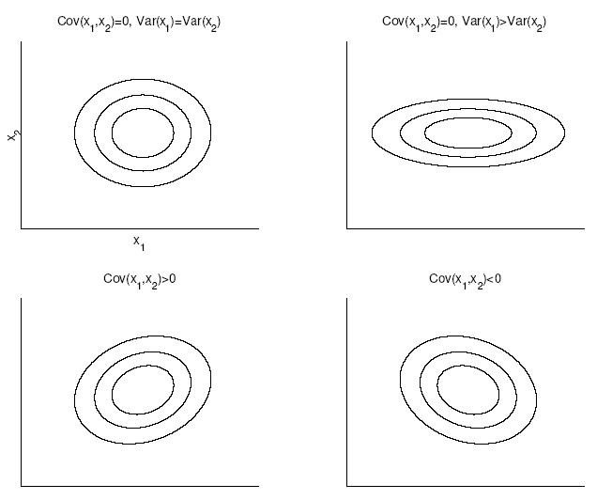
Bivariate Normal Isoprobability [i.e., (x – μ)^{T} ∑^{–1} (x – μ) = c²] contour plots
<number>
when covariance is 0, ellipsoid axes are parallel to coordinate axes
Notes:
When Cov(X1,X2)= 0, the axes of the ellipsoid are parallel to the main axes. When Cov(X1,X2) != 0, the ellipsoid axes are not aligned with the coordinate axes.
<number>

Slide 9
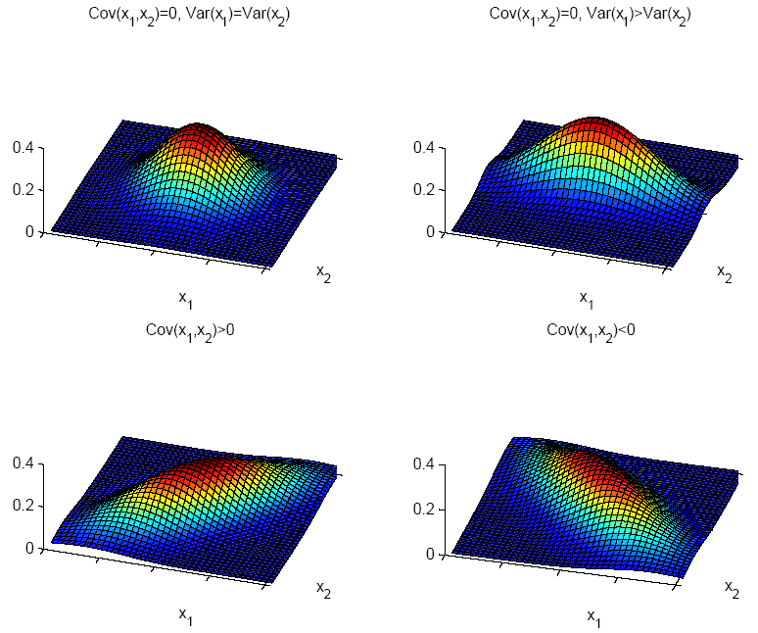
<number>
Notes:
The plots on the previous slide are slices taken from these plots, for a fixed value of the vertical axis.
<number>

Slide 10
Independent Inputs: Naive Bayes
<number>
If x_{i} are independent, offdiagonal values of ∑ are 0, Mahalanobis distance reduces to weighted (by 1/σ_{i}) Euclidean distance:
If variances are also equal, reduces to Euclidean distance
The use of the term “Naïve Bayes” in this chapter is somewhat wrong
Naïve Bayes assumes independence in the probability sense,
not in the linear algebra sense
Notes:
<number>

Slide 11
Parametric Classification
If p (x | C_{i} ) ~ N ( μ_{i} , ∑_{i} )
Discriminant functions
<number>
Notes:
The 1st term in the last line can be disregarded as it is constant.
<number>

Slide 12
Estimation of Parameters from data sample X
<number>

Slide 13
Assuming a different S_{i} for each C_{i}
Quadratic discriminant. Expanding the formula on previous slide:
has the form of a quadratic formula
See figure on next slide
<number>

Slide 14
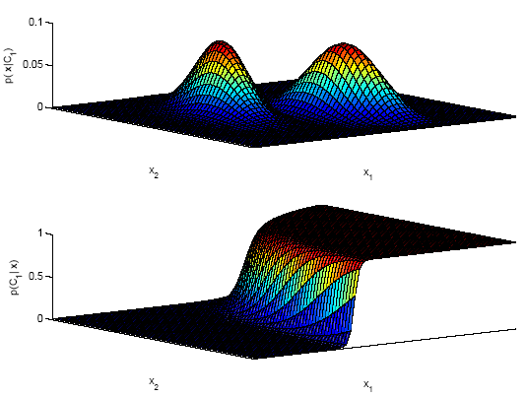
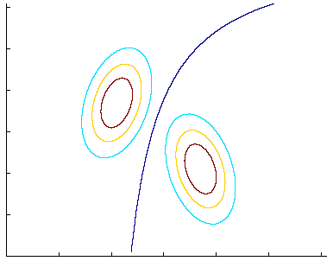
discriminant:
P (C₁|x ) = 0.5
likelihoods
posterior for C₁
<number>

Slide 15
Assuming Common Covariance Matrix S
<number>
Shared common sample covariance S
Discriminant reduces to
which is a linear discriminant

Slide 16
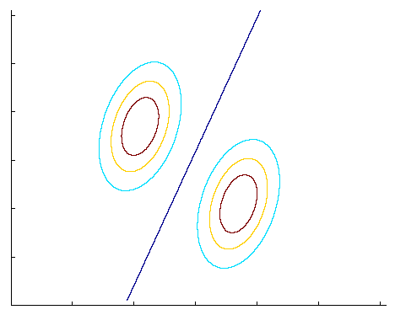
Common Covariance Matrix S
<number>
Arbitrary covariances but shared by classes

Slide 17
Assuming Common Covariance Matrix S is Diagonal
<number>
When x_{j} j = 1,..d, are independent, ∑ is diagonal
p (x|C_{i}) = ∏_{j} p (x_{j} |C_{i}) (Naive Bayes’ assumption)
Classify based on weighted Euclidean distance (in s_{j} units) to the nearest mean

Slide 18
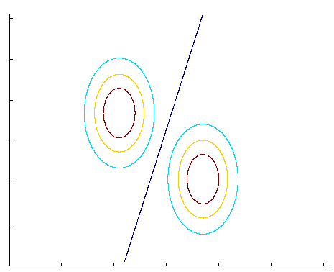
Assuming Common Covariance Matrix S is Diagonal
<number>
variances may be
different
Covariances are 0, so ellipsoid axes are parallel to coordinate axes

Slide 19
Assuming Common Covariance Matrix S is Diagonal and variances are equal
<number>
Nearest mean classifier: Classify based on Euclidean distance to the nearest mean
Each mean can be considered a prototype or template and this is template matching

Slide 20
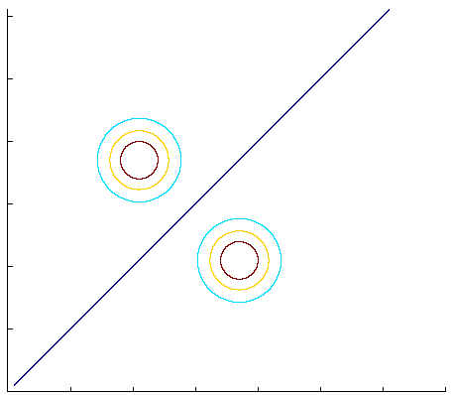
Assuming Common Covariance Matrix S is Diagonal and variances are equal
<number>
Classifier looks for nearest mean
*
?
Covariances are 0, so ellipsoid axes are parallel to coordinate axes.
Variances are the same, so ellipsoids become circles.

Slide 21
Model Selection
<number>
Assumption | Covariance matrix | No of parameters
Shared, Hyperspheric | S_{i}=S=s²I | 1
Shared, Axis-aligned | S_{i}=S, with s_{ij}=0 | d
Shared, Hyperellipsoidal | S_{i}=S | d(d+1)/2
Different, Hyperellipsoidal | S_{i} | K d(d+1)/2
As we increase complexity (less restricted S), bias decreases and variance increases
Assume simple models (allow some bias) to control variance (regularization)

Slide 22
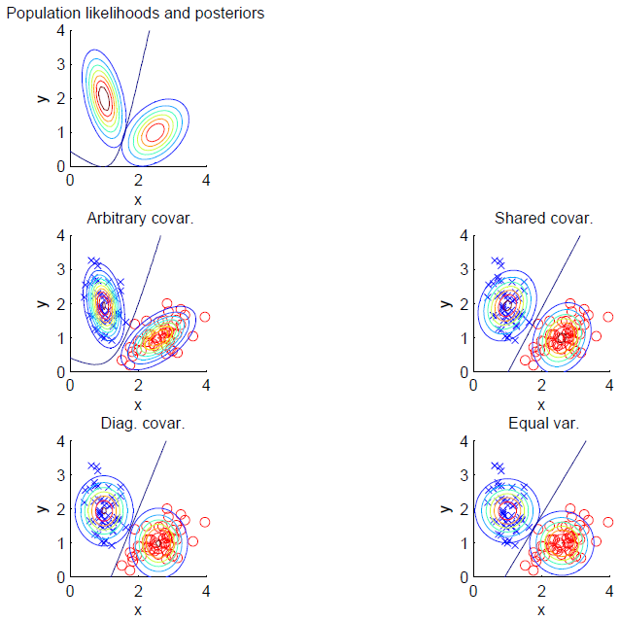
Different cases of covariance matrices fitted to the same data lead to different decision boundaries
<number>
Notes:
Discriminant is linear when covariance matrix is shared; and discriminant is quadratic when covariance matrices are different.
<number>

Slide 23
Discrete Features
<number>
Binary features:
if x_{j} are independent (Naive Bayes’)
the discriminant is linear
Estimated parameters

Slide 24
Discrete Features
<number>
Multinomial (1-of-n_{j}) features: x_{j} in {v₁, v₂,..., v_{nj}}
where z_{jk} = 1 if x_{j} = v_{k} ; or 0 otherwise
if x_{j} are independent

Slide 25
Multivariate Regression
<number>
Multivariate linear model
Multivariate polynomial model:
Define new higher-order variables
z₁=x₁, z₂=x₂, z₃=x₁², z₄=x₂², z₅=x₁x₂
and use the linear model in this new z space
(basis functions, kernel trick: Chapter 13)
Notes:
The author makes the point that the same term “multivariate regression” is used differently by statisticians. They use it in the case of regression when there are multiple output variables. They call regression when there are multiple input variables, “multiple regression” instead.
<number>

