Slide 1
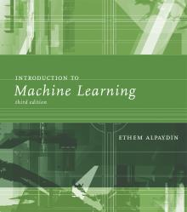
INTRODUCTION TO Machine Learning 3rd Edition
Lecture Slides for
ETHEM ALPAYDIN
© The MIT Press, 2014
alpaydin@boun.edu.tr
http://www.cmpe.boun.edu.tr/~ethem/i2ml3e

Slide 2
CHAPTER 1: Introduction

Slide 3
Big Data
Widespread use of personal computers and wireless communication leads to “big data”
We are both producers and consumers of data
Data is not random, it has structure, e.g., customer behavior
We need “big theory” to extract that structure from data for
(a) Understanding the process
(b) Making predictions for the future

Slide 4
Why “Learn” ?
Machine learning is programming computers to optimize a performance criterion using example data or past experience.
There is no need to “learn” to calculate payroll
Learning is used when:
Human expertise does not exist (navigating on Mars),
Humans are unable to explain their expertise (speech recognition)
Solution changes in time (routing on a computer network)
Solution needs to be adapted to particular cases (user biometrics)

Slide 5
What We Talk About When We Talk About “Learning”
Learning general models from a data of particular examples
Data is cheap and abundant (data warehouses, data marts); knowledge is expensive and scarce.
Example in retail: Customer transactions to consumer behavior:
People who bought “Blink” also bought “Outliers” (www.amazon.com)
Build a model that is a good and useful approximation to the data.

Slide 6
Data Mining
Retail: Market basket analysis, Customer relationship management (CRM)
Finance: Credit scoring, fraud detection
Manufacturing: Control, robotics, troubleshooting
Medicine: Medical diagnosis
Telecommunications: Spam filters, intrusion detection
Bioinformatics: Motifs, alignment
Web mining: Search engines
...

Slide 7
What is Machine Learning?
Optimize a performance criterion using example data or past experience.
Role of Statistics: Inference from a sample
Role of Computer science: Efficient algorithms to
Solve the optimization problem
Representing and evaluating the model for inference

Slide 8
Applications
Association
Supervised Learning
Classification
Regression
Unsupervised Learning
Reinforcement Learning

Slide 9
Learning Associations
Basket analysis:
P (Y | X ) probability that somebody who buys X also buys Y where X and Y are products/services.
Example: P ( chips | beer ) = 0.7

Slide 10
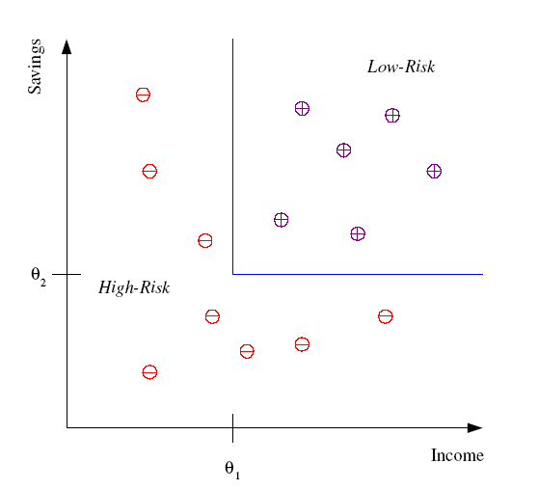
Classification
Example: Credit scoring
Differentiating between low-risk and high-risk customers from their income and savings
Discriminant: IF income > θ₁ AND savings > θ₂
THEN low-risk ELSE high-risk

Slide 11
Classification: Applications
Aka Pattern recognition
Face recognition: Pose, lighting, occlusion (glasses, beard), make-up, hair style
Character recognition: Different handwriting styles.
Speech recognition: Temporal dependency.
Medical diagnosis: From symptoms to illnesses
Biometrics: Recognition/authentication using physical and/or behavioral characteristics: Face, iris, signature, etc
Outlier/novelty detection:

Slide 12








Face Recognition
Training examples of a person
Test images
ORL dataset,
AT&T Laboratories, Cambridge UK

Slide 13
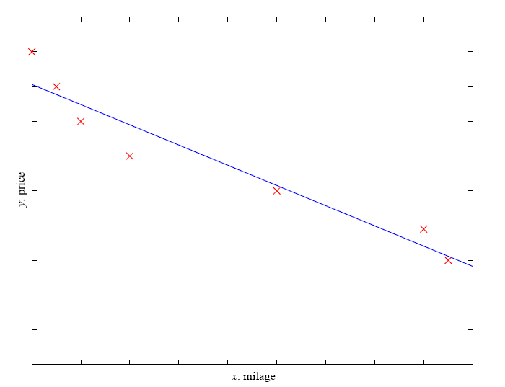
Regression
Example: Price of a used car
x : car attributes
y : price
y = g (x | θ )
g ( ) model,
θ parameters
y = wx+w₀

Slide 14
Regression Applications
Navigating a car: Angle of the steering
Kinematics of a robot arm
(x,y)
α₁= g₁(x,y)
α₂= g₂(x,y)
α₂
α₁
Response surface design

Slide 15
Supervised Learning: Uses
Prediction of future cases: Use the rule to predict the output for future inputs
Knowledge extraction: The rule is easy to understand
Compression: The rule is simpler than the data it explains
Outlier detection: Exceptions that are not covered by the rule, e.g., fraud

Slide 16
Unsupervised Learning
Learning “what normally happens”
No output
Clustering: Grouping similar instances
Example applications
Customer segmentation in CRM
Image compression: Color quantization
Bioinformatics: Learning motifs

Slide 17
Reinforcement Learning
Learning a policy: A sequence of outputs
No supervised output but delayed reward
Credit assignment problem
Game playing
Robot in a maze
Multiple agents, partial observability, ...

Slide 18
Resources: Datasets
UCI Repository: http://www.ics.uci.edu/~mlearn/MLRepository.html
Statlib: http://lib.stat.cmu.edu/

Slide 19
Resources: Journals
Journal of Machine Learning Research www.jmlr.org
Machine Learning
Neural Computation
Neural Networks
IEEE Trans on Neural Networks and Learning Systems
IEEE Trans on Pattern Analysis and Machine Intelligence
Journals on Statistics/Data Mining/Signal Processing/Natural Language Processing/Bioinformatics/...

Slide 20
Resources: Conferences
International Conference on Machine Learning (ICML)
European Conference on Machine Learning (ECML)
Neural Information Processing Systems (NIPS)
Uncertainty in Artificial Intelligence (UAI)
Computational Learning Theory (COLT)
International Conference on Artificial Neural Networks (ICANN)
International Conference on AI & Statistics (AISTATS)
International Conference on Pattern Recognition (ICPR)
...

