Slide 1
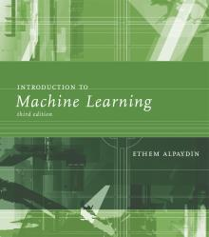
INTRODUCTION TO Machine Learning 3rd Edition
Lecture Slides for
ETHEM ALPAYDIN
© The MIT Press, 2014
alpaydin@boun.edu.tr
http://www.cmpe.boun.edu.tr/~ethem/i2ml3e
Modified by Prof. Carolina Ruiz
for CS539 Machine Learning at WPI

Slide 2
CHAPTER 2: Supervised Learning

Slide 3
Learning a Class from Examples
Class C of a “family car”
Prediction: Is car x a family car?
Knowledge extraction: What do people expect from a family car?
Output:
Positive (+) “yes, it’s a family car” and
negative (–) “no, it’s not a family car” examples
Input representation: information we have about each car
x₁: price, x₂ : engine power

Slide 4
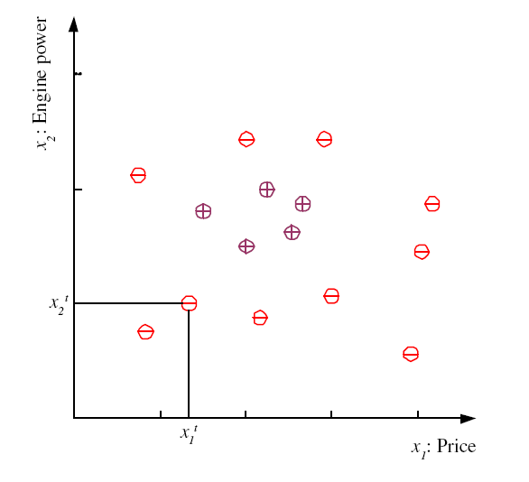
Training set X
training set for the class “family car”
each of the N data point corresponds to an
example car
each car is represented as:
where:
r is the example’s “class”
also called “label”,
“desired class” or “actual class”

Slide 5
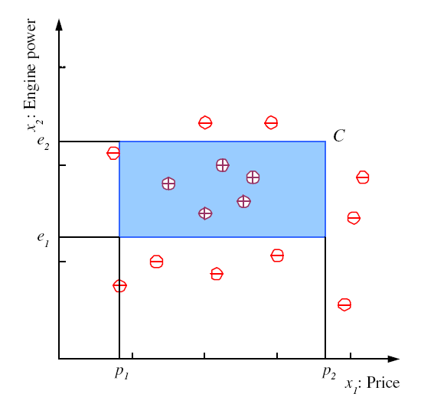
Class C:
Assume that the actual Class (“family car”) is characterized by this blue rectangle, defined in the price and engine power space
But that rectangle is not explicitly given to us!
How to learn a good approximation to this rectangle based just on the positive and negative examples given in data set X?
We create hypotheses!

Slide 6
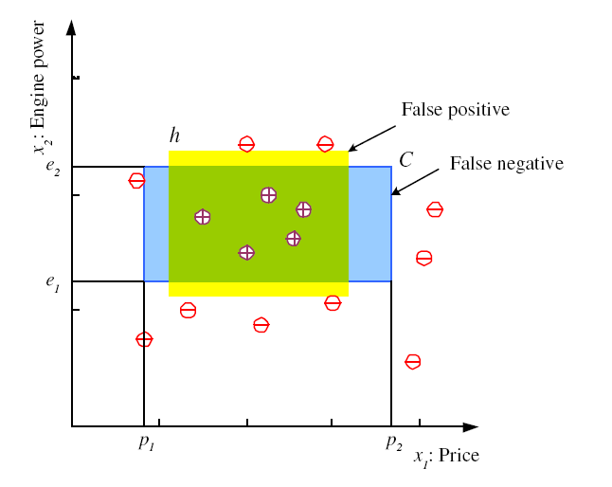
Hypothesis class space H
Let’s consider hypotheses h that are rectangles in the x₁ , x₂ space
Let H be the collection of all these possible rectangles
Take for example h to be the yellow rectangle
Error of h on H
where

Slide 7
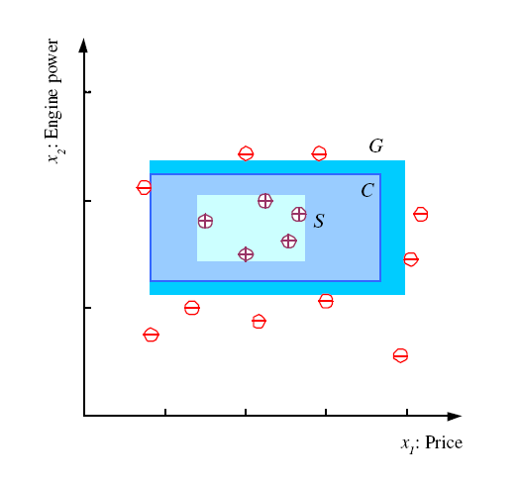
S, G, and the Version Space
most specific hypothesis, S
most general hypothesis, G
h ∈ H, between S and G is
consistent with the training set X and make up the version space
(Mitchell, 1997)

Slide 8
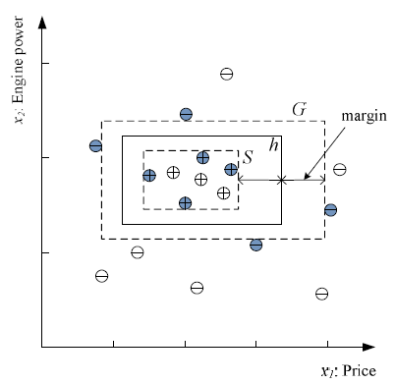
Margin
Choose h with largest margin
Why the largest margin?
because we want to minimize
the generalization error.
What’s “generalization”?
Generalization: How well a model (i.e., hypothesis) performs on new data

Slide 9
Vapnik-Chernonenkis (VC) Dimension
N points can be labeled in 2^{N} ways as +/–
H shatters N if and only if:
there is a set of N points in 2D such that for each of the 2^{N} possible ways of labelling these N points, there exists h ∈ H that is consistent with this labelling (i.e., h correctly separates the + from the – points)
VC(H ) = maximum N that can be shattered byH
measures the “capacity” of H
see example on the next slide

Slide 10
VC Dimension: Example
Let H be the set of 2D axis-aligned rectangles
VC(H ) = ? (value)
Remember:
VC(H ) = maximum N that can be shattered byH
H shatters N if and only if:
there is a set of N points in 2D such that for each of the 2^{N} possible ways of labelling these N points, there exists h ∈ H that is consistent with this labelling (i.e., correctly separates the + from the – points)
(cont.)

Slide 11
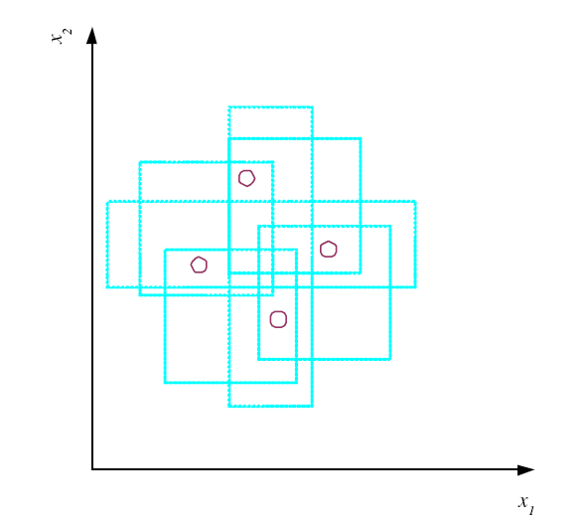
VC Dimension: Example (cont.)
Let H be the set of 2D axis-aligned rectangles
VC(H ) = 4
The family of axis-aligned rectangles shatters 4 points only !

Slide 12
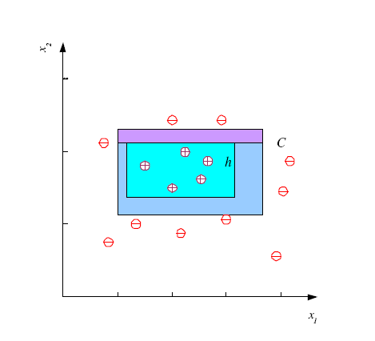
Probably Approximately Correct (PAC) Learning
If we are to use the tightest rectangle h as our chosen hypothesis, how many training examples do we need so that we can guarantee that our hypothesis is approximately correct? In other words:
Given δ (1-δ is the desired minimum confidence) and ε (desired maximum error): How many training examples, N, should we have such that with probability at least 1‒δ, h has error at most ε ?
that is, Pr(E(h|X) ≤ ε ) ≥ 1 – δ
(Blumer et al., 1989)
E(h|X) would come from a positive example falling
in the area between C and h
We need the probability of a positive example falling
in this area to be at most ε
Assume that data instances are uniformly distributed
in space and are independent from each other

Slide 13
Probably Approximately Correct (PAC) Learning (cont.)
Given δ (1-δ is the desired minimum confidence) and ε (desired maximum error): How many training examples, N, should we have such that with probability at least 1‒δ, the tightest rectangle h has error at most ε ? Pr(E(h|X) ≤ ε ) ≥ 1 - δ
E(h|X) would come from a positive example falling in the area between C and h
We need the Probab. of a positive example falling in this area to be at most ε
Pr of an instance falling in a strip should at most ε/4
Pr that the data instance misses a strip is1‒ ε/4
Pr that N instances miss a strip (1 ‒ ε/4)^{N}
Pr that N instances miss 4 strips 4(1 ‒ ε/4)^{N}
Hence we need: 4(1 ‒ ε/4)^{N} ≤ δ
(cont.)

Slide 14
Probably Approximately Correct (PAC) Learning (cont.)
Given δ (1-δ is the desired minimum confidence) and ε (desired maximum error): How many training examples, N, should we have such that with probability at least 1‒δ, the tightest rectangle h has error at most ε ? Pr(E(h|X) ≤ ε ) ≥ 1 - δ
…. we need: 4(1 ‒ ε/4)^{N} ≤ δ
Note that b = e ^{ln(b)} = exp(ln(b)) and that (1 ‒ x) ≤ e^{‒ x} Take b = (1 ‒ ε/4)^{N}
4(1 ‒ ε/4)^{N} ≤ δ
4 exp(ln[(1 ‒ ε/4)^{N} ]) ≤ δ
4 exp(N ln(1 ‒ ε/4)) ≤ δ, now using (1 ‒ x) ≤ exp(-x) :
4 exp(N ln(1 ‒ ε/4)) ≤ 4 exp(N ln(exp(-ε/4)))
Let’s make 4 exp(N ln(exp(-ε/4))) = 4 exp(N (-ε/4)) ≤ δ
4/ δ ≤ exp(εN/4)
ln(4/ δ) ≤ ln(exp(εN/4)) = εN/4
and so N ≥ (4/ε)ln(4/δ)

Slide 15
Probably Approximately Correct (PAC) Learning (cont.)
Given δ (1-δ is the desired minimum confidence) and ε (desired maximum error): How many training examples N should we have, such that with probability at least 1‒δ, the tightest rectangle h has error at most ε ? Pr(E(h|X) ≤ ε ) ≥ 1 - δ
Answer: N ≥ (4/ε)ln(4/δ)
Example: How many training examples, N,
do we need so that Pr(E(h|X) ≤ 0.1 ) ≥ 95%?
Here ε = 0.1 and 1 – δ = 0.95 and so δ = 0.05
N ≥ (4/ε)ln(4/δ) = (4/0.1)ln(4/0.05)
N ≥ 40 ln(80) = 175.28
Hence our training set X should contain at least
N = 176 data instances.

Slide 16
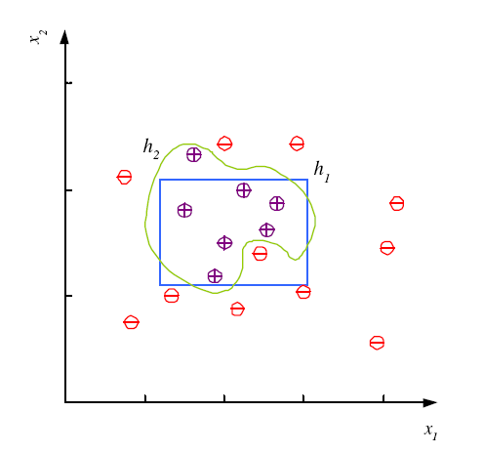
Noise and Model Complexity
Noise:
Unwanted anomaly in the data
Potential Sources of Noise
Imprecision in recording input attributes
Errors in labeling the data points (“teacher noise”)
“Hidden” or “latent” attributes that affect the labels of the instances, but which are not considered in the data

Slide 17
Noise and Model Complexity (cont.)
Use simplest model because
Simpler to use
(lower computational
complexity)
Easier to train (lower
space complexity)
Easier to explain
(more interpretable)
Generalizes better (lower
variance - Occam’s razor)

Slide 18
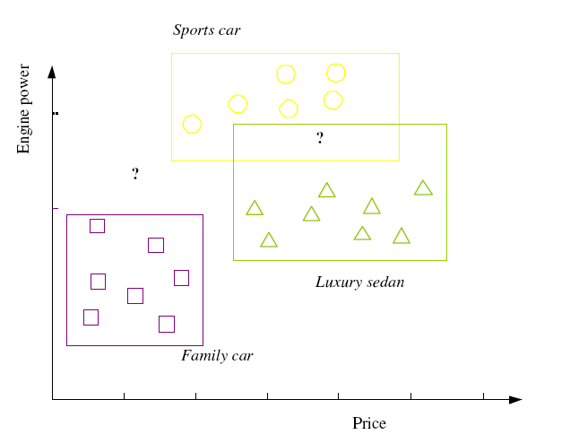

Multiple Classes, C_{i} i=1,...,K
each r^{t} is now a vector
Train hypotheses
h_{i}(x), i =1,...,K:
one hypothesis for each class
view a K-class classification problem
as K two-class classification problems

Slide 19
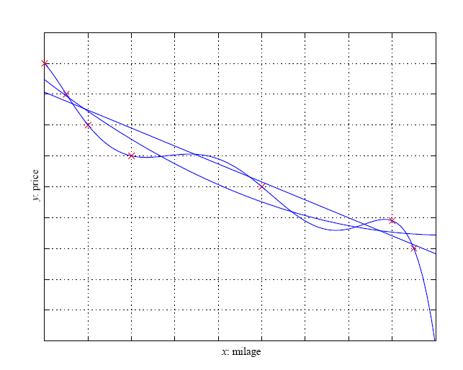
Regression
linear, second-order, and sixth-order polynomials
f: underlying function that
we want to learn from data
Error of g in linear regression:
Occam’s razor also applies in regression

Slide 20
Model Selection & Generalization
Learning is an ill-posed problem; data is not sufficient to find a unique solution
The need for inductive bias, assumptions about H
(e.g., our inductive bias in these slides’ classification examples was to select rectangles as hypotheses - they could have been circles, squares or something else)
Generalization: How well a model performs on new data
Overfitting: H more complex than C or f
(e.g., fitting a 6th-order polynomial to noisy data sampled from a 2nd – order polynomial)
Underfitting: H less complex than C or f
(e.g., fitting a 2nd-order polynomial to noisy data sampled from a 6th – order polynomial)

Slide 21
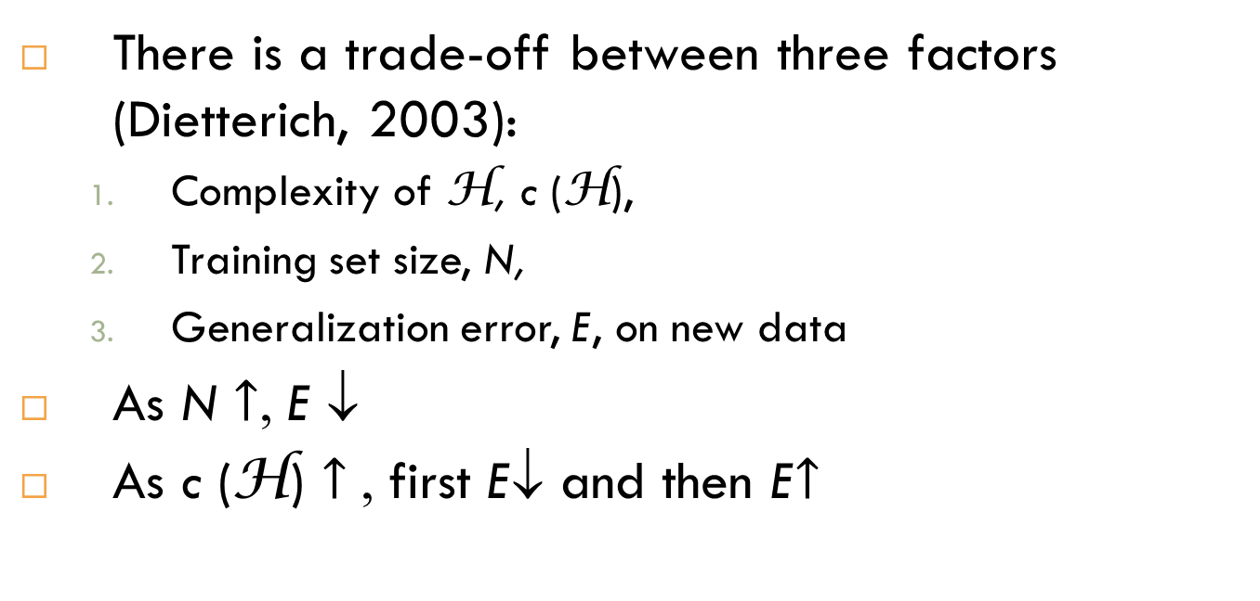
Triple Trade-Off
There is a trade-off between three factors (Dietterich, 2003):
Complexity of H, c (H),
Training set size, N,
Generalization error, E, on new data
As N $↑$, E ↓
As c (H) $↑$, first E↓ and then E$↑$

Slide 22
Cross-Validation
To estimate generalization error, we need data unseen during training. We split the data as
Training set (e.g., 50%)
data instances used to construct the model
Validation set (e.g., 25%)
data instances used to test preliminary versions of the model and/or to refine the model
Test (publication) set (e.g., 25%)
data instances used to test the final model after it has been fully constructed
Resampling when there is few data

Slide 23
Dimensions of a Supervised Learner
Model:
Loss function:
to compute the difference between the actual and predicted values
Optimization procedure:

