Slide 1
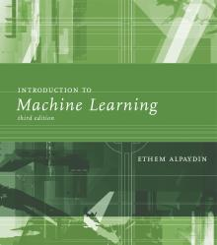
INTRODUCTION TO Machine Learning 3rd Edition
Lecture Slides for
ETHEM ALPAYDIN
© The MIT Press, 2014
alpaydin@boun.edu.tr
http://www.cmpe.boun.edu.tr/~ethem/i2ml3e
Modified by Prof. Carolina Ruiz
for CS539 Machine Learning at WPI

Slide 2
CHAPTER 3: Bayesian Decision Theory

Slide 3
Probability and Inference
Result of tossing a coin is ∈ {Heads,Tails}
Random variable X ∈{1,0}, where 1 = Heads, 0 = tails
Bernoulli: P {X= 1} = p_{o}
P {X= 0} = (1 ‒ p_{o})
Sample: X = {x^{t} }^{N}_{t =1}
Estimation: p_{o} = # {Heads}/#{Tosses} = ∑_{t} x^{t} / N
Prediction of next toss:
Heads if p_{o} > ½, Tails otherwise

Slide 4
Classification
Example: Credit scoring
Inputs are income and savings
Output is low-risk vs high-risk
Input: x = [x₁,x₂]^{T} Output: C belongs to {0,1}
Prediction:

Slide 5
Bayes’ Rule
prior
likelihood
posterior
evidence
For the case of 2 classes, C = 0 and C = 1:

Slide 6
Bayes’ Rule: K>2 Classes
To classify x:

Slide 7
Losses and Risks
Actions: α_{i} : choose class C_{i}
Loss of α_{i} when the actual class is C_{k} : λ_{ik}
Expected risk (Duda and Hart, 1973)

Slide 8
Losses and Risks: 0/1 Loss
For minimum risk, choose the most probable class

Slide 9
Losses and Risks: Misclassification Cost What class C_{i} to pick or to Reject all classes?
Assume:
there are K classes
there is a loss function: cost of making a misclassification
λ_{ik} : cost of misclassifying an instance as class C_{i} when it is actually of class C_{k}
there is a “Reject” option (i.e., not to classify an instance in any class) Let the cost of “Reject” be λ.
A possible loss function is:
For minimum risk, choose most probable class, unless is better to reject

Slide 10
Example: Exercise 4 from Chapter 4
Assume 2 classes: C₁ and C₂
Case 1: Assume the two misclassifications are equally costly, and there is no reject option:
λ₁₁= λ₂₂ = 0, λ₁₂ = λ₂₁ = 1
Case 2: Assume the two misclassifications are not equally costly, and there is no reject option:
λ₁₁= λ₂₂ = 0, λ₁₂ = 10, λ₂₁ = 5
Case 3: Like Case 2 but with a reject option:
λ₁₁= λ₂₂ = 0, λ₁₂ = 10, λ₂₁ = 5, λ = 1
See optimal decision boundaries on the next slide

Slide 11
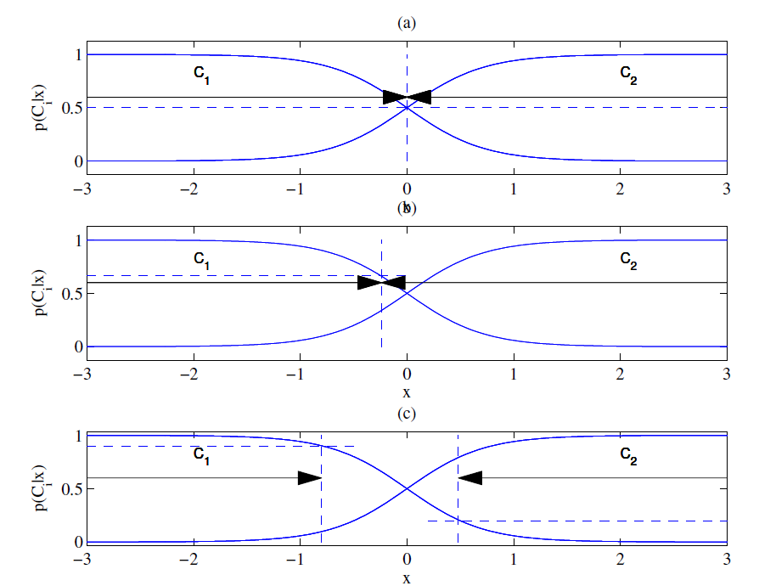
Different Losses and Reject See calculations for these plots on solutions to Exercise 4
P(C₁|x)
P(C₂|x)
Equal losses
Unequal losses
classify x as C₁
classify x as C₂
the boundary shifts toward the class that incurs the most cost when misclassified
classify x as C₁
classify x as C₂
With reject
classify x as C₁
reject
classify x as C₂
Notes:
See the solutions to Exercise 4 on pages 61-62 for the calculations needed for these plots.

Slide 12
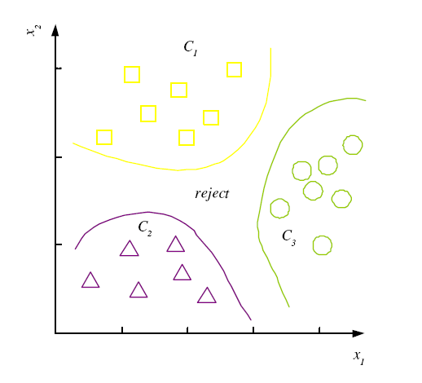
Discriminant Functions
Classification can be seen as implementing a set of discriminant functions g_{i}(x):
K decision regions R₁,...,R_{K}

Slide 13
K=2 Classes see Chapter 3 Exercises 2 and 3
Some alternative ways of combining discriminant functions g₁(x)= P(C₁|x) and g₂(x)= P(C₂|x) into just one g(x):
define g(x) = g₁(x) – g₂(x)
In terms of log odds: log[P(C₁|x)/P(C₂|x)]
define
In terms of likelihood ratio: P(x|C₁)/P(x|C₂)
define
if the priors are equal, P(C₁) = P(C₂), then the discriminant = likelihood ratio

Slide 14
Utility Theory
Prob of state k given exidence x: P (S_{k}|x)
Utility of α_{i} when state is k: U_{ik}
Expected utility:

Slide 15
Association Rules
Association rule: X → Y
People who buy/click/visit/enjoy X are also likely to buy/click/visit/enjoy Y.
A rule implies association, not necessarily causation.

Slide 16
Association measures
Support (X → Y):
Confidence (X → Y):
Lift (X → Y):

Slide 17
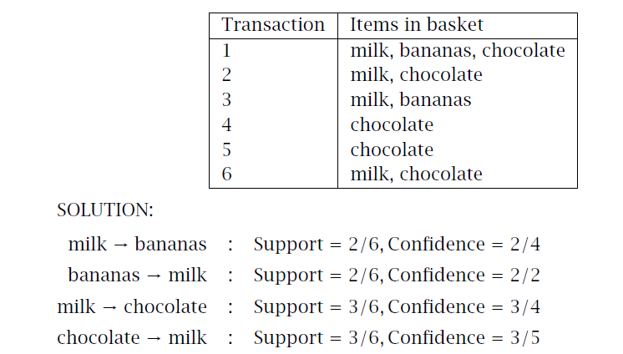
Example

Slide 18
Apriori algorithm (Agrawal et al., 1996)
For (X,Y,Z), a 3-item set, to be frequent (have enough support), (X,Y), (X,Z), and (Y,Z) should be frequent.
If (X,Y) is not frequent, none of its supersets can be frequent.
Once we find the frequent k-item sets, we convert them to rules: X, Y → Z, ...
and X → Y, Z, ...

