Slide 1
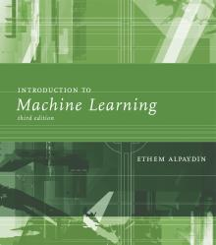
INTRODUCTION TO Machine Learning 3rd Edition
Lecture Slides for
ETHEM ALPAYDIN
© The MIT Press, 2014
alpaydin@boun.edu.tr
http://www.cmpe.boun.edu.tr/~ethem/i2ml3e
Modified by Prof. Carolina Ruiz
for CS539 Machine Learning at WPI

Slide 2
CHAPTER 4: Parametric Methods

Slide 3
Parametric Estimation
X = { x^{t} }_{t} where x^{t} ~ p (x)
Parametric estimation:
Assume a form for p (x |θ ) and estimate θ , its sufficient statistics, using X
e.g., Normal distribution N( μ, σ²) where θ = { μ, σ²}
Remember that a probability density function is defined as:
p (x₀) ≡ lim _{ε→0} P(x₀ ≤ x < x₀ + ε)
“distributed as” probability density function

Slide 4
Maximum Likelihood Estimation
Likelihood of θ given the sample X
l (θ|X) = p (X |θ) = ∏_{t} p (x^{t}|θ)
Log likelihood
L(θ|X) = log l (θ|X) = ∑_{t} log p (x^{t}|θ)
Maximum likelihood estimator (MLE)
θ* = argmax_{θ} L(θ|X)

Slide 5
Examples: Bernoulli/Multinomial
Bernoulli: Two states, failure/success, x in {0,1} (e.g, coin)
P (x) = p_{o}^{x} (1 – p_{o} ) ^{(1 – x)} p_{o} is the parameter for probability of success
L (p_{o}|X) = log ∏_{t} p_{o}^{xt} (1 – p_{o} ) ^{(1 – xt)}
MLE: p_{o} = ∑_{t} x^{t} / N
Multinomial: K>2 states, x_{i} in {0,1} (e.g., die with 6 faces)
P (x₁,x₂,...,x_{K}) = ∏_{i} p_{i}^{xi} p_{i} is the parameter for probability of state i success
L(p₁,p₂,...,p_{K}|X) = log ∏_{t} ∏_{i} p_{i}^{xit}
MLE: p_{i} = ∑_{t} x_{i}^{t} / N

Slide 6
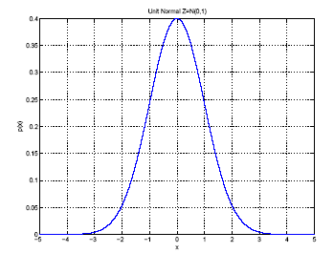
Gaussian (Normal) Distribution
p(x) = N ( μ, σ²)
MLE for μ and σ²:
μ
σ

Slide 7
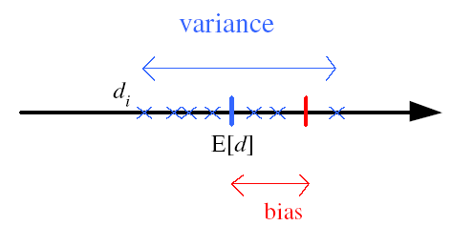
Bias and Variance
Unknown parameter θ
Estimator d_{i} = d (X_{i}) on sample X_{i}
Bias: b_{θ}(d) = E [d] – θ
Variance: E [(d–E [d])²]
Mean square error:
r (d,θ) = E [(d–θ)²]
= (E [d] – θ)² + E [(d–E [d])²]
= Bias² + Variance
θ
the smaller the bias and the variance, the better

Slide 8
Bayes’ Estimator
Treat θ as a random var with prior p (θ)
Bayes’ rule: p (θ|X) = p(X|θ) p(θ) / p(X)
Full: p(x|X) = ∫ p(x|θ) p(θ|X) dθ
Maximum a Posteriori (MAP): θ_{MAP} = argmax_{θ} p(θ|X)
Maximum Likelihood (ML): θ_{ML} = argmax_{θ} p(X|θ)
Bayes’: θ_{Bayes’} = E[θ|X] = ∫ θ p(θ|X) dθ
this prior may come from domain expertise,
without looking at X
posterior density of θ
likelihood density

Slide 9
Comparing ML, MAP, and Bayes’
Let Θ be the set of all possible solutions θ’s
Maximum a Posteriori (MAP): Selects the θ that satisfies θ_{MAP} = argmax_{θ} p(θ|X)
Maximum Likelihood (ML): Selects the θ that satisfies θ_{ML} = argmax_{θ} p(X|θ)
Bayes’: Constructs the “weighted average” over all θ’s in Θ: θ_{Bayes’} = E[θ|X] = ∫ θ p(θ|X) dθ
Note that if the θ’s in Θ are uniformly distributed then θ_{MAP}=θ_{ML}
since θ_{MAP} = argmax_{θ} p(θ|X)
= argmax_{θ} p(X|θ) p(θ)/p(X) = argmax_{θ} p(X|θ) = θ_{ML}

Slide 10
Bayes’ Estimator: Example
If x^{t} ~ N (θ, σ_{o}²) and θ ~ N ( μ, σ²)
where σ_{o}², μ, and σ² are known
then:
θ_{ML} = m sample mean
θ_{MAP} = θ_{Bayes’} =
Note: if the θ’s in Θ are normally distributed and p(X|θ) is normal, then p(θ|X) is normal and θ_{MAP}=θ_{Bayes’}

Slide 11
Parametric Classification
Remember from Chapter 3, where g_{i} is a discriminant function
If p(x|C_{i}) are Gaussian, then: (here “log” is natural log)

Slide 12
Given the sample
ML estimates are
Discriminant

Slide 13
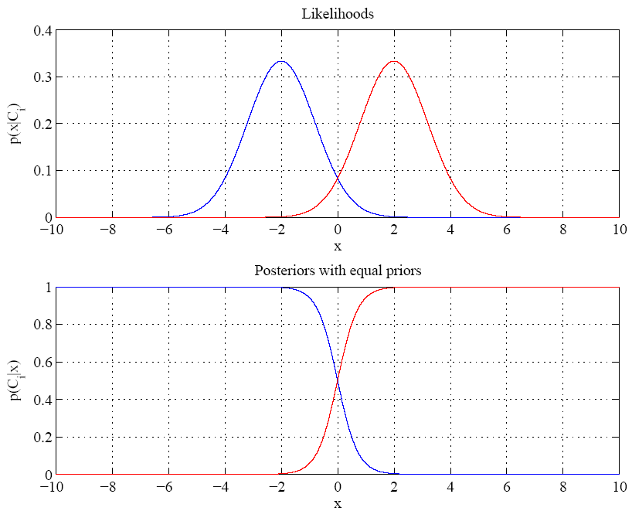
assume 2 classes with equal priors P(Ci)
Equal variances
In this case, g_{i} = - (x – m_{i})², thus we assign x to class with nearest mean
Single boundary g₁ = g₂ at
halfway between means
same as the point where the posteriors intersect

Slide 14
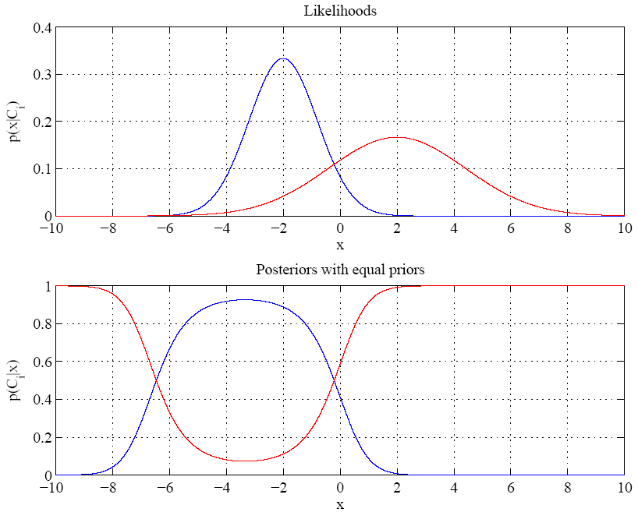
Variances are different
Two boundaries
see Exercise 4 for how to calculate these two
boundaries

Slide 15
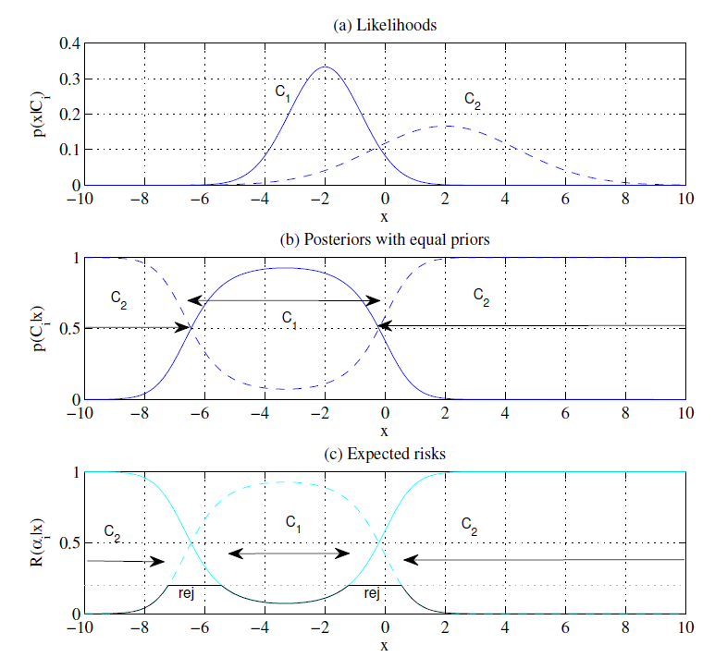
Reject with λ = 0.2

Slide 16
Parametric Classification – Notes
Note that the equations for parametric classification derived in the last few slides assume the data follows a Gaussian distribution
Hence, you need to determine whether or not your univariate data X follows a Gaussian distribution
using a statistical test for normality (e.g., Shapiro–Wilk test, Kolmogorov–Smirnov test, Lilliefors test, …)
before you consider applying these equations

Slide 17
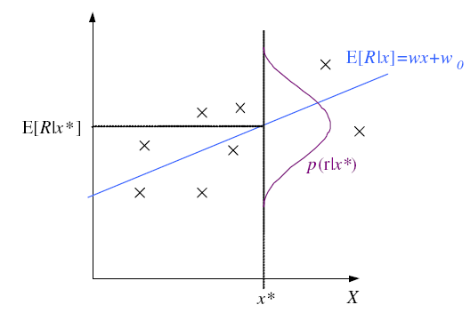
Regression
second term can be ignored

Slide 18
Regression: From LogL to Error
Maximizing the log likelihood above is the same as minimizing the Error.
θ that minimizes Error is called “least squares estimate”
Trick: When maximizing a likelihood l that contains exponents, instead minimize error E = - log l

Slide 19
Linear Regression
and so

Slide 20
Polynomial Regression
where
then

Slide 21
Maximum Likelihood and Least Squares
Taken from Tom Mitchell’s Machine Learning textbook:
“… under certain assumptions ^{(*)} any learning algorithm that minimizes the squared error between the output hypothesis predictions and the training data will output a maximum likelihood hypothesis.”
^{(*):} Assumption:
“the observed training target values are generated by adding random noise to the true target value, where the random noise is drawn independently for each example from a Normal distribution with zero mean.”

Slide 22
Other Error Measures
Square Error:
Relative Square Error (E_{RSE}):
Absolute Error:
E (θ |X) = _{∑t} |r^{t} – g(x^{t}| θ)|
ε-sensitive Error:
E (θ |X) = _{∑ t} 1(|r^{t} – g(x^{t}| θ)|>ε) (|r^{t} – g(x^{t}|θ)| – ε)
R^{2 :} Coefficient of Determination: R² = 1 – E_{RSE} (see next slide)

Slide 23
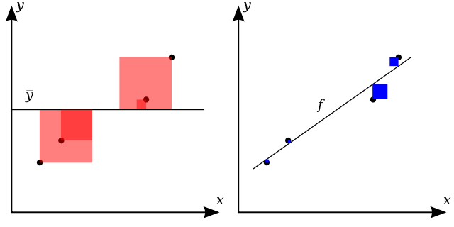
Coefficient of Determination: R²
Figure adapted from Wikipedia (Sept. 2015)
"Coefficient of Determination" by Orzetto - Own work. Licensed under CC BY-SA 3.0 via Commons –
https://commons.wikimedia.org/wiki/File:Coefficient_of_Determination.svg#/media/File:Coefficient_of_Determination.svg
The closer R² is to 1 the better
as this means that the g(.) estimates (on the right graph) fit the data well in
comparison to the simple estimate given by the average value (on the left graph)

Slide 24
Bias and Variance
Given X = {x^{t},r^{t}} drawn from unknown pdf p(x,r) Expected Square Error of the g(.) estimate at x:
it may be that for a sample X, g(.) is a very good fit, and for another sample it is not
Given samples X’s, all of size N drawn from the same joint density p(x,r). Expected value, averaged over X’s:
noise
variance of noise added
does not depend on g(.) or X
squared error
g(x) deviation from E[r|x]
depend on g(.) and X
bias
how much g(.) is wrong
disregarding effect of varying samples
variance
how much g(.) fluctuates
as samples varies

Slide 25
Estimating Bias and Variance
M samples X_{i}={x^{t}_{i} , r^{t}_{i}}, i=1,...,M
are used to fit g_{i} (x), i =1,...,M

Slide 26
Bias/Variance Dilemma
Examples:
g_{i}(x)=2 has no variance and high bias
g_{i}(x)= _{∑t} r^{t}_{i}/N has lower bias but higher variance
As we increase complexity of g(.),
bias decreases (a better fit to data) and
variance increases (fit varies more with data)
Bias/Variance dilemma: (Geman et al., 1992)

Slide 27
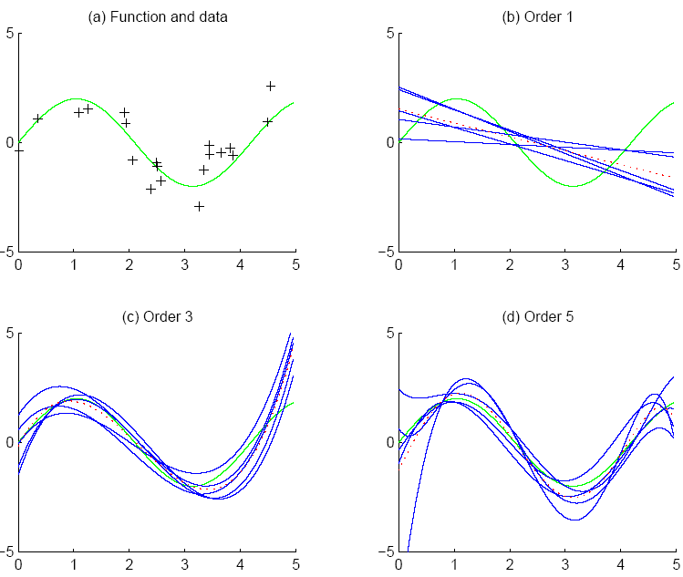
added noise ~ N(0,1)
A linear regression for each of 5 samples
f
f
bias
g_{i}
g
Polynomial regression of order 3 (left) and order 5 (right) for each of 5 samples
variance
dotted red line in each plot is the average of the five fits, $\overline{g}(x)$
Notes:
See Figure 4.5’s caption, p. 83

Slide 28
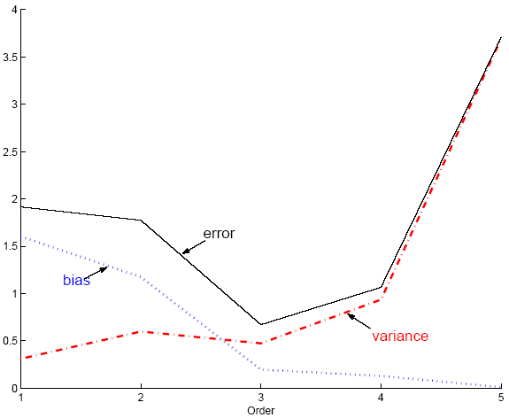
Polynomial Regression
Best fit “min error”
Same settings as plots on the previous slide, but using 100 models instead of 5
Notes:
This is Fig. 4.6 p. 84

Slide 29
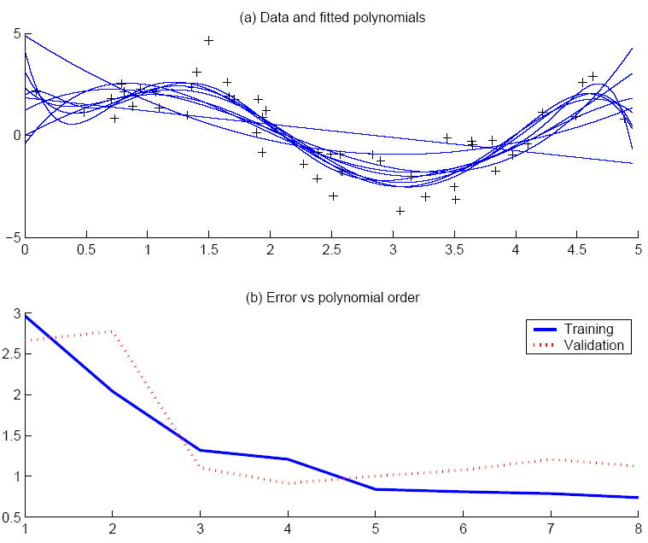
Fitted polynomials of orders 1, …, 8 on training set
Best fit, “elbow”
Settings as plots on previous slides, but using training and validation sets (50 instances each)
Notes:
This is Fig. 4.7 p. 85

Slide 30
Model Selection (1 of 2 slides) Methods to fine-tune model complexity
Cross-validation: Measures generalization accuracy by testing on data unused during training
Regularization: Penalizes complex models
E’=error on data + λ model complexity (where λ is a penalty weight)
the lower the better
Other measures of “goodness of fit” with complexity penalty:
Akaike’s information criterion (AIC)
AIC ≡ log p(X|θ_{ML},M) – k(M)
Bayesian information criterion (BIC)
BIC ≡ log p(X|θ_{ML},M) – k(M) log(N)/2
where: M is a model
log p(X|θ_{ML},M): is the log likelihood of M where M’s parameters θ_{ML} have been
estimated using maximum likelihood
k(M) = number of adjustable parameters in θ_{ML} of the model M
N= size of sample X
For both AIC and BIC, the higher the better
Notes:
λ is a penalty weight:
If λ is too high, then models allowed may be too simple, and that increases the bias.
“Optimal” value for λ can be found using cross-validation.
AIC and BIC are defined in Chapter 16, equations (16.36) and (16.35) on p. 470

Slide 31
Model Selection (2 of 2 slides) Methods to fine-tune model complexity
Minimum description length (MDL): Kolmogorov complexity, shortest description of data
Given a dataset X,
MDL (M) = Description length of model M +
Description length of data in X not correctly described by M
the lower the better
Structural risk minimization (SRM)
Uses a set of models and their complexities (measured usually using their number of free parameters or their VC-dimension)
Selects the simplest model in terms of order and best in terms of empirical error on the data

Slide 32
Bayesian Model Selection
Used when we have Prior on models, p(model)
Regularization, when prior favors simpler models
Bayes, MAP of the posterior, p(model|data)
Average over a number of models with high posterior (voting, ensembles: Chapter 17)

Slide 33
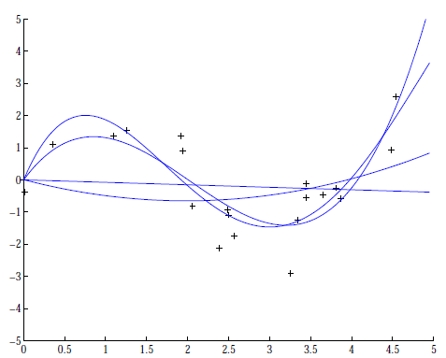
Regression example
Coefficients increase in magnitude as order increases:
1: [-0.0769, 0.0016]
2: [0.1682, -0.6657, 0.0080]
3: [0.4238, -2.5778, 3.4675, -0.0002
4: [-0.1093, 1.4356,
-5.5007, 6.0454, -0.0019]
Regularization (L2):

