Slide 1
CHAPTER 6: Dimensionality Reduction

Slide 2
Why Reduce Dimensionality?
<number>
Reduces time complexity: Less computation
Reduces space complexity: Fewer parameters
Saves the cost of observing the feature
Simpler models are more robust on small datasets
More interpretable; simpler explanation
Data visualization (structure, groups, outliers, etc) if plotted in 2 or 3 dimensions

Slide 3
Feature Selection vs Extraction
<number>
Feature selection: Choosing k<d important features, ignoring the remaining d – k
Subset selection algorithms
Feature extraction: Project the
original x_{i} , i =1,...,d dimensions to
new k<d dimensions, z_{j} , j =1,...,k

Slide 4
Subset Selection
<number>
There are 2^{d} subsets of d features
Forward search: Add the best feature at each step
Set of features F initially Ø.
At each iteration, find the best new feature
j = argmin_{i} E ( F ∪ x_{i} ) where E(.) is the error on the validation set
Add x_{j} to F if E ( F ∪ x_{j} ) < E ( F )
Hill-climbing O(d²) algorithm
Backward search: Start with all features and remove one at a time, if possible.
Floating search (Add k, remove l)

Slide 5
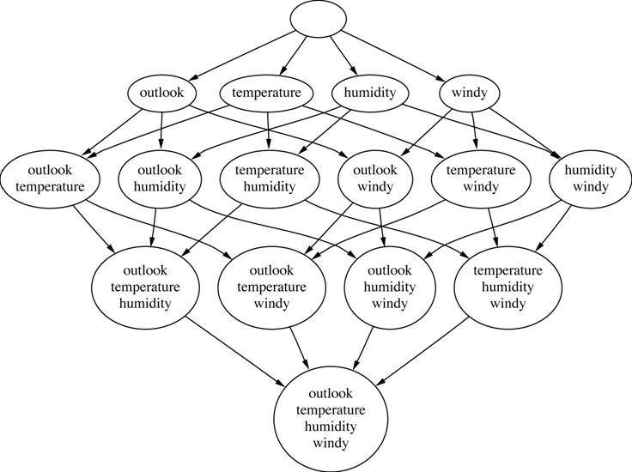
Example: weather dataset
<number>
forward
Figure taken from Witten's and Frank's “Data Mining Practical Machine Learning Tools and Techniques” textbook slides - Chapter 7.
backward

Slide 6
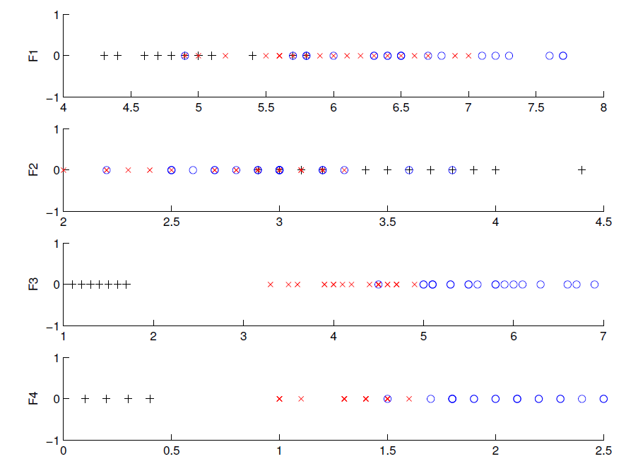
Another Example Iris data: Single feature Training data
Chosen
<number>

Slide 7
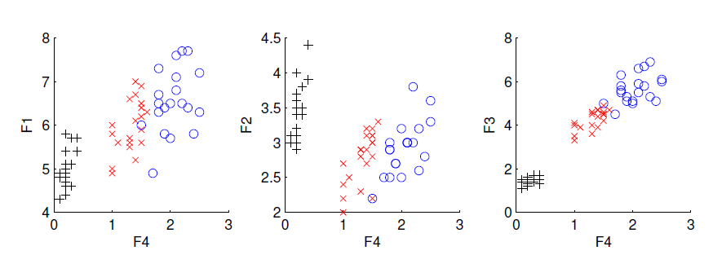
Iris data: Add one more feature to F4
Chosen
<number>

Slide 8
Principal Components Analysis
<number>
Find a low-dimensional space such that when x is projected there, information loss is minimized.
The projection of x on the direction of w is: z = w^{T}x
Find w such that Var(z) is maximized
Var(z) = Var(w^{T}x) = E[(w^{T}x – w^{T}μ)²]
= E[(w^{T}x – w^{T}μ)(w^{T}x – w^{T}μ)]
= E[w^{T}(x – μ)(x – μ)^{T}w]
= w^{T} E[(x – μ)(x –μ)^{T}]w = w^{T} ∑ w
where Var(x)= E[(x – μ)(x –μ)^{T}] = ∑

Slide 9
Maximize Var(z) subject to ||w||=1 (i.e, w₁^{T}w₁ = 1)
using Lagrange formulation:
taking derivative w.r.t. w₁ and making it equal to 0:
∑w₁ = αw₁ that is, w₁ is an eigenvector of ∑ and α its eigenvalue
Choose the one with the largest eigenvalue for Var(z) to be max
Second principal component: Max Var(z₂), s.t., ||w₂||=1 and orthogonal to w₁
∑ w₂ = α w₂ that is, w₂ is another eigenvector of ∑
and so on.
<number>
Notes:
Remember that the norm of a vector: ||w|| = ||<w1,w2,…,wn>|| = sqrt(w1^2 + w2^2+ ….+wn^2)
Remember that: The eigenvectors of a symmetric matrix A corresponding to different eigenvalues are orthogonal to each other.
<number>

Slide 10
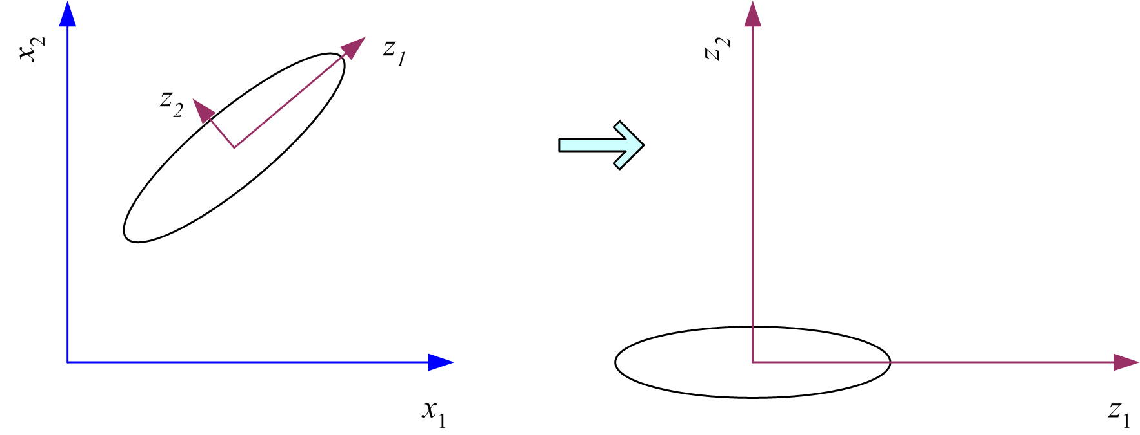
What PCA does
<number>
z = W^{T}(x – m)
where the columns of W are the eigenvectors of ∑ and m is sample mean
Centers the data at the origin and rotates the axes

Slide 11
How to choose k ?
<number>
Proportion of Variance (PoV) explained
when λ_{i} are sorted in descending order
Typically, stop at PoV>0.9
Scree graph plots of PoV vs k, stop at “elbow”

Slide 12
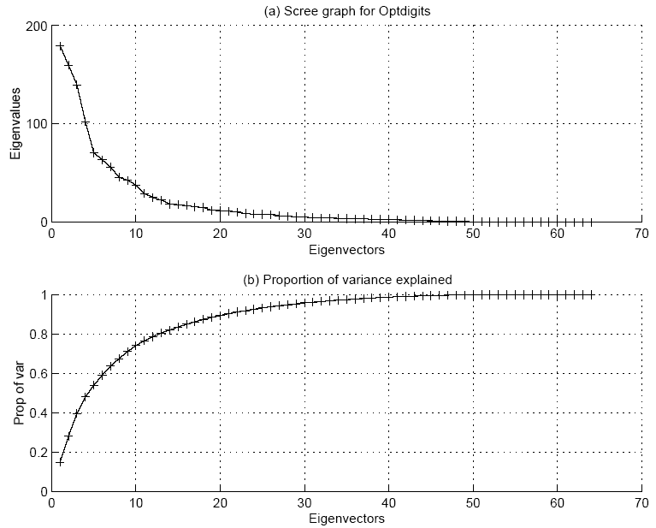
<number>

Slide 13
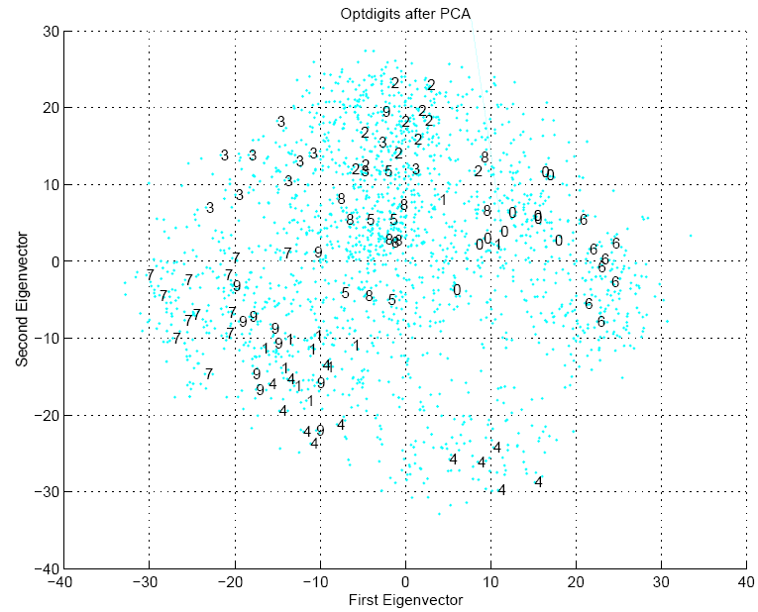
<number>

Slide 14
Feature Embedding
<number>
When X is the Nxd data matrix,
X^{T}X is the dxd matrix (covariance of features, if mean-centered)
XX^{T} is the NxN matrix (pairwise similarities of instances)
PCA uses the eigenvectors of X^{T}X which are d-dim and can be used for projection
Feature embedding uses the eigenvectors of XX^{T} which are N-dim and which give directly the coordinates after projection
Sometimes, we can define pairwise similarities (or distances) between instances, then we can use feature embedding without needing to represent instances as vectors.

Slide 15
Factor Analysis
<number>
Find a small number of factors z, which when combined generate x :
x_{i} – µ_{i} = v_{i1}z₁ + v_{i2}z₂ + ... + v_{ik}z_{k} + ε_{i}
where z_{j}, j =1,...,k are the latent factors with
E[ z_{j} ]=0, Var(z_{j})=1, Cov(z_{i ,}, z_{j})=0, i ≠ j ,
ε_{i} are the noise sources
E[ ε_{i} ]= ψ_{i}, Cov(ε_{i} , ε_{j}) =0, i ≠ j, Cov(ε_{i} , z_{j}) =0 ,
and v_{ij} are the factor loadings

Slide 16
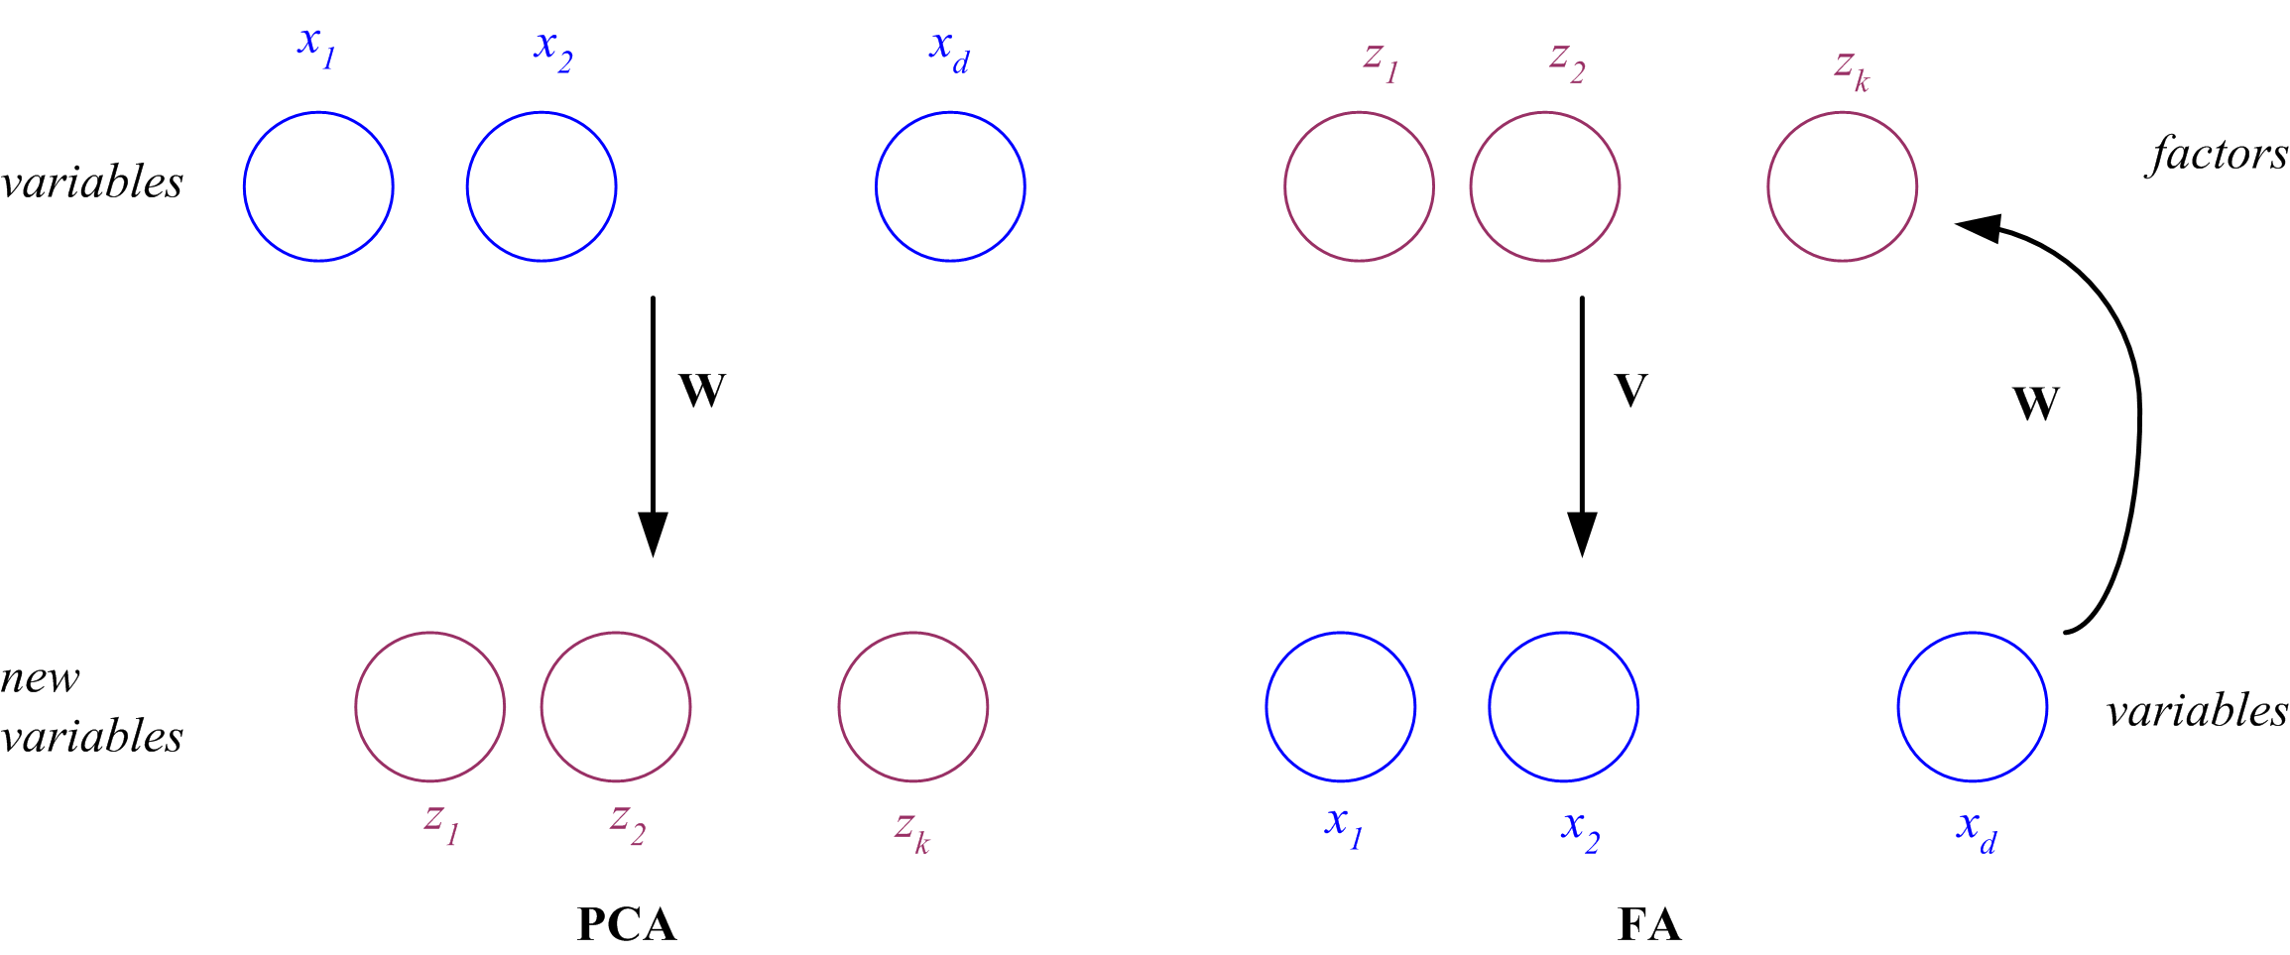
PCA vs FA
<number>
PCA From x to z z = W^{T}(x – µ)
FA From z to x x – µ = Vz + ε
x
z
z
x

Slide 17
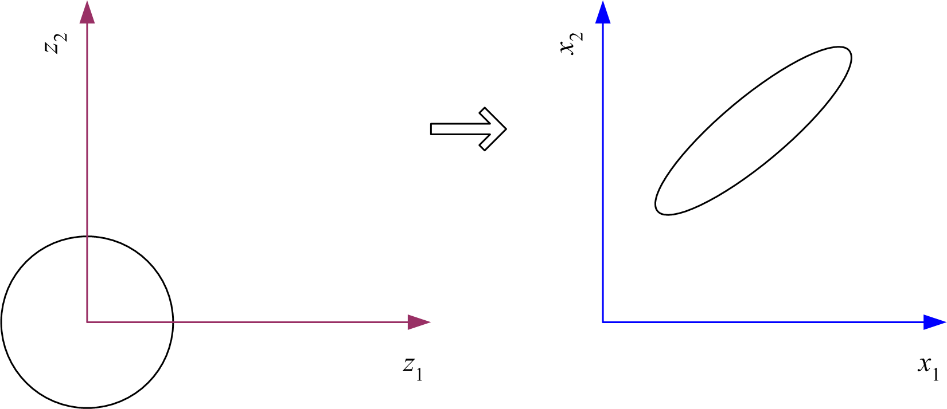
Factor Analysis
<number>
In FA, factors z_{j} are stretched, rotated and translated to generate x

Slide 18
Singular Value Decomposition and Matrix Factorization
<number>
Singular value decomposition: X=VAW^{T}
V is NxN and contains the eigenvectors of XX^{T}
W is dxd and contains the eigenvectors of X^{T}X
and A is Nxd and contains singular values on its first k diagonal
X=u₁a₁v₁^{T}+...+u_{k}a_{k}v_{k}^{T} where k is the rank of X

Slide 19
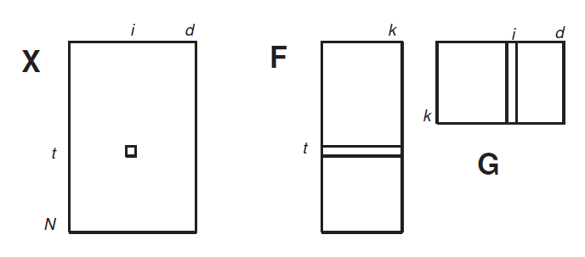
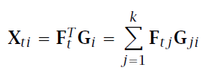
Matrix Factorization
<number>
Matrix factorization: X=FG
F is Nxk and G is kxd
Latent semantic indexing

Slide 20
Multidimensional Scaling
<number>
Given pairwise distances between N points,
d_{ij}, i,j =1,...,N
place on a low-dim map s.t. distances are preserved (by feature embedding)
z = g (x | θ ) Find θ that min Sammon stress

Slide 21
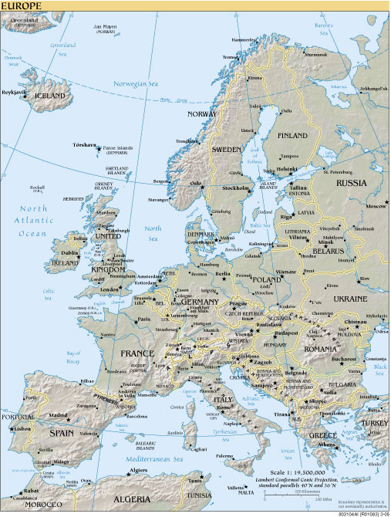
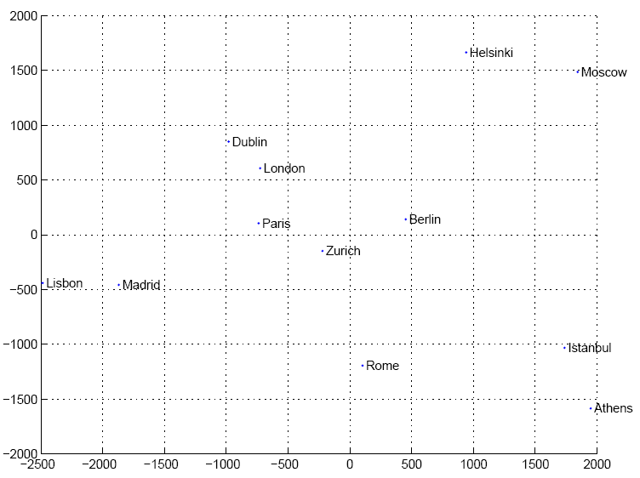
Map of Europe by MDS
<number>
Map from CIA – The World Factbook: http://www.cia.gov/
Notes:
<number>

Slide 22
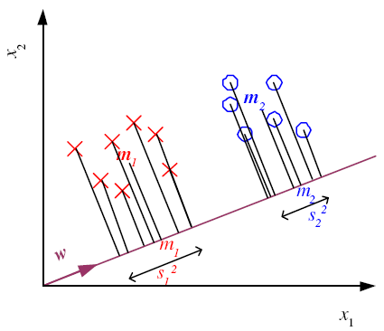
Linear Discriminant Analysis
Find a low-dimensional space such that when x is projected, classes are well-separated.
Find w that maximizes
<number>

Slide 23
Between-class scatter:
Within-class scatter:
<number>

Slide 24
Fisher’s Linear Discriminant
<number>
Find w that max
LDA soln:
Parametric soln:

Slide 25
K>2 Classes
<number>
Within-class scatter:
Between-class scatter:
Find W that max
The largest eigenvectors of S_{W}⁻¹S_{B;} maximum rank of K-1

Slide 26
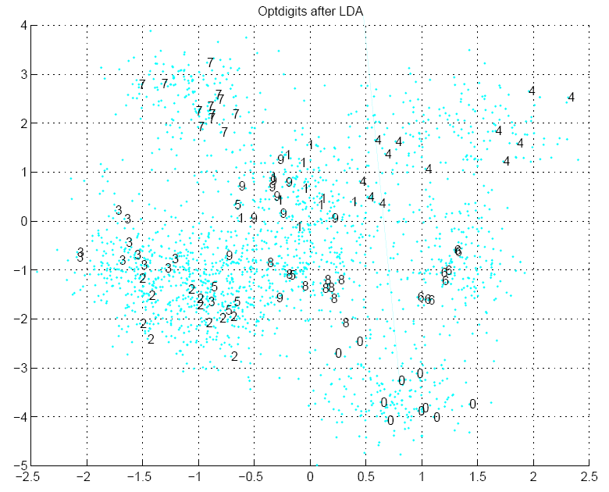
<number>

Slide 27
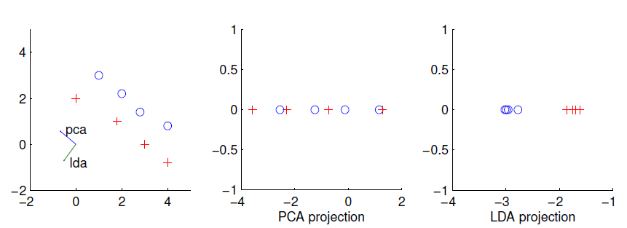
PCA vs LDA
<number>

Slide 28
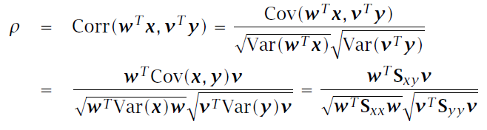
Canonical Correlation Analysis
<number>
X={x^{t},y^{t}}_{t} ; two sets of variables x and y x
We want to find two projections w and v st when x is projected along w and y is projected along v, the correlation is maximized:

Slide 29
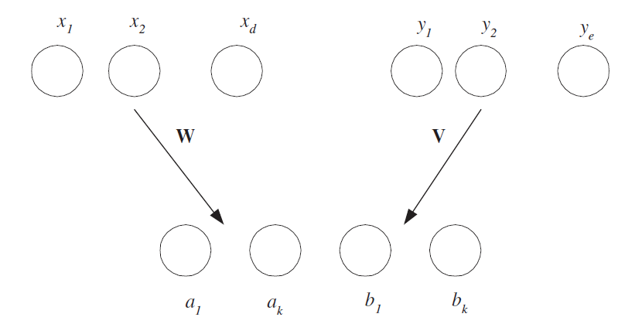
CCA
<number>
x and y may be two different views or modalities; e.g., image and word tags, and CCA does a joint mapping

Slide 30
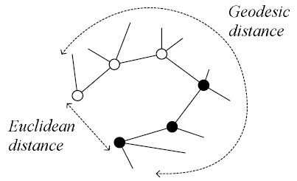
Isomap
<number>
Geodesic distance is the distance along the manifold that the data lies in, as opposed to the Euclidean distance in the input space

Slide 31
Isomap
<number>
Instances r and s are connected in the graph if
||x^{r}-x^{s}||<ε or if x^{s} is one of the k neighbors of x^{r}
The edge length is ||x^{r}-x^{s}||
For two nodes r and s not connected, the distance is equal to the shortest path between them
Once the NxN distance matrix is thus formed, use MDS to find a lower-dimensional mapping

Slide 32
Matlab source from http://web.mit.edu/cocosci/isomap/isomap.html
<number>

Slide 33
Locally Linear Embedding
<number>
Given x^{r} find its neighbors x^{s}_{(r)}
Find W_{rs} that minimize
Find the new coordinates z^{r} that minimize

Slide 34
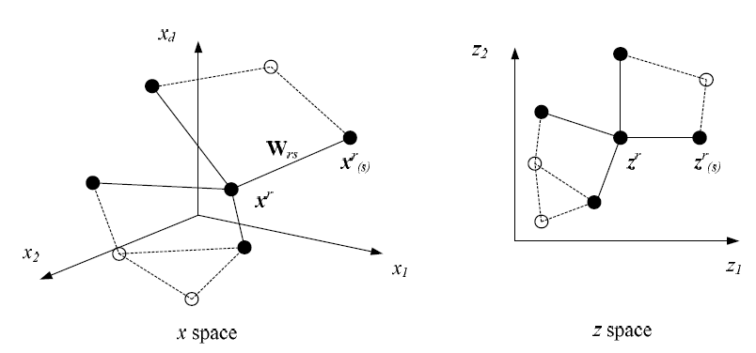
<number>

Slide 35
LLE on Optdigits
<number>
Matlab source from http://www.cs.toronto.edu/~roweis/lle/code.html

Slide 36


Laplacian Eigenmaps
<number>
Let r and s be two instances and B_{rs} is their similarity, we want to find z^{r} and z^{s} that
B_{rs} can be defined in terms of similarity in an original space: 0 if x^{r} and x^{s} are too far, otherwise
Defines a graph Laplacian, and feature embedding returns z^{r}

Slide 37
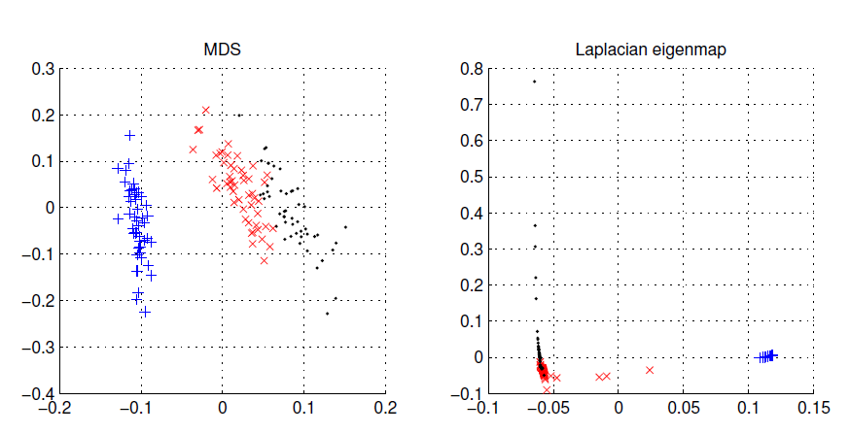
Laplacian Eigenmaps on Iris
<number>
Spectral clustering (chapter 7)

