Slide 1
CHAPTER 7: Clustering

Slide 2
Semiparametric Density Estimation
<number>
Parametric: Assume a single model for p (x | C_{i}) (Chapters 4 and 5)
Semiparametric: p (x|C_{i}) is a mixture of densities
Multiple possible explanations/prototypes:
Different handwriting styles, accents in speech
Nonparametric: No model; data speaks for itself (Chapter 8)

Slide 3
Mixture Densities
<number>
where G_{i} the components/groups/clusters,
P ( G_{i} ) mixture proportions (priors),
p ( x | G_{i}) component densities
Gaussian mixture where p(x|G_{i}) ~ N ( μ_{i} , ∑_{i} ) parameters Φ = {P ( G_{i} ), μ_{i} , ∑_{i} }^{k}_{i=1}
unlabeled sample X={x^{t}}_{t} (unsupervised learning)

Slide 4
Classes vs. Clusters
<number>
Supervised: X = {x^{t},r^{t} }_{t}
Classes C_{i} i=1,...,K
where p(x|C_{i}) ~ N(μ_{i} ,∑_{i} )
Φ = {P (C_{i} ), μ_{i} , ∑_{i} }^{K}_{i=1}
Unsupervised : X = { x^{t} }_{t}
Clusters G_{i} i=1,...,k
where p(x|G_{i}) ~ N ( μ_{i} , ∑_{i} )
Φ = {P ( G_{i} ), μ_{i} , ∑_{i} }^{k}_{i=1}
Labels r^{t}_{i} ?

Slide 5
k-Means Clustering
<number>
Find k reference vectors (prototypes/codebook vectors/codewords) which best represent data
Reference vectors, m_{j}, j =1,...,k
Use nearest (most similar) reference:
Reconstruction error

Slide 6
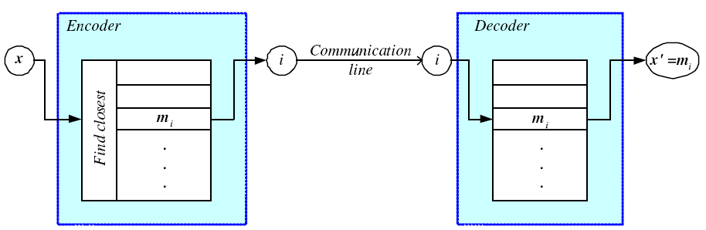
Encoding/Decoding
<number>

Slide 7
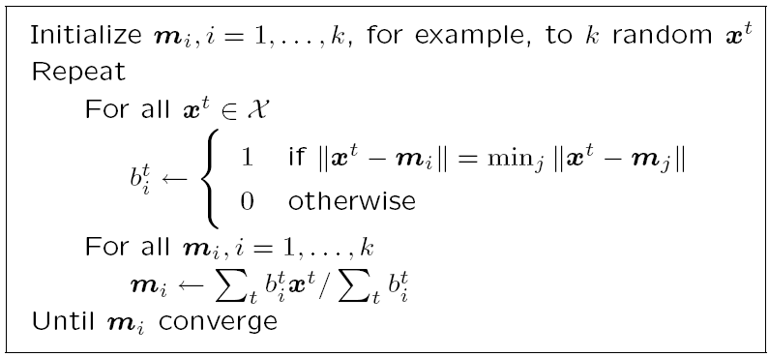
k-means Clustering
<number>

Slide 8
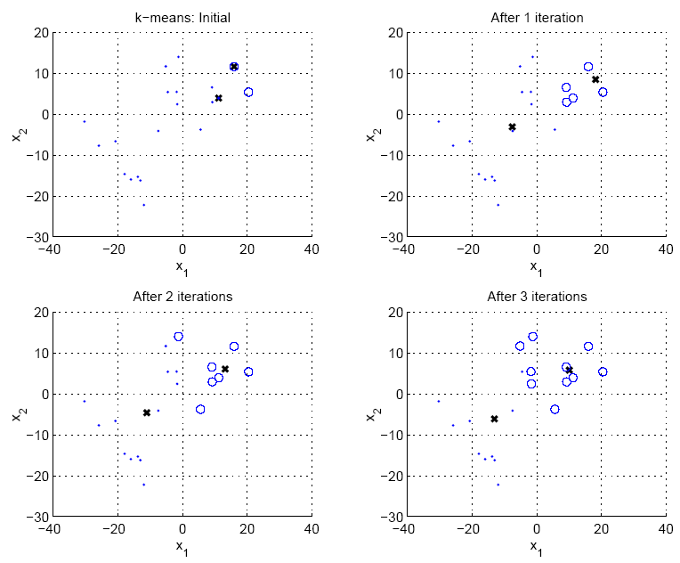
<number>

Slide 9
Expectation-Maximization (EM)
<number>
Log likelihood with a mixture model
Assume hidden variables z, which when known, make optimization much simpler
Complete likelihood, L_{c}(Φ |X,Z), in terms of x and z
Incomplete likelihood, L(Φ |X), in terms of x
Notes:
<number>

Slide 10
E- and M-steps
<number>
Iterate the two steps:
E-step: Estimate z given X and current Φ
M-step: Find new Φ’ given z, X, and old Φ.
is the expectation of the complete likelihood given X and current parameters
An increase in increases incomplete likelihood

Slide 11
EM in Gaussian Mixtures
<number>
z^{t}_{i} = 1 if x^{t} belongs to G_{i}, 0 otherwise (labels r ^{t}_{i} of supervised learning); assume p(x|G_{i})~N(μ_{i},∑_{i})
E-step:
M-step:
Use estimated labels in place of unknown labels

Slide 12
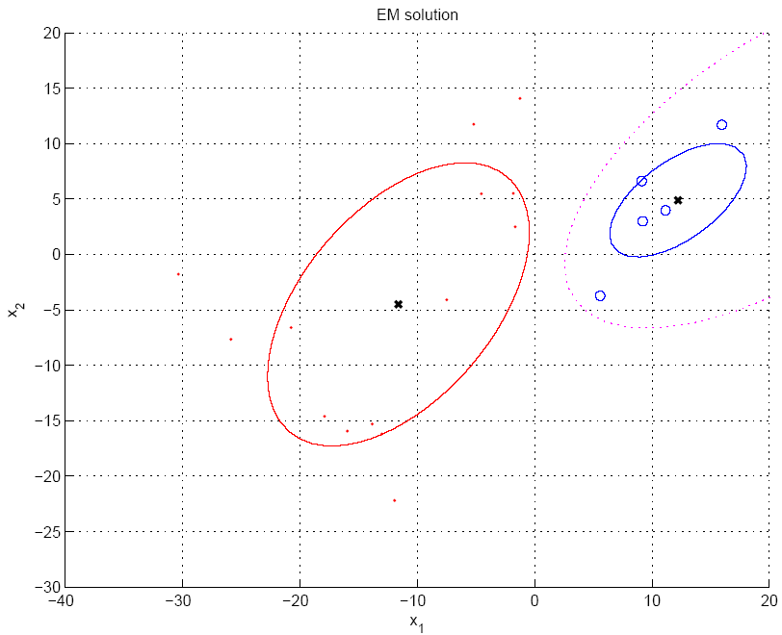
P(G₁|x)=h₁=0.5
<number>

Slide 13
Mixtures of Latent Variable Models
<number>
Regularize clusters, to avoid overfitting when attribute dimensionality is much larger than sample size
Assume shared/diagonal covariance matrices
but these assumptions may not be appropriate for a given dataset,
OR
Use PCA/FA in the clusters to decrease dimensionality: Mixtures of PCA/FA
where are factor loadings and variances of cluster G_{i}
Can use EM to learn V_{i} (Ghahramani and Hinton, 1997; Tipping and Bishop, 1999)

Slide 14
After Clustering
<number>
Dimensionality reduction methods find correlations between features and group features
Clustering methods find similarities between instances and group instances
Allows knowledge extraction through
number of clusters,
prior probabilities,
cluster parameters, i.e., center, range of features.
Example: CRM, customer segmentation

Slide 15
Clustering as Preprocessing
<number>
Estimated group labels h_{j} (soft) or b_{j} (hard) may be seen as the dimensions of a new k dimensional space, where we can then learn our discriminant or regressor.
Local representation (only one b_{j} is 1, all others are 0; only few h_{j} are nonzero) vs
Distributed representation (After PCA; all z_{j} are nonzero)

Slide 16
Mixture of Mixtures
<number>
In classification, the input comes from a mixture of classes (supervised).
If each class is also a mixture, e.g., of Gaussians, (unsupervised), we have a mixture of mixtures:

Slide 17
Spectral Clustering
<number>
Cluster using predefined pairwise similarities B_{rs} instead of using Euclidean or Mahalanobis distance
Can be used even if instances not vectorially represented
Steps:
Use Laplacian Eigenmaps (chapter 6) to map to a new z space using B_{rs}
Use k-means in this new z space for clustering

Slide 18
Hierarchical Clustering
<number>
Cluster based on similarities/distances
Distance measure between instances x^{r} and x^{s}
Minkowski (L_{p}) (Euclidean for p = 2)
City-block distance

Slide 19
Agglomerative Clustering
<number>
Start with N groups each with one instance and merge two closest groups at each iteration
Distance between two groups G_{i} and G_{j}:
Single-link:
Complete-link:
Average-link, centroid

Slide 20
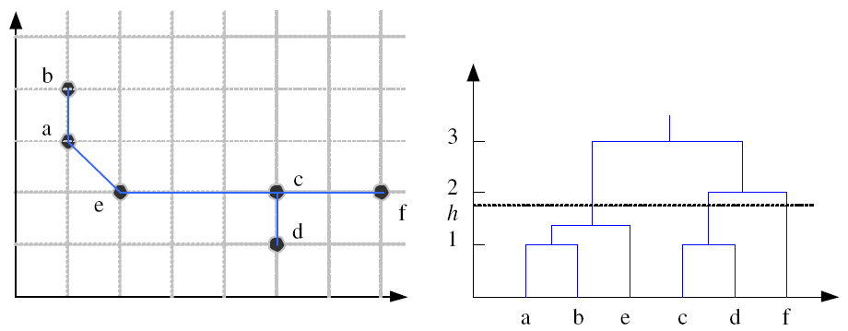
Example: Single-Link Clustering
<number>
Dendrogram

Slide 21
Choosing k
<number>
Defined by the application, e.g., image quantization
Plot data (after PCA) and check for clusters
Incremental (leader-cluster) algorithm: Add one at a time until “elbow” (reconstruction error/log likelihood/intergroup distances)
Manually check for meaning

