Slide 1
CHAPTER 8: Nonparametric Methods

Slide 2
Nonparametric Estimation
<number>
Parametric (single global model), semiparametric (small number of local models)
Nonparametric: Similar inputs have similar outputs
Functions (pdf, discriminant, regression) change smoothly
Keep the training data;“let the data speak for itself”
Given x, find a small number of closest training instances and interpolate from these
Aka lazy/memory-based/case-based/instance-based learning

Slide 3
Density Estimation
<number>
Given the training set X={x^{t}}_{t} drawn iid from p(x)
Divide data into bins of size h
Histogram:
Naive estimator:
or equivalently,

Slide 4
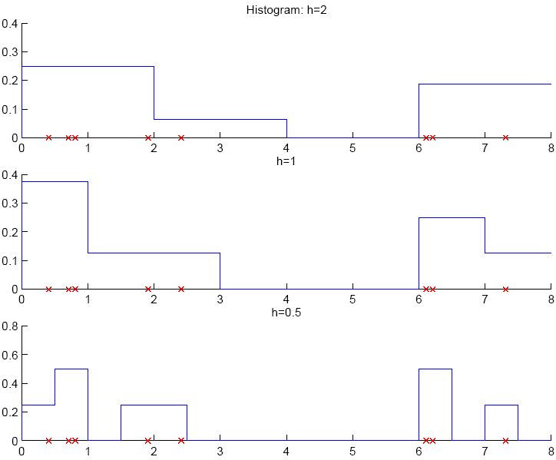
N= 8
<number>

Slide 5
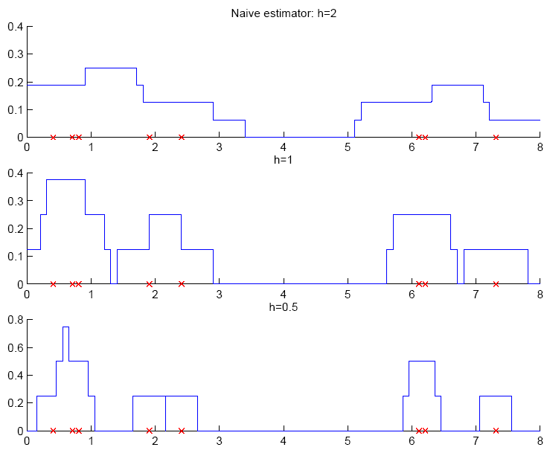
N= 8
<number>
the kernel estimate is a sum of “boxes”

Slide 6
Kernel Estimator to get a smooth estimate
<number>
Kernel function, e.g., Gaussian kernel:
Kernel estimator (Parzen windows)
the kernel function K(.) determines the shape of the “influence”
h determines the width of the “influence”
the kernel estimate is the sum of “bumps”

Slide 7
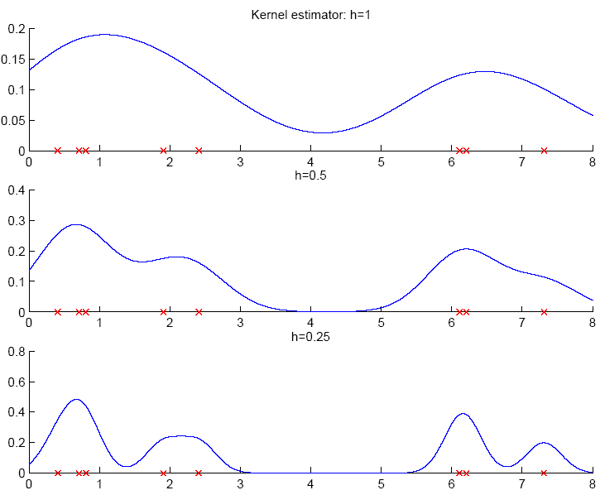
<number>

Slide 8
k-Nearest Neighbor Estimator
<number>
Instead of fixing bin width h and counting the number of instances, fix the instances (neighbors) k and check bin width
d_{k}(x), distance to kth closest instance to x
this is like a naïve estimator with

Slide 9
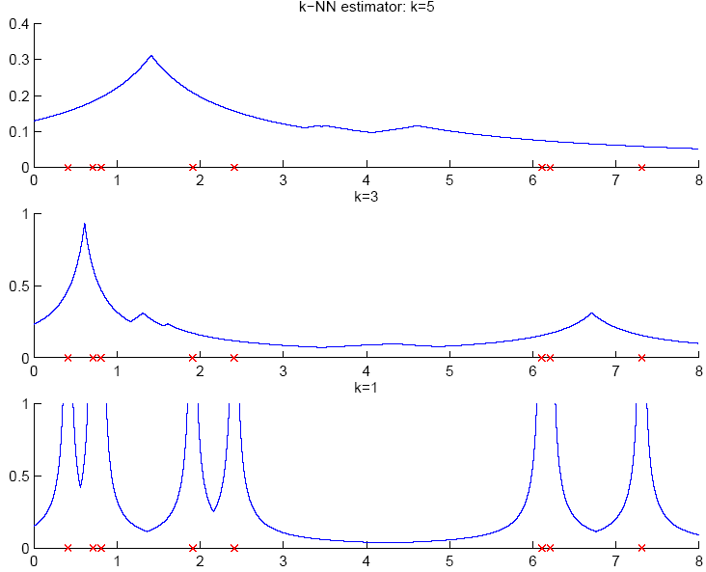
k-NN estimator is not continuous
not a pdf since its integral is not 1
but it can be smoothed using a kernel function
where density is high, bins are small and so is high
where density is low, bins are large and so is low
<number>

Slide 10
Multivariate Data (d dimensions)
<number>
Kernel density estimator
Multivariate Gaussian kernel
spheric Euclidean distance
ellipsoid Mahalanobis distance
inputs should be normalized to have the same variance

Slide 11
Nonparametric Classification
<number>
Estimate p(x|C_{i}) and use Bayes’ rule
Kernel estimator
particular case: k-NN estimator
k_{i} : # of k-nn in class C_{i}
V^{k}(x): volume of hypersphere centered at x with radius ||x-x_{(k)}||
assigns x to the class having more examples among the k-NN of x
Notes:
The point here is that the k-NN classifier assign as the class of x, the majority class among the k neighbors of x.
<number>

Slide 12
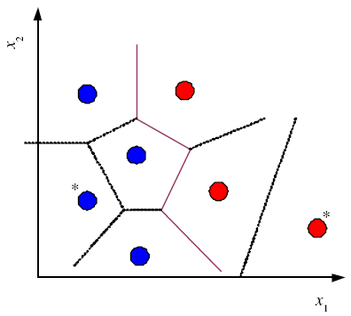
Condensed Nearest Neighbor
<number>
Time/space complexity of k-NN is O (N)
Find a subset Z of X that is small and is accurate in classifying X (Hart, 1968)
Voronoi
diagram circled data points
can be discarded

Slide 13
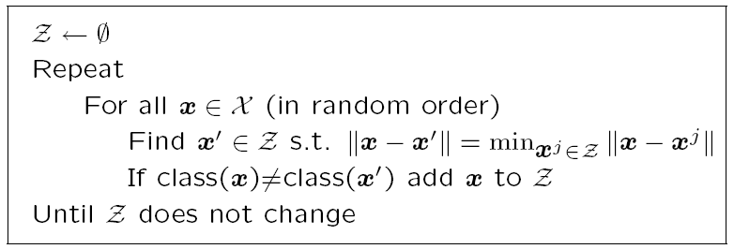
Condensed Nearest Neighbor
<number>
Incremental algorithm: Add instance if needed

Slide 14

Distance-based Classification
<number>
Find a distance function D(x^{r},x^{s}) such that
if x^{r}and x^{s}belong to the same class, distance is small and if they belong to different classes, distance is large
Assume a parametric model and learn its parameters using data, e.g.,

Slide 15
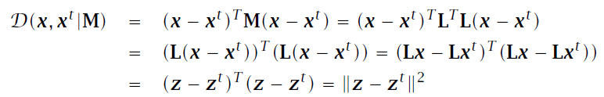
Learning a Distance Function
<number>
The three-way relationship between distances, dimensionality reduction, and feature extraction.
M=L^{T}L is dxd and L is kxd
Similarity-based representation using similarity scores
Large-margin nearest neighbor (chapter 13)

Slide 16
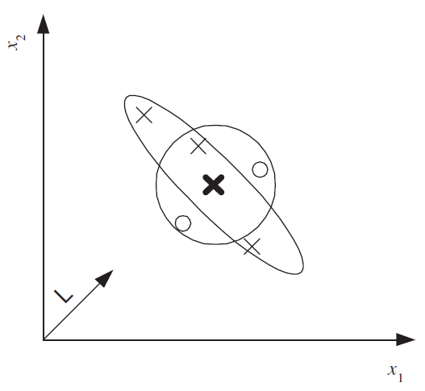
Euclidean distance (circle) is not suitable,
Mahalanobis distance using an M (ellipse) is suitable.
After the data is projected along L, Euclidean distance can be used.
<number>

Slide 17
Outlier Detection
<number>
Find outlier/novelty points
Not a two-class problem because outliers are very few, of many types, and seldom labeled
Instead, one-class classification problem: Find instances that have low probability
In nonparametric case: Find instances far away from other instances

Slide 18

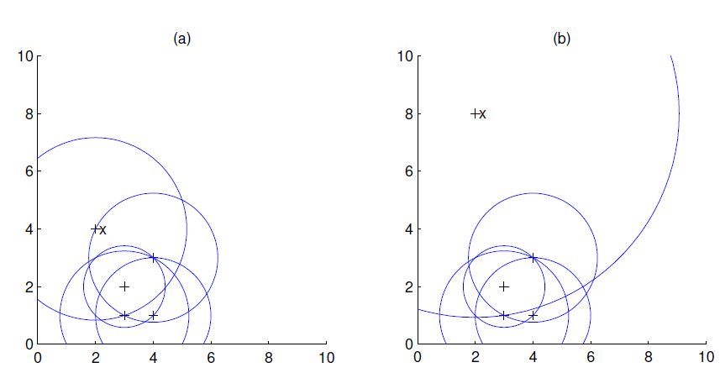
Local Outlier Factor
<number>
the larger LOF(x), the most likely x is an outlier

Slide 19
Nonparametric Regression
<number>
Aka smoothing models
Regressogram

Slide 20
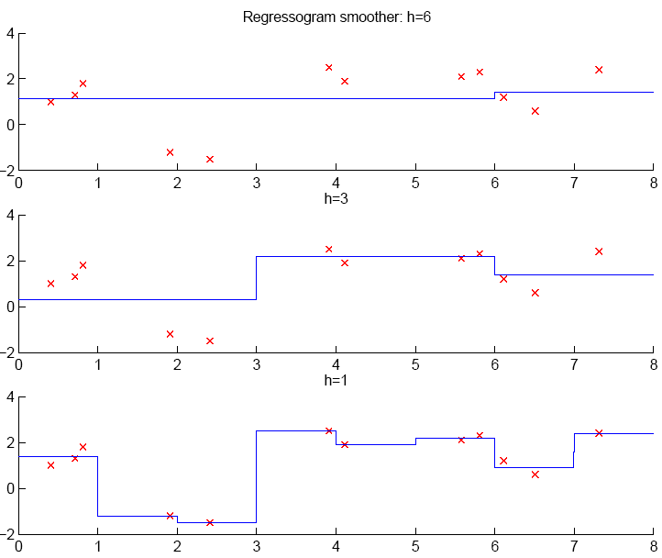
<number>

Slide 21
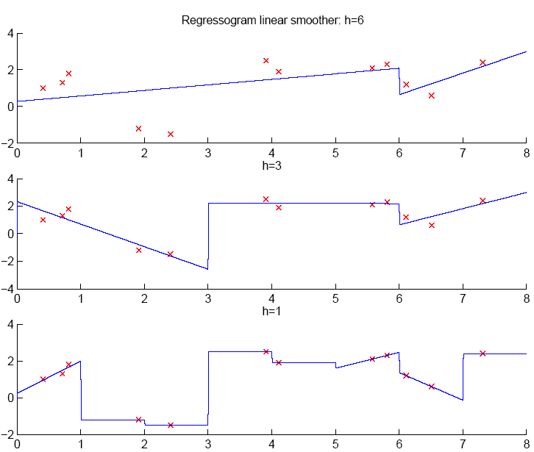
<number>

Slide 22
Running Mean/Kernel Smoother
<number>
Running mean smoother
Running line smoother
Kernel smoother
where K( ) is Gaussian
Additive models (Hastie and Tibshirani, 1990)

Slide 23
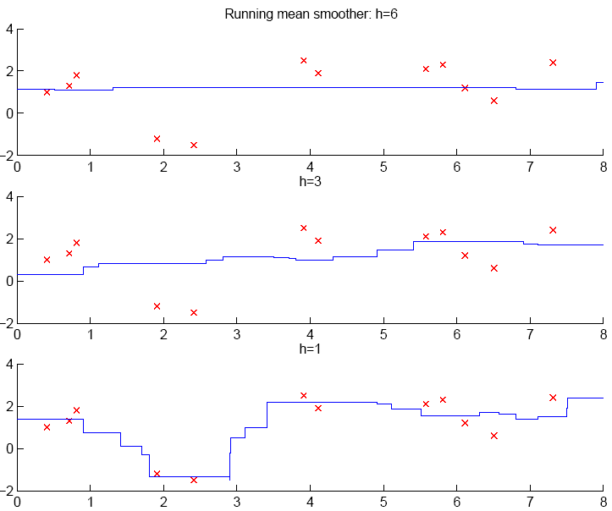
<number>

Slide 24
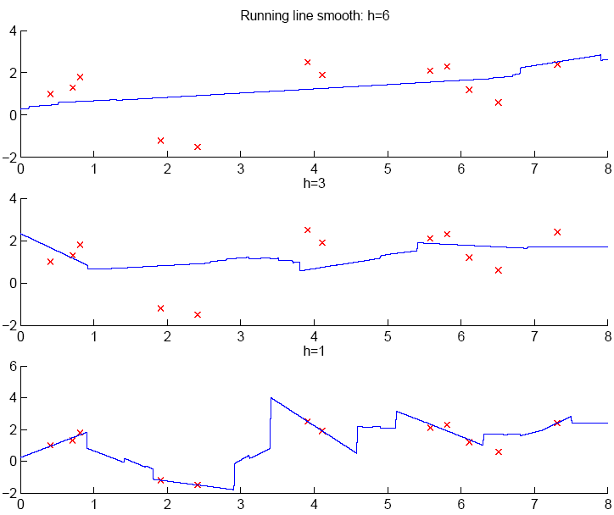
<number>

Slide 25
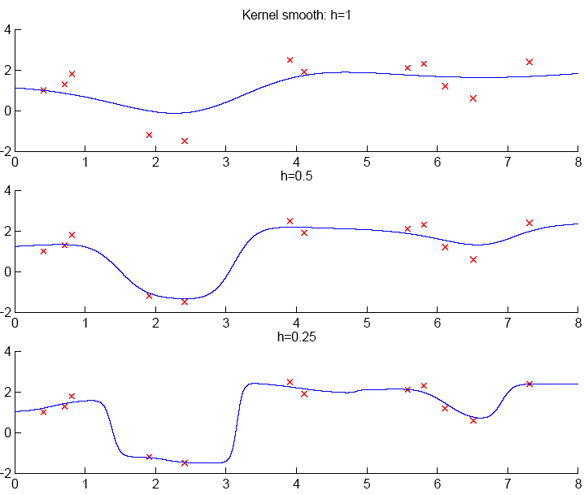
<number>

Slide 26
How to Choose k or h ?
<number>
When k or h is small, single instances matter; bias is small, variance is large (undersmoothing): High complexity
As k or h increases, we average over more instances and variance decreases but bias increases (oversmoothing): Low complexity
Cross-validation is used to finetune k or h.

Slide 27
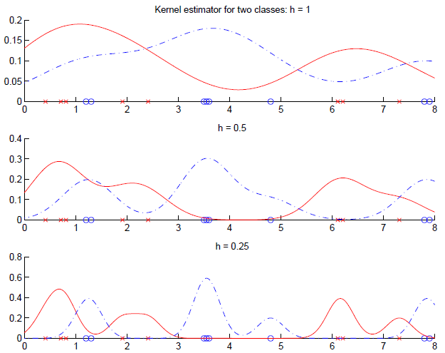
<number>

