Slide 1
CHAPTER 11: Multilayer Perceptrons

Slide 2
Neural Networks - Inspired by the human brain
<number>
Networks of processing units (neurons) with connections (synapses) between them
Large number of neurons: 10¹⁰ (other estimates say10¹¹)
Large connectitivity: 10⁵ connections per neuron: synapses
Parallel processing
Distributed computation/memory
Robust to noise, failures

Slide 3
Understanding the Brain
<number>
Levels of analysis (Marr, 1982)
Computational theory
Representation and algorithm
Hardware implementation
Reverse engineering: From hardware to theory
Parallel processing: SIMD (single instruction, multiple data machines) vs MIMD (multiple instruction, multiple data machines)
Neural net: SIMD with modifiable local memory
Learning: Update by training/experience

Slide 4
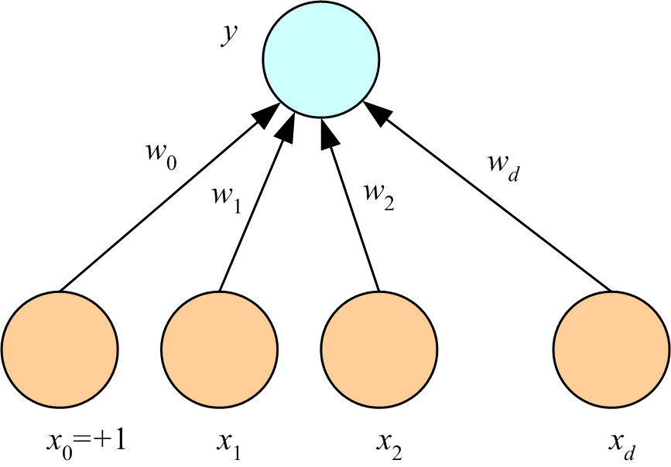
Perceptron = one “neuron” or computational unit
<number>
perceptron
output
weights
(Rosenblatt, 1962)
inputs

Slide 5
What a Perceptron Does
<number>
Regression: y=wx+w₀
Classification:y=1(wx+w₀>0)
y
y
s
y
w₀
w
w₀
w
x
w₀
x
x
x₀=+1

Slide 6
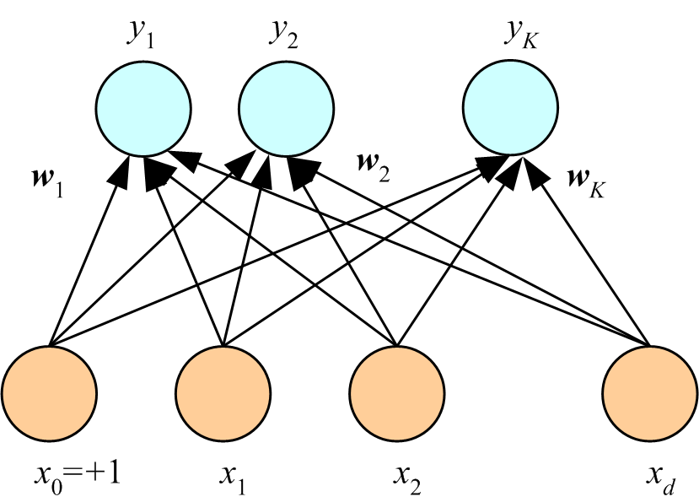
Regression:
K Outputs
<number>
Classification:
softmax
softmax function or normalized exponential function converts a real vector into one with values in the range (0, 1) that add up to 1

Slide 7
Training (i.e., learning the right weights)
<number>
Online (instances seen one by one) vs batch (whole sample) learning: In online (= incremental) learning:
No need to store the whole sample
Problem may change in time
Wear and degradation in system components
Stochastic gradient-descent (= incremental gradient descent): Update after a single data instance
Generic update rule (LMS rule):

Slide 8
Training a Perceptron: Regression
Regression (Linear output):
<number>

Slide 9
Classification
<number>
Single sigmoid output
K>2 softmax outputs
cross-entropy cost function:
used instead of the quadratic error function to speed up learning
cross-entropy
cost function
see Chapter 3 of Michael Nielsen’s “Neural Networks and Deep Learning” online texbook for an explanation of cross-entropy

Slide 10
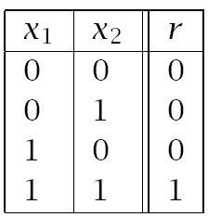
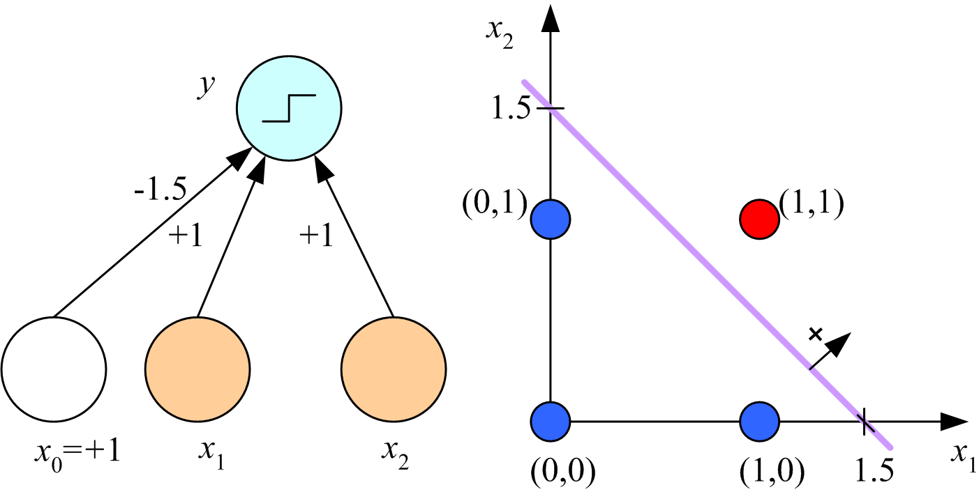
Learning Boolean AND
<number>

Slide 11
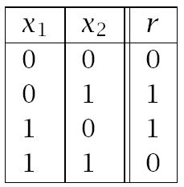
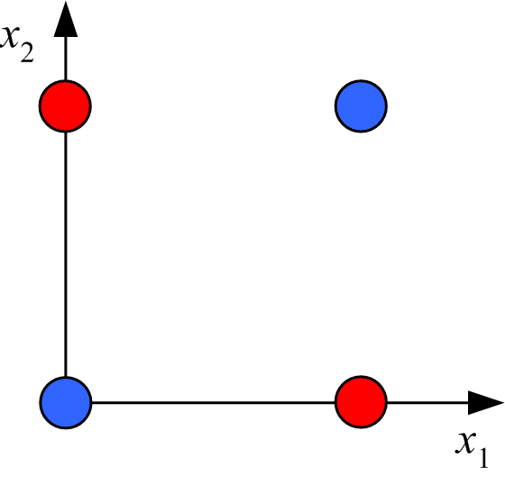
XOR
No w₀, w₁, w₂ satisfy:
(Minsky and Papert, 1969)
<number>

Slide 12
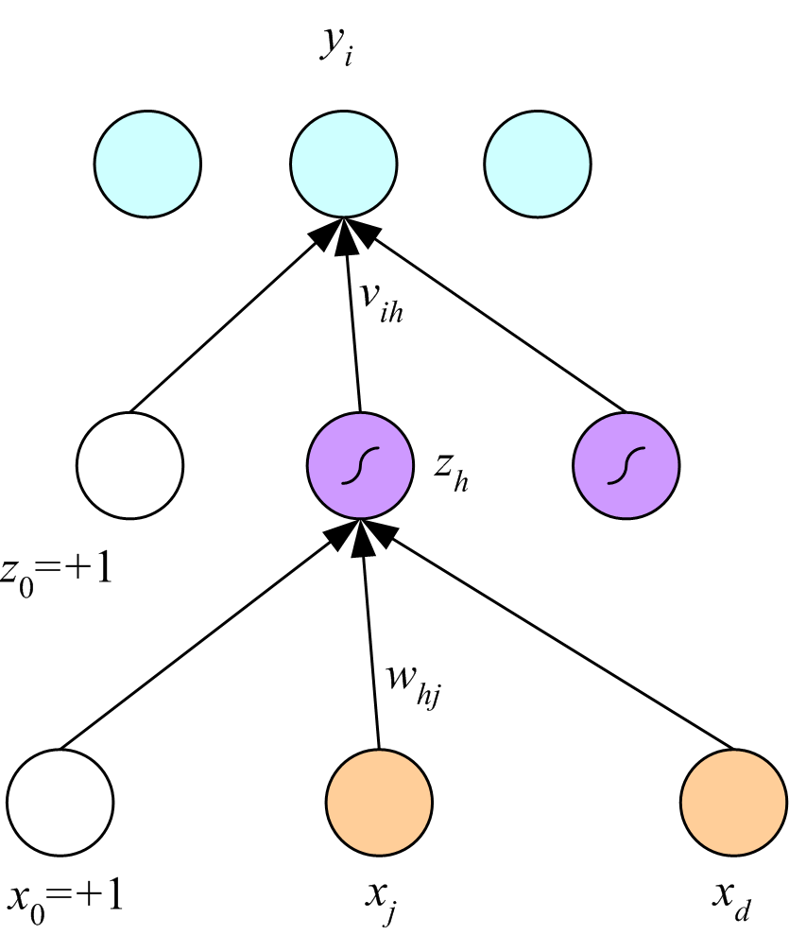
Multilayer Perceptrons
<number>
outputs
hidden layer
(Rumelhart, Hinton, and Williams, 1986)
inputs

Slide 13
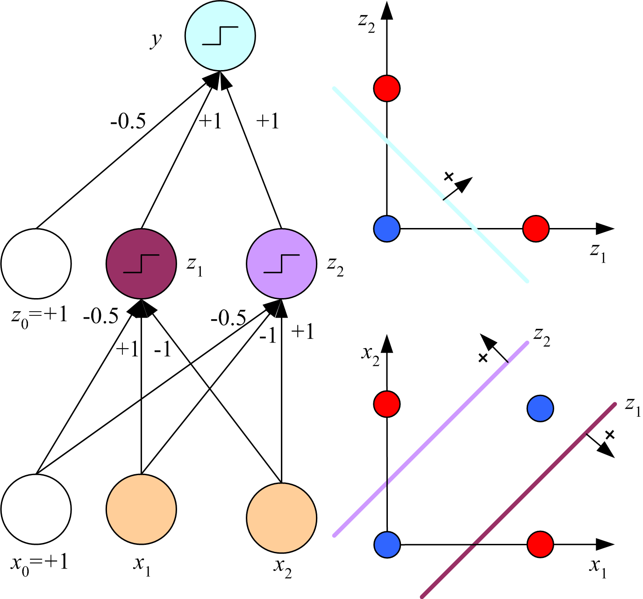
x₁ XOR x₂ = (x₁ AND ~x₂) OR (~x₁ AND x₂)
<number>

Slide 14
Backpropagation (Rumelhart, Hinton & Williams, 1986)
<number>
gradient of the error function

Slide 15
Regression
Backward
Forward
x
<number>

Slide 16
Regression with Multiple Outputs
<number>
y_{i}
v_{ih}
z_{h}
w_{hj}
x_{j}

Slide 17
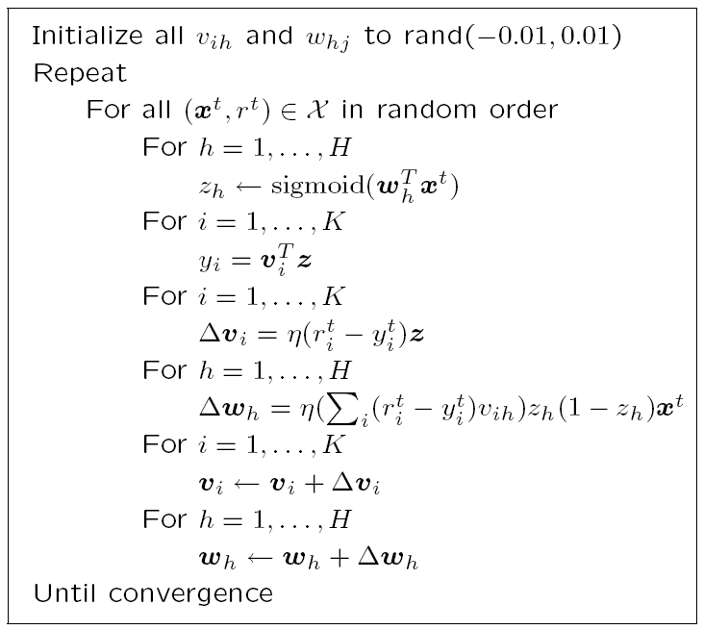
Error Back Propagation Algorithm using Stochastic Gradient Descent
small random values
(an epoch)
(h: index over hidden units)
forward propagation
of inputs
(i: index over output units)
backward propagation
of errors
weights
update
let’s talk about termination criteria
<number>

Slide 18
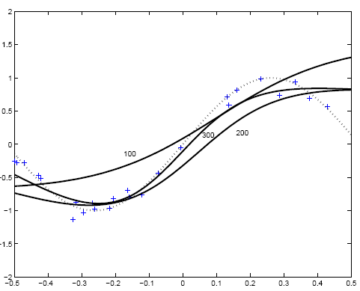
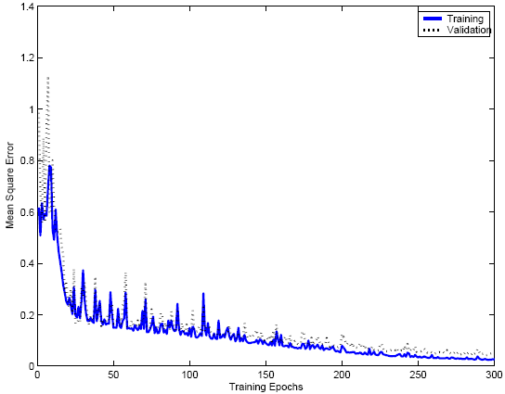
+: training instances
…: f(x) = sin(6x)
100,200, 300: Fit of an MLP with two hidden units after 100, 200, and 300 epochs
<number>

Slide 19
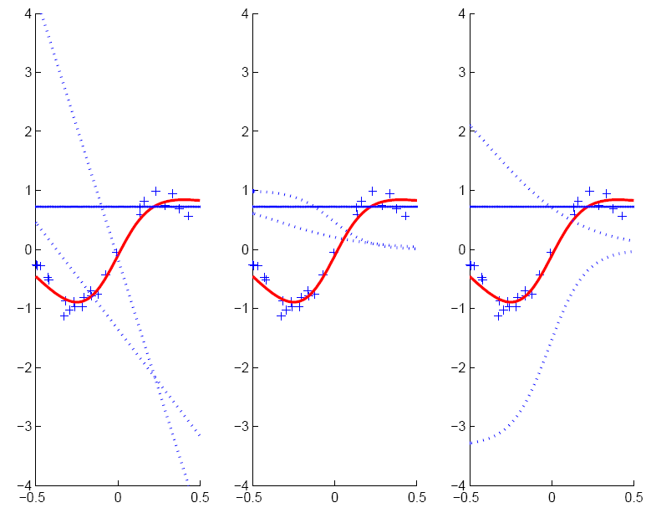
hyperplanes of two hidden units weights on 1st layer
hidden unit outputs multiplied by weights on 2nd layer
hidden unit outputs
w_{h}x+w₀
v_{h}z_{h}
z_{h}
<number>
MLP fit is formed as the sum of the outputs of the hidden units

Slide 20
Two-Class Discrimination
<number>
One sigmoid output y^{t} for P(C₁|x^{t}) and
P(C₂|x^{t}) ≡ 1-y^{t}

Slide 21
K>2 Classes
<number>
softmax

Slide 22
Multiple Hidden Layers
<number>
MLP (multi-layer perceptrons) with one hidden layer is a universal approximator (Hornik et al., 1989), but using multiple layers may lead to simpler networks

Slide 23
Improving Convergence
<number>
Momentum
Adaptive learning rate
where t is time (= epoch) and α is a constant, say between 0.5 and 1
if error rate is decreasing, increase learning rate by a constant amount;
otherwise, decrease learning rate geometrically

Slide 24
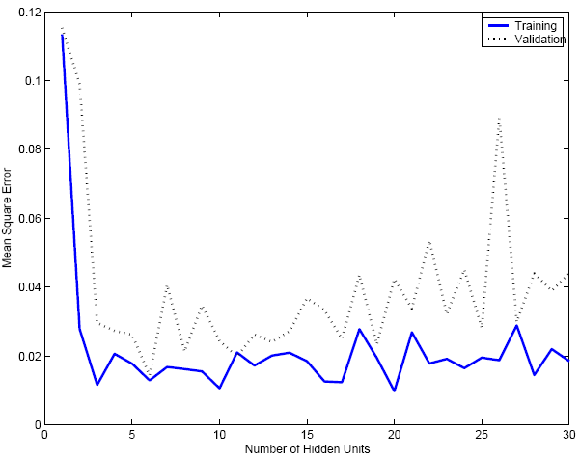
Overfitting/Overtraining
<number>
Number of weights: H (d+1)+(H+1)K
MLP with d inputs, H hidden units, and K outputs: has Hx(d+1) weights in 1st layer and Kx(H+1) in 2nd layer

Slide 25
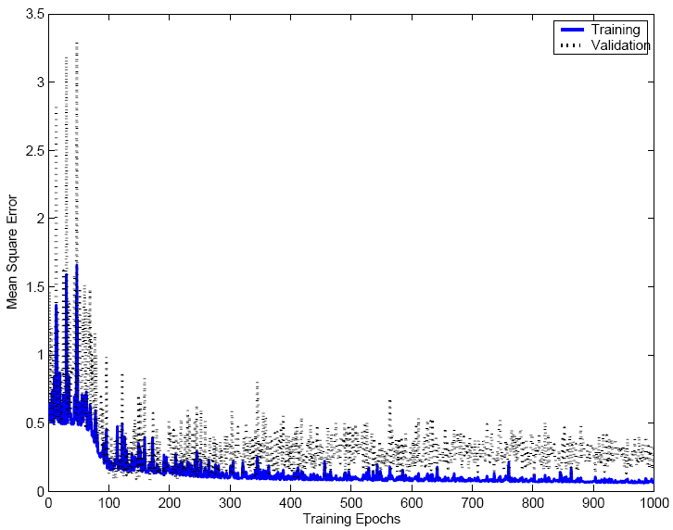
<number>

Slide 26
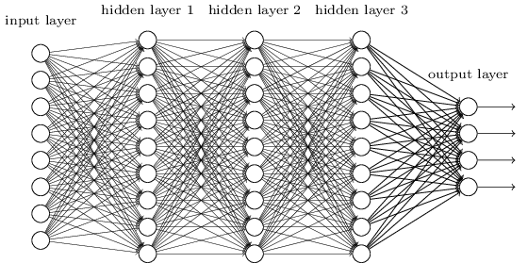
Fully Connected, Layered MLP Architecture
<number>
Taken from Chapter 6 of Michael Nielsen’s “Neural Networks and Deep Learning” online texbook

Slide 27
Expressive Capabilities of ANNs
<number>
(Taken from Tom Mitchell’s “Machine Learning” Textbook)
Boolean Functions:
Every Boolean function can be represented by a network with a single hidden layer
but might require exponential (in number of inputs) hidden units
Continuous Functions:
Every bounded continuous function can be approximated with arbitrary small error by a network with one hidden layer [Cybenko 1989; Hornik et al. 1989]
Any function can be approximated to arbitrary accuracy by a network with two hidden layers [Cybenko 1988].

Slide 28
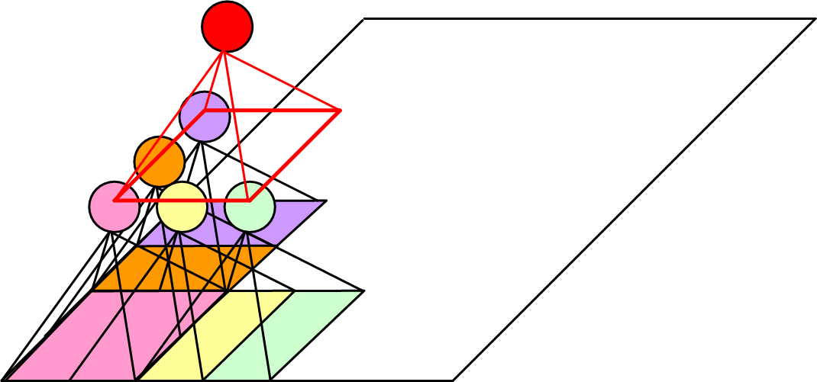
Other ANN Architectures: Structured MLP
<number>
Convolutional networks (Deep learning)
Useful on data that has “local structure” (e.g., images; sound)
each unit is
connected to a local
group of units, and
intends to capture a particular aspect of the data (e.g., an object in an image; a speech phoneme in a speech signal)
(Le Cun et al, 1989)
see Chapter 6 of Michael Nielsen’s “Neural Networks and Deep Learning” online texbook for an explanation of convolutional networks

Slide 29
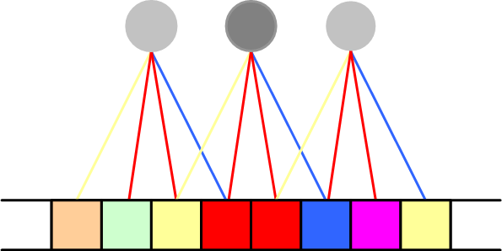
Weight Sharing
<number>
three translations over the data of the same “filter”
Each “filter” is applied on overlapping segments of the data, and uses the same weights each time that is applied during the same epoch (“translation invariance”).
These weights are updated after each epoch.

Slide 30

Hints
<number>
Invariance to translation, rotation, size
Virtual examples
Augmented error: E’=E+λ_{h}E_{h}
If x’ and x are the “same”: E_{h}=[g(x|θ)- g(x’|θ)]²
Approximation hint:
the “A” remains an “A”
(Abu-Mostafa, 1995)

Slide 31
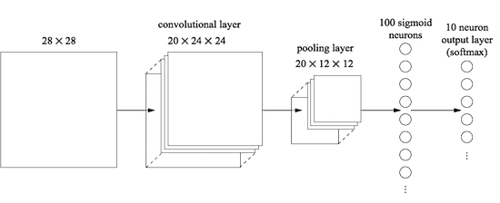
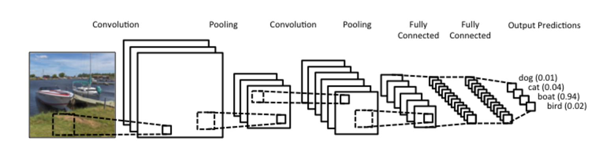
Convolutional Neural Networks in Practice
<number>
Taken from Chapter 6 of Michael Nielsen’s “Neural Networks and Deep Learning” online texbook
Taken from ”Understanding Convolutional Neural Networks for NLP”

Slide 32
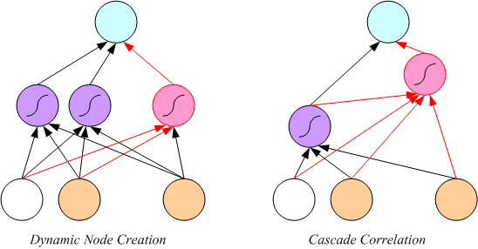
Tuning the Network Size
<number>
Destructive
Weight decay:
Constructive
Growing networks
(Ash, 1989)
(Fahlman and Lebiere, 1989)

Slide 33
Bayesian Learning
<number>
Consider weights w_{i} as random vars, prior p(w_{i})
Weight decay, ridge regression, regularization
cost=data-misfit + λ complexity
More about Bayesian methods in chapter 14

Slide 34
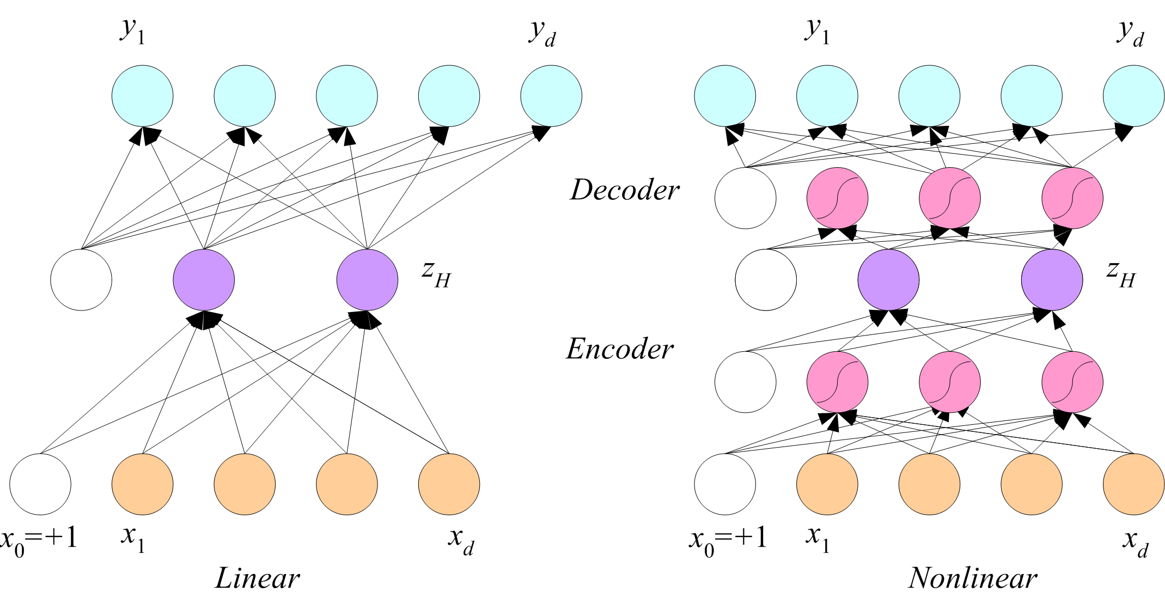
Dimensionality Reduction
<number>
Autoencoder networks

Slide 35
Autoencoder: An Example
<number>
Figure from Hinton and Salakhutdinov, Science, 2006

Slide 36
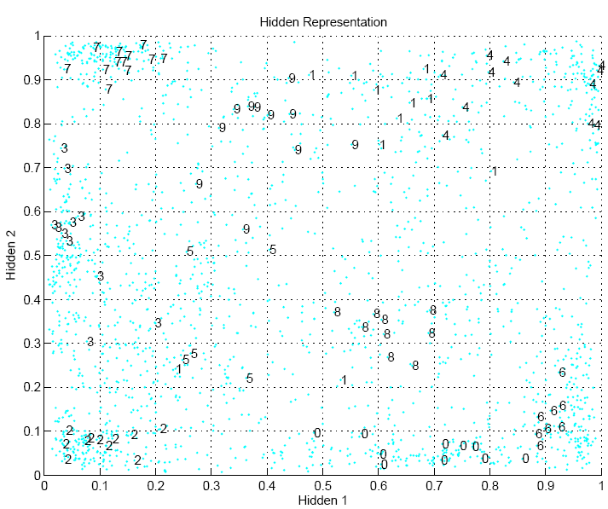
<number>

Slide 37
Learning Time
<number>
Applications:
Sequence recognition: Speech recognition
Sequence reproduction: Time-series prediction
Sequence association
Network architectures
Time-delay networks (Waibel et al., 1989)
Recurrent networks (Rumelhart et al., 1986)

Slide 38
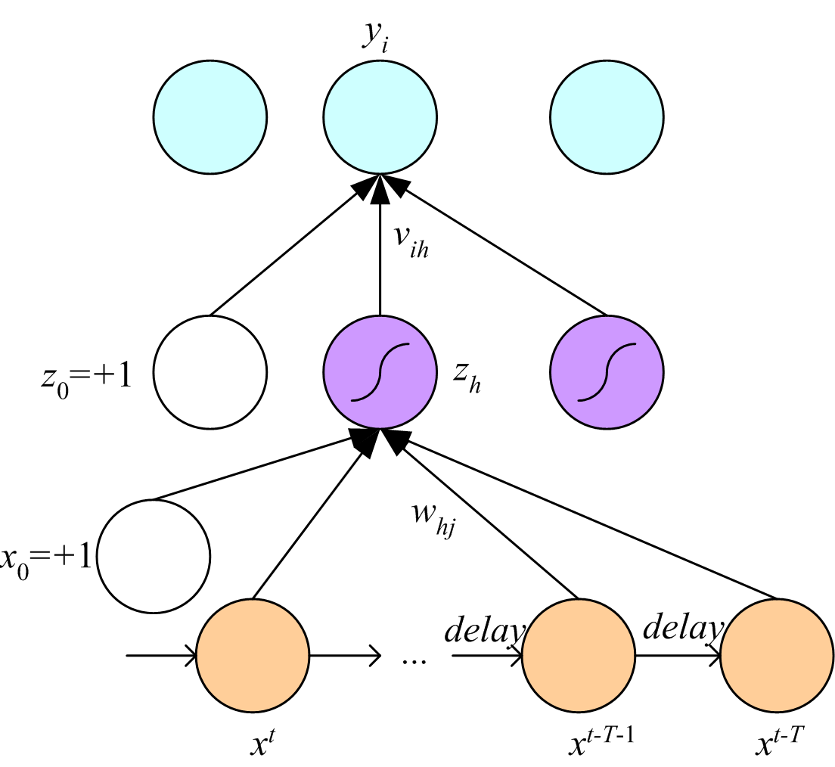
Time-Delay Neural Networks
<number>

Slide 39
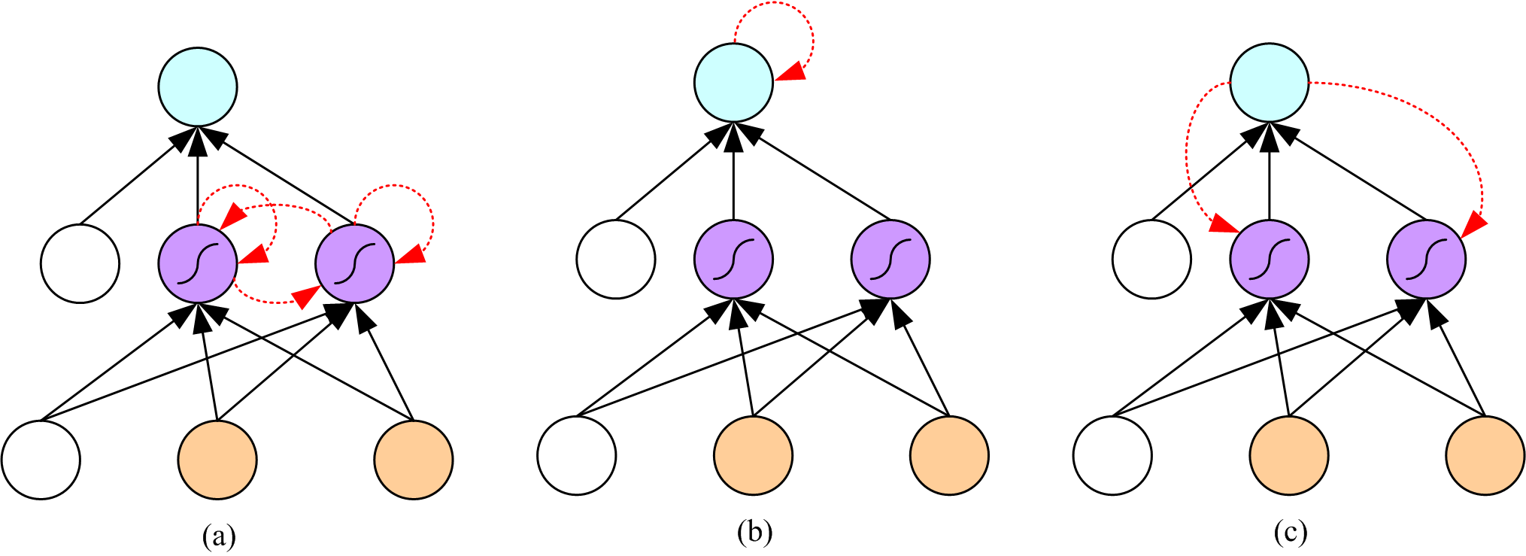
Recurrent Networks
<number>

Slide 40
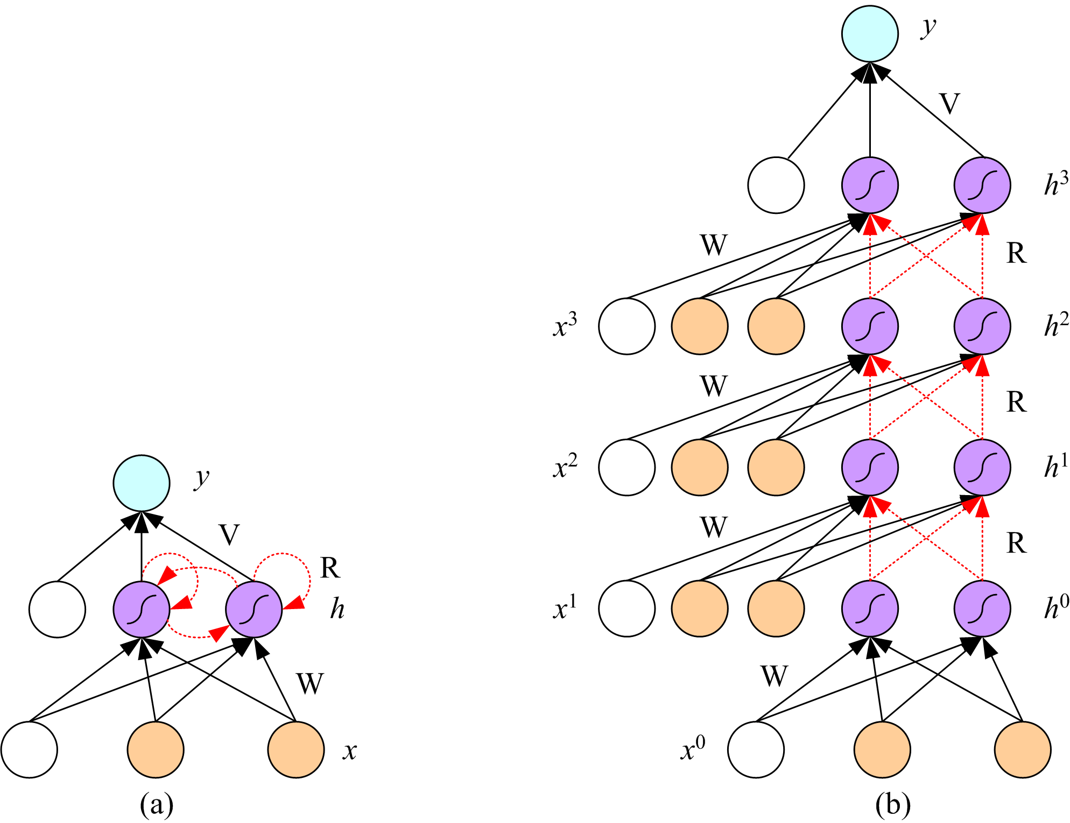
Unfolding in Time
<number>

Slide 41
Deep Networks
<number>
Layers of feature extraction units
Can have local receptive fields as in convolution networks, or can be fully connected
Can be trained layer by layer using an autoencoder in an unsupervised manner
No need to craft the right features or the right basis functions or the right dimensionality reduction method; learns multiple layers of abstraction all by itself given a lot of data and a lot of computation
Applications in vision, language processing, ...

