Slide 1
CHAPTER 13: Kernel Machines

Slide 2
Kernel Machines
<number>
Discriminant-based: No need to estimate densities first
Define the discriminant in terms of support vectors
The use of kernel functions, application-specific measures of similarity
No need to represent instances as vectors
Convex optimization problems with a unique solution

Slide 3
Optimal Separating Hyperplane
<number>
(Cortes and Vapnik, 1995; Vapnik, 1995)

Slide 4
Margin
<number>
Distance from the discriminant to the closest instances on either side
Distance of x to the hyperplane is
We require
For a unique sol’n, fix ρ||w||=1, and to max margin

Slide 5
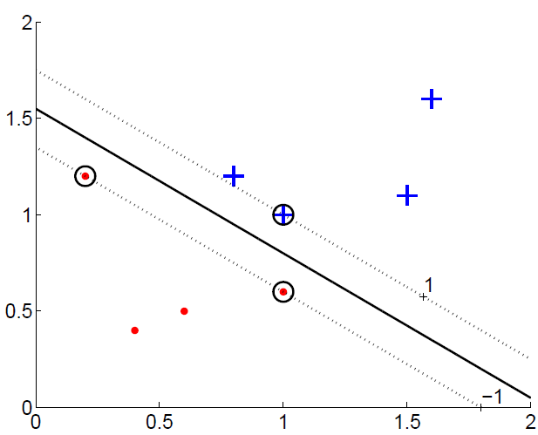
Margin
<number>

Slide 6
<number>

Slide 7
Most α^{t} are 0 and only a small number have α^{t} >0; they are the support vectors
<number>

Slide 8
Soft Margin Hyperplane
<number>
Not linearly separable
Soft error
New primal is

Slide 9
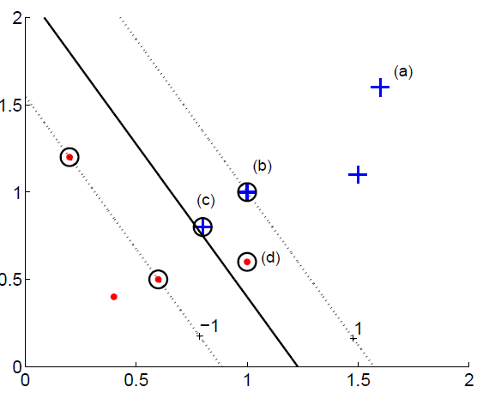
<number>

Slide 10
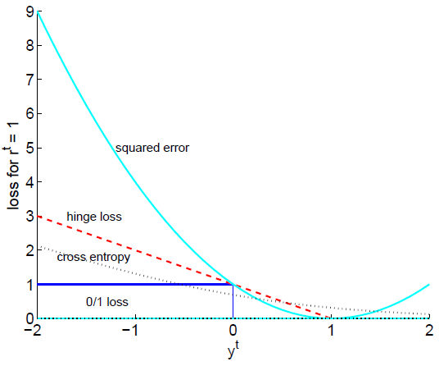
Hinge Loss
<number>

Slide 11
ν-SVM
<number>
ν controls the fraction of support vectors

Slide 12
Kernel Trick
<number>
Preprocess input x by basis functions
z = φ(x) g(z)=w^{T}z
g(x)=w^{T} φ(x)
The SVM solution

Slide 13
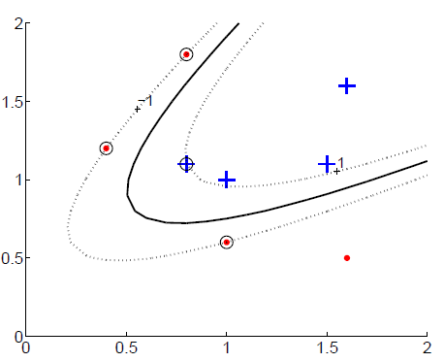
Vectorial Kernels
<number>
Polynomials of degree q:

Slide 14
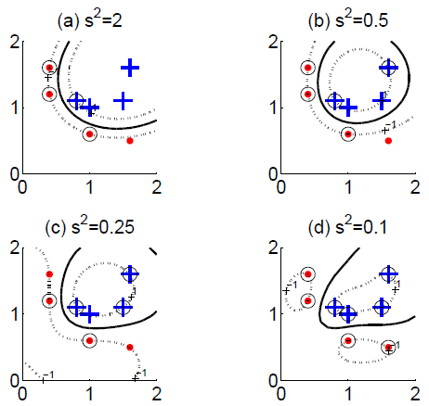
Vectorial Kernels
<number>
Radial-basis functions:

Slide 15
Defining kernels
<number>
Kernel “engineering”
Defining good measures of similarity
String kernels, graph kernels, image kernels, ...
Empirical kernel map: Define a set of templates m_{i} and score function s(x,m_{i})
φ(x^{t})=[s(x^{t},m₁), s(x^{t},m₂),..., s(x^{t},m_{M})]
and
K(x,x^{t})=φ (x)^{T} φ (x^{t})

Slide 16
Multiple Kernel Learning
<number>
Fixed kernel combination
Adaptive kernel combination
Localized kernel combination

Slide 17
Multiclass Kernel Machines
<number>
1-vs-all
Pairwise separation
Error-Correcting Output Codes (section 17.5)
Single multiclass optimization

Slide 18
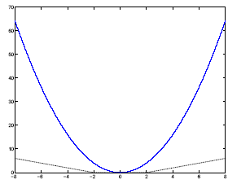
SVM for Regression
<number>
Use a linear model (possibly kernelized)
f(x)=w^{T}x+w₀
Use the є-sensitive error function

Slide 19
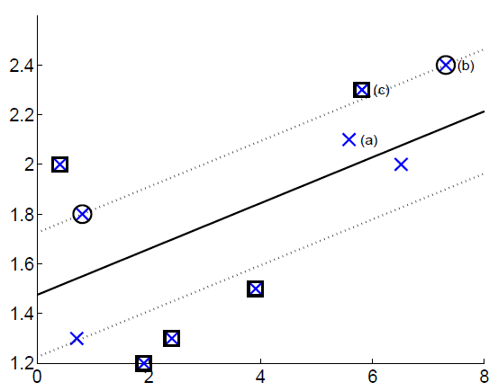
<number>

Slide 20
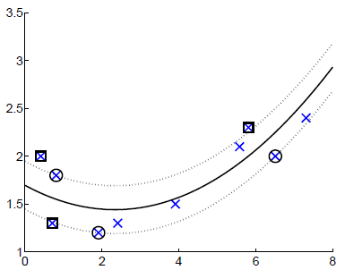
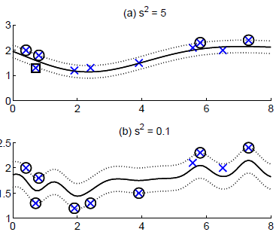
Kernel Regression
<number>
Polynomial kernel
Gaussian kernel

Slide 21
Kernel Machines for Ranking
<number>
We require not only that scores be correct order but at least +1 unit margin.
Linear case:

Slide 22
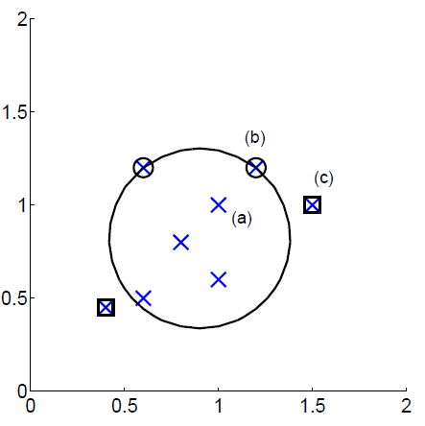
One-Class Kernel Machines
<number>
Consider a sphere with center a and radius R

Slide 23
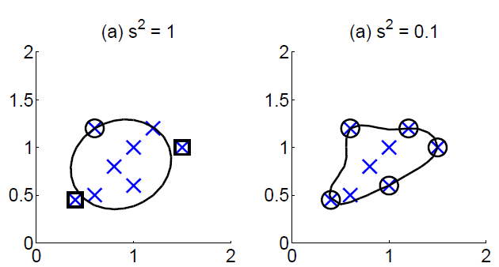
<number>

Slide 24
Large Margin Nearest Neighbor
<number>
Learns the matrix M of Mahalanobis metric
D(x^{i}, x^{j})=(x^{i}-x^{j})^{T}M(x^{i}-x^{j})
For three instances i, j, and l, where i and j are of the same class and l different, we require
D(x^{i}, x^{l}) > D(x^{i}, x^{j})+1
and if this is not satisfied, we have a slack for the difference and we learn M to minimize the sum of such slacks over all i,j,l triples (j and l being one of k neighbors of i, over all i)

Slide 25
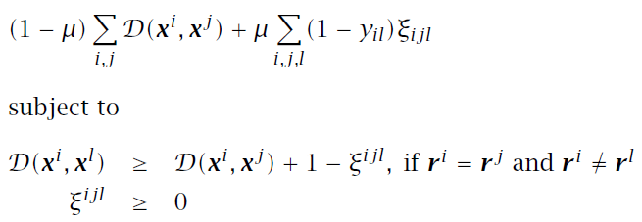
Learning a Distance Measure
<number>
LMNN algorithm (Weinberger and Saul 2009)
LMCA algorithm (Torresani and Lee 2007) uses a similar approach where M=L^{T}L and learns L

Slide 26
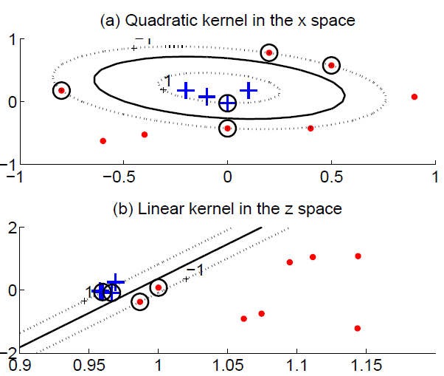
Kernel Dimensionality Reduction
<number>
Kernel PCA does PCA on the kernel matrix (equal to canonical PCA with a linear kernel)
Kernel LDA, CCA

