Slide 1
CHAPTER 19: design and analysis of machine learning experiments

Slide 2
Introduction
<number>
Questions:
Assessment of the expected error of a learning algorithm: Is the error rate of 1-NN less than 2%?
Comparing the expected errors of two algorithms: Is k-NN more accurate than MLP ?
Training/validation/test sets
Resampling methods: K-fold cross-validation

Slide 3
Algorithm Preference
<number>
Criteria (Application-dependent):
Misclassification error, or risk (loss functions)
Training time/space complexity
Testing time/space complexity
Interpretability
Easy programmability
Cost-sensitive learning

Slide 4
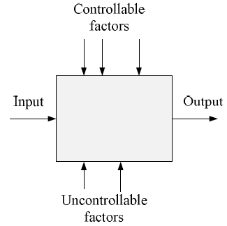
Factors and Response
<number>
Response function based on output to be maximized
Depends on controllable factors
Uncontrollable factors introduce randomness
Find the configuration of controllable factors that maximizes response and minimally affected by uncontrollable factors

Slide 5
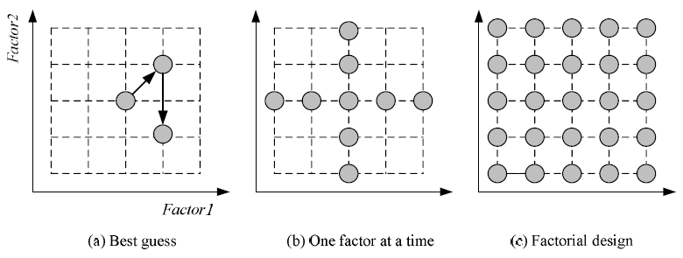
Strategies of Experimentation
<number>
How to search the factor space?
Response surface design for approximating and maximizing
the response function in terms of the controllable factors

Slide 6
Guidelines for ML experiments
<number>
Aim of the study
Selection of the response variable
Choice of factors and levels
Choice of experimental design
Performing the experiment
Statistical Analysis of the Data
Conclusions and Recommendations

Slide 7
Resampling and K-Fold Cross-Validation
<number>
The need for multiple training/validation sets
{X_{i},V_{i}}_{i}: Training/validation sets of fold i
K-fold cross-validation: Divide X into k, X_{i},i=1,...,K
T_{i} share K-2 parts

Slide 8
5×2 Cross-Validation
<number>
5 times 2 fold cross-validation (Dietterich, 1998)

Slide 9
Bootstrapping
<number>
Draw instances from a dataset with replacement
Prob that we do not pick an instance after N draws
that is, only 36.8% is new!

Slide 10
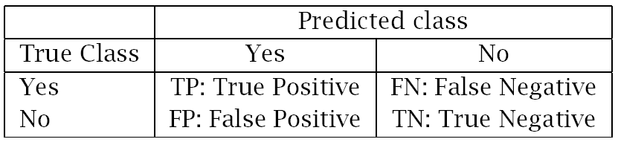
Performance Measures
<number>
Error rate = # of errors / # of instances = (FN+FP) / N
Recall = # of found positives / # of positives
= TP / (TP+FN) = sensitivity = hit rate
Precision = # of found positives / # of found
= TP / (TP+FP)
Specificity = TN / (TN+FP)
False alarm rate = FP / (FP+TN) = 1 - Specificity

Slide 11
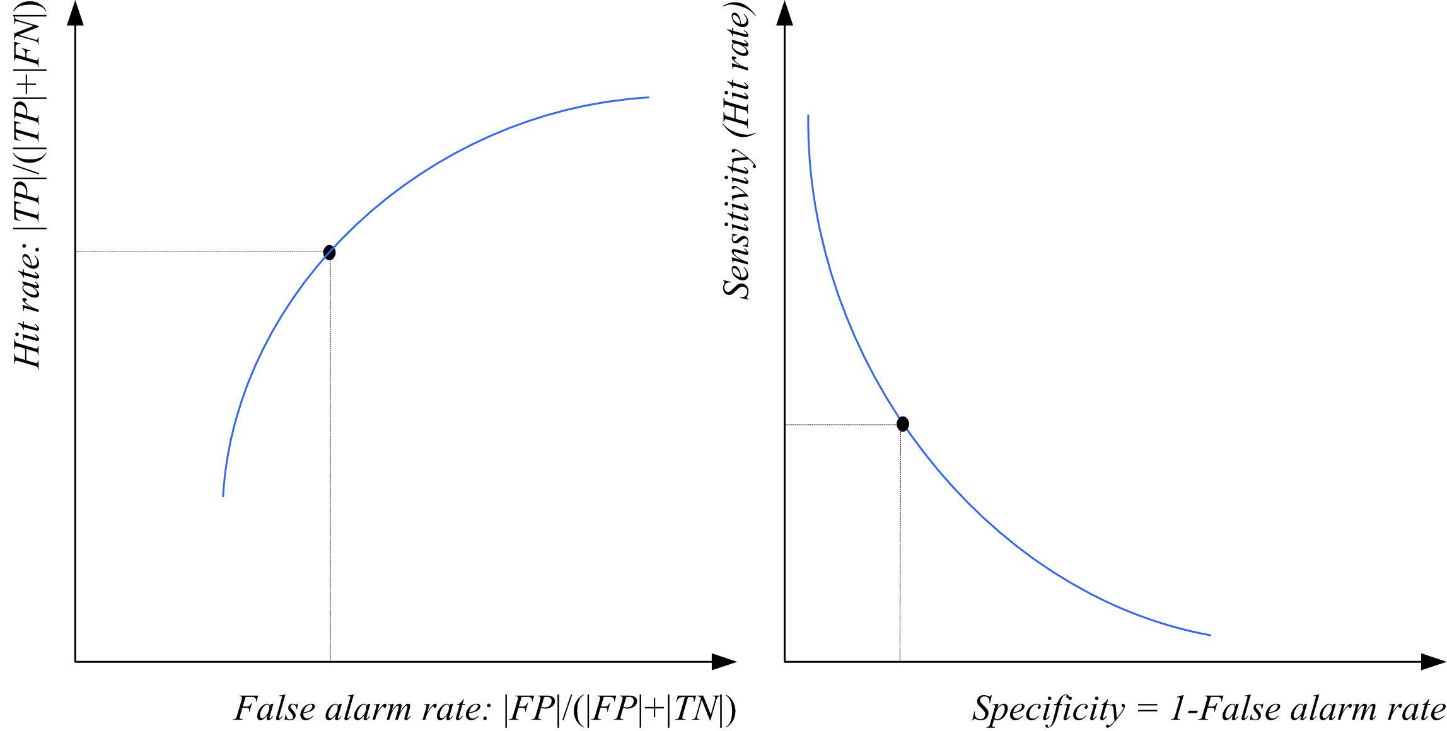
ROC Curve
<number>

Slide 12
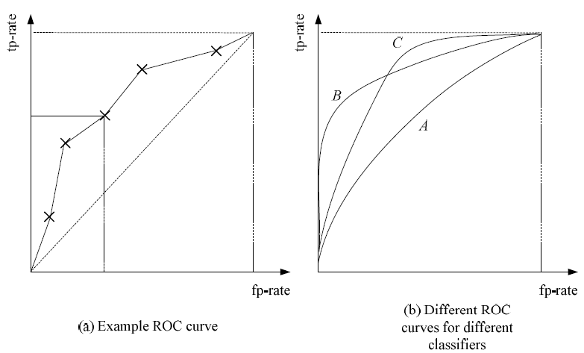
<number>

Slide 13
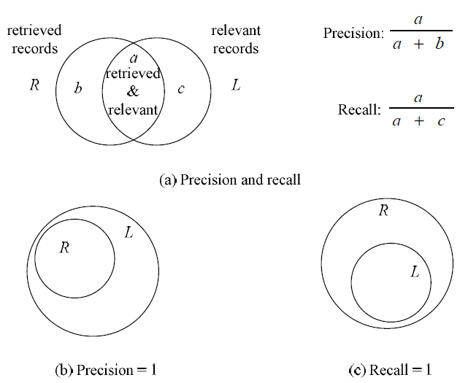
Precision and Recall
<number>

Slide 14
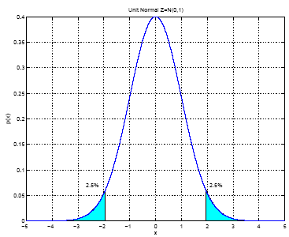
Interval Estimation
<number>
X = { x^{t} }_{t} where x^{t} ~ N ( μ, σ²)
m ~ N ( μ, σ²/N)
100(1- α) percent
confidence interval

Slide 15
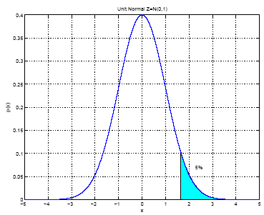
100(1- α) percent one-sided
confidence interval
When σ² is not known:
<number>

Slide 16
Hypothesis Testing
<number>
Reject a null hypothesis if not supported by the sample with enough confidence
X = { x^{t} }_{t} where x^{t} ~ N ( μ, σ²)
H₀: μ = μ₀ vs. H₁: μ ≠ μ₀
Accept H₀ with level of significance α if μ₀ is in the
100(1- α) confidence interval
Two-sided test

Slide 17
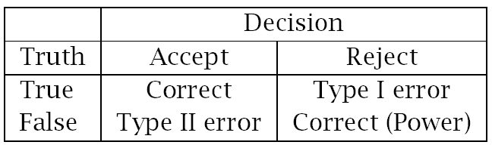
One-sided test: H₀: μ ≤ μ₀ vs. H₁: μ > μ₀
Accept if
Variance unknown: Use t, instead of z
Accept H₀: μ = μ₀ if
<number>

Slide 18
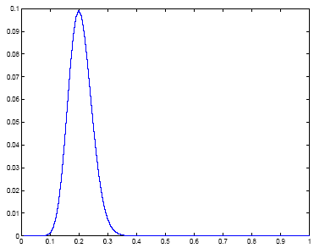
Assessing Error: H₀:p ≤ p₀ vs. H₁:p > p₀
<number>
Single training/validation set: Binomial Test
If error prob is p₀, prob that there are e errors or less in N validation trials is
Accept if this prob is less than 1- α
N=100, e=20
1- α

Slide 19
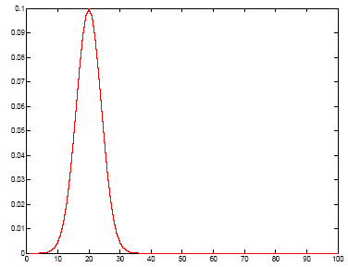
Normal Approximation to the Binomial
<number>
Number of errors X is approx N with mean Np₀ and var Np₀(1-p₀)
Accept if this prob for X = e is
less than z_{1-α}
1- α

Slide 20
Paired t Test
<number>
Multiple training/validation sets
x^{t}_{i} = 1 if instance t misclassified on fold i
Error rate of fold i:
With m and s² average and var of p_{i} , we accept p₀ or less error if
is less than t_{α,K-1}

Slide 21
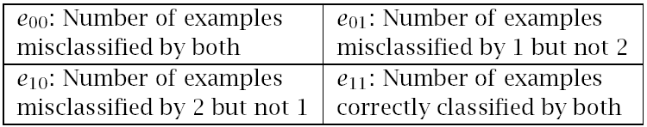
Comparing Classifiers: H₀:μ₀=μ₁ vs. H₁:μ₀≠μ₁
<number>
Single training/validation set: McNemar’s Test
Under H₀, we expect e₀₁= e₁₀=(e₀₁+ e₁₀)/2
Accept if < X²_{α,1}

Slide 22
K-Fold CV Paired t Test
<number>
Use K-fold cv to get K training/validation folds
p_{i}¹, p_{i}²: Errors of classifiers 1 and 2 on fold i
p_{i} = p_{i}¹ – p_{i}² : Paired difference on fold i
The null hypothesis is whether p_{i} has mean 0

Slide 23
5×2 cv Paired t Test
<number>
Use 5×2 cv to get 2 folds of 5 tra/val replications (Dietterich, 1998)
p_{i}^{(j)} : difference btw errors of 1 and 2 on fold j=1, 2 of replication i=1,...,5
Two-sided test: Accept H₀: μ₀ = μ₁ if in (-t_{α/2,5},t_{α/2,5})
One-sided test: Accept H₀: μ₀ ≤ μ₁ if < t_{α,5}

Slide 24
5×2 cv Paired F Test
<number>
Two-sided test: Accept H₀: μ₀ = μ₁ if < F_{α,10,5}

Slide 25
Comparing L>2 Algorithms: Analysis of Variance (Anova)
<number>
Errors of L algorithms on K folds
We construct two estimators to σ² .
One is valid if H₀ is true, the other is always valid.
We reject H₀ if the two estimators disagree.

Slide 26
<number>

Slide 27
<number>

Slide 28
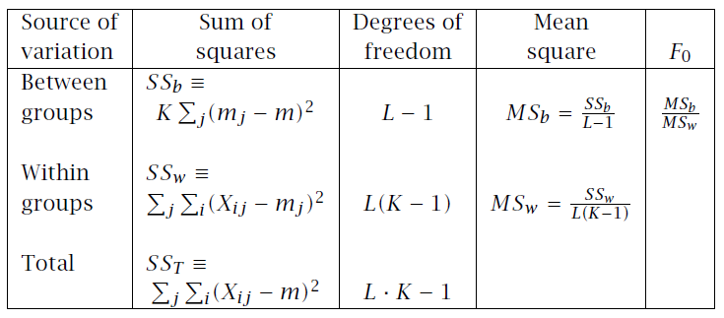
ANOVA table
<number>
If ANOVA rejects, we do pairwise posthoc tests

Slide 29
Comparison over Multiple Datasets
<number>
Comparing two algorithms:
Sign test: Count how many times A beats B over N datasets, and check if this could have been by chance if A and B did have the same error rate
Comparing multiple algorithms
Kruskal-Wallis test: Calculate the average rank of all algorithms on N datasets, and check if these could have been by chance if they all had equal error
If KW rejects, we do pairwise posthoc tests to find which ones have significant rank difference

Slide 30

Multivariate Tests
<number>
Instead of testing using a single performance measure, e.g., error, use multiple measures for better discrimination, e.g., [fp-rate,fn-rate]
Compare p-dimensional distributions
Parametric case: Assume p-variate Gaussians

Slide 31



Multivariate Pairwise Comparison
<number>
Paired differences:
Hotelling’s multivariate T² test
For p=1, reduces to paired t test

Slide 32

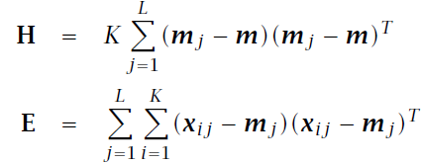

Multivariate ANOVA
<number>
Comparsion of L>2 algorithms

