Slide 1
DS502/MA543: Course Introduction
Welcome to
Statistical Methods for Data Science!
Fall 2016
Prof. Fatemeh Emdad
femdad@wpi.edu
Worcester Polytechnic Institute

Slide 2
Types of Variables
Categorical (qualitative) variables have values that can only be placed into categories, such as “yes” and “no.”
Numerical (quantitative) variables have values that represent a counted or measured quantity.
Discrete variables arise from a counting process
Continuous variables arise from a measuring process

Slide 3
Types of Variables
Variables
Categorical
Numerical
Examples:
Marital Status
Political Party
Eye Color
(Defined categories)
Discrete
Continuous
Examples:
Number of Children
Defects per hour
(Counted items)
Examples:
Weight
Voltage
(Measured characteristics)

Slide 4
Sources of Data
Primary Sources: The data collector is the one using the data for analysis
Data from a political survey
Data collected from an experiment
Observed data
Secondary Sources: The person performing data analysis is not the data collector
Analyzing census data
Examining data from print journals or data published on the internet.

Slide 5
Population vs. Sample
Population
Sample
All the items or individuals about which you want to draw conclusion(s)
A portion of the population of items or individuals
Data Is Collected From Either A Population or A Sample

Slide 6
Learning Objectives
In this chapter, you learn:
How to use regression analysis to predict the value of a dependent variable based on a value of an independent variable
The meaning of the regression coefficients b₀ and b₁
How to evaluate the assumptions of regression analysis and know what to do if the assumptions are violated
To make inferences about the slope and correlation coefficient
To estimate mean values and predict individual values

Slide 7
Correlation vs. Regression
A scatter plot can be used to show the relationship between two variables
Correlation analysis is used to measure the strength of the association (linear relationship) between two variables
Correlation is only concerned with strength of the relationship

Slide 8
Types of Relationships
Linear relationships
Curvilinear relationships
Y
Y
X
X
Y
Y
X
X

Slide 9
Types of Relationships (Weak vs Strong)
Strong relationships
Weak relationships
Y
Y
X
X
Y
Y
X
X

Slide 10
Types of Relationships
No relationship
Y
X
Y
X

Slide 11
What is Statistical Learning?
Suppose we observe (response, output, or dependent variable)
for the p inputs (predictors, input, features,
independent variables) for
We believe that there is a relationship between Y and at least one of the X’s.
We can model the relationship as
Where f is an unknown function and ε is a random error with mean zero.

Slide 12
A Simple Example

Slide 13
A Simple Example
ε_{i}
f

Slide 14
Different Standard Deviations
The difficulty of estimating f will depend on the standard deviation of the ε’s.

Slide 15
Different Estimates For f

Slide 16
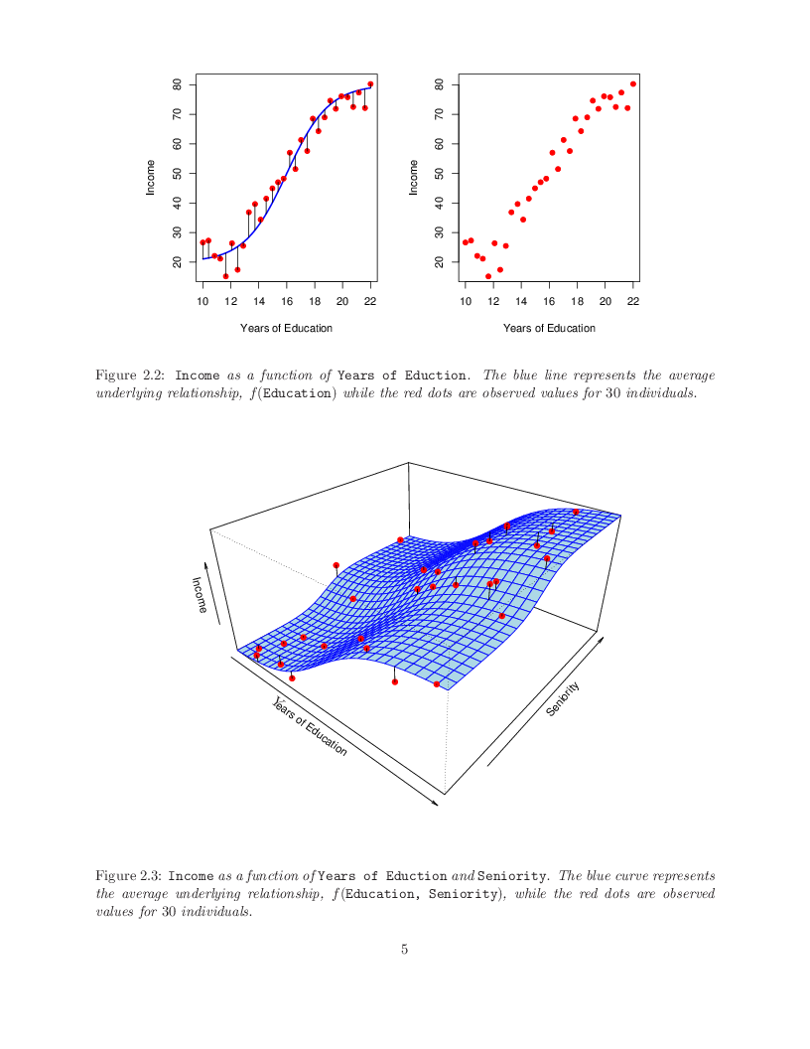
Income vs. Education & Seniority
Blue surface represents the true underlying relationship between income & years of education & seniority which is known since the data are simulated for 30 individuals.

Slide 17
Why Do We Estimate f ?
Statistical Learning, and this course, are all about how to estimate f.
The term statistical learning refers to using the data to “learn” f.
Why do we care about estimating f ?
There are 2 reasons for estimating f,
Prediction and
Inference.

Slide 18
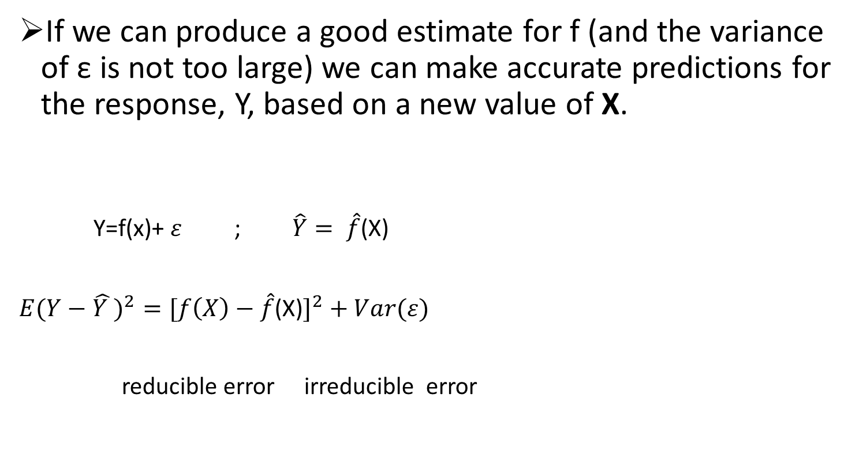
Prediction
If we can produce a good estimate for f (and the variance of ε is not too large) we can make accurate predictions for the response, Y, based on a new value of X.
Y=f(x)+ $ε$ ; $\hat{Y}= \hat{f}$(X)
$E(Y−\hat{Y })^{2}=[f\left(X\right)−\hat{f}$(X)$]^{2}+Var(ε)$
reducible error irreducible error

Slide 19
Inference
Alternatively, we may also be interested in the type of relationship between Y and the X's.
For example,
Which particular predictors actually affect the response?
Is the relationship positive or negative?
Is the relationship a simple linear one or is it more complicated etc.?

Slide 20
How Do We Estimate f?
We will assume we have observed a set of training data
We must then use the training data and a statistical method to estimate f.
Statistical Learning Methods:
Parametric Methods
Non-parametric Methods

Slide 21
Parametric Methods
It reduces the problem of estimating f down to one of estimating a set of parameters.
They involve a two-step model based approach
STEP 1:
Make some assumption about the functional form of f, i.e. come up with a model. The most common example is a linear model i.e.
However, in this course we will examine far more complicated, and flexible, models for f. In a sense the more flexible the model the more realistic it is.

Slide 22
Parametric Methods (cont.)
STEP 2:
Use the training data to fit the model i.e. estimate f or equivalently the unknown parameters such as β₀, β₁, β₂,…, β_{p}.
The most common approach for estimating the parameters in a linear model is ordinary least squares (OLS).
However, this is only one way.
We will see in the course that there are often superior approaches.

Slide 23
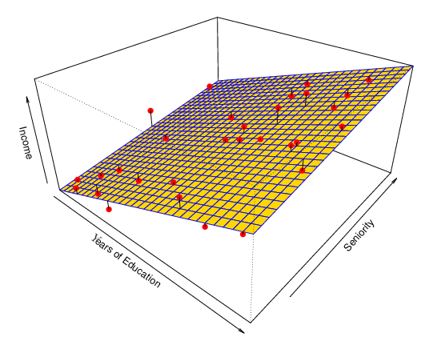
Example: A Linear Regression Estimate
Even if the standard deviation is low we will still get a bad answer if we use the wrong model.

Slide 24
Non-parametric Methods
They do not make explicit assumptions about the functional form of f.
Advantages: They accurately fit a wider range of possible shapes of f.
Disadvantages: A very large number of observations is required to obtain an accurate estimate of f

Slide 25
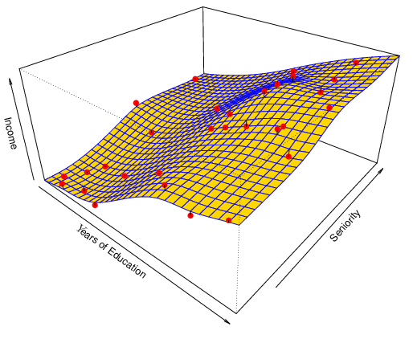
Example: A Thin-Plate Spline Estimate
Non-linear regression methods are more flexible and can potentially provide more accurate estimates.

Slide 26
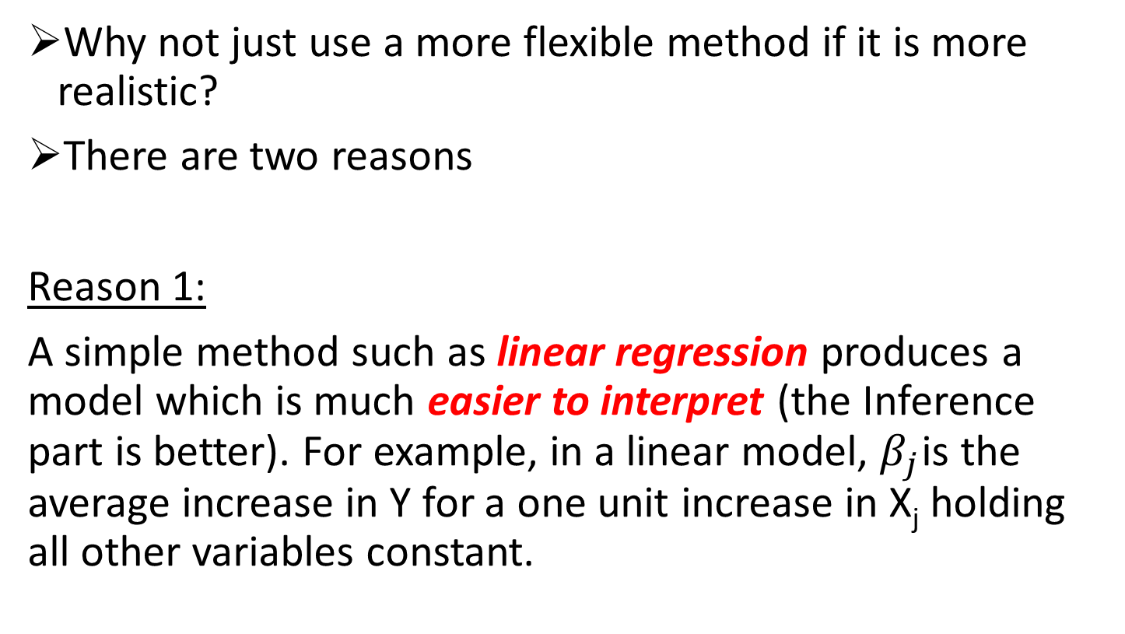
Tradeoff Between Prediction Accuracy and Model Interpretability
Why not just use a more flexible method if it is more realistic?
There are two reasons
Reason 1:
A simple method such as linear regression produces a model which is much easier to interpret (the Inference part is better). For example, in a linear model, $β_{j}$is the average increase in Y for a one unit increase in X_{j} holding all other variables constant.

Slide 27
Why not just use a more flexible method if it is more realistic?
There are two reasons
Reason 2:
Even if you are only interested in prediction, so the first reason is not relevant, it is often possible to get more accurate predictions with a simple, instead of a complicated, model. This seems counter intuitive but has to do with the fact that it is harder to fit a more flexible model.

Slide 28
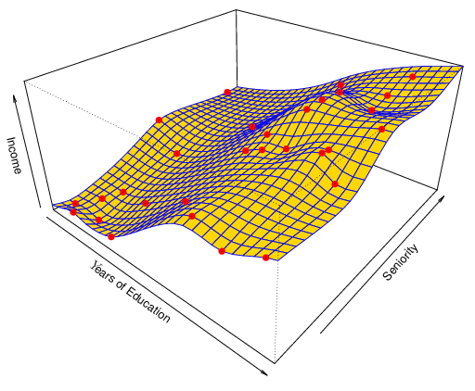
A Poor Estimate
Non-linear regression methods can also be too flexible and produce poor estimates for f.

Slide 29
Supervised vs. Unsupervised Learning
We can divide all learning problems into Supervised and Unsupervised situations
Supervised Learning:
Supervised Learning is where both the predictors, X_{i} , and the response, Y_{i} , are observed.
This is the situation you deal with in Linear Regression classes.
Most of this course will also deal with supervised learning.

Slide 30
Unsupervised Learning:
In this situation only the X_{i}’s are observed.
We need to use the X_{i}’s to guess what Y would have been and build a model from there.
A common example is market segmentation where we try to divide potential customers into groups based on their characteristics.
A common approach is clustering.
We will consider unsupervised learning at the end of this course.

Slide 31
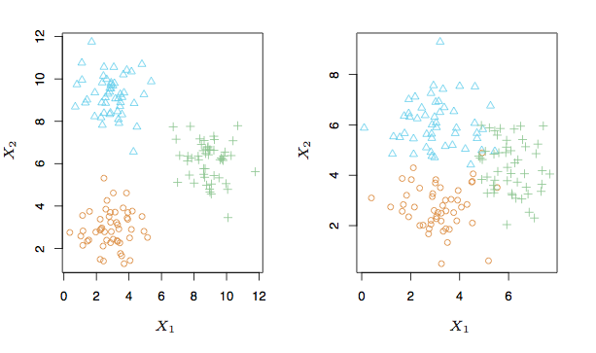
A Simple Clustering Example

Slide 32
Regression vs. Classification
Supervised learning problems can be further divided into regression and classification problems.
Regression covers situations where Y is continuous/numerical. e.g.
Predicting the value of the Dow in 6 months.
Predicting the value of a given house based on various inputs.
Classification covers situations where Y is categorical e.g.
Will the Dow be up (U) or down (D) in 6 months?
Is this email a SPAM or not?

Slide 33
Different Approaches
We will deal with both types of problems in this course.
Some methods work well on both types of problem e.g. Neural Networks
Other methods work best on Regression, e.g. Linear Regression, or on Classification, e.g. k-Nearest Neighbors.

Slide 34
Simple Linear Regression Model
Only one independent variable, X
Relationship between X and Y is described by a linear function
Changes in Y are assumed to be related to changes in X

Slide 35
Simple Linear Regression Model
Population Y intercept
Population Slope Coefficient
Independent Variable
Random Error term
Dependent Variable
Linear component
Random Error
component

Slide 36
Simple Linear Regression Model
Y
Observed Value of Y for X_{i}
ε_{i}
Slope = β₁
Predicted Value of Y for X_{i}
Random Error for this X_{i} value
Intercept = β₀
X_{i}
X

Slide 37
The Least Squares Method
b₀ and b₁ are obtained by finding the values of that minimize the sum of the squared differences between Y and :

Slide 38
Simple Linear Regression Equation (Prediction Line)
The simple linear regression equation provides an estimate of the population regression line
Estimated (or predicted) Y value for observation i
Estimate of the regression intercept
Estimate of the regression slope
Value of X for observation i

Slide 39
Interpretation of the Slope and the Intercept
b₀ is the estimated average value of Y when the value of X is zero
b₁ is the estimated change in the average value of Y as a result of a one-unit increase in X

Slide 40

Simple Linear Regression Example
A real estate agent wishes to examine the relationship between the selling price of a home and its size (measured in square feet)
A random sample of 10 houses is selected
Dependent variable (Y) = house price in $1000s
Independent variable (X) = square feet

Slide 41
Simple Linear Regression Example: Data
House Price in $1000s (Y) | Square Feet (X)
245 | 1400
312 | 1600
279 | 1700
308 | 1875
199 | 1100
219 | 1550
405 | 2350
324 | 2450
319 | 1425
255 | 1700

Slide 42
Simple Linear Regression Example: Scatter Plot
House price model: Scatter Plot

Slide 43
Simple Linear Regression Example: Graphical Representation
House price model: Scatter Plot and Prediction Line
Slope
= 0.10977
Intercept
= 98.248

Slide 44
Simple Linear Regression Example: Interpretation of b_{o}
b₀ is the estimated average value of “house price” (Y) when the value of X is zero (if X = 0 is in the range of observed X values)
Because a house cannot have a square footage of 0, b₀ has no practical application

Slide 45
Simple Linear Regression Example: Interpreting b₁
b₁ estimates the change in the average value of Y as a result of a one-unit increase in X
Here, b₁ = 0.10977 tells us that the mean value of a house increases by 0.10977*($1000) = $109.77, on average, for each additional one square foot of size

Slide 46
Simple Linear Regression Example: Making Predictions
Predict the price for a house with 2000 square feet:
The predicted price for a house with 2000 square feet is 317.85($1,000s) = $317,850

Slide 47
Simple Linear Regression Example: Making Predictions
When using a regression model for prediction, only predict within the relevant range of data
Relevant range for interpolation
Do not try to extrapolate beyond the range of observed X’s

Slide 48
Measures of Variation
Y
Y_{i}
∧
∧
SSE = ∑(Y_{i} - Y_{i} )²
Y
_
SST = ∑(Y_{i} - Y)²
∧
Y
_
∧
_
SSR = ∑(Y_{i} - Y)²
_
Y
Y
X
X_{i}

Slide 49
Measures of Variation
Total variation is made up of two parts:
Total Sum of Squares
Regression Sum of Squares
Error Sum of Squares
where:
= Mean value of the dependent variable
Y_{i} = Observed value of the dependent variable
= Predicted value of Y for the given X_{i} value

Slide 50
Coefficient of Determination, r²
The coefficient of determination is the portion of the total variation in the dependent variable that is explained by variation in the independent variable
The coefficient of determination is also called r-squared and is denoted as r²
note:

Slide 51
Examples of Approximate r² Values
Y
X
Perfect linear relationship between X and Y:
100% of the variation in Y is explained by variation in X
r² = 1
Y
X
r² = 1

Slide 52
Examples of Approximate r² Values
Y
0 < r² < 1
X
Weaker linear relationships between X and Y:
Some but not all of the variation in Y is explained by variation in X
Y
X

Slide 53
Examples of Approximate r² Values
r² = 0
Y
No linear relationship between X and Y:
The value of Y does not depend on X. (None of the variation in Y is explained by variation in X)
r² = 0
X

Slide 54
Simple Linear Regression Example: Coefficient of Determination, r²
A real estate agent wishes to examine the relationship between the selling price of a
home and its size (measured in square feet)
The regression equation is
Price = 98.2 + 0.110 Square Feet
Predictor Coef SE Coef T P
Constant 98.25 58.03 1.69 0.129
Square Feet 0.10977 0.03297 3.33 0.010
S = 41.3303 R-Sq = 58.1% R-Sq(adj) = 52.8%
Analysis of Variance
Source DF SS MS F P
Regression 1 18935 18935 11.08 0.010
Residual Error 8 13666 1708
Total 9 32600
58.08% of the variation in house prices is explained by variation in square feet

Slide 55
Standard Error of Estimate
Residual Standard Error(RSE)
The standard deviation of the variation of observations around the regression line is estimated by
Where
SSE = error sum of squares
n = sample size

Slide 56
Comparing Standard Errors
Standard error of the estimate is a measure of the variation of observed Y values from the regression line
Y
Y
X
X
The magnitude of S_{YX} should always be judged relative to the size of the Y values in the sample data
i.e., S_{YX} = $41.33K is moderately small relative to house prices in the $200K - $400K range

Slide 57
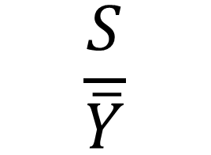
Rate the model?
0-10% Great Model
10-15% Good Model
15-20% Fair Model
> 20% Poor model
$$\frac{S}{\overline{Y}}$$

Slide 58
Assumptions of Regression L.I.N.E
Linearity
The relationship between X and Y is linear
Independence of Errors
Error values are statistically independent
Normality of Error
Error values are normally distributed for any given value of X
Equal Variance (also called homoscedasticity)
The probability distribution of the errors has constant variance

Slide 59
Potential Fit Problems
There are a number of possible problems that one may encounter when fitting the linear regression model.
Non-linearity of the data
Dependence of the error terms
Non-constant variance of error terms
Outliers
High leverage points
Collinearity
See Section 3.3.3 for more details.

Slide 60
Inferences About the Slope: t Test
t test for a population slope
Is there a linear relationship between X and Y?
Null and alternative hypotheses
H₀: β₁ = 0 (no linear relationship)
H₁: β₁ ≠ 0 (linear relationship does exist)
Test statistic
where:
b₁ = regression slope
coefficient
β₁ = hypothesized slope
S_{b1} = standard
error of the slope

Slide 61
Inferences About the Slope: t Test Example
House Price in $1000s (y) | Square Feet (x)
245 | 1400
312 | 1600
279 | 1700
308 | 1875
199 | 1100
219 | 1550
405 | 2350
324 | 2450
319 | 1425
255 | 1700
Estimated Regression Equation:
The slope of this model is 0.1098
Is there a relationship between the square footage of the house and its sales price?

Slide 62
Inferences About the Slope: t Test Example
H₀: β₁ = 0
H₁: β₁ ≠ 0
Test Statistic: t_{STAT} = 3.329
P-value=0.010
d.f. = 10- 2 = 8
Decision: Reject H₀
α/2=.025
α/2=.025
There is sufficient evidence that square footage affects house price. P-value=0.010
Reject H₀
Do not reject H₀
Reject H₀
-t_{α/2}
0
t_{α/2}
-2.3060
2.3060
3.329
Decision: Reject H₀, since p-value < α

Slide 63
Learning Objectives
In this chapter, you learn:
How to develop a multiple regression model
How to interpret the regression coefficients
How to determine which independent variables to include in the regression model
How to determine which independent variables are most important in predicting a dependent variable
How to use categorical independent variables in a regression model
How to predict a categorical dependent variable using logistic regression
How to identify individual observations that may be unduly influencing the multiple regression model

Slide 64
The Multiple Regression Model
Idea: Examine the linear relationship between
1 dependent (Y) & 2 or more independent variables (X_{i})
Multiple Regression Model with k Independent Variables:
Y-intercept
Population slopes
Random Error

Slide 65
Multiple Regression Equation
The coefficients of the multiple regression model are estimated using sample data
Multiple regression equation with k independent variables:
Estimated
(or predicted)
value of Y
Estimated
intercept
Estimated slope coefficients

Slide 66
Multiple Regression Equation
Two variable model
Y
Slope for variable X₁
X₂
Slope for variable X₂
X₁

Slide 67
Example: 2 Independent Variables
A distributor of frozen dessert pies wants to evaluate factors thought to influence demand
Dependent variable: Pie sales (units per week)
Independent variables: Price (in $)
Advertising ($100’s)
Data are collected for 15 weeks

Slide 68
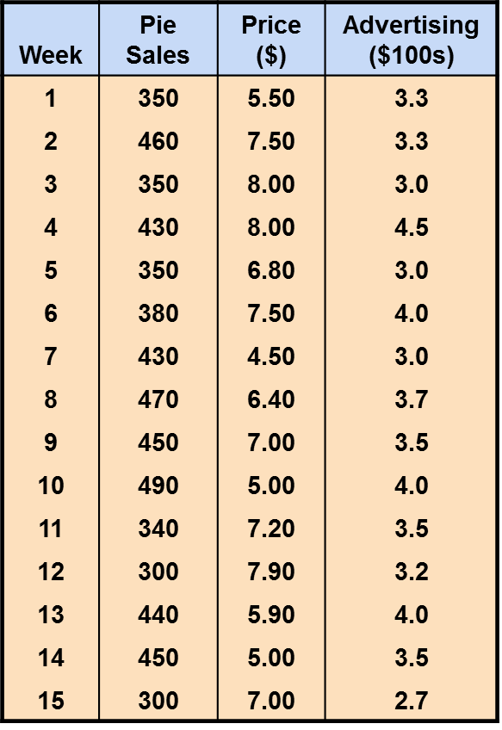
Pie Sales Example
Multiple regression equation:
Sales = b₀ + b₁ (Price)
+ b₂ (Advertising)

Slide 69
The Multiple Regression Equation
where
Sales is in number of pies per week
Price is in $
Advertising is in $100’s.
b₂ = 74.131: sales will increase, on average, by 74.131 pies per week for each $100 increase in advertising, net of the effects of changes due to price
b₁ = -24.975: sales will decrease, on average, by 24.975 pies per week for each $1 increase in selling price, net of the effects of changes due to advertising

Slide 70
Using The Equation to Make Predictions
Predict sales for a week in which the selling price is $5.50 and advertising is $350:
Note that Advertising is in $100s, so $350 means that X₂ = 3.5
Predicted sales is 428.62 pies

Slide 71
The Coefficient of Multiple Determination, r²
Reports the proportion of total variation in Y explained by all X variables taken together
52.1% of the variation in pie sales is explained by the variation in price and advertising

Slide 72
Adjusted r²
r² never decreases when a new X variable is added to the model
This can be a disadvantage when comparing models
What is the net effect of adding a new variable?
We lose a degree of freedom when a new X variable is added
Did the new X variable add enough explanatory power to offset the loss of one degree of freedom?

Slide 73
Adjusted r²
Shows the proportion of variation in Y explained by all X variables adjusted for the number of X variables used
(where n = sample size, k = number of independent variables)
Penalizes excessive use of unimportant independent variables
Smaller than r²
Useful in comparing among models
44.2% of the variation in pie sales is explained by the variation in price and advertising, taking into account the sample size and number of independent variables

Slide 74
Is the Model Significant?
F Test for Overall Significance of the Model
Shows if there is a linear relationship between all of the X variables considered together and Y
Use F-test statistic
Hypotheses:
H₀: β₁ = β₂ = … = β_{k} = 0 (no linear relationship)
H₁: at least one β_{i} ≠ 0 (at least one independent
variable affects Y)

Slide 75
F Test for Overall Significance
Test statistic:
where F_{STAT} has numerator d.f. = k and
denominator d.f. = (n – k - 1)
With 2 and 12 degrees of freedom
P-value for the F Test=0.012

Slide 76
F Test for Overall Significance
H₀: β₁ = β₂ = 0
H₁: β₁ and β₂ not both zero
α = .05
df₁= 2 df₂ = 12
Test Statistic:
Decision:
Conclusion:
Critical Value:
F_{0.05} = 3.885
Since F_{STAT} test statistic is in the rejection region (p-value < .05), reject H₀
α = .05
0
F
There is evidence that at least one independent variable affects Y
Do not
reject H₀
Reject H₀
F_{0.05} = 3.885

Slide 77
Is the whole regression explaining anything at all?
Test for:
H₀: all slopes = 0 (β₁=β₂=⋅⋅⋅=β_{p}=0),
H_{a}: at least one slope ≠ 0
Answer comes from the F test in the ANOVA (ANalysis Of VAriance) table.
The ANOVA table has many pieces of information. What we care about is the F Ratio and the corresponding p-value.

Slide 78
Residuals in Multiple Regression
Two variable model
Y
Sample observation
Y_{i}
Residual = e_{i} = (Y_{i} – Y_{i})
<
<
Y_{i}
x_{2i}
X₂
x_{1i}
The best fit equation is found by minimizing the sum of squared errors, Σe²
X₁

Slide 79
Multiple Regression Assumptions
Errors (residuals) from the regression model:
<
e_{i} = (Y_{i} – Y_{i})
Assumptions:
The errors are normally distributed
Errors have a constant variance
The model errors are independent

Slide 80
Are Individual Variables Significant?
Use t tests of individual variable slopes
Shows if there is a linear relationship between the variable X_{j} and Y holding constant the effects of other X variables
Hypotheses:
H₀: β_{j} = 0 (no linear relationship)
H₁: β_{j} ≠ 0 (linear relationship does exist
between X_{j} and Y)

Slide 81
Are Individual Variables Significant?
H₀: β_{j} = 0 (no linear relationship between X_{j} and Y)
H₁: β_{j} ≠ 0 (linear relationship does exist between X_{j} and Y)
Test Statistic:
df=n-k-1

Slide 82
Are Individual Variables Significant?
For Price t_{STAT} = -2.306, with p-value .0398
For Advertising t_{STAT} = 2.855, with p-value .0145
H₀: β_{j} = 0
H₁: β_{j} ≠ 0
d.f. = 15-2-1 = 12
= .05
t_{α/2} = 2.1788
The test statistic for each variable falls in the rejection region (p-values < .05)
Decision:
Conclusion:
α/2=.025
α/2=.025
Reject H₀ for each variable
There is evidence that both Price and Advertising affect pie sales at α = .05
Reject H₀
Do not reject H₀
Reject H₀
-t_{α/2}
0
t_{α/2}
-2.1788
2.1788

Slide 83
Confidence Interval Estimate for the Slope
Confidence interval for the population slope β_{j}
where t has (n – k – 1) d.f.
 | Coefficients | Standard Error
Intercept | 306.52619 | 114.25389
Price | -24.97509 | 10.83213
Advertising | 74.13096 | 25.96732
Here, t has (15 – 2 – 1) = 12 d.f.
Example: Form a 95% confidence interval for the effect of changes in price (X₁) on pie sales:
-24.975 ± (2.1788)(10.832)
So the interval is (-48.576 , -1.374)
(This interval does not contain zero, so price has a significant effect on sales)

Slide 84
Qualitative Predictors
How do you stick “men” and “women” (category listings) into a regression equation?
Code them as indicator variables (dummy variables)
For example we can “code” Males=0 and Females= 1.

Slide 85
Interpretation
Suppose we want to include income and gender.
Two genders (male and female). Let
then the regression equation is
β₂ is the average extra balance each month that females have for given income level. Males are the “baseline”.

Slide 86
Using Dummy Variables
A dummy variable is a categorical independent variable with two/or more levels:
yes or no, on or off, male or female
coded as 0 or 1
Assumes the slopes associated with numerical independent variables do not change with the value for the categorical variable
If more than two levels, the number of dummy variables needed is (number of levels - 1)

Slide 87
Dummy-Variable Example (with 2 Levels)
Let:
Y = pie sales
X₁ = price
X₂ = holiday (X₂ =1 if there is holiday that week) (X₂ = 0 if there was no holiday that week)

Slide 88
Dummy-Variable Example (with 2 Levels)
Holiday
No Holiday
Different intercept
Same slope
Y (sales)
If H₀: β₂ = 0 is rejected, then
“Holiday” has a significant effect on pie sales
b₀ + b₂
b₀
Holiday (X₂ = 1)
No Holiday (X₂ = 0)
X₁ (Price)

Slide 89
Interpreting the Dummy Variable Coefficient (with 2 Levels)
Example:
Sales: number of pies sold per week
Price: pie price in $
Holiday:
1 If a holiday occurred during the week
0 If no holiday occurred
b₂ = 15: on average, sales were 15 pies greater in weeks with a holiday than in weeks without a holiday, given the same price

Slide 90
Dummy-Variable Models (more than 2 Levels)
The number of dummy variables is one less than the number of levels
Example:
Y = house price ; X₁ = square feet
If style of the house is also thought to matter:
Style = ranch, split level, colonial
Three levels, so two dummy variables are needed

Slide 91
Dummy-Variable Models (more than 2 Levels)
Example: Let “colonial” be the default category, and let X₂ and X₃ be used for the other two categories:
Y = house price
X₁ = square feet
X₂ = 1 if ranch, 0 otherwise
X₃ = 1 if split level, 0 otherwise
The multiple regression equation is:

Slide 92
Interpreting the Dummy Variable Coefficients (with 3 Levels)
Consider the regression equation:
For a colonial: X₂ = X₃ = 0
With the same square feet, a ranch will have an estimated average price of 23.53 thousand dollars more than a colonial.
For a ranch: X₂ = 1; X₃ = 0
For a split level: X₂ = 0; X₃ = 1
With the same square feet, a split-level will have an estimated average price of 18.84 thousand dollars more than a colonial.

Slide 93
Other Issues Discussed
Interaction terms
Non-linear effects
Multicollinearity
Model Selection

Slide 94
Interaction
When the effect on Y of increasing X₁ depends on another X₂.
Example:
Maybe the effect on Salary (Y) when increasing Position (X₁) depends on gender (X₂)?
For example maybe Male salaries go up faster (or slower) than Females as they get promoted.
Advertising example:
TV and radio advertising both increase sales.
Perhaps spending money on both of them may increase sales more than spending the same amount on one alone?

Slide 95
Interaction Between Independent Variables
Hypothesizes interaction between pairs of X variables
Response to one X variable may vary at different levels of another X variable
Contains two-way cross product terms

Slide 96
Effect of Interaction
Given:
Without interaction term, effect of X₁ on Y is measured by β₁
With interaction term, effect of X₁ on Y is measured by β₁ + β₃ X₂
Effect changes as X₂ changes

Slide 97
Interaction Example
Suppose X₂ is a dummy variable and the estimated regression equation is
= 1 + 2X₁ + 3X₂ + 4X₁X₂
Y
12
X₂ = 1:
Y = 1 + 2X₁ + 3(1) + 4X₁(1) = 4 + 6X₁
8
4
X₂ = 0:
Y = 1 + 2X₁ + 3(0) + 4X₁(0) = 1 + 2X₁
0
X₁
0
0.5
1
1.5
Slopes are different if the effect of X₁ on Y depends on X₂ value

Slide 98
Interaction in advertising
Interaction Term
Sales =6.75 + 0.0191*TV + 0.0289*Radio + 0.0011*TV*radio
Spending $1 extra on TV increases average sales by 0.0191 + 0.0011Radio
Spending $1 extra on Radio increases average sales by 0.0289 + 0.0011TV

Slide 99
Assessing model accuracy
Chapter 02 – Part II

Slide 100
Outline
Assessing Model Accuracy
Measuring the Quality of Fit
The Bias-Variance Trade-off
The Classification Setting

Slide 101
Measuring Quality of Fit
Suppose we have a regression problem.
One common measure of accuracy is the mean squared error (MSE) i.e.
Where is the prediction our method gives for the observation in our training data.

Slide 102
A Problem
In either case our method has generally been designed to make MSE small on the training data we are looking at e.g. with linear regression we choose the line such that MSE is minimized.
What we really care about is how well the method works on new data. We call this new data “Test Data”.
There is no guarantee that the method with the smallest training MSE will have the smallest test (i.e. new data) MSE.

Slide 103
Training vs. Test MSE’s
In general the more flexible a method is the lower its training MSE will be i.e. it will “fit” or explain the training data very well.
Side Note: More Flexible methods (such as splines) can generate a wider range of possible shapes to estimate f as compared to less flexible and more restrictive methods (such as linear regression). The less flexible the method, the easier to interpret the model. Thus, there is a trade-off between flexibility and model interpretability.
However, the test MSE may in fact be higher for a more flexible method than for a simple approach like linear regression.

Slide 104
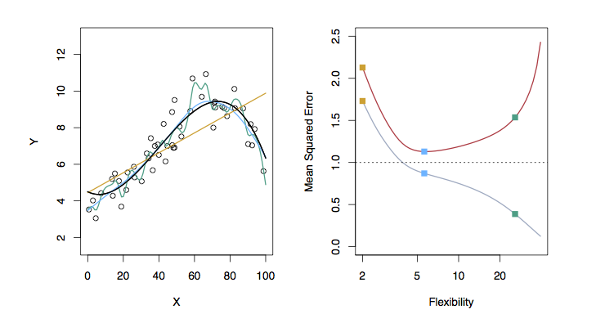
Examples with Different Levels of Flexibility: Example 1
LEFT
Black: Truth
Orange: Linear Estimate
Blue: smoothing spline
Green: smoothing spline (more flexible)
RIGHT
RED: Test MSE
Grey: Training MSE
Dashed: Minimum possible test MSE (irreducible error)

Slide 105
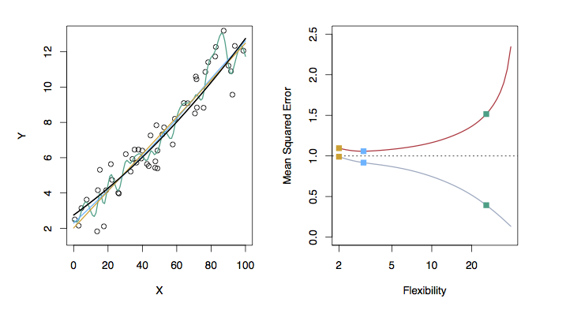
Examples with Different Levels of Flexibility: Example 2
LEFT
Black: Truth
Orange: Linear Estimate
Blue: smoothing spline
Green: smoothing spline (more flexible)
RIGHT
RED: Test MSE
Grey: Training MSE
Dashed: Minimum possible test MSE (irreducible error)

Slide 106
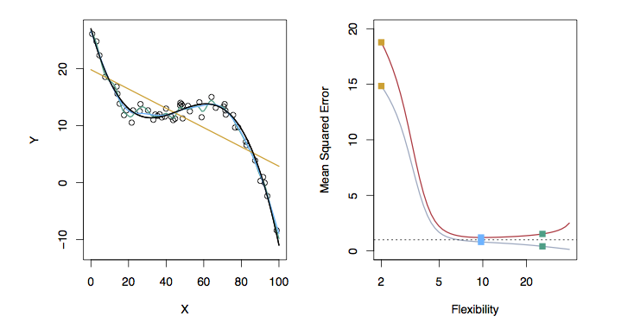
Examples with Different Levels of Flexibility: Example 3
LEFT
Black: Truth
Orange: Linear Estimate
Blue: smoothing spline
Green: smoothing spline (more flexible)
RIGHT
RED: Test MSE
Grey: Training MSE
Dashed: Minimum possible test MSE (irreducible error)

Slide 107
Bias/ Variance Tradeoff
The previous graphs of test versus training MSE’s illustrates a very important tradeoff that governs the choice of statistical learning methods.
There are always two competing forces that govern the choice of learning method i.e. bias and variance.

Slide 108
Bias of Learning Methods
Bias refers to the error that is introduced by modeling a real life problem (that is usually extremely complicated) by a much simpler problem.
For example, linear regression assumes that there is a linear relationship between Y and X. It is unlikely that, in real life, the relationship is exactly linear so some bias will be present.
The more flexible/complex a method is the less bias it will generally have.

Slide 109
Variance of Learning Methods
Variance refers to how much your estimate for f would change by if you had a different training data set.
Generally, the more flexible a method is the more variance it has.

Slide 110
The Trade-off
It can be shown that for any given, X=x₀, the expected test MSE for a new Y at x₀ will be equal to
What this means is that as a method gets more complex the bias will decrease and the variance will increase but expected test MSE may go up or down!

Slide 111
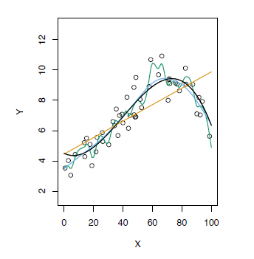
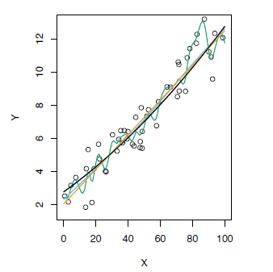
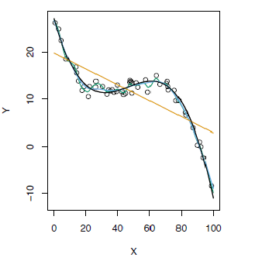
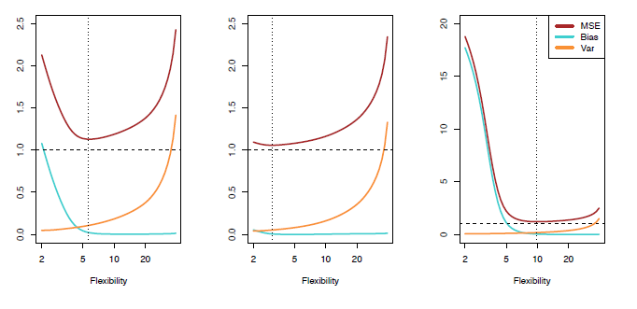
Test MSE, Bias and Variance

Slide 112
The Classification Setting
For a regression problem, we used the MSE to assess the accuracy of the statistical learning method
For a classification problem we can use the error rate i.e.
is an indicator function, which will give 1 if the
condition is correct, otherwise it gives a 0.
Thus the error rate represents the fraction of incorrect classifications, or misclassifications

Slide 113
KNN Regression
kNN Regression is similar to the kNN classifier.
To predict Y for a given value of X, consider k closest points to X in training data and take the average of the responses. i.e.
If k is small kNN is much more flexible than linear regression.
Is that better?

Slide 114
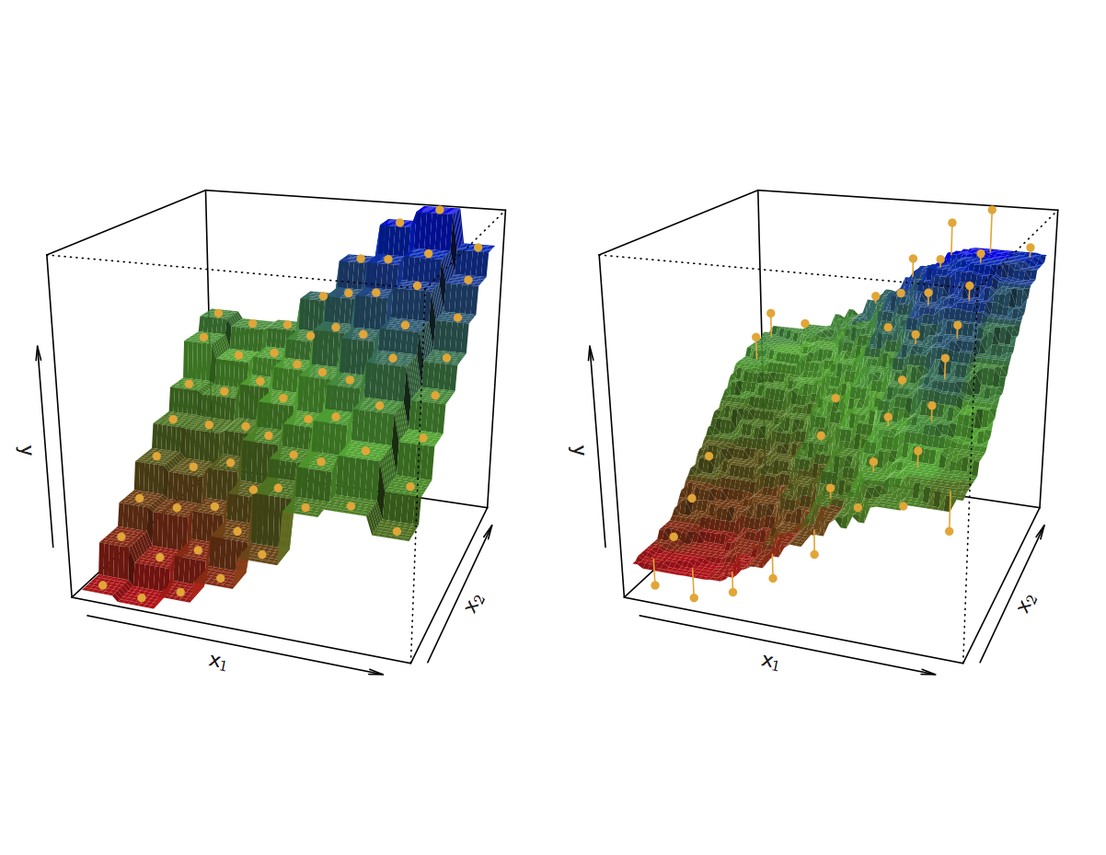
KNN Fits for k =1 and k = 9
If k is small kNN is much more flexible than linear regression.

Slide 115
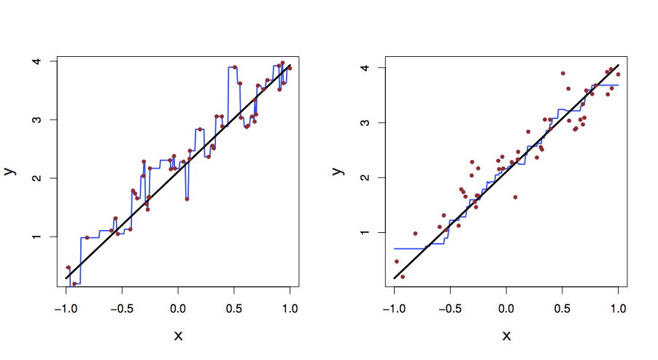
KNN Fits in One Dimension (k =1 and k = 9)
If k is small kNN is much more flexible than linear regression.

Slide 116
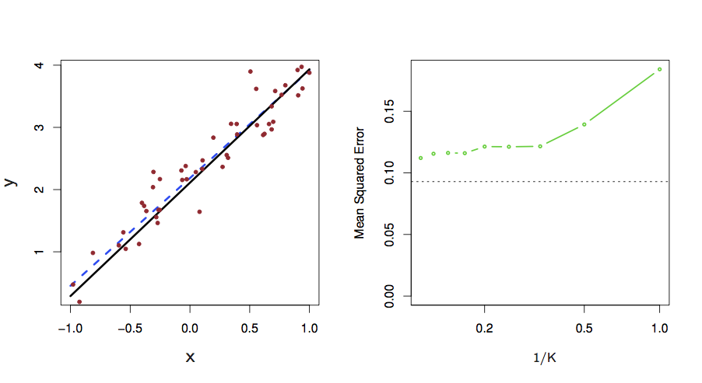
Linear Regression Fit
Left: Blue dashed line: least square fit (black line is f(x))
right: dashed horizontal line: least squares test MSE Green:MSE for KNN as a function of 1/k
Linear regression achieves a lower test MSE than KNN

Slide 117
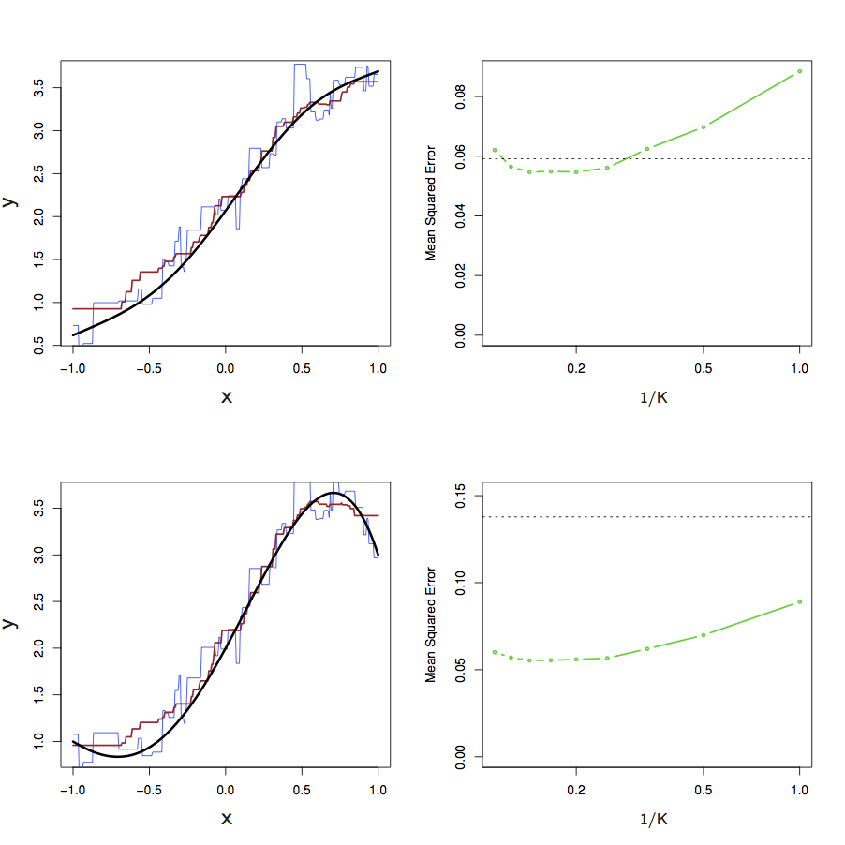
KNN vs. Linear Regression
Test set MSE
for least square regression (black dots)
For KNN (green solid lines)
Slightly non-linear used KNN(k=1,9)
Strongly non-linear used KNN(k=1,9)

Slide 118
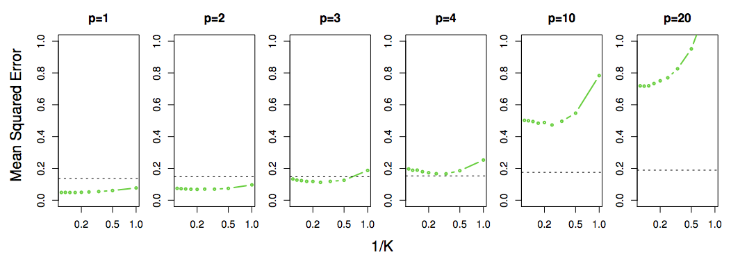
Not So Good in High Dimensional Situations
Test MSE for
linear regression (black dots)
KNN (green curves)
Note: p=# of variables
KNN’s performance degrades as p increases

Slide 119
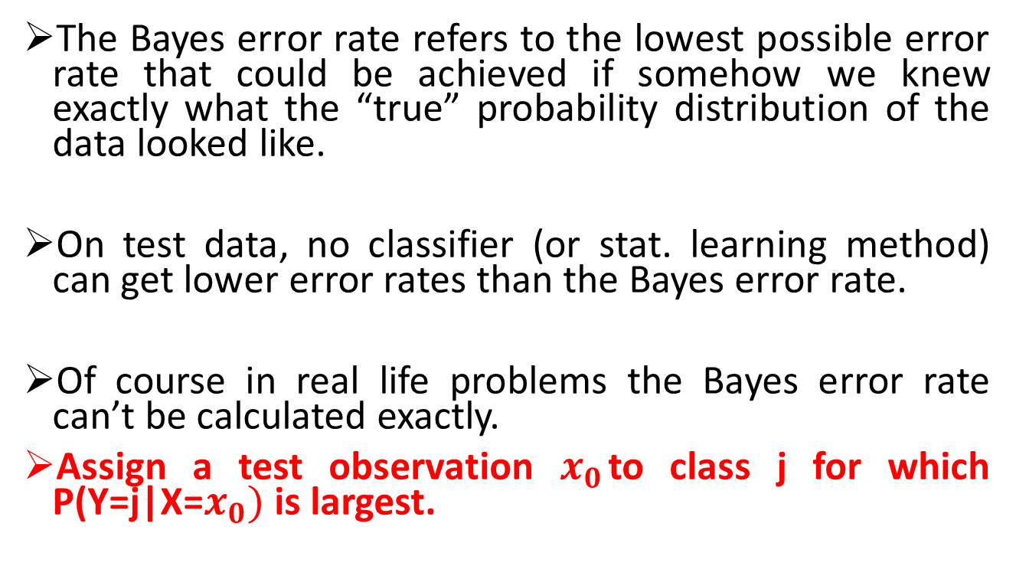
Bayes Error Rate
The Bayes error rate refers to the lowest possible error rate that could be achieved if somehow we knew exactly what the “true” probability distribution of the data looked like.
On test data, no classifier (or stat. learning method) can get lower error rates than the Bayes error rate.
Of course in real life problems the Bayes error rate can’t be calculated exactly.
Assign a test observation $x_{0}$to class j for which P(Y=j|X=$x_{0})$ is largest.

Slide 120
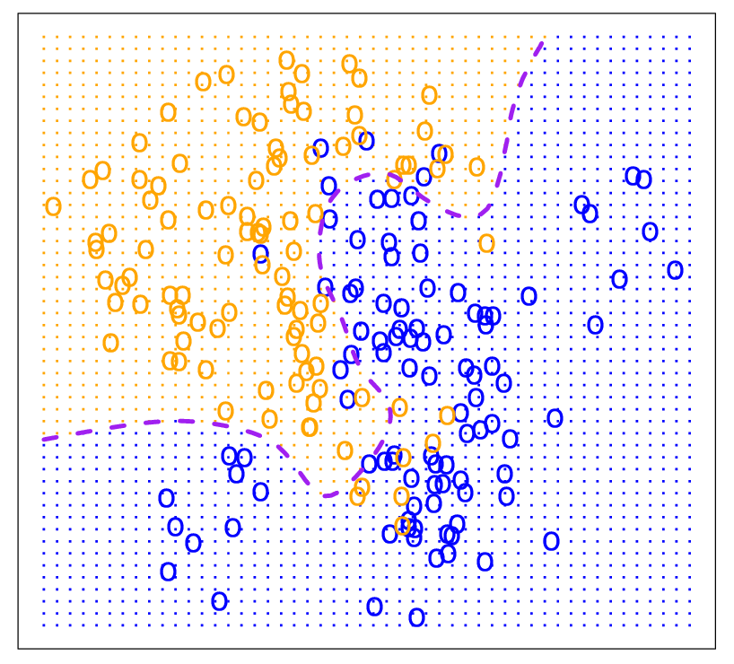
Bayes Optimal Classifier

Slide 121
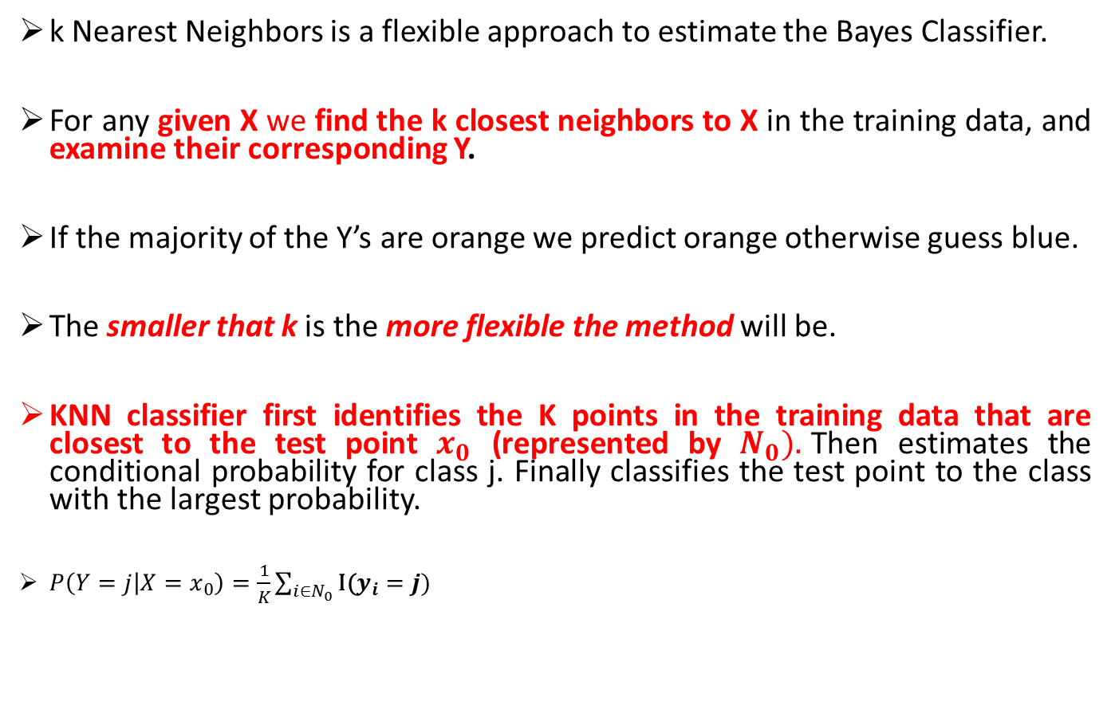
K-Nearest Neighbors (KNN)
k Nearest Neighbors is a flexible approach to estimate the Bayes Classifier.
For any given X we find the k closest neighbors to X in the training data, and examine their corresponding Y.
If the majority of the Y’s are orange we predict orange otherwise guess blue.
The smaller that k is the more flexible the method will be.
KNN classifier first identifies the K points in the training data that are closest to the test point $x_{0}$ (represented by $N_{0}).$Then estimates the conditional probability for class j. Finally classifies the test point to the class with the largest probability.
$P\left(Y=j | X=x_{0}\right)=\frac{1}{K}\sum_{i∈N_{0}}{\text{I}\text{(}y_{i}=j)}$

Slide 122
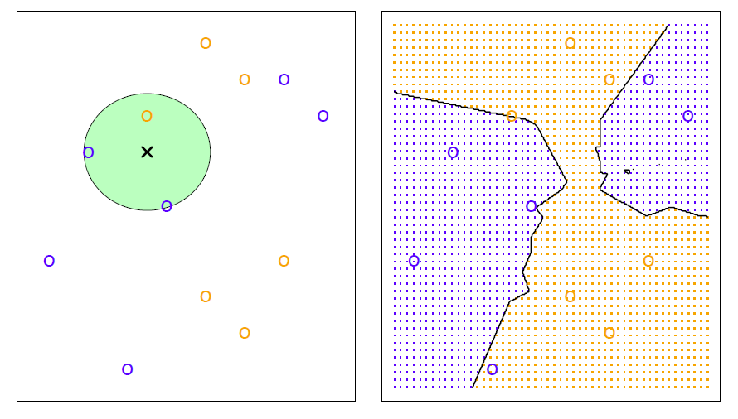
KNN Example with k = 3
The test observation belongs to the most commonly-occurring class (in this case; blue)
Right: The KNN decision boundaries

Slide 123
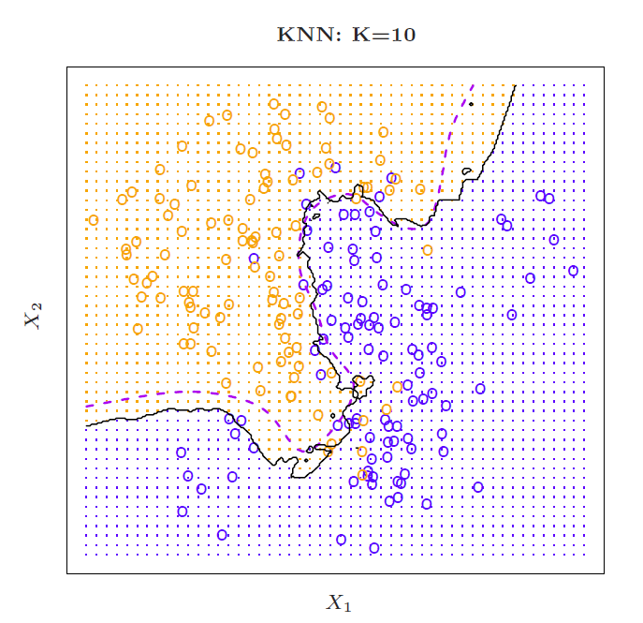
Simulated Data: K = 10
The black curve indicates the KNN decision boundary K=10
The purple dashed line is the Bayes decision boundaries

Slide 124
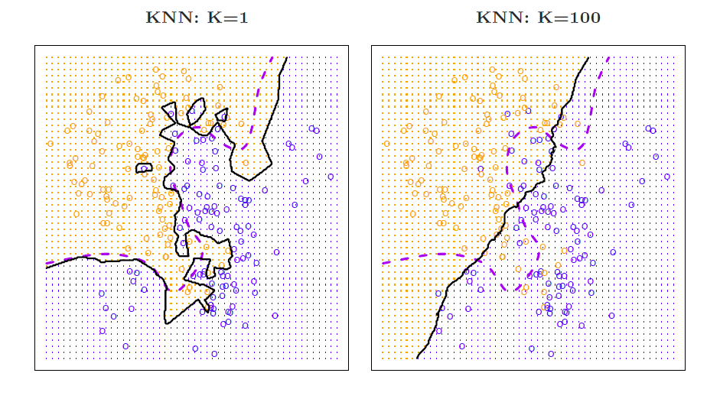
K = 1 and K = 100
The decision boundary is overly flexible when K=1
The decision boundary is not sufficiently flexible when K=100
Bayes decision boundary is in purple dashed lines
KNN decision boundaries are solid black lines

Slide 125
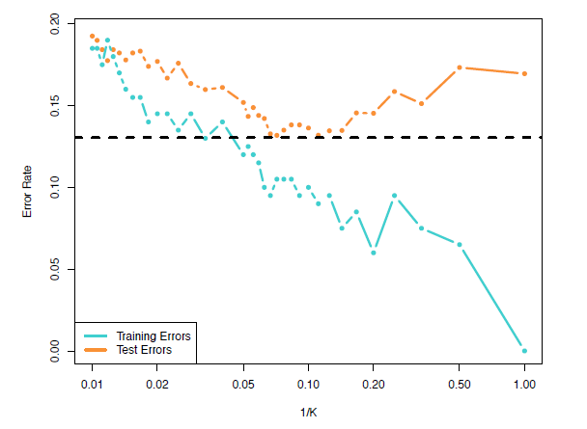
Training vs. Test Error Rates on the Simulated Data
Notice that training error rates keep going down as k decreases or equivalently as the flexibility increases.
However, the test error rate at first decreases but then starts to increase again.
The jumpiness of the curves is due to small size of the training data

Slide 126
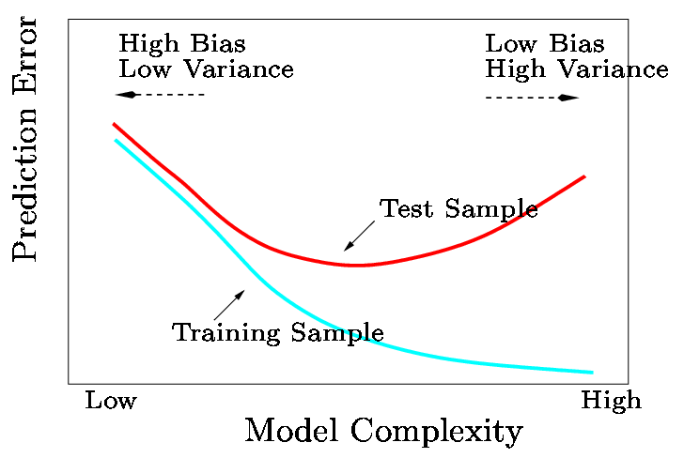
A Fundamental Picture
In general training errors will always decline.
However, test errors will decline at first (as reductions in bias dominate) but will then start to increase again (as increases in variance dominate).
We must always keep this picture in mind when choosing a learning method. More flexible/complicated is not always better!

Slide 127
Learning Objectives
In this session you learn:
To use quadratic terms in a regression model
To use transformed variables in a regression model
To measure the correlation among the independent variables
To build a regression model using either the stepwise or best-subsets approach
To avoid the pitfalls involved in developing a multiple regression model

Slide 128
Nonlinear Relationships
The relationship between the dependent variable and an independent variable may not be linear
Can review the scatter plot to check for non-linear relationships
Example: Quadratic model
The second independent variable is the square of the first variable

Slide 129
Quadratic Regression Model
Model form:
where:
β₀ = Y intercept
β₁ = regression coefficient for linear effect of X on Y
β₂ = regression coefficient for quadratic effect on Y
ε_{i} = random error in Y for observation i

Slide 130
Linear vs. Nonlinear Fit
Y
Y
X
X
residuals
X
residuals
X
Linear fit does not give random residuals
✓
Nonlinear fit gives random residuals

Slide 131
Quadratic Regression Model
Quadratic models may be considered when the scatter plot takes on one of the following shapes:
Y
Y
Y
Y
β₁ < 0
X₁
β₁ > 0
X₁
β₁ < 0
X₁
X₁
β₁ > 0
β₂ > 0
β₂ > 0
β₂ < 0
β₂ < 0
β₁ = the coefficient of the linear term
β₂ = the coefficient of the squared term

Slide 132
Testing the Overall Quadratic Model
Estimate the quadratic model to obtain the regression equation:
Test for Overall Relationship
H₀: β₁ = β₂ = 0 (no overall relationship between X and Y)
H₁: β₁ and/or β₂ ≠ 0 (there is a relationship between X and
F_{STAT} =

Slide 133
Testing for Significance: Quadratic Effect
Testing the Quadratic Effect
Compare quadratic regression equation
with the linear regression equation

Slide 134
Testing for Significance: Quadratic Effect
Testing the Quadratic Effect
Consider the quadratic regression equation
Hypotheses
(The quadratic term does not improve the model)
(The quadratic term improves the model)
H₀: β₂ = 0
H₁: β₂ ≠ 0
where:
b₂ = squared term slope
coefficient
β₂ = hypothesized slope (zero)
S_{b} = standard error of the slope

Slide 135
Testing for Significance: Quadratic Effect
Testing the Quadratic Effect
Compare r² from simple regression to
adjusted r² from the quadratic model
If adj. r² from the quadratic model is larger than the r² from the simple model, then the quadratic model is likely a better model

Slide 136
Example: Quadratic Model
Purity | Filter Time
3 | 1
7 | 2
8 | 3
15 | 5
22 | 7
33 | 8
40 | 10
54 | 12
67 | 13
70 | 14
78 | 15
85 | 15
87 | 16
99 | 17
Purity increases as filter time increases:

Slide 137
Example: Quadratic Model vs Linear
Simple regression results:
Y = -11.283 + 5.985 Time
^
 | Coefficients | Standard Error | t Stat | P-value
Intercept | -11.28267 | 3.46805 | -3.25332 | 0.00691
Time | 5.98520 | 0.30966 | 19.32819 | 2.078E-10
t statistic, F statistic, and r² are all high, but the residuals are not random:
Regression Statistics
R Square | 0.96888
Adjusted R Square | 0.96628
Standard Error | 6.15997
F | Significance F
373.57904 | 2.0778E-10

Slide 138
Example: Quadratic Model
Quadratic regression results:
Y = 1.539 + 1.565 Time + 0.245 (Time)²
^
The regression equation is
Purity = 1.54 + 1.56 Time + 0.245 Time Squared
Predictor Coef SE Coef T P
Constant 1.5390 2.24500 0.69 0.507
Time 1.5650 0.60180 2.60 0.025
Time Squared 0.24516 0.03258 7.52 0.000
S = 2.59513 R-Sq = 99.5% R-Sq(adj) = 99.4%
The adjusted r² of the quadratic model is higher than the adjusted r² of the simple regression model. The quadratic model explains 99.4% of the variation in Y.
The quadratic term is statistically significant (p-value very small)

Slide 139
Example: Quadratic Model Residual Plots
Quadratic regression results:
Y = 1.539 + 1.565 Time + 0.245 (Time)²
The residuals plotted versus both Time and Time-squared show a random pattern.

Slide 140
Using Transformations in Regression Analysis
Idea:
non-linear models can often be transformed to a linear form
Can be estimated by least squares if transformed
transform X or Y or both to get a better fit or to deal with violations of regression assumptions
Can be based on theory, logic or scatter plots

Slide 141
The Square Root Transformation
The square-root transformation
Used to
overcome violations of the constant variance assumption
fit a non-linear relationship

Slide 142
The Square Root Transformation
Shape of original relationship
Relationship when transformed
Y
Y
b₁ > 0
X
Y
Y
b₁ < 0
X

Slide 143
The Log Transformation
The Multiplicative Model:
Transformed multiplicative model
Original multiplicative model
The Exponential Model:
Original multiplicative model
Transformed exponential model

Slide 144
Interpretation of coefficients
For the multiplicative model:
When both dependent and independent variables are logged:
The coefficient of the independent variable X_{k} can be interpreted as : a 1 percent change in X_{k} leads to an estimated b_{k} percentage change in the average value of Y. Therefore b_{k} is the elasticity of Y with respect to a change in X_{k} .

Slide 145
Collinearity
Collinearity: High correlation exists among two or more independent variables
This means the correlated variables contribute redundant information to the multiple regression model

Slide 146
Collinearity
Including two highly correlated independent variables can adversely affect the regression results
No new information provided
Can lead to unstable coefficients (large standard error and low t-values)
Coefficient signs may not match prior expectations

Slide 147
Some Indications of Strong Collinearity
Incorrect signs on the coefficients
Large change in the value of a previous coefficient when a new variable is added to the model
A previously significant variable becomes non-significant when a new independent variable is added
The estimate of the standard deviation of the model increases when a variable is added to the model

Slide 148
Detecting Collinearity (Variance Inflationary Factor)
VIF_{j} is used to measure collinearity:
where R²_{j} is the coefficient of determination of variable X_{j} with all other X variables
If VIF_{j} > 5, X_{j} is highly correlated with the other independent variables

Slide 149
Example: Pie Sales
Week | Pie Sales | Price ($) | Advertising ($100s)
1 | 350 | 5.50 | 3.3
2 | 460 | 7.50 | 3.3
3 | 350 | 8.00 | 3.0
4 | 430 | 8.00 | 4.5
5 | 350 | 6.80 | 3.0
6 | 380 | 7.50 | 4.0
7 | 430 | 4.50 | 3.0
8 | 470 | 6.40 | 3.7
9 | 450 | 7.00 | 3.5
10 | 490 | 5.00 | 4.0
11 | 340 | 7.20 | 3.5
12 | 300 | 7.90 | 3.2
13 | 440 | 5.90 | 4.0
14 | 450 | 5.00 | 3.5
15 | 300 | 7.00 | 2.7
Recall the multiple regression equation of chapter 14:
Sales = b₀ + b₁ (Price)
+ b₂ (Advertising)

Slide 150
Detecting Collinearity
Check the “variance inflationary factor (VIF)” box
Predictor Coef SE Coef T P VIF
Constant 306.50 114.3 2.68 0.020
Price - 24.98 10.83 -2.31 0.040 1.001
Advertising 74.13 25.97 2.85 0.014 1.001
Output for the pie sales example:
Since there are only two independent variables, only one VIF is reported
VIF is < 5
There is no evidence of collinearity between Price and Advertising

Slide 152
Model Building
Goal is to develop a model with the best set of independent variables
Easier to interpret if unimportant variables are removed
Lower probability of collinearity
Stepwise regression procedure
Provide evaluation of alternative models as variables are added and deleted
Best-subset approach
Try all combinations and select the best using the highest adjusted r² and lowest standard error

Slide 153
Stepwise Regression
Idea: develop the least squares regression equation in steps, adding one independent variable at a time and evaluating whether existing variables should remain or be removed
The coefficient of partial determination is the measure of the marginal contribution of each independent variable, given that other independent variables are in the model

Slide 154
Best Subsets Regression
Idea: estimate all possible regression equations using all possible combinations of independent variables
Choose the best fit by looking for the highest adjusted r² and lowest standard error
Stepwise regression and best subsets regression can be performed using PHStat or Minitab

Slide 155
Alternative Best Subsets Criterion
Calculate the value C_{p} for each potential regression model
Consider models with C_{p} values close to or below k + 1
k is the number of independent variables in the model under consideration
Where k = number of independent variables included in a particular regression model
T = total number of parameters to be estimated in the full regression model
= coefficient of multiple determination for model with k independent variables
= coefficient of multiple determination for full model with all T estimated parameters

Slide 156
Steps in Model Building
1. Compile a listing of all independent variables under consideration
2. Estimate full model and check VIFs
3. Check if any VIFs > 5
If no VIF > 5, go to step 4
If one VIF > 5, remove this variable
If more than one, eliminate the variable with the highest VIF and go back to step 2
4. Perform best subsets regression with remaining variables …

Slide 157
Steps in Model Building
5. List all models with C_{p} close to or less than (k + 1)
6. Choose the best model
Consider parsimony
Do extra variables make a significant contribution?
7. Perform complete analysis with chosen model, including residual and influence analysis
8. Transform the model if necessary to deal with violations of linearity or other model assumptions
9. Use the model for prediction and inference

Slide 158
Summary
We have discussed
The quadratic regression model
Using transformations in regression models
The multiplicative model
The exponential model
Collinearity
Model building
Stepwise regression
Best subsets

