Slide 1
Resampling Methods
Chapter 05

Slide 2
Outline
Cross Validation
The Validation Set Approach
Leave-One-Out Cross Validation
K-fold Cross Validation
Bias-Variance Trade-off for k-fold Cross Validation
Cross Validation on Classification Problems

Slide 3
What are resampling methods?
Tools that involves repeatedly drawing samples from a training set and refitting a model of interest on each sample in order to obtain more information about the fitted model
Model Assessment: estimate test error rates
Model Selection: select the appropriate level of model flexibility
They are computationally expensive! But these days we have powerful computers ☺
Two resampling methods:
Cross Validation
Bootstrapping

Slide 4
Cross-Validation
Can be used to:
Estimate the test error associated with a given statistical learning method to evaluate its performance,
or select the appropriate level of flexibility
We consider a class of methods that estimate the test error rate by holding out a subset of the training observations from the fitting process, and then apply the statistical methods to those hold out observations.
Model assessment: is the process of evaluating a model’s performance
Model selection: is the process of selecting the proper level of flexibility for a model

Slide 5
Test error: the average error resulting from a learning method to predict the response on a new observation (a measurement that was not used in training the method)
Cross-Validation

Slide 6
Bootstrap
Is used to:
Provide a measure of accuracy of a parameter estimate
or provide a measure of accuracy of a given statistical learning method

Slide 7
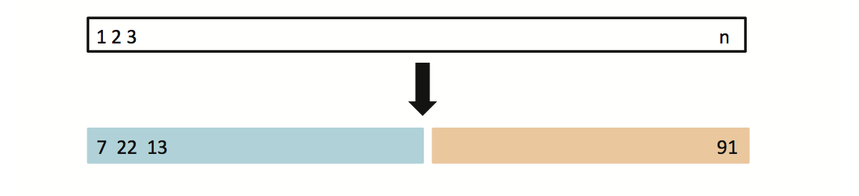
5.1.1 Typical Approach: The Validation Set Approach
Suppose that we would like to find a set of variables that give the lowest test (not training) error rate
If we have a large data set, we can achieve this goal by randomly splitting the data into training and validation(testing) parts
We would then use the training part to build each possible model (i.e. the different combinations of variables) and choose the model that gave the lowest error rate when applied to the validation data
Training Data
Testing Data

Slide 8
Example: Auto Data (n=392=196*2)
Suppose that we want to predict mpg from horsepower
Two models:
mpg ~ horsepower
mpg ~ horsepower + horspower²
Which model gives a better fit?
Randomly split Auto data set into training (196 obs.) and validation data (196 obs.)
Fit both models using the training data set
Then, evaluate both models using the validation data set
The model with the lowest validation (testing) MSE is the winner!

Slide 9
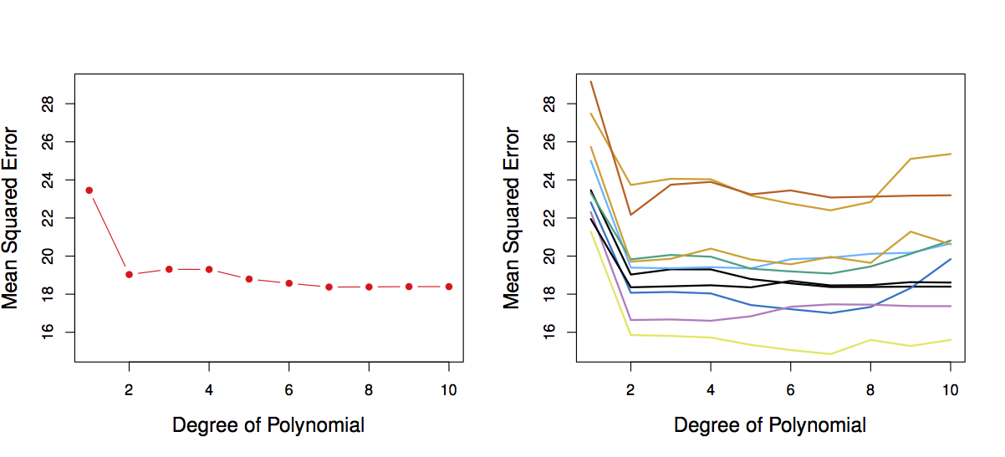
Results: Auto Data
Left: Validation error rate for a single split (MSE for quadratic fit< MSE for linear)
Right: Validation method repeated 10 times, with randomly splitting! (all curves indicate quadratic model is superior)
There is a lot of variability among the MSE’s… Not good! We need more stable methods!

Slide 10
The Validation Set Approach
Advantages:
Simple
Easy to implement
Disadvantages:
The validation MSE can be highly variable
Only a subset of observations are used to fit the model (training data). Statistical methods tend to perform worse when trained on fewer observations. Validation set error rate may tend to overestimate the test error rate for the model fit on the entire data set.

Slide 11
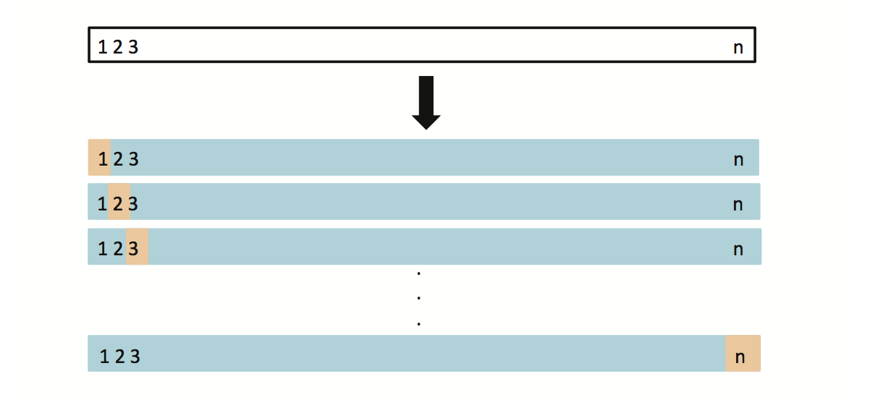
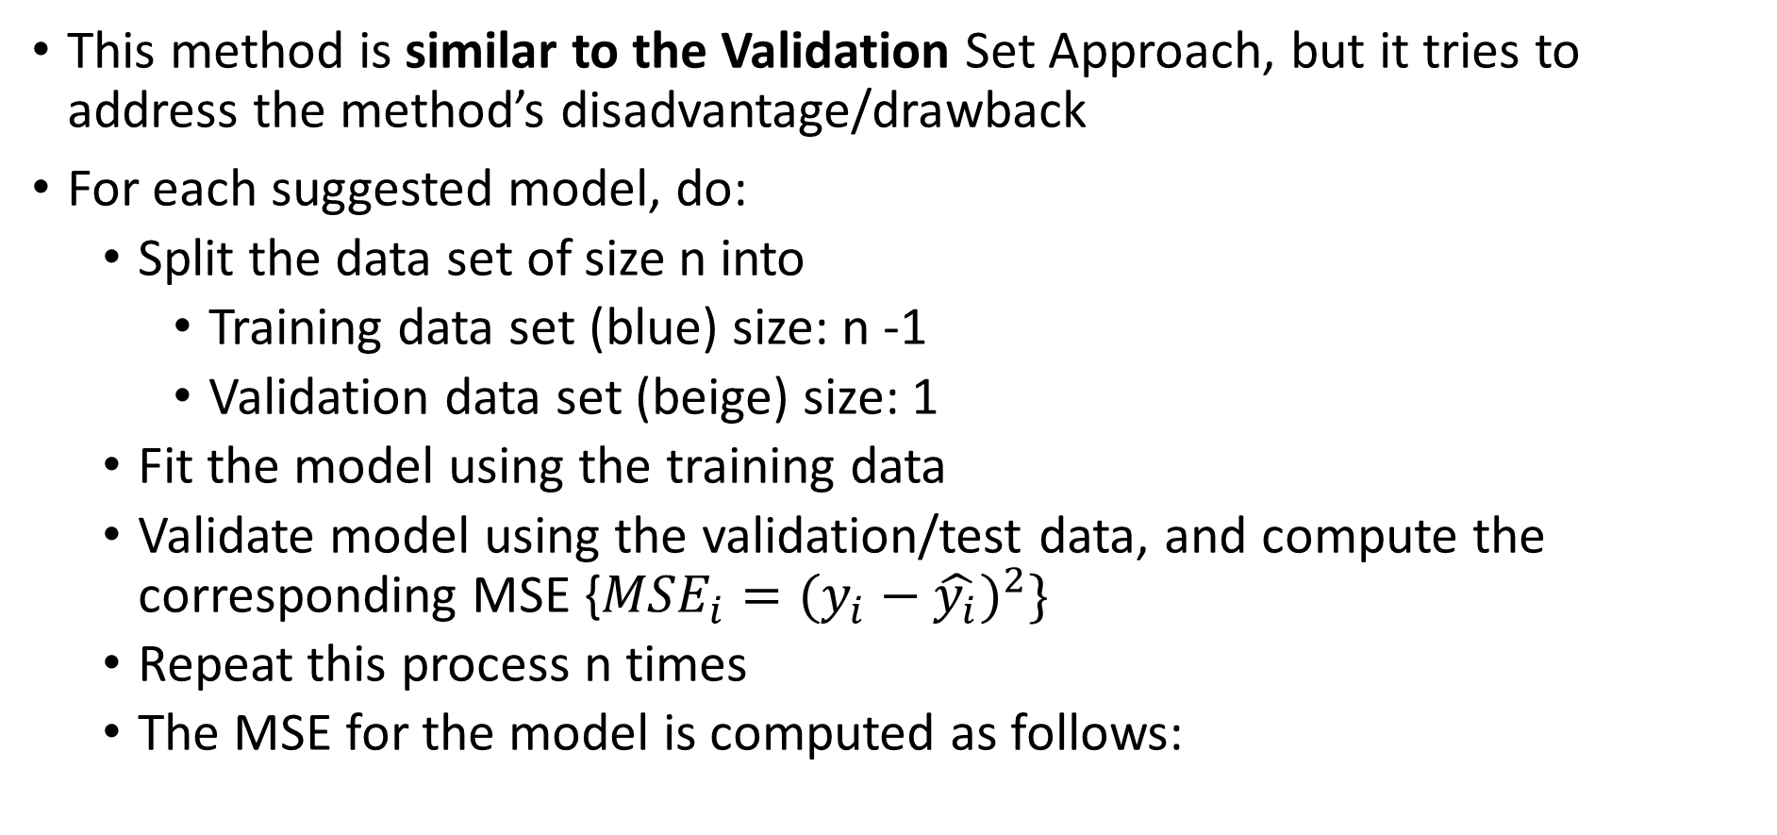
5.1.2 Leave-One-Out Cross Validation (LOOCV)
This method is similar to the Validation Set Approach, but it tries to address the method’s disadvantage/drawback
For each suggested model, do:
Split the data set of size n into
Training data set (blue) size: n -1
Validation data set (beige) size: 1
Fit the model using the training data
Validate model using the validation/test data, and compute the corresponding MSE {${MSE}_{i}=(y_{i}−\hat{y_{i}})^{2}\}$
Repeat this process n times
The MSE for the model is computed as follows:

Slide 12
LOOCV vs. the Validation Set Approach
LOOCV has less bias
We repeatedly fit the statistical learning method using training data that contains n-1 obs., i.e. almost all the data set is used
LOOCV produces a less variable MSE
The validation approach produces different MSE when applied repeatedly due to randomness in the splitting process, while performing LOOCV multiple times will always yield the same results, because we split based on 1 obs. each time
LOOCV is computationally intensive (disadvantage)
We fit the each model n times!

Slide 13
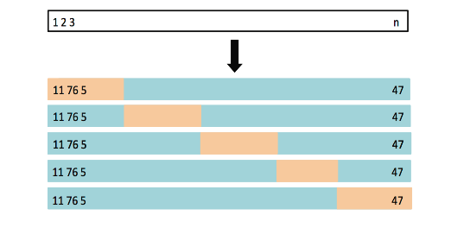
5.1.3 k-fold Cross Validation
LOOCV is computationally expensive, so we can run k-fold Cross Validation instead
With k-fold Cross Validation, we divide the data set into K different parts (e.g. K = 5, or K = 10, etc.)
We then remove the first part, fit the model on the remaining K-1 parts, and see how good the predictions are on the left out part (i.e. compute the MSE on the first part)
We then repeat this K different times taking out a different part each time
By averaging the K different MSE’s we get an estimated validation (test) error rate for new observations

Slide 14
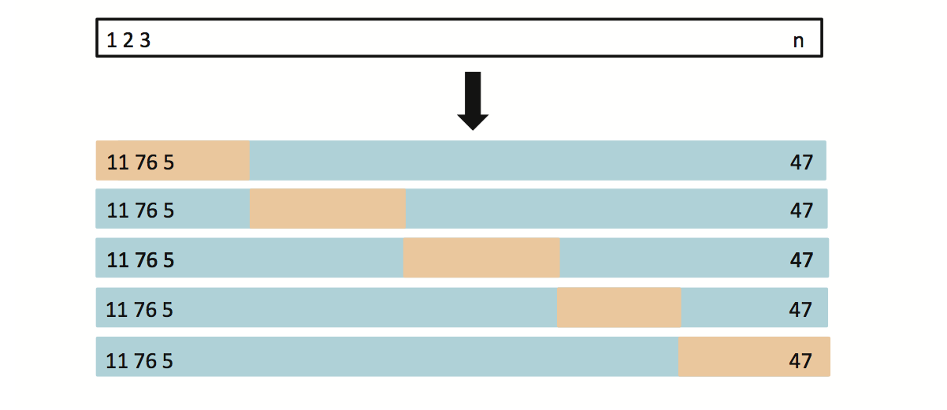
K-fold Cross Validation (k=5)
5 non-overlapping groups

Slide 15
Auto Data: LOOCV vs. K-fold CV
Left: LOOCV error curve
Right: 10-fold CV was run many times, and the figure shows the slightly different CV error rates
LOOCV is a special case of k-fold, where k = n
They are both stable, but LOOCV is more computationally intensive!

Slide 16
Auto Data: Validation Set Approach vs. K-fold CV Approach
Left: Validation Set Approach
Right: 10-fold Cross Validation Approach
Indeed, 10-fold CV is more stable!

Slide 17
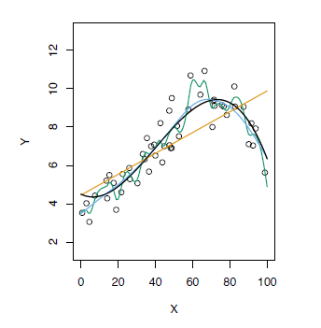
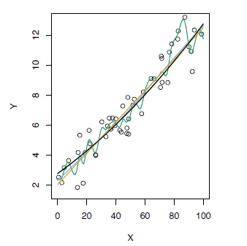
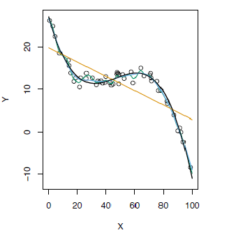
K-fold Cross Validation on Three Simulated Date
Blue: True Test MSE
Black: LOOCV MSE
Orange: 10-fold MSE
Refer to chapter 2 for the top graphs, Fig 2.9, 2.10, and 2.11

Slide 18
Bias- Variance Trade-off for k-fold CV
Putting aside that LOOCV is more computationally intensive than k-fold CV… Which is better LOOCV or K-fold CV?
LOOCV is less bias than k-fold CV (when k < n)
But, LOOCV has higher variance than k-fold CV (when k < n)
Thus, there is a trade-off between what to use
K-fold CV with k<n has a computational advantage to LOOCV
Conclusion:
We tend to use k-fold CV with (K = 5 and K = 10)
These are the magical K’s ☺
It has been empirically shown that they yield test error rate estimates that suffer neither from excessively high bias, nor from very high variance

Slide 19
Cross Validation on Classification Problems
So far, we have been dealing with CV on regression problems
We can use cross validation in a classification situation in a similar manner
Divide data into K parts
Hold out one part, fit using the remaining data and compute the error rate on the hold out data
Repeat K times
CV error rate is the average over the K errors we have computed

Slide 20
CV to Choose Order of Polynomial
The data set used is simulated (refer to Fig 2.13)
The purple dashed line is the Bayes’ boundary
Bayes’ Error Rate: 0.133

Slide 21
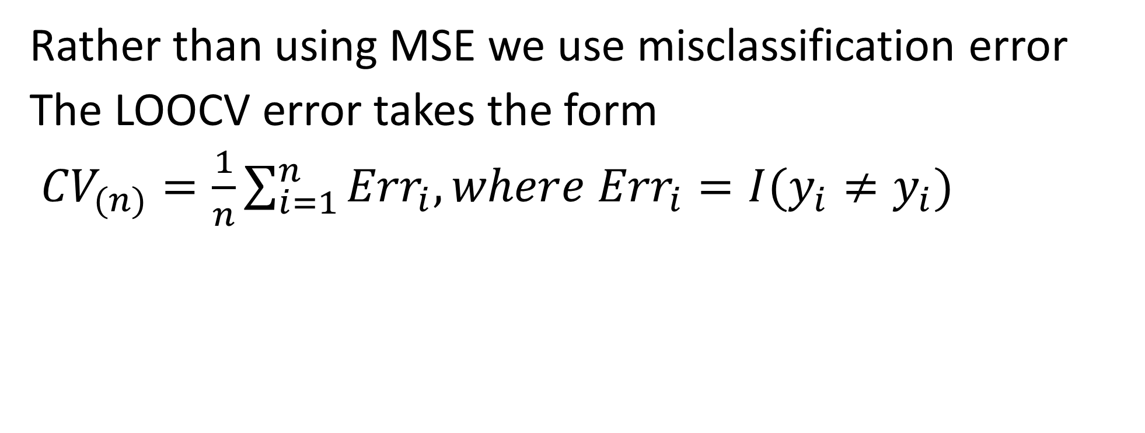
Cross Validation when Y is Qualitative
Rather than using MSE we use misclassification error
The LOOCV error takes the form
${CV}_{(n)}=\frac{1}{n}\sum_{i=1}^{n}{{Err}_{i}, where {Err}_{i}=I(y_{i}≠y_{i})}$

Slide 22
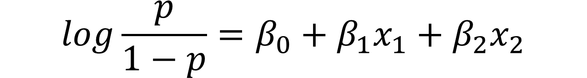
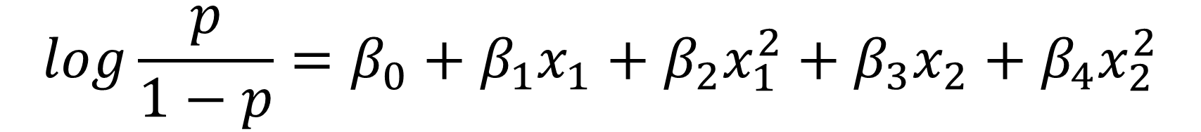
$$log\frac{p}{1−p}=β_{0}+β_{1}x_{1}+β_{2}x_{2}$$
Linear Logistic regression (Degree 1) is not able to fit the Bayes’ decision boundary
Quadratic Logistic regression does better than linear
$$log\frac{p}{1−p}=β_{0}+β_{1}x_{1}+β_{2}x_{1}^{2}+β_{3}x_{2}+β_{4}x_{2}^{2}$$
Error Rate: 0.201
Error Rate: 0.197

Slide 23
$log\frac{p}{1−p}=β_{0}+β_{1}x_{1}+β_{2}x_{1}^{2}+β_{3}x_{1}^{3}+β_{4}x_{2}+β_{5}x_{2}^{2}$+$β_{6}x_{2}^{3}$
Using cubic and quartic predictors, the accuracy of the model improves
$log\frac{p}{1−p}=β_{0}+β_{1}x_{1}+β_{2}x_{1}^{2}+β_{3}x_{1}^{3}+β_{4}x_{1}^{4}+β_{5}x_{2}+β_{6}x_{2}^{2}$+$β_{7}x_{2}^{3}+β_{8}x_{2}^{4}$
Error Rate: 0.160
Error Rate: 0.162

Slide 24
How might we decide between the four logistic regression models?
We will use Cross-validation to make the decision
Error Rate: 0.201
Error Rate: 0.197
Error Rate: 0.160
Error Rate: 0.162

Slide 25
CV to Choose the Order
Logistic Regression
KNN
Brown: Test Error
Blue: Training Error
Black: 10-fold CV Error
Test error displays a U shape curve
Training error Decreases as the flexibility of the fit increases
The 10-fold CV error rate provides a good approximation
(underestimates the error rate, reaches minimum at 4th order polynomial,

Slide 26
The Bootstrap
Can be used to quantify the uncertainty associated with a given estimator or statistical learning method.
Can be used to estimate the standard error of the coefficients from a linear regression
Sampling with replacement
Graphical illustration of the Bootstrap

Slide 27
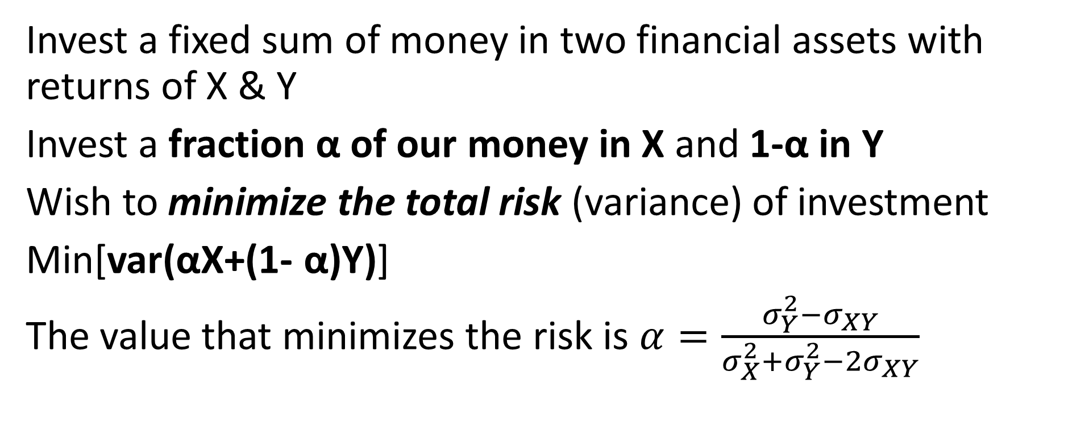
Toy Example Determine the best investment allocation under a simple model
Invest a fixed sum of money in two financial assets with returns of X & Y
Invest a fraction α of our money in X and 1-α in Y
Wish to minimize the total risk (variance) of investment
Min[var(αX+(1- α)Y)]
The value that minimizes the risk is $α=\frac{σ_{Y}^{2}−σ_{XY}}{σ_{X}^{2}+σ_{Y}^{2}−2σ_{XY}}$

Slide 28
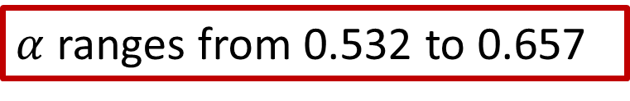
Simulated 100 pairs of returns for the investments with the return of X and Y
Used the simulations to estimate var(X), var(Y) and cov(X,Y)
$α$ ranges from 0.532 to 0.657

Slide 29
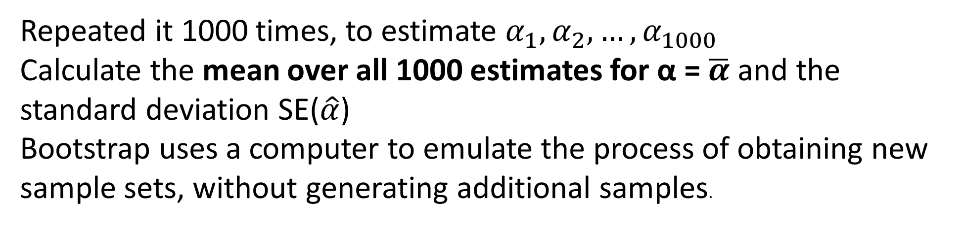
Repeated it 1000 times, to estimate $α_{1},α_{2},…,α_{1000}$
Calculate the mean over all 1000 estimates for α = $\overline{α}$ and the standard deviation SE($\hat{α}$)
Bootstrap uses a computer to emulate the process of obtaining new sample sets, without generating additional samples.
Using 1000 simulated data set from the true population
Using 1000 bootstrap samples from a single data set
Boxplots are similar, indicating Bootstarp is effective

Slide 30
Graphical illustration of the Bootstrap
Compute the standard error of these bootstrap estimates via${SE}_{B}\left(\hat{α}\right)=\sqrt{\frac{1}{B−1}\sum_{r=1}^{B}{({\hat{α}}^{∗r}−\frac{1}{B}\sum_{r^{′}=1}^{B}{{\hat{α}}^{∗r′})^{2}}}}$

