Slide 1
Linear Model Selection and regularization
Chapter 06

Slide 2
Outline
Subset Selection
Best Subset Selection
Stepwise Selection
Choosing the Optimal Model
Shrinkage Methods
Ridge Regression
The Lasso

Slide 3
Improving on the Least Squares Regression Estimates?
We want to improve the Linear Regression model, by replacing the least square fitting with some alternative fitting procedure, i.e., the values that minimize the mean square error (MSE)
There are 2 reasons we might not prefer to just use the ordinary least squares (OLS) estimates. Alternative fitting procedures can yield
Better Prediction Accuracy
Better Model Interpretability

Slide 4
1. Prediction Accuracy
Assuming linear relationship
The least squares estimates have relatively low bias and low variance when n>>p
But, when n~p , then the least squares fit can have high variance and may result in over fitting and poor estimates on unseen observations,
And, when n<p , then the variability of the least squares fit increases dramatically, and the variance of these estimates is infinite, the method can not be used at all
Solution:
By constraining or shrinking the estimated coefficients, we can reduce the variance, at the cost of increase in bias

Slide 5
2. Model Interpretability
When we have a large number of variables X in the model there will generally be many that have little or no effect on Y, or irrelevent
Leaving these variables in the model makes the model more complex and makes it harder to see the “big picture”, i.e., the effect of the “important variables”
The model would be easier to interpret by removing (i.e. setting the coefficients to zero) the unimportant/irrelevant variables

Slide 6
Solution (3 important methods)
Subset Selection
Identifying a subset of the p predictors that we believe to be related to the response Y, and then fitting the model using this subset
e.g. best subset selection and stepwise selection
Shrinkage
Fitting a model involving all p predictors
Involves shrinking the estimated coefficients towards zero (regularization)
This shrinkage reduces the variance
Some of the coefficients may shrink to exactly zero, and hence shrinkage methods can also perform variable selection
e.g. Ridge regression and the Lasso
Dimension Reduction
Involves projecting all p predictors into an M-dimensional space (M different linear combinations of the predictors) where M < p, and then fitting linear regression model for these M projections
e.g. Principle Components Regression

Slide 7
6.1 Subset selection
Idea: estimate all possible regression equations using all possible combinations of independent variables
Choose the best fit by looking for the highest adjusted r² and lowest standard error

Slide 8
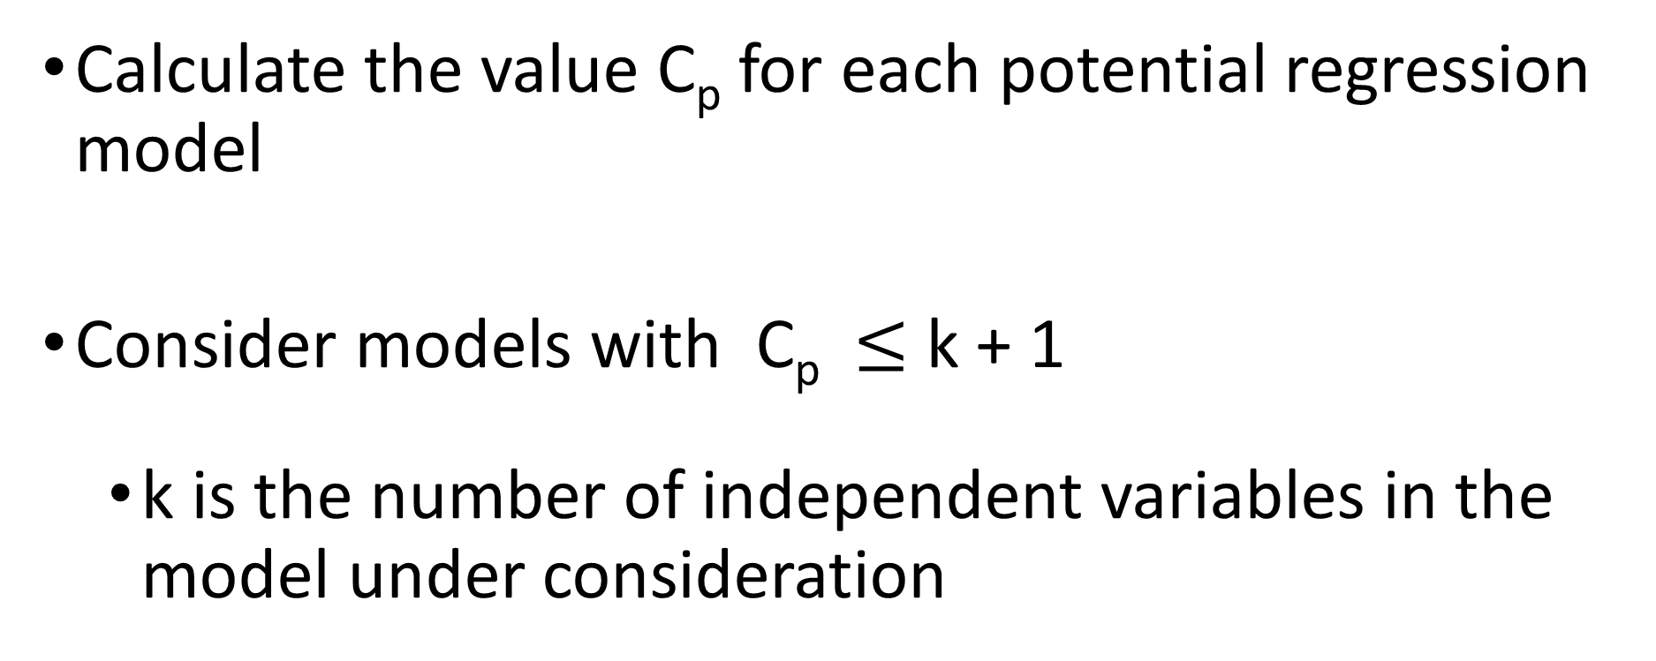
Alternative Best subsets Criteria
Calculate the value C_{p} for each potential regression model
Consider models with C_{p} $≤$ k + 1
k is the number of independent variables in the model under consideration

Slide 9
Alternative Best Subsets Criterion
The C_{p} Statistic
Where k = number of independent variables included in a particular regression model
T = total number of parameters to be estimated in the full regression model
= coefficient of multiple determination for model with k independent variables
= coefficient of multiple determination for full model with all T estimated parameters

Slide 10
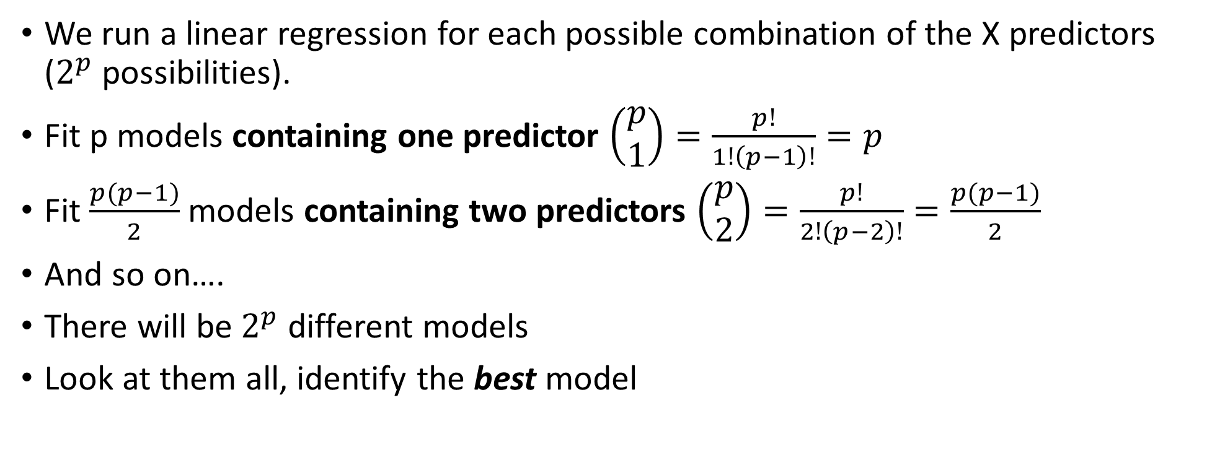
6.6.1 Best Subset Selection
We run a linear regression for each possible combination of the X predictors ($2^{p}$possibilities).
Fit p models containing one predictor $\left(\begin{matrix}p \\ 1\end{matrix}\right)=\frac{p!}{1!\left(p−1\right)!}=p$
Fit $\frac{p(p−1)}{2}$ models containing two predictors $\left(\begin{matrix}p \\ 2\end{matrix}\right)=\frac{p!}{2!\left(p−2\right)!}=\frac{p(p−1)}{2}$
And so on….
There will be $2^{p}$ different models
Look at them all, identify the best model

Slide 11
6.6.1 Best Subset Selection
How do we judge which subset is the “best”?
One simple approach is to take the subset with the smallest RSS or the largest R²
Unfortunately, one can show that the model that includes all the variables will always have the largest R² (and smallest RSS)

Slide 13

Credit Data (10 predictors including one categorical with 3 values): R² vs. Subset Size
The RSS/R² will always decline/increase as the number of variables increase so they are not very useful
Low RSS or high R² indicates low training error where we are actually looking for low test error
We will use cross validation, or adjusted R² , …

Slide 14
Credit Data (10 predictors including one categorical with 3 values): R² vs. Subset Size
The red line tracks/connects the best model for a given number of predictors,
according to RSS and R²
A little improvement from the 3-variable model on

Slide 15
Other Measures of Comparison
To compare different models, we can use other approaches:
Adjusted R²
AIC (Akaike information criterion)
BIC (Bayesian information criterion)
C_{p} (equivalent to AIC for linear regression)
These methods add penalty to RSS for the number of variables (i.e. complexity) in the model
None are perfect

Slide 16
Model Building Flowchart
Choose X₁,X₂,…X_{k}
Run subsets regression to obtain “best” models in terms of C_{p}
No
Run regression to find VIFs
Any VIF>5?
Yes
Do complete analysis
Remove variable with highest VIF
Yes
More than one?
Add quadratic and/or interaction terms or transform variables
No
Remove this X
Perform predictions

Slide 17

Model selection
How do you compare two models with different numbers of predictors?
Small numbers are good.
Normalized Error Criterion
Large numbers are good.

Slide 18
Model Selection
How do you pick the “best” model with a given number of predictors?
“Best”
Subset Selection
Forward
Backward

Slide 19
Question 1
Normalized Error Criterion
“Best”
Subset Selection
Question 2
Forward
Backward
Ridge
Shrinkage
Both!
Lasso

Slide 20
Credit Data: C_{p}, BIC, and Adjusted R²
A small value of C_{p} and BIC indicates a low error, and thus a better model
A large value for the Adjusted R² indicates a better model

Slide 21
6.1.2 Stepwise Selection
Idea: develop the least squares regression equation in steps, adding one independent variable at a time and evaluating whether existing variables should remain or be removed
Best Subset Selection is computationally intensive especially when we have a large number of predictors (large p)
More attractive methods:
Forward Stepwise Selection: Begins with the model containing no predictor, and then adds one predictor at a time that improves the model the most until no further improvement is possible
Backward Stepwise Selection: Begins with the model containing all predictors, and then deleting one predictor at a time that improves the model the most until no further improvement is possible

Slide 22
Question?
True or False?
In data mining where huge data sets are being explored to discover relationships among a large number of variables, the best-subsets approach is more practical than the stepwise regression approach.
The stepwise regression approach takes into consideration all possible models.
In stepwise regression, an independent variable is not allowed to be removed from the model once it has entered into the model.
Using the Cp statistic in model building, all models with Cp ≤ (k + 1) are equally good.

Slide 23
6.2 Shrinkage Methods

Slide 24
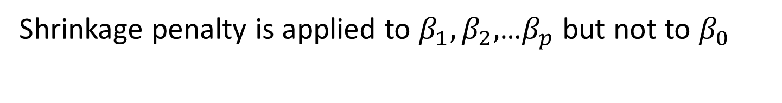
6.2.1 Ridge Regression
Ordinary Least Squares (OLS) estimates by minimizing
Ridge Regression uses a slightly different equation
Shrinkage penalty is applied to $β_{1},β_{2},$…$β_{p}$ but not to $β_{0}$

Slide 25
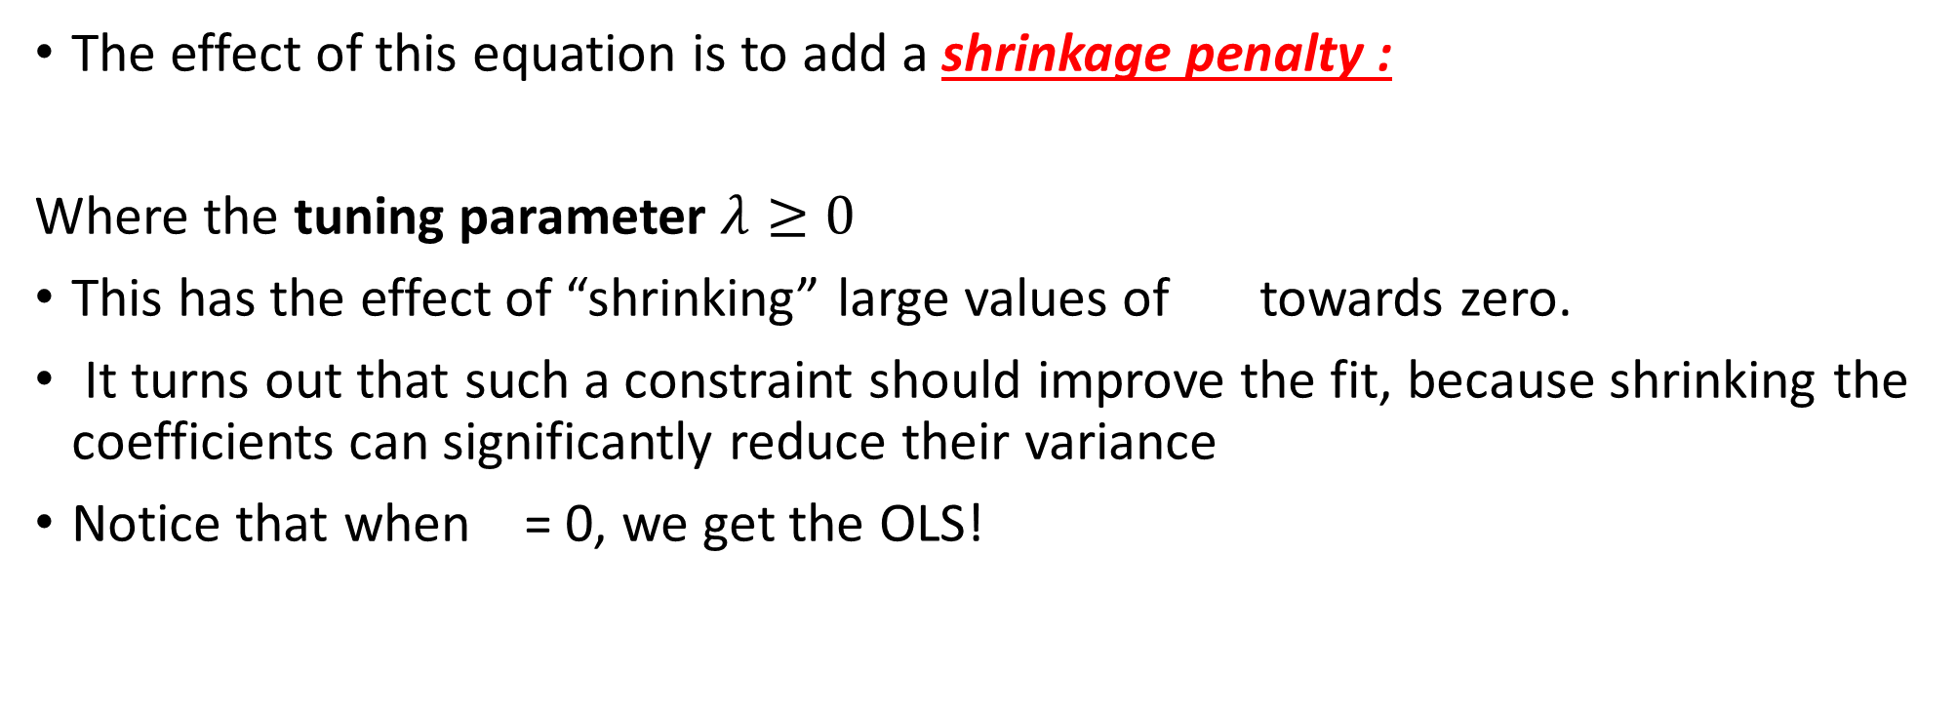
Ridge Regression Adds a Penalty on !
The effect of this equation is to add a shrinkage penalty :
Where the tuning parameter $λ≥0$
This has the effect of “shrinking” large values of towards zero.
It turns out that such a constraint should improve the fit, because shrinking the coefficients can significantly reduce their variance
Notice that when = 0, we get the OLS!

Slide 26

Credit Data: Ridge Regression
As $λ$ increases, the standardized coefficients shrinks towards zero.
Unlike OLS, Ridge regression will produce different set of coefficient estimates, for each value of $λ$, include all of the variables in the model

Slide 27
Why can shrinking towards zero be a good thing to do?
It turns out that the OLS estimates generally have low bias but can be highly variable. In particular when n and p are of similar size or when n < p, then the OLS estimates will be extremely variable
The penalty term makes the ridge regression estimates biased but can also substantially reduce variance
Thus, there is a bias/ variance trade-off

Slide 28
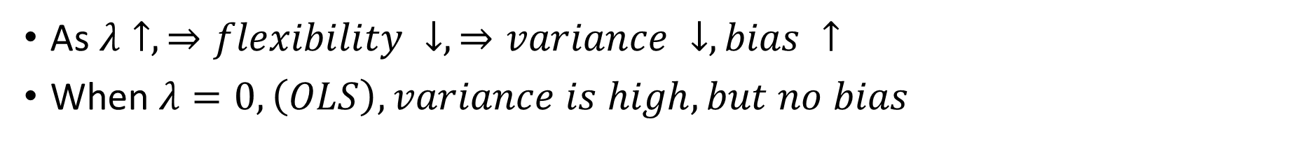
Ridge Regression Bias/ Variance( n=50, p=45)
As $λ↑, ⇒flexibility ↓, ⇒variance ↓, bias ↑$
When $λ=0, \left(OLS\right), variance is high, but no bias$
Black: Bias
Green: Variance
Purple: MSE
For $λ up to 10:variance ↓rapidly, bias ↑very little, MSE ↓considerably$
For $λ after 10, variance ↓slow, bias ↑rapidly$
Min(MSE)$≈30$

Slide 29
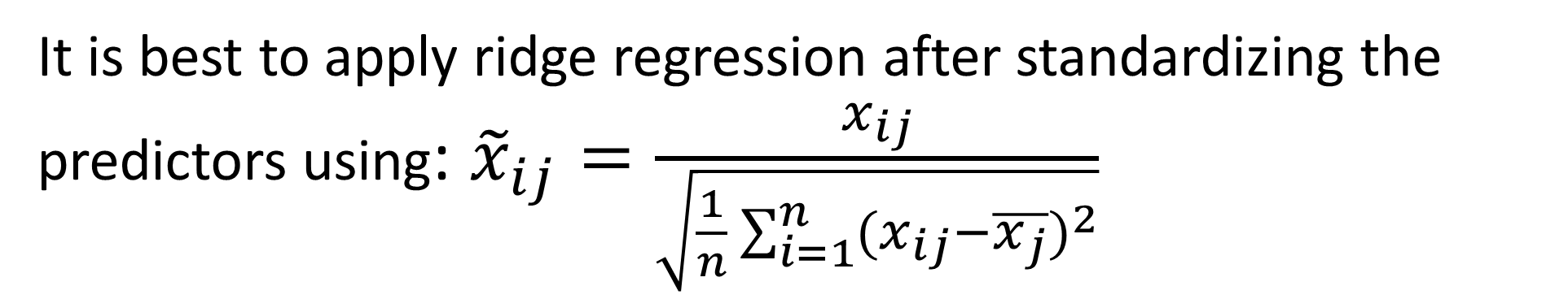
Ridge Regression
It is best to apply ridge regression after standardizing the predictors using: ${\tilde{x}}_{ij}=\frac{x_{ij}}{\sqrt{\frac{1}{n}\sum_{i=1}^{n}{(x_{ij}−\overline{x_{j}})^{2}}}}$

Slide 30
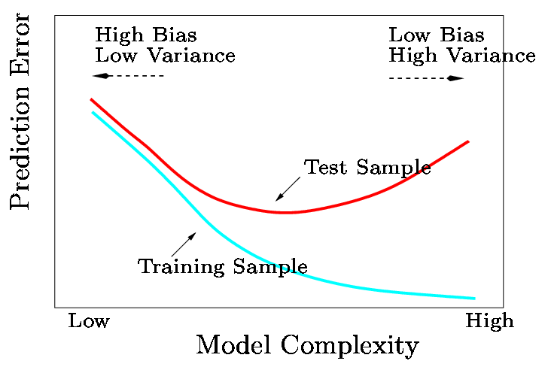
Bias/ Variance Trade-off
In general, the ridge regression estimates will be more biased than the OLS ones but have lower variance
Ridge regression will work best in situations where the OLS estimates have high variance

Slide 31
Computational Advantages of Ridge Regression
If p is large, then using the best subset selection approach requires searching through enormous numbers of possible models
With Ridge Regression, for any given , we only need to fit one model and the computations turn out to be very simple
Ridge Regression can be used when p > n, a situation where OLS fails completely!

Slide 32

6.2.2. The LASSO
Ridge Regression isn’t perfect
One significant problem is that the penalty term will never force any of the coefficients to be exactly zero. Thus, the final model will include all p variables, which makes it harder to interpret
A more modern alternative is the LASSO
The LASSO works in a similar way to Ridge Regression, except it uses a different penalty term

Slide 33
LASSO’s Penalty Term
Ridge Regression minimizes
The LASSO estimates the by minimizing the

Slide 34
What’s the Big Deal?
This seems like a very similar idea but there is a big difference
Using this penalty, it could be proven mathematically that some coefficients end up being set to exactly zero.
Lasso yields Sparse models( models involving only a subset of the variables)
With LASSO, we can produce a model that has high predictive power and it is simple to interpret

Slide 35
Credit Data: LASSO

Slide 36
Another formulation for Ridge regression and the Lasso

Slide 37

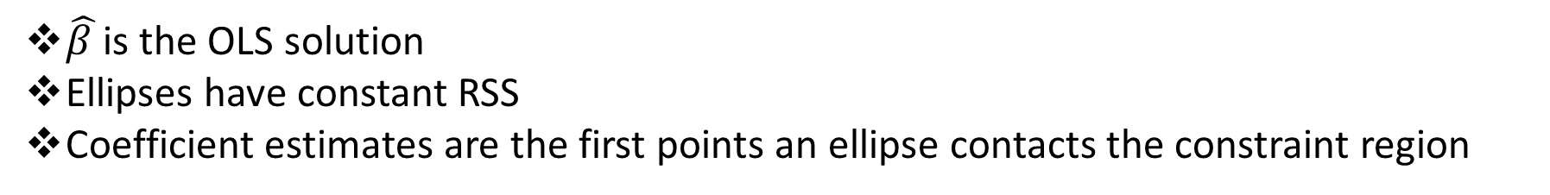
Ridge regression and Lasso (p=2)
Lasso coefficient estimates have the smallest RSS out of all points that lie within the diamond defined by $|β_{1}+β_{2}|≤s$
Ridge Regression estimates have the smallest RSS out of all points that lie within the circle defined by $(β_{1}^{2}+β_{2}^{2})≤s$
$\hat{β }$is the OLS solution
Ellipses have constant RSS
Coefficient estimates are the first points an ellipse contacts the constraint region

Slide 38
Ridge Regression and Lasso P=3 & P>3
P=3
Lasso constraint region: Polyhedron
Ridge Regression constraint region: Sphere
P>3
Lasso constraint region: Polytope
Ridge Regression constraint region: hypersphere

Slide 39

6.2.3 Selecting the Tuning Parameter
We need to decide on a value for
Select a grid of potential values, use cross validation to estimate the error rate on test data (for each value of $λ$) and select the value that gives the least error rate

Slide 41
Learning Objective
To develop an awareness of the topic of data mining and what it is being used for in business today

Slide 42
Data Mining Is A Sophisticated Quantitative Analysis That Attempts To Discover Useful Patterns Or Relationships In A Group Of Data
Some examples of data mining in use today are:
Mortgage acceptance & default -- predicting which applicants will qualify for a specific type of mortgage
Retention -- who will remain a customer of the financial services company
Response to promotions -- predicting who will respond to promotions
Purchasing associations -- predicting what product a consumer will purchase given that they have purchased another product
Product failure -- Predicting the type of product that will fail during a warranty period

Slide 43
Data Mining Typically Involves The Analysis Of Very Large Data Sets
Large data sets have many observations and many variables
Working with such data sets increases the importance of how data is collected so that it can be readily analyzed to arrive at useful conclusions

Slide 44
Data Mining Can be Divided Into Two Types Of Tasks
Exploratory Data Analysis
Examining the basic features of a data set via
Tables, Descriptive Statistics, & Graphic Displays
Predictive Modeling
Building a model to predict a variable based on the value of other variables via
Simple Linear Regression, Multiple Regression Model Building, Stepwise Regression, & Logistic Regression

