Slide 1
Hadoop Streaming

Slide 2
Hadoop Streaming
Hadoop streaming is a utility that comes with the Hadoop distribution
The utility allows you to create and run map/reduce jobs with any executable or script as the mapper and/or the reducer
C, Python, Java, Ruby, C#, perl, shell commands
Map and Reduce classes can even be written in different languages

Slide 3
Using Streaming Utility
Path to the streaming jar library
> hadoop jar <dir>/hadoop-*streaming*.jar \
-file /path/to/mapper.py \
-mapper /path/to/mapper.py \
-file /path/to/reducer.py \
-reducer /path/to/reducer.py \
-input /user/hduser/books/* \
-output /user/hduser/books-output
Location of mapper file, and define it as mapper
Location of reducer file, and define it as reducer
Input and output locations

Slide 4
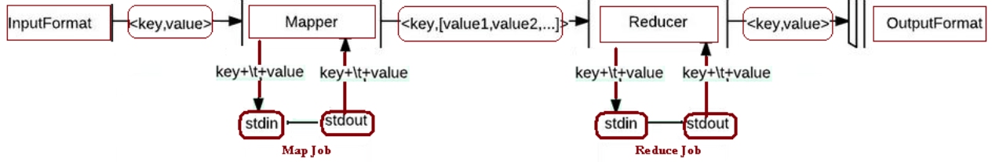
Execution Flow
Your Code

Slide 5
Hadoop Streaming: Basic Concept
Map and reduce functions read their input from STDIN and produce their output to STDOUT
Map
Hadoop streaming reads the input data line by line
Pass it to the map function through the STDIN
Do your code (any language)
Produce output to STDOUT
Key + \t + value
Hadoop streaming reads the output from STDOUT
Performs the shuffling and sorting based on the Key part
User’s code

Slide 6
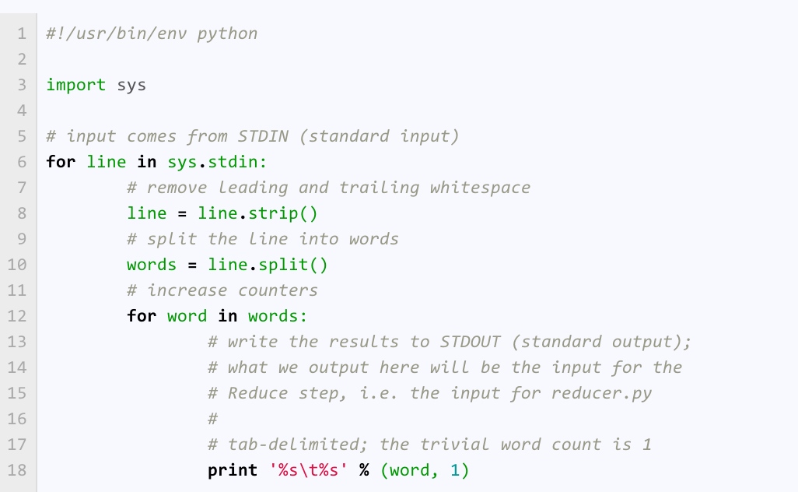
WordCount: Mapper.py
The code is simply reading from STDIN and writing to STDOUT
Tab delimited Key + value

Slide 7
Hadoop Streaming: Basic Concept (Cont’d)
Reducer
Hadoop streaming shuffles and sorts the map outputs based on the Key
Passes one record at a time to the reduce function through the STDIN
Do your code (any language)
Produce output to STDOUT
Key + \t + value
Hadoop streaming reads the output from STDOUT
Writes to the output file
Assume the data is sorted but not grouped

Slide 8
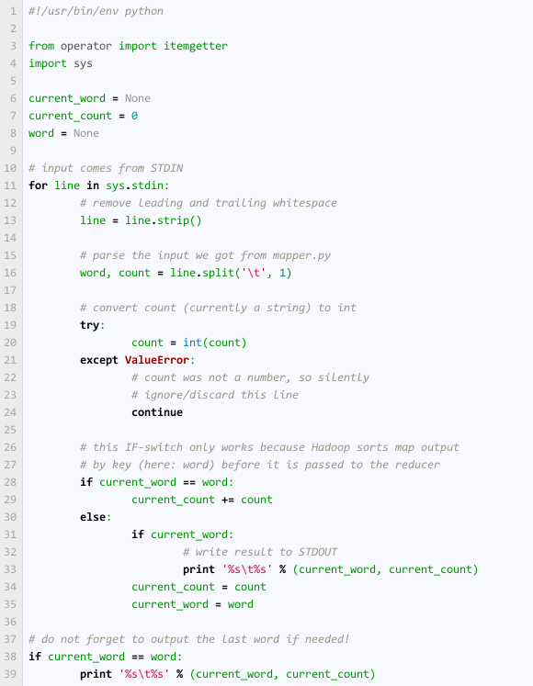
WordCount: Reducer.py
Read from STDIN
Make one split to get the word and the count
If it is like the previous word, then increment. Otherwise, report.

Slide 9
Call the Utility
> hadoop jar <dir>/hadoop-*streaming*.jar \
-file /path/to/mapper.py \
-mapper /path/to/mapper.py \
-file /path/to/reducer.py \
-reducer /path/to/reducer.py \
-input /user/hduser/books/* \
-output /user/hduser/books-output
HDFS files

Slide 10
Test Code in Local Mode
> cat inputs | ./mappper.py | sort | ./reducer.py
Should preduce each word and its count (in local mode)

Slide 11
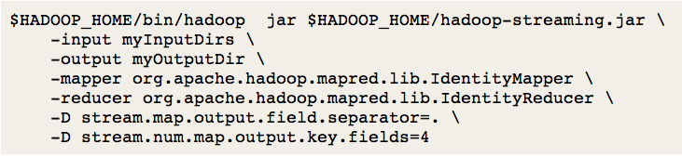
Possible Customization
Many parameters to set
-- The map output fields are “.” separated
-- The first 4 fields form the key

Slide 12
Links
http://www.michael-noll.com/tutorials/writing-an-hadoop-mapreduce-program-in-python/

