Slide 1
Advanced Analytics on Hadoop
(Part 1)
WPI, Mohamed Eltabakh

Slide 2
Matrix-Vector Multiplication
n
1
M
n
X
V
n
n
Z_{i} =ΣM_{ij} * V_{j}
j = 1
Z
=
n

Slide 3
What If n is very large
in Page Ranking n ≈ 10¹⁰

Slide 4

Map-Only Solution
Each mapper is assigned a set of rows in M
V is distributed (cached) to all mappers
A mapper will do:
Store V in memory
Read one of the assigned rows (say row k)
Compute and output Z_{k}
Notes:
1- Row k does not have to be stored entirely in memory
2- One record is still one cell in M, i.e., M_{ij}
3- Matrix M needs to store row-oriented
How many rows to assign to each mapper?
How to ensure an entire row goes to one mapper?

Slide 5
Map-Only Solution
Pros:
No Reduce phase
No Shuffling and sorting phase
M is read once
Cons:
V is read many times (each mapper will read V entirely)
V needs to fit in memory

Slide 6
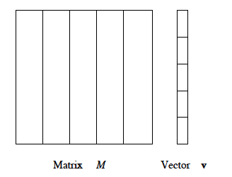
Map-Reduce Solution
Divide M into vertical strips (set of columns)
Divide V into same number, but horizontal strips

Slide 7
Map-Reduce Solution
Each mapper takes one vertical strip (set of columns)
If mapper is assigned strip S, it reads the corresponding
strip S from V (Cache it in memory)
Mapper: When processing cells from row k
Output (key = k)
Output (value = sum of multiplications Z_{k-S})
Reducer: All partial sums contributing to Z_{k} are
received by one reducer
How many? The number of strips
Reducer will sum the values to get Z_{k}

Slide 8
Map-Reduce Solution
Notes:
1- Strip S does not have to be stored entirely in memory
2- One record is still one cell in M, i.e., M_{ij}
3- Matrix M needs to store Strip-oriented or Column-Oriented
Pros:
Both M and V are read once
Only one strip from V needs to fit in memory
Scales better for very large n
Cons:
Cost of shuffling/sorting
Cost of reducers
How many columns to assign to each mapper?
How to ensure an entire column goes to one mapper?

Slide 9
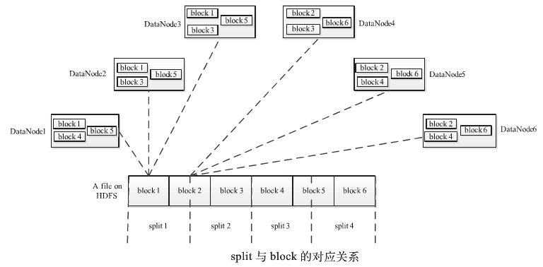
HDFS Blocks vs. Splits

Slide 10
HDFS Blocks vs. Splits
HDFS Block
Physical entity (Default = 64MBs)
Unit of reading/writing from HDFS
Has no notion of semantics or record boundaries
Split
Logical entity defined by (Start position, End position)
Created by the InputFormat
The unit assigned to one mapper
By default: One block is one split
InputFormat may combine multiple blocks to 1 split
InputFormat may divide one block to many split

Slide 11
Back to the Map-Only Solution
M is stored row-oriented
Assume:
n = 10⁹ (one billion rows and columns)
A row 2MBs ➔ Block will be 32 rows
If Block = Split Then
# mappers = 10⁹/32 = 30M+
To avoid many mappers, each is doing little work
➔ Split = 100 or 1000 blocks
Another way: Make the block size of M large, e.g., 1 GB

Slide 12
Back to the Map-Reduce Solution
M is stored column-oriented
Assume:
n = 10⁹ (one billion rows and columns)
Each column is stored as a file
Default Behavior: Each block in each file is one split
May consider each file as one split (now each mapper processes 1 column)
May consider multiple files as one split.

Slide 13
Matrix Multiplication

Slide 14
Matrix Multiplication
T_{ik} = row M_{i} x column N_{k}
= Σ (M_{ij} x N_{jk})
y
j=1

Slide 15
Storage of M & N
Assume matrix M is stored as file of records
(i, j, M_{ij})
Assume matrix N is stored as file of records
(j, k, N_{jk})
Coordinates of a cell
Cell’s value
1…x
1…y
1…y
1…z

Slide 16
Two Map-Reduce Jobs
Join M & N (1st job)
Values in column j in M ⬅➔ Values in row j in N
Map Function
From M (i, j, M_{ij})
Key: j value: (FlagM, i, M_{ij})
From N (j, k, N_{jk})
Key: j value: (FlagN, k, N_{jk})

Slide 17
Two Map-Reduce Jobs
Join M & N (1st job)
Values in column j in M ⬅➔ Values in row j in N
Reduce Function (For a given j)
Separate values from M and N
Produce output (i, k, M_{ij} * N_{jk} = v)

Slide 18
Two Map-Reduce Jobs
Aggregation (2nd job)
Group By (i,k) and Sum the values
Map Function
Key: (i, k) value: v
Reduce Function
Sum v’s and produce (i, k, T_{ik})

Slide 19
More Ways
Book: Mining of Massive Datasets
has more ways to do the multiplication
The book is available in Blackboard System

