Slide 1
Advanced Analytics
on Hadoop
WPI, Mohamed Eltabakh

Slide 2



Data Analytics
Include machine learning and data mining tools
Analyze/mine/summarize large datasets
Extract knowledge from past data
Predict trends in future data

Slide 3
Data Mining & Machine Learning
Subset of Artificial Intelligence (AI)
Lots of related fields and applications
Information Retrieval
Stats
Biology
Linear algebra
Marketing and Sales

Slide 4
Tools & Algorithms
Collaborative Filtering
Clustering Techniques
Classification Algorithms
Association Rules
Frequent Pattern Mining
Statistical libraries (Regression, SVM, …)
Others…

Slide 5
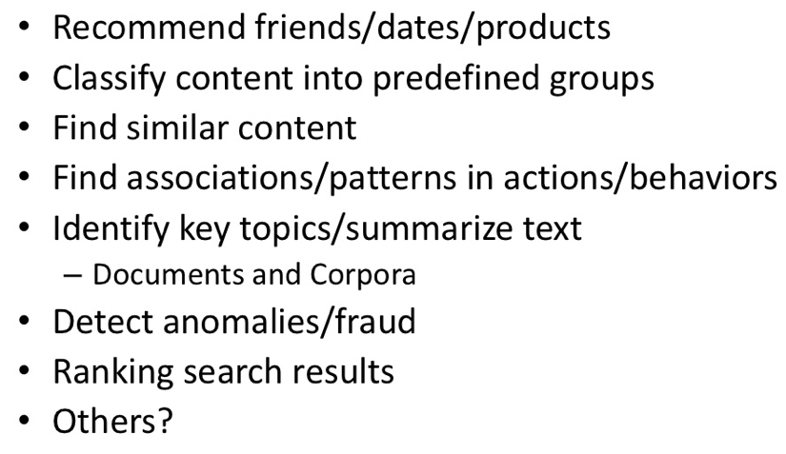
Common Use Cases

Slide 6


In Our Context…
--Efficient in analyzing/mining data
--Do not scale
--Efficient in managing big data
--Does not analyze or mine the data
How to integrate these two worlds together

Slide 7
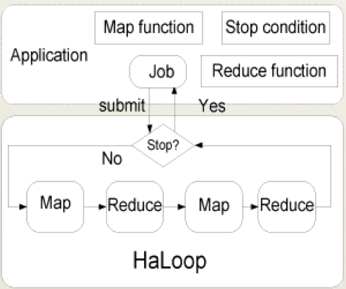
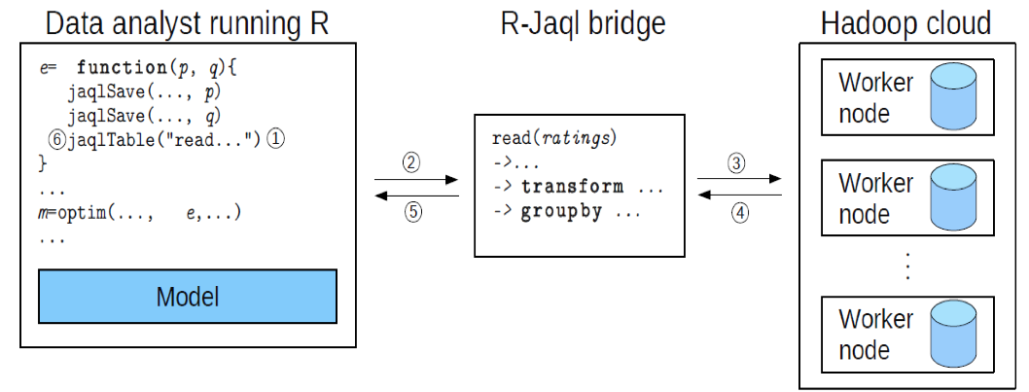
On Going Research Effort
Ricardo (VLDB’10): Integrating Hadoop and R using Jaql
Haloop (SIGMOD’10): Supporting iterative processing in Hadoop

Slide 8


Other Projects
Apache Mahout
Open-source package on Hadoop for data mining and machine learning
Revolution R (R-Hadoop)
Extensions to R package to run on Hadoop

Slide 9

Apache Mahout

Slide 10

Apache Mahout
Apache Software Foundation project
Create scalable machine learning libraries
Why Mahout? Many Open Source ML libraries either:
Lack Community
Lack Documentation and Examples
Lack Scalability
Or are research-oriented

Slide 11
Goal 1: Machine Learning

Slide 12
Goal 2: Scalability
Be as fast and efficient as the possible given the intrinsic design of the algorithm
Most Mahout implementations are Map Reduce enabled
Work in Progress

Slide 13
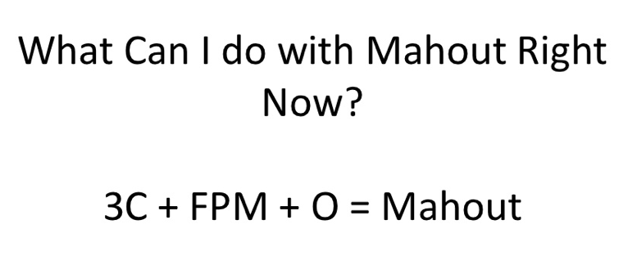
Mahout Package

Slide 14
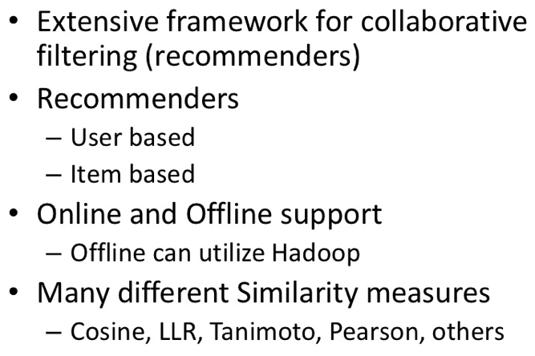
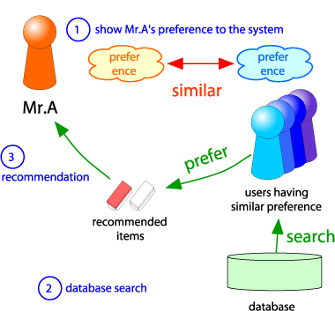
C1: Collaborative Filtering

Slide 15
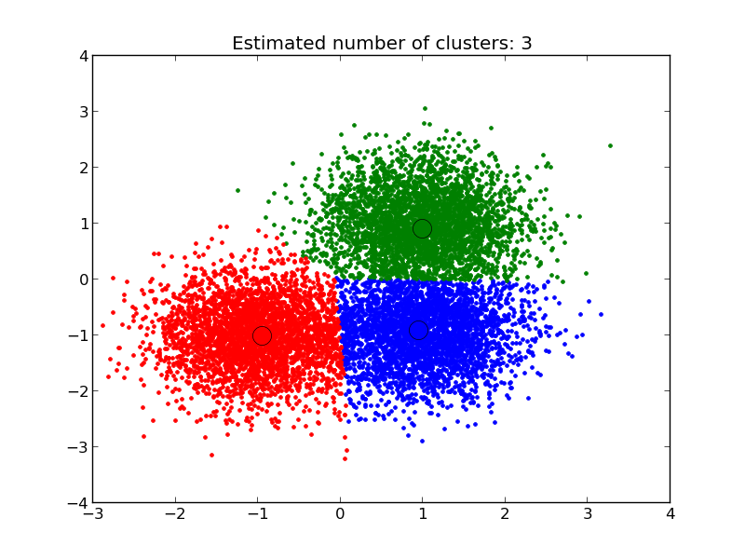
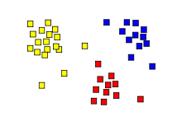
C2: Clustering
Group similar objects together
K-Means, Fuzzy K-Means, Density-Based,…
Different distance measures
Manhattan, Euclidean, …

Slide 16
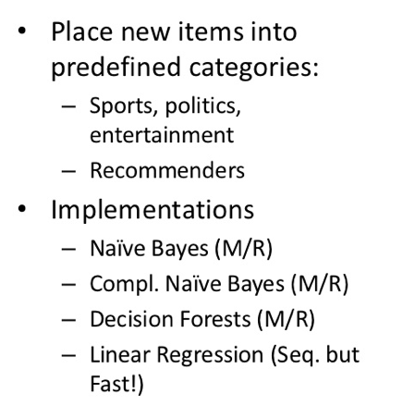
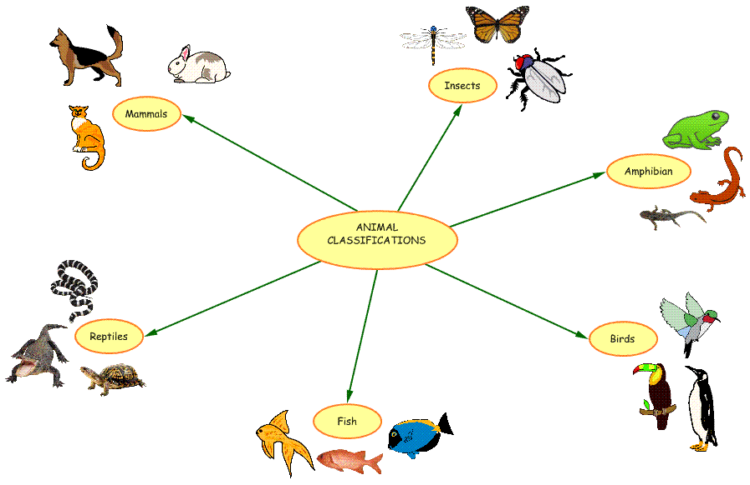
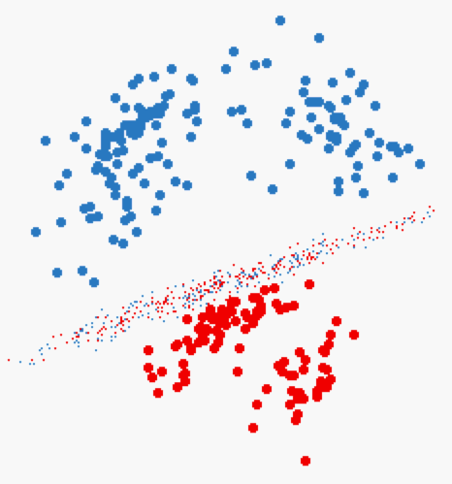
C3: Classification

Slide 17
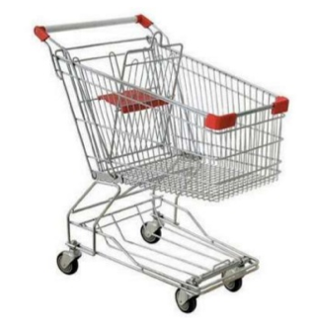
FPM: Frequent Pattern Mining
Find the frequent itemsets
<milk, bread, cheese> are sold frequently together
Very common in market analysis, access pattern analysis, etc…

Slide 18
We Focus On…
Clustering ➔ K-Means
Classification ➔ Naïve Bayes
Frequent Pattern Mining ➔ Apriori
-- Technique logic
-- How to implement in Hadoop

Slide 19
K-Means Algorithm

Slide 20
K-Means Algorithm
Step 1: Select K points at random (Centers)
Step 2: For each data point, assign it to the closest center
Now we formed K clusters
Step 3: For each cluster, re-compute the centers
E.g., in the case of 2D points ➔
X: average over all x-axis points in the cluster
Y: average over all y-axis points in the cluster
Step 4: If the new centers are different from the old centers (previous iteration) ➔ Go to Step 2

Slide 21
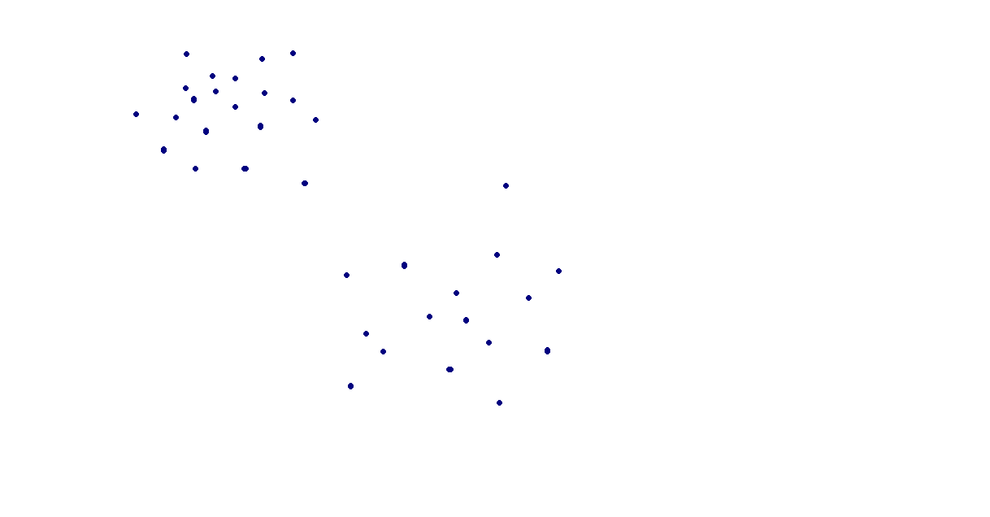
Here we have a dataset!
Assume K = 2

Slide 22
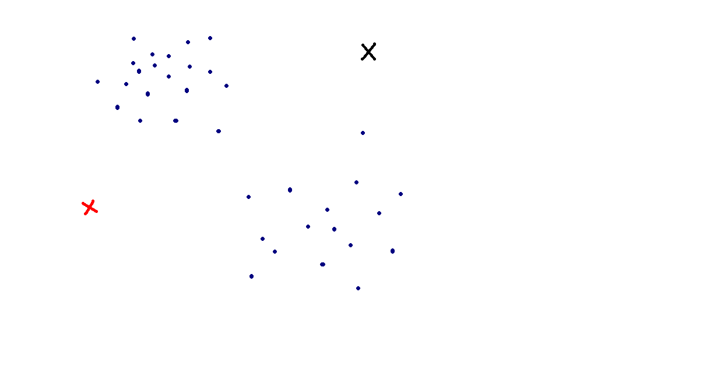
We randomly choose 2 group centroids!
Points do not have to be real data points
Step 1: Assign each point in the dataset to the closest center

Slide 23
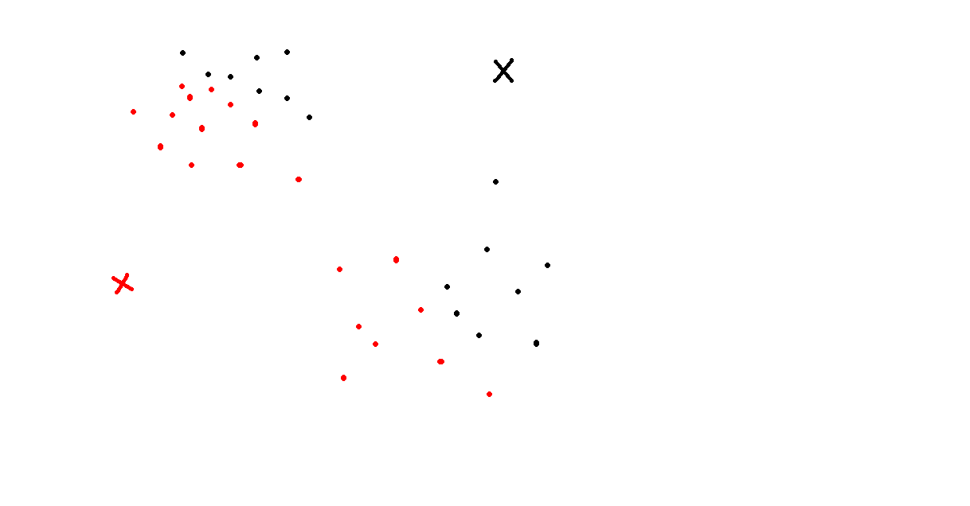
We assign each point to the group that has the closest centroit.
Step 2: For each group, re-compute the center

Slide 24
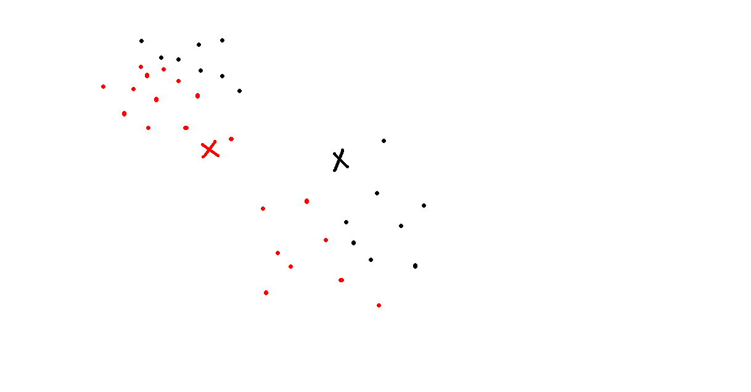
We recalculate the positions of the centroids.
These are the new centers
Step 1: Assign each point in the dataset to the closest center

Slide 25
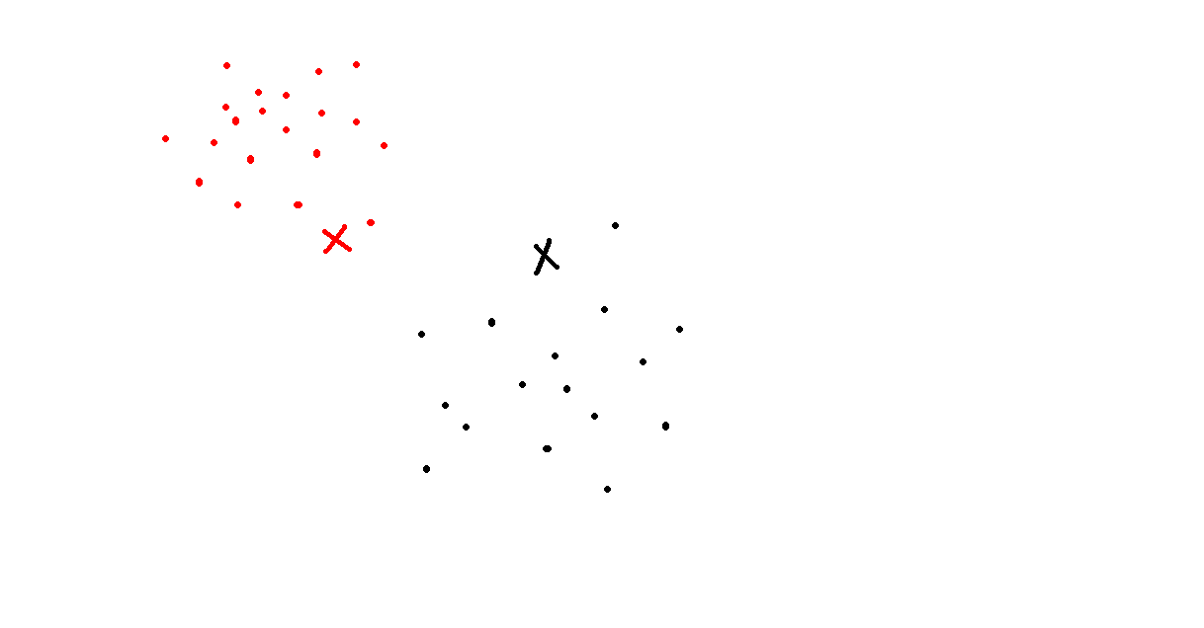
We assign each point to the group that has the closest centroid.

Slide 26
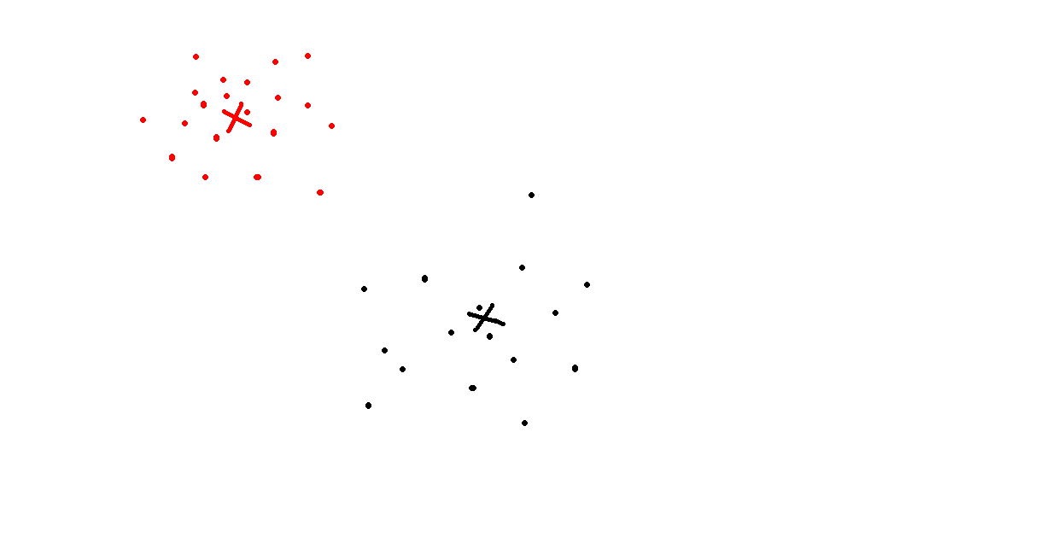
We recalculate the positions of the centroids.

Slide 27
Algorithm Terminates
No matter how many times the algorithm will be executed, from now on the centroids won’t move!! ☺
So the clustering it’s over!

Slide 28
K-Means Questions
What Data Type ?
What Distance Function ?
What Termination Criteria ?
Is It Guaranteed to Terminate ?
How to Choose K?
Is It Deterministic ?

Slide 29

K-Means: Data Type & Distance Fun
K-Means is good only for numeric data points
Does not work with categorical data points
Common Distance Function
Euclidean Distance function

Slide 30
K-Means: Data Type & Distance Fun
Computing the centers
Centers are not real data points
Take the average over each dimension

Slide 31
K-Means: Termination Criteria
Users define the termination criteria
If none of the centers move by more than ε, then stop
Termination is not guaranteed
Usually we have additional condition (E.g., Max Iterations = 20)

Slide 32
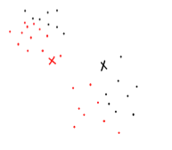
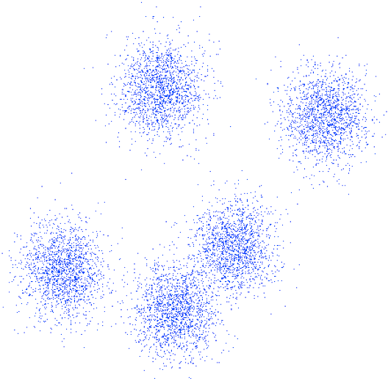

K-Means: How to choose K?
Best is 2
Best is 5
Hard to know in advance
Try different values and then measure the quality of the output clusters

Slide 33
K-Means: Is It Deterministic?
No…
For the same value “k”, we may generate different values
Remember the k initial centers are generated randomly
Can you give an example ???
If you consider the same initial “k” centers
Then it is deterministic

Slide 34
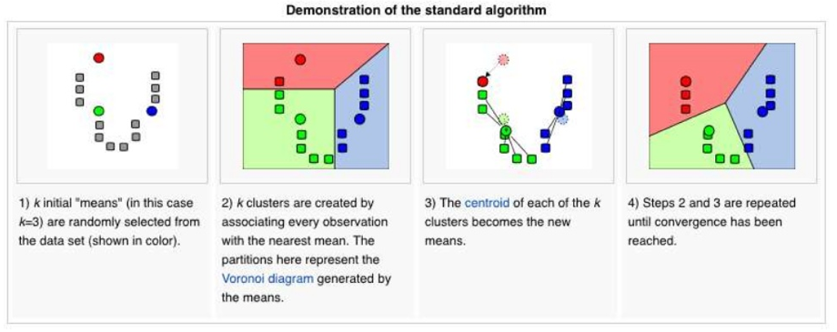
K-Means Algorithm: Summary
Iterative algorithm until converges

Slide 35
K-Means Algorithm: Summary
Step 1: Select K points at random (Centers)
Step 2: For each data point, assign it to the closest center
Now we formed K clusters
Step 3: For each cluster, re-compute the centers
E.g., in the case of 2D points ➔
X: average over all x-axis points in the cluster
Y: average over all y-axis points in the cluster
Step 4: If the new centers are different from the old centers (previous iteration) ➔ Go to Step 2

Slide 36
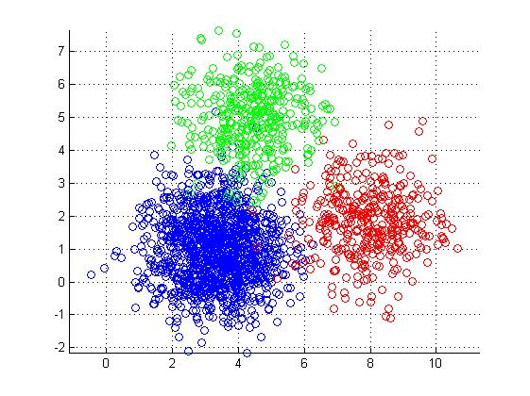
K-Means in MapReduce
Input
Dataset (set of points in 2D) --Large
Initial centroids (K points) --Small
Map Side
Each map reads the K-centroids + one block from dataset
Assign each point to the closest centroid
Output <centroid, point>

Slide 37
K-Means in MapReduce (Cont’d)
Reduce Side
Gets all points for a given centroid
Re-compute a new centroid for this cluster
Output: <new centroid>
Iteration Control
Compare the old and new set of K-centroids
If similar ➔ Stop
Else
If max iterations has reached ➔ Stop
Else ➔ Start another Map-Reduce Iteration

Slide 38
K-Means Optimizations
Use of Combiners
Similar to the reducer
Computes for each centroid the local sums (and counts) of the assigned points
Sends to the reducer <centroid, <partial sums>>
Use of Single Reducer
Amount of data to reducers is very small
Single reducer can tell whether any of the centers has changed or not
Creates a single output file

Slide 39
We Focus On…
Clustering ➔ K-Means
Classification ➔ Naïve Bayes
Frequent Pattern Mining ➔ Apriori
-- Technique logic
-- How to implement in Hadoop

Slide 40
Naïve Bayes Classifier
Given a dataset (training data), we learn (build) a statistical model
This model is called “Classifier”
Each point in the training data is in the form of:
<label, feature 1, feature 2, ….feature N>
Label ➔ is the class label
Features 1..N ➔ the features (dimensions of the point)
Then, given a point without a label <??, feature 1, ….feature N>
Use the model to decide on its label

Slide 41
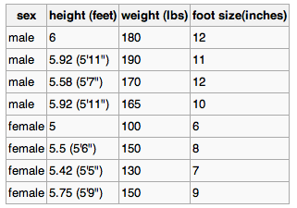
Naïve Bayes Classifier: Example
Best described through an example
Three features
Class label (male or female)
Training dataset

Slide 42

Naïve Bayes Classifier (Cont’d)
For each feature in each label
Compute the mean and variance
That is the model (classifier)

Slide 43

Naïve Bayes: Classify New Object
Male or female?
For each label ➔ Compute posterior value
The label with the largest posterior is the suggested label

Slide 44

Naïve Bayes: Classify New Object (Cont’d)
Male or female?
>> evidence: Can be ignored since it is the same constant for all labels
>> P(label): % of training points with this label
>> p(feature|label) = , f is feature value in sample
f

Slide 45


Naïve Bayes: Classify New Object (Cont’d)
Male or female?

Slide 46
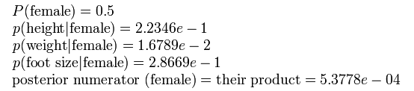
Naïve Bayes: Classify New Object (Cont’d)
Male or female?
The sample is predicted to be female

Slide 47

Naïve Bayes in Hadoop
How to implement Naïve Bayes as a map-reduce job?

Slide 48
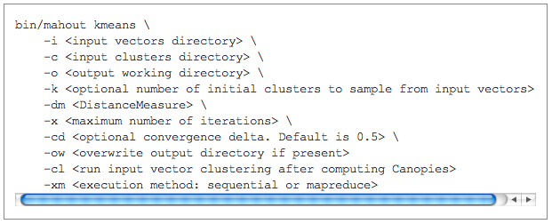
Apache Mahout
http://mahout.apache.org/

