Slide 1
MapReduce High-Level Languages
WPI, Mohamed Eltabakh

Slide 2
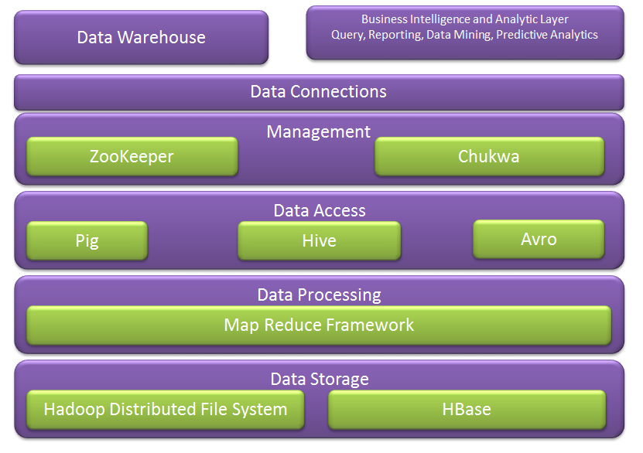
Hadoop Ecosystem
Next week we cover more of these
We covered these

Slide 3
Hive

Slide 4
Motivation
Yahoo worked on Pig to facilitate application deployment on Hadoop.
Their need mainly was focused on unstructured data
Simultaneously Facebook started working on deploying warehouse solutions on Hadoop that resulted in Hive.
They focused on structured data

Slide 5

Apache Hive
A data warehouse infrastructure built on top of Hadoop for providing data summarization, query, and analysis
Hive Provides
ETL: Extract-Transform-Load
Structure
Access to different storage (HDFS or HBase)
Query execution via MapReduce
Key Building Principles
SQL is a familiar language
Extensibility – Types, Functions, Formats, Scripts
Performance

Slide 6
Hive Components
High-level language (HiveQL)
Set of commands
Two Main Components
Two execution modes
Local: reads/write to local file system
Mapreduce: connects to Hadoop cluster and reads/writes to HDFS
Interactive mode
Console
Two modes
Batch mode
Submit a script

Slide 7
Hive deals with Structured Data
Data Units
Databases
Tables
Partitions
Buckets (or clusters)
Structure is known in advance
Very similar to SQL and Relational DBs

Slide 8
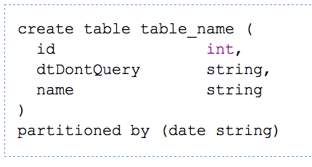
Hive DDL Commands
CREATE TABLE sample (foo INT, bar STRING) PARTITIONED BY (ds STRING);
SHOW TABLES '.*s';
DESCRIBE sample;
ALTER TABLE sample ADD COLUMNS (new_col INT);
DROP TABLE sample;
A table in Hive is an HDFS directory in Hadoop
Schema is known at creation time (like DB schema)
Partitioned tables have “sub-directories”, one for each partition

Slide 9
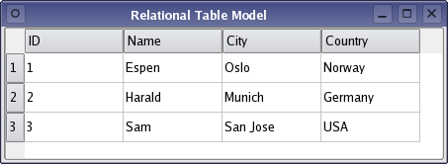
Hive vs. DB
DB
Hive
Virtual Table
Data is parsed at insertion time
Data types are checked
Loaded into relational table
No parsing at insertion time
Data remain in its file
File is inserted into the HDFS directory
corresponding to the table

Slide 10
Hive DML
Load data from local file system
Delete previous data from that table
LOAD DATA LOCAL INPATH './sample.txt' OVERWRITE INTO TABLE sample;
LOAD DATA INPATH '/user/falvariz/hive/sample.txt’ INTO TABLE partitioned_sample PARTITION (ds='2012-02-24');
Load data from HDFS
Augment to the existing data
Must define a specific partition for partitioned tables
Loaded data are files copied to HDFS under the corresponding directory

Slide 11
Hive File Format
Hive lets users store different file formats
Helps in performance improvements
SQL Example:
CREATE TABLE dest1(key INT, value STRING)
STORED AS
INPUTFORMAT
'org.apache.hadoop.mapred.SequenceFileInputFormat'
OUTPUTFORMAT
'org.apache.hadoop.mapred.SequenceFileOutputFormat'

Slide 12
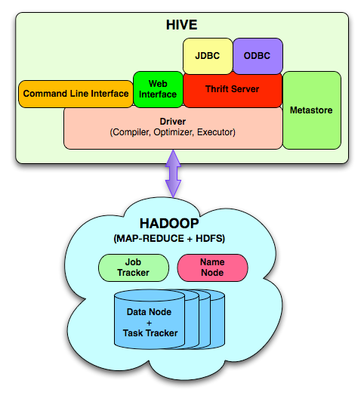
Hive Components
Hive CLI: Hive Command Line Interface
MetaStore: For storing the schema information, data types, partitioning columns, etc…
Hive QL: The query language, compiler, and executer
Thrift Server: cross-language framework to support many languages C, Java, Python, Ruby, PHP

Slide 13
Data Model
3-Levels: Tables → Partitions → Buckets
Table: maps to a HDFS directory
Table R: Users all over the world
Partition: maps to sub-directories under the table
Partition R by country name
It is the user’s responsibility to upload the right data to the right partition
Bucket: maps to files under each partition
Divide a partition into buckets based on a hash function on a certain column(s)

Slide 14
Data Model (Cont’d)

Slide 15
Query Examples I: Select & Filter
SELECT foo FROM sample WHERE ds='2012-02-24';
INSERT OVERWRITE DIRECTORY '/tmp/hdfs_out' SELECT * FROM sample WHERE ds='2012-02-24';
INSERT OVERWRITE LOCAL DIRECTORY '/tmp/hive-sample-out' SELECT * FROM sample;
Create HDFS dir for the output
Create local dir for the output

Slide 16
Query Examples II: Aggregation & Grouping
SELECT MAX(foo) FROM sample;
SELECT ds, COUNT(*), SUM(foo) FROM sample GROUP BY ds;
FROM sample s INSERT OVERWRITE TABLE bar SELECT s.bar, count(*) WHERE s.foo > 0 GROUP BY s.bar;
Hive allows the From clause to come first !!!
Store the results into a table
This new syntax is to facilitate the “Multi-Insertion”

Slide 17
Query Examples III: Multi-Insertion
FROM page_view_stg pvs
INSERT OVERWRITE TABLE page_view PARTITION(dt='2008-06-08', country='US')
SELECT pvs.viewTime, … WHERE pvs.country = 'US'
INSERT OVERWRITE TABLE page_view PARTITION(dt='2008-06-08', country='CA')
SELECT pvs.viewTime, ... WHERE pvs.country = 'CA'
INSERT OVERWRITE TABLE page_view PARTITION(dt='2008-06-08', country='UK')
SELECT pvs.viewTime, ... WHERE pvs.country = 'UK';

Slide 18
Example IV: Joins
CREATE TABLE customer (id INT,name STRING,address STRING)
ROW FORMAT DELIMITED FIELDS TERMINATED BY '#';
CREATE TABLE order_cust (id INT,cus_id INT,prod_id INT,price INT)
ROW FORMAT DELIMITED FIELDS TERMINATED BY '\t';
SELECT * FROM customer c JOIN order_cust o ON (c.id=o.cus_id);
SELECT c.id, c.name, c.address, ce.exp
FROM customer c JOIN (SELECT cus_id,sum(price) AS exp
FROM order_cust
GROUP BY cus_id) ce ON (c.id=ce.cus_id);

Slide 19
Example V: Another Syntax for Join
FROM page_view pv JOIN user u ON (pv.userid = u.id)
INSERT INTO TABLE pv_users
SELECT pv.*, u.gender, u.age
WHERE pv.date = 2008-03-03;
Join
FROM page_view pv FULL OUTER JOIN user u
ON (pv.userid = u.id)
INSERT INTO TABLE pv_users
SELECT pv.*, u.gender, u.age
WHERE pv.date = 2008-03-03;
Outer Join

Slide 20

Performance
JOIN operation
Traditional Map-Reduce Join
Early Map-side Join
very efficient for joining a small table with a large table
Keep smaller table data in memory first
Join with a chunk of larger table data each time

Slide 21
Inserts into Files, Tables and Local Files
FROM pv_users
INSERT INTO TABLE pv_gender_sum
SELECT pv_users.gender, count_distinct(pv_users.userid)
GROUP BY(pv_users.gender)
INSERT INTO DIRECTORY ‘/user/tmp/dir’
SELECT pv_users.age, count_distinct(pv_users.userid)
GROUP BY(pv_users.age)
INSERT INTO LOCAL DIRECTORY ‘/home/local/dir’
FIELDS TERMINATED BY ‘,’
LINES TERMINATED BY \013
SELECT pv_users.age, count_distinct(pv_users.userid)
GROUP BY(pv_users.age);

Slide 22
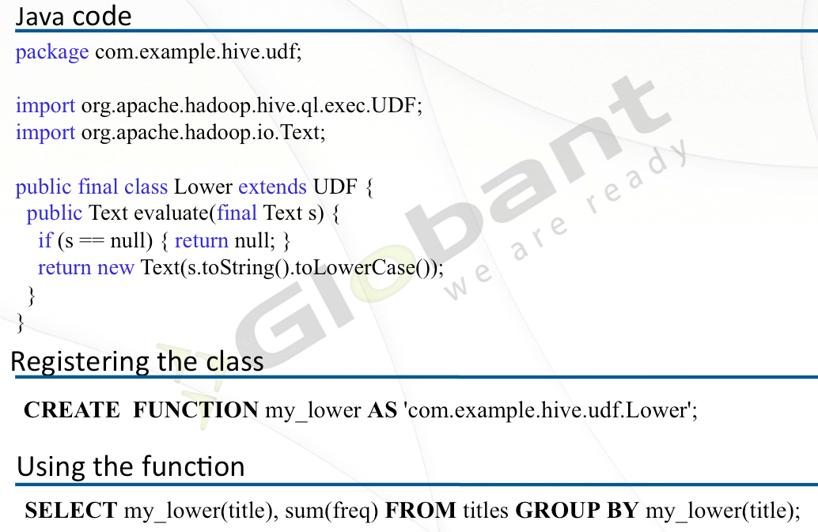
User-Defined Functions

Slide 23
Word Count in Hive
FROM (
MAP doctext USING 'python wc_mapper.py' AS (word, cnt)
FROM docs
CLUSTER BY word ) a
REDUCE word, cnt USING 'pythonwc_reduce.py’;
>> The map & reduce functions are black-box written in Python

Slide 24
Complex Example

