Slide 1

Apache Spark II

Slide 2
RDD Summary
You can persist (cache) an RDD
Can choose storage level (MEMORY_ONLY, DISK_ONLY, MEMORY_AND_DISK, etc.)
Memory Caching allows future actions to be much faster (often >10x).
Mark RDD to be persisted using the persist() or cache() methods on it.

Slide 3
RDD Summary
Memory Cache RDD is fault-tolerant using Lineage mechanism
Disk Copy RDD is fault-tolerant using HDFS replication
Can manually call unpersist()

Slide 4
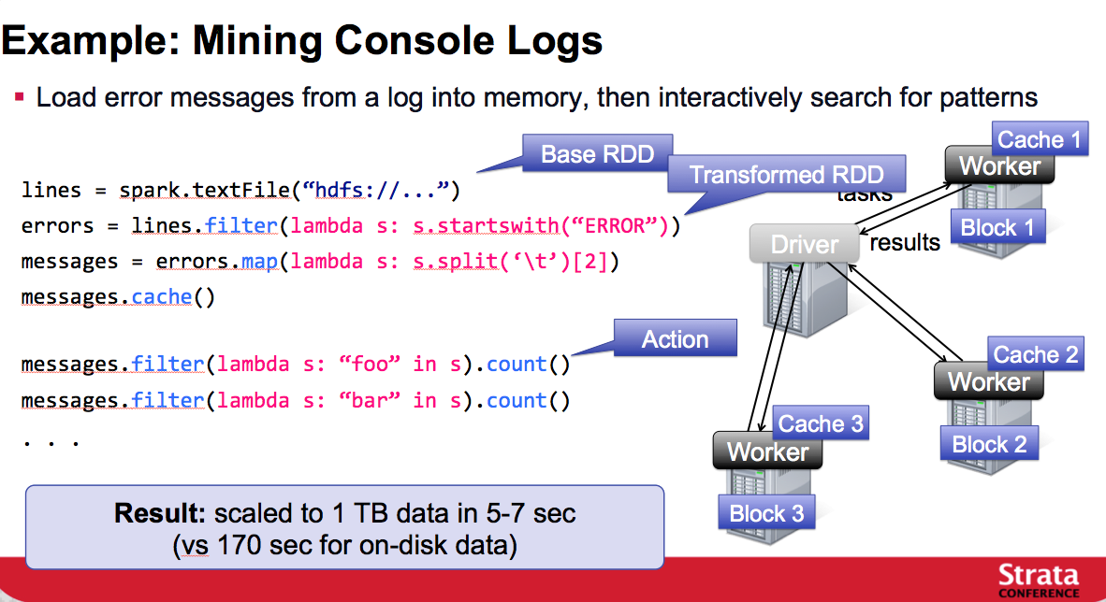
Example I

Slide 5
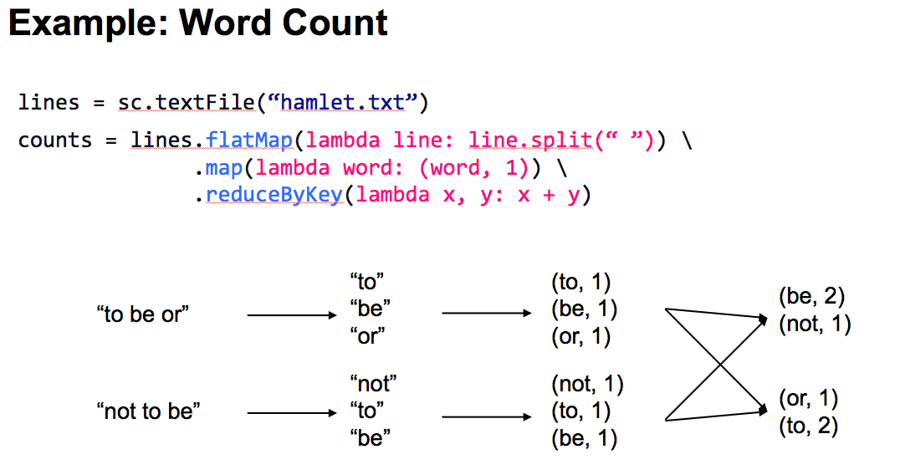
Example II

Slide 6
Performance
Spark is faster than Hadoop 10x – 100x
Especially for Iterative algorithms
Spark needs more memory than Hadoop
Jobs that require one iteration
No big difference between Spark & Hadoop
Spark performance is more sensitive to availability of memory

Slide 7
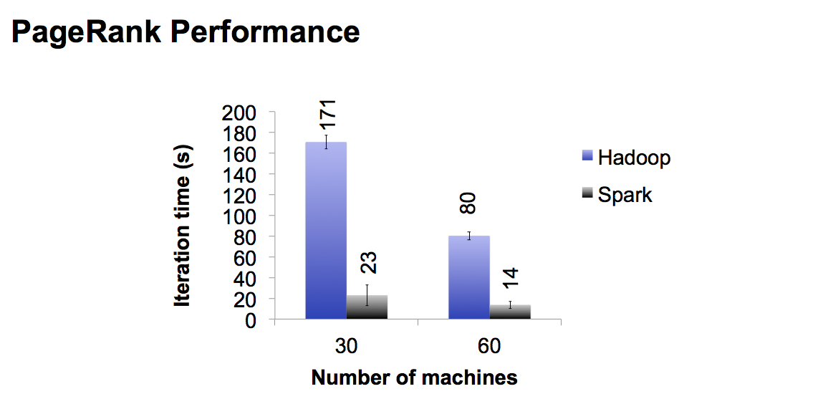
PageRank

Slide 8
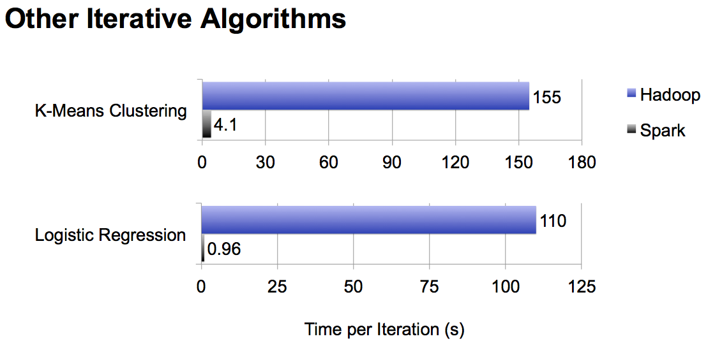
K-Means & L. Regression

