Slide 1



Spark SQL: Relational Data Processing in Spark
Authors:
Matei Zaharia
Michael Armbrust
Reynold S. Xin
Cheng Lian
Yin Huai
Davies Liu
Joseph K. Bradley
Xiangrui Meng
Tomer Kaftanz
Michael J. Franklin
Ali Ghodsi

Slide 2







What is Spark SQL?
SQL
One of the 4 major components of Apache Spark
Spark's module for working with structured data
Spark
SQL
Spark
SQL
Spark Streaming real-time
GraphX
graph
MLlib machine learning
…
Spark

Slide 3
About Spark SQL
Spark – Most contributed Open Source in 2015
Spark SQL – Most contributed module in Spark

Slide 4
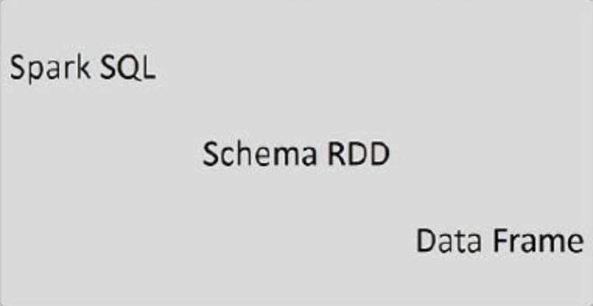
Why Spark SQL?
Many applications manage structured data
Specially after some cleaning and massaging of row data
Use of structure allows for more optimizations

Slide 5
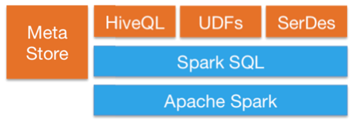
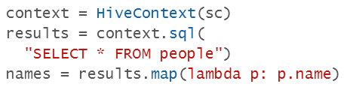
Why Spark SQL? (Cont’d)
Hive Compatibility
Full compatibility with existing Hive data, queries, and UDFs
Integrated SQL capabilities

Slide 6
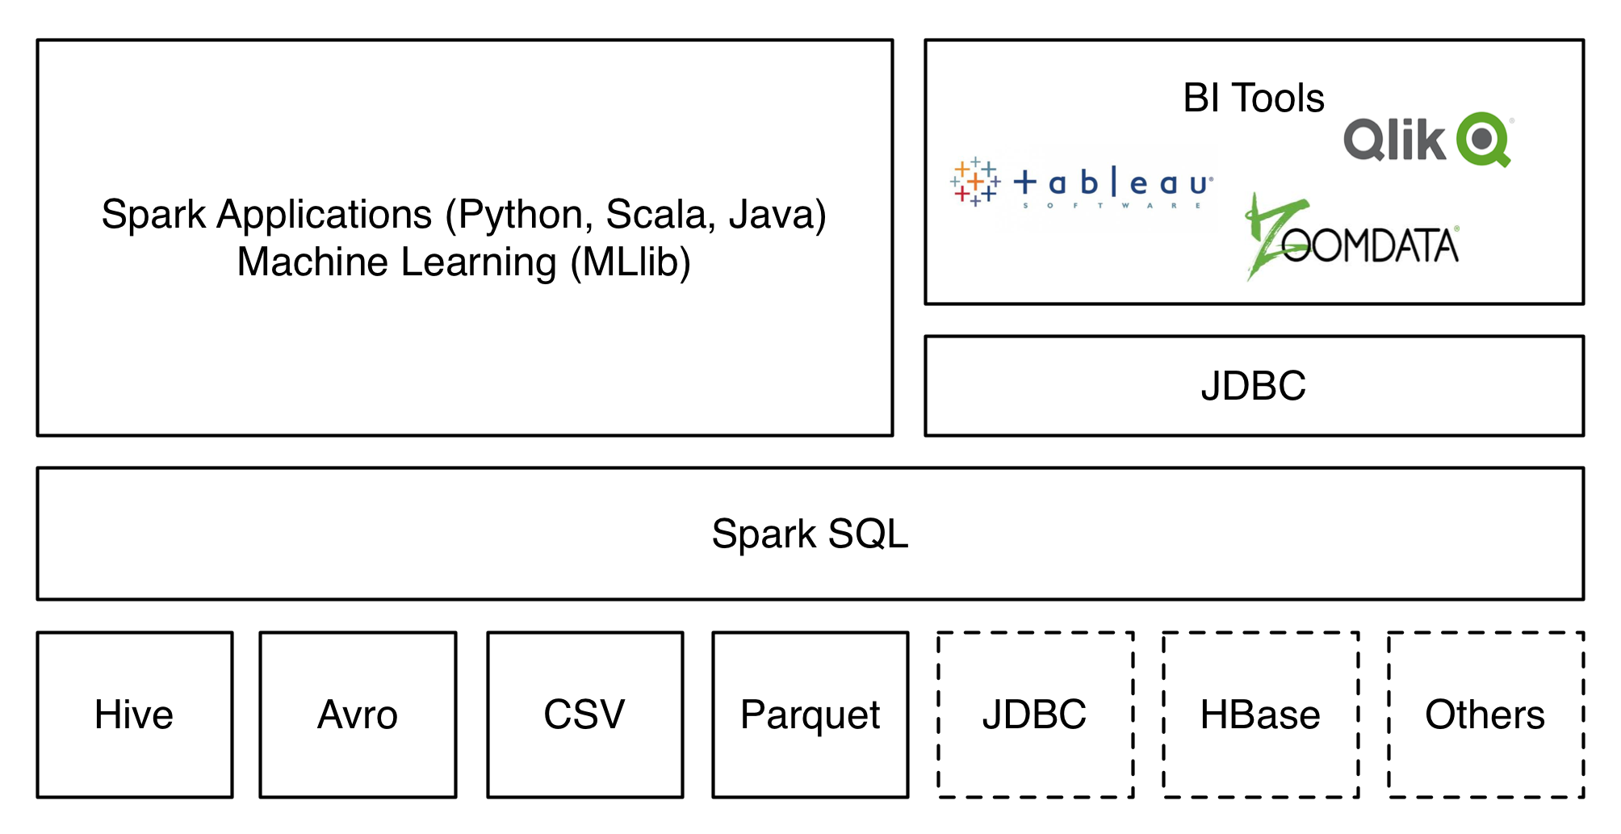
Why Spark SQL? (Cont’d)
Uniform Data Access
Connect to any data source: Hive, Avro, Parquet, JSON, JDBC, etc.

Slide 7




Evolution of Spark SQL
MapReduce:
Low-level, Procedural Programming Interface
Tons of Code; Manual Optimization
PIG, HIVE, Dremel, etc:
Relational Interfaces for Big Data
Declarative Queries; Richer Optimizations
Runs on MapReduce; Lacks support for complex algorithms

Slide 8


Evolution of Spark SQL (Cont’d)
Shark:
Uses HIVE Engine on Spark
Limited functionality:
Queries only external data stored in the Hive catalog
Hive optimizer was tailored for MapReduce:
Difficult to extend for Machine Learning algorithms
Spark SQL:

Slide 9
Goals
Support Relational processing in:
Spark programs (Native RDDs)
External data sources
Provide high performance using existing DBMS techniques
Support new data sources, including semi-structured data and external databases
Enable extension for advanced Analytics algorithms

Slide 10
Core Components
Procedural and Relational interfaces
Combine them
Intermix the two seamlessly
Structured RDDs
=> DATAFRAME API
DMBS level optimization
Give users the option to write optimization rules
=> CATALYST OPTIMIZER

Slide 11
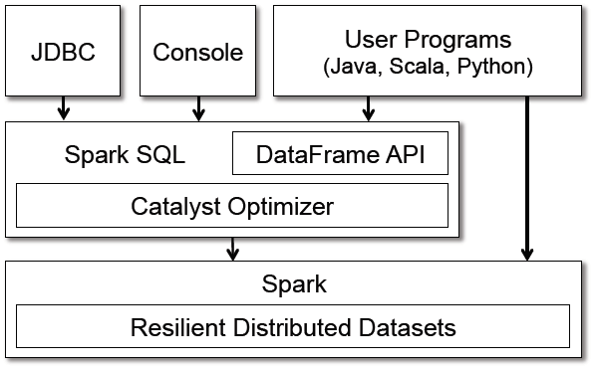
Programming Interface

Slide 12
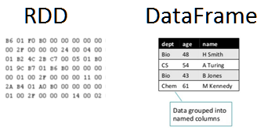
DataFrame API
DataFrame = RDD + Schema
Distributed collection of data organized into columns
Like a table in a relational database
Blackbox to Spark
Known structure to Spark

Slide 13
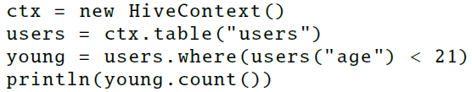
DataFrame API (Cont’d)
Example
Schema is obtained from Hive
DataFrame

Slide 14
SQL + Procedural Workflow
Can apply SQL commands on DataFrame
Can apply Procedural Workflow using SQL constructs

Slide 15
Data Model
Uses nested data model
Supports all major SQL data types:
Primitive: boolean, integer, double, decimal, string, date, and timestamp
Complex: structs, arrays, maps and unions
Also supports User Defined Functions (UDFs)

Slide 16
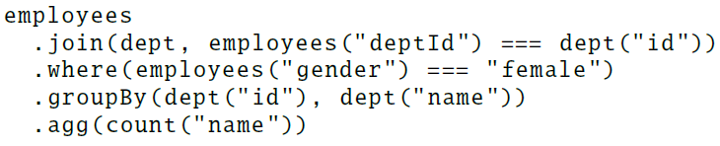
DataFrame Operations
Supports all major relational operations:
select, join, where, groupBy, agg, etc.
Compute the number of female employees in each department
Dataframes

Slide 17

DataFrame Operations
Can be registered as temporary table and queried using SQL
Procedural SQL constructs
Register output as TempTable
SQL query

Slide 18
DataFrames vs Relational Query Languages
DataFrames = Relational + Procedural
=> SQL + Java, Scala or Python
=> SQL + Loops, If statements, etc
Users can break up their code into Scala, Java or Python functions that pass DataFrames between them to build a logical plan
Benefits in optimizations across the whole plan

Slide 19





Querying Native Datasets
Construct RDDs => Build DataFrame
Scala and Java:
Type information extracted from the language’s type system
Python:
Schema inference due to the dynamic type system

Slide 20
In-Memory Caching
Materializes (“caches”) hot data in memory using columnar storage
Uses Columnar compression:
Memory compression by 10X
Highly benefits in iterative algorithms
Can store more data in memory
Machine Learning and Graph Processing

Slide 21
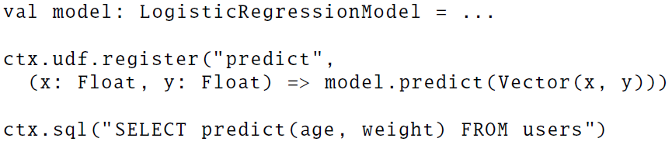
User-Defined Functions
Traditional Database Systems
Uses UDFs for JSON, ML Algorithms support
Done in different programming environment
Requires packing, registration and import
In Spark SQL
Can be registered “inline” with Scala, Java or Python functions
Useful for BI tools through JDBC/ODBC interface

Slide 22
CATALYST OPTIMIZER

Slide 23
Catalyst Optimizer
What is Catalyst Optimizer?
A new extensible optimizer for Spark SQL
Rule-Based Optimizer
Catalyst Extensible Design Purpose:
Make it easy to add new optimization features and techniques
Extendable Optimizer by adding new rules

Slide 24
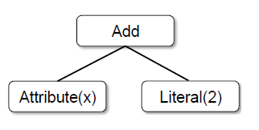
Catalyst Trees
The main data type in Catalyst is a tree.
Composed of node objects.
Each node has a node type and zero or more children.
New node types can be defined as subclasses of TreeNode class.
Node objects are immutable.
Trees can be manipulated using functional transformations (rules).

Slide 25
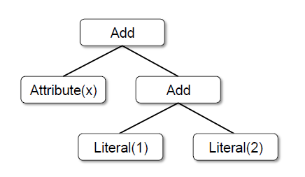
Catalyst Trees Example
Tree for the expression
x + (1 + 2)
Scala code representation:
Add(Attribute(x), Add(Literal(1), Literal(2)))

Slide 26
Tree Transformation using Rules
Tree Transformation
Rules that transform a Tree to another equivalent Tree
Pattern matching functions are used to find and replace subtrees with a specific structure
Transformation rules from RDBMSs are already built in

Slide 27
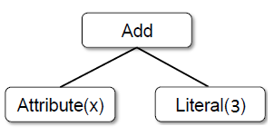
Tree Transformation using Rules
Suppose we have rule that folds Add operation between constants
tree.transform{
case Add(Literal(c1), Literal(c2)) => Literal(c1 + c2)
}
Applying this rule to the expression x + (1 + 2) will give us a new tree x + 3

Slide 28
Tree Transformation using Rules
We can define multiple patterns in the same transform call
tree.transform{
case Add(Literal(c1), Literal(c2)) => Literal(c1 + c2)
case Add(left, Literal(0)) => left
case Add(literal(0), right) => right
}

Slide 29
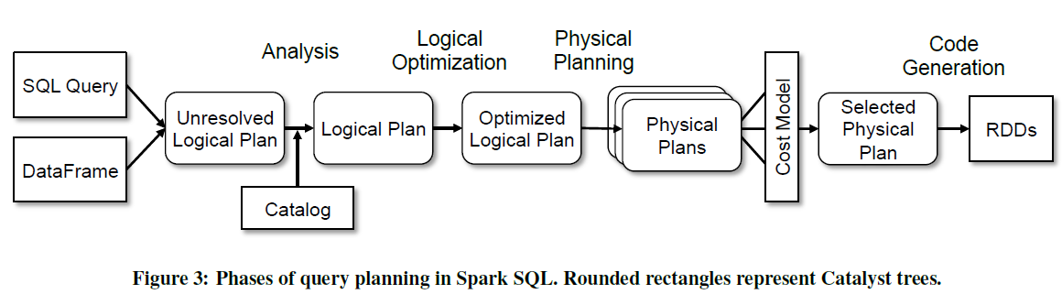
Using Catalyst in Spark SQL
Catalyst general tree framework is used in four phases

Slide 30
Example of Rule Transformations

Slide 31
Logical vs. Physical Plans
SELECT name
FROM (
SELECT id, name
FROM People) p
WHERE p.id = 1

Slide 32
Advanced Features on DataFrames

Slide 33
Advanced Analytics Features
Three features for “big data” environments
Spark SQL schema inference for JSON and other semi structured data.
Spark SQL incorporated into Spark’s machine learning library (MLib).
Spark SQL supports query federation, allowing a single program to efficiently query disparate sources.

Slide 34
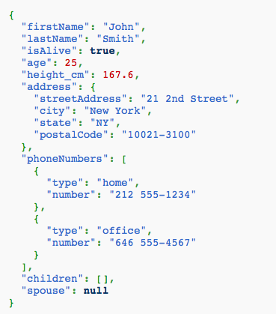
Schema Inference For Semi structured Data
Semistructured data is common in large-scale applications
JSON is very common

Slide 35
Schema Inference For Semi structured Data
Spark SQL contains a JSON data source that automatically infers a schema from a set of records.
The schema inference algorithm works in one pass over the data, and can also be run on sample of the data if desired.

Slide 36
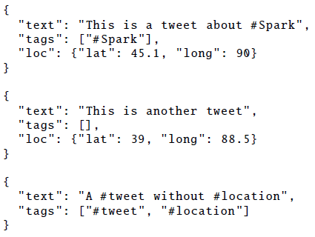

Schema Inference For Semi structured Data
Consider we have a sample set of JSON records (tweets)
Inferred schema

Slide 37
Spark MLlib Pipelines
tokenizer = Tokenizer(inputCol="text", outputCol="words”)
hashingTF = HashingTF(inputCol="words", outputCol="features”)
lr = LogisticRegression(maxIter=10, regParam=0.01)
pipeline = Pipeline(stages=[tokenizer, hashingTF, lr])
df = sqlCtx.load("/path/to/data")
model = pipeline.fit(df)
lr
ds0
ds1
ds2
ds3
tokenizer
hashingTF
lr.model
Pipeline Model

Slide 38
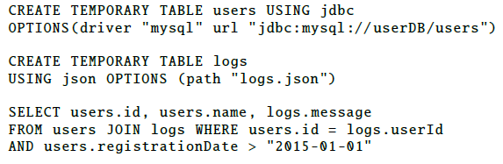
Query Federation to External Databases
Data may come from heterogeneous sources
Data frames unify the flow of data

Slide 39

The not-so-secret truth...
SQL
is about more than SQL.

Slide 40
Declarative BigData Processing
Let Developers Create and Run Spark Workflows Faster:
Write less code
Read less data
Let the optimizer do the hard work

Slide 41

Write Less Code: Compute an Average
private IntWritable one =
new IntWritable(1)
private IntWritable output =
new IntWritable()
proctected void map(
LongWritable key,
Text value,
Context context) {
String[] fields = value.split("\t")
output.set(Integer.parseInt(fields[1]))
context.write(one, output)
}
IntWritable one = new IntWritable(1)
DoubleWritable average = new DoubleWritable()
protected void reduce(
IntWritable key,
Iterable<IntWritable> values,
Context context) {
int sum = 0
int count = 0
for(IntWritable value : values) {
sum += value.get()
count++
}
average.set(sum / (double) count)
context.Write(key, average)
}
data = sc.textFile(...).split("\t")
data.map(lambda x: (x[0], [x.[1], 1])) \
.reduceByKey(lambda x, y: [x[0] + y[0], x[1] + y[1]]) \
.map(lambda x: [x[0], x[1][0] / x[1][1]]) \
.collect()

Slide 42
Write Less Code: Compute an Average
Using RDDs
data = sc.textFile(...).split("\t")
data.map(lambda x: (x[0], [int(x[1]), 1])) \
.reduceByKey(lambda x, y: [x[0] + y[0], x[1] + y[1]]) \
.map(lambda x: [x[0], x[1][0] / x[1][1]]) \
.collect()
Using SQL
SELECT name, avg(age)
FROM people
GROUP BY name
Using Pig
P = load '/people' as (name, name);
G = group P by name;
R = foreach G generate … AVG(G.age);
Using DataFrames
sqlCtx.table("people") \
.groupBy("name") \
.agg("name", avg("age")) \
.collect()

Slide 43
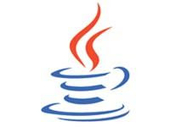















Extensible Input & Output
Spark’s Data Source API allows optimizations like column pruning and filter pushdown into custom data sources.
Built-In
External
{ JSON }
JDBC
and more…

