Slide 1
MongoDB-3
WPI, Mohamed Eltabakh

Slide 2
Modeling Tree Structure

Slide 3
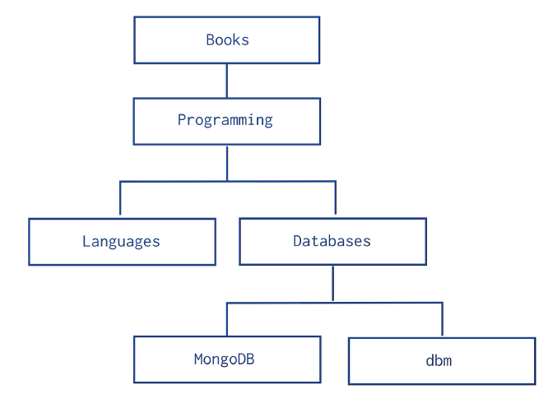
Collections with Tree-Like Relationships
Insert these records while maintaining this tree-like relationship
Given one node, answer queries:
Report the parent node
Report the children nodes
Report the ancestors
Report the descendants
Report the siblings

Slide 4
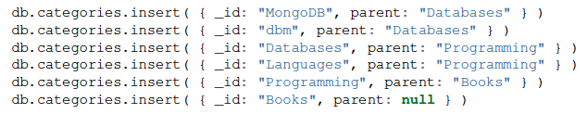
Method 1: Parent References
Each document has a field “parent”
Order does not matter

Slide 5
Method 1: Parent References
Q1: Parent of “Programming”
db.categories.find( {_id: "Programming"}, {parent: 1, _id: 0});
Q2: Siblings of “Databases”
var parentDoc = db.categories.findOne( {_id: "Databases"});
db.categories.find( {parent: parentDoc.parent,
_id: { $ne :"Databases"} });

Slide 6
Method 1: Parent References
Q3: Descendants of “Programming”
Complex…Requires recursive calls

Slide 7
Method 1: Parent References
Q3: Descendants of “Programming”
var descendants = [];
var stack = [];
var item = db.categories.findOne({_id: "Programming"});
stack.push(item);
while (stack.length > 0) {
var current = stack.pop();
var children = db.categories.find( {parent: current._id});
while (children.hasNext() == true) {
var child = children.next();
descendants.push(child._id);
stack.push(child);
}
}
descendants;

Slide 8
Method 1: Parent References
Q4: Ancestors of “MongoDB”
Try it yourself….
Should be:
“Databases”, “Programming”, “Books”

Slide 9

Method 2: Child References
Each document has an array of immediate children

Slide 10
Method 2: Child References
Q1: Get children documents of “Programming”
var x = db.categories.findOne({_id: "Programming"}).children;
db.categories.find({_id: {$in: x}});

Slide 11
Method 2: Child References
Q2: Ancestors of “MongoDB”

Slide 12
Method 2: Child References
Q2: Ancestors of “MongoDB”
var results=[];
var parent = db.categories.findOne({children: "MongoDB"});
while(parent){
print({Message: "Going up one level…"});
results.push(parent._id);
parent = db.categories.findOne({children: parent._id});
}
results;

Slide 13
Method 2: Child References
Q3: descendants of “Books”
Try it yourself….
Should be all nodes

Slide 14
Other Methods
Several other methods:
Include both parent and children
Include Ancestors
Include root-to-node path
Check MongoDB manual…

