Slide 1
MongoDB-4
WPI, Mohamed Eltabakh

Slide 2
Aggregation in MongoDB (Chapter 7)

Slide 3
Aggregation Mechanisms
Aggregation Pipeline
Documents go through a pipeline of operators until aggregated
Map-Reduce Model

Slide 4
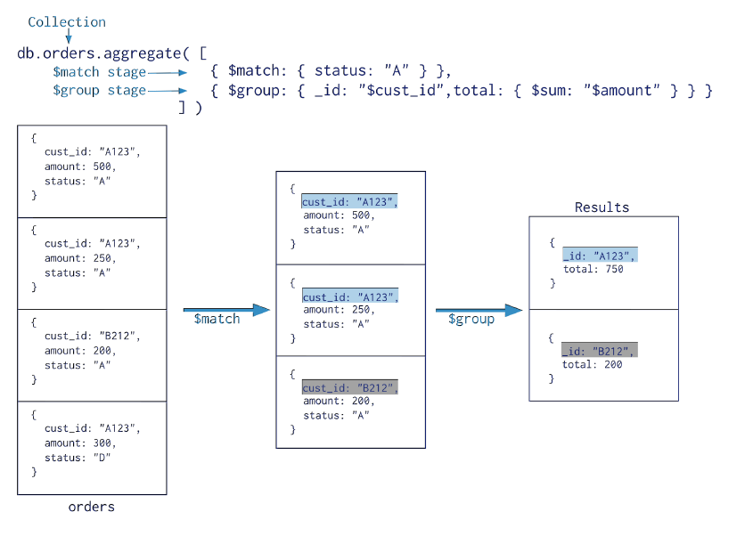
Aggregation Pipeline
Use “aggregate” operator
All predicates, e.g., AND & OR can go here
Defines the grouping column(s)
Aggregation fields

Slide 5
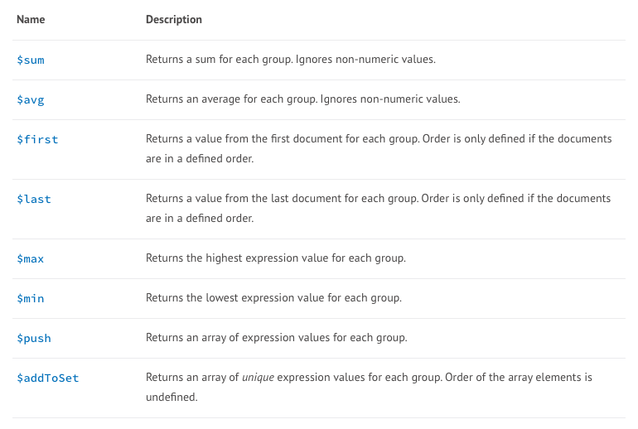
Aggregation Function

Slide 6
Example 1
{ "_id" : 1, "item" : "abc", "price" : 10, "quantity" : 2, "date" : ISODate("2014-03-01T08:00:00Z") }
{ "_id" : 2, "item" : "jkl", "price" : 20, "quantity" : 1, "date" : ISODate("2014-03-01T09:00:00Z") }
{ "_id" : 3, "item" : "xyz", "price" : 5, "quantity" : 10, "date" : ISODate("2014-03-15T09:00:00Z") }
{ "_id" : 4, "item" : "xyz", "price" : 5, "quantity" : 20, "date" : ISODate("2014-04-04T11:21:39.736Z") }
{ "_id" : 5, "item" : "abc", "price" : 10, "quantity" : 10, "date" : ISODate("2014-04-04T21:23:13.331Z") }
For each day, get the:
- TotalPrice ⬅ Sum (Price * Quantity)
- average quantity
- Count

Slide 7
{ "_id" : 1, "item" : "abc", "price" : 10, "quantity" : 2, "date" : ISODate("2014-03-01T08:00:00Z") }
{ "_id" : 2, "item" : "jkl", "price" : 20, "quantity" : 1, "date" : ISODate("2014-03-01T09:00:00Z") }
{ "_id" : 3, "item" : "xyz", "price" : 5, "quantity" : 10, "date" : ISODate("2014-03-15T09:00:00Z") }
{ "_id" : 4, "item" : "xyz", "price" : 5, "quantity" : 20, "date" : ISODate("2014-04-04T11:21:39.736Z") }
{ "_id" : 5, "item" : "abc", "price" : 10, "quantity" : 10, "date" : ISODate("2014-04-04T21:23:13.331Z") }
db.sales.aggregate([
{$group : {_id : { month: { $month: "$date" },
day: { $dayOfMonth: "$date" },
year: { $year: "$date" } } ,
totalPrice: { $sum: { $multiply: [ "$price", "$quantity" ] } },
averageQuantity: { $avg: "$quantity" },
count: { $sum: 1 }
}}])

Slide 8
Example 2
{ "_id" : 1, "item" : "abc", "price" : 10, "quantity" : 2, "date" : ISODate("2014-03-01T08:00:00Z") }
{ "_id" : 2, "item" : "jkl", "price" : 20, "quantity" : 1, "date" : ISODate("2014-03-01T09:00:00Z") }
{ "_id" : 3, "item" : "xyz", "price" : 5, "quantity" : 10, "date" : ISODate("2014-03-15T09:00:00Z") }
{ "_id" : 4, "item" : "xyz", "price" : 5, "quantity" : 20, "date" : ISODate("2014-04-04T11:21:39.736Z") }
{ "_id" : 5, "item" : "abc", "price" : 10, "quantity" : 10, "date" : ISODate("2014-04-04T21:23:13.331Z") }
Get the distinct values of the items…
db.sales.aggregate([ {$group : {_id : "$item” } ])
db.sales.distinct("item")

Slide 9
Group By…Having
In MongoDB ➔ $match operator after the $group
{ "_id": "10280",
"country": "USA",
"city": "NEW YORK",
"state": "NY",
"pop": 5574,
"loc": [ -74.016323, 40.710537]
}
Select state, sum(pop)
From collection
Where country = “USA”
Group By state
Having sum(pop) > 10,000,000;
For all documents of USA, report the states having total population > 10,000,000

Slide 10
Group By…Having
In MongoDB ➔ $match operator after the $group
{ "_id": "10280",
"country": "USA",
"city": "NEW YORK",
"state": "NY",
"pop": 5574,
"loc": [ -74.016323, 40.710537]
}
Select state, sum(pop)
From collection
Where country = “USA”
Group By state
Having sum(pop) > 10,000,000;
db.zipcodes.aggregate( [
{ $match: { country: "USA" }},
{ $group: { _id: "$state", totalPop: { $sum: "$pop" } } },
{ $match: { totalPop: { $gt: 10*1000*1000 } } }
] )

Slide 11
Example 3
{ "_id": "10280",
"country": "USA",
"city": "NEW YORK",
"state": "NY",
"pop": 5574,
"loc": [ -74.016323, 40.710537]
}
{ "_id": "10290",
"country": "USA",
"city": "NEW YORK",
"state": "NY",
"pop": 87652,
"loc": [ 43.23, 121.53]
}
For USA, Report for each state, the average population across its cities

Slide 12
Example 4
{ "_id": "10280",
"country": "USA",
"city": "NEW YORK",
"state": "NY",
"pop": 5574,
"loc": [ -74.016323, 40.710537]
}
{ "_id": "10290",
"country": "USA",
"city": "NEW YORK",
"state": "NY",
"pop": 87652,
"loc": [ 43.23, 121.53]
}
For each state, return the largest and the smallest city along with their population.

Slide 13
Aggregation Mechanisms
Aggregation Pipeline
Documents go through a pipeline of operators until aggregated
Map-Reduce Model
Similar concept as Hadoop
Uses JavaScript inside the functions

Slide 14
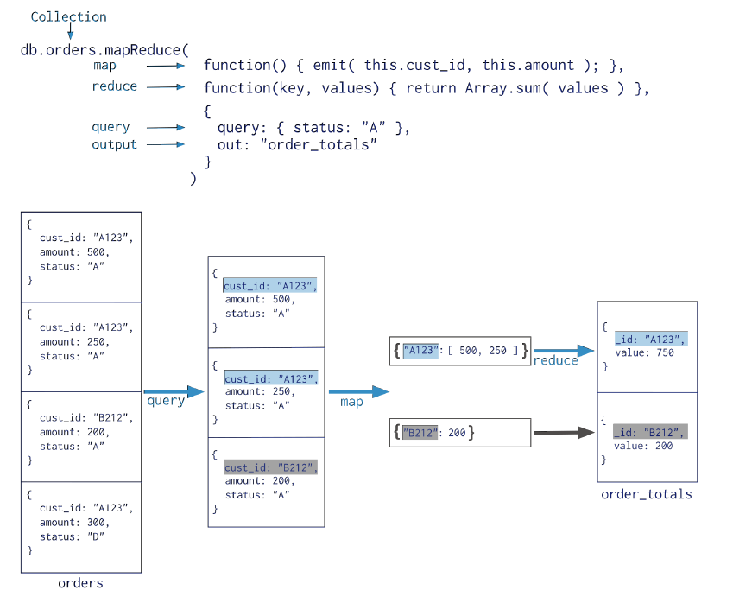
Map-Reduce Model
Map ➔ emits key-value pair
All processing is internal within MongoDB
(No Hadoop communication)
Slower than “aggregate” as it involve
black-box JavaScript code

Slide 15
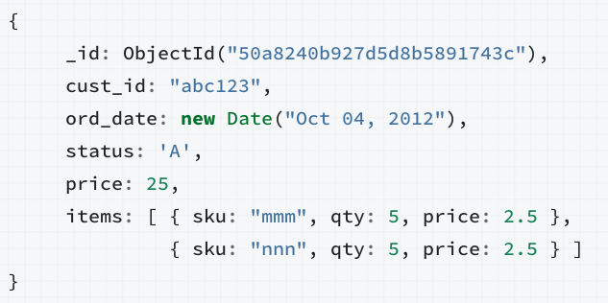
Example 1
Aggregation over all records in “items” array
Group the documents by the customer id, and get the sum of Price

Slide 16
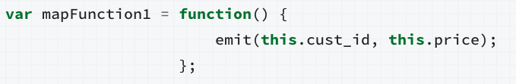
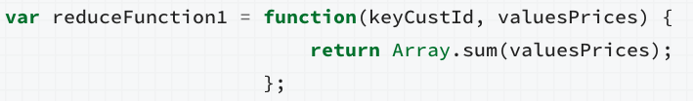
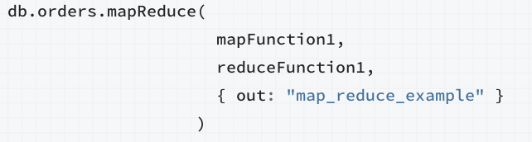
Example 1

Slide 17
Example 2
For each item.sku, report the average quantity across all orders after 1/1/2012

Slide 18
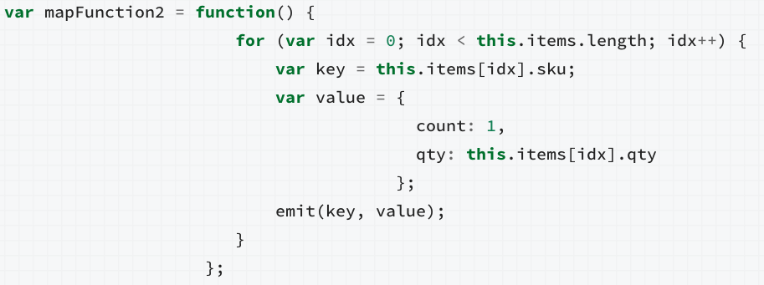
Example 2: Map Function

Slide 19
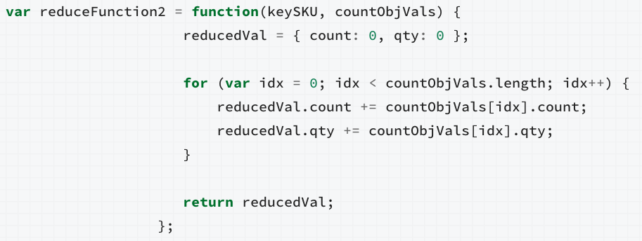
Example 2: Reduce Function

Slide 20
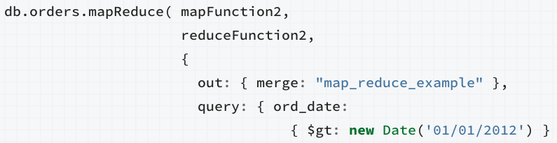
Example 2: Final
}})

