Slide 1
MongoDB-5
WPI, Mohamed Eltabakh

Slide 2
Architecture Replication & Sharding (Chapters 9, 10)

Slide 3
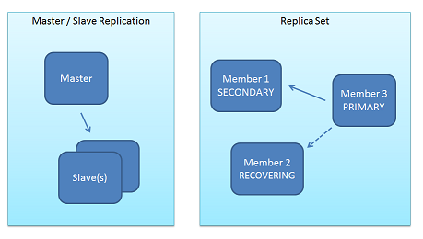
Replication (Chapter 9)
Replica Set
Similar in concept to Master-Slave architecture
Goal: Availability, Fault Tolerance, Load Balancing
Replica sets are more recent mechanisms
Give more flexibility (fine tuning)

Slide 4
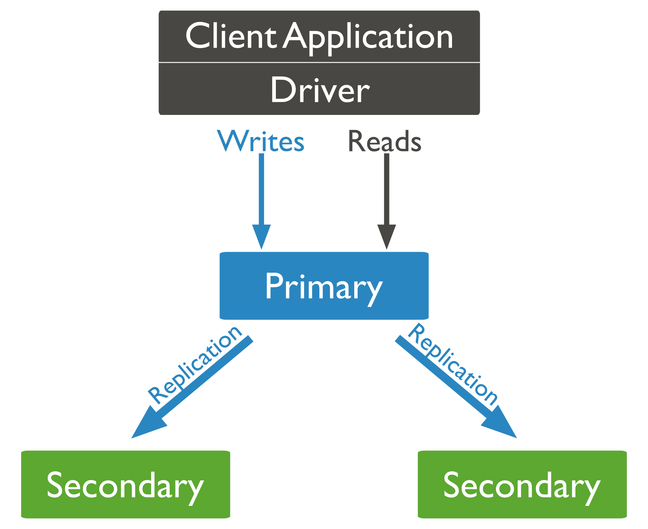
Replica Set
Consists of one “Primary” and multiple “Secondary”
All write ops must go to the primary
Primary maintains a log “oplog”
Secondary sites periodically read & apply the log from the primary site
Eventual Consistency

Slide 5
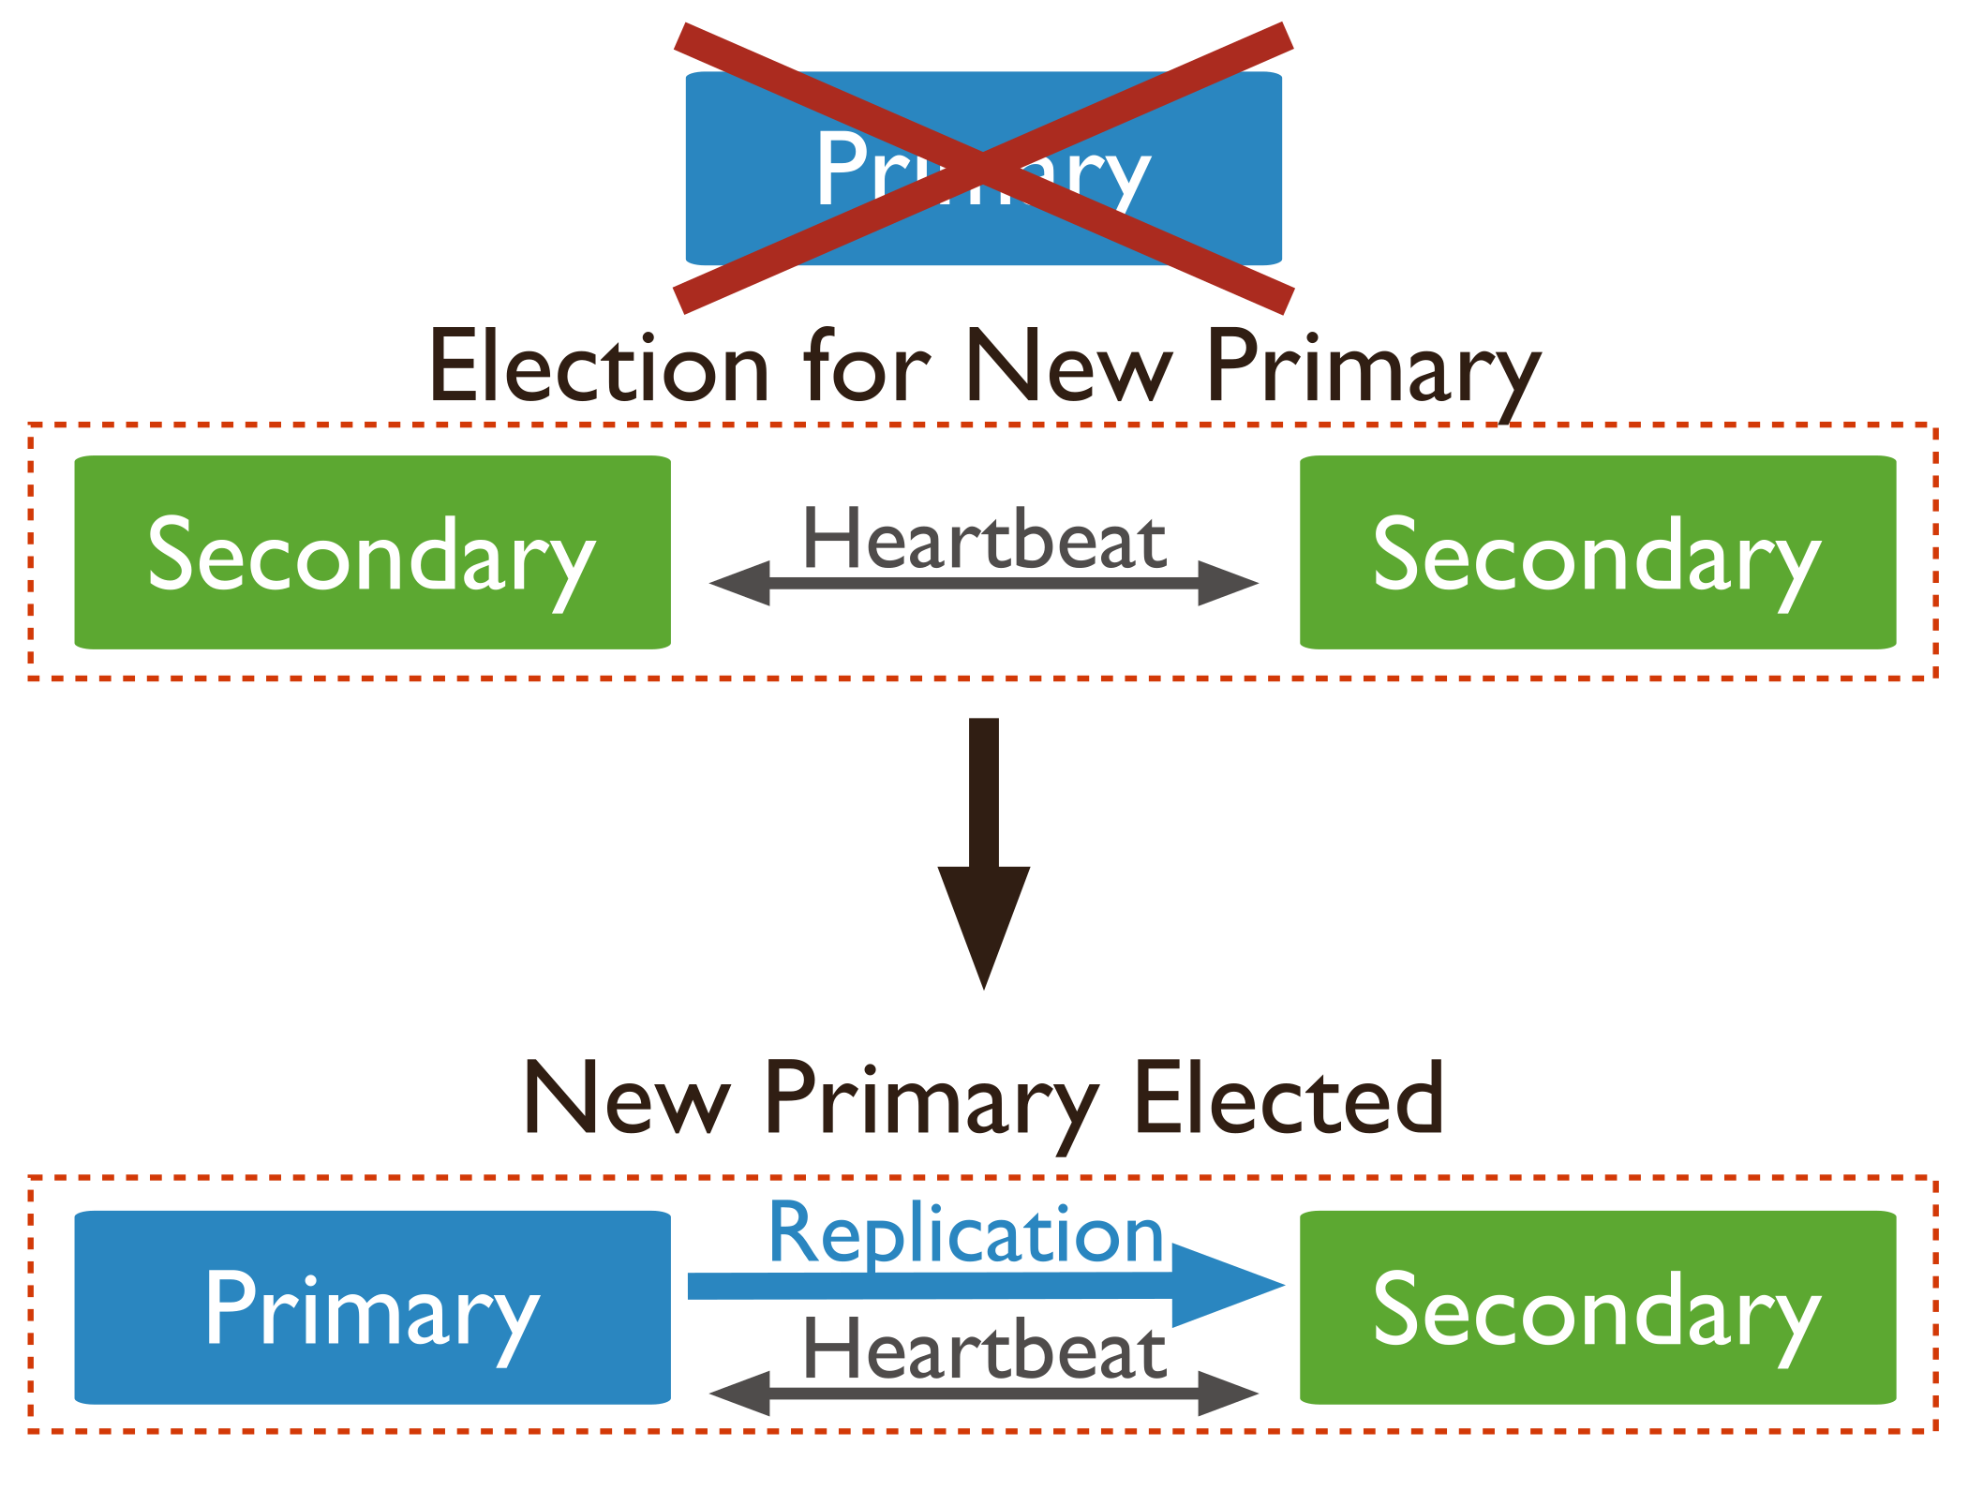
Election when Primary Fails
Based on majority voting
Number of members should be odd
During election, no writes are accepted

Slide 6
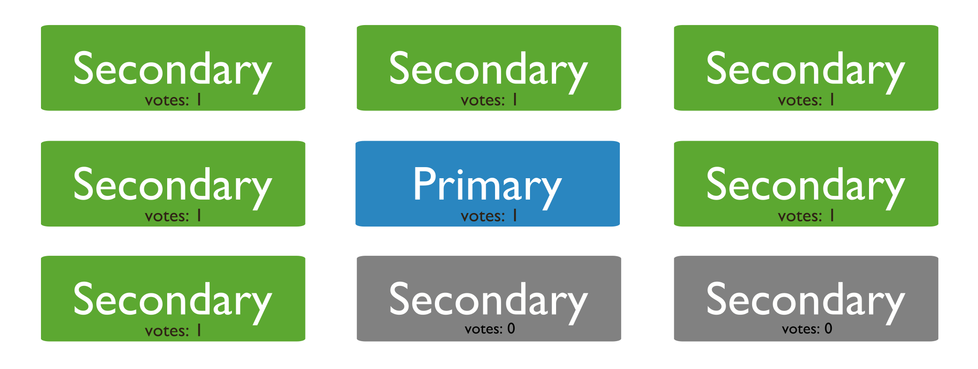
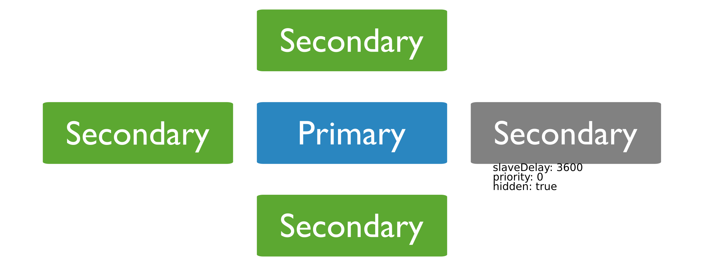
Configuring Secondary Sites
Number of secondaries
Priority = 0 ⬅ cannot be elected as primary
Hidden = True ⬅ Cannot serve client operations
SlaveDelay = m ⬅ waits m msec before getting the updates from the primary site

Slide 7
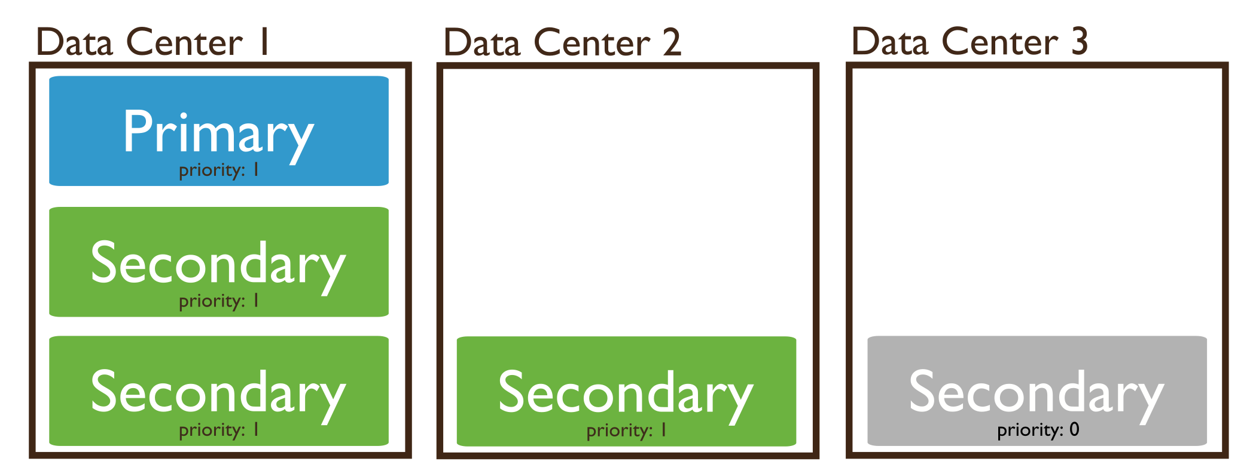
Configuring Secondary Sites
Priority = 0
Cannot be primary
Cannot accept write
Still has data & accept reads
May want some data centers not to accept write ops
Hidden = True
Imply Priority = 0
But also cannot accept reads from clients
Good for dedicated offline tasks, e.g., reporting
SlaveDelay = m
Should be Hidden = True
Good to recover from bad transactions

Slide 8
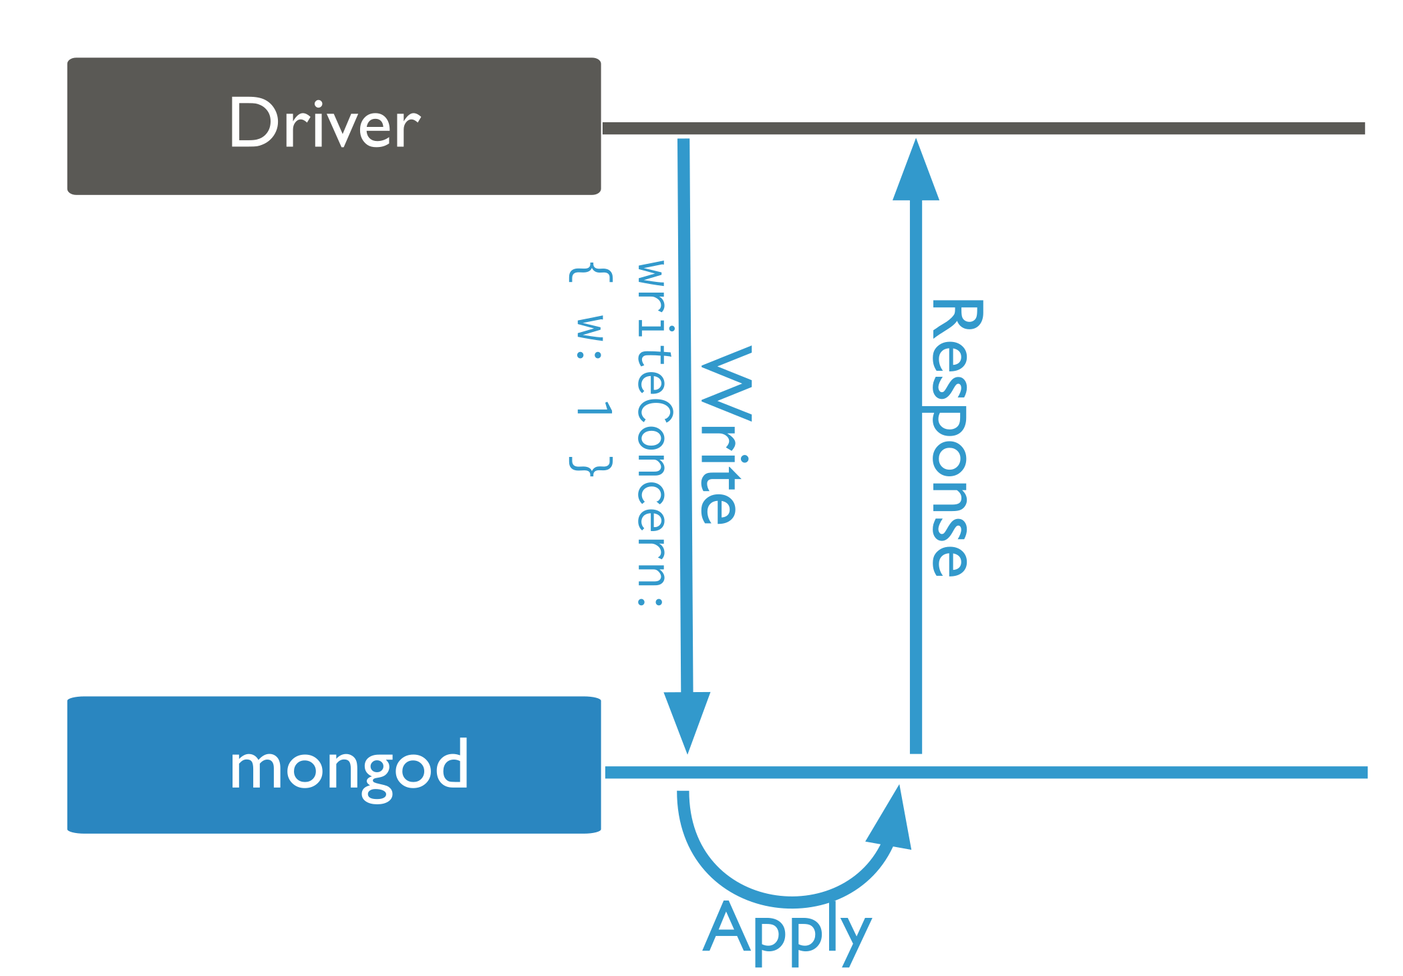
Writing/Reading: Default Behavior
Write
All writes go to the primary
A write is accepted once the primary accept op. (in memory)
Secondaries are not updated yet
Read
All reads go to the primary
Ensures Strict Consistency
Accepted data can be lost
In this case Secondaries are mostly for
Availability & Fault Tolerance

Slide 9
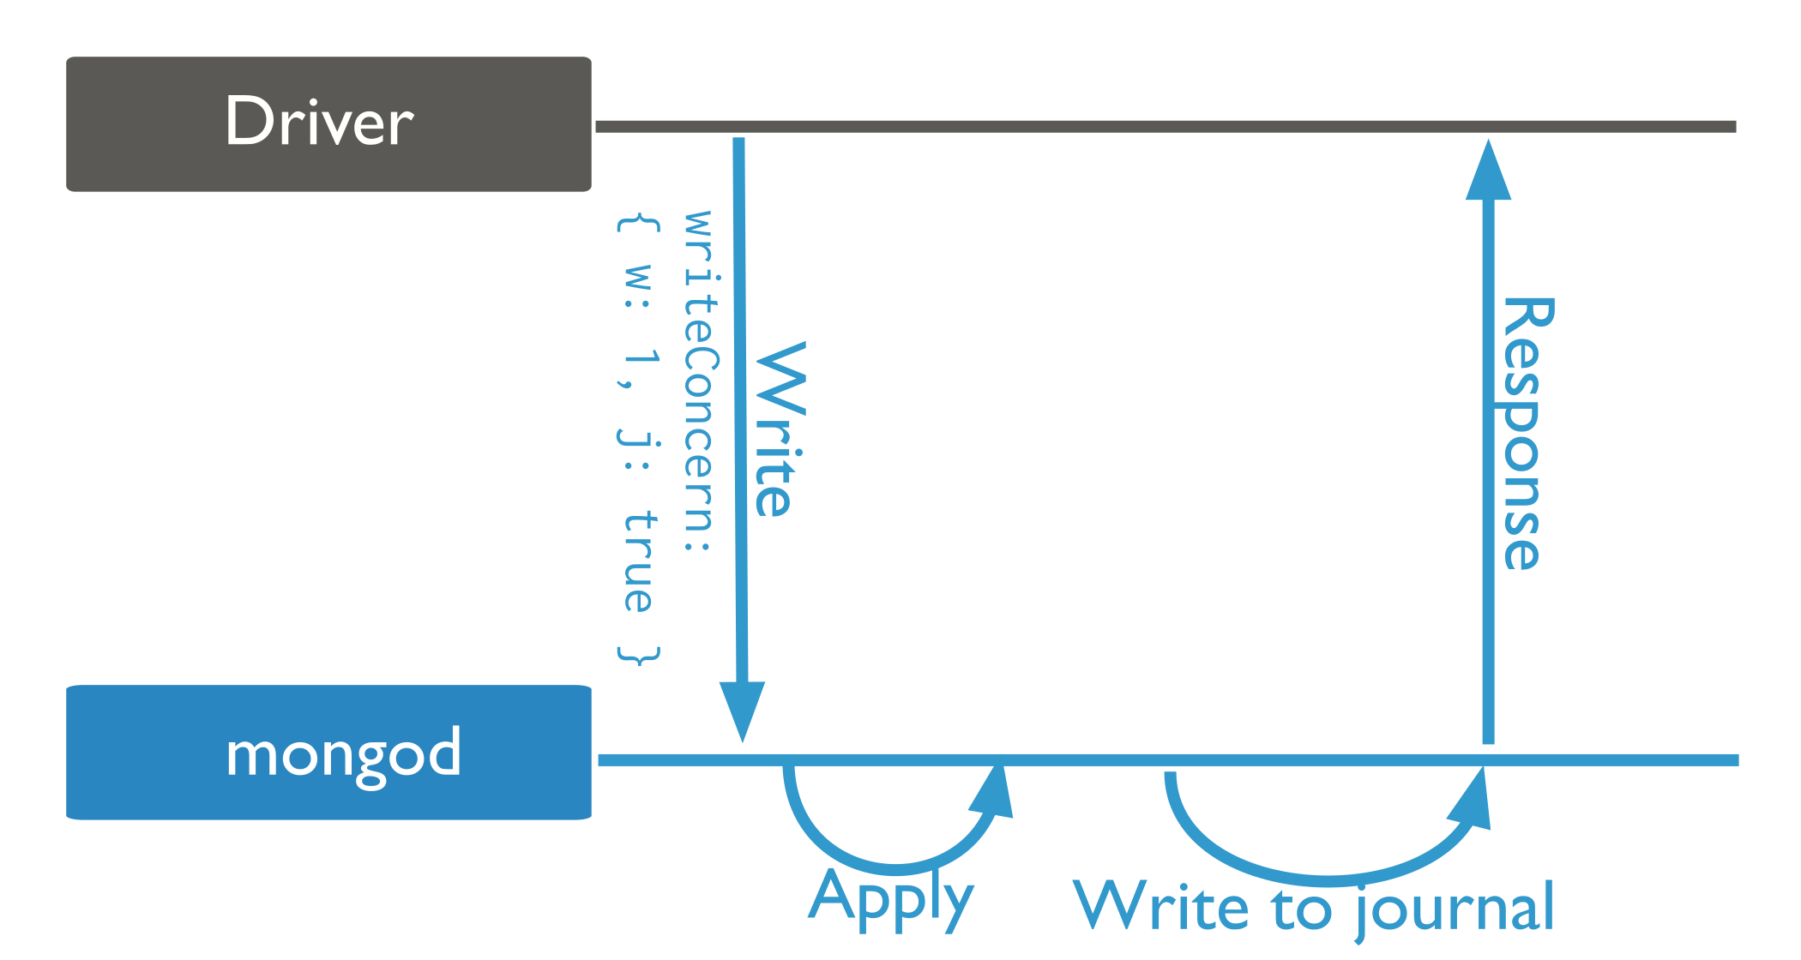
Journaling: Persistent Data
As before, but a write is accepted only after written to a log on disk
Still on the primary site
Accepted data become persistent

Slide 10
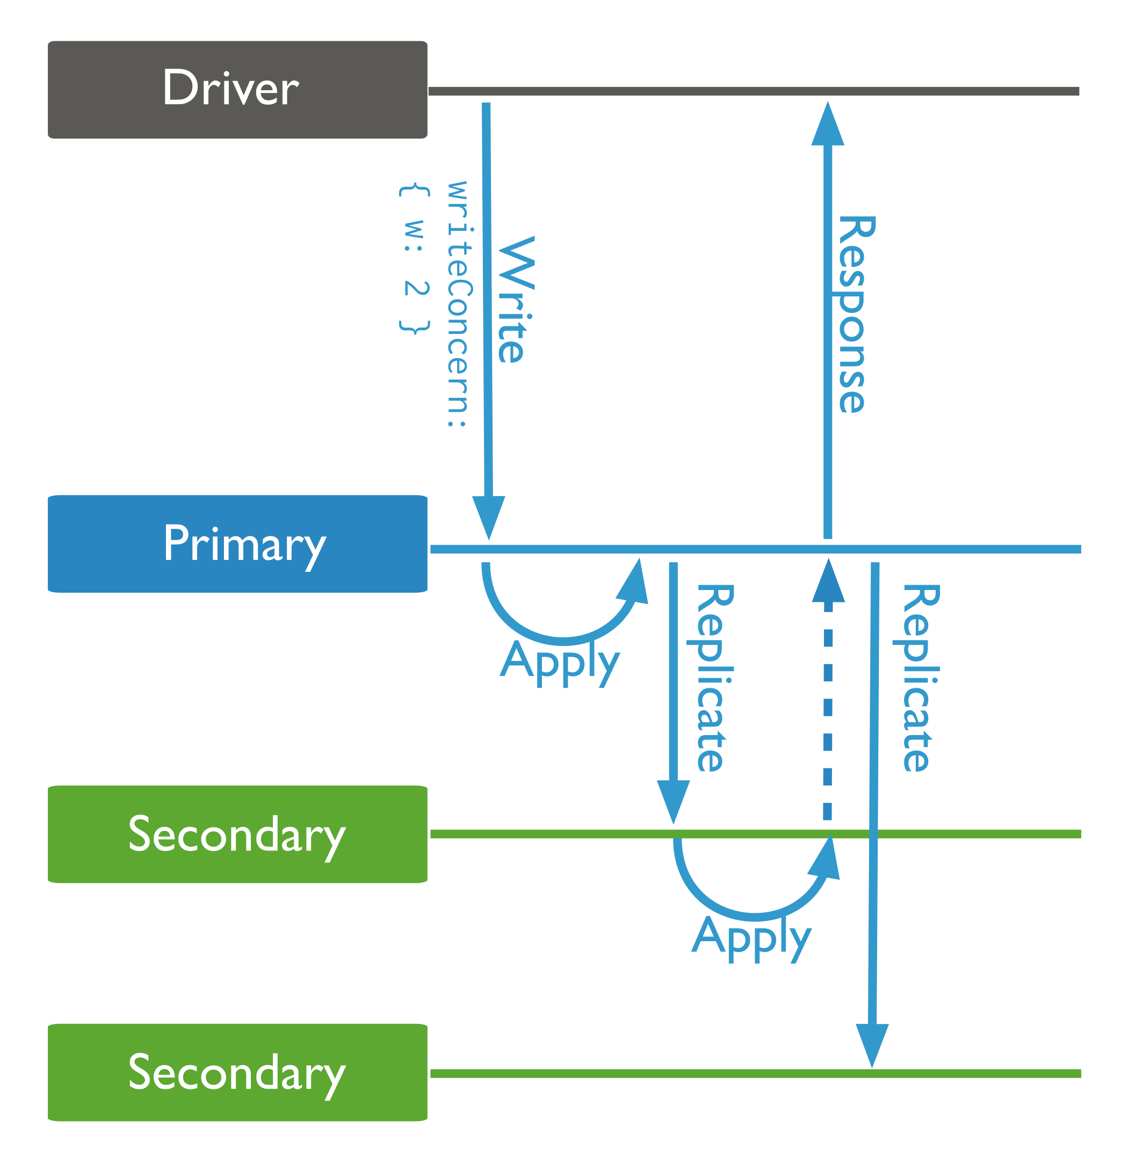
Higher Consistency For Reads
Option 1: Read From Primary
Keep writing as is
Enforce the read from Primary
➔ Strict Consistency
Option 2: Expensive Write
Write is not accepted until m secondaries are also updated
db.products.insert(
{ item: "envelopes", qty : 100, type: "Clasp" },
{ writeConcern: { w: 2, wtimeout: 5000 } }
)

Slide 11
Read Modes
Primary
PrimaryPreferred
Secondary
SecondayPreferred
Nearest

Slide 12
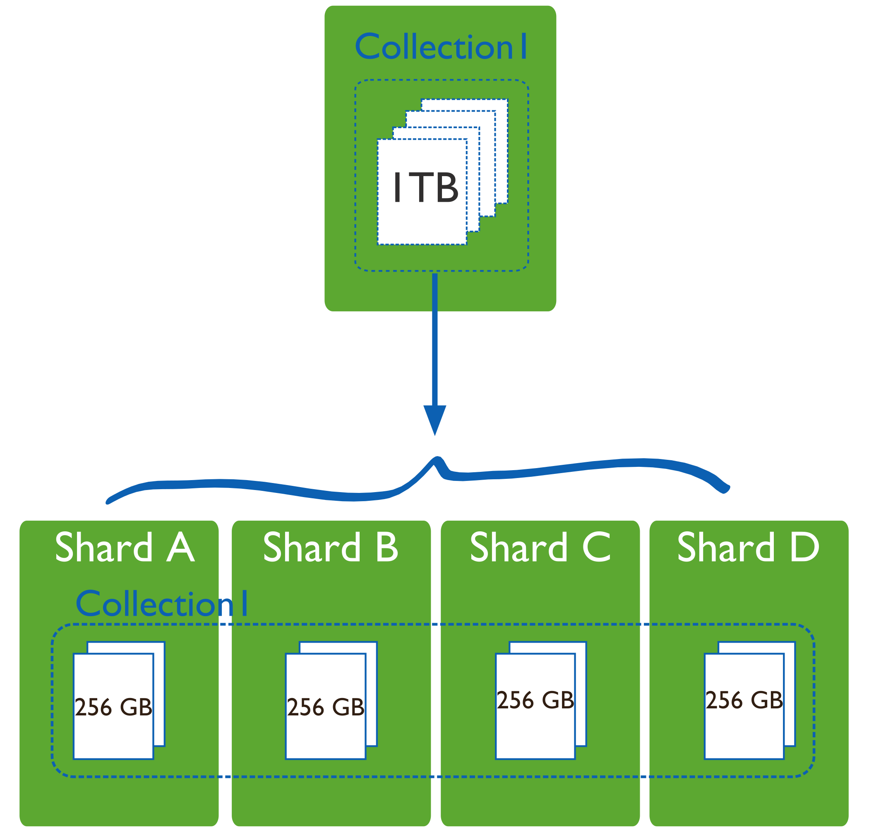
Sharding (Chapter 10)
Partitioning the data across many machine
Orthogonal to “Replication”
In this Figure
Only sharding, No replication

Slide 13
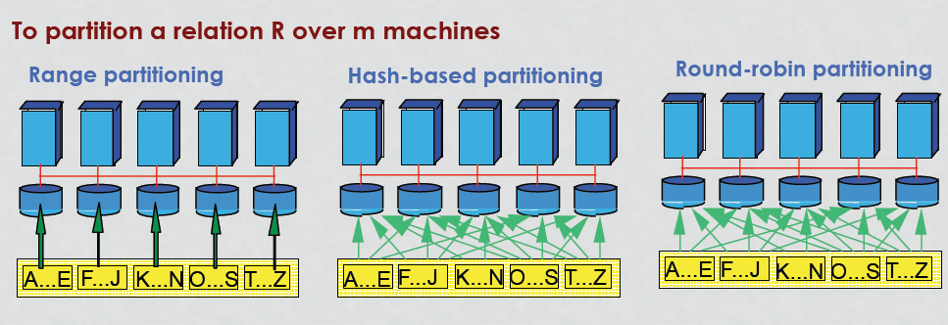
Similar Concept in DDBMS

Slide 14
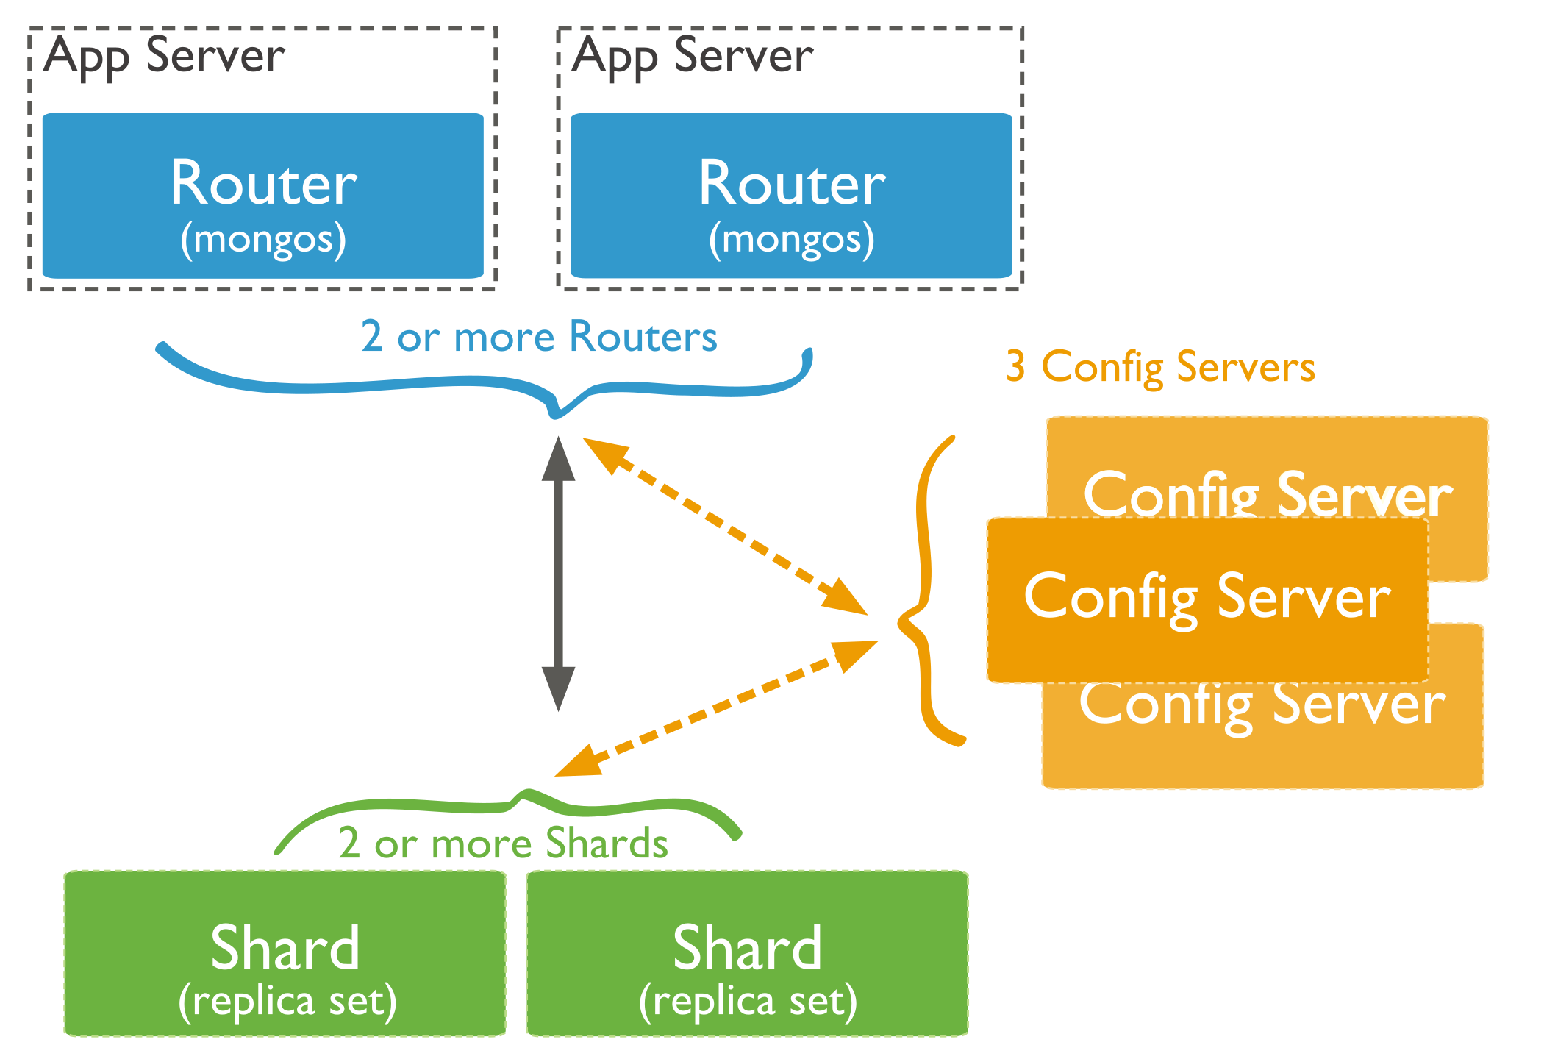
MongoDB Sharded Cluster
Shard: storing data, can be replicated (replica set)
Config Server: Storing metadata info
Router: Accepts and routes client’s queries & update operations

Slide 15
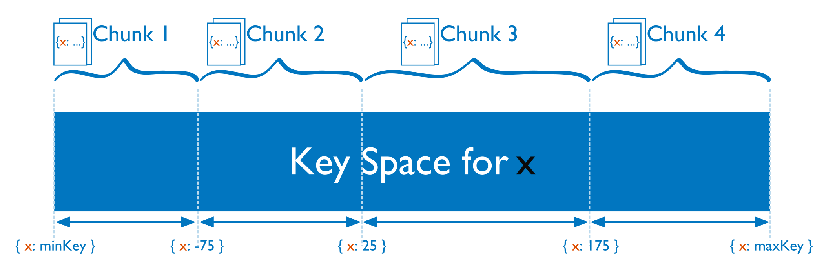
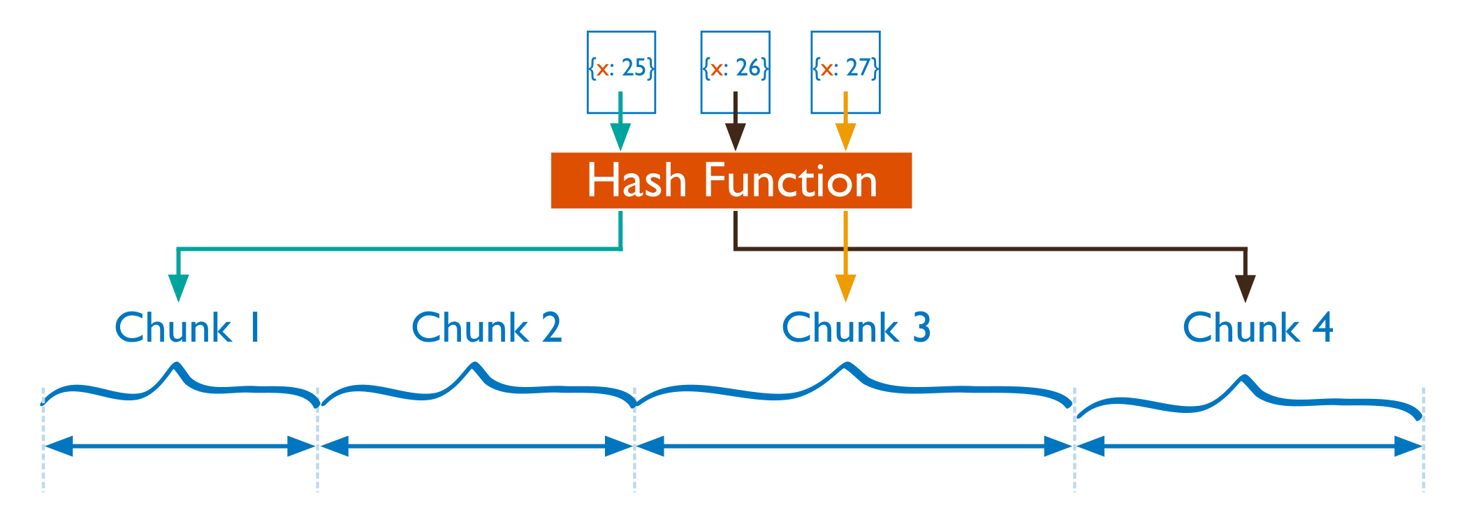
Shard Key
A collection is sharded based on a key into chunks
Key: must be present in each document (and indexed)
Range-Based
Hash-Based

Slide 16
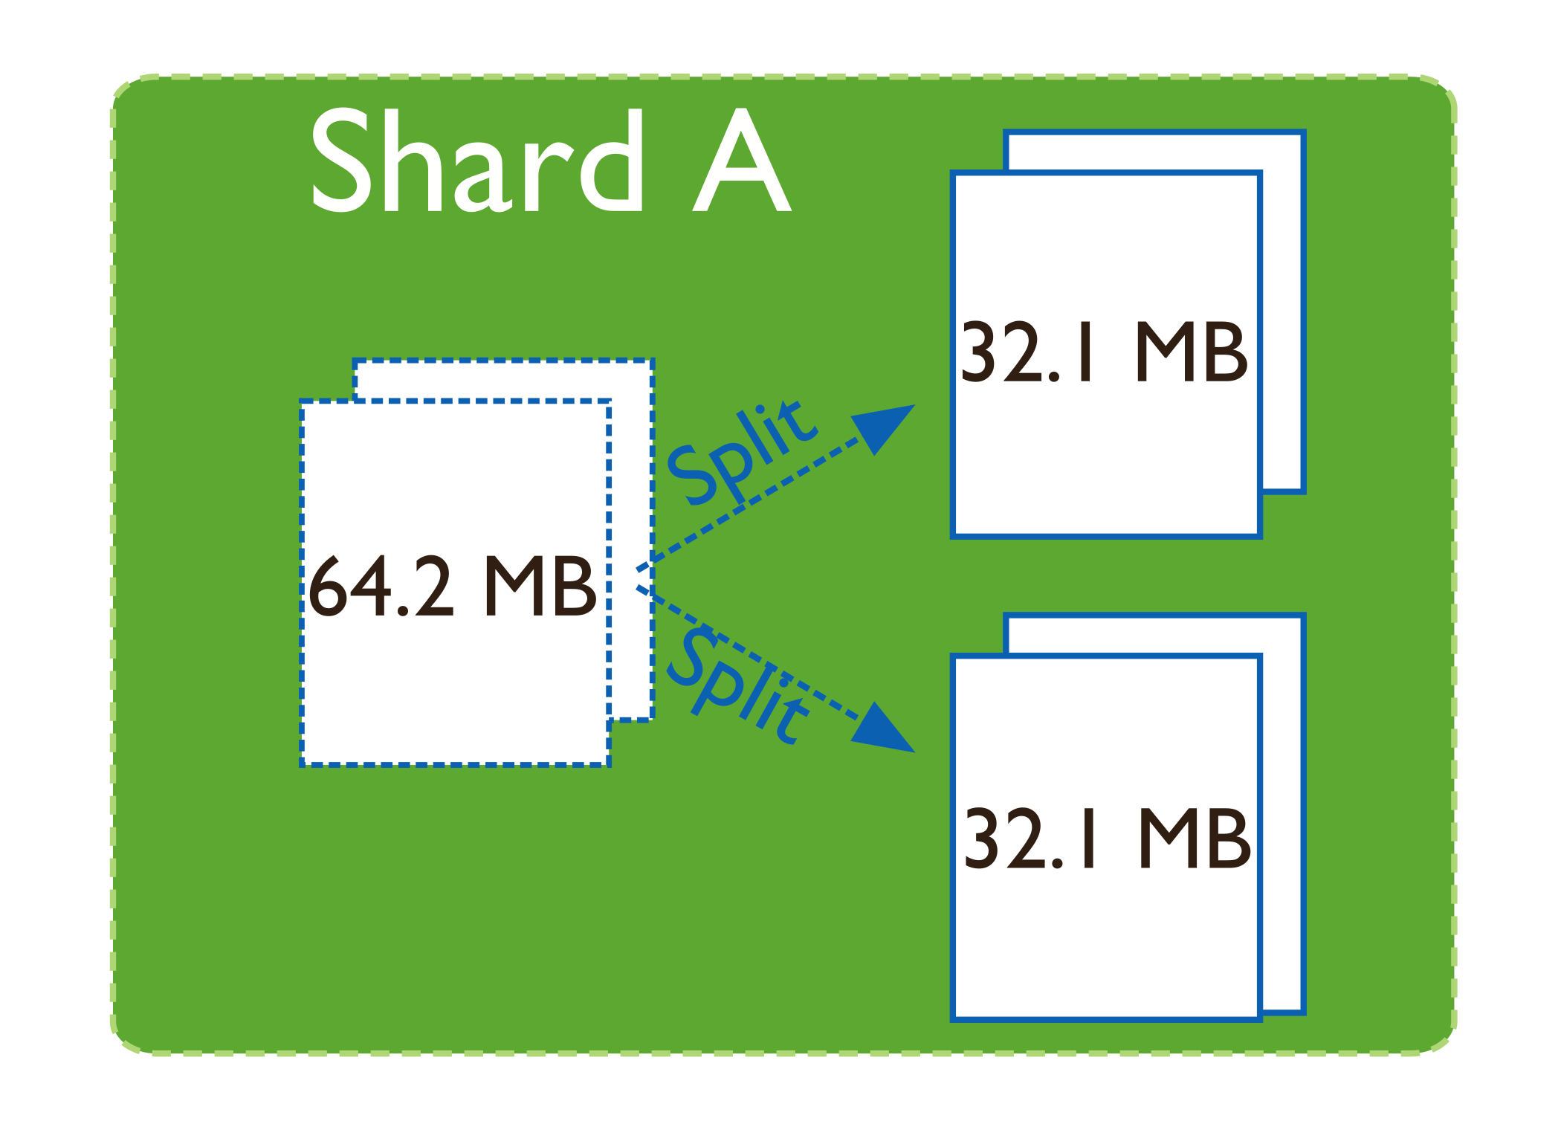
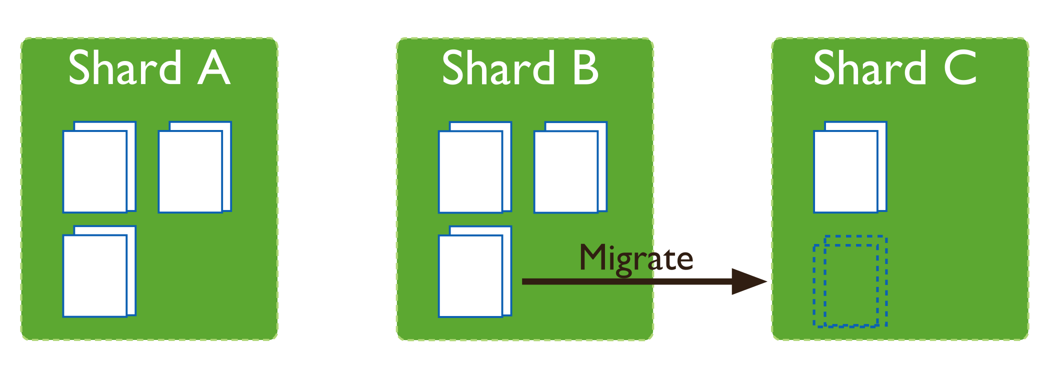
Keeping Balanced Shards
Splitter
Splits a big chunk into two
No change in metadata info
Triggered by inserts/updates
Balancer
Migrates chunks from one shard (largest in number) to another (least in number)
Changes the metadata into

Slide 17
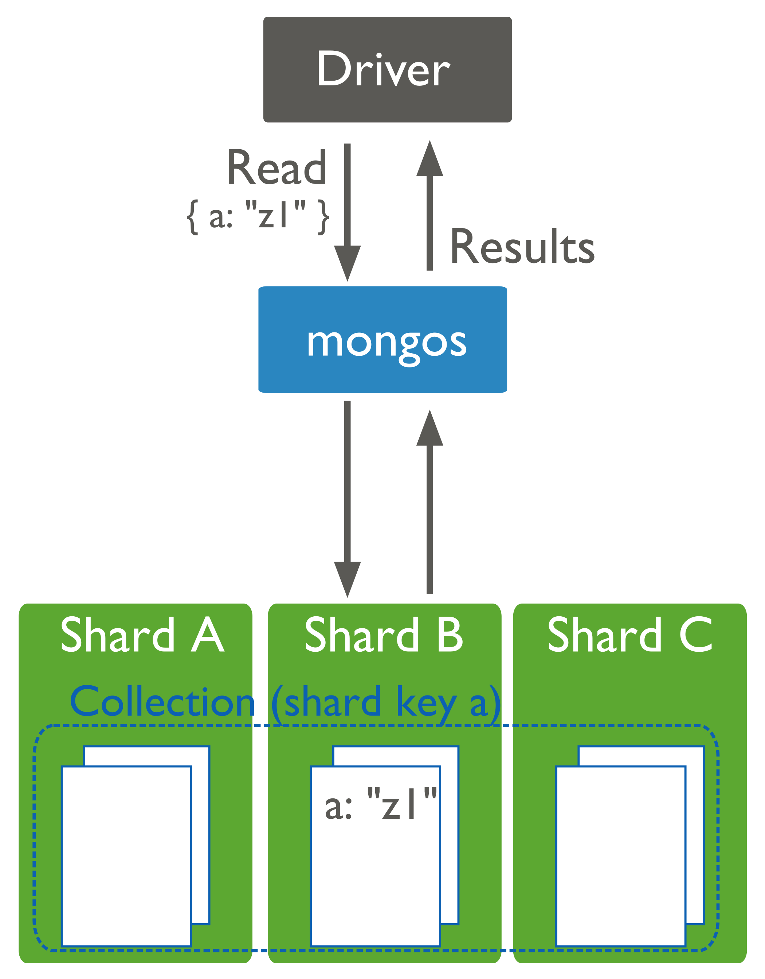
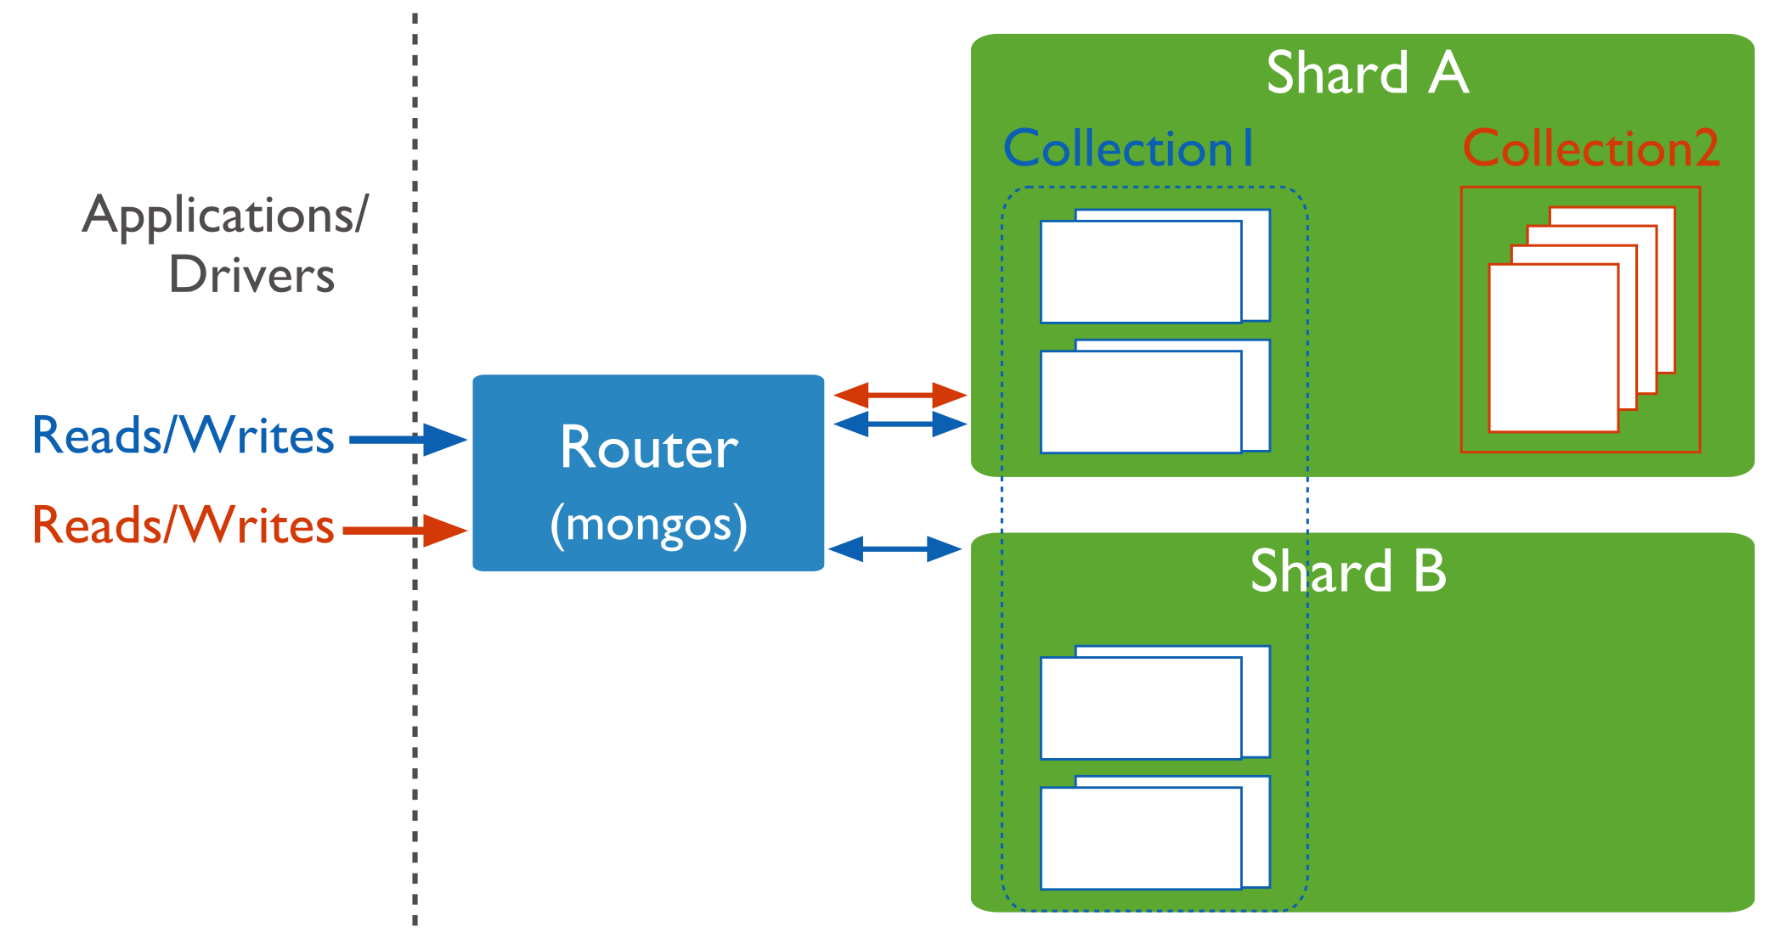
Routing Operations to Shards
Read/write operations are sent from client to mongos
Mongos routes them to the appropriate shards(s)

Slide 18
Indexing (Chapter 8)

Slide 19
Indexes
Speedup queries
MongoDB uses B-Tree indexes
Can build the index on any field of the document
Skips documents that do not have the indexed field (Sparse index)

Slide 20
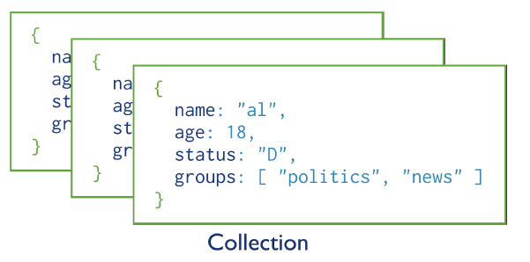
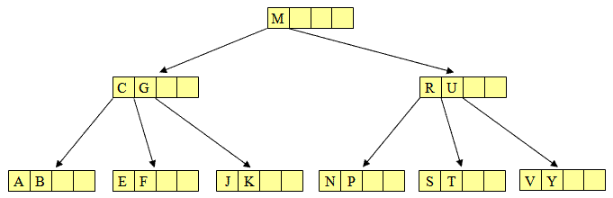
Indexes
Index is an auxiliary data structure
Stores the values of specific field(s) in a sorted order
Organized in a certain structure to speedup the search

Slide 21
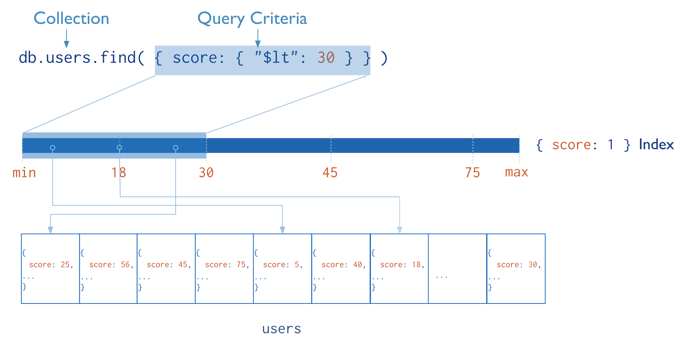
Index Usage
Ascending
order

Slide 22
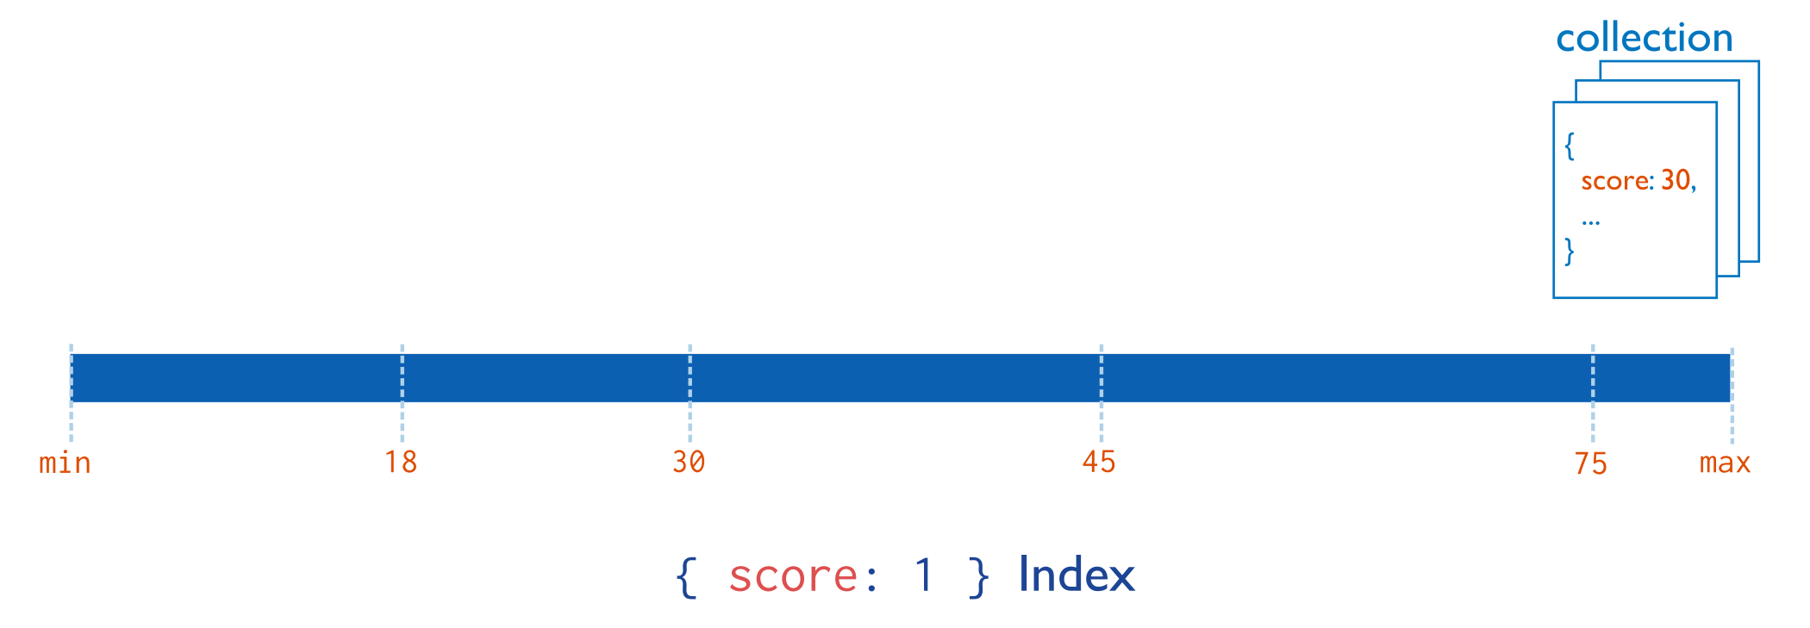
Indexed Fields
_id: Unique, automatically has a B-Tree index
Others are user-defined indexes
Single-Field index

Slide 23
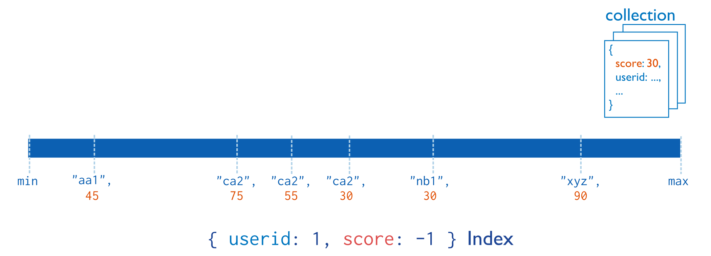
Indexed Fields: Compound-Fields
Searching has to involve the 1st level field
(userid in the example)
descending
order

Slide 24
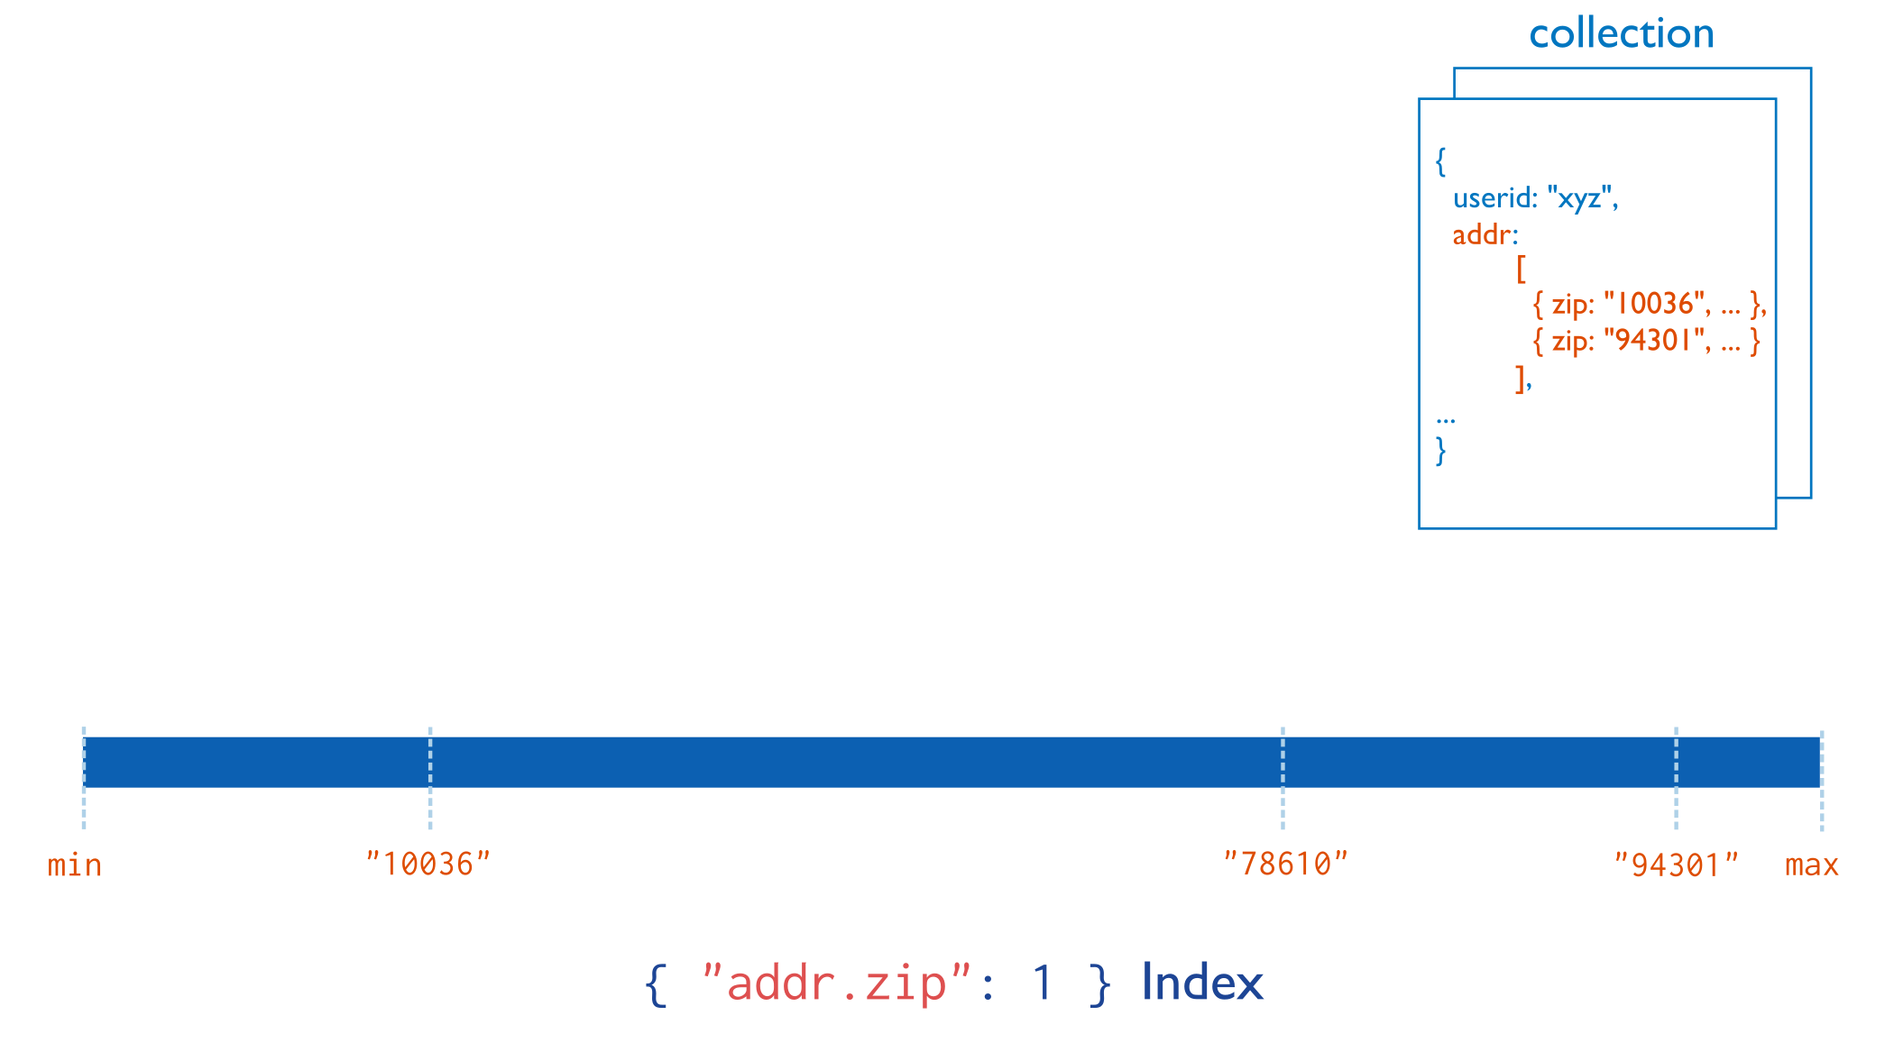
Indexed Fields: Arrays
MongoDB automatically detects that “addr” is an array
Indexes all the fields inside the array
Many index values will point to the same document

Slide 25
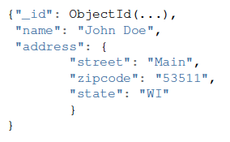
Examples
Field Level
db.people.createIndex(“name”: 1)
Sub-Field Level
db.people.createIndex(“address.zipcode”: 1)
db.people.createIndex(“address”: 1)
Embedded document Level
(equality search only)

Slide 26
Examples
Compound-Field Index
db.people.createIndex({“name”: 1, “_id”: -1})
db.people.find(“_id”: 1000})
Index cannot answer this query
(must have a predicate on “name”)

Slide 27
Index Creation Options
db.people.createIndex({“name”: 1, “_id”: -1},
{“background: True”, “Sparse”: True,
“unique”: True})

Slide 28
Text Indexes
Over fields that are strings or array of strings
Index is used when using $text search operator
Only one index on the collection
But it can include multiple fields
One field
db.collection.createIndex({content: "text”});
Two fields
db.collection.createIndex({subject: "text”,content: "text”});
All text fields
db.collection.createIndex({”$**": "text”});

Slide 29

$Text
Text search in mongoDB (Exact match)
Uses a text index and searches the indexed fields
Search for “coffee” in the indexed field(s)
db.articles.find( { $text: { $search: "coffee" } } )
Apply “OR” semantics
db.articles.find( { $text: { $search: "bake coffee cake" } } )

Slide 30
$Text
Text search in mongoDB
Uses a text index and searches the indexed fields
Treated as one sentence
db.articles.find( { $text: { $search: "\"coffee cake\"" } } )
“bake” or “coffee” but not “cake”
db.articles.find( { $text: { $search: "bake coffee -cake" } } )

Slide 31
$Text Score
$Text returns a score for each matching document
Score can be used in your query
db.articles.find(
{ $text: { $search: "cake" } },
{ score: { $meta: "textScore" } }
).sort( { score: { $meta: "textScore" } } ).limit(3)
For regular expression match use $regex operator

Slide 32
