Slide 1

Apache ZooKeeper

Slide 2
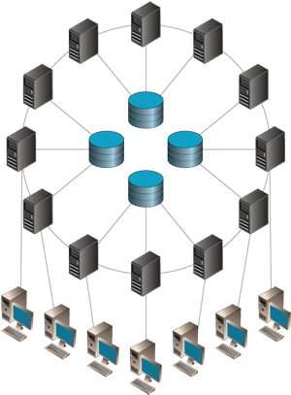
Why Needed ??
Distributed systems always need some form of coordination
Programmers cannot use locks correctly
Message based coordination can be hard to use in some applications

Slide 3


Why Not Needed in Hadoop & DDBMSs
Read-Only and no need for CC or Synchronization
Already has built-in Concurrency Control

Slide 4
Objectives
Simple, Robust, Good Performance
High Availability, High throughput, Low Latency
Tuned for Read dominant workloads
Familiar models and interfaces
Wait-Free: A slow/failed client will not interfere with the requests of a fast client

Slide 5
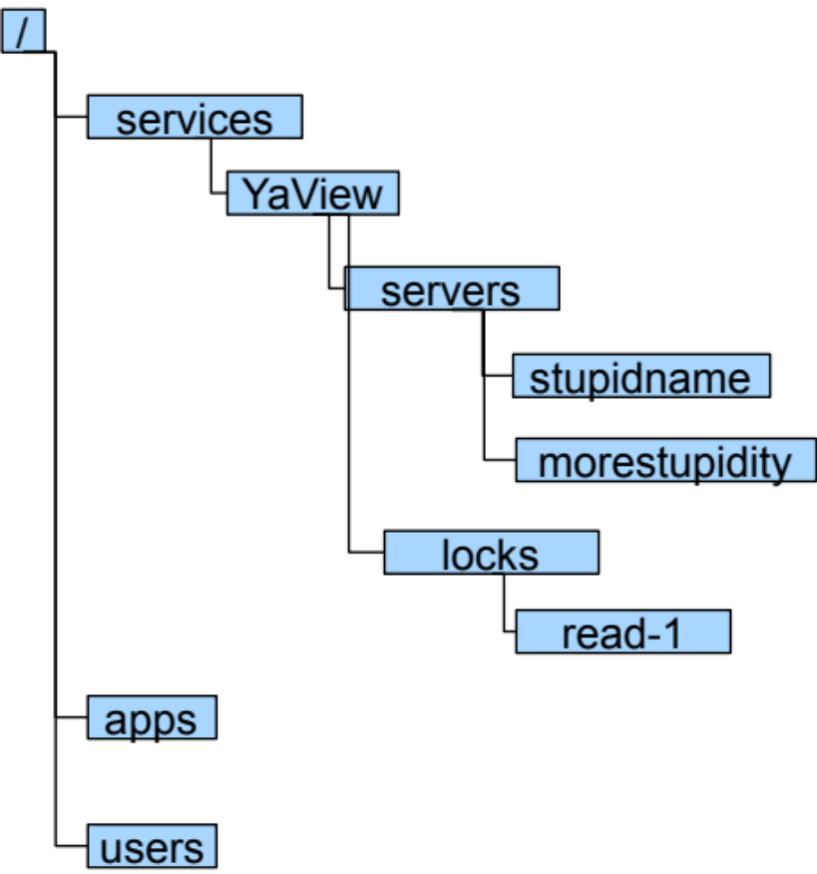
Data Model
One znode
Hierarchal namespace (like a file system)‏
Each node is called “znode”
Each znode has data and children
The entire Zookeeper tree is kept in main memory

Slide 6
What is stored in ZNodes
Configurations
Status
Counters
Parameters
Location information
Keeps metadata information
Does not store big datasets

Slide 7
ZooKeeper Servers
ZooKeeper Service
Leader
Server
Server
Server
Server
Server
Server
Client
Client
Client
Client
Client
Client
Client
Client
All servers store a copy of the data tree (in memory)‏
A leader is elected at startup
Followers service clients
A client establish a connection with one server

Slide 8
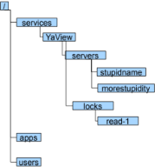
ZooKeeper Servers
Leader
Server
Server
Server
Server
Server
Server
Client
Client
Client
Client
Client
Client
Client
Client
Simple, Robust, Good Performance
High Availability, High throughput, Low Latency
Tuned for Read dominant workloads
Familiar models and interfaces
Wait-Free: A slow/failed client will not interfere with the requests of a fast client

Slide 9
ZooKeeper Reads/Writes/Watches
ZooKeeper Service
Leader
Server
Server
Server
Server
Server
Server
Client
Client
Client
Client
Client
Client
Client
Client
Reads: between the client and single server
Writes: sent between servers first, get consensus, then respond back
Watches: between the client and single server
  A watch on a znode basically means “monitoring it”

Slide 10

ZooKeeper API
String create(path, data, ACL, flags)‏
void delete(path, expectedVersion)‏
Stat setData(path, data, expectedVersion)‏
(data, Stat) getData(path, watch)‏
Stat exists(path, watch)‏
String[] getChildren(path, watch)‏
…

Slide 11
ZooKeeper Servers
Leader
Server
Server
Server
Server
Server
Server
Client
Client
Client
Client
Client
Client
Client
Client
Simple, Robust, Good Performance
High Availability, High throughput, Low Latency
Tuned for Read dominant workloads
Familiar models and interfaces
Wait-Free: A slow/failed client will not interfere with the requests of a fast client

Slide 12
Example
A client submits a request to start jobtracker and a set of tasktrackers to torque
The ip address and the ports that the jobtracker will bind to is not known apriori
The tasktrackers need to find the jobtracker
The client needs to find the jobtracker
Torque
Client
JT
TT
TT
TT

Slide 13
… with ZooKeeper
Torque
Client
ZooKeeper
create /hod/jt- Ephemeral|Sequence
JT
TT
/
TT
/hod/jt-1
hod
TT

Slide 14
HOD with ZooKeeper
Torque
When the client spawns the TT and JT tasks
in torque, it passes the path of the newly
create znode (/hod/jt-1) as a startup parameter.
The client and TT watch the znode for data
populated by JT. JT and TT watch the existence
of the znode and exit if it goes away.
TT
JT
TT
TT
setData /hod/jt-1
<contact info>
Client
ZooKeeper
getData /hod/jt-1 true
/
hod
jt-1

Slide 15
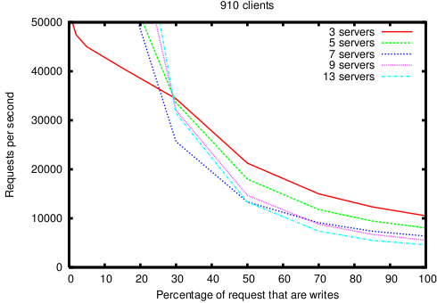
Performance

Slide 16
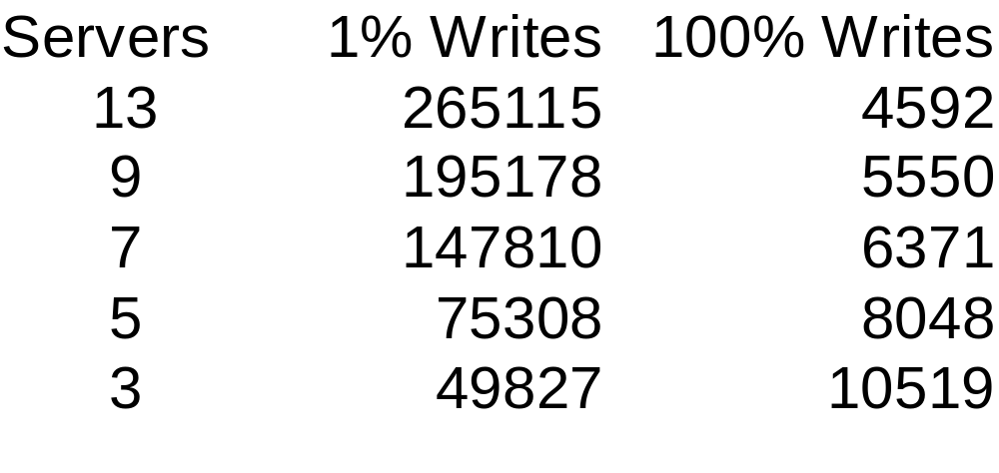
Performance at Extremes
Numbers are operations per second

