Slide 1
MongoDB-2
WPI, Mohamed Eltabakh

Slide 2
Query Language in MongoDB

Slide 3
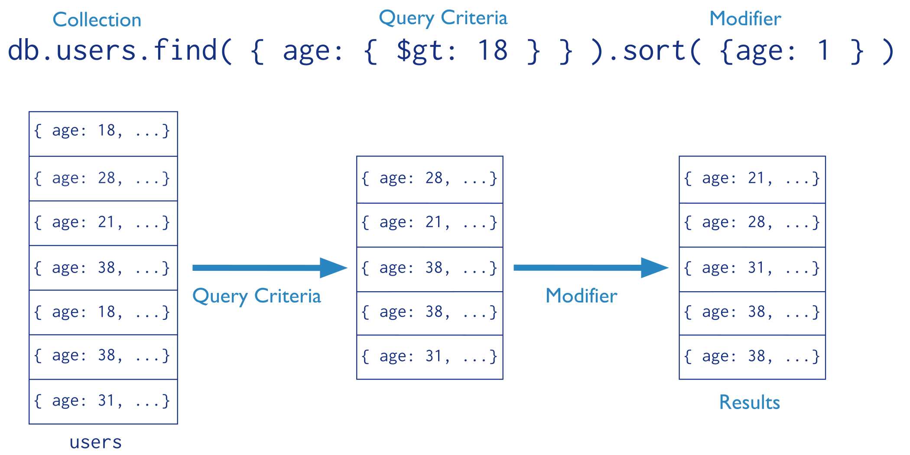
Find() Operator
Means ascending

Slide 4
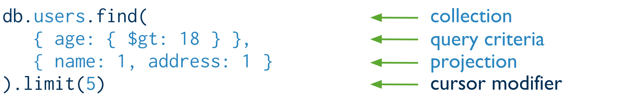
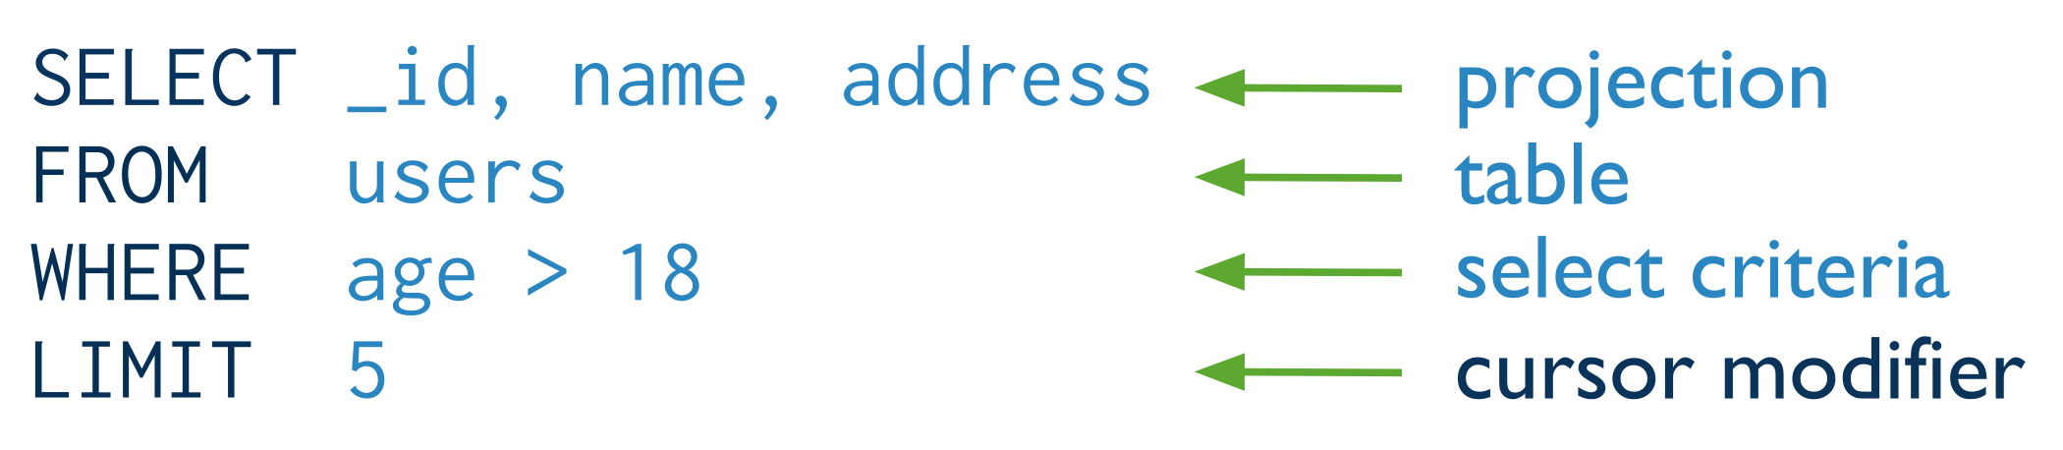
Find() + Projection
Means inclusion +
_id is always automatically included
Equivalent to in SQL:

Slide 5
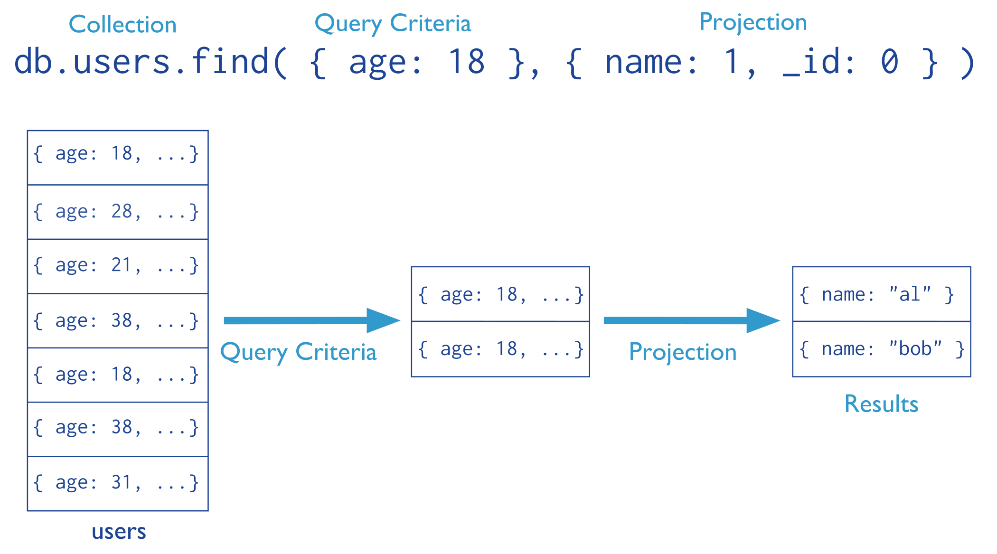
Find(): Exclude Fields
Means exclusion
Means equality
Cannot mix “inclusion & exclusion” in the same operator except for _id

Slide 6
Find() More Examples
Report all documents in the “inventory” collection
db.inventory.find( )
Select *
From inventory;
Equivalent to in SQL:
db.inventory.find( {} )
Report all documents in the “inventory” collection
Where type = ‘food’ or ‘snacks’
Equivalent to in SQL:
Select *
From inventory
Where type in
(‘food’, ‘snacks’);
db.inventory.find(
{ type: { $in: [ 'food', 'snacks' ] } }
)

Slide 7
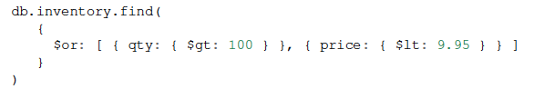
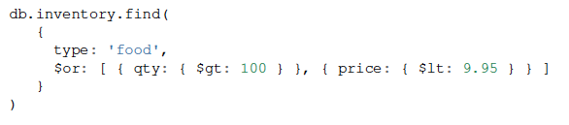
Find(): AND & OR
AND Semantics
OR Semantics
AND + OR Semantics
Type = ‘food’ and (qty > 100 or price < 9.95)

Slide 8
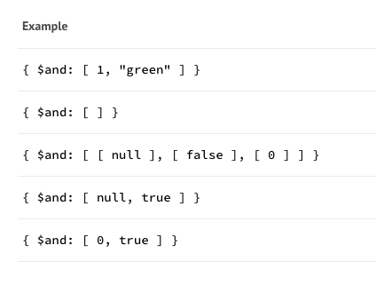
$AND
True
True
True
False
False
Any thing is true except 0 (for numbers), Null (for objects).
Arrays evaluate to True

Slide 9
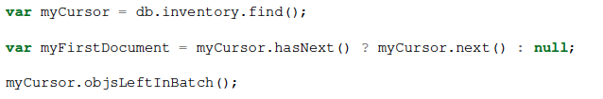
Queries Return Cursors
All queries return a the results in a cursor
If not assigned to a variable ➔ Printed to screen
Results are stored in a cursor
Many operators on top of that to manipulate the cursor
Cursor’s Methods:
http://docs.mongodb.org/manual/reference/method/js-cursor/

Slide 10

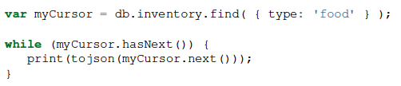


Cursor Manipulation
Dumps the content to screen (1st 20 document)
Explicitly iterate over each document
Shortcuts for iterations

Slide 11
Querying Complex Types

Slide 12
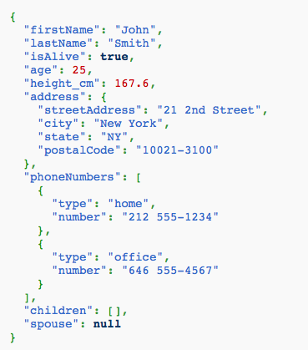
Querying Complex Types
Documents can be complex, E.g.,
(Arrays, embedded documents, any nesting of these, many levels)
Queries get complex too !!!

Slide 13

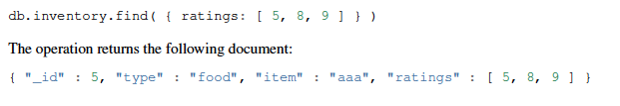
Array Manipulation (Exact Match)

Slide 14
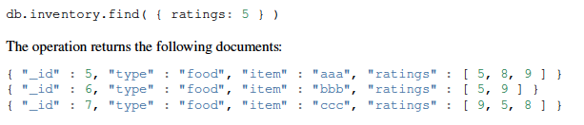
Array Manipulation (Search By Element)
Notice: if a document has “ratings” as an Integer field = 5, it will be returned

Slide 15
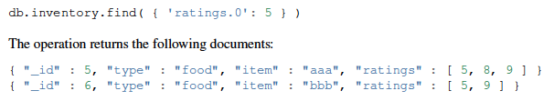
Array Manipulation (Search By Position)
Notice: if a document has “ratings” as an Integer field = 5, it will not be returned

Slide 16
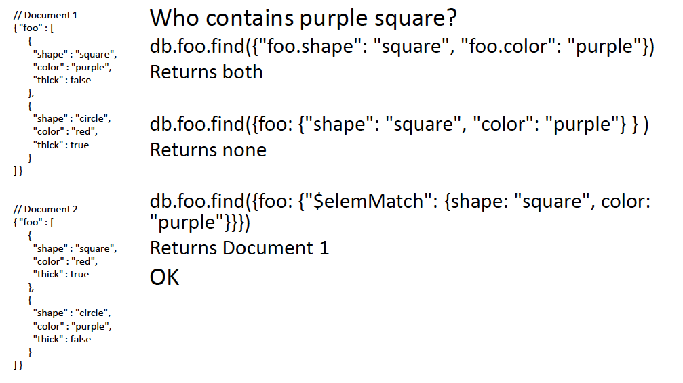
Array Manipulation ($elemMatch)

Slide 17

Another Example

Slide 18
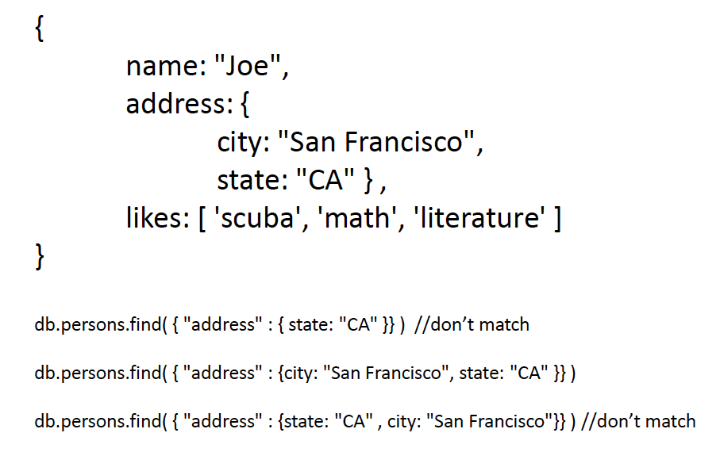
Embedded Object Matching (Exact doc Matching)
Exact-match (entire object)
// match

Slide 19
Embedded Object Matching (Field Matching)
Find the user documents where the address’s state = ‘CA’
db.persons.find( {“address.state” : “CA”})
Using dot notation

Slide 20
Try This
Find the user documents where the address’s state = ‘CA’ and City = “San Francisco”
Find the user documents where the address’s state = ‘CA’ Or likes ‘Math’

Slide 21
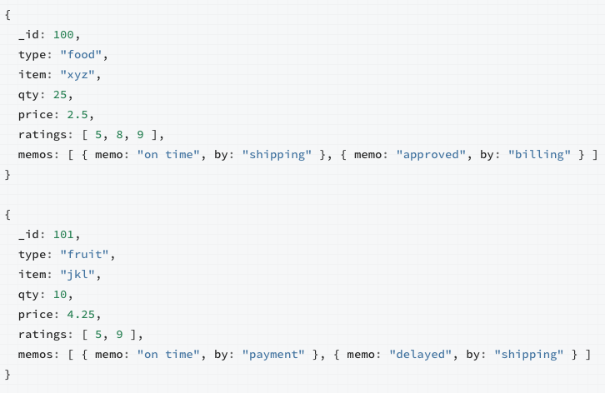
Matching Arrays of Embedded Documents
Select all documents where the memos array contains in the 1st element a document written by 'shipping’ department

Slide 22
Matching Arrays of Embedded Documents
db.inventory.find( { 'memos.0.by': 'shipping' } )
// Returns 1st document
Means the 1st element in the array

Slide 23
Matching Arrays of Embedded Documents
Select all documents where the memos array contains a document written by 'shipping’ department

Slide 24
Matching Arrays of Embedded Documents
db.inventory.find( { 'memos.by': 'shipping' } )
// Returns both documents
Means any element in the array

Slide 25
Matching Arrays of Embedded Documents: Multiple Conditions
Select all documents where the memos array contains a document written by 'shipping’ department and the content “on time”

Slide 26
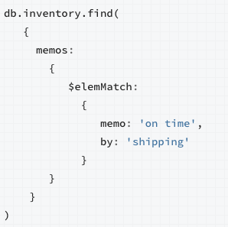
Matching Arrays of Embedded Documents: Multiple Conditions

Slide 27
Query Operators
http://docs.mongodb.org/manual/reference/operator/query/
Comparison Operators
Logical Operators
Element Operators
Evaluation Operators
Array Operators
…

Slide 28
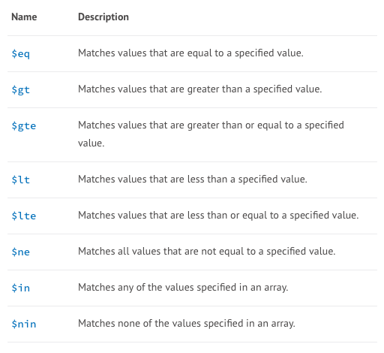
Query Operators: Comparison Op
db.inventory.find( { qty: { $gte: 20 } } )
db.inventory.update(
{ "carrier.fee": { $gte: 2 } },
{ $set: { price: 9.99 } }
)

Slide 29
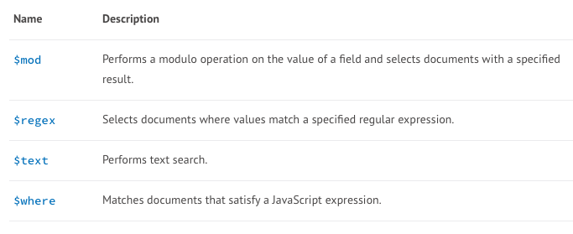
Query Operators: Evaluation Op

Slide 30
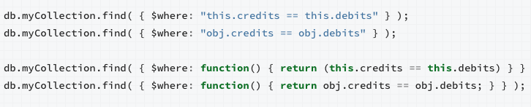
$Where Operator
Passes a JavaScript expression or function to the query system
Very flexible in expressing complex conditions
But it is relatively slow as it evaluates for each document (no indexes)
Similar to using UDF in the Where clause in relational databases
);

Slide 31
$Where Operator
Can combine MongoDB operators with $Where
db.myCollection.find( { active: true, $where: "this.credits - this.debits < 0" } );
db.myCollection.find( { active: true,
$where: function() { return obj.credits - obj.debits < 0; } } );
Is this And semantics or Or semantics ???

Slide 32
Collection Modeling

Slide 33
Collection Modeling
Modeling multiple collections that reference each other
In Relational DBs ➔ FK-PK Relationships
In MongoDB, two options
Referencing
Embedding

Slide 34
FK-PK in Relational DBs
Each tuple in “Enrolled” reference a specific student and a specific course

Slide 35
How to Define FK-PK

Slide 36
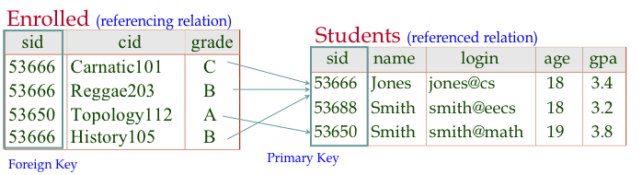
FK-PK in Relational DBs
It comes with an enforcement mechanism
Cannot insert a FK for a non-existing PK
You cannot delete a PK that has a FK

Slide 37
In MongoDB
Referencing between two collections
Use Id of one and put in the other
Very similar to FK-PK in Relational DBs
Does not come with enforcement mechanism
Embedding between two collections
Put the document from one collection inside the other one

Slide 38
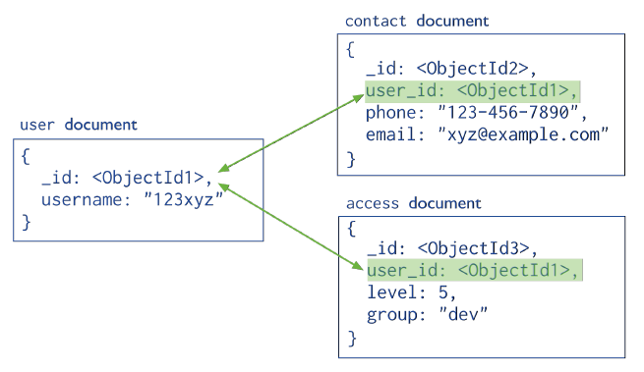
Referencing
No Enforcements
Normalized Way
Have three collections in the DB: “User”, “Contact”, “Access”
Link them by _id (or any other field(s))

Slide 39
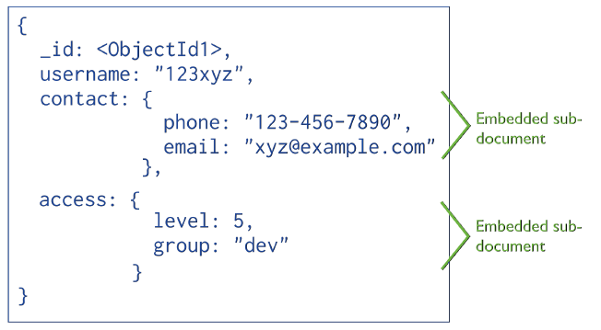
Embedding
De-Normalized Way
Have one collection in DB: “User”
The others are embedded inside each user’s document

Slide 40

Examples (1)
“Patron” & “Addresses”
Referencing
If it is 1-1 relationship
If usually read the address with the name
If address document usually does not expand
If most of these hold
➔ better use Embedding

Slide 41
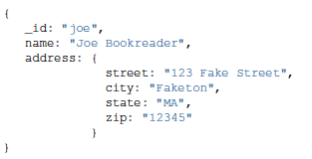
Examples (2)
“Patron” & “Addresses”
Embedding
When you read, you get the entire document at once
In Referencing ➔ Need to issue multiple queries

Slide 42
Examples (3)
What if a “Patron” can have many “Addresses”
Referencing
Do you read them together ➔ Go for Embedding
Are addresses dynamic (e.g., add new ones frequently)
➔ Go for Referencing

Slide 43
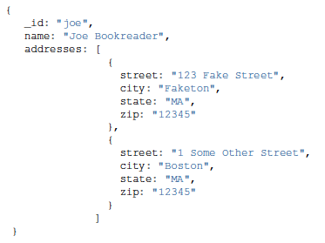
Examples (4)
What if a “Patron” can have many “Addresses”
Embedding
Use array of addresses

Slide 44
Examples (5)
If addresses are added frequently …
This array will expand frequently
Size of “Patron” document increases frequently
May trigger re-locating the document each time (Bad)

Slide 45
Document Size and Storage
Each document needs to be contiguous on disk
If doc size increases ➔ Document location must change
If doc location changes ➔ Indexes must be updates ➔ leads to more expensive updates
In a newer version, each document is allocated a power-of-2 bytes (the smallest above its size)
Meaning, the system keeps some space empty for possible expansion

Slide 46
Examples (6)
One-to-Many “Book”, “Publisher”
A book has one publisher
A publisher publishes many books
If embed “Publisher” inside “Book”
Repeating publisher info inside each of its books
Very hard to update publisher’s info
If embed “Book” inside “Publisher”
Book becomes an array (many)
Frequently update and increases in size
Referencing is better
in this case

