Slide 1
Titian: Data Provenance Support in Spark
Tom Meagher
&
Fangling Zhang

Slide 2
What’s Titian
A library that debug data quickly in Apache Spark
Enables data provenance by obtaining a LineageRDD reference from any given RDD

Slide 3
Why Titian
The limitations of current approach (RAMP and Newt) of supporting data lineage in DISC systems (Hadoop or Spark):
Use external storage (sharded DBMS or HDFS) to retain lineage information
supported in a separate programming interface
Little support for viewing or replaying intermediate data

Slide 4
Titian’s Contributions
A data lineage capture and query support system in Apache Spark.
Exhibit an overhead of less than 30%.
Interactive data provenance query support that extends the familiar Spark RDD programming model.
A variety of design alternatives for capturing and tracing data lineage

Slide 5
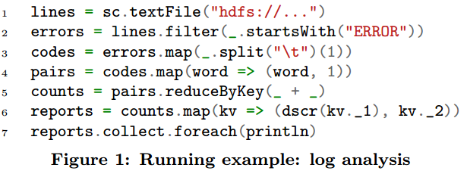
Running example: log analysis
Obtain a report containing the description of each error, together with its count.

Slide 6
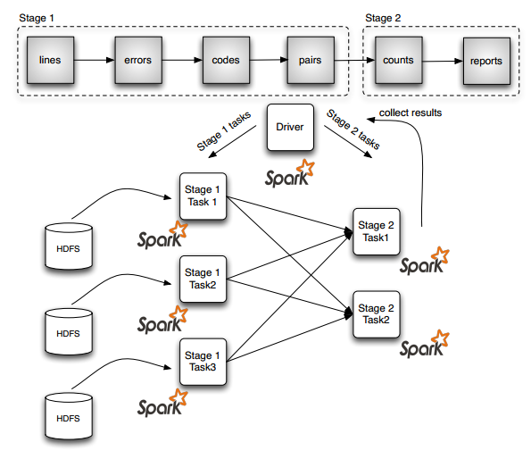
Running example: log analysis

Slide 7
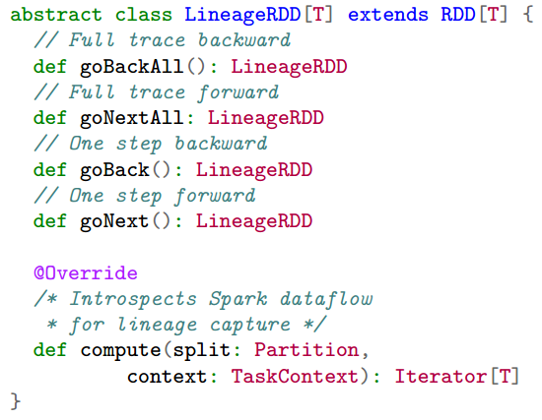
Titian: Details
LineageRDD application programming interface, which extends the RDD abstraction with tracing capabilities.
goBackAll, goNextAll: to compute the full trace backward and forward respectively
goBack and goNext :A single step backward or forward

Slide 8
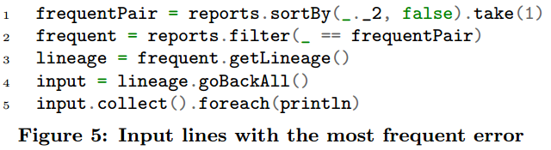
Titian Application Examples
Example 1: Backward Tracing -selects the most frequent error, then traces back to the input lines containing such errors and prints them.

Slide 9
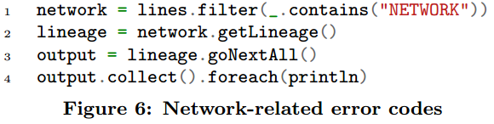
Titian Application Examples
Example 2: Forward Tracing - find the error codes generated from the network sub-system.

Slide 10
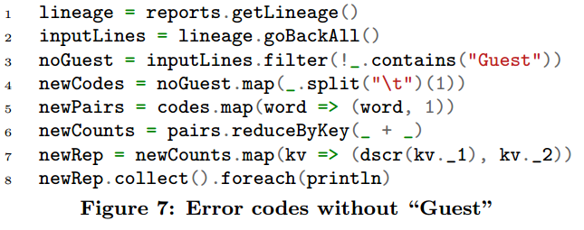
Titian Application Examples
Example 3: Selective Replay - seeing the errors distribution without the ones caused by “Guest."

Slide 11
Titian’s Capture Points
Titian captures data lineage (from Spark’s stage DAG) in three places:
Input: Data imported from some external source e.g., HDFS, Java Collection, etc.
Stage: The output of a stage executed by a task.
Aggregate: In an aggregation operation i.e., combiner, group-by, reduce, and join.

Slide 12
Titian’s agents
Titian uses agents to capture data lineage. The responsibility of these agents:
To generate unique identifiers for each new record
Associate output records of a given operation (i.e., stage, shuffle step) with relevant input records

Slide 13
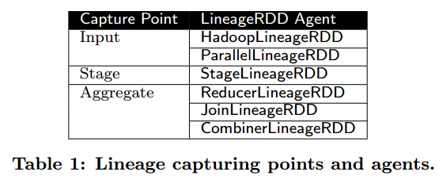
Titian’s agents
Titian uses agents to capture data lineage. The responsibility of these agents:
To generate unique identifiers for each new record
Associate output records of a given operation (i.e., stage, shuffle step)with relevant input records

Slide 14
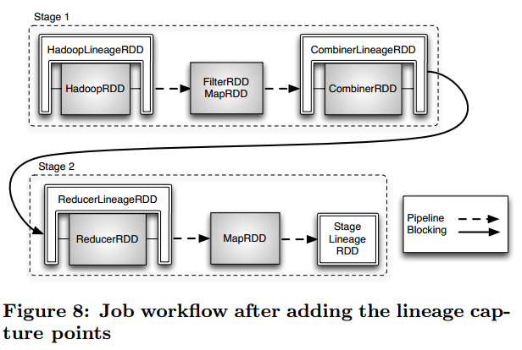
Dataflow Instrumentation
Example 4: Returning to our running example…
2, 3
1
4
7
5
6

Slide 15
Lineage Storage
Titian stores all data lineage in the BlockManager (Spark’s internal storage layer for intermediate data).
The agents’ associations are stored in a BlockManager table, which defines two columns containing the:
(1) input record identifiers, and
(2) output record identifiers. (*Tracing occurs by recursively joining the tables)

Slide 16
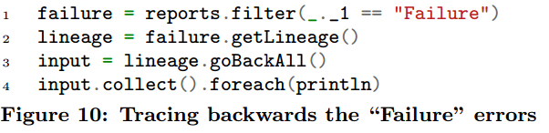
Querying the Lineage Data
Example 5: To trace back and see the actual log entries that correspond to a “Failure" (code =4)

Slide 17
failure = reports.filter(_._1 == “Failure”)
reports
failure
filter
(code = 4)

Slide 18
lineage = failure.getLineage()
reports
failure
lineage
filter
getLineage
(code = 4)

Slide 19
input = lineage.goBackAll()
reports
failure
lineage
filter
getLineage
goBackAll
(code = 4)
input

Slide 20
input = lineage.goBackAll()
reports
failure
lineage
filter
getLineage
goBackAll
(code = 4)
StageLineageRDD
input

Slide 21
input = lineage.goBackAll()
reports
failure
lineage
filter
getLineage
goBackAll
(code = 4)
HadoopLineageRDD
…
StageLineageRDD
input
recursively join inputs & outputs

Slide 22
input = lineage.goBackAll()
reports
failure
lineage
filter
getLineage
goBackAll
(code = 4)
HadoopLineageRDD
…
StageLineageRDD
input
input.collect().foreach(println)
recursively join inputs & outputs

Slide 23
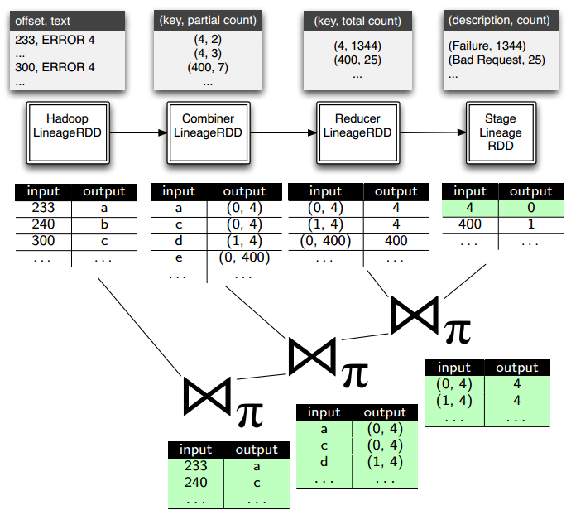
Querying the Lineage Data
Example 5: A logical trace plan that recursively joins data lineage tables

Slide 24
Titian’s Fault-tolerance
Titian does not break the fault tolerance model of Spark.
During the tracing phase, LineageRDDs behave as a normal RDD and, as such, are resilient to failures.

Slide 25
Titian’s Alternative Designs
Titian-D: stores data lineage distributed in the BlockManager local to the capture agent.

Slide 26
Titian’s Alternative Designs
Titian-D: stores data lineage distributed in the BlockManager local to the capture agent.
Titian can easily implement other debugging strategies:
Titian-P: each capturing agent generates the lineage data and without storing it; lineage references are instead appended to a list and propagated downstream. The final stage capture point will then store the complete lineage data.

Slide 27
Titian’s Alternative Designs
Titian-D: stores data lineage distributed in the BlockManager local to the capture agent.
Titian can easily implement other debugging strategies:
Titian-P: each capturing agent generates the lineage data and without storing it; lineage references are instead appended to a list and propagated downstream. The final stage capture point will then store the complete lineage data.
Titian-C: saves all the lineage into a unique centralized server in its local file system.

Slide 28
Titian’s Alternative Designs
Titian-D: stores data lineage distributed in the BlockManager local to the capture agent.
Titian can easily implement other debugging strategies:
Titian-P: each capturing agent generates the lineage data and without storing it; lineage references are instead appended to a list and propagated downstream. The final stage capture point will then store the complete lineage data.
Titian-C : saves all the lineage into a unique centralized server in its local file system.
Both Titian-C and Titian-P tradeoff space overheads, by aggregating lineage data into a more centralized storage, for a faster tracing time.

Slide 29
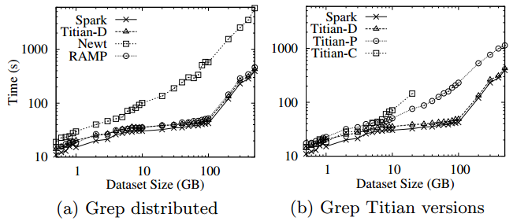
Experimental Evaluation
Data Lineage Capture Overheads Comparison

Slide 30
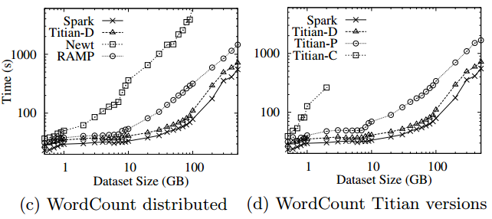
Experimental Evaluation
Data Lineage Capture Overheads Comparison

Slide 31
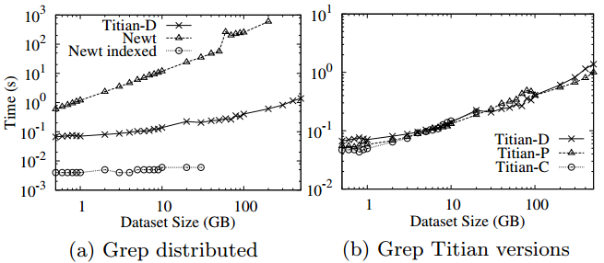
Experimental Evaluation
Tracing Time Comparison

Slide 32
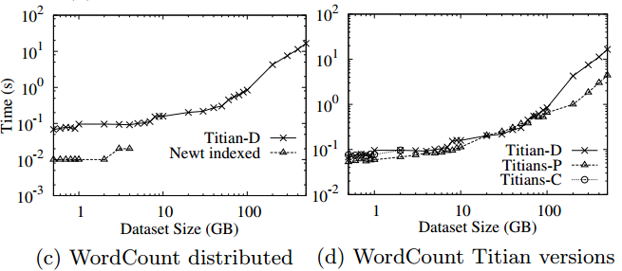
Experimental Evaluation
Tracing Time Comparison
6173124300

Slide 33
Questions
Tom Meagher
&
Fangling Zhang

