Slide 1
Transaction Management

Slide 2
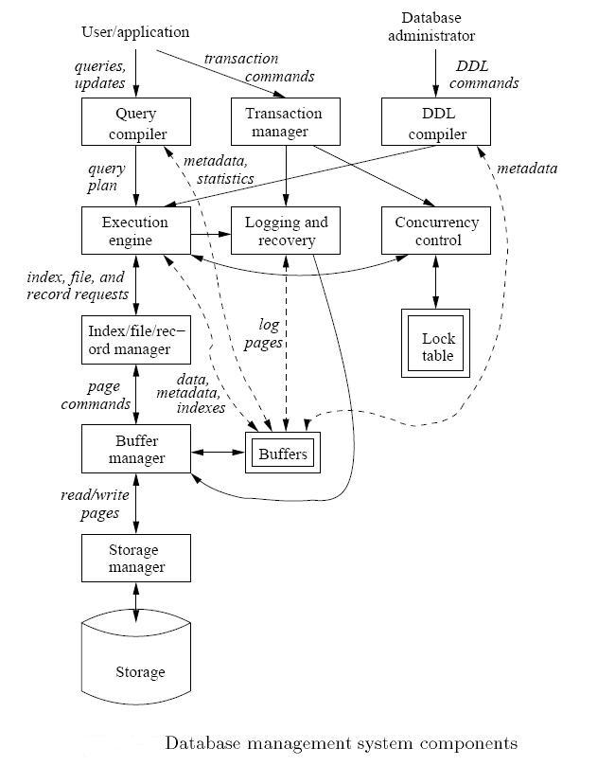
DBMS Backend Components
Our next focus

Slide 3
Transactions
A transaction = sequence of operations that either all succeed, or all fail
Basic unit of processing in DBMS
Transactions have the ACID properties

Slide 4
Goal: The ACID properties
A tomicity: All actions in the transaction happen, or none happen.
C onsistency: If each transaction is consistent, and the DB starts consistent, it ends up consistent.
I solation: Execution of one transaction is isolated from that of all others.
D urability: If a transaction commits, its effects persist.

Slide 5
Integrity & Consistency of Data
Data in the DB should be always correct and consistent
Is this data correct (consistent)?
Name
Age
White
Green
Gray
52
3421
1
How DBMS decides if data is consistent?

Slide 6
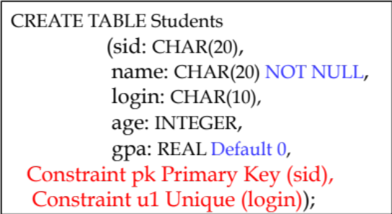
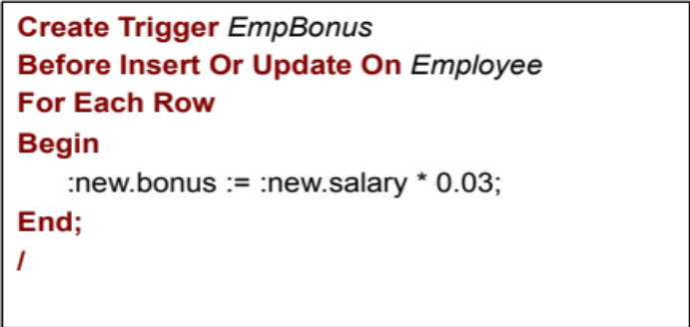
Integrity & Consistency Constraints
Define predicates and constraints that the data must satisfy
Examples:
  - x is key of relation R
  - x → y holds in R
  Domain(x) = {Red, Blue, Green}
  No employee should make more than twice the average salary
Defining constraints
Schema-level
Add Constraint command
Business-constraint
Use of Triggers

Slide 7

FACT: DBMS is Not Consistent All the Time
Example: a1 + a2 +…. an = TOT (constraint)
Deposit $100 in a2: a2 ← a2 + 100
TOT ← TOT + 100
A transaction hides intermediate states
(Even under failure)
Initial state
Intermediate state
Final state
.
.
.
.
.
.
a2
50
150
150
.
.
.
.
.
.
TOT
1000
1000
1100
Not

Slide 8
Transaction: a collection of actions that preserve consistency
Concept of Transactions
Consistent DB
Consistent DB’
T
Main Assumption
If T starts with consistent state
AND
T executes in isolation
THEN
⇒ T leaves consistent state

Slide 9
How Can Constraints Be Violated?
DBMS can easily detect and prevent that (if constraints are defined)
Transaction Bug
  The semantics of the transaction is wrong
  E.g., update a2 and not ToT
DBMS Bug
  DBMS fails to detect inconsistent states
Hardware Failure
  Disk crash, memory failure, …
Concurrent Access
  Many transactions accessing the data at the same time
  E.g., T1: give 10% raise to programmers
T2: change programmers ⇒ systems analysts
Should not use this DBMS
Recovery & Concurrency Control

Slide 10
Plan of Attack (ACID properties)
First we will deal with “I”, by focusing on concurrency control.
Then we will address “A” and “D” by looking at recovery.
What about “C”?
  Well, if you have the other three working, and you set up your integrity constraints correctly, then you get “C” for free

Slide 11
Transaction Management
Concurrency Control (Ch. 18)
Book ➔ Database Systems: The Complete Book, Second Edition

Slide 12

Concurrent Transactions
T1
T2
T3
Tn
DB
(consistency
constraints)
Many transactions access the data at the same time
Some are reading, others are writing
May conflict

Slide 13
Transactions: Example
T1: Read(A) T2: Read(A)
A ← A + 100 A ← A × 2
Write(A) Write(A)
Read(B) Read(B)
B ← B+100 B ← B × 2
Write(B) Write(B)
Constraint: A=B
Read:
From disk to memory
Write:
From memory to disk
How to execute these two transactions?
How to schedule the read/write operations?

Slide 14
A Schedule
An ordering of operations (reads/writes) inside one or more transactions over time
What is correct outcome ?
Leads
To
What is good schedule ?

Slide 15
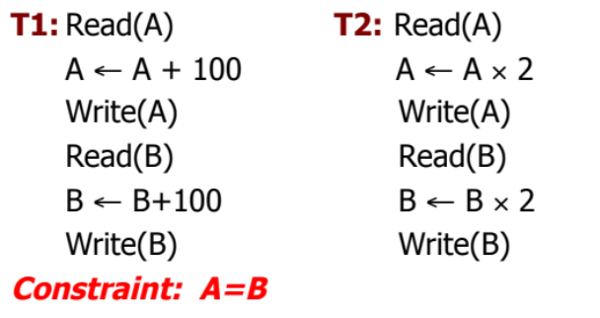
Schedule A
Values
on disk
T1 T2
Read(A); A ← A+100
Write(A);
Read(B); B ← B+100;
Write(B);
Read(A);A ← A×2;
Write(A);
Read(B);B ← B×2;
Write(B);
A B
25 25
125
125
250
250
Serial Schedule: T1, T2
250 250

Slide 16
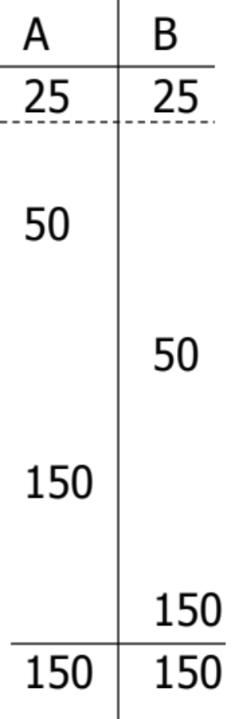
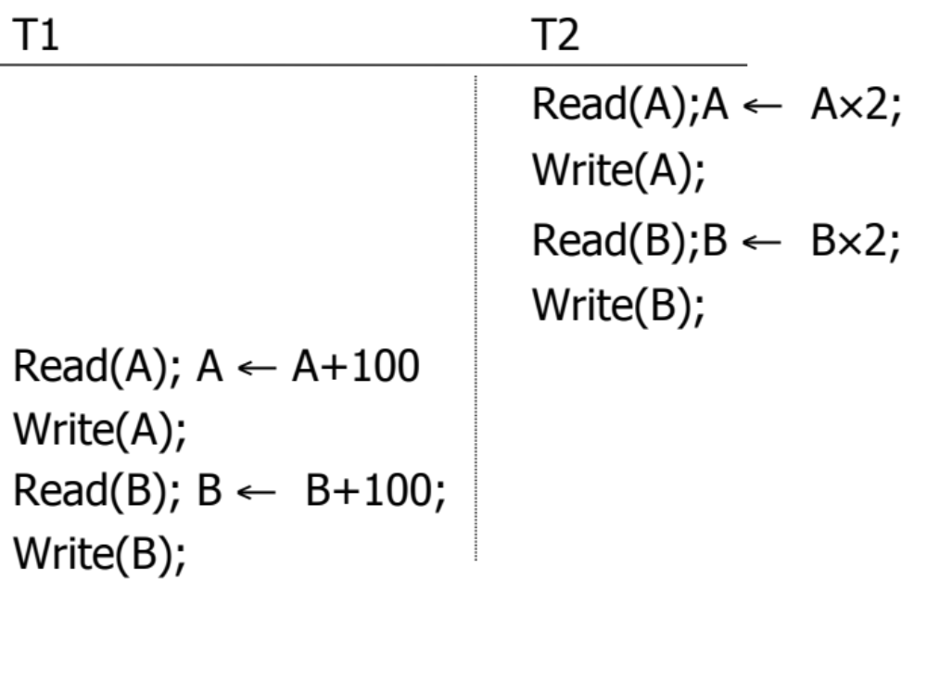
Schedule B
Serial Schedule: T2, T1

Slide 17
Serial Schedules !
Definition: A schedule in which transactions are performed in a serial order (no interleaving)
The Good: Consistency is guaranteed
➔Any serial schedule is “good”.
The Bad: Throughput is low, need to execute in parallel
Solution ➔ Interleave Transactions in A Schedule…

Slide 18

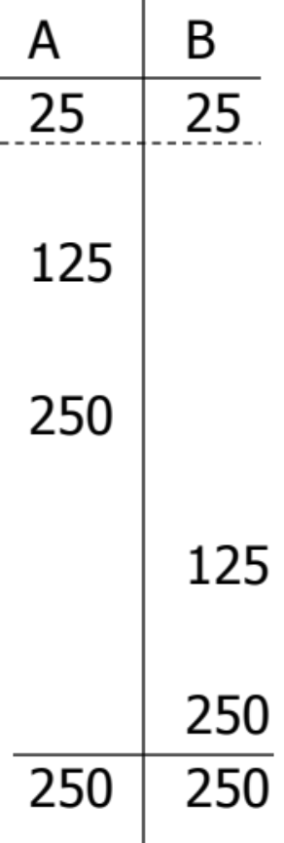
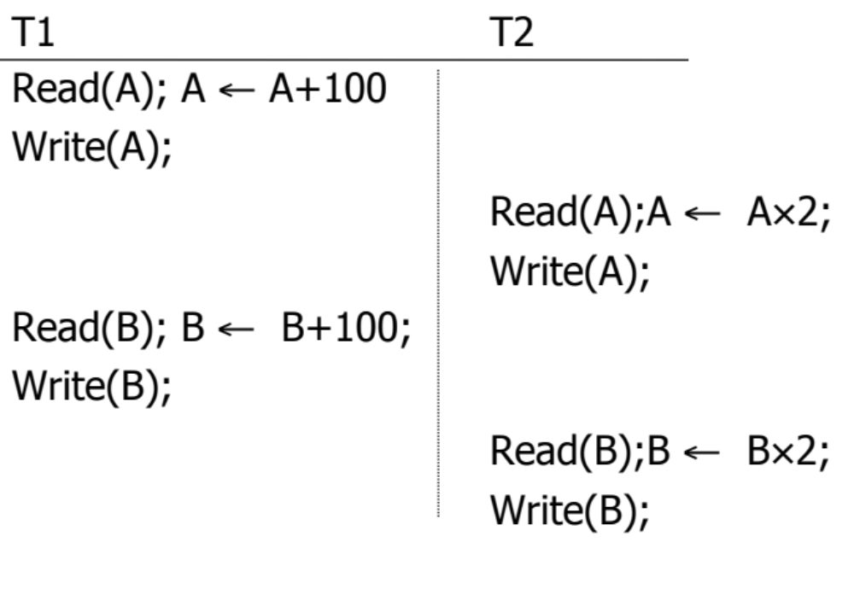
Schedule C
Schedule C is NOT serial but its Good

Slide 19
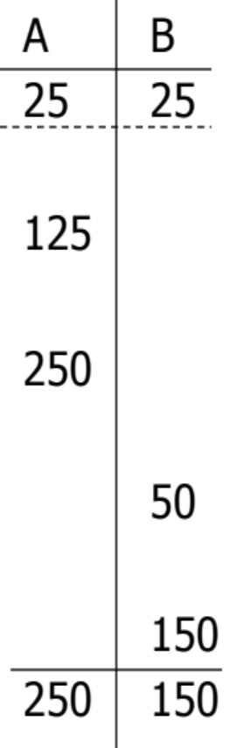
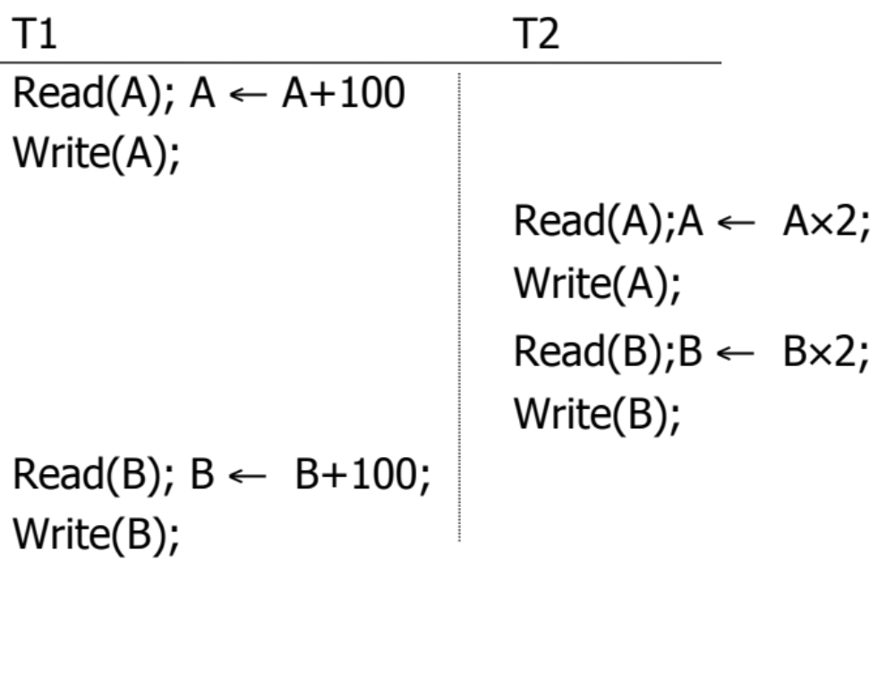
Schedule D
Schedule C is NOT serial but its Bad
Not Consistent

Slide 20
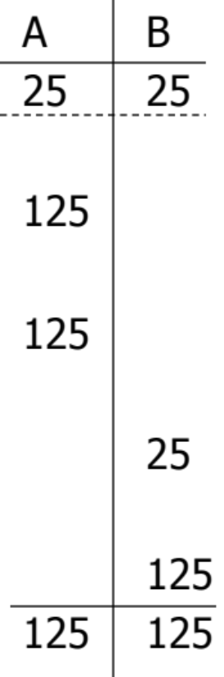

Schedule E
Same as Schedule D
but with new T2’
Same schedule as D, but this one is Good
Consistent

Slide 21
What Is A ‘Good’ Schedule?
Does not depend only on the sequence of operations
  Schedules D and E have the same sequence
  D produced inconsistent data
  E produced consistent data
We want schedules that are guaranteed “good” regardless of:
  The initial state and
  The transaction semantics
Hence we consider only:
  The order of read/write operations
  Any other computations are ignored (transaction semantics)
Transaction semantics played a role
Example:
Schedule S =r1(A) w1(A) r2(A) w2(A) r1(B) w1(B) r2(B) w2(B)

Slide 22
Example: Considering Only R/W Operations
Schedule S =r1(A) w1(A) r2(A) w2(A) r2(B) w2(B) r1(B) w1(B)

Slide 23

Concept: Conflicting Actions
Conflicting actions: Two actions from two different transactions on the same object are conflicting iff one of them is write
r1(A) ←→ W2(A)
➔ Transaction 1 reads A, Transaction 2 write A
w1(A) ←→ r2(A)
➔ Transaction 1 writes A, Transaction 2 reads A
w1(A) ←→ w2(A)
➔ Transaction 1 writes A, Transaction 2 write A
No Conflict
r1(A) ←→ r2(A)
➔ Transaction 1 reads A, Transaction 2 reads A
Conflicting actions can cause anomalies…Which is Bad

Slide 24
Our Goal
We need schedule that is equivalent to any serial schedule
It should allow interleaving
Any serial order is good
Produces consistent result & anomaly-free
Given schedule S:
If we can shuffle the non-conflicting actions to reach a serial schedule L
➔ S is equivalent to L
➔ S is good

Slide 25
Example: Schedule C

Slide 26
Example: Schedule C
S_{c}= r1(A) w1(A) r2(A) w2(A) r1(B) w1(B) r2(B) w2(B)
Can be switched because they are not conflicting
S_{c}”= r1(A) w1(A) r1(B) w1(B) r2(A) w2(A) r2(B) w2(B)
T1
T2
➔ Schedule C is equivalent to a serial schedule ➔ So it is “Good”

Slide 27
Why Schedule C turned out to be Good ?
(Some Formalization)
S_{c}= r1(A) w1(A) r2(A) w2(A) r1(B) w1(B) r2(B) w2(B)
T1 → T2
T1 → T2
(T1 precedes T2)
(T1 precedes T2)
 No cycles ⇒ S_{c} is “equivalent” to a
serial schedule where T1 precedes T2.

Slide 28
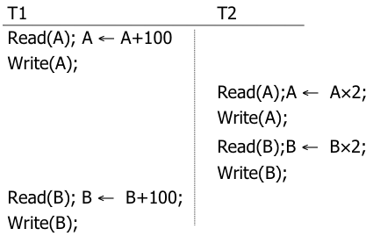
Example: Schedule D
S_{D}= r1(A) w1(A) r2(A) w2(A) r2(B) w2(B) r1(B) w1(B)
Can we shuffle non-conflicting actions to make T1 T2 or T2 T1 ??

Slide 29
Example: Schedule D
S_{D}= r1(A) w1(A) r2(A) w2(A) r2(B) w2(B) r1(B) w1(B)
Can we make T1 first ➔ [T1 T2]?
  No…Cannot move r1(B) w1(B) forward
  Why: because r1(B) conflict with w2(B) so it cannot move….Same for w1(B)

Slide 30
Example: Schedule D
S_{D}= r1(A) w1(A) r2(A) w2(A) r2(B) w2(B) r1(B) w1(B)
Can we make T2 first ➔ [T2 T1]?
  No…Cannot move r2(A) w2(A) forward
  Why: because r2(A) conflict with w1(A) so it cannot move….Same for w2(A)
➔ Schedule D is NOT equivalent to a serial schedule ➔ So it is “Bad”

Slide 31
Why Schedule D turned out to be Bad?
(Some Formalization)
S_{D}= r1(A) w1(A) r2(A) w2(A) r2(B) w2(B) r1(B) w1(B)
T1 → T2
T2 → T1
T1 T2
(T1 precedes T2)
(T2 precedes T1)
Cycle Exist ⇒ S_{D} is “Not equivalent” to any serial schedule.

Slide 32
Recap
Serial Schedules are always “Good” (Consistency + no anomaly)
  But they limit the throughput
Goal: Find interleaving schedule that is “equivalent to” a serial schedule
Identify “Conflicting Actions”, and try to arrange the non-conflicting ones to reach a serial schedule
When formalized ➔ Maps to Dependency Graphs and Cycle Testing
Next…

Slide 33
How to Determine a good Schedule?
A Precedence Graph !
If no cycles
If cycles
Schedule is conflict serializable (Good)
Schedule is NOT conflict serializable (Bad)

Slide 34
Precedence Graph P(S) (S is schedule)
Nodes ➔ Transactions in S
Edges ➔ Ti → Tj whenever the 3 conditions are met
- pi(A), qj(A) are actions in S
- pi(A) <_{S} qj(A)
- at least one of pi, qj is a write
Two actions, one from Ti and one from Tj
Ti’s action before Tj’s action
They are conflicting actions

Slide 35
Precedence Graph
Precedence graph for schedule S:
  Nodes: Transactions in S
  Edges: Ti → Tj whenever
    S: … ri (X) … wj (X) …
    S: … wi (X) … rj (X) …
    S: … wi(X) … wj (X) …
Note: not necessarily consecutive

Slide 36
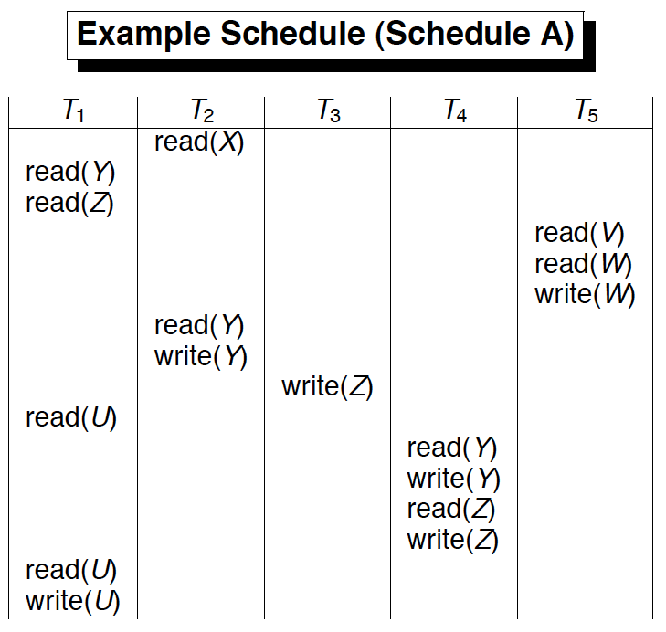
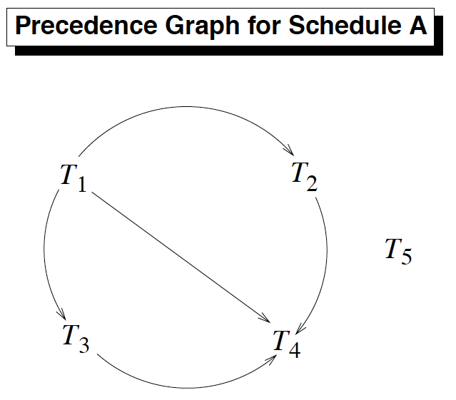
Build P(A)
No cycles
Schedule A is Conflict Serializable

Slide 37
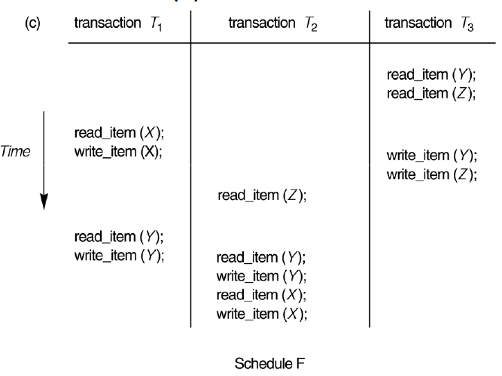
Exercise:
Build P(F)….Is F Conflict Serializable ?

Slide 38
How to Find the Equivalent Serial Order
No cycles ➔ Schedule A is Conflict Serializable
So What is the serial order equivalent to A???

Slide 39
Use Topological Sorting…
One order ➔ T5 T1 T2 T3 T4
Another order ➔ T1 T3 T5 T2 T4
….

Slide 40
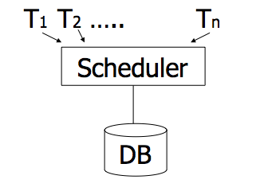
Locking Protocol
“Scheduler” uses a locking protocol to enforce serializability
Two New actions
  Lock (exclusive): l_{i}(A) ➔ Transaction Ti locks item A
  Unlock: U_{i}(A) ➔ Transaction Ti unlocks (releases) item A
lock
table

Slide 41
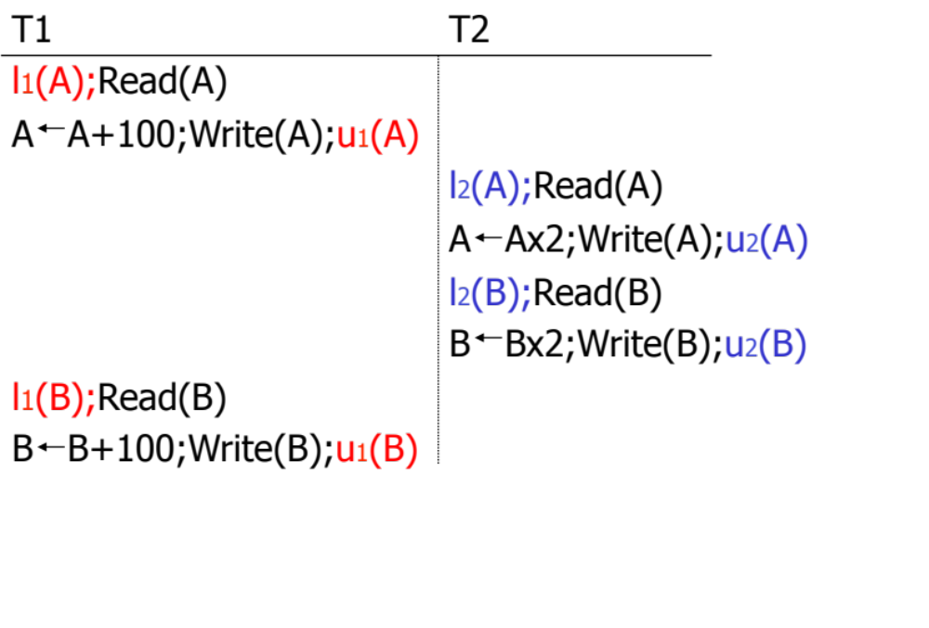

Schedule F: Let’s Add Some Locking!
Does the locking mechanism working? Does it guarantee serializable schedule??

Slide 42
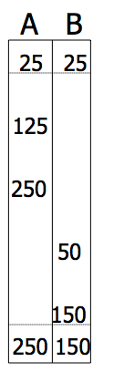
Still Something is Missing…
Still by applying the locks….results is not consistent !!!

Slide 43
2 Phase Locking Protocol
Take all needed locks before releasing any lock
# of locks held by a transaction
Collect locks
Release locks
Growing Phase
Shrinking Phase

Slide 44
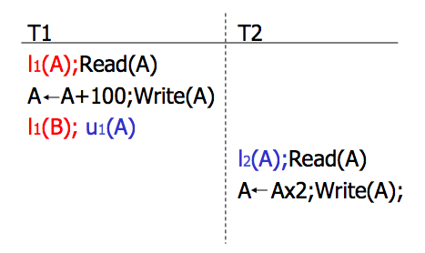

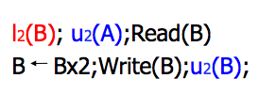
Example 2PL: Schedule G
Scheduler will deny this request
(T2 will wait…)
l₂(B)
T2 Continue processing
At this point the scheduler can resume T2

Slide 45
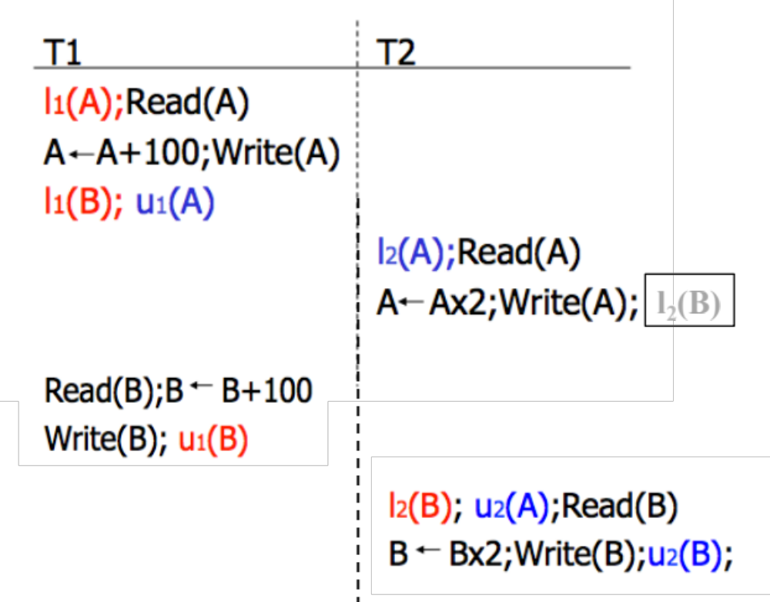

Scheduler Forced Schedule G to be Serializable

