Slide 1
CS585/DS503 Big Data Management
Relational DBs: Overview
WPI, Mohamed Eltabakh

Slide 2




Relational DBs: History
Traditional
Applications
Started in mid 70s
IBM developed the relational DB model
System R
Banking
Retail Sys
Airlines
Universities

Slide 3
Relational DBs: Core Assumptions
Data is nicely structured (known in advance)
Data is correct & certain
Data is relatively static & small-mid size
Access pattern: Mix Read/Write
Notion of transactions (Interactive)
Will see how these affected the design of DB Systems

Slide 4
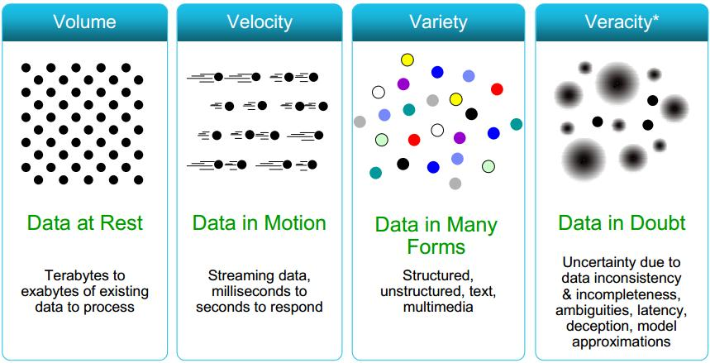
Link Contradicting Assumptions
Data is nicely structured (known in advance)
Data is correct & certain
Data is relatively static & small-mid size
Access pattern: Mix Read/Write
Notion of transactions
In Big Data: It is read only, No notion of transactions

Slide 5
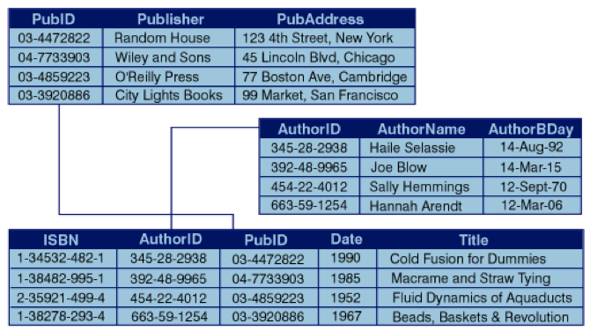

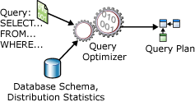



Assumptions → Design
Simple data types, Straightforward processing
Data is nicely structured (known in advance)
Data is correct & certain
Data is relatively static & small-mid size
Access pattern: Mix Read/Write
Notion of transactions (Interactive)
Disk-based Processing
Centralized
Concurrency Control
ACID Properties
Recovery Control

Slide 6
Relational Model
Order of rows & columns does not matter
DB is a set of interconnected relations

Slide 7
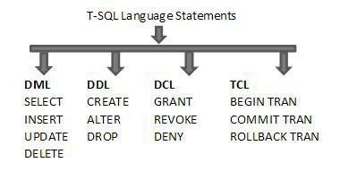
SQL: Structured Query Language
The interface for interaction with DBMSs
CREATE TABLE Students
(sid CHAR(20) Primary Key,
name CHAR(20),
login CHAR(10) Unique,
age INTEGER,
gpa REAL);
CREATE TABLE Courses
(cid Varchar2(20) Primary Key,
name varchar2(50),
maxCredits integer,
graduateFlag char(1));
High-Level Declarative Language

Slide 8
Foreign Keys in SQL
Create “Students” relation
Create “Courses” relation
CREATE TABLE Students
(sid CHAR(20) Primary Key ,
name CHAR(20) NOT NULL,
login CHAR(10),
age INTEGER,
gpa REAL Default 0);
CREATE TABLE Courses
(cid Varchar2(20) Primary Key,
name varchar2(50),
maxCredits integer,
graduateFlag char(1));
Create “Enrolled” relation
CREATE TABLE Enrolled
(sid: CHAR(20) Foreign Key References Students (sid),
X: Varchar2(20),
enrollDate: date,
grade: CHAR(2),
Constraint fk_cid Foreign Key (X) References Courses (cid));
Two ways to define the FK constrain while creating a table

Slide 9
SQL: Inserting, Updating, Deleting Data
This is performed using Data Manipulation Language of SQL (DML)
Insertion
Insert into Students values (‘1111’, …);
Deletion
Delete from Students;
Delete from Students Where sid = ‘1111’;
Update
Update Students Set GPA = GPA + 0.4;
Update Students Set GPA = GPA + 0.4 Where sid = ‘1111’;
Record-Level Operations

Slide 10
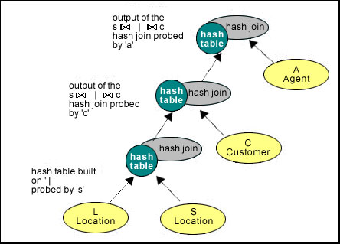
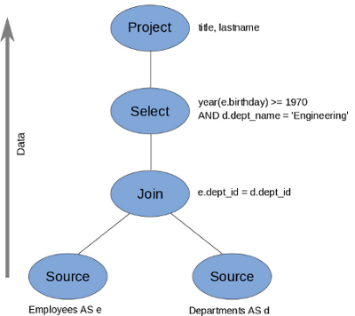
SQL: Querying Data (Select Statement)
Will be mapped to the algebraic operators that we learned
SELECT <projection list>
FROM <relation names>
WHERE <conditions>
GROUP BY <grouping columns>
HAVING <grouping conditions>
ORDER BY <order columns>;
Query Plans
Very Powerful
Query Language

Slide 11
Query Processing (Ch. 15 & 16)
Book ➔ Database Systems: The Complete Book, Second Edition

Slide 12
Example
Data:
relation R (A, B, C)
relation S (C, D, E)
Query:
SELECT B, D
FROM R, S
WHERE R.A = “c” and S.E = 2 and R.C=S.C
Select B, D From R, S Where R.A = “c” And S.E = 2 And R.C=S.C

Slide 13
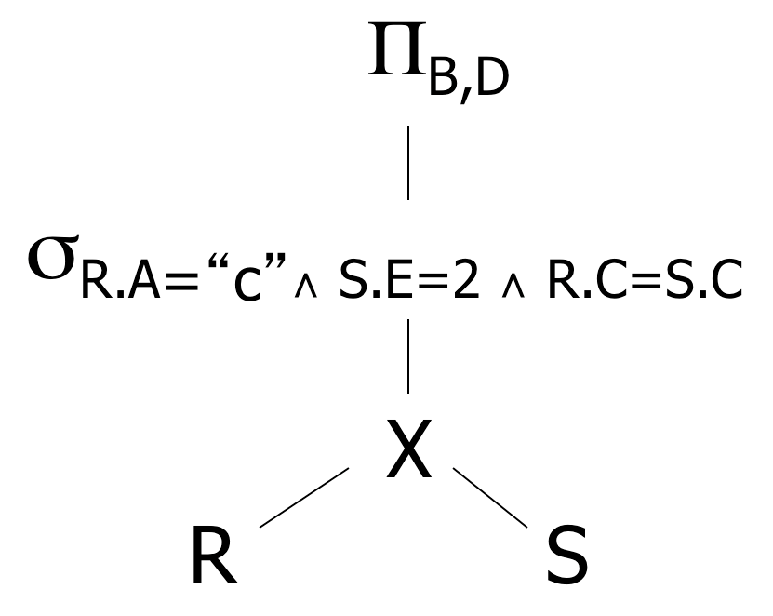
Relational Algebra – Possible Query Plans
Select B, D From R, S Where R.A = “c” And S.E = 2 And R.C=S.C
Plan 1
OR: Π_{B,D} [ σ_{R.A=“c”∧ S.E=2 ∧ R.C = S.C} (R X S)]

Slide 14
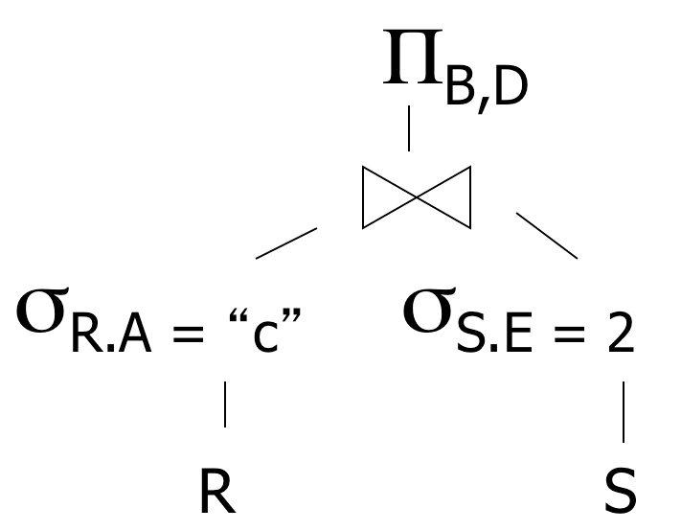
Relational Algebra – Possible Query Plans
Select B, D From R, S Where R.A = “c” And S.E = 2 And R.C=S.C
Plan 2
Natural join
(C is common column)

Slide 15
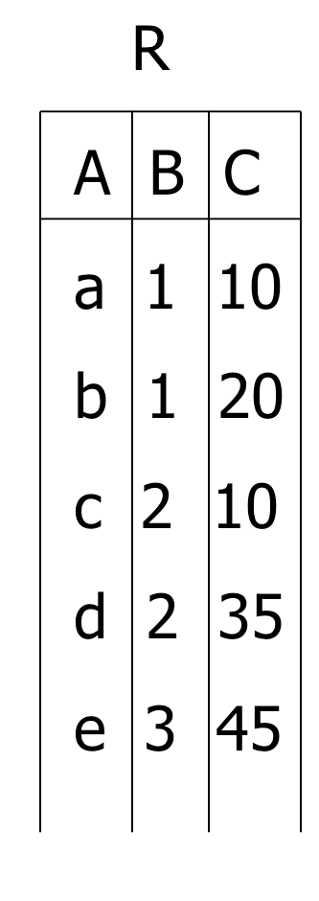
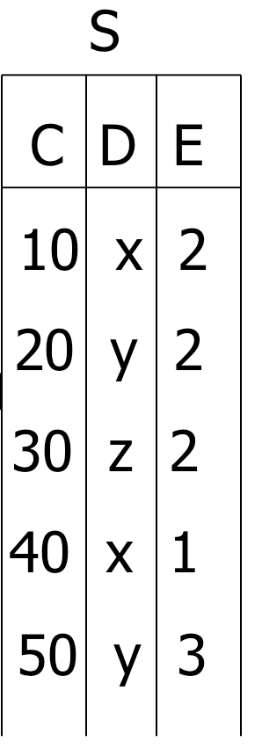
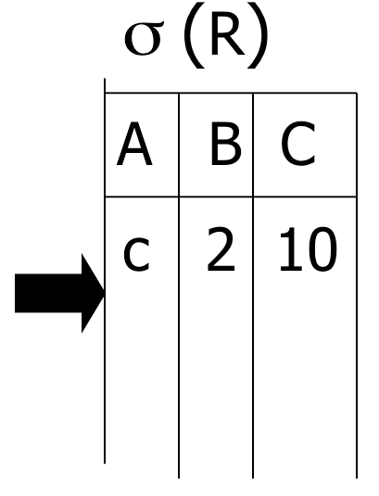
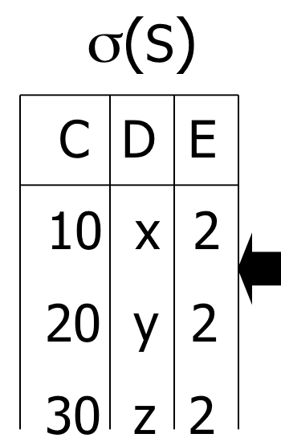

Select B, D From R, S Where R.A = “c” And S.E = 2 And R.C=S.C
Plan 2

Slide 16
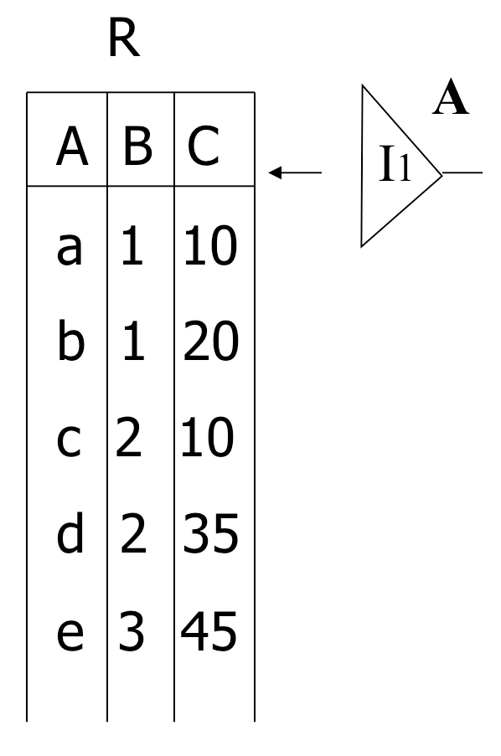
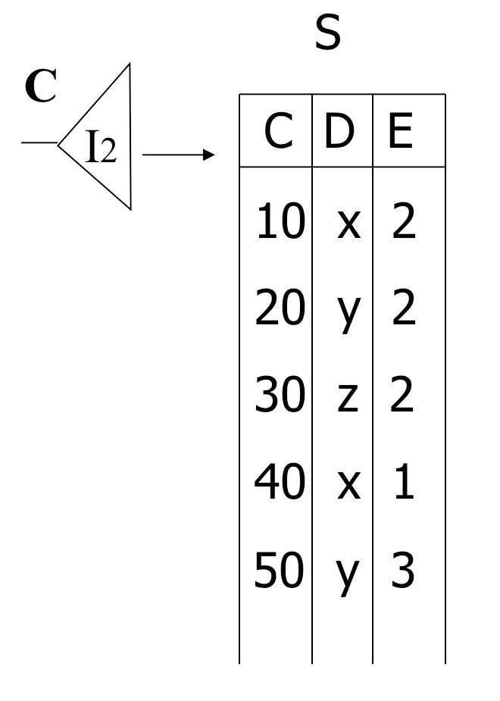
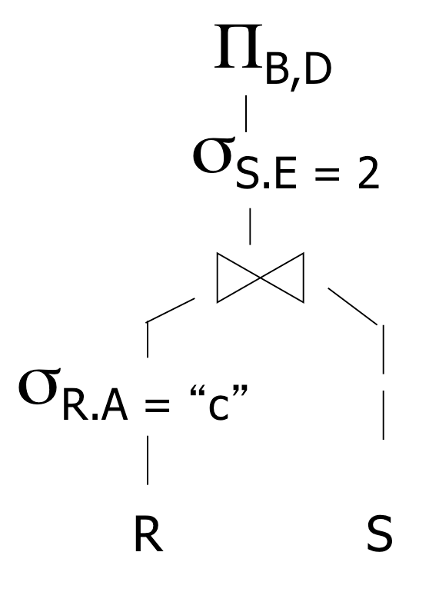
Select B, D From R, S Where R.A = “c” And S.E = 2 And R.C=S.C
Assume indexes on R.A and S.C
Plan 3
=“c”
<c,2,10>
<10,x,2>
Check E=2?
output: <2,x>

Slide 17
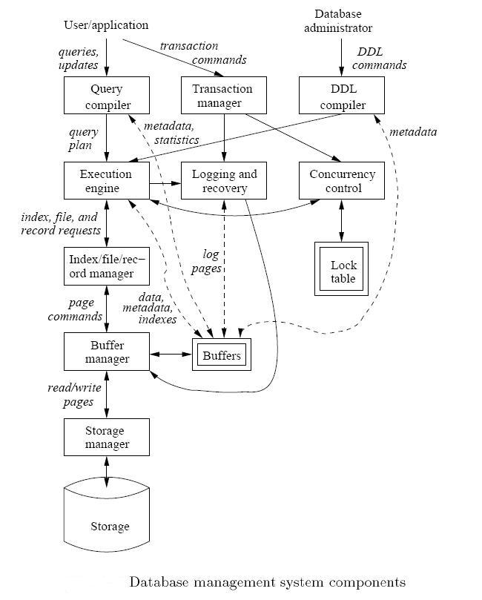
Query Compilation, Optimization and Execution
DB has the ability to optimize because:
Schema & structure is known
The query is known

Slide 18
Overview of Query Execution
SQL Query ➔ Compile ➔ Optimize ➔ Execute

Slide 19
Example
Query : Find the movies with stars born in 1960
SELECT title
FROM StarsIn
WHERE starName IN (
SELECT name
FROM MovieStar
WHERE birthdate LIKE ‘%1960’);

Slide 20
Step 1: Generate Parse Tree

Slide 21
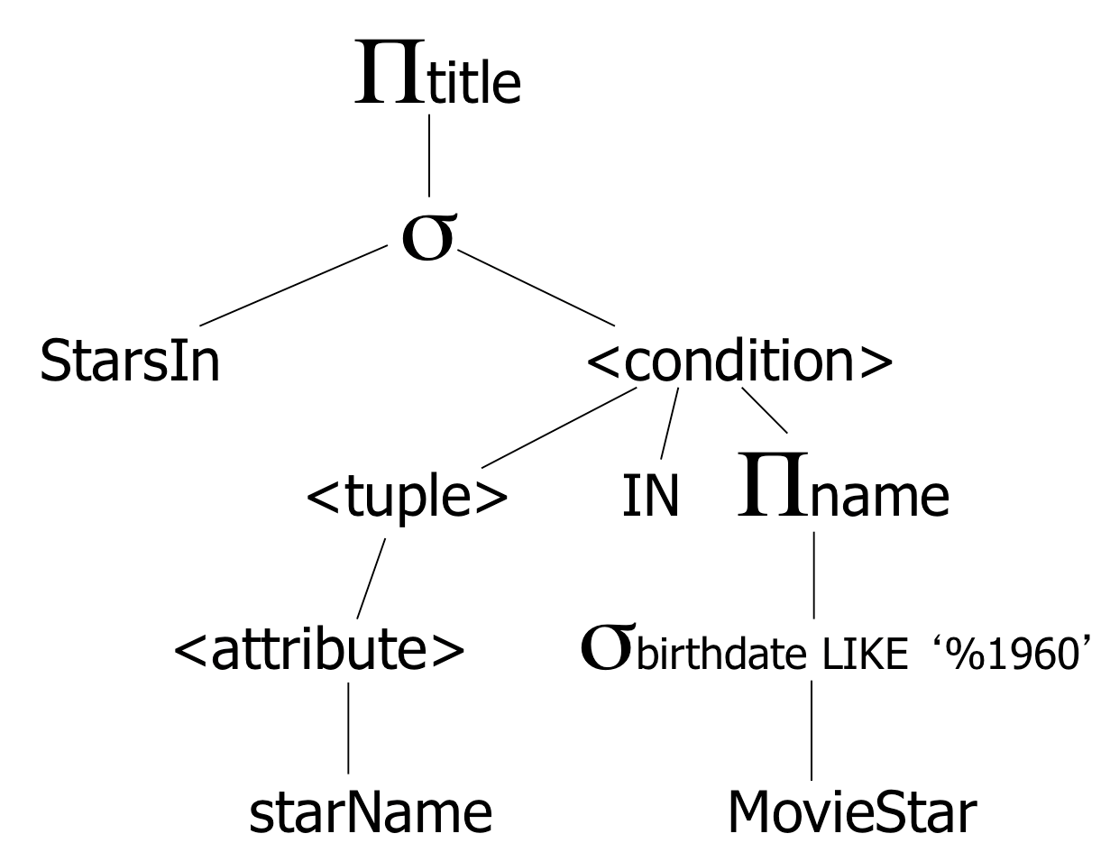
Step 2: Relational Algebra & Logical Plan
SELECT title
FROM StarsIn
WHERE starName IN (
SELECT name FROM MovieStar WHERE birthdate LIKE ‘%1960’);
Expression Tree
Logical Query Plan
Expression Tree is a midway between a parse tree and relational algebra

Slide 22
Step 3: Optimize & Create Several Logical Plans
SELECT title
FROM StarsIn
WHERE starName IN (
SELECT name FROM MovieStar WHERE birthdate LIKE ‘%1960’);
Plan 1
Plan 2
Question:
Push project to
StarsIn?

Slide 23

Overview of Query Execution
SQL Query ➔ Compile ➔ Optimize ➔ Execute

Slide 24
Step 4: Estimate the Sizes
That is done for each plan
Statistics Collection
For the entire relation
For each column
…

Slide 25
Step 5: Consider Physical Plans
Physical plan means how each operator will execute (which algorithm)
E.g., Join can be nested-loop, hash-based, merge-based, or sort-based
Each logical plan will map to multiple physical plans
Logical Plan
One Physical Plan

Slide 26
Overview of Query Execution
SQL Query ➔ Compile ➔ Optimize ➔ Execute

Slide 27
Step 6: Estimate the Cost
This is done for each physical plan
Select the cheapest to execute…

Slide 28
Overview of Query Execution
SQL Query ➔ Compile ➔ Optimize ➔ Execute

Slide 29
Common Statistics over Relation R
B(R): # of blocks to hold all R tuples
T(R): # tuples in R
S(R): # of bytes in each of R’s tuple
V(R, A): # distinct values in attribute R.A
M: # of memory buffers available

Slide 30
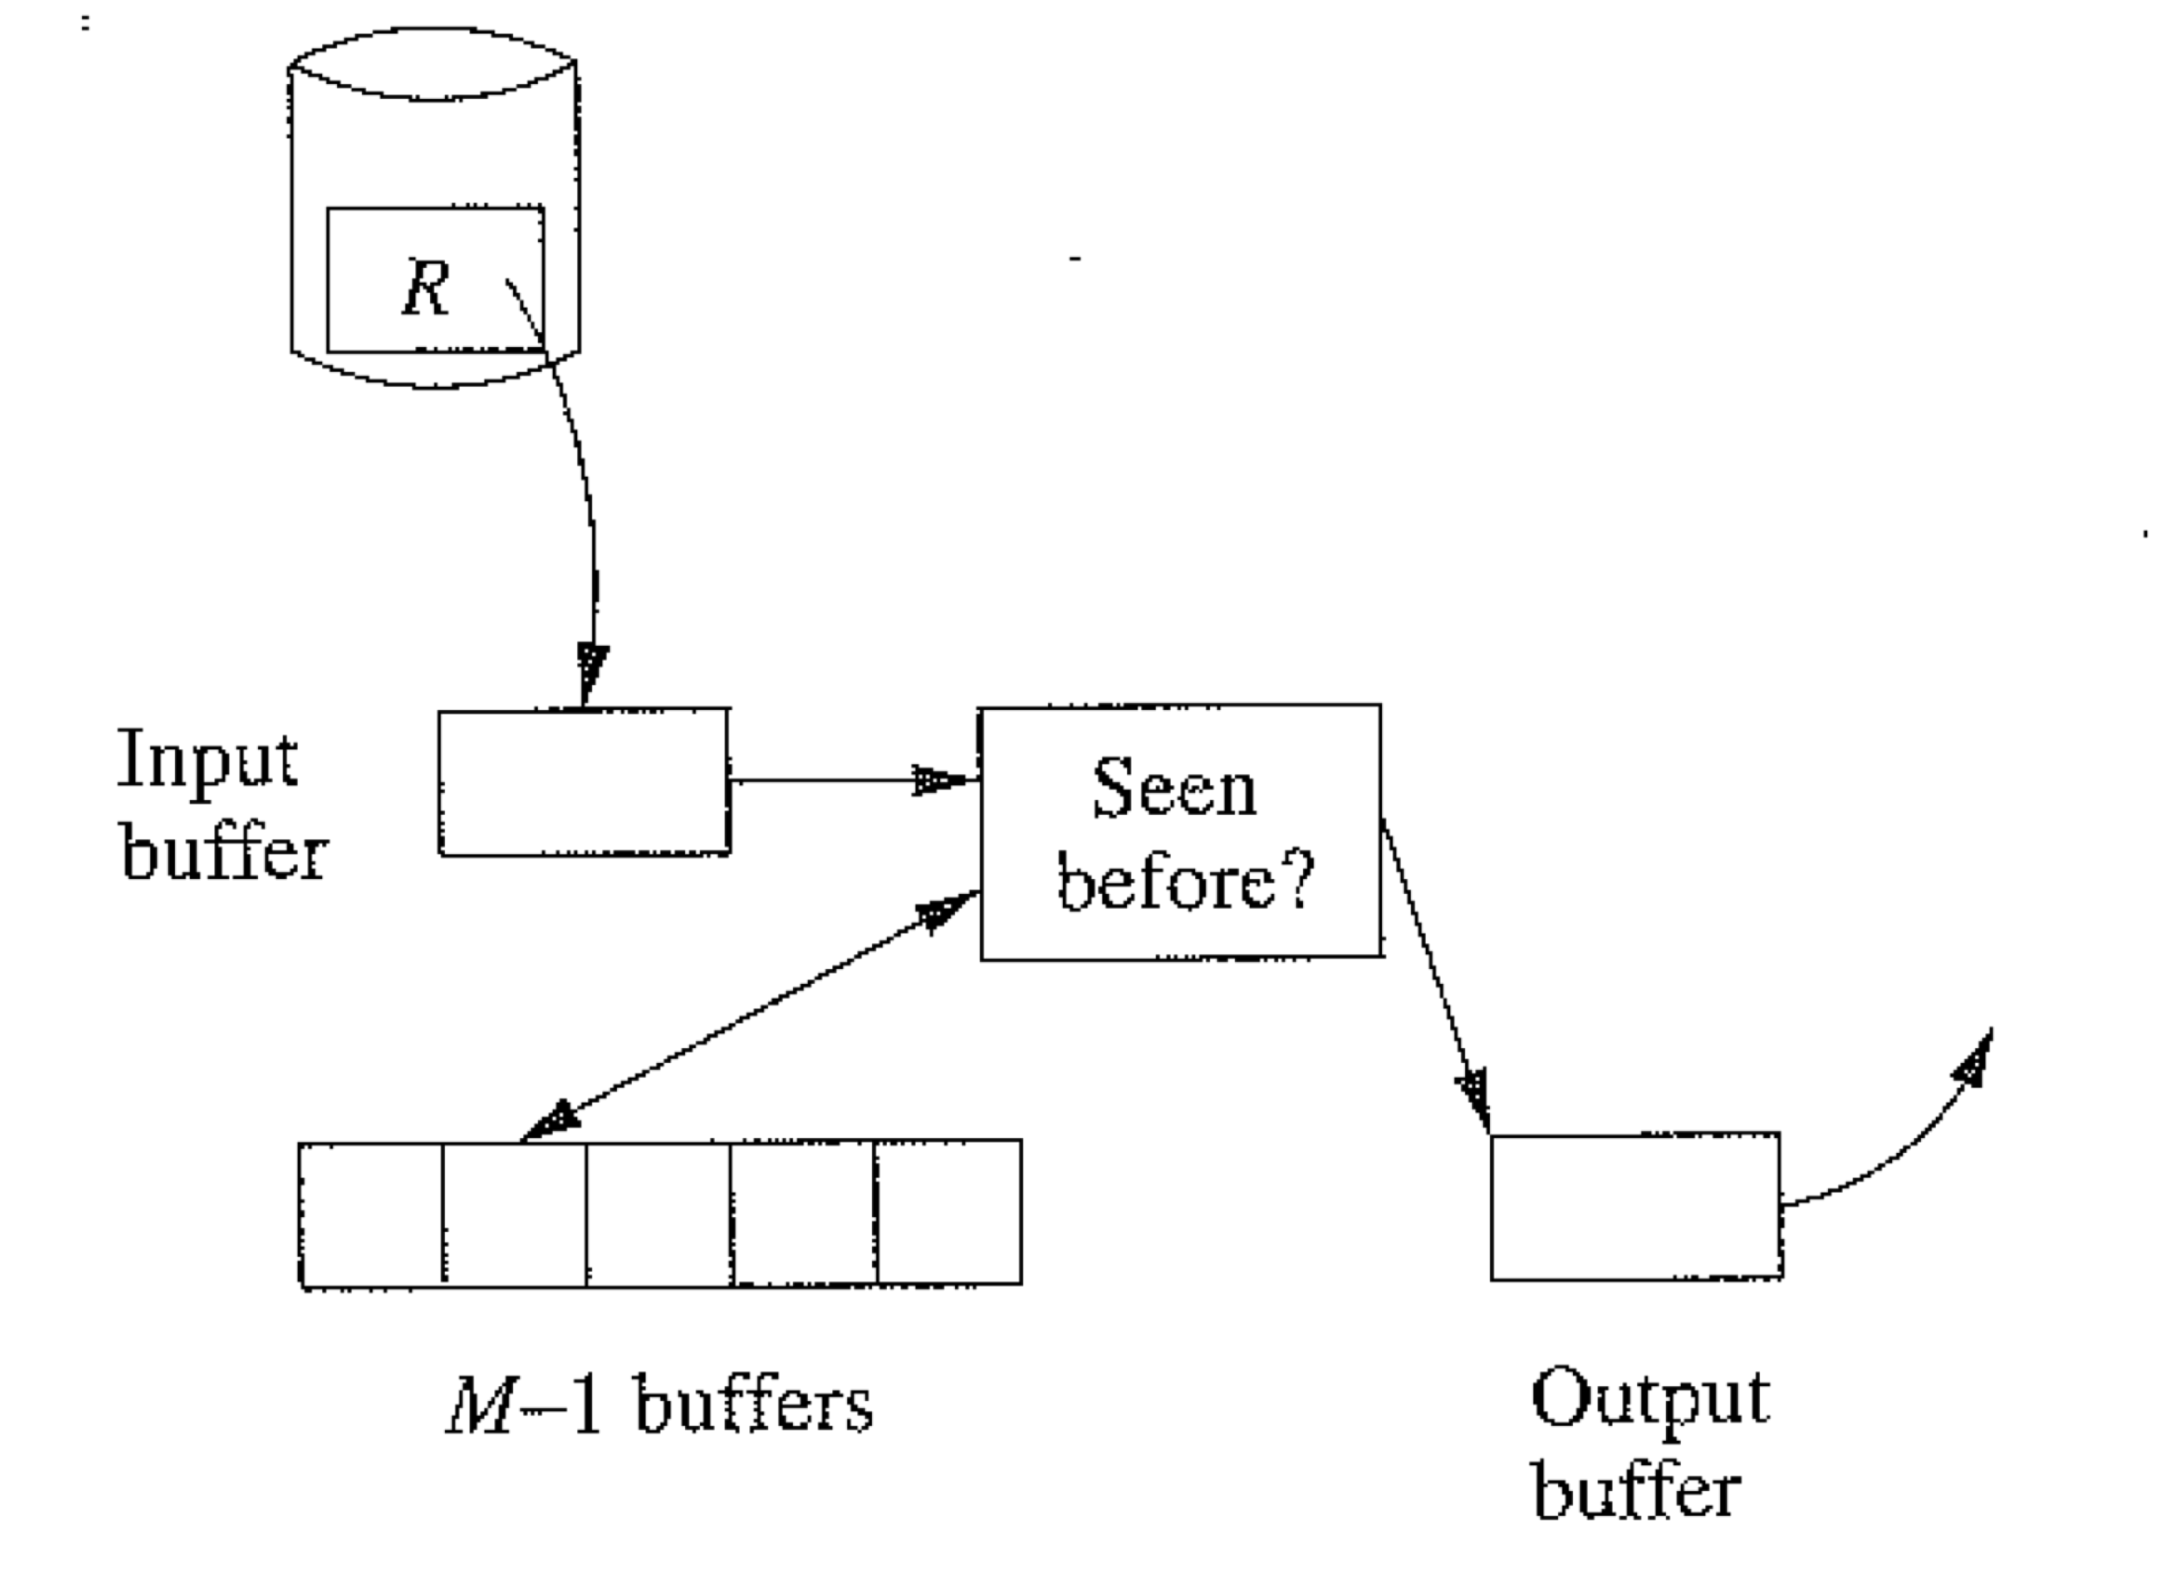

Example: Duplicate Elimination
Distinct
One Pass
Iteration
R
Keep a main memory search data structure D (use search tree or hash table) to store one copy of each tuple ➔ (M-1 Buffers)
Read in each block of R one at a time (use table scan) ➔ (1 buffer)
For each tuple check if it appears in D
If Yes, then skip
If Not, then add it to D and to the output buffer
1 memory buffer for reading
M-1 memory buffers for storing distinct copies
What are the constraints for this algorithm to work in one pass?
What is the I/O Cost
The distinct tuples of R must fit in M-1 Buffers
>> B( (R)) <= M-1
>> As an approximation B( (R)) <= M
B(R)

Slide 31
Example: Duplicate Elimination
Distinct
R
What if relation R is sorted
How the duplicate elimination op. works ???
Are there any size constraints to be in one pass ???
What is the I/O cost ???

Slide 32
Example: Duplicate Elimination (Cont’d)
Distinct
R
What if relation R is sorted
How the duplicate elimination op. works ???
No need for the M-1 Buffers (we keep only the last reported tuple)
Are there any size constraints to be in one pass ???
No (1 memory buffer to handle R of any size)
What is the I/O cost ???
B(R)
Each operator must know the properties of its input relations
(Sorted or not, grouped or not, …)
Makes big difference in execution and performance

Slide 33
Two-Pass Algorithms
First Pass: Do a prep-pass and write the intermediate result back to disk
>> We count Reading + Writing
Second Pass: Read from disk and compute the final results
>> We count Reading only (if it is the final pass)
Sort-based two-pass algorithms
The first pass does a sort on some parameter(s) of each operand
The second pass algorithm relies on the sort results and can be pipelined
Hash-based two-pass algorithms

Slide 34
Example: 2-Pass External Sort
Sort
R
Phase 1: Read M blocks at a time, sort them, write to disk as one run
Each run is sorted of size M
(we have B(R)/M runs)
What are the constraints for this algorithm to work in one pass?
Phase 2: Merge the runs and produce the sorted output (each run must have one memory buffer)
What is the I/O Cost
B(R)/M runs

Slide 35
Example: 2-Pass External Sort
Sort
R
Phase 1: Read M blocks at a time, sort them, write to disk as one run
Each run is sorted of size M
(we have B(R)/M runs)
What are the constraints for this algorithm to work?
Phase 2: Merge the runs and produce the sorted output (each run must have one memory buffer)
Phase 1 → no constraints
Phase 2 → each run must have a memory
buffer + one for output
>> B(R)/M <= M-1
>> Approx. B(R)/M <= M
>> B(R) <= M²
B(R)/M runs

Slide 36
Example: 2-Pass External Sort
Sort
R
Phase 1: Read M blocks at a time, sort them, write to disk as one run
Each run is sorted of size M
(we have B(R)/M runs)
What is the I/O Cost
Phase 2: Merge the runs and produce the sorted output (each run must have one memory buffer)
Phase 1 → 2 x B(R) [reading & writing]
Phase 2 → B(R) [reading]
Total 3 B(R)
B(R)/M runs

Slide 37
Sort-Based Duplicate Elimination
Distinct
R
Same as sorting, except that:
While merging in Phase 2, eliminate the duplicates and produce one copy from each group of identical tuples
Eliminate duplicates
What are the constraints for this algorithm to work in two pass?
What is the I/O Cost
Same as the sorting operator itself

Slide 38
Naïve Two-Pass JOIN (Sort-Join)
Join
R
S
Sort R and S on the join key
Merge and join the sorted R and S
Step 1 (Sorting each Relation)
R
Sorted R
2-Pass Sort
S
Sorted S
2-Pass Sort

Slide 39
Naïve Two-Pass JOIN
Join
R
S
Sort R and S on the join key
Merge and join the sorted R and S
Step 2 (Merge and Join R & S)
Read one block from each relation at a time, join the tuples that exist in both relations
When one block is consumed, read the next block from its relation
Output buffer
Sorted R
Joined output
Sorted S
Memory
What are the constraints for this algorithm to work in two pass?
What is the I/O Cost

Slide 40
Naïve Two-Pass JOIN
Join
What is the I/O Cost
R
S
I/O Cost = 4 B(R)
Notice: we counted the output writing since it is intermediate
I/O Cost = 4 B(S)
I/O Cost = B(R) + B(S)
Total I/O Cost = 5( B(R) + B(S))

Slide 41
Naïve Two-Pass JOIN
Join
What are the constraints
R
S
>> B(R) <= M²
From the sorting algorithm
>> B(S) <= M²
No Constraints

