Slide 1
BME 525 Project: Cardiac Cell Simulations
Alex Kyu

Slide 2
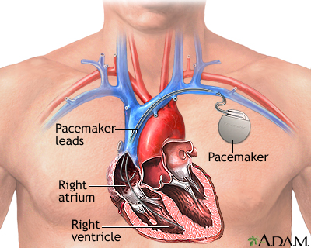
Motivation
Medical Device testing for pre-clinical trial product development.
Notes:
Med Device Dev – Pacemakers
No testing on hearts until Clinical Trials
Dangerous to patients
Small issues can push back development and be very costly
Emulated models would be helpful for earlier stages of development to get preliminary results

Slide 3
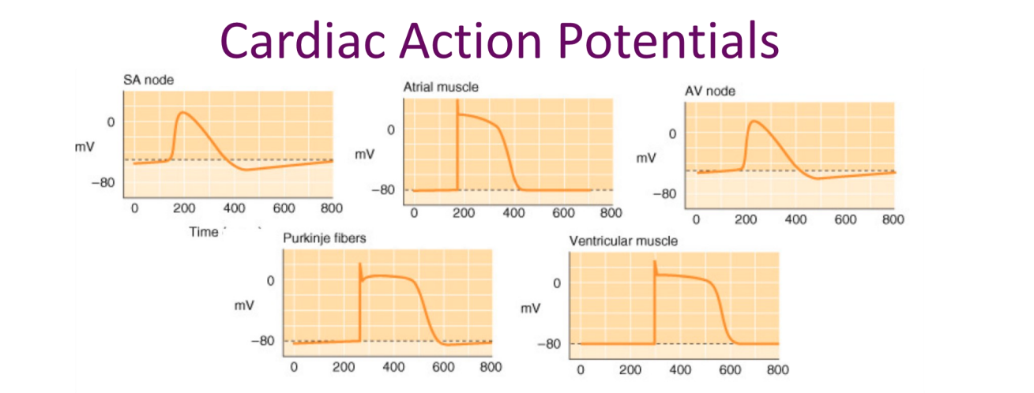
Background
Notes:
Different types of cardiac action potentials
Nodal Pacemaker Cells – Lack the Characteristic early repolarization and shallow plateau, have slow depolarization
Cardiomyocyte Cells – Flat Resting Phase and early repolarization
Subsidiary Pacemaker Cells – Similar to Cardiomyocytes but have Pacemaker quality

Slide 4
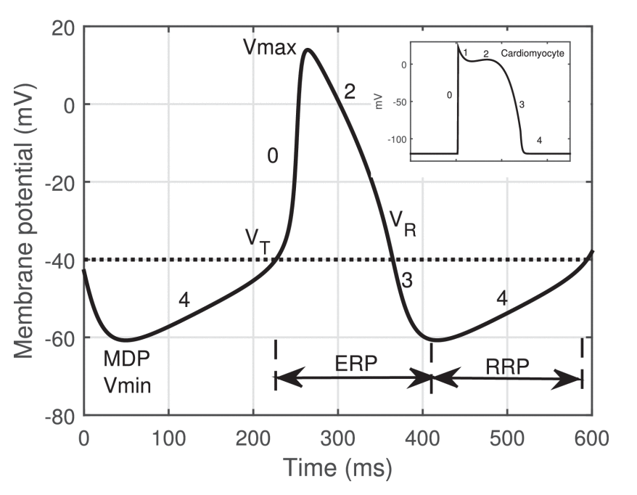
Background (Continued)
Notes:
Mechanical Design
Tmotor R80 KV110
So with those three pillars in mind, we have started our design process. On the picture on the left, you can see the first and second pillar with the four bar mechanism. This will be directly driven by our BLDC attached to a custom cycloidal drive in order to get the correct torque and speed required. And you can see in that bottom animation how a cycloidal drive works.

Slide 5
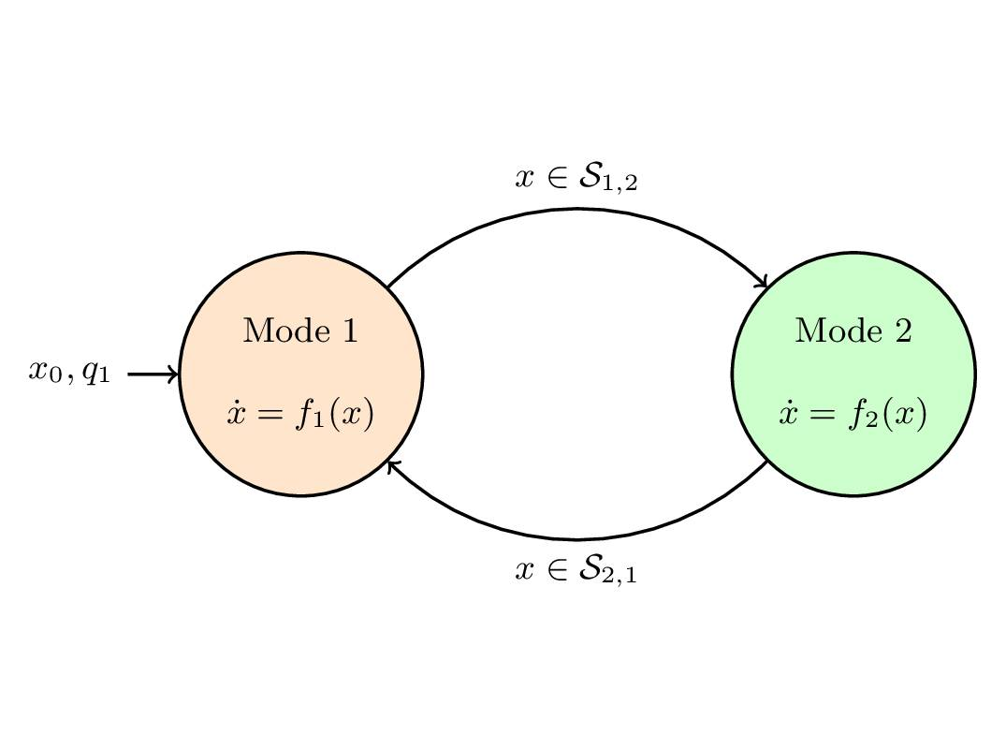
Background (Continued)
Notes:
Hybrid Automata/Automaton Model
Discrete Model that can take on Analog Inputs/Outputs
Defined by FSM
Multiple states with conditions that transition between states
Differential equations within each state characterize the model
Initial conditions of variables

Slide 6
Models
Cardiomyocyte
Nodal Pacemaker Cell
Cell Path
Subsidiary Pacemaker Cell
Notes:
There are three main pillars to our design. The first is a fourbar linkage mechanism at the knee. This type of mechanism mimics a healthy human knee by providing a moving center of rotation and by providing hardstop limits.
The second pillar is the use of a BLDC motor to drive the fourbar linkage in the knee. This type of motor provides high torque while being efficient and reliable.
The third pillar is a neural network-based control system. This would involve taking in data from several sensors on healthy walking subjects to train the model to capture user intention and move the leg accordingly.

Slide 7
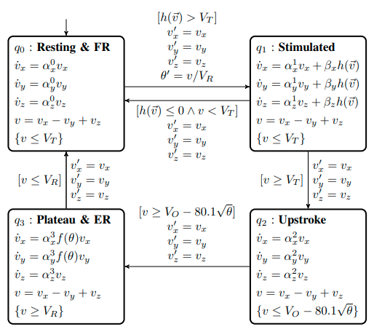


Cardiomyocyte Model
$$h_{k}\left(\vec{v}\right)=\sum_{n=1}^{n}{\left(\frac{Γ_{ik}σ_{ik}}{A_{m}C_{m}}\left(v_{i}^{out}−v_{k}\right)\right) }$$
$$f\left(θ\right)=\left\{\begin{aligned}0.29∗e^{62.89∗θ}+e^{−10.99∗θ}, if θ<0.04 \\ 4.0395, &if θ≥0.04\end{aligned}\right.$$
Notes:
HA Model from University of Auckland (in NZ) Based on the Stony Brook Model
4 different states, not aligned with states identified before
each phase is characterized by a membrane voltage which is broken down into 3 different differential functions, vx, vy, vz
alpha and beta values from Stony Brook Model
added stimulated phase
Talk about between phase q0 and q1
hk(v)
f(theta)

Slide 8
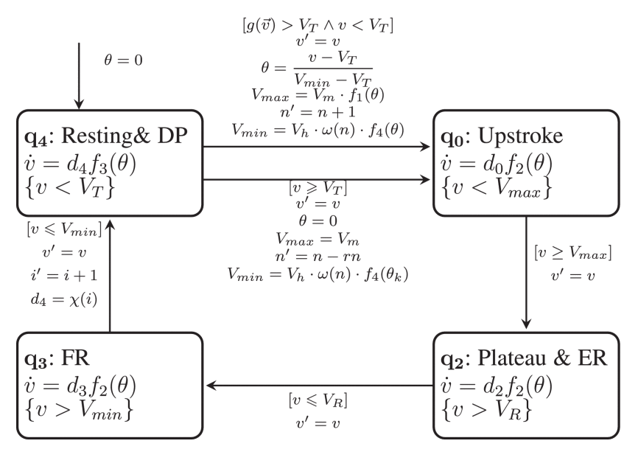

Pacemaker Cell Model
The range of θ (θ∈R) is [0,1] and it is updated when the transition from q4 to q0 happens. If the cell is paced faster and activated in the early RRP, the value of θ is closer to 1.
n is the number of consecutive overdrive stimuli representing the duration of overdrive. We define ω(n) in (6) to capture the effect of duration.
$$g\left(\vec{v}\right)=\sum_{n=1}^{n}{\left(D_{ik}∗v_{i}^{out}−v_{k}\right)}$$
Notes:
Mechanical Design
Tmotor R80 KV110
So with those three pillars in mind, we have started our design process. On the picture on the left, you can see the first and second pillar with the four bar mechanism. This will be directly driven by our BLDC attached to a custom cycloidal drive in order to get the correct torque and speed required. And you can see in that bottom animation how a cycloidal drive works.

Slide 9
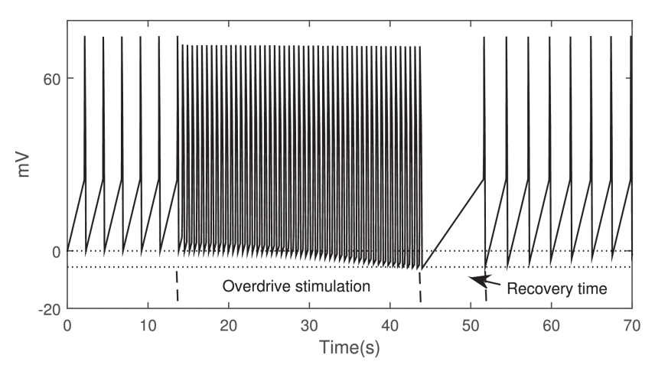
Pacemaker Cell Model (Continued)
The range of θ (θ∈R) is [0,1] and it is updated when the transition from q4 to q0 happens. If the cell is paced faster and activated in the early RRP, the value of θ is closer to 1.
n is the number of consecutive overdrive stimuli representing the duration of overdrive. We define ω(n) in (6) to capture the effect of duration.
$$g\left(\vec{v}\right)=\sum_{n=1}^{n}{\left(D_{ik}∗v_{i}^{out}−v_{k}\right)}$$
Notes:
Mechanical Design
Tmotor R80 KV110
So with those three pillars in mind, we have started our design process. On the picture on the left, you can see the first and second pillar with the four bar mechanism. This will be directly driven by our BLDC attached to a custom cycloidal drive in order to get the correct torque and speed required. And you can see in that bottom animation how a cycloidal drive works.

Slide 10
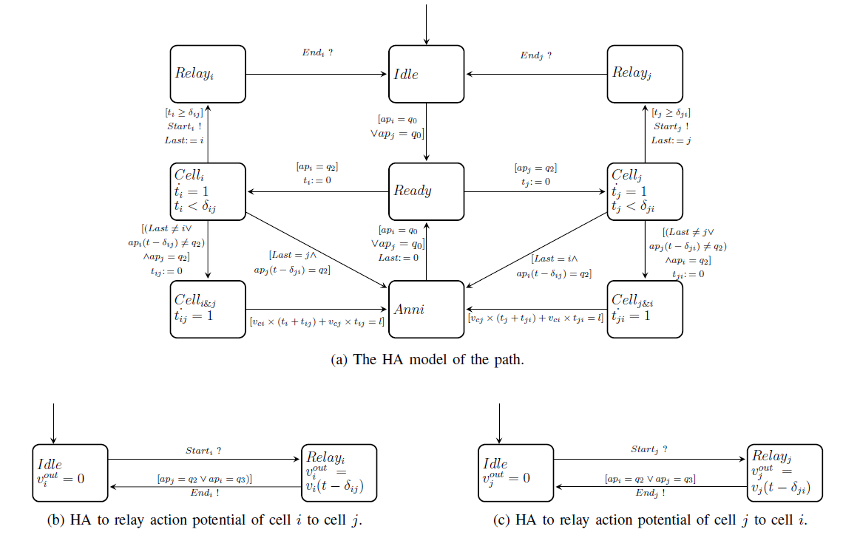
Path Model
Notes:
HA Model, but with time elements
Use of conduction velocity and length to determine the voltage effect from one cell to another
Also Emulates Signal Annihilation in the case where both cells send out an AP

Slide 11
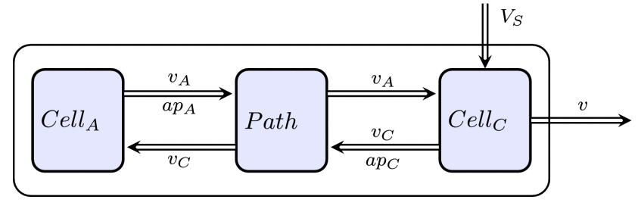
Subsidiary Pacemaker Cell Model
Model is an encapsulation of two cells connected by a Path Model
Cell C is a Cardiomyocyte cell and Cell A is a Nodal Pacemaker Cell set to a much lower BPM
Distance between the cells are 0, so Conduction Velocity is irrelevant
Allows for an Action Potential shape similar to Cardiomyocytes, but also maintain a constant beat
Notes:
Mechanical Design
Tmotor R80 KV110
So with those three pillars in mind, we have started our design process. On the picture on the left, you can see the first and second pillar with the four bar mechanism. This will be directly driven by our BLDC attached to a custom cycloidal drive in order to get the correct torque and speed required. And you can see in that bottom animation how a cycloidal drive works.

Slide 12


Implementation
Nodal Pacemaker Model
Path Model
Backend
Subsidiary Pacemaker Model
Kivy Frontend
Cardiomyocyte Model
Notes:
Mechanical Design
Tmotor R80 KV110
So with those three pillars in mind, we have started our design process. On the picture on the left, you can see the first and second pillar with the four bar mechanism. This will be directly driven by our BLDC attached to a custom cycloidal drive in order to get the correct torque and speed required. And you can see in that bottom animation how a cycloidal drive works.

Slide 13
Demo Time!
Notes:
There are three main pillars to our design. The first is a fourbar linkage mechanism at the knee. This type of mechanism mimics a healthy human knee by providing a moving center of rotation and by providing hardstop limits.
The second pillar is the use of a BLDC motor to drive the fourbar linkage in the knee. This type of motor provides high torque while being efficient and reliable.
The third pillar is a neural network-based control system. This would involve taking in data from several sensors on healthy walking subjects to train the model to capture user intention and move the leg accordingly.

Slide 14
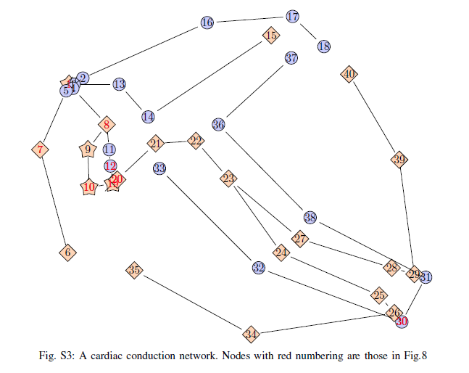
Tissue/Cell Properties and Disease and Pathologies in Simulation
Notes:
2D Model
Limitation

Slide 15
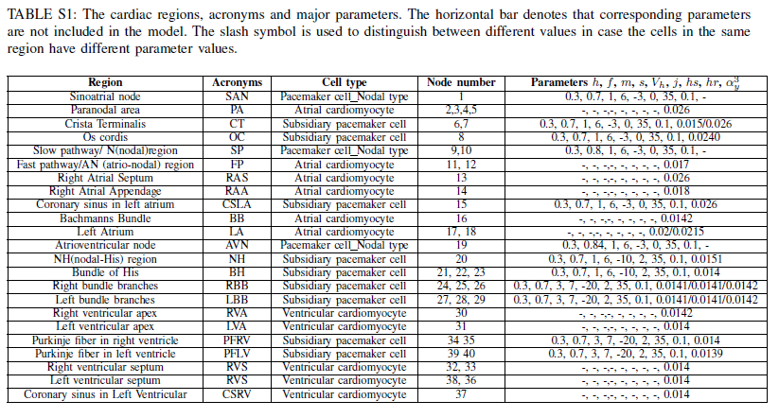
Tissue/Cell Properties and Disease and Pathologies in Simulation
Notes:
Mechanical Design
Tmotor R80 KV110
So with those three pillars in mind, we have started our design process. On the picture on the left, you can see the first and second pillar with the four bar mechanism. This will be directly driven by our BLDC attached to a custom cycloidal drive in order to get the correct torque and speed required. And you can see in that bottom animation how a cycloidal drive works.

Slide 16
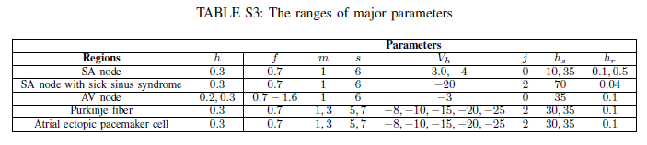
Tissue/Cell Properties and Disease and Pathologies in Simulation
Notes:
Mechanical Design
Tmotor R80 KV110
So with those three pillars in mind, we have started our design process. On the picture on the left, you can see the first and second pillar with the four bar mechanism. This will be directly driven by our BLDC attached to a custom cycloidal drive in order to get the correct torque and speed required. And you can see in that bottom animation how a cycloidal drive works.

Slide 17
Future Work
Implement in a different programming language
Implement these defined cells with the parameters shown in the previous slides
Implement various disease states or pathologies
Implement a method to add voltage probes and monitors
Allows for testing pacemaker (device) models/inputs
Notes:
Mechanical Design
Tmotor R80 KV110
So with those three pillars in mind, we have started our design process. On the picture on the left, you can see the first and second pillar with the four bar mechanism. This will be directly driven by our BLDC attached to a custom cycloidal drive in order to get the correct torque and speed required. And you can see in that bottom animation how a cycloidal drive works.

Slide 18
Questions?
References
Towards the Emulation of the Cardiac Conduction System for Pacemaker Validation | ACM Transactions on Cyber-Physical Systems. (2018). ACM Transactions on Cyber-Physical Systems. https://dl.acm.org/doi/10.1145/3134845
Ai, W., Patel, N. D., Roop, P. S., Malik, A., Andalam, S., Yip, E., Allen, N., & Trew, M. L. (2018). A Parametric Computational Model of the Action Potential of Pacemaker Cells. IEEE Transactions on Biomedical Engineering, 65(1), 123–130. https://doi.org/10.1109/tbme.2017.2695537
P. Ye, E. Entcheva, S. A. Smolka, and R. Grosu, “Modelling Excitable Cells Using Cycle-Linear Hybrid Automata,” IET Systems Biology, vol. 2, no. 1, pp. 24 – 32, Jan. 2008.
McSharry, P. E., Clifford, G. D., Tarassenko, L., & Smith, L. A. (2003). A dynamical model for generating synthetic electrocardiogram signals. IEEE Transactions on Biomedical Engineering, 50(3), 289–294. https://doi.org/10.1109/tbme.2003.808805

