Slide 1
ParallelJ
“From model to performance, there’s only one step.”
Notes:
Introduction rapide, présentation: on va parler de ParallelJ.

Slide 2

What’s that ParallelJ you talk about ?
Tool that manage execution flows:
  Modeling
  Generation
  Development
  Execution
  Monitoring
And executes the flow with:
  High performances
    Conditional execution
    Parallel execution
  Stability and security
    Restart on errors
    Track execution
  High customization level
    Number of parallel tasks
    Manipulated data
http://parallelj.org - Parallel computing at its best.
Notes:
Outil de gestion de flow d’exécutions. Il permet de modélisation / générer / développer / exécuter / monitorer.
Hautes performances grace à exécution conditionnelle, exécution parallèle
Stabilitié, et sécurité : redémarrage sur erreur, tracking de l’exécution (possibilité rejouer)
Optimisation et customisation possible
Réutilisabilité et scalabilité des tâches !

Slide 3

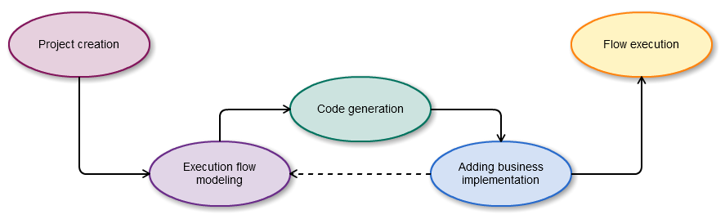
Relying on strong methodology
Model Driven Engineering
MDE is a software development methodology which focuses on creating and exploiting domain models, rather than on the computing concepts.
Iterative development process
Customization available either in model and code
Usable with or without GUI interactions
http://parallelj.org - Parallel computing at its best.
Notes:
Repose sur une méthodologie éprouvée !
MDE !
Processus de développement itératif (cf schéma)
Customisation dans code / model / fichiers de conf
Utilisable avec GUI (mde) ou sans.

Slide 4
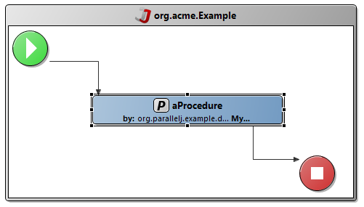
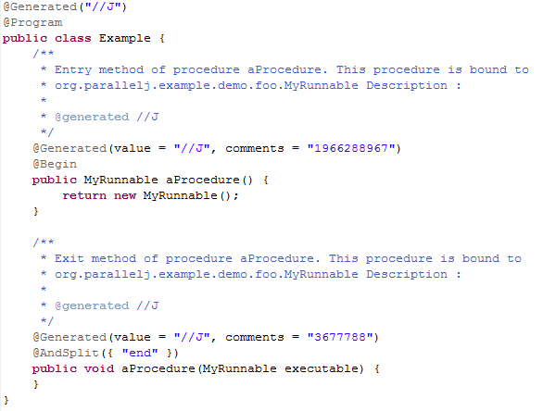
Model ? Source code ?
http://parallelj.org - Parallel computing at its best.

Slide 5


Wait.
We’re talking about Camel, aren’t we ?
  Not the same needs:
    Camel: connecting heterogeneous environments
    ParallelJ: Organizing processes (modeling, executing, conditioning, parallelizing)
  Industrialization:
    Development methodology
    Advanced tooling out of the box
    Graphical editor
    Monitoring, restart on errors
    Learning curve
Ok. So it’s Spring Batch.
  Not the same approach:
    Methodology (MDE)
    Graphical editor
    Ease of use
http://parallelj.org - Parallel computing at its best.

Slide 6

Right, so… ParallelJ you said ?
Runtime:
  Annotations to describe a process in java
  Execution with performances and flexibility
  Archetype for project creation
  REST interface for remote control
Studio: A set of Eclipse plug-ins
  Process modeling
  Source code generation
  Source code merging
http://parallelj.org - Parallel computing at its best.
Notes:
Set de plugins eclipse = studio
Runtime basé sur l’AOP

Slide 7
And what’s good in ParallelJ ?
Complete Eclipse integration
  Builders
  Wizards
Execution’s optimization and customization
  ParallelJ advanced components
  Source code enhancements through annotations’ arguments
Remote control
Track and Restart
  Records the whole execution and lets you play it again if you need to
  Detects errors and manage to process only the missing part when launched back
http://parallelj.org - Parallel computing at its best.

Slide 8

Is it extensible or something ?
Fore sure, with a plug-in mechanism:
In the Studio part:
  Components’ palette extension
  Code generator’s extension
In the Runtime part:
  New tasks extension
  Connectors (data sources, …)
  Monitoring
http://parallelj.org - Parallel computing at its best.

Slide 9



What’s inside ?
Studio?
  Eclipse editor thanks to GMF
  Code generation through Xpand / Xtend
  Code merging through internal merger
Runtime?
  AOP based
  Implementation of Petri nets
http://parallelj.org - Parallel computing at its best.

Slide 10


A look in the future…
Grid computing
http://parallelj.org - Parallel computing at its best.

Slide 11

Ok. Now, I want it !
http://www.parallelj.org/
https://github.com/XA-Labs/ParallelJ-Studio
https://github.com/XA-Labs/ParallelJ-Runtime
http://www.parallelj.org/repository/eclipse/36/update/
http://repo1.maven.org/maven2/org/parallelj/parallelj/
parallelj-dev@googlegroups.com
http://groups.google.com/group/parallelj-dev
irc://irc.freenode.net/#parallelj
http://parallelj.org - Parallel computing at its best.

Slide 12

Live coding !
Live coding and explanations
AWLContact-Batch :
  Little study of an actually developed application
  Look at the execution
http://parallelj.org - Parallel computing at its best.

Slide 13
Fork us !
https://github.com/XA-Labs/ParallelJ-Studio
https://github.com/XA-Labs/ParallelJ-Runtime
https://github.com/XA-Labs/ParallelJ-Resources
http://parallelj.org - Parallel computing at its best.

Slide 14
Thanks !
Feel free to ask your questions !
Presentation will be available on:
https://github.com/XA-Labs/ParallelJ-Resources
http://parallelj.org - Parallel computing at its best.

