Slide 1
ParallelJ
Parallel Computing at its best…

Slide 2




What’s ParallelJ ?
Open-Source Contribution
International Collaboration
Processing Framework
Strong Methodology
Industrialized Solution
Begin to End Tooling
http://parallelj.org - ParallelJ !

Slide 3
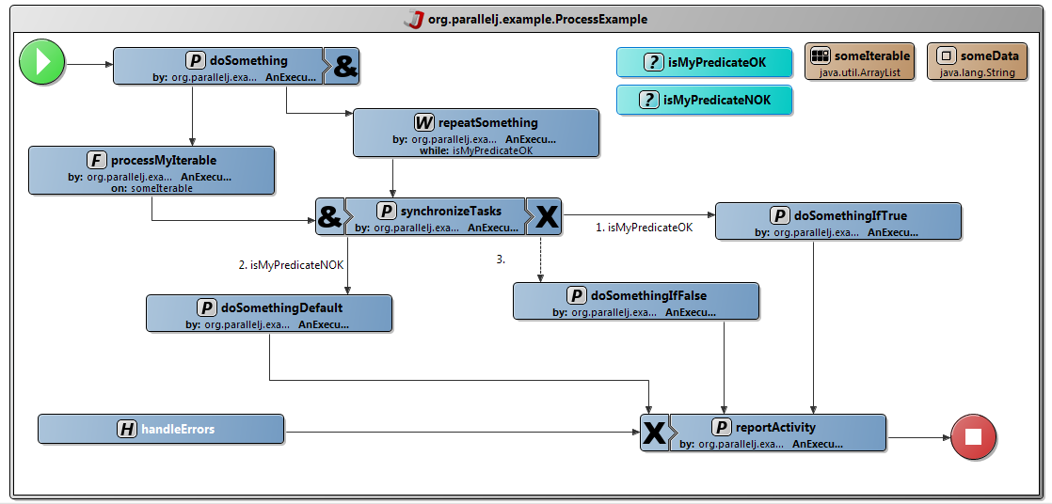
Model Driven Engineering
http://parallelj.org - ParallelJ !

Slide 4
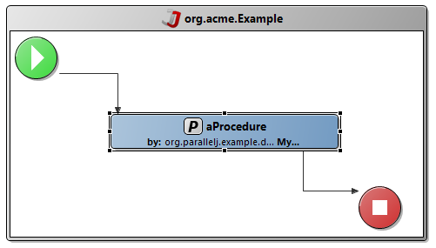

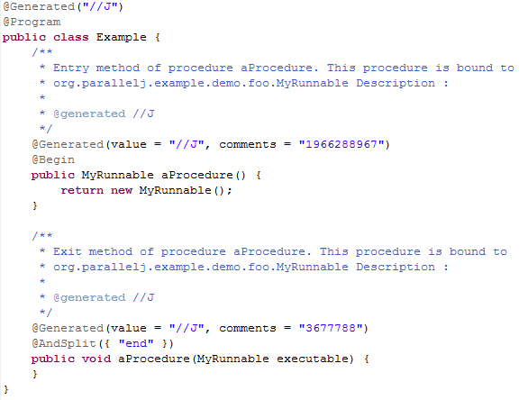
Code generation
http://parallelj.org - ParallelJ !

Slide 5


Processing ecosystem ?
Camel:
    Not the same needs: connecting heterogeneous environments
    No development methodology
    No advanced tooling out of the box
    No graphical editor
    No monitoring, restart on errors
    Learning curve more important
    Too much XML configuration
Spring Batch:
    No methodology
    No graphical editor
    Not easy to use (no code generation)
    Not so standards-friendly (JEE stack compliant)
    Need to bring the whole Spring framework
    Some things rely on naming conventions
    Too much XML configuration
    Focuses only on batches and not processing
http://parallelj.org - ParallelJ !

Slide 6









Inside ParallelJ
ParallelJ Runtime
ParallelJ Studio
http://parallelj.org - ParallelJ !

Slide 7
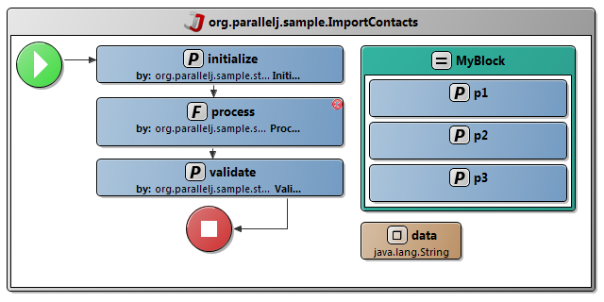
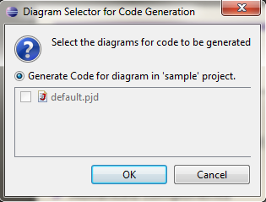
Features
Eclipse Indigo support
Graphical representation of a processing flow
Live validation
Advanced components
New code generator
http://parallelj.org - ParallelJ !

Slide 8
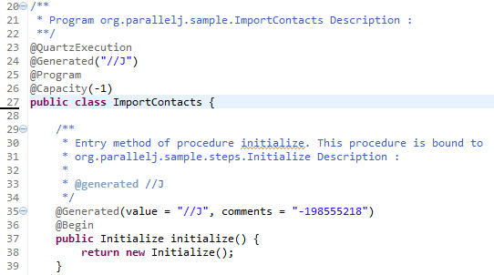
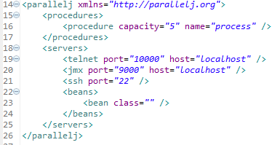
Features
Human readable source code
High level user APIs
Remote Access facilities
Configuration file
Source code merging
Easy quick modifications
http://parallelj.org - ParallelJ !

Slide 9
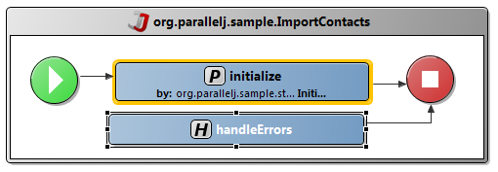
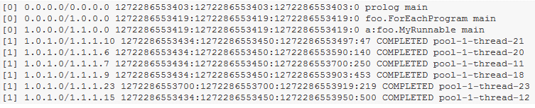
Features
Detailed logs
Handler for error management
Track’n’Restart feature
Monitoring tools integration
http://parallelj.org - ParallelJ !

Slide 10
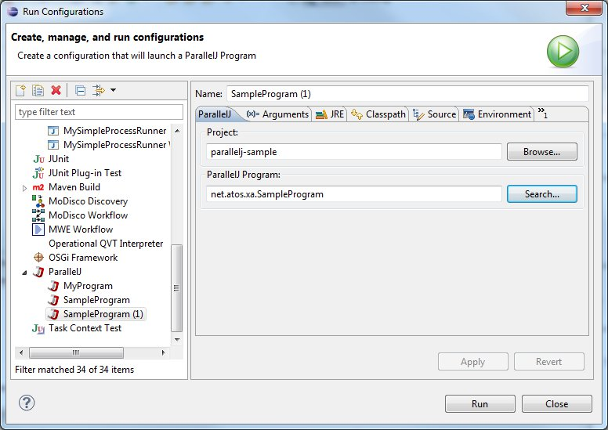
Features
Quick launch through Eclipse
XSD to JAXB
Configuration generation
http://parallelj.org - ParallelJ !

Slide 11
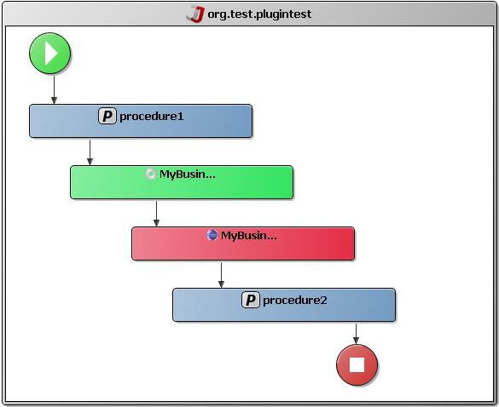
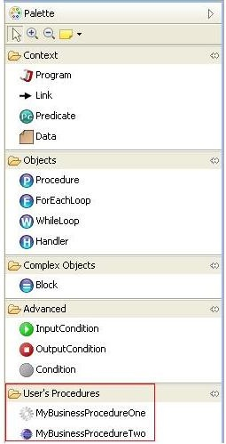
Extensibility
http://parallelj.org - ParallelJ !

Slide 12


We talked about it !
http://parallelj.org
ParallelJ has been presented during a Java User Group:
http://chtijug.org/chtijug-tapestry-parallelj-atos-worldline/
http://parallelj.org - ParallelJ !

Slide 13
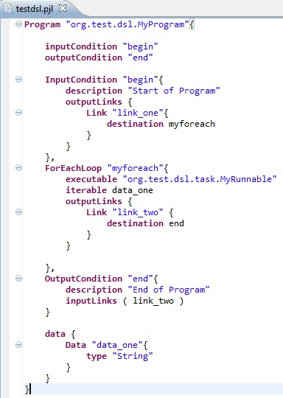

Roadmap
First stable release (1.0.0): already available !
Production ready release: coming in October:
  Benchmarks,
  Enhanced Track’n’Restart,
  Complete training (on site + eLearning).
Incubation features:
  DSL integration !
http://parallelj.org - ParallelJ !

Slide 14

Thank you !
A few links if you’re interested in //J:
  http://www.parallelj.org/
  https://github.com/XA-Labs/org.parallelj
  https://github.com/XA-Labs/org.parallelj.studio
  http://www.parallelj.org/repository/eclipse/37/
parallelj-dev@googlegroups.com
http://parallelj.org - ParallelJ !

Slide 15

Demo / Questions ?
http://parallelj.org - ParallelJ !

