Slide 1
Most printed resources for the escape room are here.
Some slides here need to be printed in A3 (e.g. the Tempora cover)
Some slides are printed double sided (e.g. the puzzle and items)

Slide 2
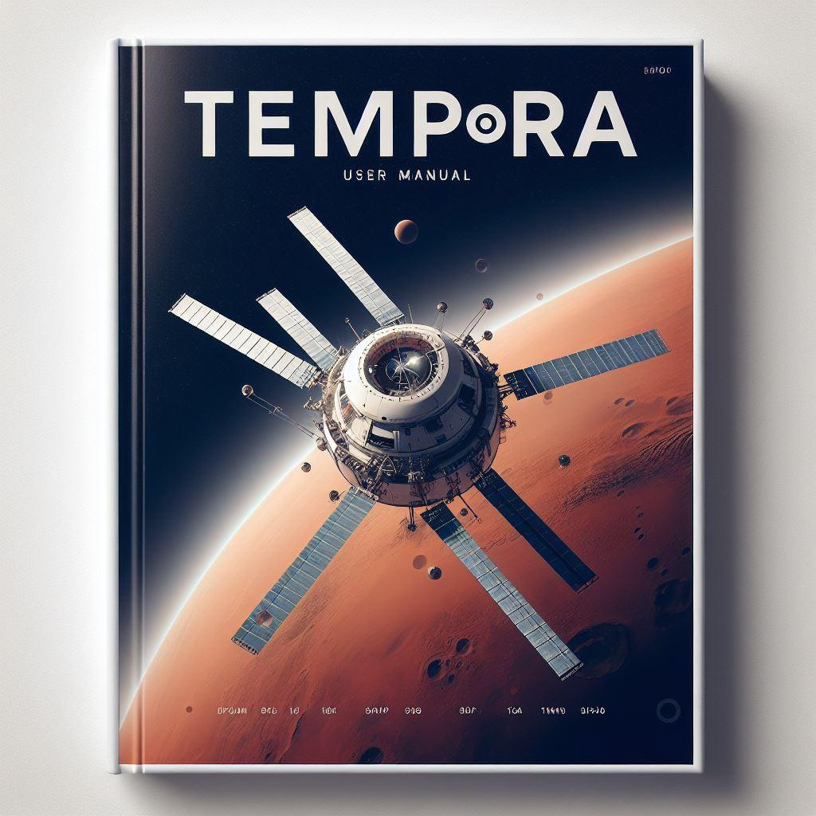

Slide 3
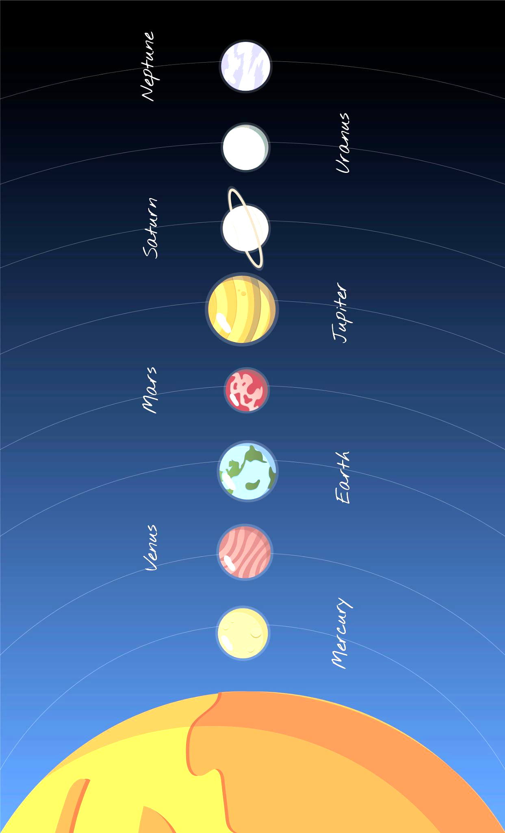
Print "flip on long edge"

Slide 4









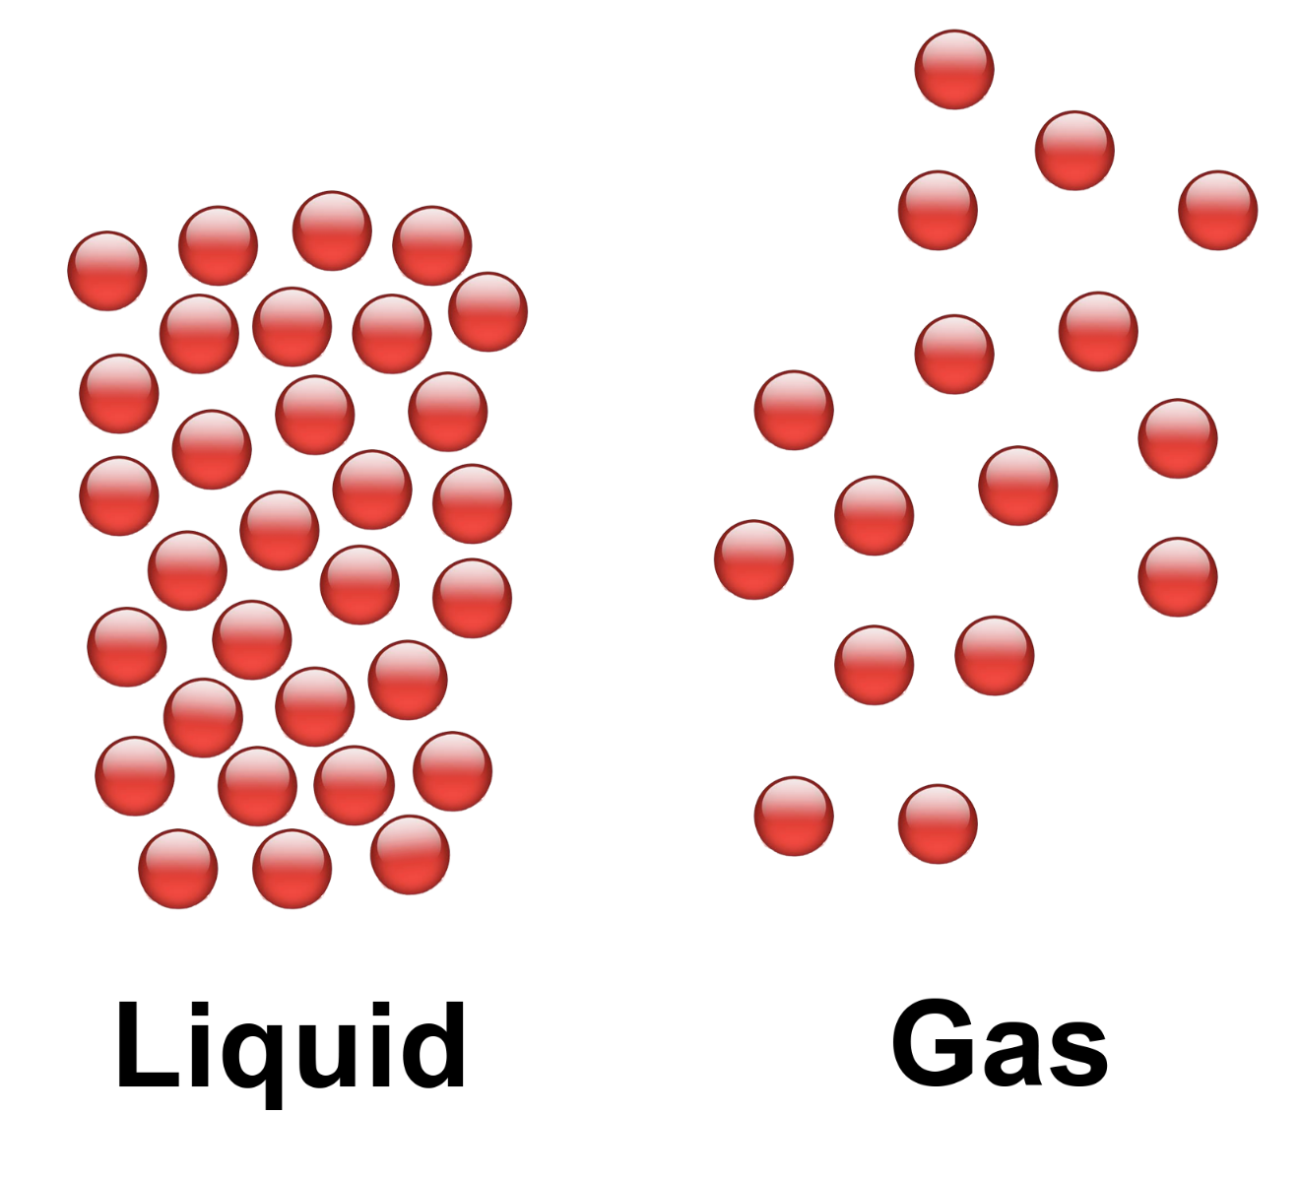
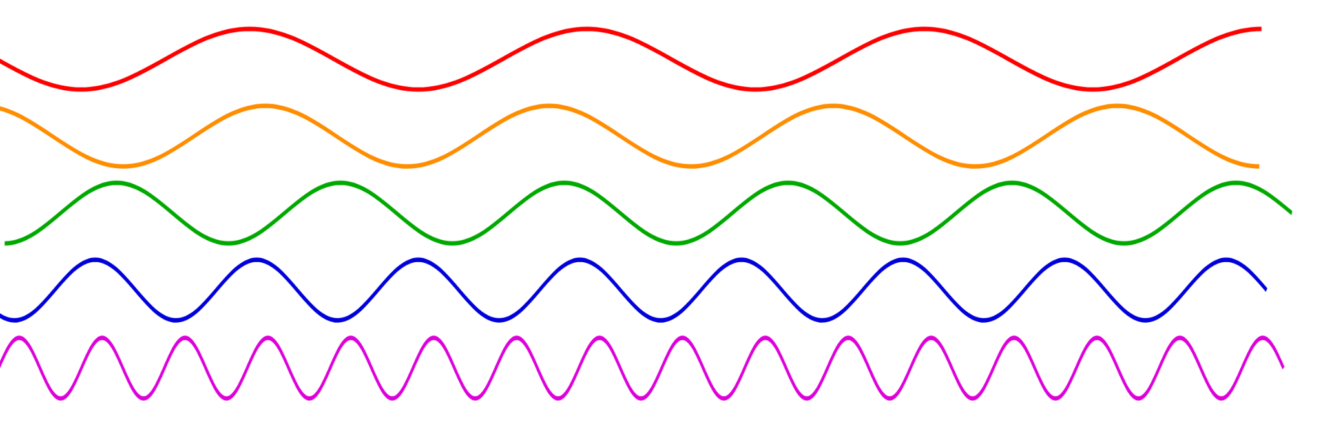
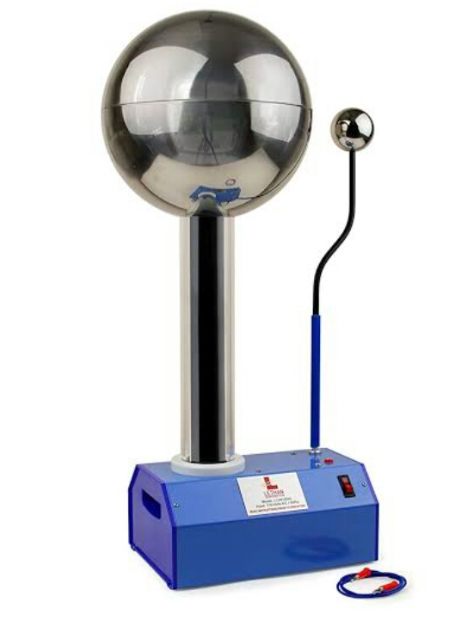







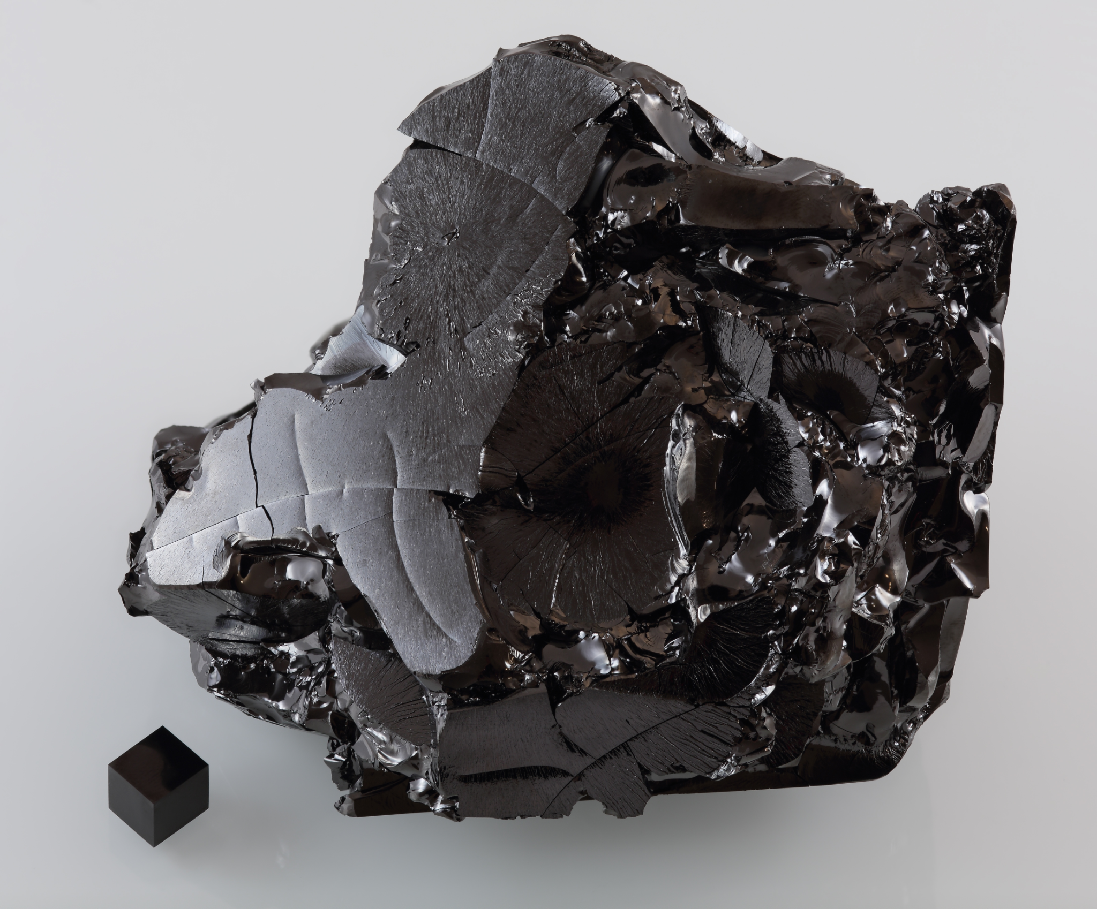

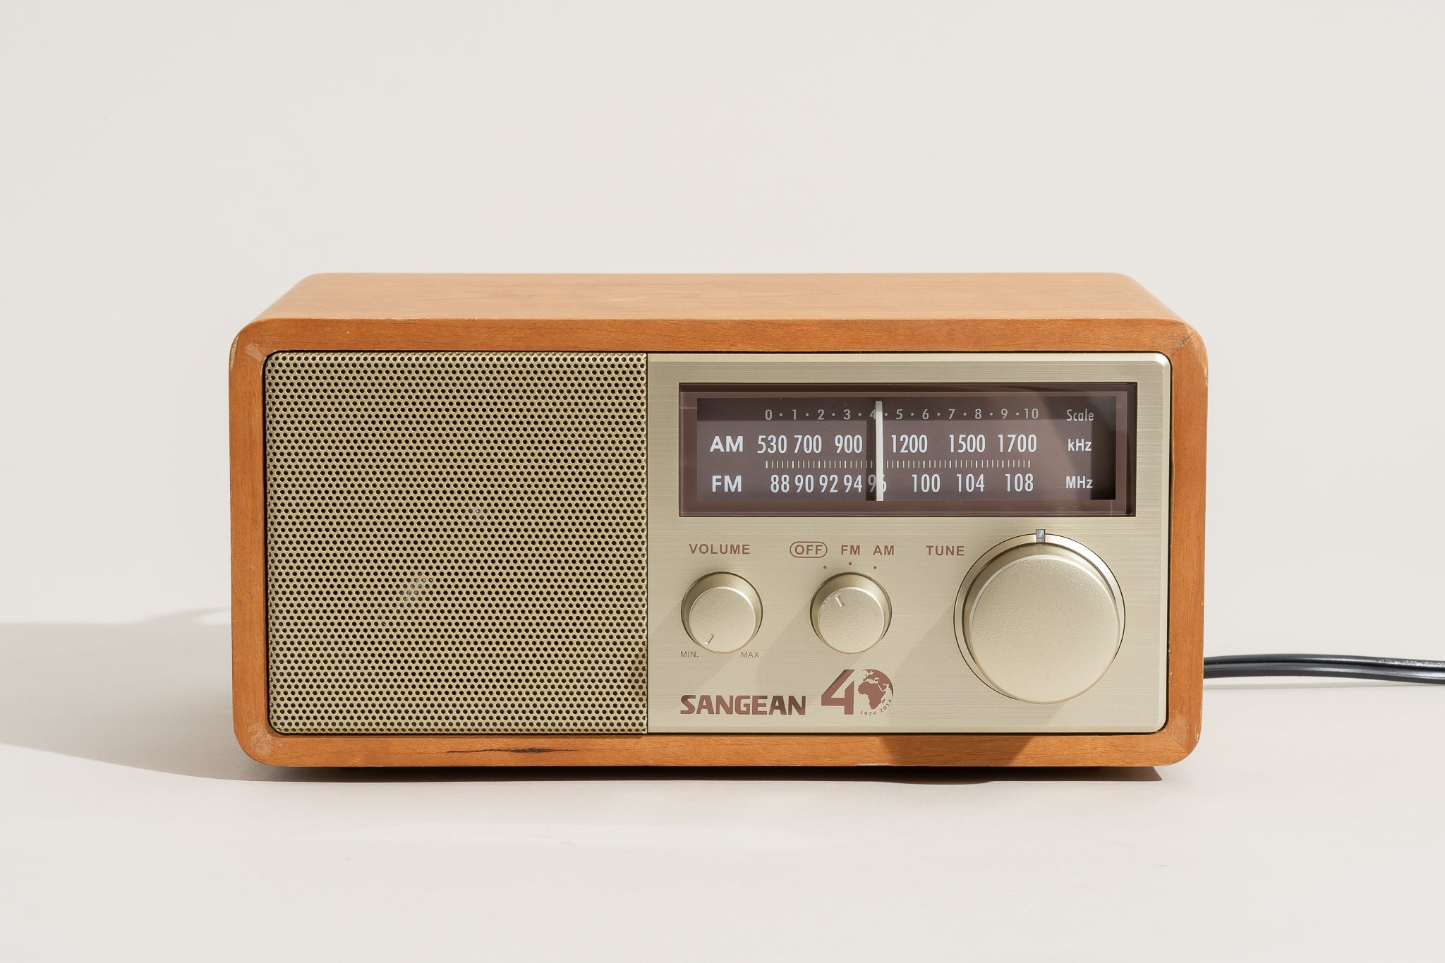
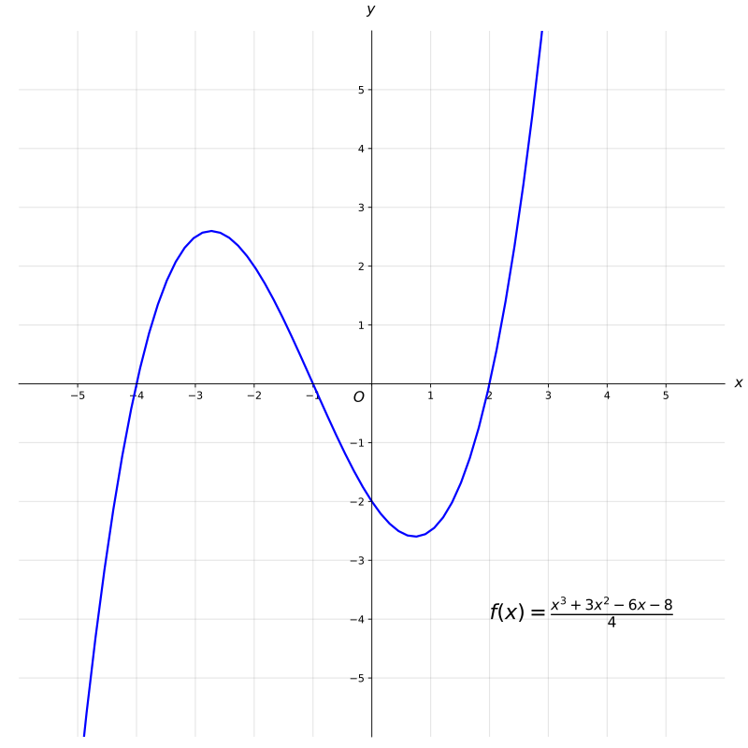



Slide 5


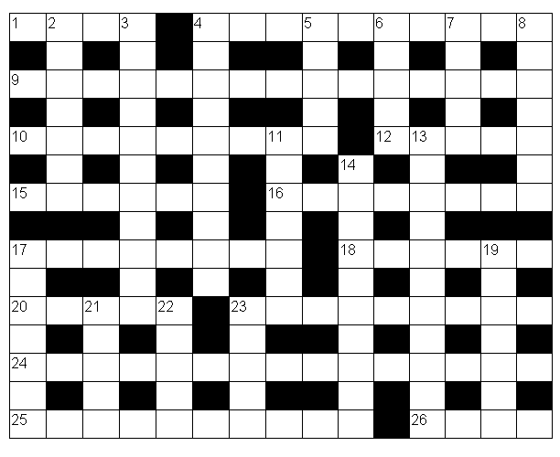

Slide 7






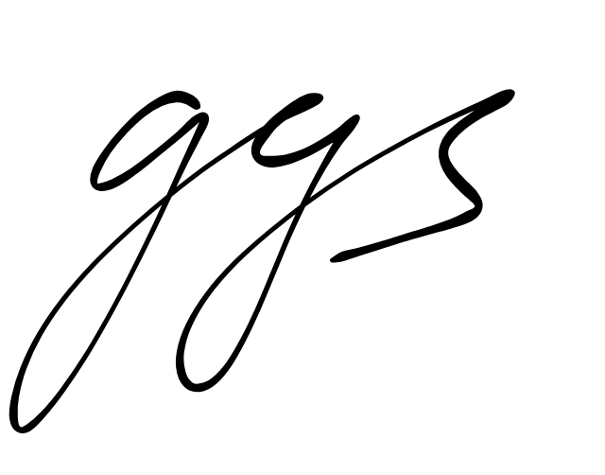
+
+
+
= 28
×
= 21
×
-
= 17

Slide 8
+
+
+
= 28
×
= 21
×
-
= 17

Slide 9
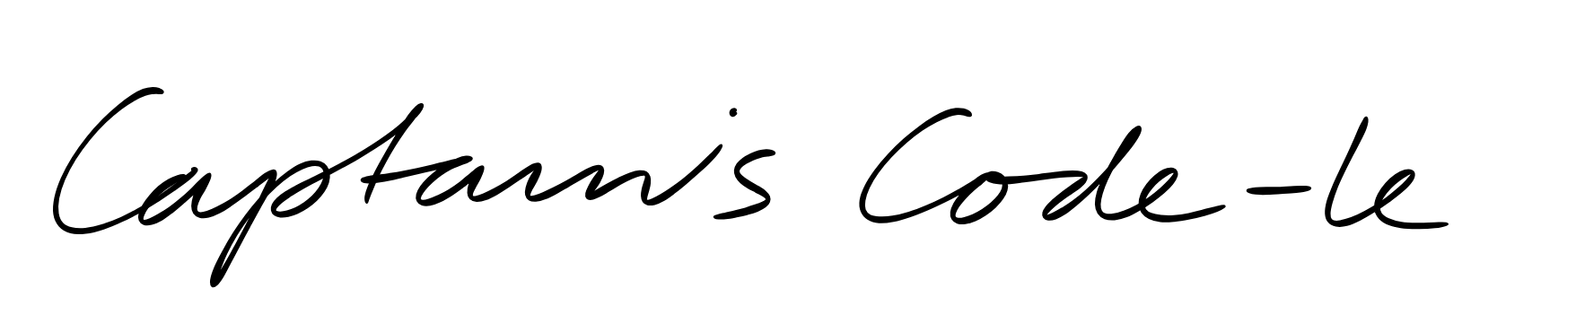
? | ? | ?
8 | 4 | 1
1 | 5 | 7
Two numbers are correct but both are in the wrong position
One number is correct but in the wrong position
1 | 2 | 8
6 | 2 | 4
One number is correct and in the correct position
One number is correct but in the wrong position
3 | 6 | 2
Nothing is correct

Slide 10
? | ? | ?
8 | 4 | 1
1 | 5 | 7
Two numbers are correct but both are in the wrong position
One number is correct but in the wrong position
1 | 2 | 8
6 | 2 | 4
One number is correct and in the correct position
One number is correct but in the wrong position
3 | 6 | 2
Nothing is correct

Slide 11
1 | 5 | 7
8 | 4 | 1
1 | 2 | 8
3 | 6 | 2
6 | 2 | 4
? | ? | ?

Slide 12
1 | 5 | 7
8 | 4 | 1
1 | 2 | 8
3 | 6 | 2
6 | 2 | 4
? | ? | ?

Slide 13

3. The Nature of Time
In the realm of philosophical inquiry, where the great minds of antiquity and modernity converge in pursuit of existential understanding, there exists a perennial fascination with the passage of time. Scholars and sages alike ponder the intricacies of temporal flux, grappling with the profound implications of its ceaseless march.
Within this vast tapestry of contemplation, amidst the discourse on the nature of existence and the mysteries of the universe, one maxim emerges as a beacon of wisdom: "Time's tide waits for no one: set course for the future." These words, imbued with the weight of centuries of introspection, echo through the corridors of thought, reminding seekers of truth of the imperative to embrace the fleeting nature of human existence and to chart a course towards the beckoning shores of tomorrow.
It is in this context of existential reflection that philosophers find themselves confronted with the profound implications of time's inexorable advance. As they navigate the labyrinthine pathways of metaphysical inquiry, probing the depths of consciousness and the essence of being, they are reminded of the fleeting nature of each passing moment. And yet, amidst the ephemeral dance of seconds and minutes, there arises a call to action—a summons to transcend the constraints of temporal limitation and to embark upon a voyage of self-discovery and enlightenment. For in the crucible of time, where past, present, and future converge in a symphony of moments, lies the promise of infinite potential, awaiting those bold enough to heed the timeless wisdom that time's tide waits for no one.
Print "flip on long edge"

Slide 14
In the pursuit of philosophical inquiry, there exists a recognition of the profound interplay between time and human consciousness. As minds grapple with the complexities of existence, they are confronted by the inexorable march of hours, each tick of the clock a reminder of the transient nature of mortal life. Yet, amid this existential contemplation, there arises a profound realization: that within the fleeting embrace of time lies the crucible of human experience, where moments of joy and sorrow, triumph and tribulation, converge in a tapestry of existence.
For philosophers, this acknowledgment of temporal impermanence serves as a catalyst for introspection and self-discovery. As they delve into the recesses of thought and contemplation, they are drawn inexorably towards the horizon of the future, where the promise of enlightenment beckons like a distant star. Guided by the timeless maxim that time's tide waits for no one, they chart a course through the currents of uncertainty, propelled by the conviction that each passing moment presents an opportunity for growth and transcendence.
In this journey towards enlightenment, philosophers are confronted by the perennial question of human agency amidst the vast expanse of time. As they grapple with the intricacies of free will and determinism, they are reminded of the delicate balance between fate and choice, between the currents of destiny and the rudder of individual volition. And yet, amidst this philosophical quandary, there emerges a resolute affirmation: that while time may shape the contours of human existence, it is ultimately the choices we make and the paths we forge that define the trajectory of our lives.
Print "flip on long edge"

Slide 15
E N G I N E
R E S T A R T
C O D E I S
8 6 4 3
U B Z 8 Q G 4
F E L 2 2 B B
1 8 D E D E D E 8 P 9 Z E L 2 X
G 7 7 3 K 8 0 3 T
Q 9 P 43 G 8 13 B 6
U B Z 8 Q G 4
F E L 2 2 B B
1 8 D E D E D E 8 P 9 Z E L 2 X
E N G I N E
R E S T A R T
C O D E I S
8 6 4 3
U B Z 8 Q G 4
F E L 2 2 B B
1 8 D E D E D E 8 P 9 Z E L 2 X
G 7 7 3 K 8 0 3 T
Q 9 P 43 G 8 13 B 6

Slide 16
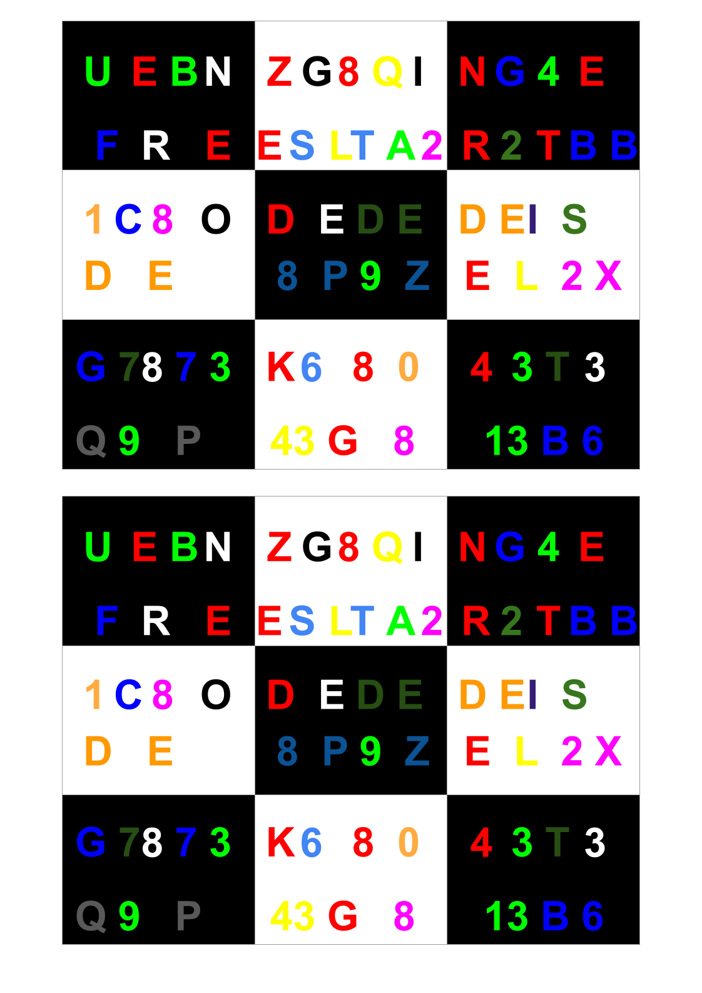

Slide 17


Slide 18

For the top of the box

Slide 19

For the bottom of the box

