Slide 1


erbio
LEASEHAWK – TRY AND BUY AGREEMENT

Slide 2

Confidentiality Notice
02
The information contained in this presentation is confidential and belongs to VERBIO TECNOLOGIES S.L. Any form of disclosure, reproduction, copying or distributing all or part of it is prohibited and may not be used for any other purpose without permission from VERBIO TECNOLOGIES S.L.

Slide 3
Index
03
Purpose of this document
Functional Scope
Technology Overview
Methodology
Pricing
Try and Buy Agreement
Support Model

Slide 4
Purpose of the Document
04
The purpose of the proposal is to present Verbio’s ability to build and deploy that required by the client, LeaseHawk , with regard to a Transcription solution. The proposal will outline the requirements, Verbio’s capabilities, an estimated timeline, a preliminary budget and the deliverables.

Slide 5

Functional Scope of the Proposal
05
The solution automatically converts the audio from an audio file into text in an offline (batch mode) basis.
The technology involved is Verbio Transcriptor
Verbio has the knowledge, technology and experience in order to achieve the functional scope, which includes:
Create a specialized language model for telephony transcription,
Provide Professional Services, and
Maintain the service.

Slide 6
Transcription – Technology Overview
06
Verbio Transcriptor:
Verbio Transcriptor is our solution that automatically converts spoken audio from your customer into text. Unlike Verbio ASR the engine does not use a grammar to match the audio to words, but rather a statistical language model. The statistical language model must be built for each unique application of Verbio Transcriptor. For example, the health industry would need a different language model than the automotive manufacturing industry. The overall process can be visualized in these 4 steps:
The Statistical Language Model will be built using a large volume of text or transcribed calls. (depending on the size of the vocabulary, can be greater than 1Gb)
Spoken audio will be sent to the speech engine in Linear PCM, A-law or Mu-law format, 8 KHz
The speech engine will extract acoustic features from the audio file
The language engine, in conjunction with the statistical language model, will return the most probable spoken words.
Acoustic Model
Statistical Language Model
Provided Text
Audio User Interaction
Speech Engine + Language Engine
Recognized Text

Slide 7
Transcription – Methodology
07
The transcription methodology is listed below
The proposal is to detect new records when they are finished and stored in Asterisk (“WatchFolder” approach) and then:
Launch the transcription process
Store the filename and result of the transcription in a Database
Create a web-based interface to access the information stored in the database
§ Supervisors could see the transcription
§ Supervisors could hear the audio
§ Supervisors could correct the transcriptions
Using Natural Language, we could further classify the calls (using the transcription) into different categories: wrong call, interested in leasing, etc. If LeaseHawk is interested in going to this new feature, supervisors could manually classify transcription’s calls at the beginning. In this way, in some weeks Verbio would have the required material to try an automatic classification system. So that, if LeaseHawk is interested, the web-based interface would contain a drop-down box to select one of the possible categories.

Slide 8
Transcription – Phases and Pricing
08
Phases of the verification approach suggested in the previous slide:
Phase 1:
Transcribe a significant number of calls (20,000 or 500 hours of audio) for the Statistical Language Model (SLM)
Phase 2:
Train the SLM to create a specific language model
Phase 3:
Install Verbio Transcriptor with the new SLM and deploy the WatchFolder approach
Develop the Front-End web (SEE my COMMENTS below)
Test the solution
Phase 4:
Maintenance of the models
Item | Unit Price | Units | Total
Verbio Transcription Server License (50 concurrent channels) | $25,999 | 1 | $25,999
Transcriptions for SLM | $0.225/min | 30000 | $6,750
Develop the SLM | $9,999 | 1 | $9,999
Maintenance and Support (first 2 years are included) | 15% | Per/year | $5,250

Slide 9
Try and Buy - Terms of Agreement -Process
09
Phase 1: Transcription of Audio
LeaseHawk and Verbio Agree that LeaseHawk is going to send at least 300 hours of audio for transcription
Verbio will receive the records and will test the quality and size for their compatibility
Once Verbio approves the quality and length for compatibility, Verbio will send to select vendors for transcription
Verbio will receive the transcriptions within 1 month of reception by vendors (transcription turnaround time for high accuracy and low cost)
Once Verbio has received the transcription, they will verify the accuracy and quality of the transcriptions
Phase 2 & 3: Creation of Language Models
With these transcriptions, Verbio will make the models for the Transcription Engine
After completion, Verbio will send the transcription engine to LeaseHawk for testing
Once LeaseHawk has proven the transcription accuracy, Verbio will complete the solution via integration.
Phase 4: Continual Improvement
After integration with LeasHawks system, the engines accuracy will continue to be improved via re-feeding
Levels of Accuracy
LeaseHawk agrees that if Verbio achieves 80% of accuracy within the first iteration of the models, LeaseHawk must purchase the agreed upon sum as per pg. 16
Agreement on the terms of accuracy
Accuracy means the number of words correctly transcribed on average from the entirety of the transcribed audio.

Slide 10
Try and Buy - Terms of Agreement – Economic Conditions
10
Economic agreement for the transcription of audio
LeaseHawk agrees to pay half of the cost for transcribing the audio
Verbio will send LeaseHawk the budget of the second-party transcription as it is received from each vendor
LeaseHawk must approve through written consent, the proposed budget. Once approved, Verbio will pay the vendor and invoice LeaseHawk (payable immediately after receipt)
Economic Conditions
As per pg. 16, LeaseHawk agrees to the price of $34,998.00 and cannot refuse this price if Verbio achieves an average of 80% accuracy as stated previously on pg. 17

Slide 11
Support Model
11
Functional and Technical Support
The different services encompassed within this aspect of the support are intended to resolve doubts or queries on the technical and functional uses of the final solution.
Verbio has a team for telephone support in English from 8 to 20h UTC + 1:00 , in every case the maximum response can be expected in under 4 hours.
The contact channels that Verbio offers are:
Direct phone number: +34 93 444 7979
Email support@verbio.com (in English)
Web: www.verbio.com (http://verbio.zendesk.com/home)
Verbio support will be provided from the Verbio headquarters in Barcelona, ​​where the technical team is the most robust.
Absolutely all users of Verbio’s systems can use these channels. Each contact will be recorded by the internal Verbio tool and be assessed for: Reason for support, possible resolution, script generated (if any),and employee time needed for resolution.

Slide 12
Support Model
12
Corrective and Adaptive Maintenance Support
For the corrective and adaptive maintenance ,Verbio takes appropriate action to correct the malfunction of the software without modifying the functional abilities of the solution.
This implies:
Verbio’s support will be provided remotely from Verbio headquarters in Barcelona, ​​where the technical team has the most depth of knowledge and is the most robust.
Verbio’s corrective maintenance includes adaptive maintenance of the solution, ie the modification of the solution to adapt to changes in the environment in which the system operates.
Additionally, Verbio will provide the necessary resources so that the system can meet the changing needs of the client over time, making Evolutionary Maintenance services that are specialized in speech technologies available that will allow the solution to be extrapolated to other services.

Slide 13
Support Model
13
Product Training – Business Staff
Once the implementation of the solution is complete, you will be able to access your System Management Interface. This allows users to be independent of the process of extracting the information while still interacting and defining subsequent improvements in the processes. In order to use the solution to its full extent, training will be provided for the following:
System administration (start, stop, etc.)
Interface Management Configuration
Categorization of calls
Feedback models
Generating new reports
Information provided by the system
Best practices in Speech Analytics
Strategic tools for Employment
The training will be carried out remotely via teleconference. However, if there are problems or queries during usage, users can make use of Functional Support enabled for this case. In the case of corrective and adaptive maintenance, Verbio takes appropriate actions to correct the malfunction of the software without modifying the functional abilities of the solution.

Slide 14
Support Model
14
Product Training – Technical Staff
In addition to functional training oriented to business staff, there is a more technical training of the underlying technologies within Verbio Speech Analytics. The objective of this training is to match the technical and functional knowledge of the agent who will assume the role of the manager of the Verbio Speech Analytics solution with Verbio’s own staff. training will be provided for the following:
System administration (start, stop, etc.)
Interface Management Configuration
System configuration with the audio files and locations to be analyzed.
Parameterization of the test elements
Information flows
Best practices in Speech Analytics
Solution employment strategies
Certification Course in Verbio Speech Technologies
The training will be carried out remotely via teleconference. If there are any further technical questions during operations, users can make use of Verbio Technical Support which has been developed for this case.

Slide 15
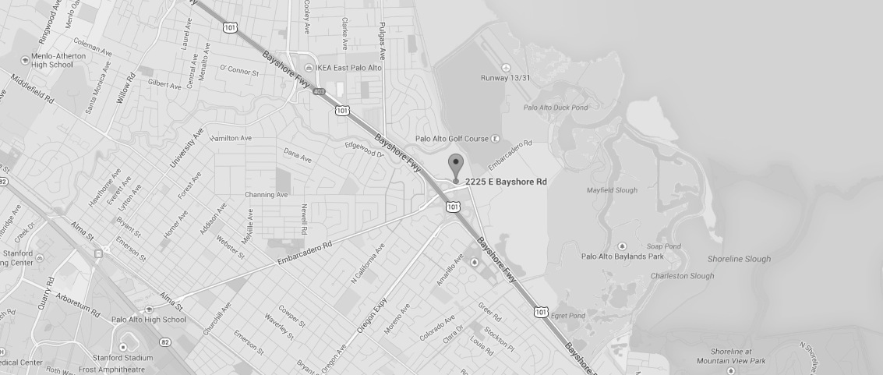
2225 East Bayshore Road
Suite 200 Palo Alto, 94303
Contact us
verbio@verbio.com

