Slide 1

Dwi Nur Cahyani
what’s interesting about sinking of titanic data?

Slide 2
Data Processing
Search data titanic
Explanatory Data Analysis
Simple Visualization
Evaluating
Feature Engineering
Modeling

Slide 3
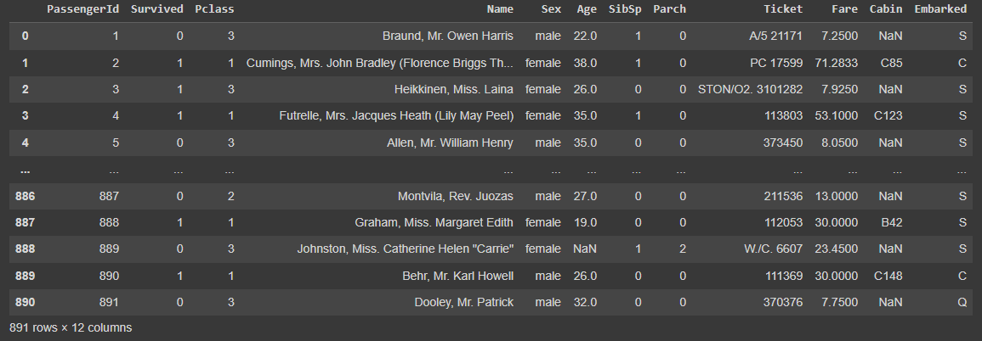
Titanic Data
Source : kaggle

Slide 4
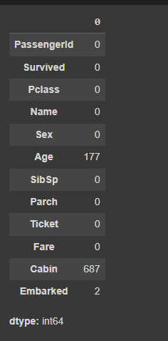
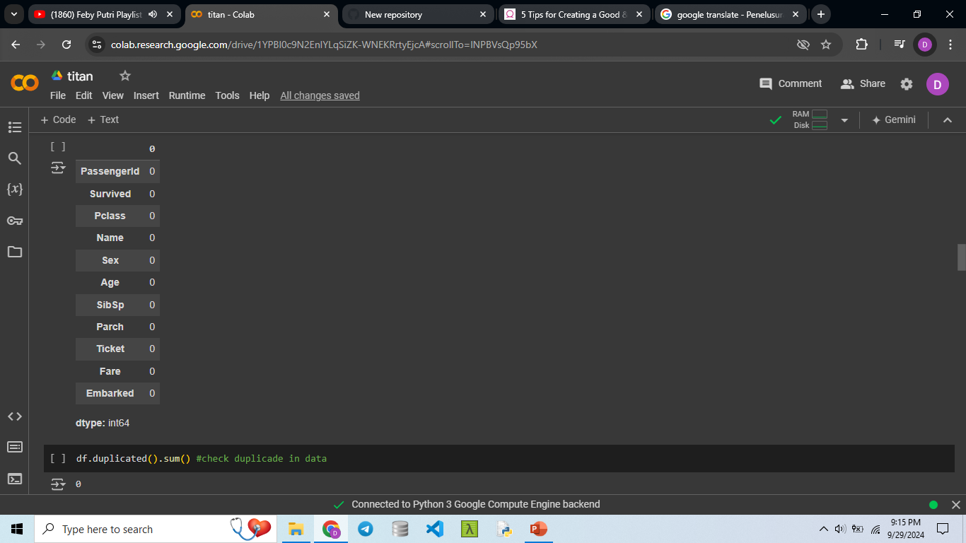
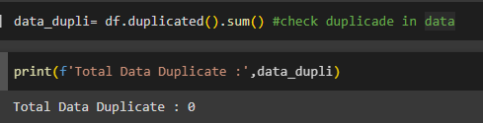
EXPLANATORY DATA ANALYSIS
Imparing missing values and checking data duplicates for prevent data bias, so we create better model to predict the data
Check missing value
Handling missing value

Slide 5
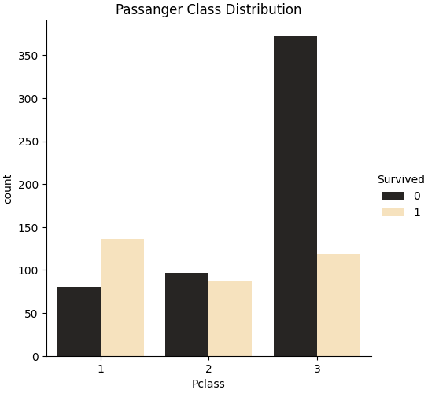
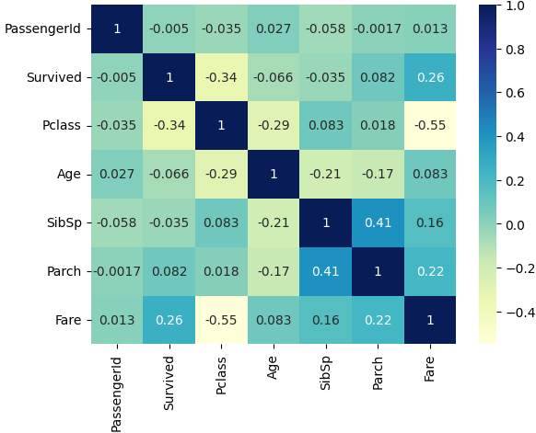
Simple Visualization
Survived Vs Not Survived
Correlation of Each Feature
The highest class that survives is Pclass 1
it means if your Pclass is 1, your chances of still being able to live are higher

Slide 6
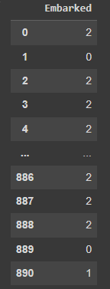
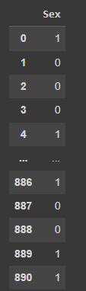
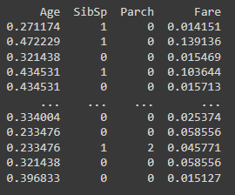
Convert to numeric
1 = Male
2 = Female
0 = C/Cherbourg harbour
1 = Q/queenstown harbour
2 = S/Southampton harbour
Convert to the same scale (MinMaxScaler)

Slide 7
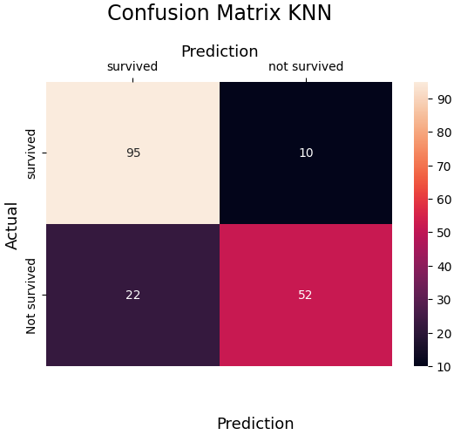
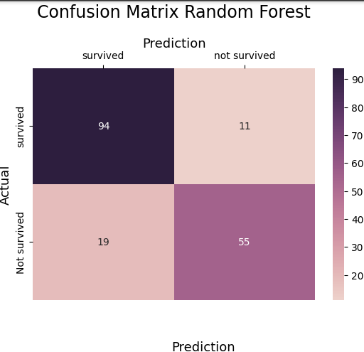
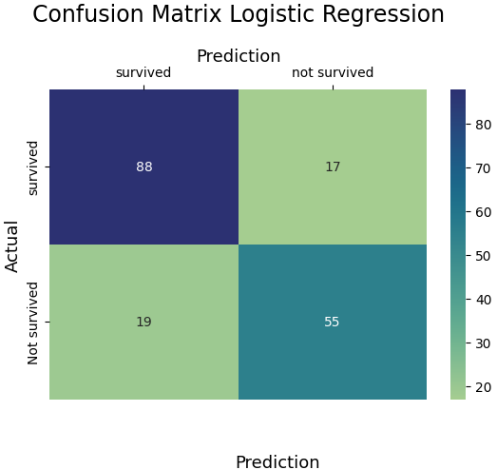
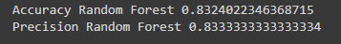
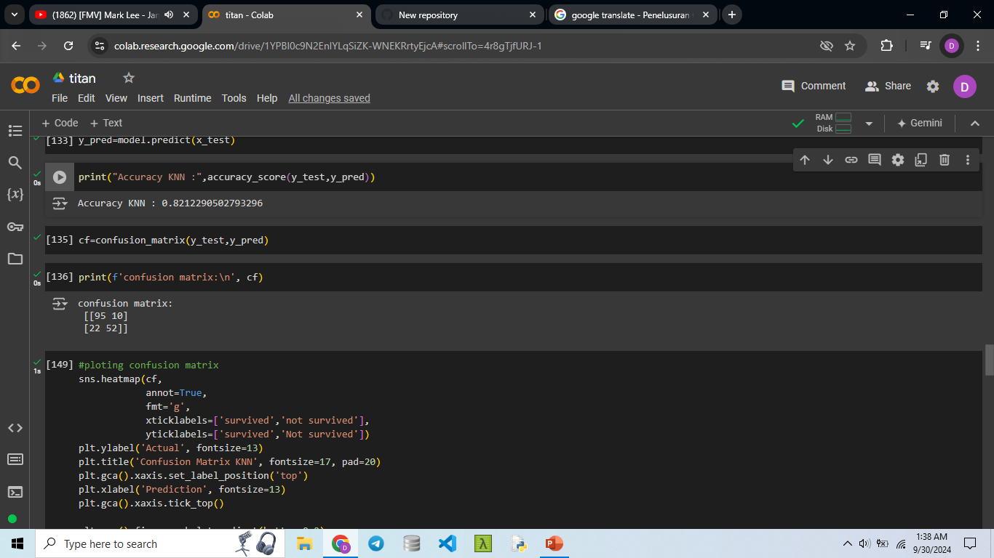
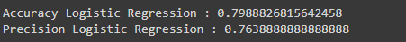
KNN VS LOGISTIC REGRESION VS RANDOM FOREST
Accuracy score used to evaluate performance the model by calculate the percentage of correct prediction by model.
Precision is metric for measuring of positive case from all positive cases.
The greater accuracy and precision value is best model.
So, the best model is random forest.

