Slide 1
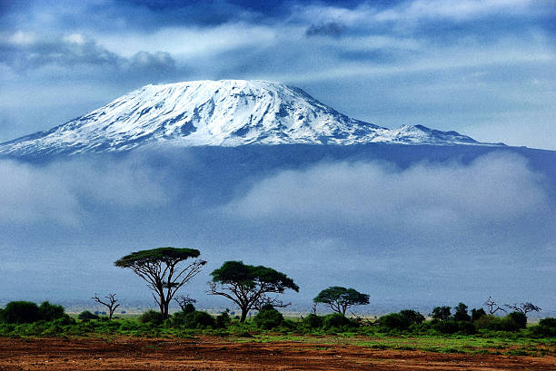
Tourism in Tanzania

Slide 2
BUSINESS OVERVIEW

Slide 3
LAND AREA
Tanzania is the only country in the World that allocated more than 25% of its total land area for Wildlife, National Parks and Protected Areas.
ASSETS
Mount Kilimanjaro, the highest mountain in Africa is in Tanzania.
GDP
Tourism contributes 17% of Tanzania’s Gross Domestic Product and 25% of all the foreign exchange revenues.
REVENUE
In 2018, Tourism generated about 2.4 billion dollars in Tanzania.
EMPLOYMENT
Tourism creates jobs for over 2.6 million Tanzanians (directly and indirectly).
ARRIVALS
The number of tourist arrivals has increased from about 500,000 in 2000 to over 1.1 million international visitors in 2014.

Slide 4
The aim of this analysis is to get a better understanding of the Tourism Sector & provide an instrument for sector growth.
Analyzing Spending Habits
Predicting Tourists Expenditure
This would help tour operators estimate expenditure during tour visits
Useful for tour boards to help tourists estimate expenditure before visiting
This would help tour operators identify which tour groups spend the most and the most profitable tour activities for the Tanzanian tourism sector.

Slide 5
INSIGHTS

Slide 6
👪
DOMINICIA
TOUR GROUPS
2.30 Nights
Tourists tend to spend more time, on average in Mainland than in Zanzibar
ZANZIBAR
Country with highest average spending habit
Tourists who travel alone spend the least
Tourists who travel with families spend most
8.49 Nights
Spent: TZS 33.15 MILLION
Transactions: 134
MAINLAND
Most Profitable Tour Activities
Payment Methods
👶
First time tourists spend more, on average than other tourists.
86.7%
Most tourists prefer to pay in Cash and Card. There are also other payment methods accounting for about 0.4% of payment methods used.
More tourists opt for the Independent plan than the Package plan. Tourists who opt for the Package Plan spend more.
Diving and Sport Fishing (TZS 17.1 MIL)
Cash
12.9%
Wildlife Tourism (TZS 10.6 MIL)
Card
🎈
The primary purpose of tourism is Leisure and Holidays
Conference Tourism (TZS 10.3 MIL)

Slide 7
MODEL OVERVIEW

Slide 8
MODEL
The linear regression model was applied to predict the expenditure of a tourist/tour group would spend visiting Tanzania.
TOOL
For testing for Linear Model Assumptions, Modelling and Model Evaluation, the Statsmodels library in Python was applied.
EVALUATION
The Mean Absolute Error and Root Mean Squared Error were computed and found to be 5627882 and 9640520 respectively.

Slide 9
CONCLUSIONS AND RECOMMEDATIONS

Slide 10

Tourism is a Major Source of revenue for the Tanzanian Economy.
The main aim of tourism is Leisure, it is also the most profitable purpose.
Cashless payment is not a popular means of payment for tourists.
Family tour groups spend more than other groups.
Tourists spend more time in Mainland than in Zanzibar.
Sport Fishing and Wildlife Tourism are the most profitable tour activities.
The tour operators and business partners should research the reasons behind the above highlighted and other key insights and leverage them to improve customer experience and generate more revenue. Some possible suggestions are:
Making cashless payments more convenient for tourists.
Creating a family tour plan to encourage more families to visit.
Restructuring Zanzibar to encourage tourists to spend more time there etc.

Slide 11
Predictive Analysis was done using Linear Regression in an attempt to predict the estimated budget of a tourist/tour group based on some factors, including those highlighted in the key insights.
In order to boost model performance, other regression models can also be explored.
For better accessibility for the tour operators, tour boards and tourists; the Data Team can partner with the Software Engineering team by deploying the model as a Web Application.

Slide 12
THANK YOU

