Slide 1
NTRES 6940 Special Topics Fundamentals of R
Instructors: Cat Sun, Alec Wong

Slide 2
Logistics:
Meeting Times Tuesday: Fernow 210
Wednesday: Morrison 344
Thursday: Morrison 344
Friday: Fernow 210
Monday: Fernow 210
Enrollment: Add/Drop form (Roberts Hall 140) if you have a time conflict and cannot enroll online.
Most topics will not need entire 2:00-4:25 time period. Or we can just roll into.

Slide 3
Introductions
Name
Department
Year
Reason for interest in R, what do you hope to get out of this class
R competency

Slide 4
Course Objectives
Is not to be an R expert. Instead, be comfortable to get started on your own. R is like riding a bike.
Basic data manipulation, and common plotting and statistical analyses
Ability to understand/figure out what errors mean
Best practices, conventions, and tips

Slide 5
Course Outline
Day 1: Reading in data, running scripts, creating and basic data manipulation
Day 2: Logic, loops
Day 3: Plotting
Day 4: Basic statistics
Day 5: Conventions, best practices, answer questions, analyze your own data
Throughout: Interpreting errors, how to solve code bugs

Slide 6
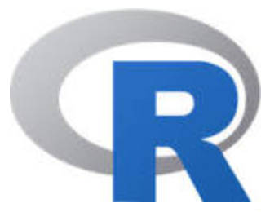
What is it? A way to do math, stats
All purpose software, built by statisticians, good at:
Statistics, data visualization, send emails!
Uses special language/notation, based on S
Why not just Excel? Because R supports:
Really large data sets
Reproducible workflow
Better graphing functions (Standard errors!?)
All sorts of datatypes
More complex math and calculations
Also, Free.
Also, computer science is the future.
Notes:
Excel has a lot of bloat: font, color, formatting, etc.

Slide 7
How it works
Write scripts/documents (e.g., myScript.R)
Has the math/stats you want to perform
Can include notes (#annotation)
Built in functions to perform/calculate common things
Sum(), Mean(), min(), max(), standard deviation,
Can create your own custom functions
Special packages for specific functions around a theme/analysis
Store things you’ve calculated to use again
Grouped into different types of things (called objects(
Matrix, vector, string, variable, list

Slide 8
Lets download R
https://www.r-project.org/
If you use it regularly, or once you start using it more, make sure you keep current with the newest version
And while we’re at it, R Studio.
https://www.rstudio.com/
Why? Has useful components for organization

Slide 9
Reference card
https://cran.r-project.org/doc/contrib/Short-refcard.pdf

